Slide 1

Selenium Automation
TestNG

Slide 2
TestNG
TestNG is a unit test framework designed for testing needs.
It is inspired from JUnit by adding new functionalities which made TestNG more powerful than other unit test frameworks.

Slide 3
Why use TestNG or Advantages of TestNG?
Selenium does not have a inbuilt reporting capabilities. Using TestNG we can generate HTML Report
We can run classes without using Main method.
We can Parameterize Tests.
Simple but precise annotations which makes it easier to run the test cases according to our needs.
Test cases can be Grouped & Prioritized more easily.
Parallel testing is possible.
Provide data to the test cases with the Data provider present in TestNG.

Slide 4
What are the different annotations available in selenium?
@BeforeSuite: This annotation method will execute before all tests in this suite
@AfterSuite:This annotation method will execute after all tests in this suite
@BeforeTest: This annotation method will execute before any test method belonging to the classes inside the Test tag is executed.
@AfterTest: This annotation method will execute after all the test methods belonging to the classes inside the Test tag have executed.

Slide 5
@BeforeGroups: The list of groups that this configuration method will execute before. This method is guaranteed to execute shortly before the first test method that belongs to any of these groups is invoked.
@AfterGroups: The list of groups that this configuration method will execute after. This method is guaranteed to execute shortly after the last test method that belongs to any of these groups is invoked.
@BeforeClass: This annotation method will execute before the first test method in the current class is invoked.
@AfterClass: This annotation method will execute after all the test methods in the current class have been executed.

Slide 6
@BeforeMethod: This annotation method will execute before each test method.
@AfterMethod:The annotated method will be executed after each test method.
@Test: The annotated method will execute our actual test cases

Slide 7
Assertions in TestNG
What is Assertion?
Asserts helps us to verify the conditions of the test and decide whether test has failed or passed.
A test is considered successful ONLY if it is completed without throwing any exception.
Example:
@Test
public void testCaseVerifyHomePage() {
driver= new FirefoxDriver();
driver.navigate().to("http://google.com");
Assert.assertEquals("Google", driver.getTitle());}
It can also be written as below Assert.assertEquals("Goooogle", driver.getTitle(), "Title not matching");

Slide 8
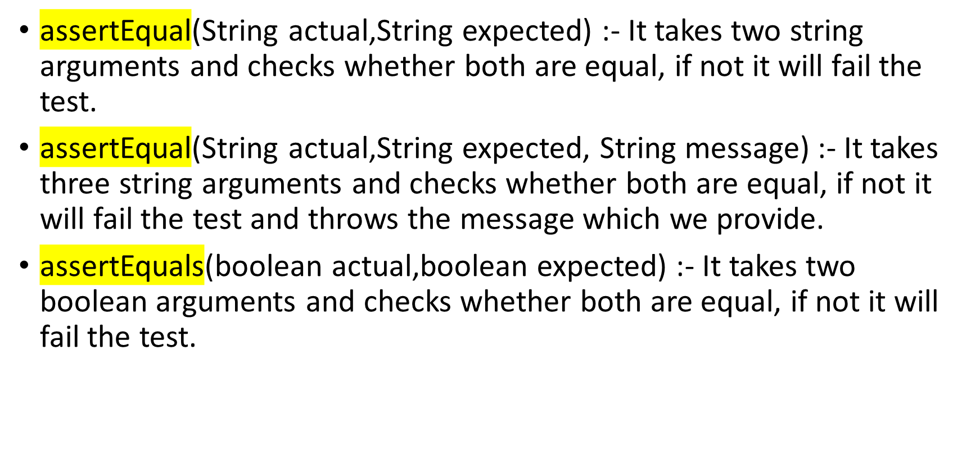
Most frequently used other Assertions in Selenium

Slide 9
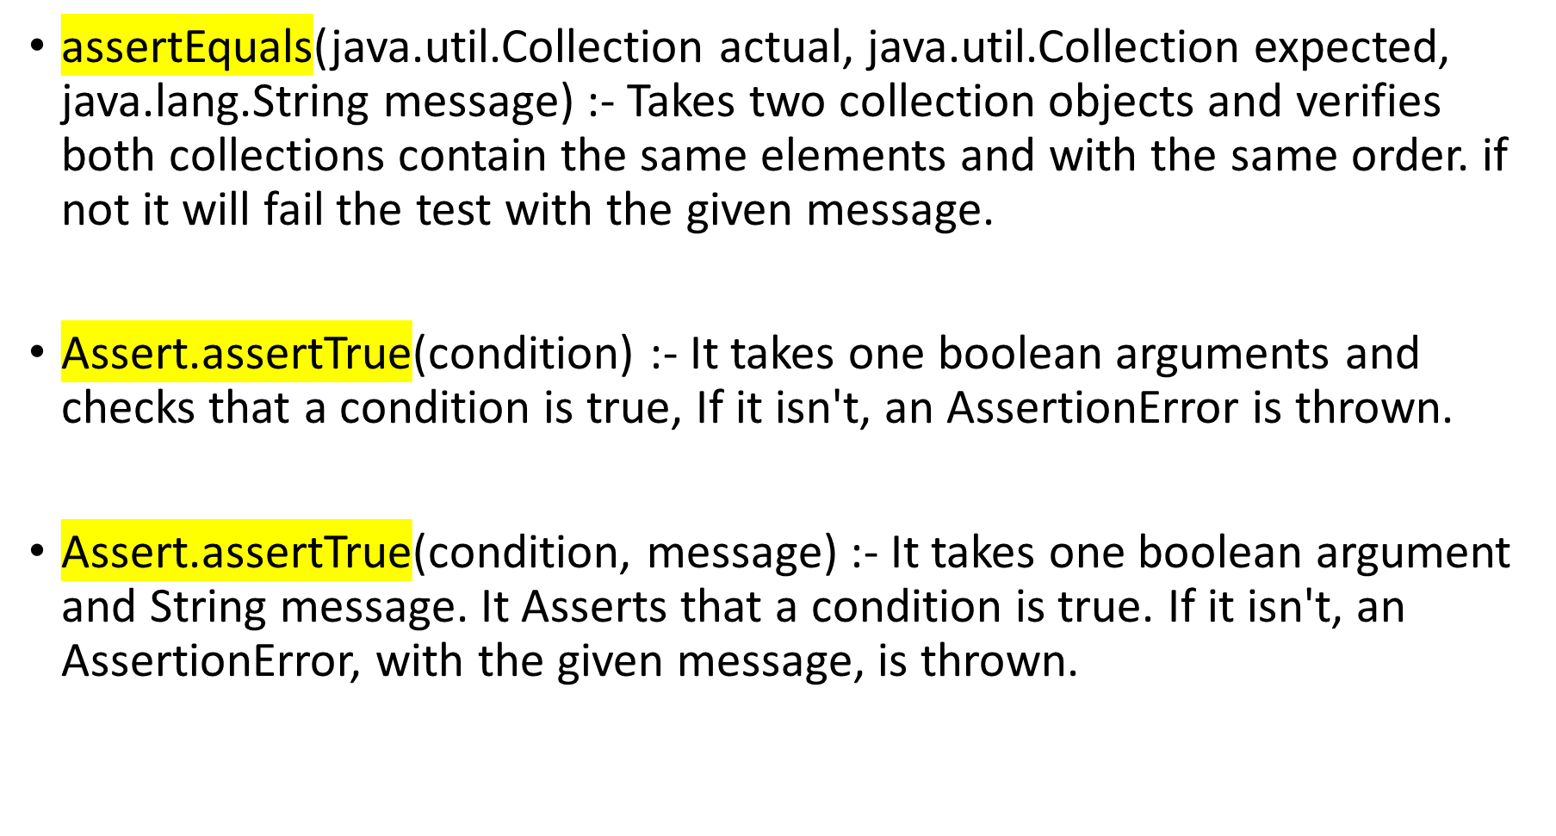

Slide 10
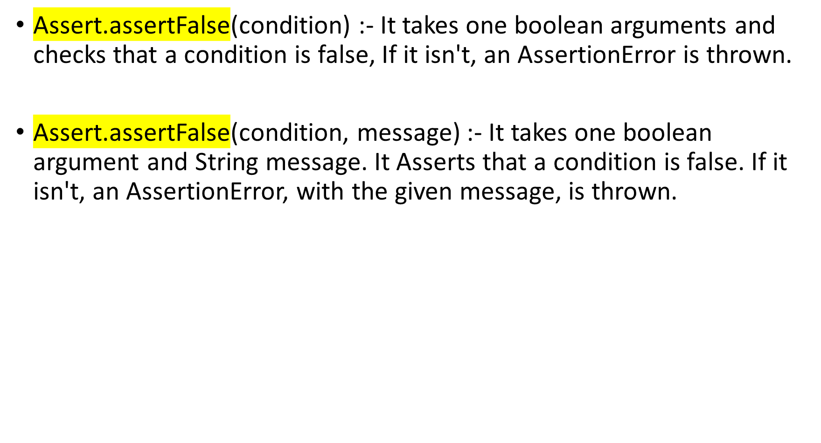

Slide 11
DataProvider in TestNG
Marks a method as supplying data for a test method. The annotated method must return an Object[][] where each Object[] can be assigned the parameter list of the test method.
The @Test method that wants to receive data from this DataProvider needs to use a dataProvider name equals to the name of this annotation.
The name of this data provider. If it's not supplied, the name of this data provider will automatically be set to the name of the method.

