Slide 1
How does Netflix and Jio Cinema handle the sudden increase in traffic?

Slide 2
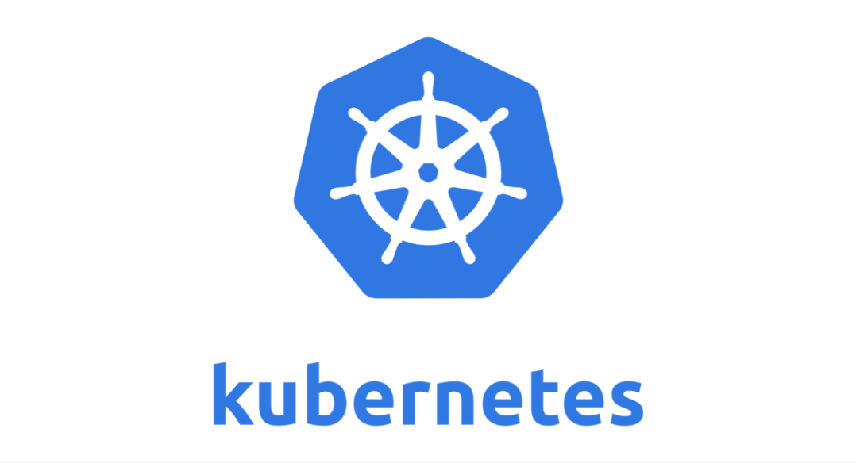
They use an open-source container orchestration system.

Slide 3
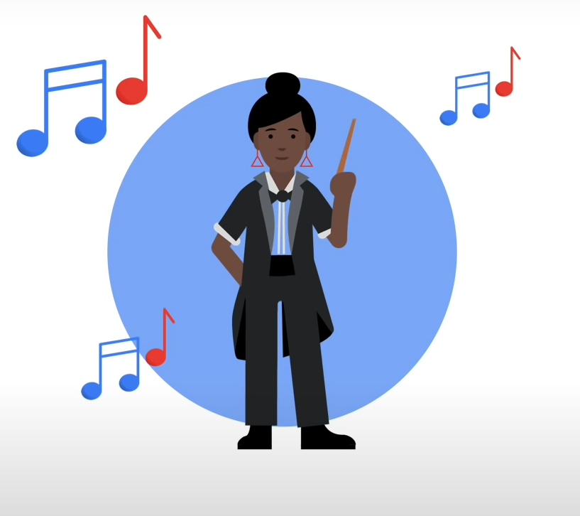
Just like in an orchestra, the conductor makes sure that the song sounds like the composer intended.
Kubernetes ensures the services are running smoothly just like the app developer intended.

Slide 4
What features do orchestration tools offers?
1 High availability or no downtime
2 Scalability or high performance
3 Self healing

Slide 5
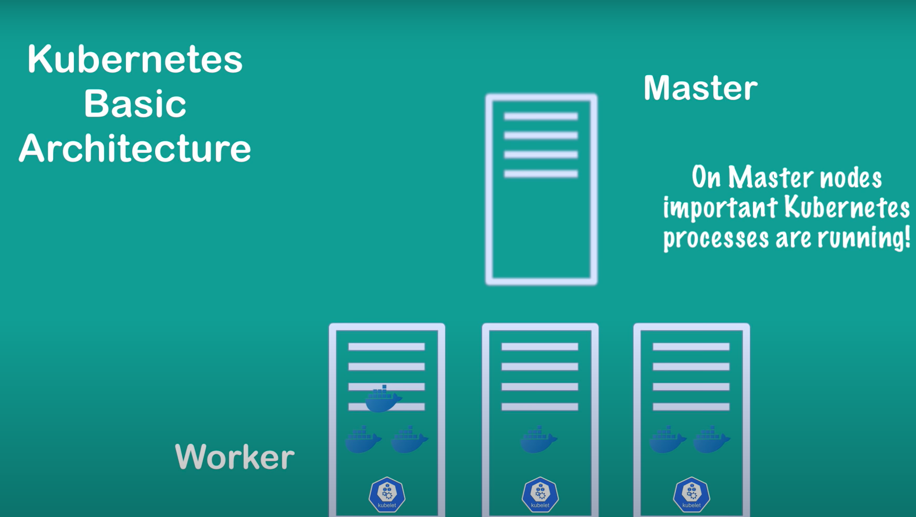
Nodes
Kubelet connects the nodes in the clusture
Nodes

Slide 6
How Kubernetes organizes containers?
Kubernetes doesn’t run containers directly instead it wraps one or more containers into a higher-level structure called a pod.

Slide 7
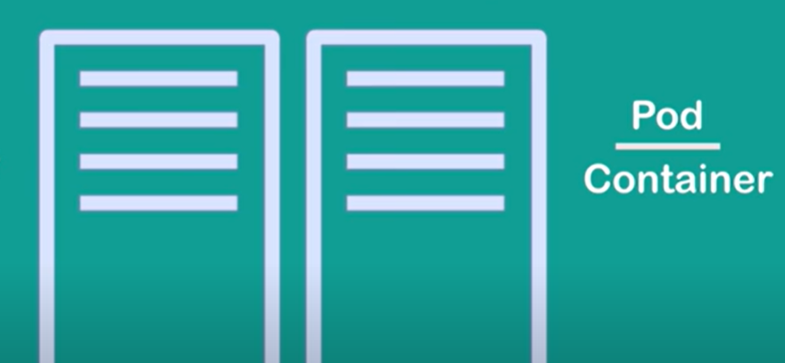
1 Pod is smallest unit. 2 Inside pod there are many containers. 3 1 pod per application. 4 Each pod is its own self-contained server. 5 Pods gets new IP address on creation

Slide 8
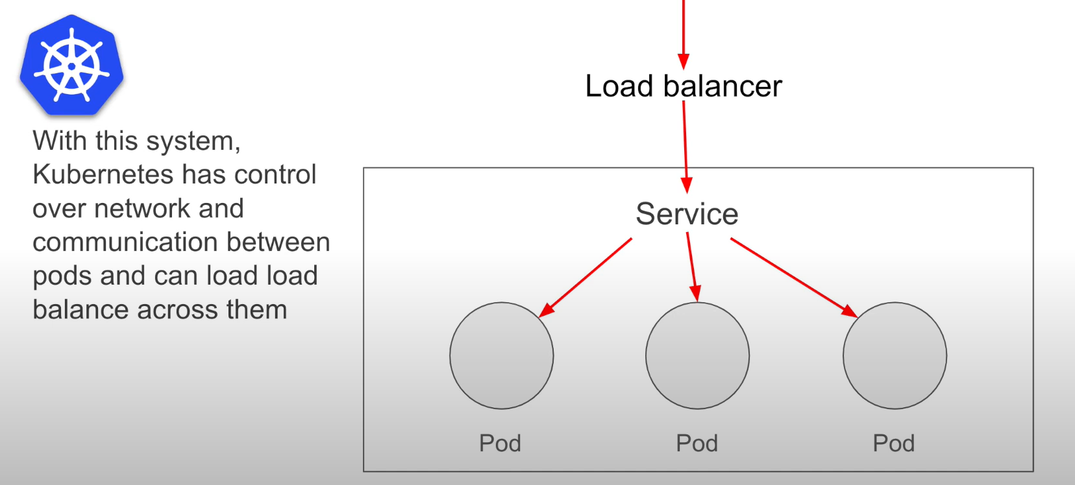
Service discovery and load balancing
Traffic

Slide 9
