Slide 1

DAYANANDA SAGAR UNIVERSITY DEPARTMENT OF COMPUTER APPLICATIONS SCHOOL OF ENGINEERING KUDLU GATE, HOSUR ROAD, BANGALORE -560068
Project Title: XML Elements
Presented To: Dr. Mithilesh Kumar
(Internet Technologies)
Submitted By: KUMAR AKASH (ENG22CA0032)

Slide 2
Content
XML Syntax
Tree Structure
Elements vs. Attributes
Namespaces
Display XML
Cascading Style Sheets
Document Type Definitions
Element Content Specification

Slide 3
XML Elements
An XML element is the fundamental building block of an XML document. It is used to store and organize data in a structured way. XML elements are defined by a pair of tags: a start tag and an end tag. Elements can also contain attributes, other nested elements (child elements), and text content.

Slide 4
XML Syntax Elements & Attributes
Uses less-than and greater-than characters (<…>) as delimiters
Every opening tag must having an accompanying closing tag
<First Name>Sanjay</First Name>
Empty tags do not require an accompanying closing tag.
Empty tags have a forward slash before the greater-than sign e.g. <Name/>
Tags can have attributes which must be enclosed in double quotes
<name first=“Sanjay” last=“Goel”)
Elements should be properly nested
The nesting can not be interleaved
Each document must have one single root element
Elements and attribute names are case sensitive

Slide 5
Tree Structure Elements
XML documents have a tree structure containing multiple levels of nested tags.
Root element is a single XML element which encloses all of the other XML elements and data in the document
All other elements are children of the root element
<?xml version=“1.0” encoding=“UTF-8” standalone=“yes” ?>
<contact> ⬅ Root Element
<name>
<first name>Sanjay</first name>
<last name>Goel</last name>
</name>
<address>
<street>56 Della Street</street> ⬅ Child Elements
<city>Phoenix</city>
<state>AZ</state>
<zip>15784</zip>
</address>
</contact>

Slide 6
Elements vs. Attributes Comparison
Data should be stored in Elements
Information about data (meta-data) should be stored in attributes
When in doubt use elements
Rules of thumb
Elements should have information which some one may want to read.
Attributes are appropriate for information about document that has nothing to do with content of document
e.g. URLs, units, references, ids belong to attributes
What is your meta-data may be some ones data

Slide 7
Namespaces Basics
XML documents come from different sources
Combining elements from different sources can result in name conflict
Namespaces allow the interpreter to resolve the elements
Namespaces
Declared within element start-tag using attribute xmlns
Represented as an actual URI (since namespaces are globally unique)
e.g. <Collection xmlns:book="http://www.mjyOnline.com/books"
xmlns:cd=http://www.mjyOnline.com/books>
Here book and cd are short hands for the full namespace name
Default namespace is used if no other namespace is defined
It does not have any prefix associated with it

Slide 8
Namespaces Example
<?xml version="1.0"?>
<!-- File Name: Collection.xml -->
<COLLECTION
xmlns:book="http://www.mjyOnline.com/books"
xmlns:cd="http://www.mjyOnline.com/cds">
<ITEM Status="in">
<TITLE>The Adventures of Huckleberry Finn</book:TITLE>
<AUTHOR>Mark Twain</book:AUTHOR>
<PRICE>$5.49</book:PRICE>
</ITEM>
<ITEM Status="in">
<TITLE>The Marble Faun</TITLE>
<AUTHOR>Nathaniel Hawthorne</AUTHOR>
<PRICE>$10.95</PRICE>
</ITEM>
<ITEM>
<ITEM Status="out">
<TITLE>Leaves of Grass</TITLE>
<AUTHOR>Walt Whitman</AUTHOR>
<PRICE>$7.75</PRICE>
</ITEM>
<ITEM Status="out">
<TITLE>The Legend of Sleepy Hollow</TITLE>
<AUTHOR>Washington Irving</AUTHOR>
<PRICE>$2.95</PRICE>
</ITEM>
<?xml version="1.0"?>
<!-- File Name: Collection.xml -->
<COLLECTION
<ITEM>
<TITLE>Violin Concertos Numbers 1, 2, and 3</TITLE>
<COMPOSER>Mozart</COMPOSER>
<PRICE>$16.49</PRICE>
</ITEM>
<TITLE>Violin Concerto in D</TITLE>
<COMPOSER>Beethoven</COMPOSER>
<PRICE>$14.95</PRICE>
</ITEM>
</COLLECTION>
Books and CDs are tracked in different files if combined will lead to conflicts

Slide 9
Namespaces Example
<?xml version="1.0"?>
<!-- File Name: Collection.xml -->
<COLLECTION
xmlns:book="http://www.mjyOnline.com/books"
xmlns:cd="http://www.mjyOnline.com/cds">
<book:ITEM Status="in">
<book:TITLE>The Adventures of Huckleberry Finn</book:TITLE>
<book:AUTHOR>Mark Twain</book:AUTHOR>
<book:PRICE>$5.49</book:PRICE>
</book:ITEM>
<cd:ITEM>
<cd:TITLE>Violin Concerto in D</cd:TITLE>
<cd:COMPOSER>Beethoven</cd:COMPOSER>
<cd:PRICE>$14.95</cd:PRICE>
</cd:ITEM>
<book:ITEM Status="out">
<book:TITLE>Leaves of Grass</book:TITLE>
<book:AUTHOR>Walt Whitman</book:AUTHOR>
<book:PRICE>$7.75</book:PRICE>
</book:ITEM>
<cd:ITEM>
<cd:TITLE>Violin Concertos Numbers 1, 2, and 3</cd:TITLE>
<cd:COMPOSER>Mozart</cd:COMPOSER>
<cd:PRICE>$16.49</cd:PRICE>
</cd:ITEM>
<book:ITEM Status="out">
<book:TITLE>The Legend of Sleepy Hollow</book:TITLE>
<book:AUTHOR>Washington Irving</book:AUTHOR>
<book:PRICE>$2.95</book:PRICE>
</book:ITEM>
<book:ITEM Status="in">
<book:TITLE>The Marble Faun</book:TITLE>
<book:AUTHOR>Nathaniel Hawthorne</book:AUTHOR>
<book:PRICE>$10.95</book:PRICE>
</book:ITEM>
</COLLECTION>

Slide 10
Display XML Style Sheets
A style sheet is a file that contains instructions for rendering individual elements in an XML document
Two kinds of style sheets exist
Cascading Style Sheets (CSS)
Extensible Stylesheet language (XSLT)
Please refer to the following web site for comprehensive information on style sheets
http://www.w3schools.com/css/default.asp

Slide 11
Cascading Style Sheets Example
<?xml version="1.0"?>
<!-- File Name: Inventory01.xml -->
<?xml-stylesheet type="text/css" href="Inventory01.css"?>
<INVENTORY>
<BOOK>
<TITLE>The Adventures of Huckleberry Finn</TITLE>
<AUTHOR>Mark Twain</AUTHOR>
<BINDING>mass market paperback</BINDING>
<PAGES>298</PAGES>
<PRICE>$5.49</PRICE>
</BOOK>
<BOOK>
<TITLE>Leaves of Grass</TITLE>
<AUTHOR>Walt Whitman</AUTHOR>
<BINDING>hardcover</BINDING>
<PAGES>462</PAGES>
<PRICE>$7.75</PRICE>
</BOOK>
<BOOK>
<TITLE>The Legend of Sleepy Hollow</TITLE>
<AUTHOR>Washington Irving</AUTHOR>
<BINDING>mass market paperback</BINDING>
<PAGES>98</PAGES>
<PRICE>$2.95</PRICE>
</BOOK>
<BOOK>
<TITLE>The Marble Faun</TITLE>
<AUTHOR>Nathaniel Hawthorne</AUTHOR>
<BINDING>trade paperback</BINDING>
<PAGES>473</PAGES>
<PRICE>$10.95</PRICE>
</BOOK>
<BOOK>
<TITLE>Moby-Dick</TITLE>
<AUTHOR>Herman Melville</AUTHOR>
<BINDING>hardcover</BINDING>
<PAGES>724</PAGES>
<PRICE>$9.95</PRICE>
</BOOK>
</INVENTORY>

Slide 12
Cascading Style Sheets Example
/* File Name: Inventory02.css */
BOOK
{display:block;
margin-top:12pt;
font-size:10pt}
TITLE
{display:block;
font-size:12pt;
font-weight:bold;
font-style:italic}
AUTHOR
{display:block;
margin-left:15pt;
font-weight:bold}
BINDING
{display:block;
margin-left:15pt}
PAGES
{display:none}
PRICE
{display:block;
margin-left:15pt}

Slide 13
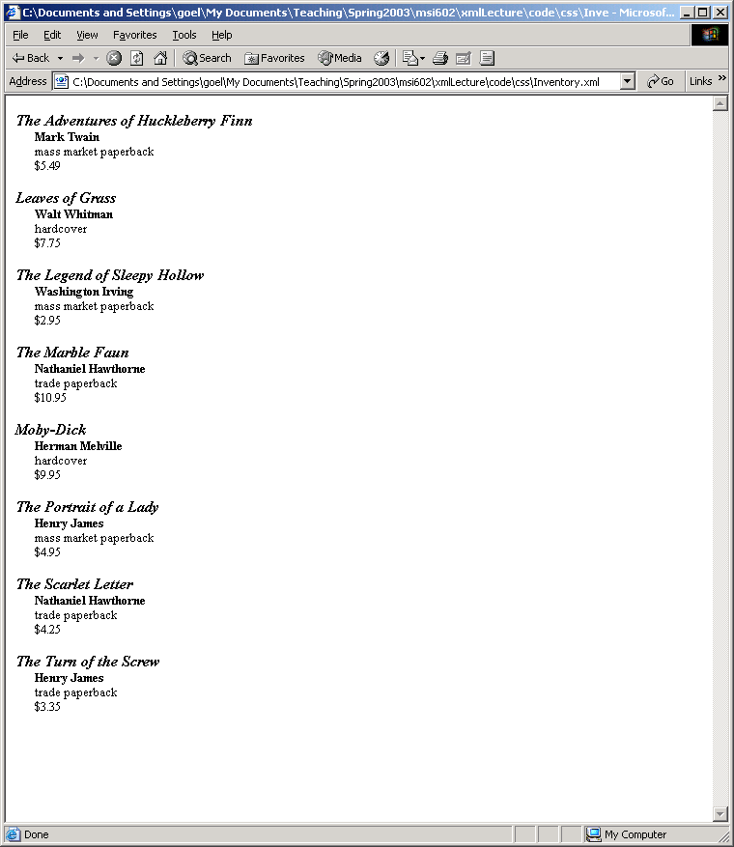
Cascading Style Sheets Display

Slide 14
Document Type Definitions Basics
Document type definition (DTD) consists of a series of markup declarations enclosed in square brackets
<?xml version=“1.0” standalone=“yes”?>
<!DOCTYPE GREETING [
<!ELEMENT GREETING (#PCDATA)>
]>
<GREETING>
Hello XML!
</GREETING>
A DTD can also be stored separately from the XML document and referenced in it.

Slide 15
Document Type Definitions Syntax
Element Type Declaration
Syntax: <!Element Name contentspec>
Name is the name of the element
contentspec is the content specification
Example:
<!Element Title (#PCDATA)>
Content specification can have four types of values
EMPTY content – Element must not have content
<!Element Image EMPTY>
ANY Content – Can contain any thing
<!Element misc ANY>
Element Content – Child elements but no character data
<!DOCTYPE BOOK [
<!ELEMENT BOOK (TITLE, AUTHOR)>
<!ELEMENT TITLE (#PCDATA)>
<!ELEMENT AUTHOR (#PCDATA)>
Mixed Content – character data and child elements interspersed

Slide 16
Element Content Specification Types
Content Specification indicates allowed child elements and their order
If element has element content it can not contain any character data
Types of content specifications
Sequence: Indicates that each element must have a specific sequence of child elements
Example
<!Doctype Mountain [
<!ELEMENT MOUNTAIN (NAME, HEIGHT, STATE)>
<!ELEMENT NAME (#PCDATA)
<!ELEMENT HEIGHT (#PCDATA)
<!ELEMENT STATE (#PCDATA)
]>
Valid XML
<MOUNTAIN>
<NAME>Wheeler</NAME>
<HEIGHT>13161</HEIGHT>
<STATE>New Mexico</STATE>
</MOUNTAIN>

Slide 17
Element Content Specification Types
Types of content specifications
Choice: Indicates that element can have one of a series of child elements
Each element is separated by a | sign
Example
<!Doctype FILM [
<!ELEMENT FILM (STAR | NARRATOR | INSTRUCTOR)>
<!ELEMENT STAR (#PCDATA)>
<!ELEMENT NARRATOR (#PCDATA)>
<!ELEMENT INSTRUCTOR (#PCDATA)>
]>
Valid XML
<FILM>
<STAR>ROBERT REDFORD</STAR>
</FILM>
Invalid XML
<FILM>
<NARRATOR>Sir Gregory Parsloe</NARRATOR>
<INSTRUCTOR>Galahad Threepwood</INSTRUCTOR>
</FILM>

Slide 18
Element Content Specification Number of Elements
Specifying the number of elements allowed
? zero or one
+ one or more
* zero or more
Example
<!Doctype Mountain [
<!ELEMENT MOUNTAIN (NAME+, HEIGHT?, STATE)>
<!ELEMENT NAME (#PCDATA)
<!ELEMENT HEIGHT (#PCDATA)
<!ELEMENT STATE (#PCDATA)
]>
Valid XML
<MOUNTAIN>
<NAME>Peublo Peak</NAME>
<NAME>Taos Mountain</NAME>
<STATE>New Mexico</STATE>
</MOUNTAIN>

Slide 19
Element Content Specification Modification
Modifying a group of elements
Example
<!Doctype FILM [
<!ELEMENT FILM (STAR | NARRATOR | INSTRUCTOR)+>
<!ELEMENT STAR (#PCDATA)>
<!ELEMENT NARRATOR (#PCDATA)>
<!ELEMENT INSTRUCTOR (#PCDATA)>
]>
Valid XML
<FILM>
<NARRATOR>Sir Gregory Parsloe</NARRATOR>
<STAR>ROBERT REDFORD</STAR>
<NARRATOR>PLUG BASHMAN</NARRATOR>
</FILM>

Slide 20
Element Content Specification Nesting
Nesting in specification
Example
<!Doctype FILM [
<!ELEMENT FILM TITLE, CLASS,(STAR | NARRATOR | INSTRUCTOR)+>
<!ELEMENT TITLE (#PCDATA)>
<!ELEMENT CLASS (#PCDATA)>
<!ELEMENT STAR (#PCDATA)>
<!ELEMENT NARRATOR (#PCDATA)>
<!ELEMENT INSTRUCTOR (#PCDATA)>
]>
Valid XML
<FILM>
<TITLE>The Net</TITLE>
<CLASS>Action</CLASS>
<STAR>Sandra Bullock</STAR>
</FILM>

Slide 21
Element Content Specification Mixed Content Model
Mixed Content Model: Allows element to contain
Character Data
Child elements in any position and any frequency (zero or more repetitions)
Child elements can be interspersed with data
Character data only
Example
<!ELEMENT TITLE (#PCDATA)>
Character data and elements
Example:
<!ELEMENT TITLE (#PCDATA | SUBTITLE)+>
<!ELEMENT SUBTITLE (#PCDATA)>
Valid XML
<TITLE>Moby Dick <SUBTITLE>Or, The Whale</SUBTITLE></TITLE>
<TITLE><SUBTITLE>Or, The Whale</SUBTITLE>Moby Dick</TITLE>

Slide 22
THANK YOU

