Slide 1
What is AZURE?
Azure is a cloud computing platform and an online portal that allows you to access and manage cloud services and resources provided by Microsoft.
These services and resources include storing your data and transforming it, depending on your requirements.
To get access to these resources and services, all you need to have is an active internet connection and the ability to connect to the Azure portal.

Slide 2
Cloud Computing Service Models
SAAS
PAAS
IAAS
Software as a Service(SAAS) is a software distribution model in which applications are hosted by a vendor or service provider and made available to customers over a network, typically the Internet.
Platform as a Service (PAAS) is a cloud computing model that delivers applications over the internet. In a PAAS model, a cloud provider delivers hardware and software tools, usually those needed for application development, to its users as a service.
Infrastructure as a Service (IAAS) is a form of cloud computing that provides virtualized computing resources over the internet. In an IAAS model, a third party provider hosts hardware, software, servers, storage and other infrastructure components on the behalf of its users.

Slide 3
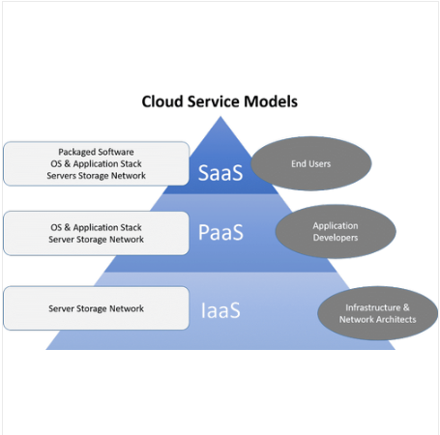

Slide 4
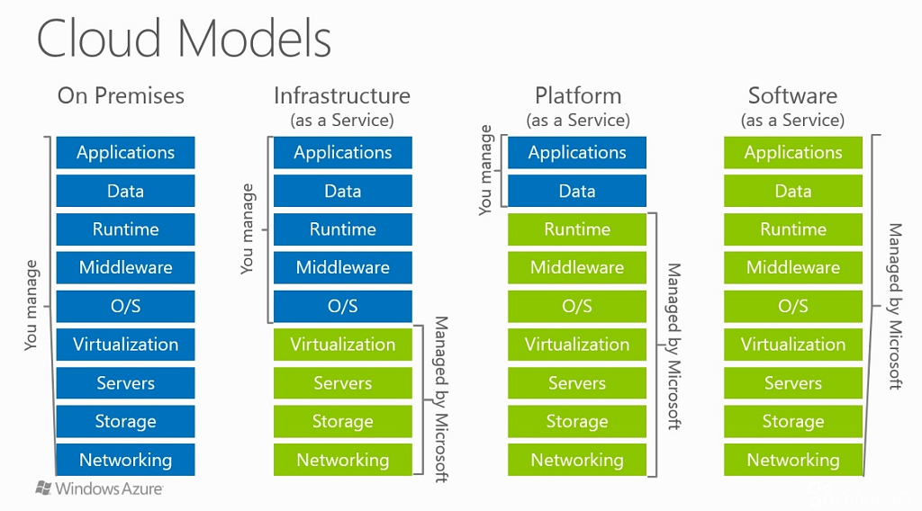

Slide 5
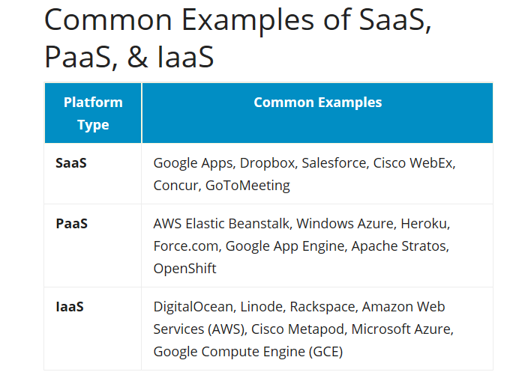

Slide 6
Payment method in Azure
Pay-as-you-go
Whatever resource are you using you have to pay for that.
Reserved (1 or 3 yrs)
Significantly reduce costs—up to 72 percent compared to pay-as-you-go prices—with one-year or three-year terms on Windows and Linux virtual machines (VMs). When you combine the cost savings gained from Azure RIs with the added value of the Azure Hybrid Benefit, you can save up to 80 percent**.
Dedicated
Azure Dedicated Host is an Azure service that provides physical servers - able to host one or more Azure virtual machines - dedicated to your organisation and your workloads. The server capacity is not shared with other customers. As you provision the host, you gain direct visibility and control over the underlying Azure infrastructure.

Slide 7
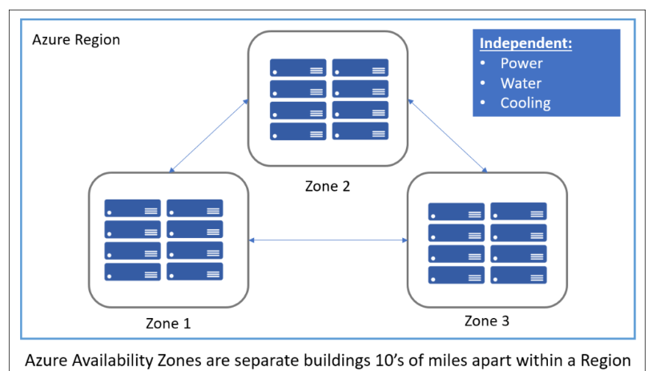
Region and Zone

