Slide 1

PROPERTY RENTAL FORECASTING: PREDICTIVE ANALYTICS AND INSIGHTS

Slide 2
Background Context and Problems
Bad property management, a lack of available rental properties, poor customer service, ineffective operations, and a lack of market distinction is just a few of the difficulties that rental companies may encounter.
We intend to evaluate the Indian housing market through dataset analysis and gather important knowledge that will aid in our comprehension of the housing markets in Chennai, Bangalore, Hyderabad, Delhi, and Kolkata.
Our analysis clarifies the current situation of the Indian housing market and how it affects the social and economic climate of the nation.

Slide 3
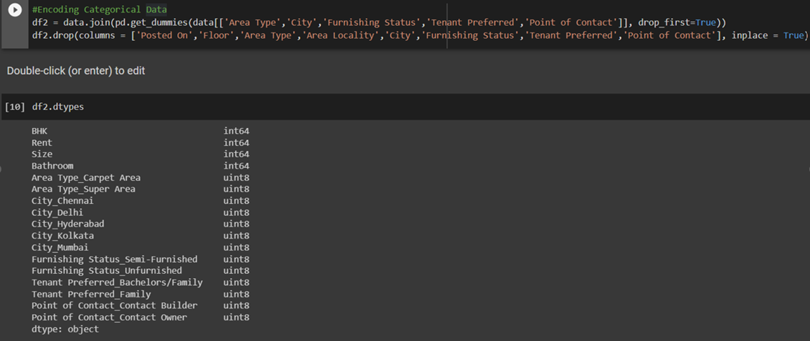
Data Mining
Predictive analytics can be used to calculate monthly rent for particular flats.
Positively, our methodology forecasts rental rates for properties of a similar size.
There are a number of categorical factors in our dataset that should be taken into account, including:
The impact of a city's or location's bedroom population.
These factors' collinearity or dependency is taken into account.
To create the predictive model, try encoding the category data and lowering the number of input variables.

Slide 4
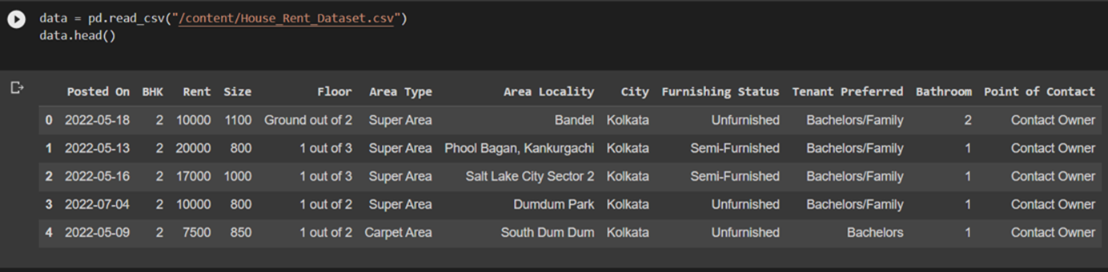
Data Description
More than 4700 homes, flats, and condominiums are available for rent in our dataset, and they are categorized by BHK, Rent, Size, Floors, Area Type, Area Location, City, Amenities Condition, Preferred Tenant Type, and Bus. contains details regarding other criteria, such the amount of rooms. contact info.

Slide 5
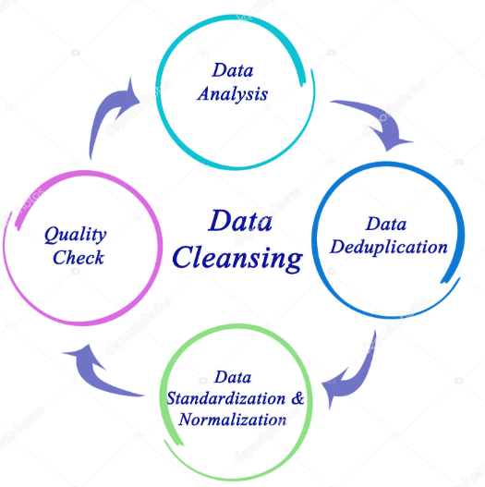
Data Cleaning
In order to derive valuable insights, we improved the dataset by cleaning the dataset
In addition to removing duplicates and outliers, we have treated our dataset for null values as well.
After completing all of that, we converted all of our data into the same format.

Slide 6

Methods
We have utilized Python as the programming language to carry out our code study.
We first imported data from datasets and performed low-level analysis. This procedure takes into account row counts, missing values, and specific values for record columns and records.
In order to create visualizations as part of the data analysis process, our team used PowerBI.

Slide 7
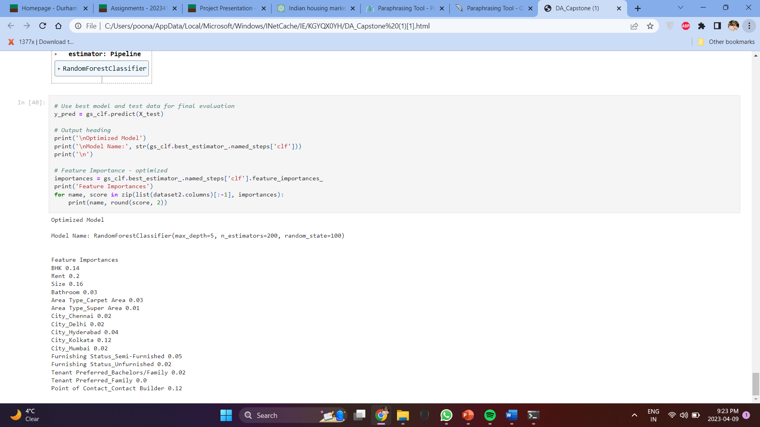
Feature Selection
On a record, a function selection code was executed.
BHK, rent, and size received the highest scores, according to the results.
This indicates that the three properties listed above are crucial for properly assessing the dataset.
The terms BHK (bedrooms), rent (cost of renting the house), and size (total square footage of the property) all refer to the number of bedrooms in the home.
The process of feature selection aids in determining which features are most crucial to the analysis's outcomes. You may get actionable insights from your dataset and make decisions by concentrating on these crucial qualities.

Slide 8
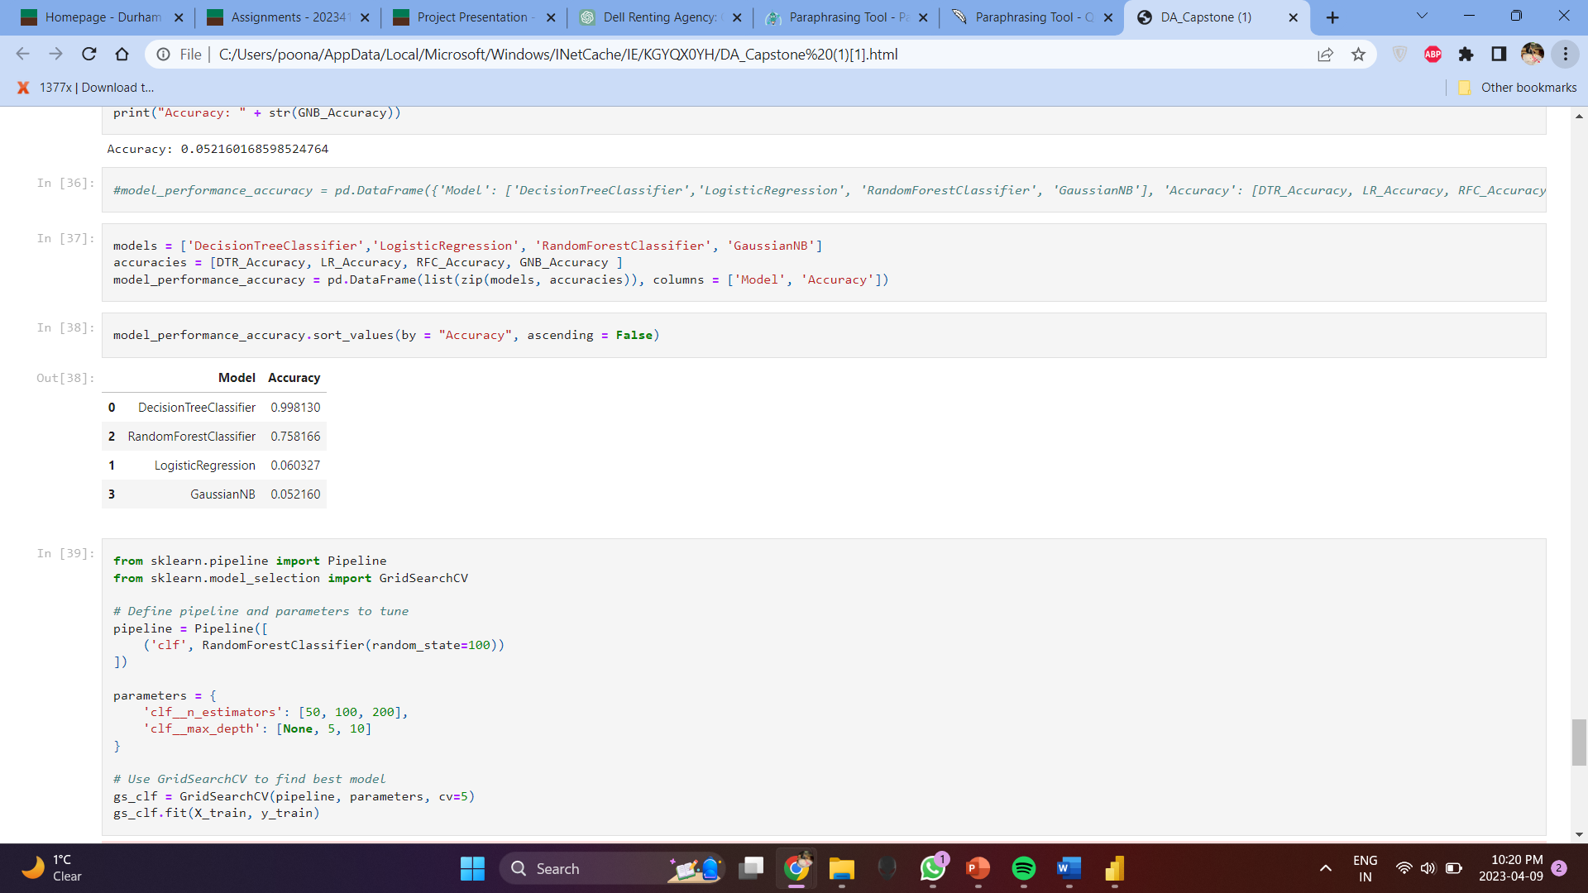
Evaluation
For a specific data set, this table displays the accuracy ratings of four machine learning models.
The models are Logistic Regression, Decision Tree, Random Forest, and Gaussian NB.
The range of precision values is 0.052160 to 0.998130.
The best precision for DecisionTreeClassifier is 0.998130.
The accuracy score for RandomForestClassifier is 0.758166. Precision for Logistic Regression is 0.060327.
The accuracy of GaussianNB is the lowest, at 0.052160.

Slide 9
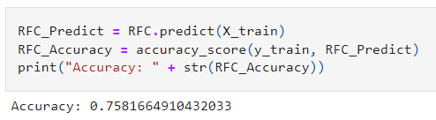
Evaluation
The accuracy score of a machine learning model gauges how effectively it forecasts the result of the data it was trained on.
Scores vary from 0 to 1, with 1 representing perfect accuracy and 0 representing complete inaccuracy.
The model's accuracy in this instance is 0.7581664910432033.
This indicates that on the dataset, the model accurately predicted the result 75.82% of the time.

Slide 10
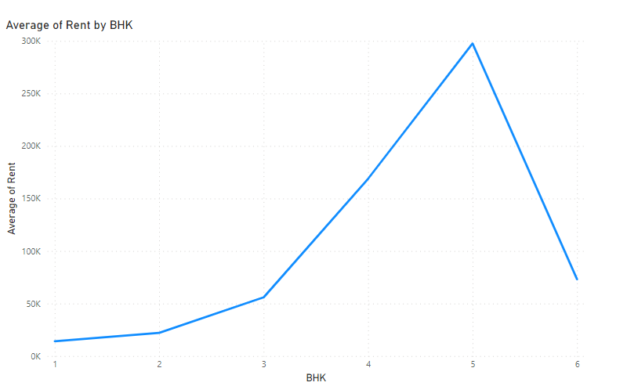
Evaluation
Here one can see that highest rent is for 5 BHK property however lowest rent is for 1 BHK property.
As the units in BHK increases the average rent gradually increase upto 5 BHK.
After 5 BHK, even with an increase in BHK unit rent decreases maybe due to the housing gets unaffordable for people.

Slide 11
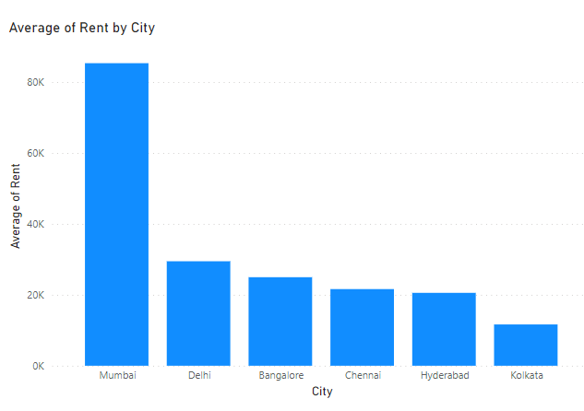
Evaluation
From this visualization below are the insights drawn:
Indian Housing market is the most expensive in mumbai with average rent greater than 80k.
Delhi, Bangalore, Chennai and Hyderabad have the same bracket of pricing which is between 20-25k.
Kolkata is the cheapest city with average rental between 10-15k.

Slide 12
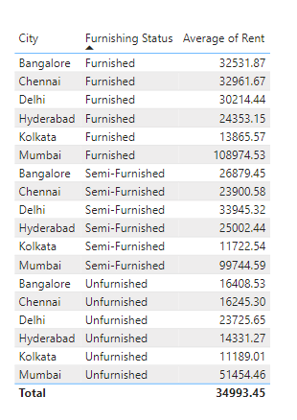
Evaluation
Furnished houses are most expensive however unfurnished houses are cheapest to get.
The average rental for a furnished house is around 30k for most of the cities, whereas unfurnished comes around 15k,
Semi-furnished housing is a great option as it is not too expensive, and you get some of the fixtures as well.

Slide 13
Implications
Provide distinctive features or target a certain niche market to set your service out from the competition.
Create a plan for customer retention.
Improve the way you manage your property
Use technology to enhance business processes and client experiences.
Be alongside the modifications to the housing market and client preferences.
To get more tenants to the properties owned by your agency, have a strong web presence.
These suggestions can be used by Dell Rental Agency to resolve business problems and enhance operations. You'll be able to meet your objectives of high occupancy, steady revenue growth, and keeping a solid reputation in the business and become more competitive in the Indian housing market.

Slide 14

Recommendations:
These analyses are based on our capability of cleaning the data. The results would be better and more pertinent if one worked to improve the dataset's quality.
Customers' personal data should be protected because Dell Rental Agency would recommend homes based on their unique needs. The business must have a data privacy policy.
The data above is based on a research of the present market and the market keeps changing. Therefore, the change should be continuously tracked, and the evaluations should be updated, as necessary.
A platform where clients can provide feedback ought to exist. Due to their awareness of the gap between consumer wants and the services offered, Dell Rental Agency will be better able to analyze its data in the future.

