Slide 1



Water Quality Prediction

Slide 2

Learning Objectives
Understanding Water Quality Parameters
Learn the significance of parameters like pH, Dissolved oxygen, nitrates, temperature etc.
Learn how these parameters affect human health , agriculture and aquatic life.
Explore Data Collection
Learn how to gather data from sensors or Government Datasets.
Apply data cleaning , handle missing values, normalization and feature scaling.
Apply Machine Learning Algorithms
Implement and compare various machine learning models e.g. RandomForestRegressor, MutiOutputRegressor for predicting water quality index.
Evaluate Model Performance
Use metrics like Mean Square Error, R2 score, to understand the model evaluation.
Design a Real-Time Monitoring System
Understand the social impact of water pollution and the importance of early detection.
GOAL
Source :
www.freepik.com/

Slide 3
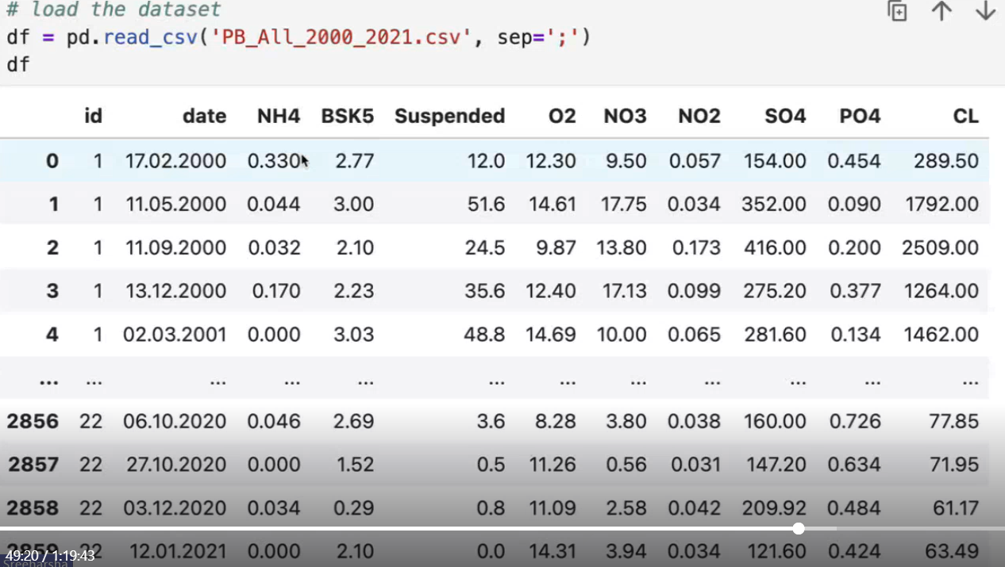
Tools and Technology used
Dataset - Access parameter definitions, acceptable ranges, and environmental standards.
CSV, EXCEL- Store and organize collected datasets.
Pandas, NumPy – Data handling
Scikit-learn – Machine learning model and evaluation
Matplotlib, Seaborn – Data visualization
Jupyter Notebook /Google Colab – Interactive experimentation

Slide 4
Methodology
Data Collection: Acquired water quality dataset with multiple parameters.
Data Preprocessing: Handled missing values, normalized features.
Exploratory Data Analysis: Visualized correlations and Understand data distributions.
Model Selection: Trained models like Random Forest Regressor, Multi Output Regressor.
Model Evaluation: Used Mean Squared Error and R2 score.
Prediction: Classified water as potable or non-potable.
Visualization: Plotted confusion matrix and feature importance.

Slide 5
Problem Statement:
Access to clean and safe drinking water is a global challenge. Traditional water testing methods are time-consuming and resource-intensive. There is a need for a fast, scalable, and intelligent system to predict water quality based on measurable parameters.
Degrading water quality is a major global concern due to rapid urbanization, industrial discharge, and agricultural runoff.
Manual sampling and lab-based testing are time-consuming, expensive, and not scalable.
Lack of real-time monitoring leads to delayed responses to pollution events, affecting:
Human health (e.g., waterborne diseases)
Aquatic ecosystems (e.g., fish kills, algal blooms)
Agriculture (e.g., crop damage, soil salinity)
Policy makers and the public lack accessible and timely information on water quality.

Slide 6
Solution:
Developed a predictive model that classifies water as potable or non-potable
Achieved high accuracy using ensemble models such as Random Forest
Enabled data-driven decision-making for water quality monitoring
Potential to integrate with IoT sensors for real-time alerts and dashboards
Can be extended to other environmental monitoring applications
Implement automated pipelines for Data ingestion (from sensors or APIs), Preprocessing(cleaning, scaling, feature selection), Model training and deployment.
Predicted Water Quality Parameters -The model predicts multiple water quality parameters such as:
NH4
BOD5 (BSK5)
Colloids
O2, NO3, NO2, SO4, PO4 and
CL

Slide 7
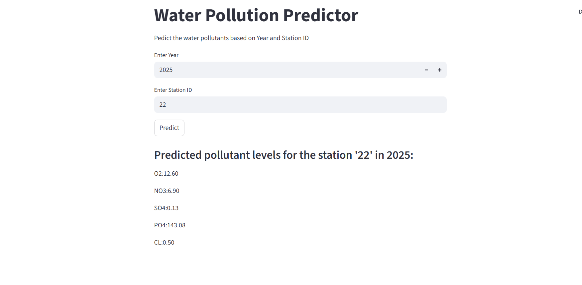
Screenshot of Output:

Slide 8
Conclusion:
Water quality is a critical global issue that impacts human health, agriculture, biodiversity, and sustainable development.
Traditional water testing methods are often slow, manual, and geographically limited, making real-time decision-making difficult.
By leveraging machine learning and IoT technologies, we can:
Predict water quality accurately,
Monitor water bodies in real time,
Provide timely alerts to prevent environmental and public health crises.
The proposed system enables:
Data-driven decision-making for policymakers,
Proactive water management by authorities,
Greater transparency and awareness for communities.
Scalable, cost-effective, and adaptable, this solution can be deployed across urban and rural areas to support clean water access, meet sustainability goals, and ensure long-term ecosystem health.
Predicted Water Quality Parameters
The model predicts multiple water quality parameters such as: NH4, BOD5, Colloids, O2, NO3, SO4, PO4 AND CL.

