Slide 1

Student Performance Prediction using Machine Learning
Shanwi Ansari | Roll No: 24103460107
Department of Computational Science, Brainware University
Subject: Machine Learning | Subject Code: BCA57205
Notes:
Good morning. My project is Student Performance Prediction using Machine Learning. It predicts a student's final marks from seven simple answers.

Slide 2



Introduction
Many things decide marks
Class tests, assignments, study hours, sleep and phone use all matter.
7 → 1
Machine learning learns from data
It studies past students and finds the pattern between habits and marks.
7 simple answers give 1 predicted final mark
Predict before the exam
Teachers and students can act early, not after the result.
Supervised learning • Regression
Notes:
A student's marks depend on many things. Machine learning can learn from old data. Then it can predict marks for a new student before the exam. Our system takes 7 answers and gives 1 predicted mark.

Slide 3
Problem Statement
Teachers find struggling students only after the results are out.
Today
Marks checked after the exam
No early warning for weak students
Hard to know which habit matters
By then it is too late to help. There is no simple tool that predicts marks in advance.
What is needed
Predict marks before the exam
Show the factors that matter
An easy tool anyone can use
Notes:
Right now we only know a student is weak after the result. We need a tool that predicts marks early, shows what affects marks, and is easy to use.

Slide 4




Objectives
Build a model
Find key factors
Predict final marks from 7 factors
Show what affects marks the most
Compare algorithms
Make it easy to use
Linear Regression, Random Forest, Gradient Boosting
A simple web page with 7 questions
Expected outcome: a working system that predicts marks and shows the important factors.
Notes:
Our four objectives: build a model, find the key factors, compare three algorithms, and make a simple web page. The final outcome is a working system.

Slide 5



Scope of the Project
Coverage
Target users
Limitations
7 factors: CT-1, CT-2, assignments, study, participation, sleep, phone use
Predicts final marks (0 to 100)
Gives a category and tips
Students who want to know where they stand
Teachers and mentors who want to find weak students early
Data is a created sample
Only 7 factors used
Result is an estimate, not a promise
Notes:
Scope: it covers seven factors and predicts final marks. Students and teachers can use it. Limits: the data is a created sample and only seven factors are used.

Slide 6
Literature Review / Existing System
Existing approach | What it does | Limitation
Manual marks sheets | Teacher compares marks after exams | Late, no prediction
Fixed pass-mark rules | Simple limits such as 40% | Ignores study habits
Excel result reports | Tables and charts of old marks | Not interactive, no forecast
ML research papers | Regression and Random Forest on student data | Hard for a student to use
Finding: earlier test marks are the strongest predictor of final marks, and study habits also help. Our system adds an easy interface.
Notes:
Existing methods are manual or rule-based, so they only look back. Research shows machine learning can predict marks, and that previous test marks matter most. Our project adds a simple interface on top.

Slide 7



Proposed System
7 simple questions
3 models compared
Predicted marks
Sliders, no typing needed
Best one is saved
A number from 0 to 100
Performance category
Improvement tips
Important factors chart
Excellent, Good, Average, At Risk
Simple advice for weak habits
Shows what matters most
Notes:
Our system has six key features: seven simple questions, three models compared, predicted marks, a category, improvement tips, and a chart of important factors.

Slide 8
Project Methodology
Development approach: step-by-step machine learning workflow
Python
pandas / NumPy
scikit-learn
matplotlib / seaborn
Streamlit
CSV dataset
VS Code + GitHub
Database: a CSV file (no separate database needed)
Notes:
We follow the standard machine learning steps: load data, clean it, explore it with charts, split it, train three models, evaluate them, save the best one and connect it to a web app. All tools are free Python libraries.

Slide 9
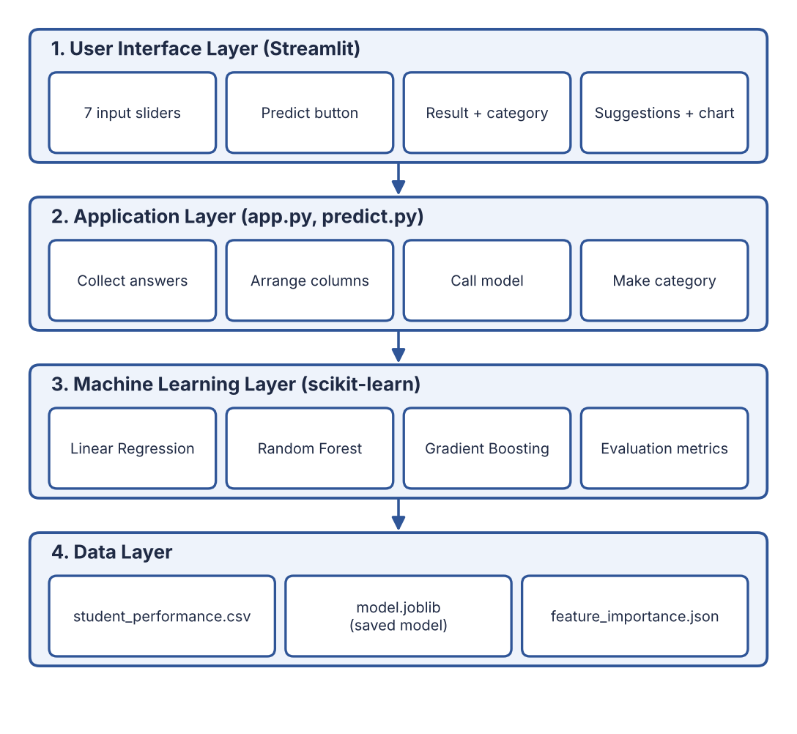
Project Internal Structure
student-performance-predictor/
├─ app.py (web UI)
├─ requirements.txt
├─ Student_Performance_
│ Prediction.ipynb
├─ data/
│ └─ student_performance.csv
├─ src/
│ ├─ eda.py
│ ├─ train.py
│ └─ predict.py
├─ models/model.joblib
├─ outputs/ (charts)
└─ docs/ (report, PPT)
Notes:
This is the internal structure. On the left, four layers: user interface, application, machine learning and data. On the right, the folder structure of the project on GitHub.

Slide 10
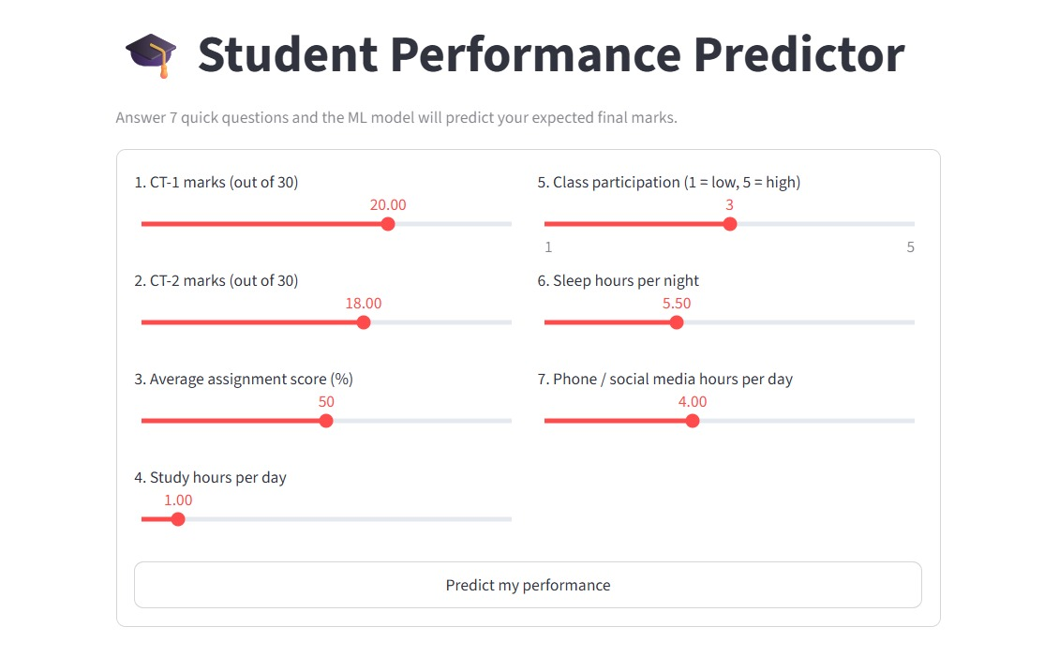
Implementation
eda.py
Draws charts to understand the data
train.py
Cleans data, trains 3 models, saves the best
predict.py
Loads the model and predicts marks
app.py
Streamlit page: 7 sliders and result
Notes:
There are four main code files. eda.py makes charts. train.py trains and saves the model. predict.py predicts marks. app.py is the web page. Show the live demo here, or paste a screenshot of the app in the box.

Slide 11
Testing and Results
0.90
3.09
R² score of the best model
marks average error
Test case | Input (CT-1, CT-2, study hours) | Predicted | Category
Strong student | 26, 27, 5 hours | 83.0 | Excellent
Average student | 20, 21, 3.5 hours | 64.0 | Average
Weak student | 10, 9, 1 hour | 24.7 | At Risk
Notes:
We tested on 200 students the model had never seen. Linear Regression was best: about 3 marks error on average and R squared of 0.90, so it explains about 90 percent of the variation. We also tested a strong, an average and a weak student. The results make sense.

Slide 12

Which Factors Matter Most?
Class tests lead
CT-2 and CT-1 together give about 79% of the importance.
Habits help
More study hours and good assignments raise marks.
Phone use hurts
More phone time lowers the predicted marks.
Notes:
The feature importance chart shows what matters most. CT-2 and CT-1 marks are the biggest. Then study hours and assignments. Too much phone time lowers the marks.

Slide 13
Conclusion
Built a working system that predicts final marks from 7 answers
Compared 3 algorithms; Linear Regression was best
Found the factors that matter most: class tests, study hours, assignments
All objectives were achieved
R² 0.90
about 90% of marks explained
3.09
marks average error
7
factors used
Notes:
In conclusion, we built a working system. Linear Regression gave the best result. We found the important factors. All our objectives were achieved.

Slide 14



Future Scope
Use real college data
Add more factors, like attendance
Try advanced models
Teacher dashboard for the whole class
Put the app online
Make a mobile app
Notes:
In the future we can use real college data, add more factors, try advanced models, build a teacher dashboard, put the app online and make a mobile app.

Slide 15

References
scikit-learn documentation: scikit-learn.org
Streamlit documentation: docs.streamlit.io
pandas and NumPy documentation: pandas.pydata.org, numpy.org
Kaggle: Student Performance Factors dataset
UCI Machine Learning Repository: Student Performance data
Géron, A. Hands-On Machine Learning with Scikit-Learn, Keras and TensorFlow, O'Reilly
Project on GitHub
https://github.com/Shanwi0635O/
Student-Performance-Prediction
Thank you
Notes:
These are the sources I used. The full project, documentation and this presentation are on GitHub. Thank you. I am happy to take questions.

