Slide 1

HOUSE PRICE PREDICTION SYSTEM
A Machine Learning Approach to Real Estate Valuation
using the California Housing Dataset
AIML Summer Internship 2026
IIHMF, MNNIT Allahabad, Prayagraj
Submitted by Shanya Kakkar
B.Tech Computer Science & Engineering | United College of Engineering and Research, Prayagraj

Slide 2


Introduction & Background
Real estate valuation is shaped by location, physical features, neighbourhood demographics, and market conditions.
Traditional manual appraisal is time-consuming, subjective, and inconsistent across appraisers.
This Project
Applies supervised regression techniques to the California Housing dataset to build an automated house price prediction system.
Machine Learning enables data-driven pricing models that learn directly from historical data.
ML can process far more variables than a human appraiser and detect non-linear pricing relationships.
House Price Prediction System
2

Slide 3


Problem Statement
Given measurable attributes of a residential census block —
Geographic coordinates
Proximity to the ocean
20,640
Age of housing structures
census block records
across California
Number of rooms & households
...predict the median house value for that block.
Goal: predict median_house_value using only interpretable, objective-aligned features.
The core challenge: select a feature set that is both predictive and interpretable — avoiding target leakage while mapping meaningfully to real-world attributes such as area, location, rooms, age, and amenities.
House Price Prediction System
3

Slide 4






Objectives
1
2
3
4
5
Collect & Preprocess
Explore the Data
Engineer Features
Train & Compare Models
Deploy the Model
Prepare the California Housing Prices dataset (Kaggle) for regression modelling.
Perform EDA to understand feature distributions and the strongest predictors.
Derive rooms_per_household & population_per_household for better signal.
Benchmark Linear Regression, Random Forest, and XGBoost.
Ship the best performer as an interactive Streamlit web app.
House Price Prediction System
4

Slide 5

Dataset Description
20,640
10
1990
Records
Attributes
U.S. Census Source
Column | Description | Type
longitude, latitude | Geographic coordinates of the block | Numeric
housing_median_age | Median age of houses in the block (years) | Numeric
total_rooms / total_bedrooms | Room counts in the block | Numeric
population, households | Residents & housing units in the block | Numeric
median_income | Median household income (in $10,000s) | Numeric
ocean_proximity | Location descriptor (e.g., INLAND, NEAR BAY) | Categorical
median_house_value | Target variable — median house value ($) | Numeric
No direct “amenities” field exists — population & households are used as density proxies to approximate it.
House Price Prediction System
5

Slide 6




Methodology
Preprocessing
Feature
Engineering
Evaluation
Deployment
1
2
3
4
5
6
7
8
Data
Collection
EDA
Model
Training
Persistence
An 8-stage, end-to-end pipeline — from raw data ingestion through to a deployed, interactive prediction interface.
House Price Prediction System
6

Slide 7

Data Preprocessing
Missing Value Treatment
Duplicate Removal
total_bedrooms had 207 nulls (~1%) — imputed using the column median.
Dataset checked for duplicate rows — none were found.
Outlier Handling
Categorical Encoding
Price cap at $500,001 retained as-is; tree-based models are naturally robust to outliers.
ocean_proximity one-hot encoded via pandas.get_dummies (drop_first=True).
House Price Prediction System
7

Slide 8
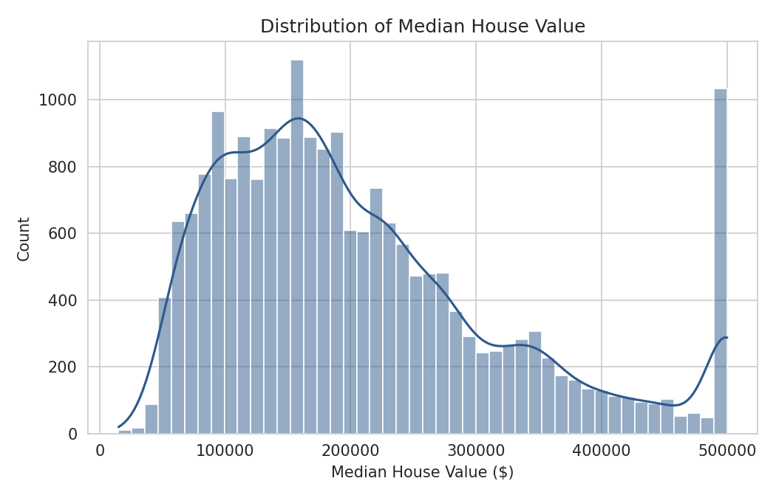
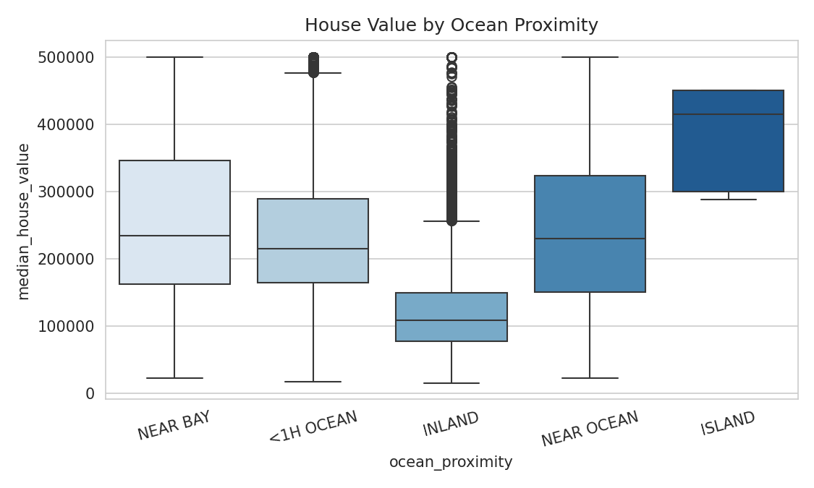
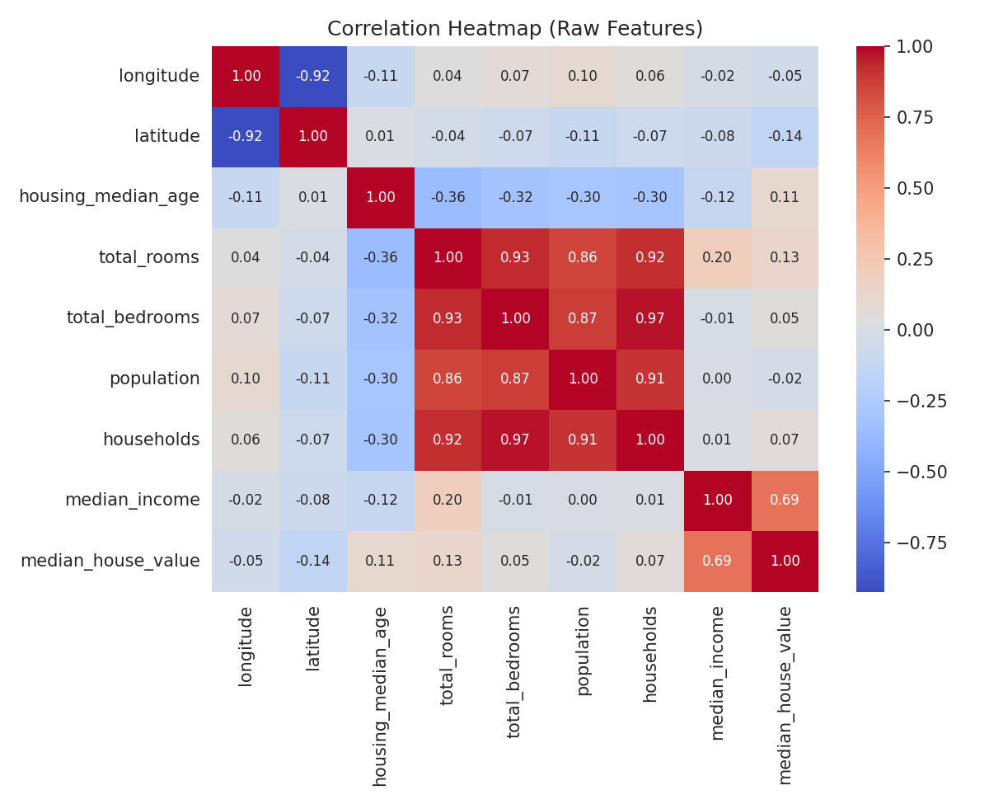
Exploratory Data Analysis
Fig 1
Fig 2
Fig 3
Median house value is right-skewed with a hard cap at $500,001.
INLAND blocks show systematically lower prices than coastal ones.
median_income has the strongest linear correlation (0.69) with price.
House Price Prediction System
8

Slide 9

Feature Engineering
rooms_per_household
population_per_household
total_rooms ÷ households
population ÷ households
Indicates the average size of dwellings in the block.
Indicates household density and occupancy levels.
These normalised ratios carry more predictive signal than raw totals, since they account for varying block sizes.
House Price Prediction System
9

Slide 10
Models Used
BEST PERFORMER
Linear Regression
Random Forest
XGBoost
Baseline model assuming a linear relationship between features and target.
Ensemble of decision trees. 200 estimators, max depth 15.
Gradient boosting ensemble. 300 estimators, depth 6, learning rate 0.05.
House Price Prediction System
10

Slide 11

Results & Performance Metrics
Model | MAE ($) | RMSE ($) | R² Score
Linear Regression | 65,053 | 88,463 | 0.403
Random Forest | 31,598 | 48,352 | 0.822
XGBoost | 31,340 | 46,623 | 0.834
XGBoost wins: lowest MAE ($31,340) and highest R² (0.834) on 4,128 held-out test records — despite excluding median_income entirely.
House Price Prediction System
11

Slide 12

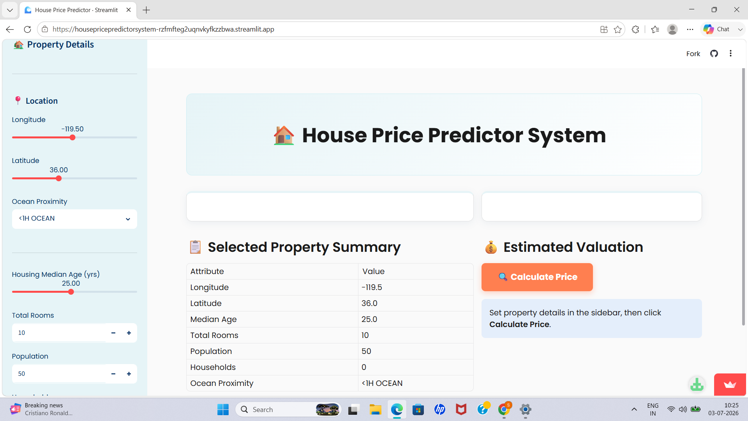
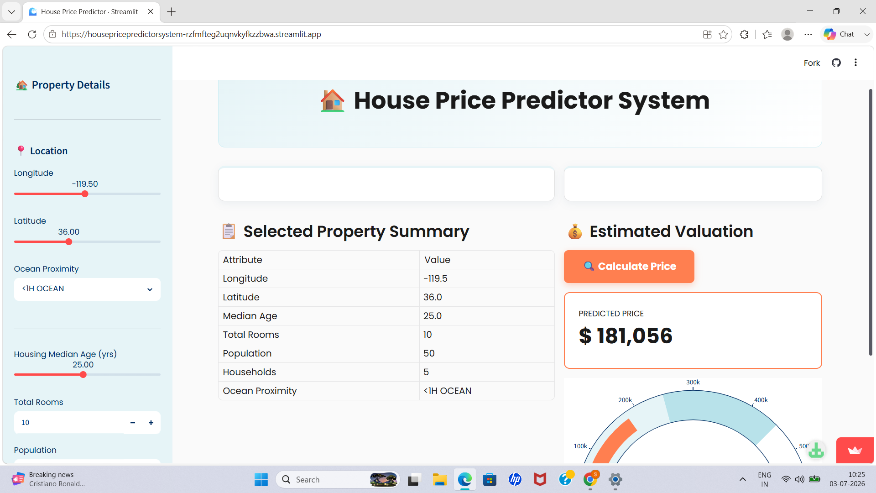
Demo Screenshots
Add screenshot here
Add screenshot here
App Input Panel
Prediction Output
Sidebar widgets for longitude, latitude, housing age, rooms, population, households & ocean proximity.
Predicted price shown as a numeric value with a visual gauge chart.
House Price Prediction System
12

Slide 13
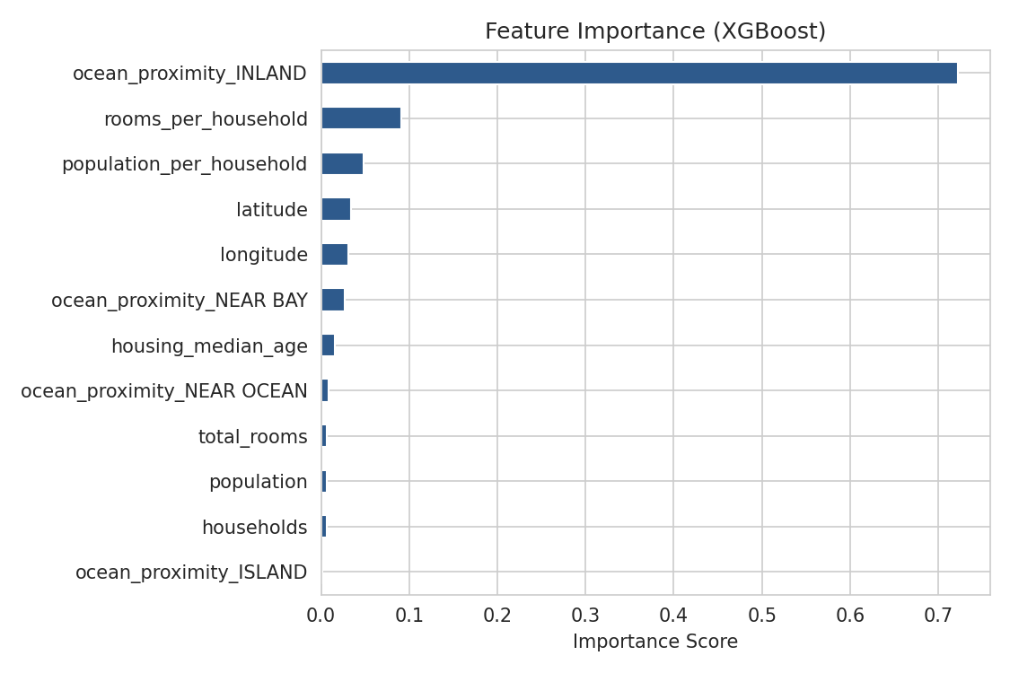
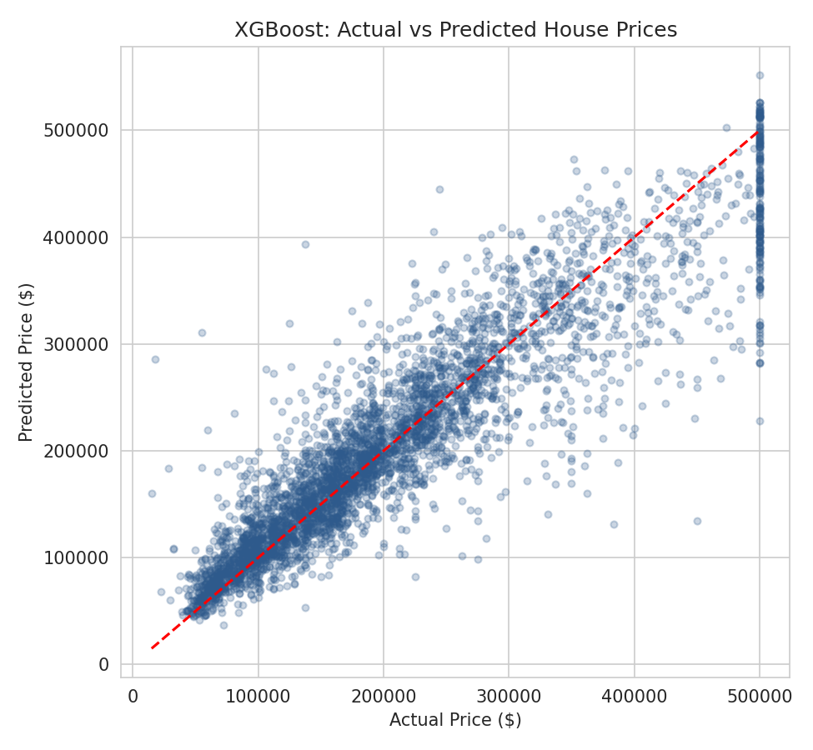
Comparative Analysis
Non-linearity dominates:
XGBoost (0.834) and Random Forest (0.822) far outperform Linear Regression (0.403), confirming a highly non-linear price relationship.
Income removal impact:
Excluding median_income hurt Linear Regression far more than the ensembles — tree models found non-linear substitutes via ocean_proximity_INLAND.
Feature importance:
ocean_proximity_INLAND alone accounts for over 70% of XGBoost's decision weight.
House Price Prediction System
13

Slide 14
Conclusion
0.834
$31,340
3
Best R² Score (XGBoost)
Mean Absolute Error
Models Benchmarked
Built a complete, end-to-end ML pipeline
— collection, preprocessing, EDA, feature engineering, training, evaluation, and deployment. Deployed as an interactive Streamlit app
for real-time price predictions from user-supplied property details. Disciplined feature selection:
deliberately excluded features that didn't map to the stated objective, at under 1% R² cost.
House Price Prediction System
14

Slide 15


Future Scope
Additional real-world features (school distance, crime rate)
Systematic hyperparameter tuning (GridSearchCV / Optuna)
Ensemble & stacking techniques for further error reduction
Thank You
Updated dataset with more recent housing data
Questions & Discussion
Public cloud deployment via Streamlit Community Cloud
Shanya Kakkar
B.Tech CSE, UCER Prayagraj
House Price Prediction System
15

