Slide 1
33333strategy
R09922125
曾苡珊

Slide 2
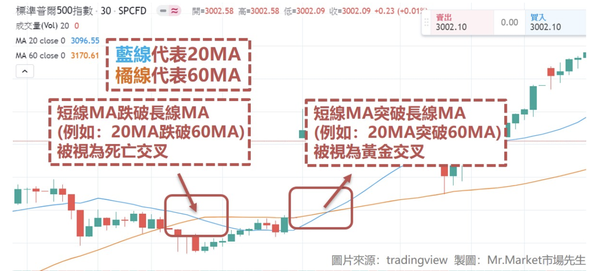
Technical Indicator - Gold Cross / Death cross
period = 360*60
ma_short = 5
ma_long = 30

Slide 3
When to buy?
Record the last three times of current ma cross state
UP -> DOWN -> DOWN
Gold Cross

Slide 4
When to sell?
Record the last three times of current ma cross state
DOWN -> UP -> UP
Buy for more than three days
Death Cross

Slide 5
Improvement
Learn more financial knowledges
Combine Machine Learning in strategy
Combine Data analysis in strategy

