Slide 1
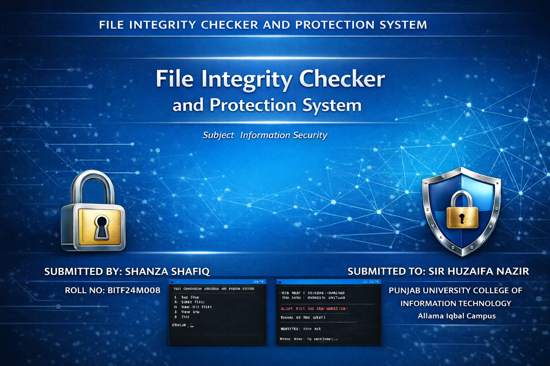

Slide 2
Table of Contents
01
Problem Statement
06
How It Works — Flow
02
Proposed Solution
07
Security Concepts
03
What is Hashing?
08
Code Structure
04
SHA-256 Algorithm
09
Demo & Output
05
System Features
10
Conclusion
Sha

Slide 3
Problem Statement
⚠
Unauthorized Modification
Important files like reports, documents and system files can be changed without the user's knowledge.
No Detection Mechanism
Most users have no simple way to verify if their files have been altered or tampered with.
Security Breaches
Undetected modifications can lead to data corruption, loss of information or serious security threats.

Slide 4
Proposed Solution
A C++ based File Integrity Monitoring System that generates a unique hash value for selected files and stores it securely.
🔐
Hash Generation
🔍
Verification
Compute SHA-256 hash of any file in binary mode — works on .txt, .pdf, .docx and more.
Re-calculate hash at any time and compare with the stored baseline to detect changes.
💾
Secure Storage
🚨
Alert System
Store the baseline hash with timestamp in a local database file (hash.txt).
Immediately alerts the user when file modification or tampering is detected.

Slide 5
What is Hashing?
Hashing is the process of converting any data into a fixed-size unique string called a HASH or DIGEST.
Original
File
SHA-256
Function
64-char
Hash
▶
▶
Deterministic
One-Way
Avalanche Effect
Fixed Size
Same file ALWAYS gives same hash
Cannot reverse hash to get original file
1 character change = completely different hash
Always 64 characters regardless of file size

Slide 6
SHA-256 Algorithm
SHA = Secure Hash Algorithm
256 = Output is 256 bits
Output = 64 hex characters
Developed by NSA (USA)
Used in Bitcoin, TLS, HTTPS
Industry standard algorithm
Implemented manually in C++
No external library needed
What is SHA-256?
1
Set initial hash values
8 fixed numbers from prime square roots
2
Pad the message
Make size a multiple of 512 bits
3
Break into 64-byte blocks
Process each block separately
4
64 rounds of mixing
Bitwise AND, OR, XOR, rotate operations
5
Produce final hash
Convert 256-bit result to 64 hex chars

Slide 7
System Features
🔑 Password Login
➕ Add File
✅ Check Integrity
Password-protected access. System locks after 3 wrong attempts. Input hidden with * while typing.
Compute SHA-256 hash of any file. Store as baseline in hash.txt with timestamp.
Re-compute hash and compare with stored baseline. Shows SAFE or MODIFIED alert.
👁 View All Files
📋 Activity Log
🗑 Remove File
List all monitored files with their stored hash values and dates.
Every action is saved to log.txt with date and time for audit purposes.
Remove any file from monitoring. Database updated without that entry.

Slide 8
How It Works — Process Flow
BASELINE PHASE
VERIFICATION PHASE
Select File
Select Same File
▼
▼
Read in Binary Mode
Read in Binary Mode
VS
▼
▼
Compute SHA-256 Hash
Recompute SHA-256 Hash
▼
▼
Store Hash + Timestamp
Compare with Stored Hash
✔ HASHES MATCH → FILE IS SAFE
✘ MISMATCH → FILE TAMPERED!

Slide 9
Security Concepts Demonstrated
01
Data Integrity
02
Access Control
SHA-256 hash detects any modification to the file, even a single character change.
Password login ensures only authorized users can access the integrity system.
03
Account Lockout
04
Audit Logging
System locks itself after 3 wrong password attempts to prevent brute force attacks.
Every action is recorded in log.txt with timestamp — creating a full audit trail.
05
Tamper Detection
06
Avalanche Effect
Immediately alerts when hash mismatch is found — file has been modified or tampered.
Even 1 byte change produces a completely different 64-character hash output.

Slide 10
Code Structure
Libraries Used
Key Functions
computeSHA256() → Manual SHA-256 hash byteToHex() → Byte to hex string readFile() → Binary file read addFile() → Store baseline hash checkFile() → Verify integrity login() → Password control
<iostream> cin, cout <fstream> read / write files <string> string type <ctime> date and time <conio.h> hidden password
Function Call Flow:
main()
→
login()
addFile()
hashFile()
computeSHA256()
checkFile()
→
→
→
→
Database File Format (hash.txt)
C:\Users\Shanza\Documents\report.pdf | a3f2c1d8e9b7...64chars | 2025-04-19 14:30:00
C:\Users\Shanza\Desktop\notes.txt | 7b8d2e4f1a9c...64chars | 2025-04-19 15:10:22

Slide 11
FILE INTEGRITY CHECKER AND PROTECTION SYSTEM
Program Output — Demo
● ● ● Terminal
● ● ● File SAFE
Enter Password: ********
[ACCESS GRANTED] Welcome!
1. Add File
2. Check File
3. Exit
Choice: 2
File path: C:\report.pdf
Old Hash: a3f2c1d8...
New Hash: a3f2c1d8...
[OK] File SAFE ✔
● ● ● File TAMPERED
Old Hash: a3f2c1d8...
New Hash: 9f1b4c7e...
[ALERT] File MODIFIED! ✘
● ● ● activity_log.txt
[2025-04-19 14:30:00] : Login Successful
[2025-04-19 14:31:10] : File Added: C:\report.pdf | Hash: a3f2c1d8e9b7...
[2025-04-19 14:32:05] : SAFE: C:\report.pdf
[2025-04-19 14:35:22] : MODIFIED: C:\report.pdf

Slide 12
FILE INTEGRITY CHECKER AND PROTECTION SYSTEM
Conclusion
✔
Ensures file integrity using SHA-256.
✔
Demonstrated core security concepts: Data Integrity, Access Control, Audit Logging and Tamper Detection.
✔
Password-based login with 3-attempt lockout prevents unauthorized access to the system.
✔
Binary file reading ensures the system works on all file types — .txt, .pdf, .docx and more.
✔
Activity log maintains a complete audit trail of every action with date and time.

Slide 13


