Slide 1
Digitising candidate scripts
Notes:
[Sources]
- Digitisation_data_analysis_methods_and_results.pptx (user-supplied source presentation)
[/Sources]

Slide 2
What our digitisation analysis does
1 — UNDERSTAND OCR BEHAVIOUR
Compare Captured with human-verified Published; recover character edits; analyse by question type, language group and confidence.
2 — USE ANSWER KEYS AS EVIDENCE
Parse accepted variations and calculate exact-match, edit, character and token similarity signals.
3 — TARGET HUMAN REVIEW
Rank rows likely to be changed by a reviewer, while keeping possible answer-key gaps as a separate decision.
Notes:
[Sources]
- Digitisation_notes.docx
- HITL_PIPELINE.md
- hitl_pipeline.py
[/Sources]

Slide 3
Current run: a controlled queue of 3.95% for review
The validation recall is 0.98. Results on the >0.85 cohort describe queue size only: those rows are not yet verified ground truth.
Measure | Updated result | Context
Validation operating point | 98.0% recall 25.0% precision | 8.84% reviewed 30 corrections missed
>0.85 OCR queue | 5,477 rows 3.95% | Unreviewed scoring estimate
AK / combined queue | 193 AK candidates 5,501 combined | 0.14% AK 3.96% combined
Notes:
[Sources]
- output/hitl/validation_report.json, updated 2026-08-28 11:37
- output/hitl/no_human_flagged.scoring_report.json, updated 2026-08-28 11:38
[/Sources]

Slide 4
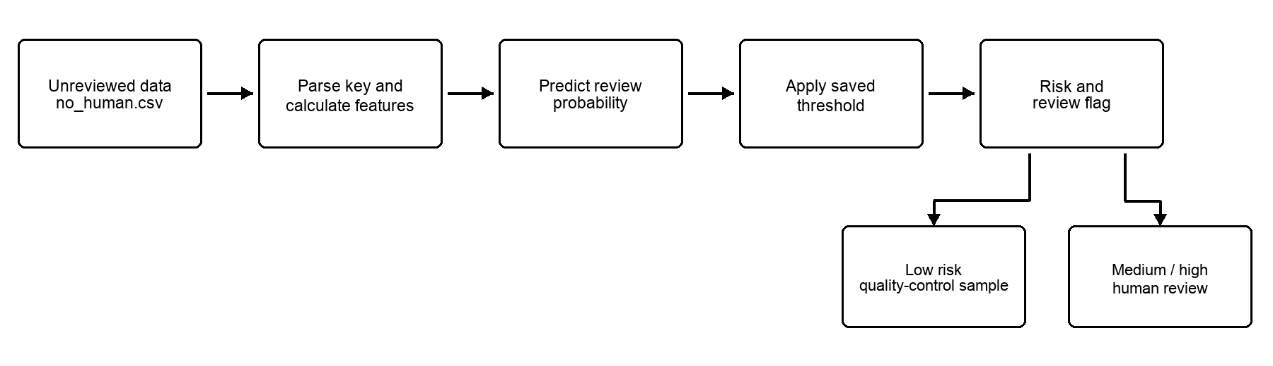
Targeted human review for high OCR confidence data
The pipeline parses the key, calculates evidence and applies a saved threshold. Medium/high-risk rows go to human review; low-risk rows remain subject to quality-control sampling. It prioritises work instead of correcting answers.
Notes:
[Sources]
- HITL_PIPELINE.md
- hitl_pipeline.py
- output/hitl/doc_assets/scoring_workflow.png
[/Sources]

Slide 5
What our digitisation analysis does
1 — UNDERSTAND OCR BEHAVIOUR
Compare Captured with human-verified Published; recover character edits; analyse by question type, language group and confidence.
2 — USE ANSWER KEYS AS EVIDENCE
Parse accepted variations and calculate exact-match, edit, character and token similarity signals.
3 — TARGET HUMAN REVIEW
Rank rows likely to be changed by a reviewer, while keeping possible answer-key gaps as a separate decision.
Notes:
[Sources]
- Digitisation_notes.docx
- HITL_PIPELINE.md
- hitl_pipeline.py
[/Sources]

Slide 6
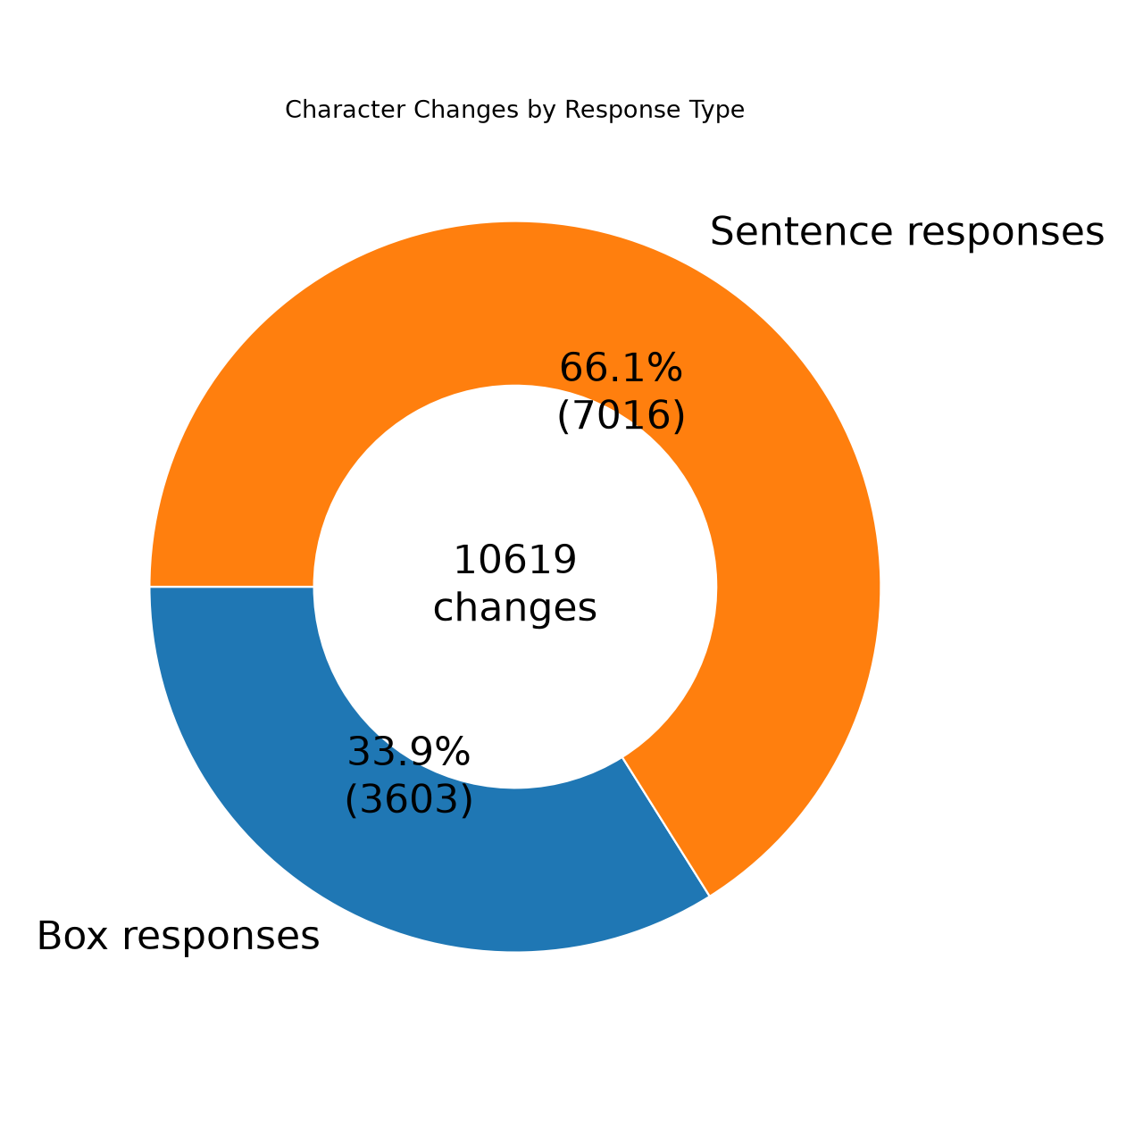
Box-letter and sentence responses fail differently
Across 7,876 HITL teleforms: box-only changes 16.5%; sentence-only 20.9%; both 7.1%; no short-answer character changes 55.6%.
BOX-LETTER — substitutions dominate: one symbol is read as another.
SENTENCE — insertions and deletions dominate, often from joined or unclear handwriting.
Notes:
[Sources]
- Digitisation_data_analysis_methods_and_results.pptx, source slides 9–10
- Digitisation_notes.docx
[/Sources]

Slide 7
Targeted human review for high OCR confidence data
The pipeline parses the key, calculates evidence and applies a saved threshold. Medium/high-risk rows go to human review; low-risk rows remain subject to quality-control sampling. It prioritises work instead of correcting answers.
Notes:
[Sources]
- HITL_PIPELINE.md
- hitl_pipeline.py
- output/hitl/doc_assets/scoring_workflow.png
[/Sources]

Slide 8
What our digitisation analysis does
1 — UNDERSTAND OCR BEHAVIOUR
Compare Captured with human-verified Published; recover character edits; analyse by question type, language group and confidence.
2 — USE ANSWER KEYS AS EVIDENCE
Parse accepted variations and calculate exact-match, edit, character and token similarity signals.
3 — TARGET HUMAN REVIEW
Rank rows likely to be changed by a reviewer, while keeping possible answer-key gaps as a separate decision.
Notes:
[Sources]
- Digitisation_notes.docx
- HITL_PIPELINE.md
- hitl_pipeline.py
[/Sources]

Slide 9
Targeted human review for high OCR confidence data
The pipeline parses the key, calculates evidence and applies a saved threshold. Medium/high-risk rows go to human review; low-risk rows remain subject to quality-control sampling. It prioritises work instead of correcting answers.
Notes:
[Sources]
- HITL_PIPELINE.md
- hitl_pipeline.py
- output/hitl/doc_assets/scoring_workflow.png
[/Sources]

Slide 10
Current run: a controlled queue of 3.95% for review
The validation recall is 0.98. Results on the >0.85 cohort describe queue size only: those rows are not yet verified ground truth.
Measure | Updated result | Context
Validation operating point | 98.0% recall 25.0% precision | 8.84% reviewed 30 corrections missed
>0.85 OCR queue | 5,477 rows 3.95% | Unreviewed scoring estimate
AK / combined queue | 193 AK candidates 5,501 combined | 0.14% AK 3.96% combined
Notes:
[Sources]
- output/hitl/validation_report.json, updated 2026-08-28 11:37
- output/hitl/no_human_flagged.scoring_report.json, updated 2026-08-28 11:38
[/Sources]

Slide 11
Targeted human review for high OCR confidence data
The pipeline parses the key, calculates evidence and applies a saved threshold. Medium/high-risk rows go to human review; low-risk rows remain subject to quality-control sampling. It prioritises work instead of correcting answers.
Notes:
[Sources]
- HITL_PIPELINE.md
- hitl_pipeline.py
- output/hitl/doc_assets/scoring_workflow.png
[/Sources]

Slide 12
What our digitisation analysis does
1 — UNDERSTAND OCR BEHAVIOUR
Compare Captured with human-verified Published; recover character edits; analyse by question type, language group and confidence.
2 — USE ANSWER KEYS AS EVIDENCE
Parse accepted variations and calculate exact-match, edit, character and token similarity signals.
3 — TARGET HUMAN REVIEW
Rank rows likely to be changed by a reviewer, while keeping possible answer-key gaps as a separate decision.
Notes:
[Sources]
- Digitisation_notes.docx
- HITL_PIPELINE.md
- hitl_pipeline.py
[/Sources]

Slide 13
What our digitisation analysis does
1 — UNDERSTAND OCR BEHAVIOUR
Compare Captured with human-verified Published; recover character edits; analyse by question type, language group and confidence.
2 — USE ANSWER KEYS AS EVIDENCE
Parse accepted variations and calculate exact-match, edit, character and token similarity signals.
3 — TARGET HUMAN REVIEW
Rank rows likely to be changed by a reviewer, while keeping possible answer-key gaps as a separate decision.
Notes:
[Sources]
- Digitisation_notes.docx
- HITL_PIPELINE.md
- hitl_pipeline.py
[/Sources]

Slide 14
Current run: a controlled queue of 3.95% for review
The validation recall is 0.98. Results on the >0.85 cohort describe queue size only: those rows are not yet verified ground truth.
Measure | Updated result | Context
Validation operating point | 98.0% recall 25.0% precision | 8.84% reviewed 30 corrections missed
>0.85 OCR queue | 5,477 rows 3.95% | Unreviewed scoring estimate
AK / combined queue | 193 AK candidates 5,501 combined | 0.14% AK 3.96% combined
Notes:
[Sources]
- output/hitl/validation_report.json, updated 2026-08-28 11:37
- output/hitl/no_human_flagged.scoring_report.json, updated 2026-08-28 11:38
[/Sources]

Slide 15
What we are learning
Response type is useful context: box-letter answers tend towards substitutions, while sentence responses show more insertions and deletions.
Exact answer-key matches are strong evidence; confidence alone does not isolate review-worthy errors.
The classifier can be a triage component.
Notes:
[Sources]
- Digitisation_notes.docx
- HITL_PIPELINE.md
- output/hitl/validation_report.json
- output/hitl/no_human_flagged.scoring_report.json
[/Sources]

