Slide 1
Visualizing CHiP-Seq Data
Eckart Bindewald

Slide 2
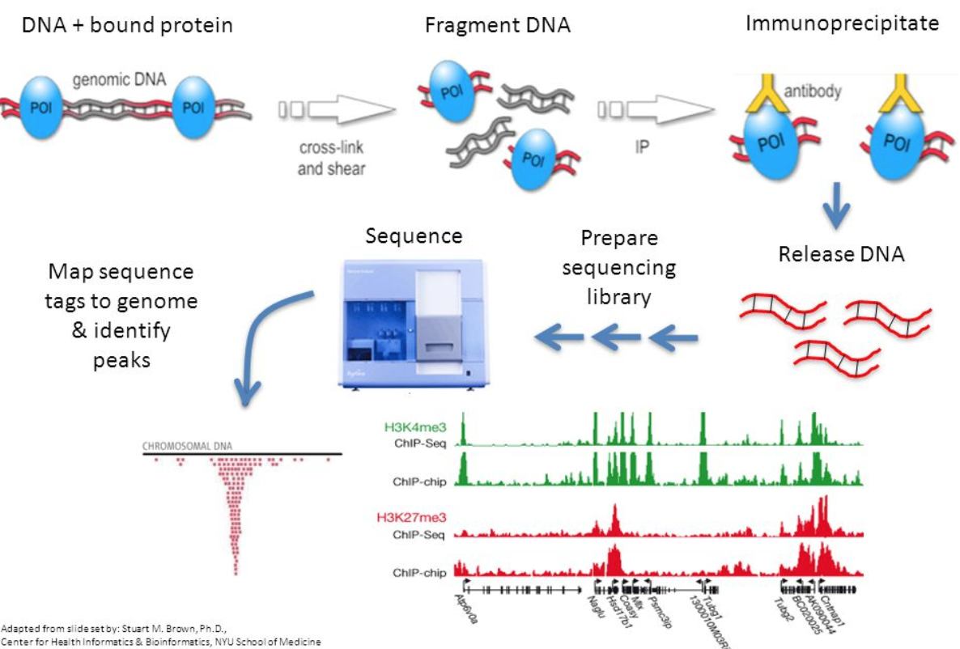
CHiP-Seq: chromatin immunoprecipitation (ChIP) combined with DNA sequencing
break up the DNA into small pieces, around 100 base pairs in length (sonication)
wash the DNA with the target protein. The protein will bind to specific sequences of DNA. (enrichment)
use antibodies that bind specifically to the target protein to grab the DNA that has the protein attached to it
make more copies of the DNA (amplification) with the protein attached to it
sequence the DNA
https://noorsiddiqui.com/what-is-chip-seq-atac-seq/

Slide 3
What to do with all those reads?
Align it to reference genome!

Slide 4
Where do we get the reference genome?
Ask collaborator what species and strain was used in experiment
Typically retrieve publicly available reference genome data
SOMETIMES: reference genome is created as part of experiement - if no reference genome data available - if specific variant/strain was used

Slide 5
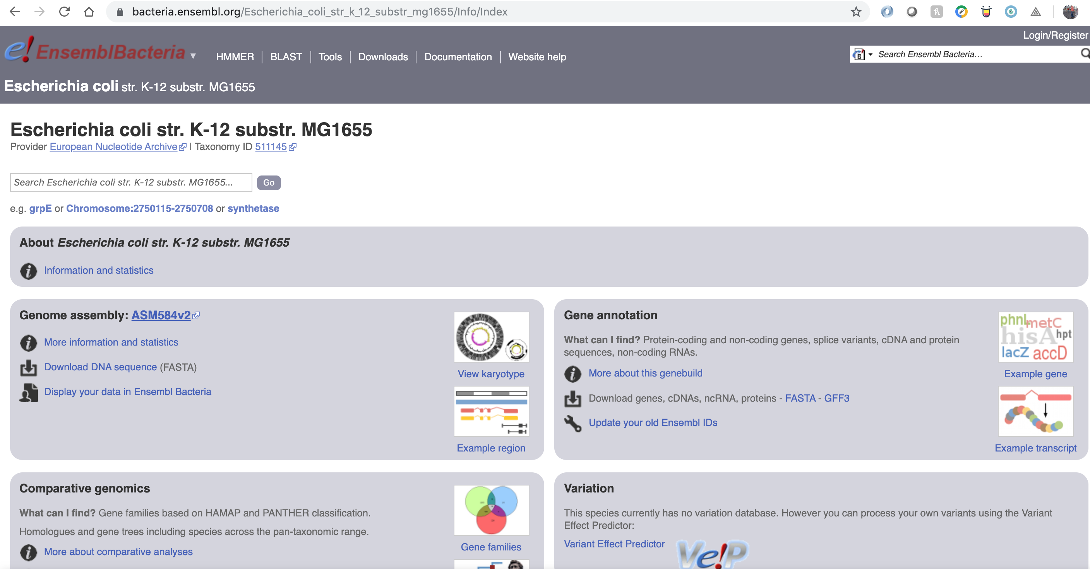
E-coli Genome Data from the EBI
https://bacteria.ensembl.org/Escherichia_coli_str_k_12_substr_mg1655/Info/Index

Slide 6
Creating Local Copies via Symbolic Links
mkdir chipseq_tutorial
cd chipseq_tutorial
cp /home/bindewald/genomics/chip-seq/ecoli_mg1655/genome/ecoli_mg1655.fa .
ln -s /home/bindewald/genomics/chip-seq/ecoli_mg1655/experiments/SRR576933/SRR576933.fastq.gz .
srun –pty bash
## 2. Quality control of raw sequencing data
fastqc SRR576933.fastq.gz

Slide 7
Creating Local Copies via Symbolic Links
## 2. Quality control of raw sequencing data
fastqc SRR576933.fastq.gz
ls
ecoli_mg1655.fa README.md SRR576933_fastqc.html SRR576933_fastqc.zip SRR576933.fastq.gz

Slide 8
Viewing Result Files on local Computer
pwd /home/bindewald/genomics/chip-seq/tutorial/work1
scp bindewald@144.175.88.21:/home/bindewald/genomics/chip-seq/tutorial/work1/SRR576933_fastqc.html .
NOTE: replace “Bindewald” with our Unix username!
Verify that you now have a file with name SRR576933_fastqc.html on your computer

Slide 9
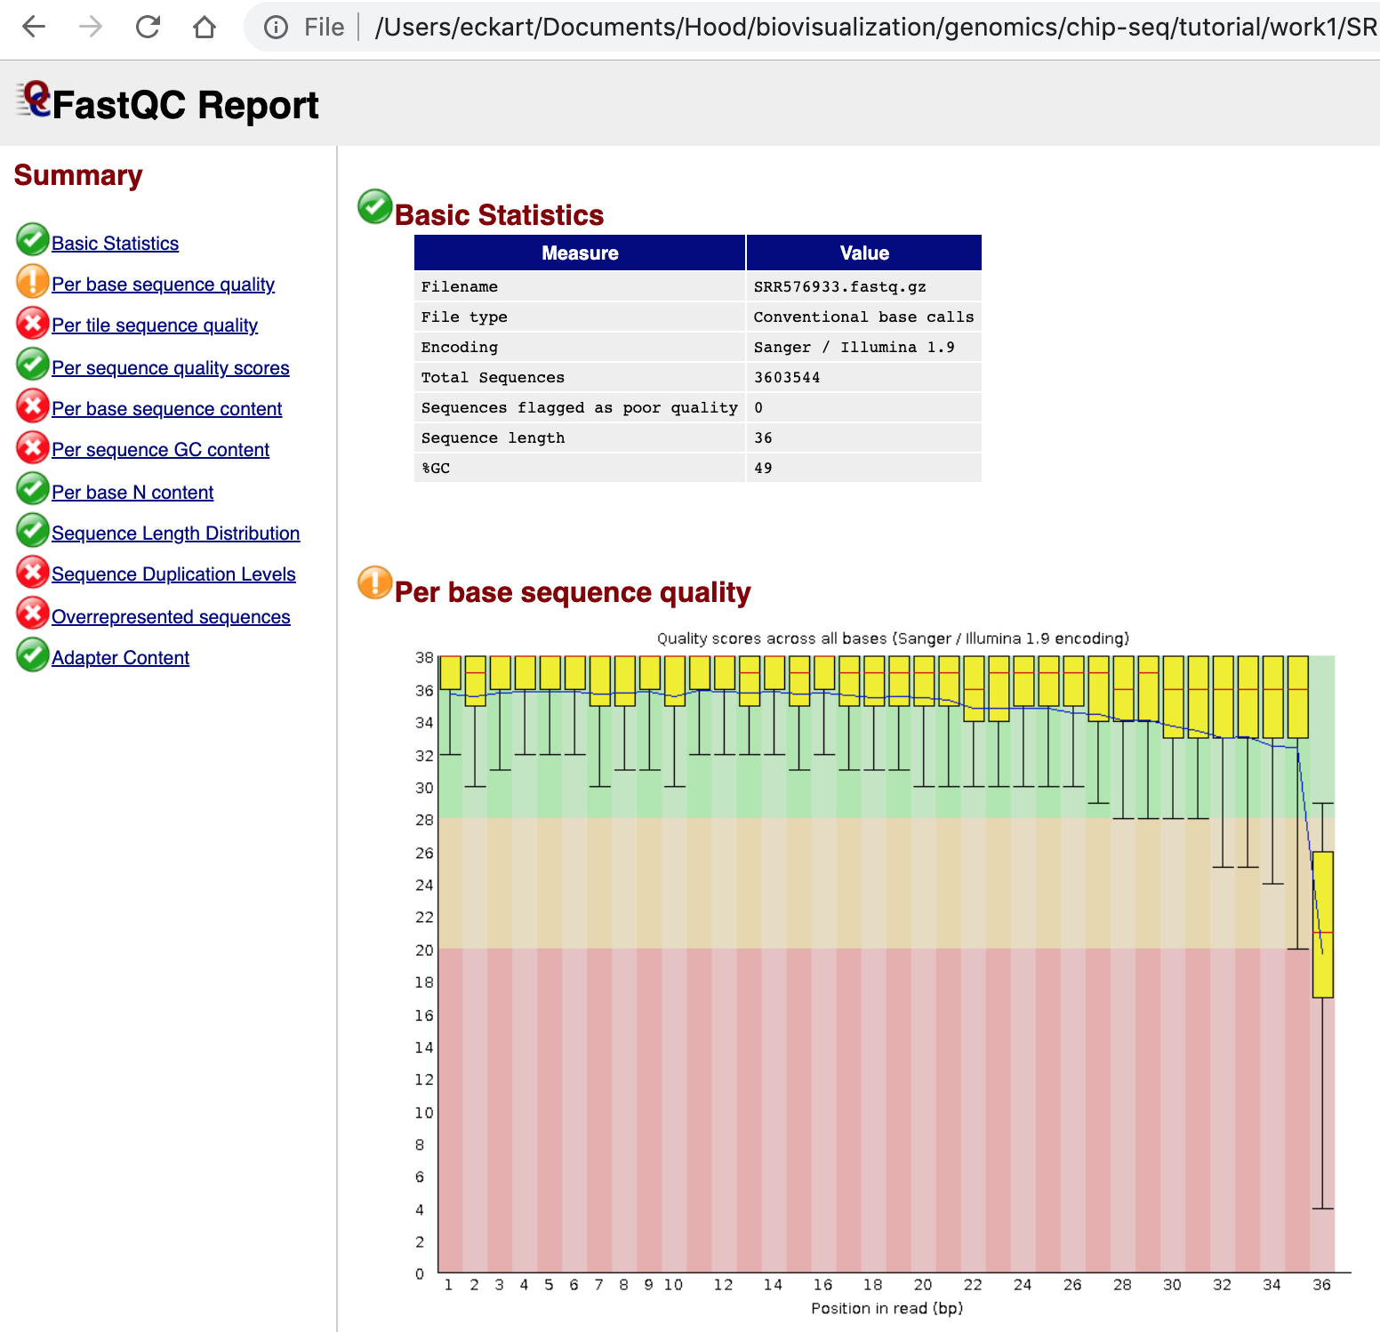
View FastQC result in Web Browser
File: SRR576933_fastqc.html

Slide 10
Key step: align reads to genome
Using alignment program “bwa”
Modern short-read alignment programs are fast. They achieve that by pre-processing the reference genome sequence into indexed sets of sequence-patches
Create index: bwa index ecoli_mg1655.fa
Files:
ecoli_mg1655.fa ecoli_mg1655.fa.pac SRR576933_fastqc.zip
ecoli_mg1655.fa.amb ecoli_mg1655.fa.sa SRR576933.fastq.gz
ecoli_mg1655.fa.ann README.md
ecoli_mg1655.fa.bwt SRR576933_fastqc.html

Slide 11
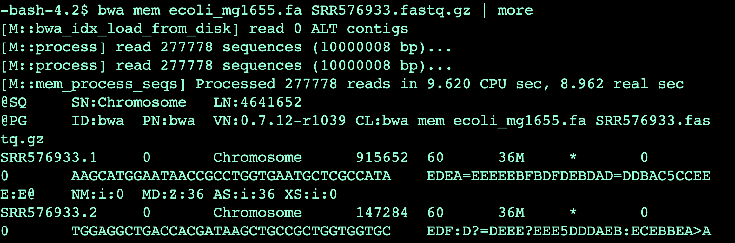
Running the alignment program:
bwa mem ecoli_mg1655.fa SRR576933.fastq.gz > SRR576933_bwa.sam

Slide 12
Inspect created output
Consult definition of SAM format: https://samtools.github.io/hts-specs/SAMv1.pdf
What information is stored in the “header” portion of the output?
What could be practical challenges with this header information?
What are the first 3 aligned reads in the created SAM-formatted file?
At what positions in the E-coli reference genome do these reads align?
Do these alignments correspond to perfect matches or do they contain mismatches, insertions, delections (hint: inspect “CIGAR” string)?
Are these alignments sorted by genomic position?
What advantages could there be for sorting alignments by genomic position?

Slide 13
Convert SAM format to BAM with samtools
The samtools program is a “swiss army knife” for processing aligned read data files
First challenge: created SAM files are potentially large. They can benefit from compression. A compressed SAM file is called BAM file
Type samtools view to obtain help information: samtools view
samtools view –h -b -S SRR576933_bwa.sam -o SRR576933_bwa.bam
Options: -S: read in SAM format -b: write in BAM format -o: specify output file (write to standard output if not specified)
-h : header information

Slide 14
Sorting BAM files by Position
Programs that need to access portions of the aligned reads by position can be much faster if the files of aligned reads are sorted by the position with which they match for the reference genome (postion-sorted)
samtools sort SRR576933_bwa.bam SRR576933_bwa_sort
This creates a file SRR576933_bwa_sort.bam
Inspect the created file with the command: samtools view SRR576933_bwa_sort.bam Are the resulting alignments now sorted by reference genome position?
What happened to the header information? (hint: option –h)

Slide 15
Creating an Index for Fast Processing
samtools index SRR576933_bwa_sort.bam
Ensure that a file SRR576933_bwa_sort.bam.bai was created

Slide 16
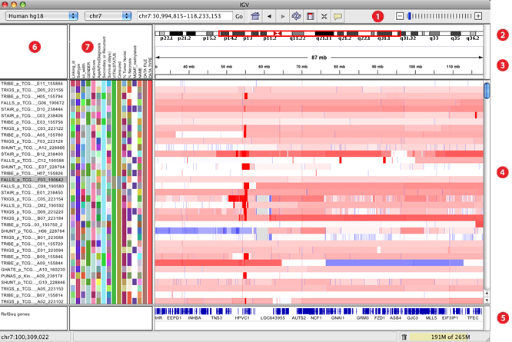
IGV: Integrated Genomics Viewer
Tool bar
Ideogram indicating visible portion
Positions on chromosome
Visualization of data tracks
Feature tracks (here gene annotation)
Track name
Track feature visualization
http://software.broadinstitute.org/software/igv/book/export/html/6

Slide 17
Installation
One of following approaches: - Bioconda (Mac, Unix): conda install igv - or download and follow installation instructions at https://software.broadinstitute.org/software/igv/download

Slide 18
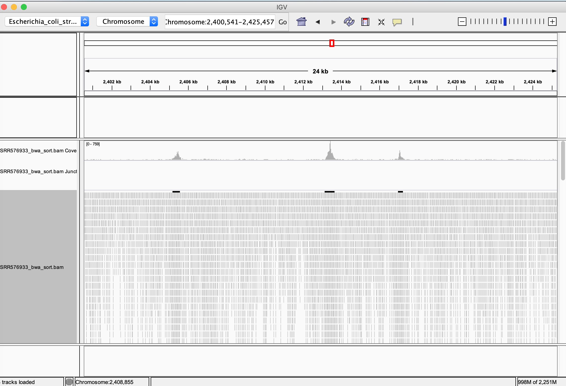
IGV: Visualizing Aligned Reads in ChiP-Seq

Slide 19
IGV: Specify genome
Load predefined genome data with annotation
In IGV, choose: Genome->Load Genome from Server->E. coli K-12 MG1655 (NC_000913.2)

Slide 20
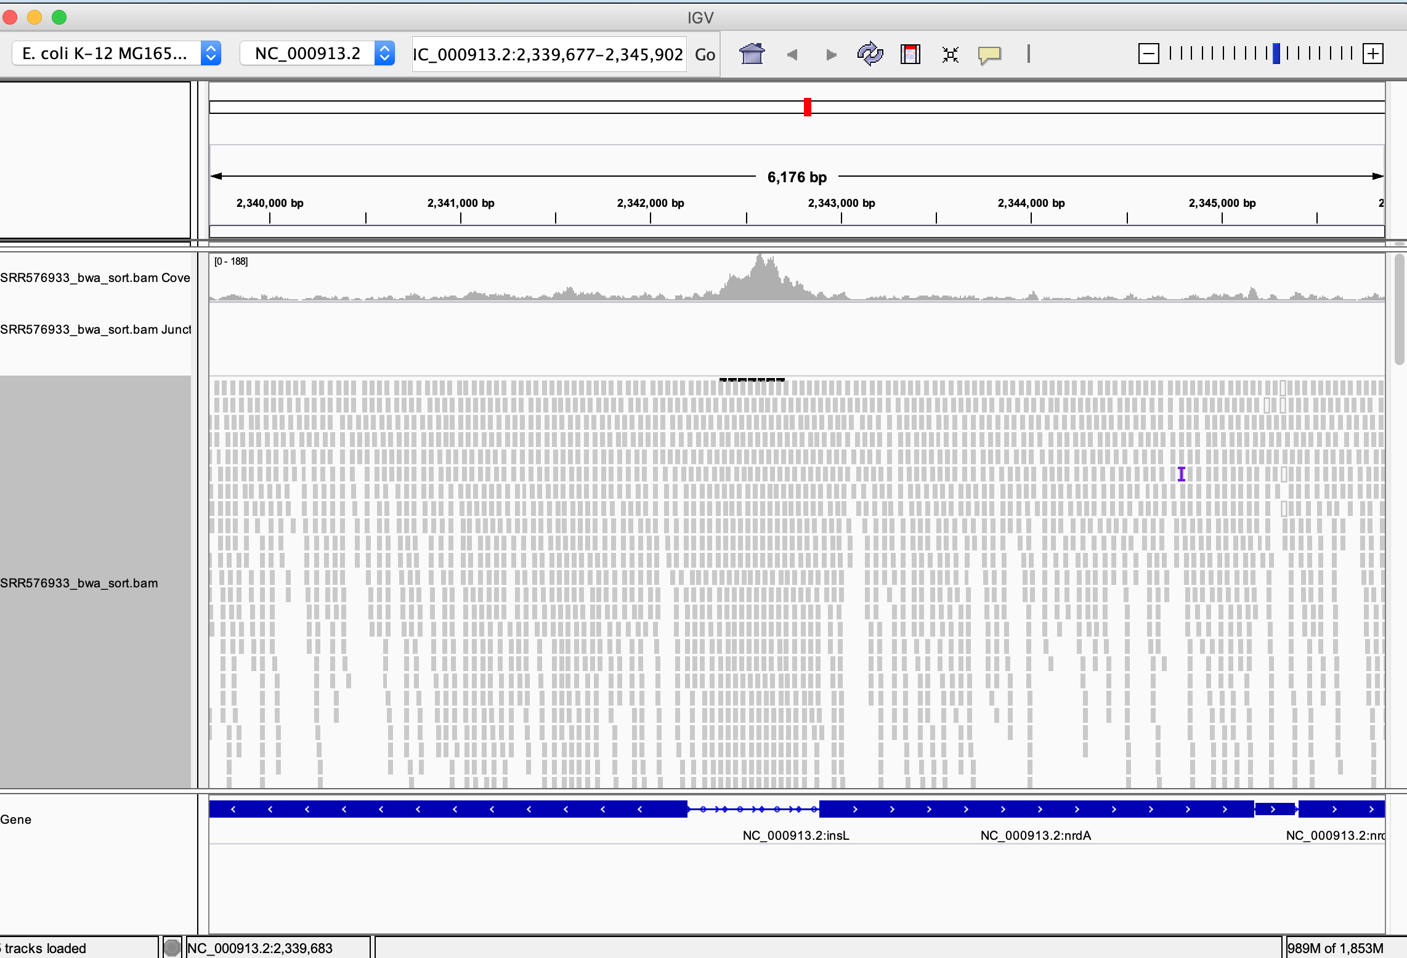
Load your BAM File
In IGV, choose: File->Load from File->[choose your working dir.]->SRR576933_bwa_sort.bam

Slide 21
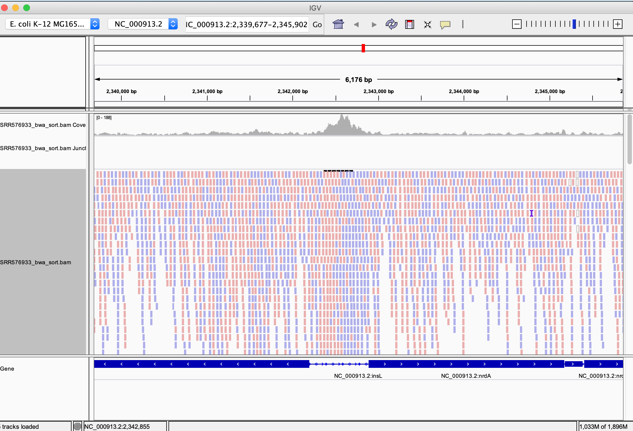
Choose Range and Explore
In the Range text box, copy-paste: NC_000913.2:2,339,677-2,345,902
Right-click on data track with reads. Choose: Color alignments by->read strand
Use mouse to scroll left/right and up/down
Which region contains most mapped reads?
At what position are most reads aligned? [mouse-hover over coverage plot]
Which gene is downstream of that region?
What could be a biological interpretation?
Try out different views [right click on data track]

Slide 22
Trouble-shooting IGV
The chosen genome assembly [Genomes->load genome from…] MUST MUST MUST match the genome sequence you used for mapping your reads with your alignment program] Names of chromosomes must match also
You CAN load the genome data from the same sequence file you used for aligning [Genomes->load genomes from file] but better is to use a “load genome from server” because this will contain added annotation
Sometimes you have to choose right-click “Re-pack alignments” after for example changing the sorting order [right click->sort alignments by]
Notes:
http://www.igv.org/workshops/BroadApril2017/IGV_SlideDeck.pdf
http://www.igv.org/workshops/March2017/SlidesHandouts/IGV_Exercise_1_UIBasics.pdf
https://bioinformatics-core-shared-training.github.io/cruk-autumn-school-2017/ChIP/Materials/Lectures/Lecture4_Introduction%20to%20ChIP-seq%20and%20ATAC-seq_SS.pdf

Slide 23
Exercise
Find other E-coli genes that are preceded by peaks of our CHiP-Seq data
Each time, identify a good interval for your actual peak and also try to improve the visualization to make it publication-ready
Save created visualizations with File->Save Image
Can you find peaks in our data that are not associated with known genes?

Slide 24
Important tutorial
https://www.biologie.ens.fr/~mthomas/other/chip-seq-training/
Peak calling
From Wikipedia, the free encyclopedia
Jump to navigationJump to searchPeak calling is a computational method used to identify areas in a genome that have been enriched with aligned reads as a consequence of performing a ChIP-sequencing or MeDIP-seq experiment. These areas are those where a protein interacts with DNA.^{[1]} When the protein is a transcription factor, the enriched area is its transcription factor binding site (TFBS). Popular software programs include MACS.^{[2]} Wilbanks and colleagues^{[3]} is a survey of the ChIP-seq peak callers, and Bailey et al.^{[4]} is a description of practical guidelines for peak calling in ChIP-seq data.
Peak calling may be conducted on transcriptome/exome as well to RNA epigenome sequencing data from MeRIPseq^{[5]} or m6Aseq^{[6]} for detection of post-transcriptional RNA modification sites with software programs, such as exomePeak.^{[7]} Many of the peak calling tools are optimised for only some kind of assays such as only for transcription-factor ChIP-seq or only for DNase-seq.^{[8]} However new generation of peak callers such as DFilter^{[9]} are based on generalised optimal theory of detection and has been shown to work for nearly all kinds for tag profile signals from next-gen sequencing data. It is also possible to do more complex analysis using such tools like combining multiple ChIP-seq signal to detect regulatory sites. ^{[10]}
In the context of ChIP-exo, this process is known as 'peak-pair calling'.^{[11]}
Differential peak calling is about identifying significant differences in two ChIP-seq signals. One can distinguish between one-stage and two-stage differential peak callers. One stage differential peak callers work in two phases: first, call peaks on individual ChIP-seq signals and second, combine individual signals and apply statistical tests to estimate differential peaks. DBChIP^{[12]} and MAnorm^{[13]} are examples for one stage differential peak callers.
Two stage differential peak callers segment two ChIP-seq signals and identify differential peaks in one step. They take advantage of signal segmentation approaches such as Hidden Markov Models. Examples for two-stage differential peak callers are ChIPDiff,^{[14]} ODIN.^{[15]} and THOR. Differential peak calling can also be applied in the context of analyzing RNA-binding protein binding sites.^{[16]}

Slide 25
CHiP-Seq dataset description
Who produce chip=seq dataset?
CHiP-Seq datasets produced by Theodorou et al.
Why authos used CHIP seq technology? The authors used ChIP-Seq technology in order to systematically identify ESR1 binding regions across the human genome. Importantly, they demonstrated that knock-down of GATA3 through siRNA greatly affect ESR1 binding.
Abstract
What is the role of estrogen receptor in human breast cancer?what is inducing by it?
Estrogen receptor (ESR1) drives growth in the majority of human breast cancers by binding to regulatory elements and inducing transcription events that promote tumor growth. Differences in enhancer occupancy by ESR1 contribute to the diverse expression profiles and clinical outcome observed in breast cancer patients. GATA3 is an ESR1-cooperating transcription factor mutated in breast tumors; however, its genomic properties are not fully defined.
Why they use chip seq?
In order to investigate the composition of enhancers involved in estrogen-induced transcription and the potential role of GATA3, we performed extensive ChIP-sequencing in unstimulated breast cancer cells and following estrogen treatment.
We find that GATA3 is pivotal in mediating enhancer accessibility at regulatory regions involved in ESR1-mediated transcription. GATA3 silencing resulted in a global redistribution of cofactors and active histone marks prior to estrogen stimulation. These global genomic changes altered the ESR1-binding profile that subsequently occurred following estrogen, with events exhibiting both loss and gain in binding affinity, implying a GATA3-mediated redistribution of ESR1 binding. The GATA3-mediated redistributed ESR1 profile correlated with changes in gene expression, suggestive of its functionality. Chromatin loops at the TFF locus involving ESR1-bound enhancers occurred independently of ESR1 when GATA3 was silenced, indicating that GATA3, when present on the chromatin, may serve as a licensing factor for estrogen-ESR1-mediated interactions between cis-regulatory elements. Together, these experiments suggest that GATA3 directly impacts ESR1 enhancer accessibility, and may potentially explain the contribution of mutant-GATA3 in the heterogeneity of ESR1+ breast cancer.
Notes:
http://bioinformatics.sph.harvard.edu/knowledgebase/chipseq/tools.html

Slide 26
Viewing the results with Integrated Genome Browser (IGV).
The Integrative Genomics Viewer (IGV) is a high-performance visualization tool for interactive exploration of large, integrated genomic datasets. It supports a wide variety of data types, including array-based and next-generation sequence data, and genomic annotations.
Download IGV and launch it with 750 MB or 1.2 Gb depending of your machine.
Select hg19 genome and go to chromosome 21.
Select Tools > Run Igvtools. Select command > sort, select iput file and browse to the sam file. Press Run.
Select command > index, select input file and browse to the sorted sam file. Press Run.
Select command > count, select input file and browse to the sorted sam file (! not the *.bai)). Press Run.
Close the igvtools window.
Load the tdf and sorted sam file.
Go to TFF1 gene.
Unzoom and and select regions displaying high signal based on tdf track
NB:The tdf file is a IGV specific format that is closed to the bigWig format (the compressed version of wig format).

Slide 27
Summary This training gives an introduction to ChIP-seq data analysis, covering the processing steps starting from the reads to the peaks. Among all possible downstream analyses, the practical aspect will focus on motif analyses. A particular emphasis will be put on deciding which downstream analyses to perform depending on the biological question. This training does not cover all methods available today. It does not aim at bringing users to a professional NGS analyst level but provides enough information to allow biologists understand what DNA sequencing practically is and to communicate with NGS experts for more in-depth needs.
Dataset description For this training, we will use a dataset produced by Myers et al (see on the right of the page for details on the publication) involved in the regulation of gene expression under anaerobic conditions in bacteria. We will focus on one factor: FNR.

