Slide 1

Analysing 10X Single Cell RNA-Seq Data
v2023-01
Simon Andrews
simon.andrews@babraham.ac.uk

Slide 2
Course Outline
How 10X single cell RNA-Seq works
Evaluating CellRanger QC
[Exercise] Looking at CellRanger QC reports
Dimensionality Reduction (PCA, tSNE, UMAP)
[Exercise] Using the Loupe cell browser
R Frameworks for scRNA analysis
[Exercise] Analysing data in R using Seurat

Slide 3
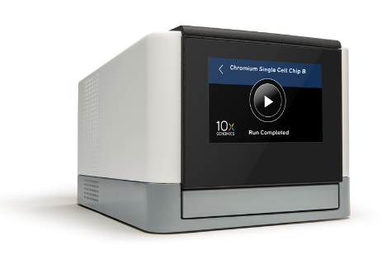
How 10X RNA-Seq Works
RT Reagents
Oil
Cells
Barcoded Beads
Gel Beads in Emulsion (GEMs)

Slide 4
How 10X RNA-Seq Works
Oligo dT
UMI (all different)
Cell barcode (same within GEM)
Priming site

Slide 5
How 10X RNA-Seq Works
AAAAAGATTCGTAGTGCTGATGCT...
Reverse Transcription
Mix RNAs
and Cells
Oligo dT
UMI (all different)
Cell barcode (same within GEM)
Priming site
Illumina Library Prep

Slide 6
How 10X RNA-Seq Works
Read 1
Read 3
Illumina
Adapter
Cell Barcode
UMI
3’ RNA Insert
Illumina
Adapter
Sample Barcode
Read 2
Sample level barcode – same for all cells and RNAs in a library
Cell level barcode (16bp) – same for all RNAs in a cell
UMI (10bp) – unique for one RNA in one cell

Slide 7
10X Produces Barcode Counts
Sample WT
Sample KO
Cell WT A
Cell WT B
Cell WT C
Cell KO A
Cell KO B
Cell KO C
UMI
UMI
UMI
UMI
UMI
UMI
UMI
UMI
UMI
UMI
UMI
UMI
UMI
UMI
UMI
UMI
UMI
UMI
UMI
UMI
UMI
UMI
UMI
UMI
UMI
UMI
UMI
UMI
UMI
UMI
UMI
UMI
UMI
UMI
UMI
UMI
UMI
UMIs are finally related to genes to get per-gene counts

Slide 8
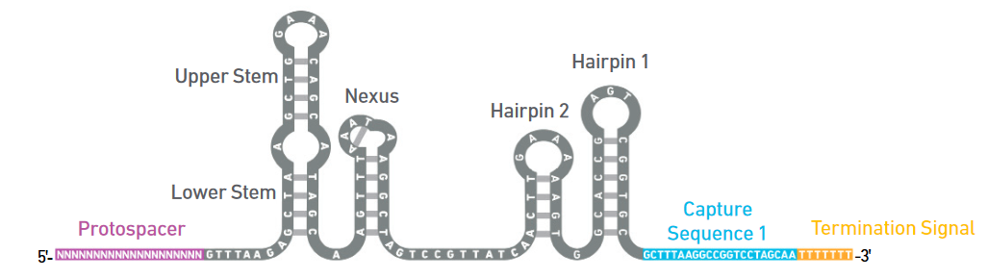
Extension Techniques
Variants of the basic protocol which allow for other measures
Introduce artificial sequences which are measured alongside the normal RNAs
Cell Surface Markers
CRISPR guide RNAs
Beads use custom captures (in addition to TTTT)
Attach sequences to sgRNA or tag to antibodies

Slide 9
The 10X Software Suite
Chromium
Controller
Cell
Ranger
Loupe
Browser
Runs the chromium system for creating GEMs
Pipeline for mapping, filtering, QC and quantitation of libraries
Desktop software for visualisation and analysis of single cell data.

Slide 10
Cell Ranger
FastQ Files
Cell Barcode Extraction
UMI
Extraction
Deduplication
Gene Assignment
Reference Alignment
Count table
tSNE
UMAP
Clustering
Markers

Slide 11
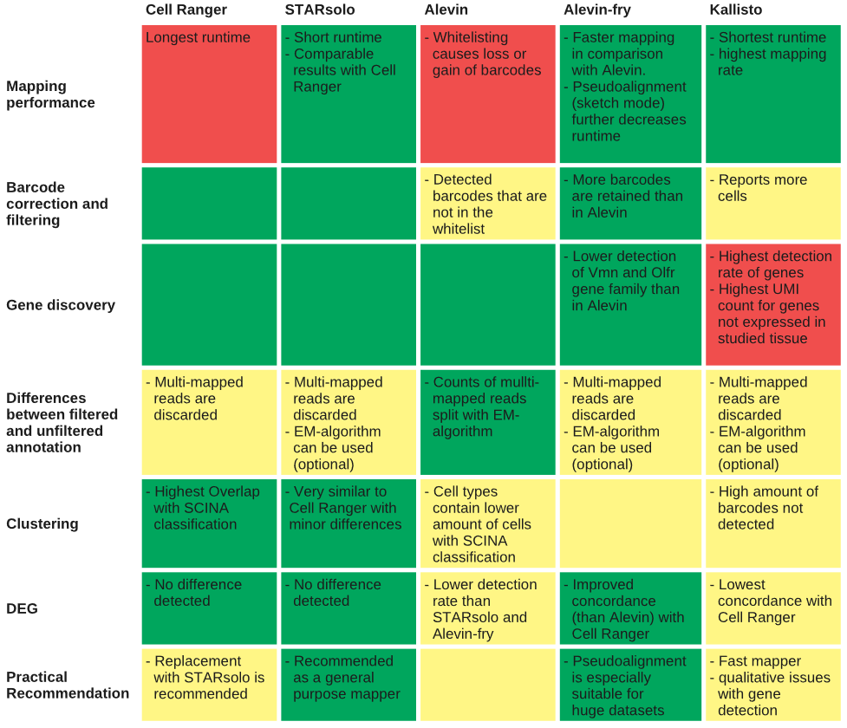
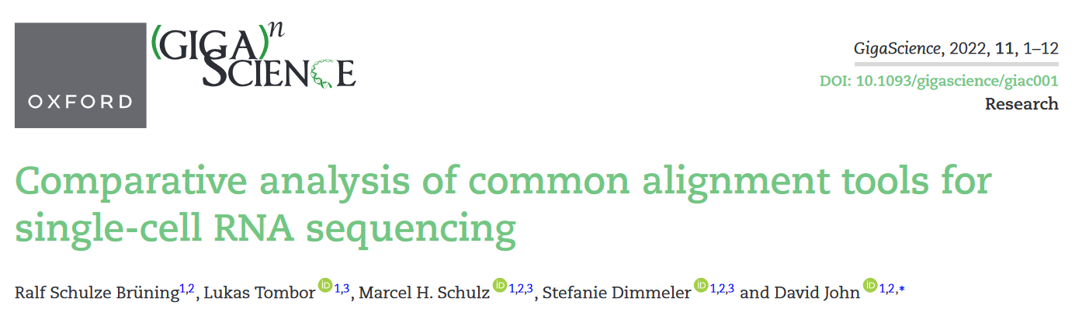
CellRanger Alternatives
StarSolo gives virtually identical results more quickly, but no Loupe integration
Pseudo-alignments are much quicker, but generate artefacts and won't include intronic data

Slide 12
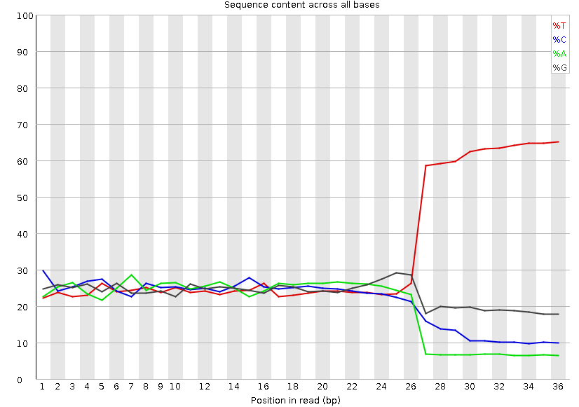
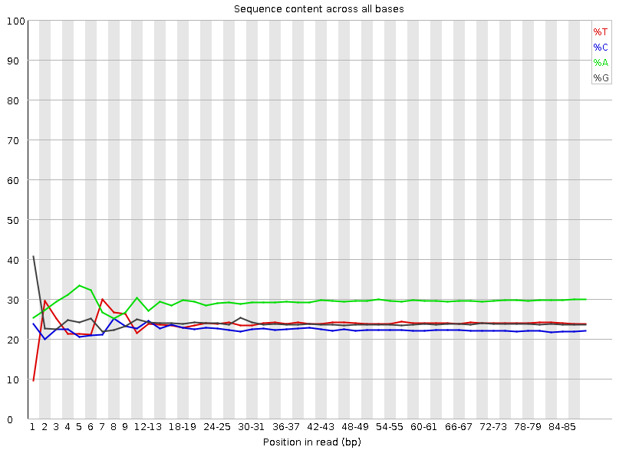
CellRanger Commands
scrALI001_S1_L001_I1_001.fastq.gz
scrALI001_S1_L001_R1_001.fastq.gz
scrALI001_S1_L001_R2_001.fastq.gz
I1
Index file. Sets of 4 barcodes per sample
R1
Barcode reads
16bp cell level barcode
10bp UMI
R2
3’ RNA-seq read

Slide 13
CellRanger Commands
CellRanger Count (quantitates a single run)
$ cellranger count --id=COURSE \
--transcriptome=/bi/apps/cellranger/references/GRCh38/ \
--fastqs=/bi/home/andrewss/10X/ \
--localcores=8 \
--localmem=32
CellRanger aggr (merges multiple runs)
$ cellranger aggr --id=MERGED \
--csv=merge_me.csv \
--normalize=mapped

Slide 14
CellRanger Aggregate CSV file
Required
Optional
library_id | molecule_h5 | sex | genotype
WT1 | /data/WT1/outs/molecule_info.h5 | Male | WT
WT2 | /data/WT2/outs/molecule_info.h5 | Female | WT
WT3 | /data/WT3/outs/molecule_info.h5 | Male | WT
WT4 | /data/WT4/outs/molecule_info.h5 | Female | WT
KO1 | /data/KO1/outs/molecule_info.h5 | Male | KO
KO2 | /data/KO2/outs/molecule_info.h5 | Female | KO
KO3 | /data/KO3/outs/molecule_info.h5 | Male | KO
KO4 | /data/KO4/outs/molecule_info.h5 | Female | KO

Slide 15
Output files generated
web_summary.html - Web format QC report
filtered_feature_bc_matrix.h5 Single file of cell counts
filtered_features_bc_matrix
barcodes.tsv.gz - cell level barcodes seen in this sample
features.tsv.gz - list of quantitated features (usually Ensembl genes)
matrix.mtx.gz - (sparse) matrix of counts for cells and features
possorted_genome_bam.bam BAM file of mapped reads
molecule_info.h5 Details of the cell barcodes – used for merging, can also use for analysis
cloupe.cloupe Analysis data for Loupe Cell browser

Slide 16
Evaluating CellRanger Output
Look at barcode splitting report
Check sample level barcodes
Look at web_summary.html file
Check number of cells
Check quality of data
Check coverage per cell
Check library diversity

Slide 17
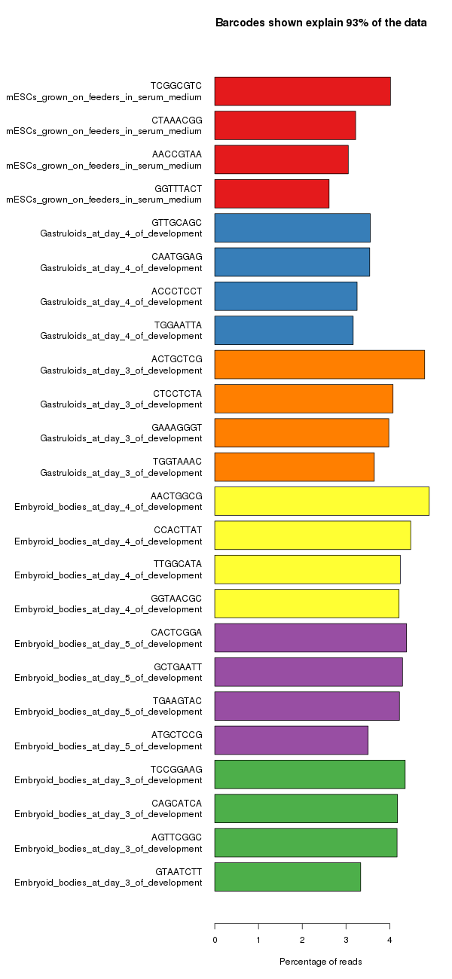
Sample Level Barcodes
Only present if multiple libraries mixed in a lane
Get standard barcode split report, but with 4 barcodes used per sample
Even coverage within and between libraries

Slide 18
CellRanger Reports
HTML report – comes with each sample and aggregated group of samples
Gives some basic metrics to judge the quality of the samples and spot any issues in the data or processing

Slide 19
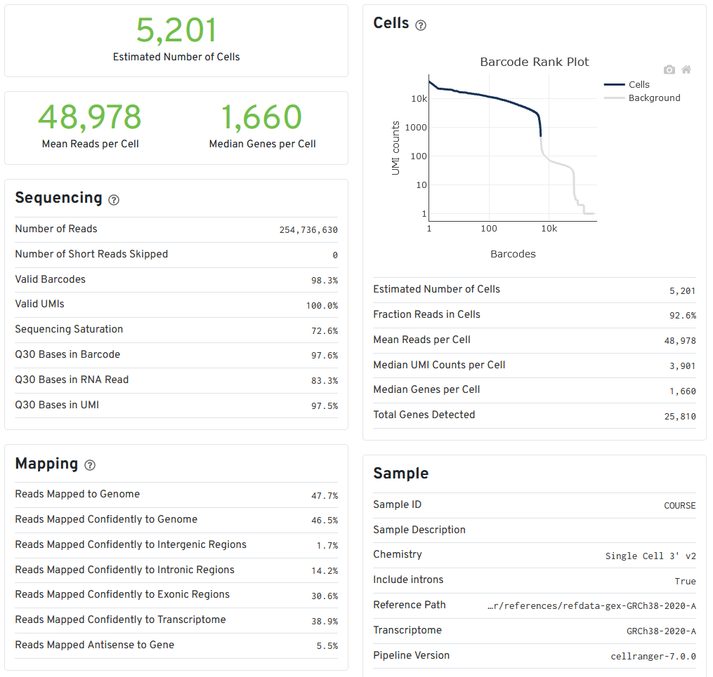
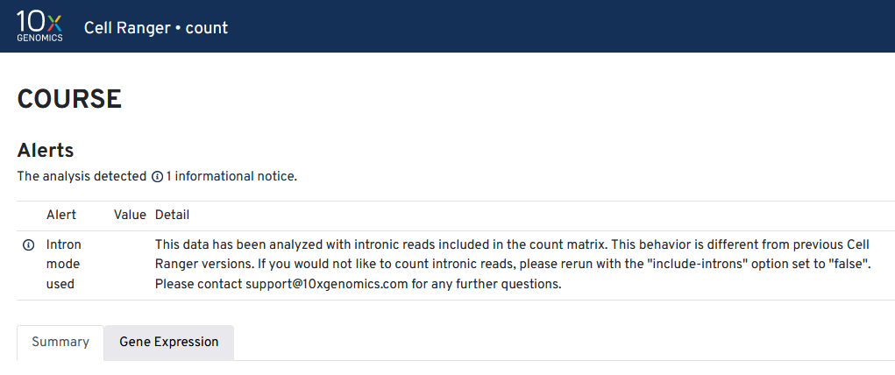

Slide 20
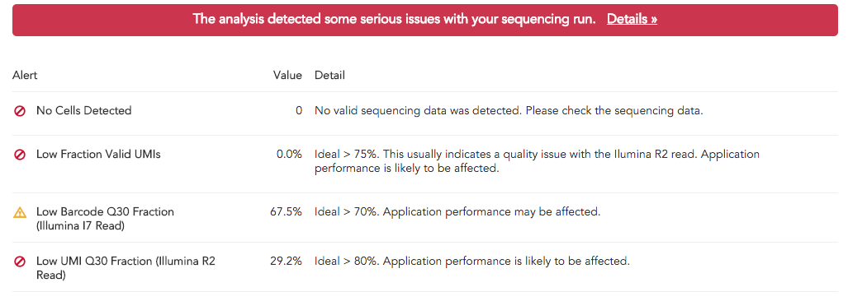
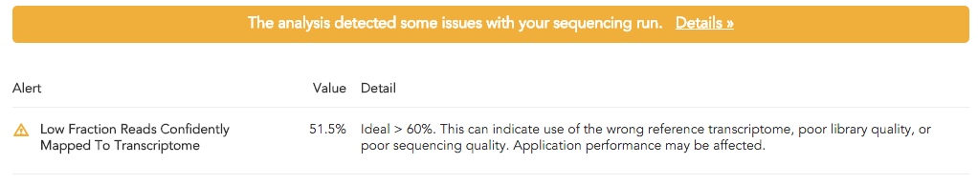
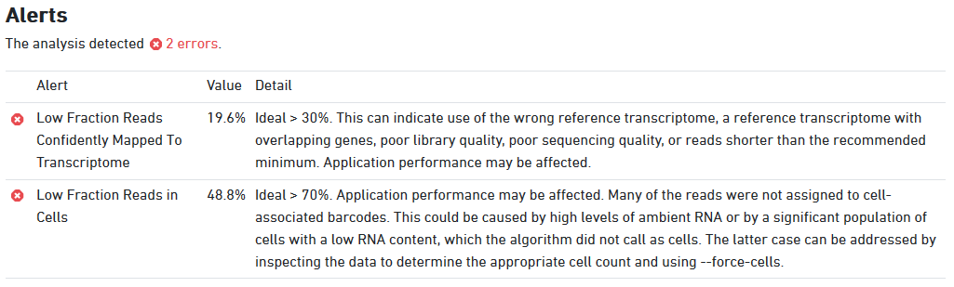
Errors and Warnings

Slide 21
How many cells do you have?
Cell number is determined from the number of cell barcodes with ‘reasonable’ numbers of observations
Need to separate signal from background – real cell associated barcodes vs noise from empty GEMs and mis-called sequences
Changing the thresholds used can give very different predictions for cell numbers

Slide 22
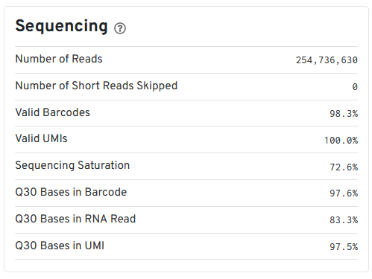
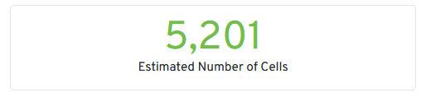
How many cells do you have?
Start by looking at the quality of the base calls in the barcodes
Bad calls will lead to inaccurate cell assignments

Slide 23
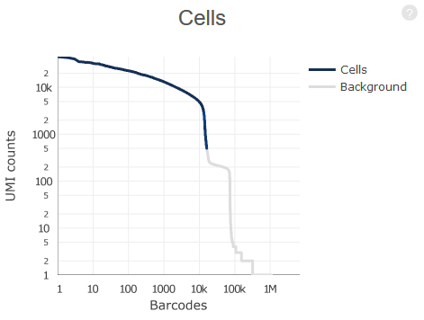
How many cells do you have
Plot of UMIs (reads) per cell vs number of cells
Blue region was called as valid cells
Grey region is considered noise
Both axes are log scale!!!

Slide 24
How many cells do you have
5000 reads per cell. 10k cells
500 reads per cell. 15k cells
CellRanger v3 uses a liberal cutoff to define cells. This was designed to accommodate (normally cancer) samples where cells might have wildly different amounts of RNA. It will include large numbers of cells with small numbers of UMIs. If this doesn’t apply to your sample then this will over-predict valid cells.

Slide 25
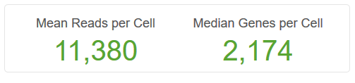
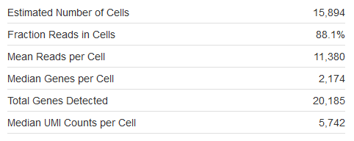
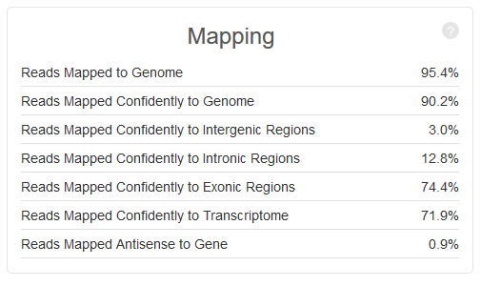
How much data do you have per cell?
Reads should map well
Check reads are mostly in transcripts
Means and medians can be misleading when cells are variable
Note difference between read and UMI

Slide 26
How much data do you have per cell?
Some details about mapping
Reads should map to the 3’ end of transcripts (oligo dT selection)
Reads count as exonic if 50% of them overlaps an exon
Multi-mapped reads which only hit one exon are considered to be uniquely mapped
Reads associate with genes based on overlap and direction
Only confident (unique) transcriptome reads are used for analysis. As of CellRanger v7 intronic reads as well as exonic are counted by default

Slide 27
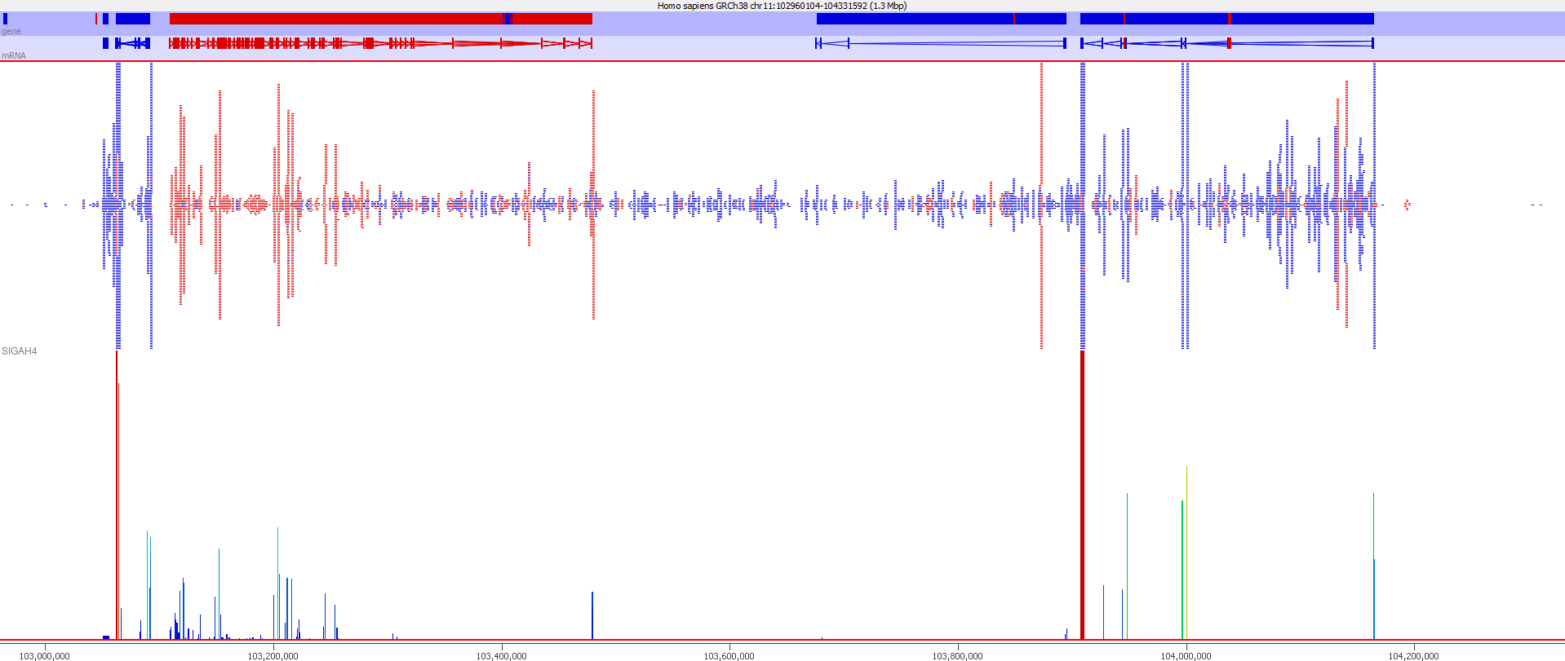

Slide 28
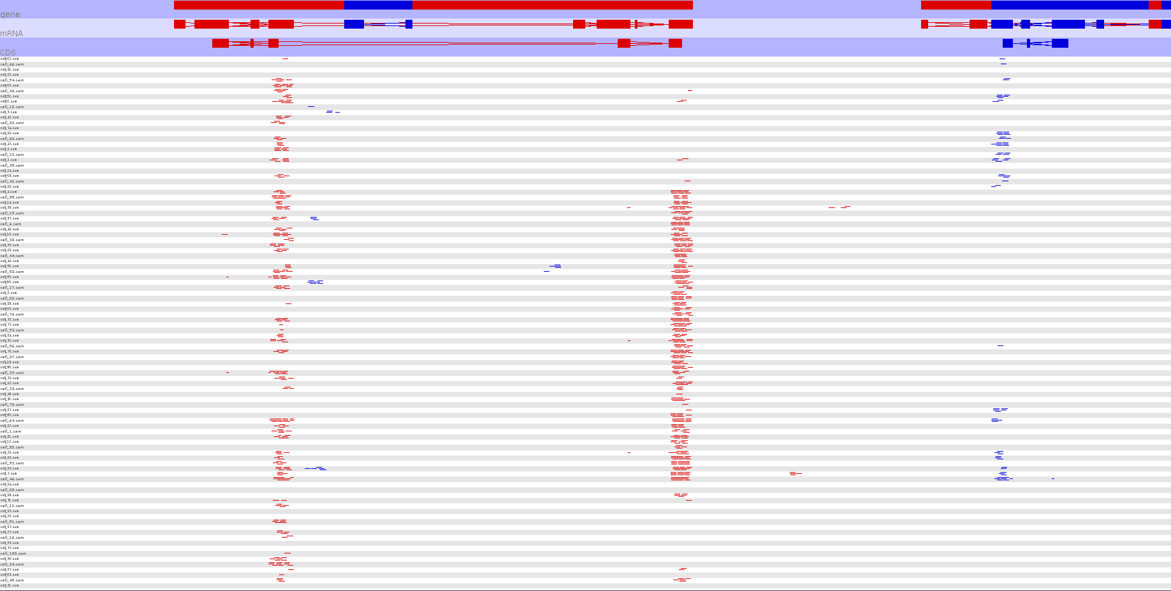

Slide 29
How much data do you have per cell?
Difficult to generalise how much data to create/expect
Depends on cell type, genome and other factors
In general though, sensible numbers would be:
Reads per cell ~10,000
Genes per cell 2000 – 3000
Be aware of the difference between reads (raw) and UMIs (deduplicated) – they can be very different

Slide 30
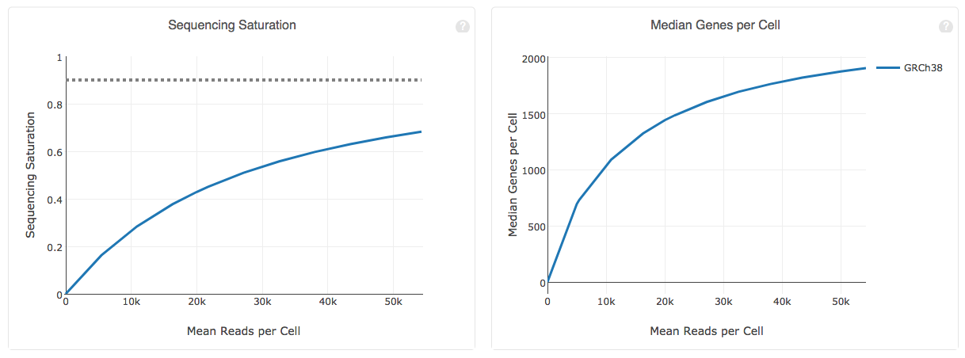
How deeply sequenced is your library

Slide 31
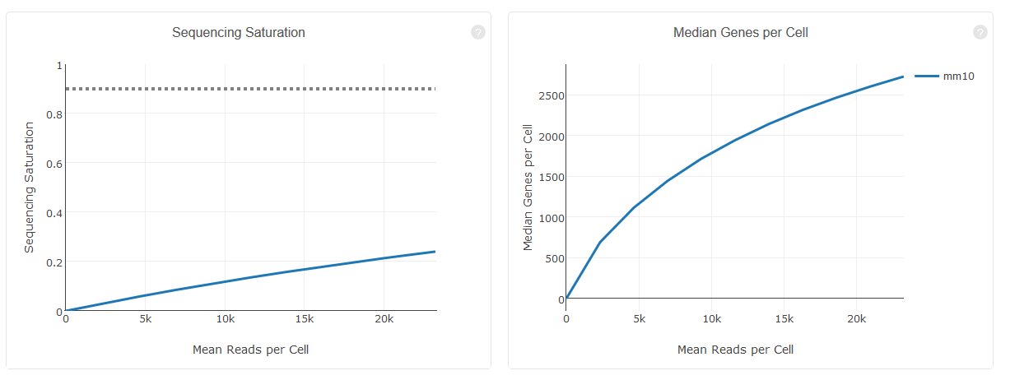
How deeply sequenced is your library

Slide 32
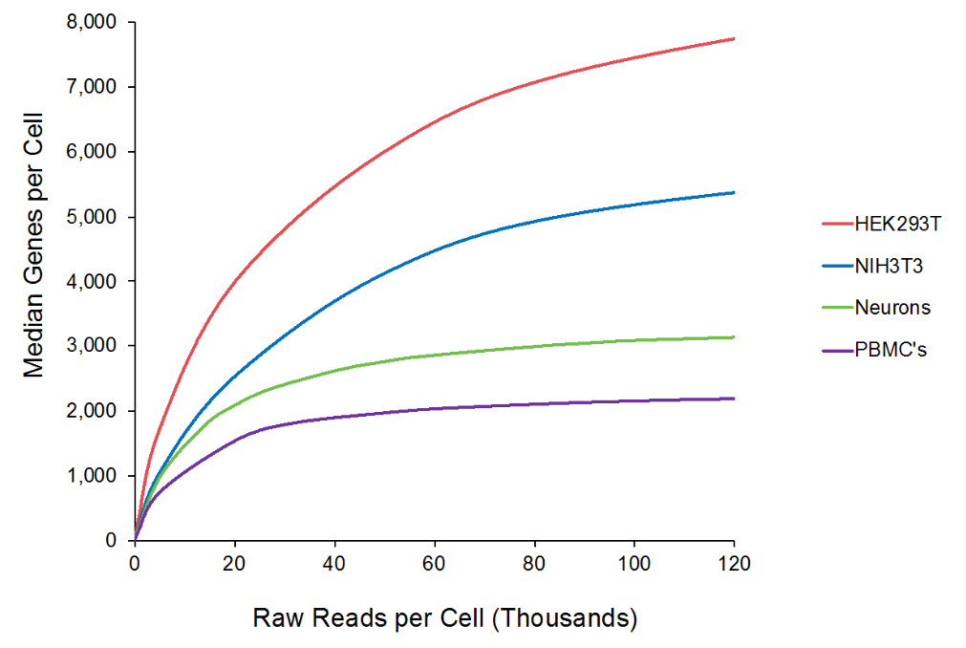
How deeply sequenced is your library
Expected diversity varies by cell type
Figure from 10X Genomics 2018

Slide 33
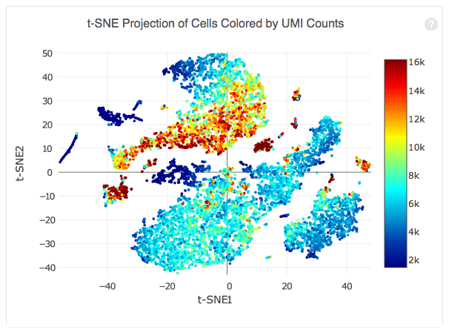
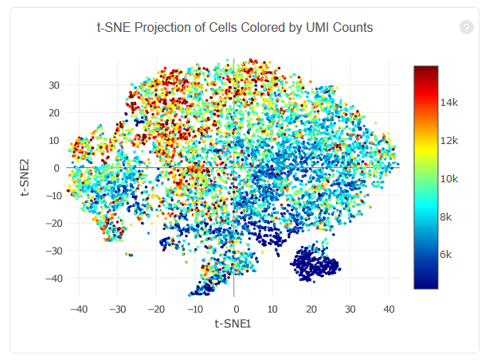
Is coverage variation affecting your data?

Slide 34
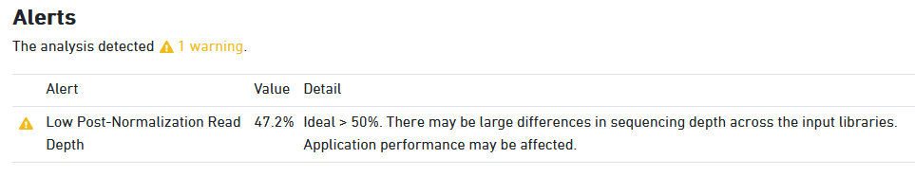
Aggregation QC
Web Summary with added “Aggregation” section
Aggregation ‘normalisation’ is done via sub-sampling to get even coverage
Can be problematic if libraries are of different sizes (especially is one is really small)

Slide 35
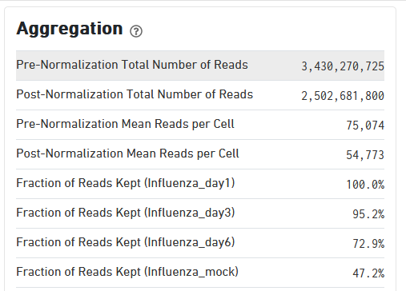
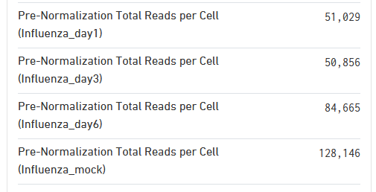
Aggregation QC

Slide 36
Exercise – Evaluating CellRanger Reports
Look at the selection of CellRanger reports to get an idea for the metrics they provide
Is the quality of the data good
How many cells are there
How much data per cell is there (both UMIs and Genes)
Is there any separation? Is it driven by amount of data?
The data we’re going to use for the rest of the day is in “course_web_summary.html”, do you see any problems which would concern us with this data at this stage?

Slide 37
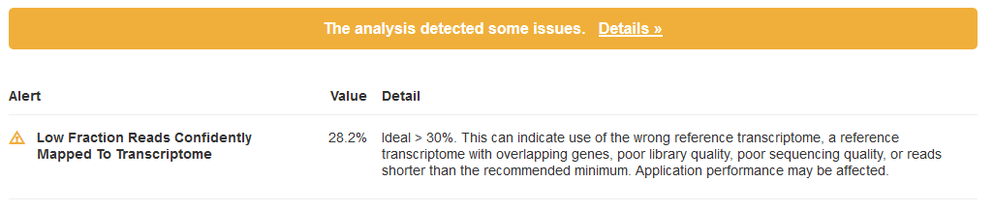
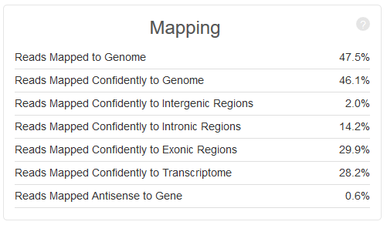
Course Data CellRanger QC
Actual Problem
Value Reported

Slide 38
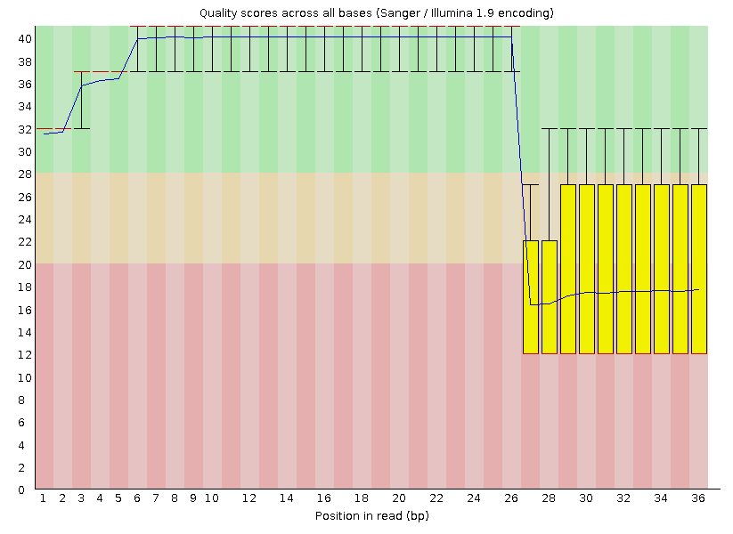
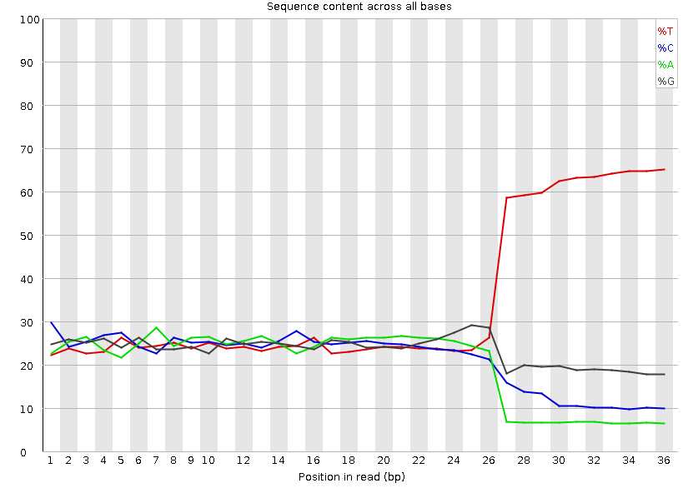
Course Data QC – Read1 (Barcodes)

Slide 39
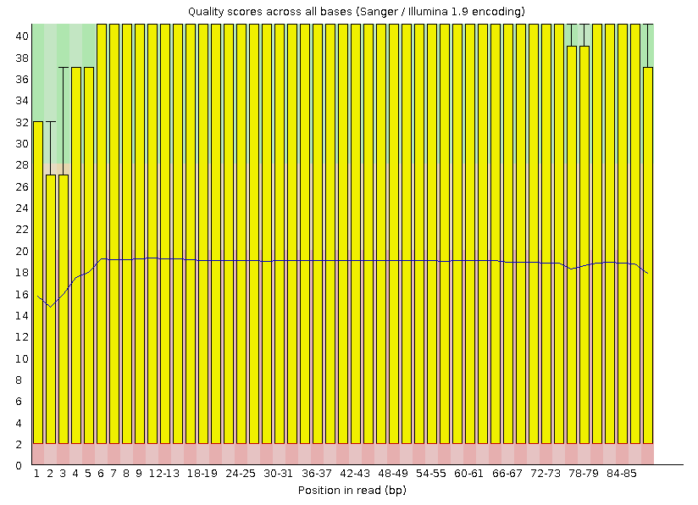
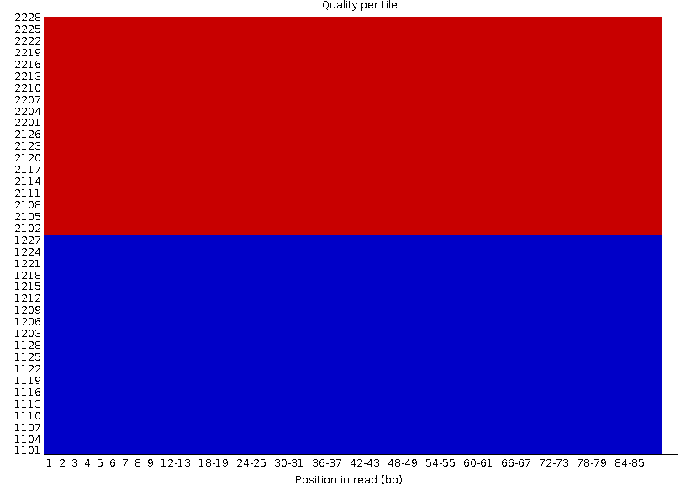
Course Data QC – Read2 (RNA)

