Slide 1
Readmission Prediction
张少魁 计算机系 2018310862
胡旭强 计算机系 2018310800

Slide 2
Overview
Data Analysis & Preprocessing
Neural Network
Decision Tree
Experiments (Scores)

Slide 3
Data Analysis & Preprocessing
ID & Number are deleted
One-Hot Encoding for Neural Network
Missing values (?) are encode as Zeros, e.g. [0,0,0,0,0,0,0,0,0]
Diag_1,2,3 are treated independently
Label Encoding for Decision Tree
Missing values are filled with most frequent values
Attribute “weights” are deleted for decision tree

Slide 4
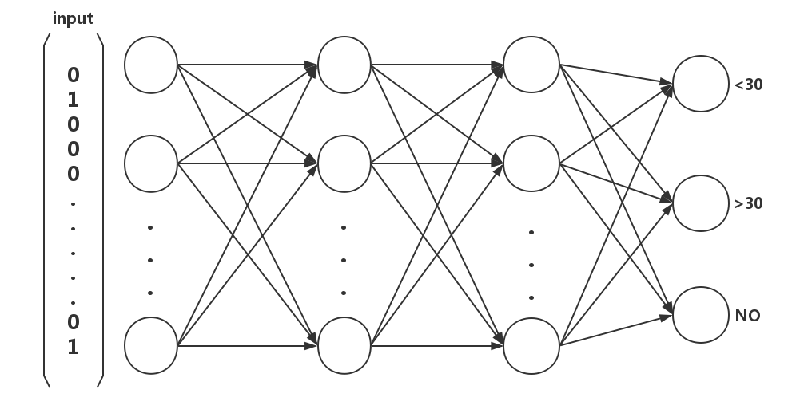
Neural Network with Branches
Three different architectures are tried:

Slide 5
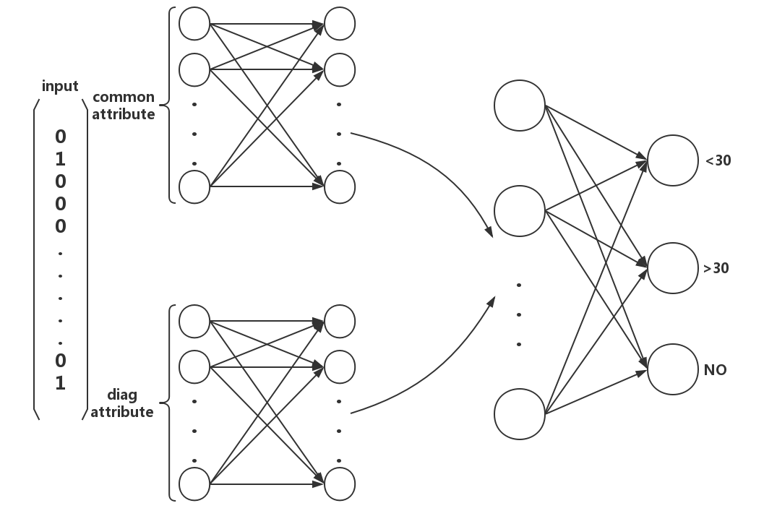
Neural Network with Branches
Three different architectures are tried:

Slide 6
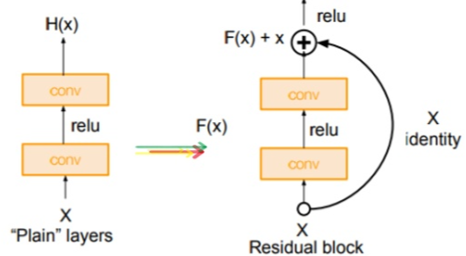
Neural Network Details
Activation function: leaky_relu
Sigmoid, Tanh are tried but accuracy is much lower
Relu is not stable
Initialization: Gaussian μ=0.0, σ=0.1
Tried Adam (Faster) & Pure Gradient Descent
L2 Regularization, Exponential Decay
Dropout, normalization made ANN hard to converge
Residual Block is tried ☺ … … … but with nearly no improvement ☹
He et al. Deep residual learning for image recognition

Slide 7
Decision Tree
CART
Label encoding
Missing values are filled with most frequent values
Id, nbr, weights attributes are deleted
Tackling Over-fitting:
Try different maximal depth
Try different measurement, e.g. gini, information gain

Slide 8
Experiments
Tensor-Flow Core & Sklearn
Ten fold cross validation
Chou et al. A Fully Private Pipeline for Deep Learning on Electronic Health Records
 | Accuracy | Precision | Recall | MACRO-F1
Decision Tree | 0.576332 | 0.492892 | 0.400452 | 0.441653
ANN | 0.586621 | 0.647774 | 0.409252 | 0.498674
ANN Dense | 0.591126 | 0.619101 | 0.421538 | 0.498526
ANN with Branches | 0.588568 | 0.624058 | 0.416974 | 0.500300
Chou et al. | 0.650 |  | 0.552

