Slide 1
MOABS/DT
Figures and diagrams

Slide 2
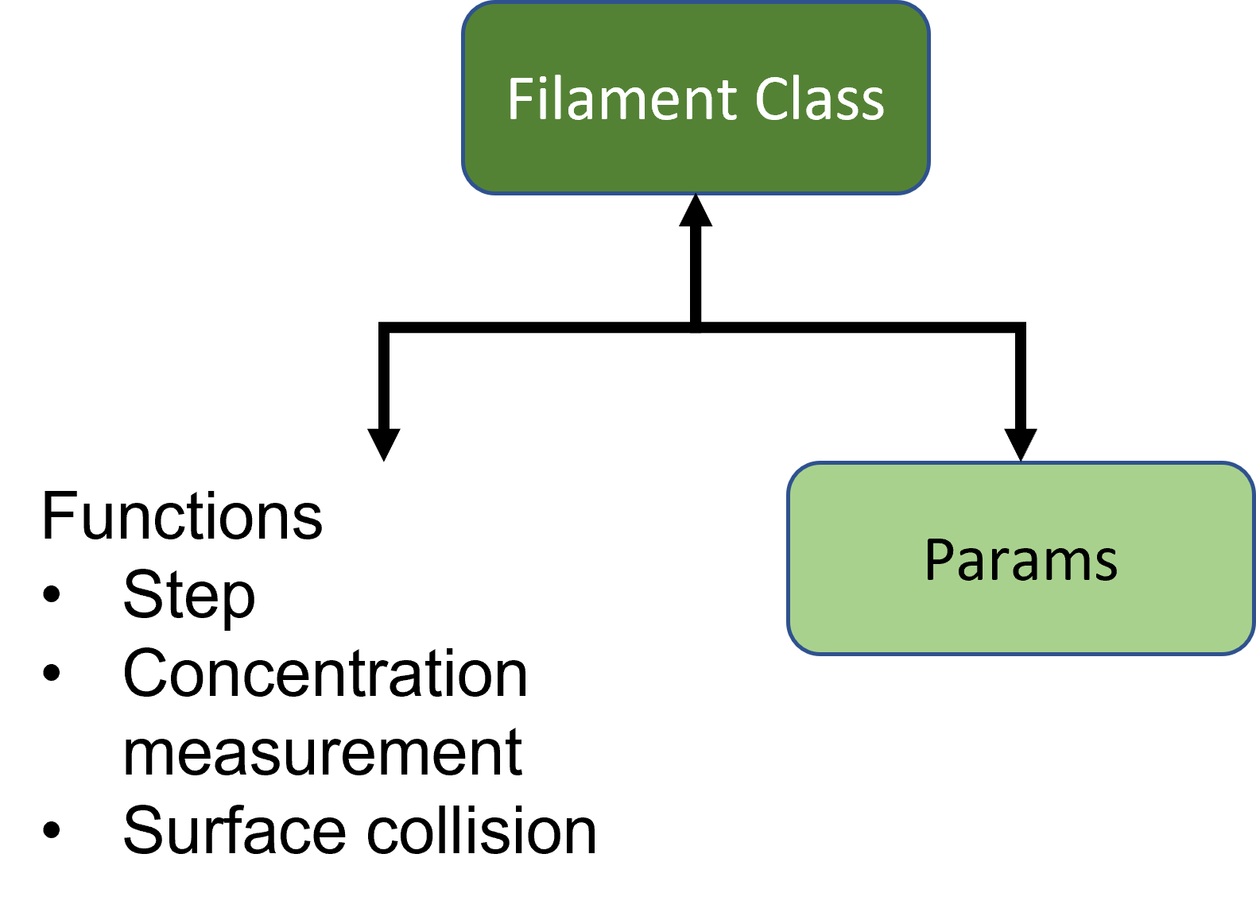
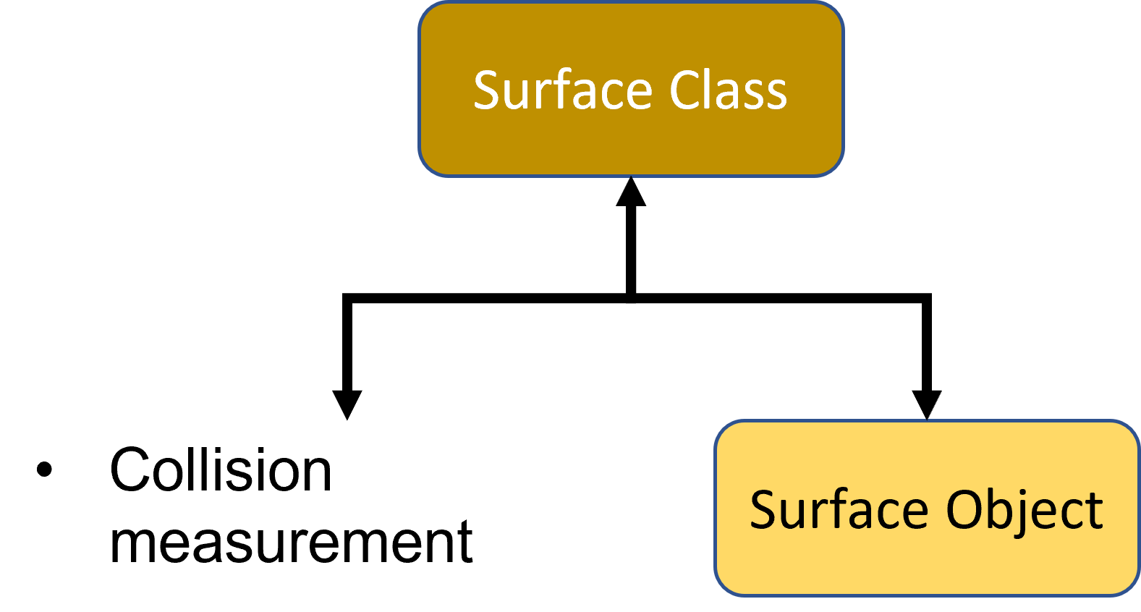
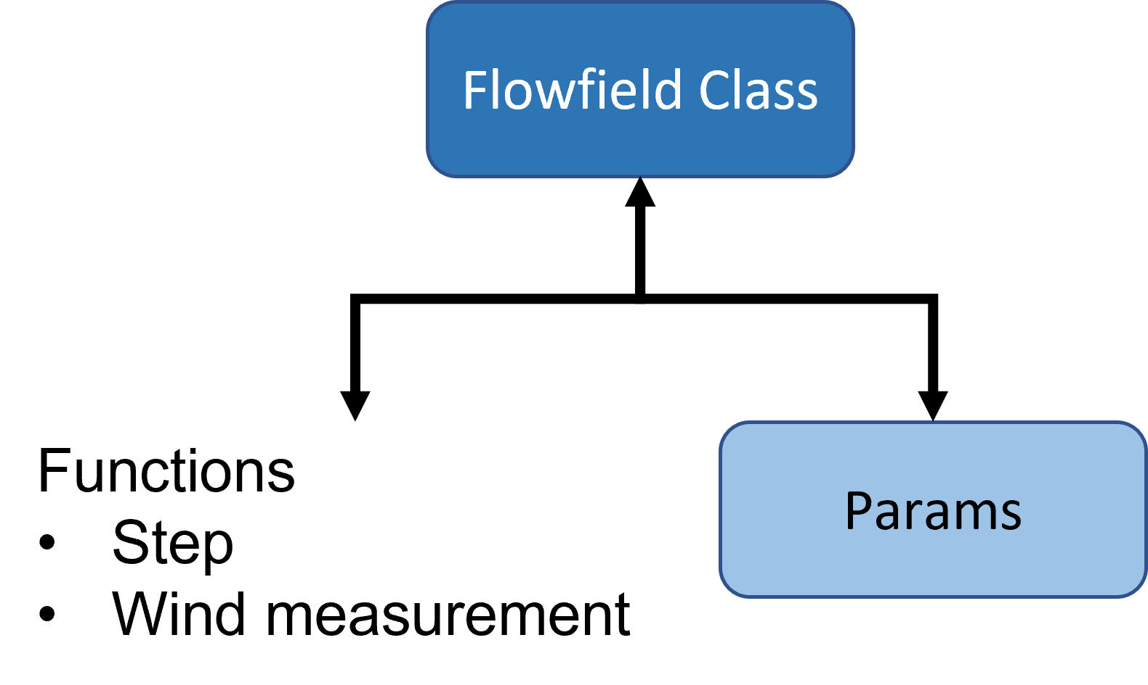
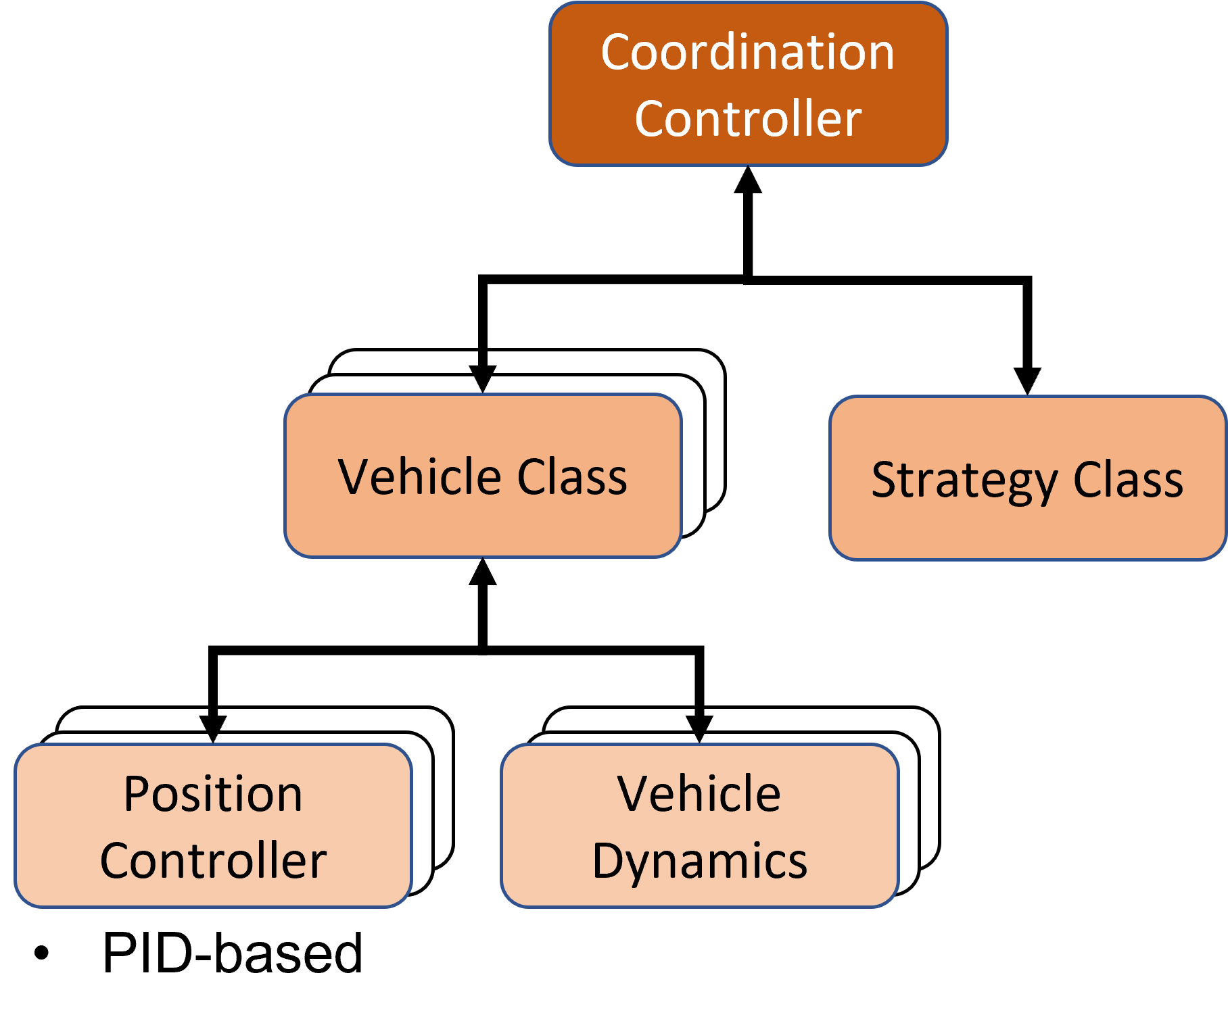
Simulation Layers
Vehicle Class
Vehicle Class
Step()
Wind_Measurement()
FlowfieldClass
Vehicle Class
Step()
Concentration_Measurement()
Vehicle Class
FilamentClass
Environment Class
Vehicle Class
Vehicle Class
Vehicle Class
Vehicle Class
VehicleClass
Vehicle dynamics
Vehicle Class
Vehicle Class
PlannerClass
Vehicle Class
StrategyClass
Vehicle Class
Position Controller
Vehicle Class
Step()
Collision_Measurement()
Vehicle Class
SurfaceClass

Slide 3
Simulation Layers
Vehicle Class
Vehicle Class
Surface Class
Vehicle Class
Vehicle Class
Filament Class
Environment Class
Vehicle Class
Vehicle Class
Flowfield Class
Vehicle Class
Vehicle Class
Coordination Controller

Slide 4
Coordination Controller
Vehicle Class
Vehicle Class
Vehicle Class
Strategy Class
Vehicle Class
Vehicle Class
Vehicle Class
Vehicle Class
Vehicle Class
Vehicle Class
Vehicle Dynamics
Position Controller
PID-based

Slide 5
Surface Class
Functions
Collision measurement
Surface Object

Slide 6
Filament Class
Functions
Step
Concentration measurement
Surface collision
Params

Slide 7
Flowfield Class
Functions
Step
Wind measurement
Params

