Slide 1
ECE 683
Computer Network Design & Analysis
Syllabus

Slide 2
Instructor Information
Instructor: Dr. Sihua Shao
Office: 325 ECEC
Contact: 973-596-3533, ss2536@njit.edu
Office hours
  By appointment via email or call
URL
  https://web.njit.edu/~ss2536/teaching/ece683.html

Slide 3
Textbook and References
Textbook: Communications Networks, 2nd Edition, Leon-Garcia & Widjaja, McGraw-Hill
Ref. 1: Computer Networks, Tanenbaum, 4th Edition, Prentice-Hall, 2002
Ref. 2: Data & Computer Communications, 8th Edition, William Stallings, Prentice-Hall, 2006
Ref. 3: Data Networks, 2nd Edition, Bertsekas & Gallager, Prentice-Hall, 1991

Slide 4
Prerequisite
Basic knowledge of probability theory (ECE 673)
  Probability, conditional probability, probability distribution, random variables, random processes
Basic knowledge of communication systems
  Analog communications, AM/FM, simple digital communication concepts, bandwidth, etc.
Warning: It is advised NOT to take this course if you do not have the above background

Slide 5
Course Outline
Overview of communication networks and services (chap. 1)
Layered architecture (chap. 2)
Digital transmission fundamentals (chap. 3)
  Data transmissions: information representation, coding/decoding
  Channel characterization (including transmission media)
  Fundamental limits of transmissions
  Modulation/demodulation (including line coding)

Slide 6
Course Outline (cont’d)
Multiplexing and switching (chap. 4)
Data link control (DLC) protocols
  Error control (CRC and FEC) (chap. 3)
  Automatic Repeat reQuest (ARQ) (chap. 5)
Midterm (most likely the 7th week)
Medium Access Control Protocols and Local Area Networks (chap. 6)
Routing protocols (chap. 7)
Transport layer protocols and congestion control (chap. 7/8)

Slide 7
Course Outline (cont’d)
Selected advanced topics
  Network Security (chap. 11)
  Advanced Network Techniques and Attacks
  …
Final exam

Slide 8
Grading Policy
Homework will be assigned but not collected; solutions will be posted
There are totally 5 in-class quizzes based on homework and course materials, each lasting 15-20 minutes. The quizzes may be given at the beginning of a class or in the middle of a class.
Quizzes (20%) + midterm (40%) + final (40%)
Attendance: It is not required, but highly recommended; and all quizzes are almost required. Hints for exams will be discussed in the lectures (especially the lecture before the exam).

Slide 9
Honor Code
The NJIT Honor Code will be upheld, and any violations in quizzes and exams will be brought to the immediate attention of the Dean of Students.
Everyone must sign the honor code for exams.
Everyone must have your 8-digit student ID number for the exams.

Slide 10
Reasons for Not Taking My Course
Do not have the pre-requisites
You have to get a grade at least B
You are interested only in a grade (with the hope of good grade)
You rely on good memory only
You expect that all materials in the textbook will be taught in class
You do not want to do your homework independently
You hope that your ID # = your neighbor’s

Slide 11
How to Be a Good Graduate Student
Learn to become an independent thinker, use your own brain and question the authority
Stop being an information collector, and ask why and how more often
Do not believe what your teacher tells you, or what the book says, and really understand what you learn
Start to enjoy the imperfect lectures and allow your teacher to make mistakes in front of you and sort out how he/she corrects the mistakes
(from Prof. Michael Fang at Univ. of Florida)

Slide 12
Q & A
?

Slide 13
ECE 683
Computer Network Design & Analysis
Note 1: Overview of Communication Networks and Services

Slide 14
Outline
Ancient Communication Methods
Modern Network Architectures and Services
Telegraph Networks & Message Switching
Telephone Networks and Circuit Switching
Computer Networks & Packet Switching
Uses of Computer Networks

Slide 15
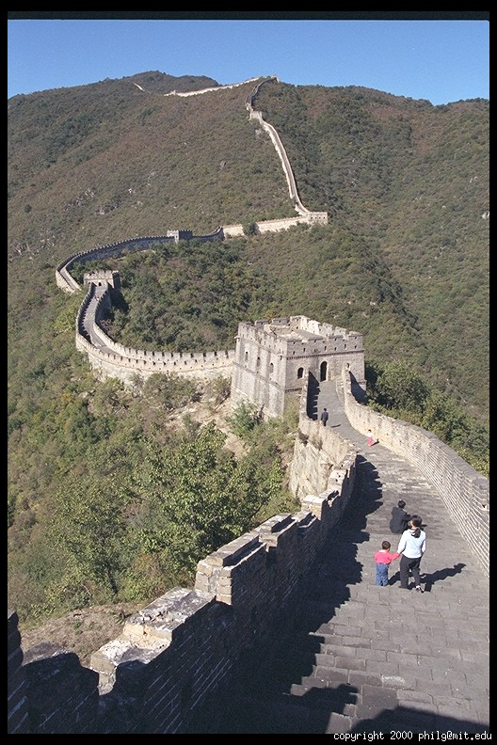

Ancient Communication Methods
By smoke
1046 - 771 BC: Story of Western Zhou Dynasty
Notes:
.

Slide 16
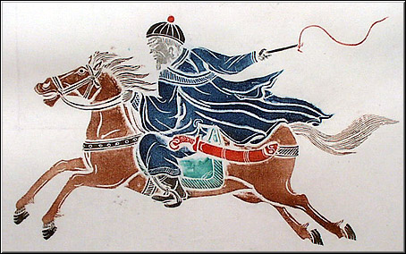
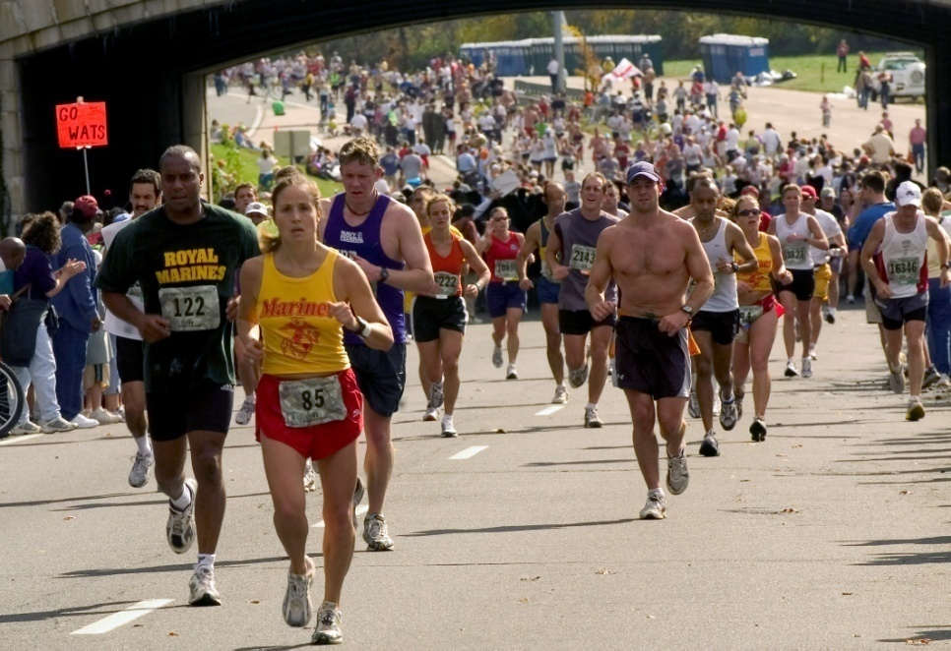
Case 2: By horse/foot
By foot: story of Marathon
By horse: pony express

Slide 17
Note 1: Overview of Communication Networks and Services
Modern Network Architectures and Services

Slide 18


Communication Services & Applications
A communication service enables the exchange of information between users at different locations.
Communication services & applications are everywhere.
E-mail
E-mail
server
Exchange of text messages via servers

Slide 19

Communication Services & Applications
A communication service enables the exchange of information between users at different locations.
Communication services & applications are everywhere.
Web Browsing
Web server
Retrieval of information from web servers

Slide 20
Communication Services & Applications
A communication service enables the exchange of information between users at different locations.
Communication services & applications are everywhere.
Instant Messaging
Direct exchange of text messages

Slide 21

Communication Services & Applications
A communication service enables the exchange of information between users at different locations.
Communication services & applications are everywhere.
Telephone
Real-time bidirectional voice exchange

Slide 22

Communication Services & Applications
A communication service enables the exchange of information between users at different locations.
Communication services & applications are everywhere.
Cell phone
Real-time voice exchange with mobile users

Slide 23

Communication Services & Applications
A communication service enables the exchange of information between users at different locations.
Communication services & applications are everywhere.
Short Message Service
Fast delivery of short text messages

Slide 24
Many other examples!
Peer-to-peer applications
  Napster, Gnutella, Kazaa file exchange, Bit Torrent
  Searching for ExtraTerrestrial Intelligence (SETI)
Audio & video streaming
Network games
On-line purchasing
Text messaging in PDAs, cell phones (SMS)
Voice-over-Internet, e.g., Skype

Slide 25
Services & Applications
Service: Basic information transfer capability
  Internet transfer of individual block of information
  Internet reliable transfer of a stream of bytes
  Real-time transfer of a voice signal
Applications build on communication services
  E-mail & web build on reliable stream service
  Fax and modems build on basic telephone service
New applications build on multiple services
  SMS builds on Internet reliable stream service and cellular telephone text messaging

Slide 26
What is a communication network?
Communication
Network
The equipment (hardware & software) and facilities that provide the basic communication service
Virtually invisible to the user; Usually represented by a cloud
Equipment
  Routers, servers, switches, multiplexers, hubs, modems, …
Facilities
  Copper wires, coaxial cables, optical fiber
  Ducts, conduits, telephone poles …
How are communication networks designed and operated?

Slide 27
Communication Network Architecture
Network architecture: the plan that specifies how the network is built and operated
Architecture is driven by the network services
Overall communication process is complex
Network architecture partitions overall communication process into separate functional areas called layers

Slide 28
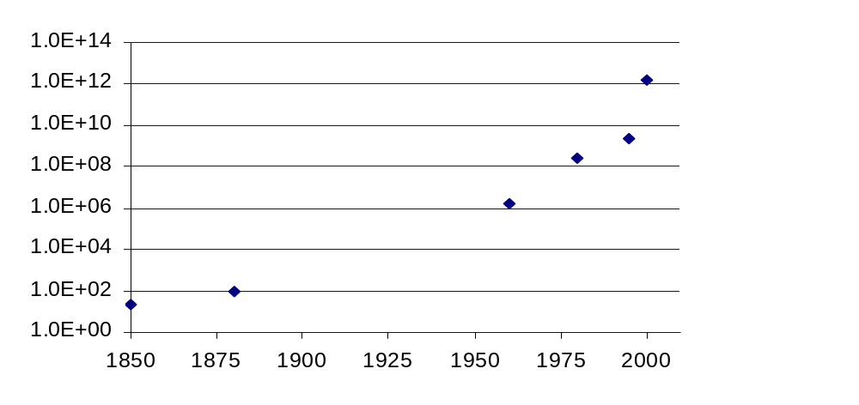
Network Architecture Evolution
?
Information transfer
per second
Telegraph
networks
Telephone
networks
Internet, Optical
& Wireless
networks
Next Generation Internet
Notes:
Samuel Morse, 1840s; Thomas Edison made the first full duplex and quadruplex telegraphs; Alexander Graham Bell adapted the telegraph to build the first working telephone.

Slide 29
Network Architecture Evolution
Telegraph Networks
  Message switching & digital transmission
Telephone Networks
  Circuit Switching
  Analog transmission → digital transmission
  Mobile communications
Internet
  Packet switching & computer applications

Slide 30
Note 1: Overview of Communication Networks and Services
Telegraph Networks & Message Switching

Slide 31
Telegraphs & Long-Distance Communications
Approaches to long-distance communications
Courier: physical transport of the message
  Messenger pigeons, pony express
Telegraph: message is transmitted across a network using signals
  Drums, beacons, mirrors, smoke, flags, semaphores…
  Electricity, light
Telegraph delivers message much sooner

Slide 32

Optical (Visual) Telegraph
Claude Chappe invented optical telegraph in the 1790’s
Semaphore mimicked a person with outstretched arms with flags in each hand
Different angle combinations of arms & hands generated hundreds of possible signals
Code for enciphering messages kept secret
Signal could propagate 800 km in 3 minutes!

Slide 33
Message Switching
Network nodes were created where several optical telegraph lines met (Paris and other sites)
Store-and-Forward Operation:
  Messages arriving on each line were decoded
  Next-hop in route determined by destination address of a message
  Each message was carried by hand to next line, and stored until operator became available for next transmission
Network
Node
North
line
West
line
East
line
South
line

Slide 34
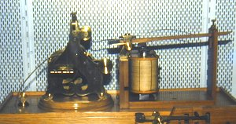
Electric Telegraph
William Sturgeon Electro-magnet (1825)
  Electric current in a wire wrapped around a piece of iron generates a magnetic force
Joseph Henry (1830)
  Current over 1 mile of wire to ring a bell
Samuel Morse (1837)
  Pulses of current deflect electromagnet to generate dots & dashes
  Experimental telegraph line over 40 miles (1840)
Signal propagates at the speed of light!!!
  Approximately 2 x 10⁸ meters/second in cable

Slide 35
Digital Communications
Morse code converts text messages into sequences of dots and dashes
Use transmission system designed to convey dots and dashes
 | Morse Code |  | Morse Code |  | Morse Code |  | Morse Code
A | · — | J | · — — — | S | · · · | 2 | · · — — —
B | — · · · | K | — · — | T | — | 3 | · · · — —
C | — · — · | L | · — · · | U | · · — | 4 | · · · · —
D | — · · | M | — — | V | · · · — | 5 | · · · · ·
E | · | N | — · | W | · — — | 6 | — · · · ·
F | · · — · | O | — — — | X | — · · — | 7 | — — · · ·
G | — — · | P | · — — · | Y | — · — — | 8 | — — — · ·
H | · · · · | Q | — — · — | Z | — — · · | 9 | — — — — ·
I | · · | R | · — · | 1 | · — — — — | 0 | — — — — —

Slide 36
Electric Telegraph Networks
Electric telegraph networks exploded
  Message switching & Store-and-Forward operation
  Key elements: Addressing, Routing, Forwarding
Optical telegraph networks disappeared
Message
Message
Message
Source
Message
Switches
Destination

Slide 37
Baudot Telegraph Multiplexer
Operator 25-30 words/minute
  but a wire can carry much more
Baudot multiplexer (1874): Combine 4 signals in 1 wire
  Binary block code (ancestor of ASCII code)
    A character represented by 5 binary digits
  Time division multiplexing
    Binary codes for characters are interleaved
  Framing is required to recover characters from the binary sequence in the multiplexed signal
  Keyboard converts characters to bits

Slide 38
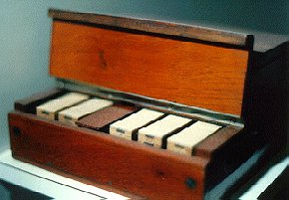
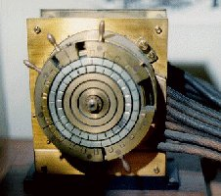
Baudot Telegraph Multiplexer
Keyboard
Paper
Tape
Printer
… A₃ A₂ A₁
Baudot
Multiplexer
Baudot
Demultiplexer
Paper
Tape
Printer
…B₂B₁
…C₂C₁
…A₂D₁C₁B₁A₁
Paper
Tape
Printer
… D₃ D₂ D₁
5 bits / character
Paper
Tape
Printer

Slide 39
Elements of Telegraph Network Architecture
Digital transmission
  Text messages converted into symbols (dots/dashes, zeros/ones)
  Transmission system designed to convey symbols
Multiplexing
  Framing needed to recover text characters
Routing based on destination addresses
  Messages contain source & destination addresses
  Store-and-Forward: Messages forwarded hop-by-hop across the network
  Routing according to the destination address

Slide 40
Note 1: Overview of Communication Networks and Services
Telephone Networks and Circuit Switching

Slide 41
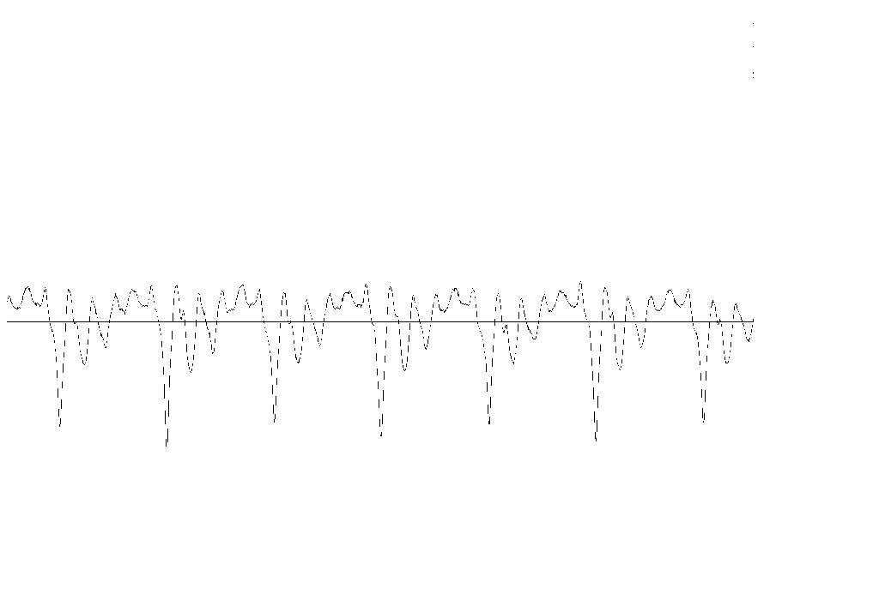
Bell’s Telephone
Alexander Graham Bell (1875) working on harmonic telegraph to multiplex telegraph signals
Discovered voice signals can be transmitted directly
  Microphone converts voice pressure variation (sound) into analogous electrical signal
  Loudspeaker converts electrical signal back into sound
Telephone patent granted in 1876
Bell Telephone Company founded in 1877
Signal for “ae” as in cat
Microphone
Loudspeaker
analog
electrical
signal
sound
sound

Slide 42
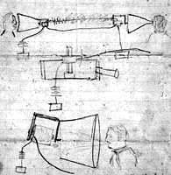
Bell’s Sketch of Telephone

Slide 43
The N² Problem
For N users to be fully connected directly
Requires N(N – 1)/2 connections
Requires too much space for cables
Inefficient & costly since connections not always on
1
N = 1000
N(N – 1)/2 = 499500
N
2
. . .
4
3

Slide 44
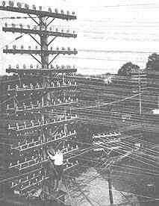
Telephone Pole Congestion

Slide 45

Circuit Switching
Patch cord panel switch invented in 1877
Operators connect users on demand
  Establish circuit to allow electrical current to flow from inlet to outlet
Only N connections required to a central office
1
N
N – 1
2
3

Slide 46
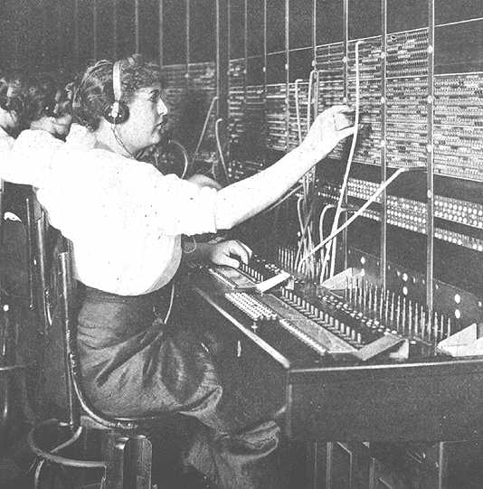
Manual Switching

Slide 47
Strowger Switch
Human operators intelligent & flexible
  But expensive and not always discreet
Strowger invented automated switch in 1888
  Each current pulse advances wiper by 1 position
  User dialing controls connection setup
Decimal telephone numbering system
Hierarchical network structure simplifies routing
  Area code, exchange (CO), station number
1st digit
2nd digit
. . .
0
0
0
9
.
.
.
.
.
.
.
.
.
0
9
9
9

Slide 48
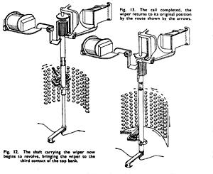
Strowger Switch

Slide 49
Hierarchical Network Structure
Toll
CO = central office
Tandem
Tandem
CO
CO
CO
CO
CO
Telephone subscribers connected to local CO (central office)
Tandem & Toll switches connect CO’s

Slide 50


Three Phases of a Connection
1.
Telephone
network
Pick up phone
Dial tone.
Connection set up
2.
Telephone
network
Dial number
3.
Telephone
network
Network selects route;
Sets up connection;
Called party alerted
4.
Telephone
network
Information transfer
5.
Telephone
network
Exchange voice signals
Connection release
6.
Telephone
network
Hang up.

Slide 51
Digitization of Telephone Network
Pulse Code Modulation digital voice signal
  Voice gives 8 bits/sample x 8000 samples/sec = 64x10³ bps
Time Division Multiplexing for digital voice
  T-1 multiplexing (1961): 24 voice signals = 1.544x10⁶ bps
Digital Switching (1980s)
  Switch TDM signals without conversion to analog form
Digital Cellular Telephony (1990s)
Optical Digital Transmission (1990s)
  One OC-192 optical signal = 10x10⁹ bps
  One optical fiber carries 160 OC-192 signals = 1.6x10¹² bps!
All digital transmission, switching, and control

Slide 52
Digital Transmission Evolution
Wavelength
Division
Multiplexing
?
Information transfer
per second
SONET
Optical
Carrier
T-1 Carrier
Baudot
Morse

Slide 53
Computer Connection Control
A computer controls connection in telephone switch
Computers exchange signaling messages to:
  Coordinate set up of telephone connections
  To implement new services such as caller ID, voice mail, . . .
  To enable mobility and roaming in cellular networks
“Intelligence” inside the network
A separate signaling network is required
Computer
Signaling
Switch connects
Inlets to Outlets
. . .
. . .
Voice

Slide 54
Elements of Telephone Network Architecture
Transmission systems
  Transfer of voice signals
Telephone switches
  Transfer of a signal from an incoming line to an output line
  Form an end-to-end circuit across the network
Telephone numbering system
  Decimal numbering system
  Hierarchical structure
Routing system
  Identify a path based on a request for a voice connection
Signaling system
  Distribute signaling messages
  Involves computer communications

Slide 55
Note 1: Overview of Communication Networks and Services
Computer Networks & Packet Switching

Slide 56
Computer Network Evolution Overview
1950s: Telegraph technology adapted to computers
1960s: Dumb terminals access shared host computer
  SABRE airline reservation system
1970s: Computers connect directly to each other
  ARPANET packet switching network
  TCP/IP internet protocols
  Ethernet local area network
1980s & 1990s: New applications and Internet growth
  Commercialization of Internet
  E-mail, file transfer, web, P2P, . . .
  Internet traffic surpasses voice traffic

Slide 57
What is a protocol?
Communications between computers requires very specific unambiguous rules
A protocol is a set of rules that governs how two or more communicating parties should interact
  Internet Protocol (IP)
  Transmission Control Protocol (TCP)
  HyperText Transfer Protocol (HTTP)
  Simple Mail Transfer Protocol (SMTP)

Slide 58


A familiar protocol
Caller
Dials 411
“What city”?
System replies
Caller replies
“Springfield”
“What name?”
System replies
Caller replies
“Simpson”
“Thank you, please hold”
System replies
Caller waits
“Do you have a first name or street?”
Operator replies
Caller replies
“Evergreen Terrace”
“Thank you, please hold”
Operator replies
Caller waits
System replies with number
Caller dials

Slide 59
Terminal-Oriented Networks
Early computer systems are very expensive
Time-sharing methods allowed multiple terminals to share local computer
Remote access via telephone modems
Terminal
. . .
Terminal
Modem
Telephone
Network
Modem
Terminal
Host computer

Slide 60
Medium Access Control
Dedicated communication lines were expensive
Terminals generated messages sporadically
Let multiple terminals share a line
Medium Access Controls for sharing a line were developed
Example: Polling protocol on a multidrop line
Frames carried messages to/from attached terminals
Address in frame header identified terminal
Polling frames & output frames
input frames
Terminal
Terminal
. . .
Terminal
Terminals at different locations in a city
Must avoid collisions on inbound line
Host computer

Slide 61
Statistical Multiplexing
Statistical multiplexer allows a line to carry frames that contain messages to/from multiple terminals
Frames are buffered at multiplexer until line becomes available, i.e. store-and-forward
Address in frame header identifies terminal
Header carries other control information
Frame
CRC Information Header
Terminal
Terminal
Header Information CRC
. . .
Terminal
Host computer
Multiplexer

Slide 62
Error Control Protocol
Communication lines introduced errors
Error checking codes used on frames
  “Cyclic Redundancy Check” (CRC) calculated based on frame header and information payload, and appended
  Header also carries ACK/NAK control information
Retransmission requested when errors detected
CRC Information Header
Terminal
Header Information CRC

Slide 63
Tree Topology Networks
National & international terminal-oriented networks
Routing was very simple (to/from host)
Each network typically handled a single application
.
.
.
.
.
.
San Francisco
New York City
.
.
.
T
T
.
.
.
Chicago
T
Atlanta

Slide 64
Computer-to-Computer Networks
As cost of computing dropped, terminal-oriented networks viewed as too inflexible and costly
Need to develop flexible computer networks
  Interconnect computers as required
  Support many applications
Application Examples
  File transfer between arbitrary computers
  Execution of a program on another computer
  Multiprocess operation over multiple computers

Slide 65
Packet Switching
Message Switching
  Transfer arbitrary message size
  But in store-and-forward operation, long messages induce high delay on interactive traffic that consists of short messages
Packet switching introduced
  Network transfers packets using store-and-forward
  Packets have maximum length
  Break long messages into multiple packets
  Low delays for interactive traffic
ARPANET testbed led to many innovations

Slide 66
ARPANET Packet Switching
Host generates message
Source packet switch converts message to packet(s)
Packets transferred independently across network
Destination packet switch reassembles message
Destination packet switch delivers message
Packet Switch
Message
Packet 2
Message
Packet 2
Packet Switch
Packet Switch
Packet 1
Packet Switch
Packet 1
Packet 1
Packet Switch

Slide 67
ARPANET Routing
Routing is highly nontrivial
No connection setup prior to packet transmission
Packets header includes source & destination addresses
Packet switches have table with next hop per destination
Routing tables calculated by packet switches using distributed algorithm
Packet Switch
Hdr
Packet
Packet Switch
Packet Switch
Dest: Next Hop:
xyz abc
wvr edf
Packet Switch
Packet Switch

Slide 68
Other ARPANET Protocols
Error control between adjacent packet switches
Congestion control between source & destination packet switches limit number of packets in transit
Flow control between host computers prevents buffer overflow
Packet Switch
Error Control
Packet Switch
Congestion Control
Packet Switch
Packet Switch
Packet Switch
Flow Control

Slide 69
ARPANET Applications
ARPANET introduced many new applications
Email, remote login, file transfer, …
Intelligence at the edge
AMES
McCLELLAN
UTAH
BOULDER
GWC
CASE
RADC
ILL
LINC
CARN
AMES
USC
MIT
UCSB
MITRE
STAN
SCD
ETAC
UCLA
RAND
TINKER
BBN
HARV
NBS

Slide 70
Ethernet Local Area Network
In 1980s, affordable workstations available
Need for low-cost, high-speed networks
  To interconnect local workstations
  To access local shared resources (printers, storage, servers)
Low cost, high-speed communications with low error rate possible using coaxial cable
Ethernet is the standard for high-speed wired access to computer networks

Slide 71

Ethernet Medium Access Control
A network interface card (NIC) connects a workstation to LAN
Each NIC has a globally unique address
Frames are broadcast into the coaxial cable
NICs listen to medium for frames with their addresses
Transmitting NICs listen for collisions with other stations, and abort and reschedule retransmissions
Transceivers

Slide 72
The Internet
Different network types emerged for data transfer between computers
ARPA also explored packet switching using satellite and packet radio networks
Each network has its protocols and is possibly built on different technologies
Internetworking protocols required to enable communications between computers attached to different networks
Internet: a network of networks

Slide 73

Internet Protocol (IP)
Routers (gateways) interconnect different networks
Host computers prepare IP packets and transmit them over their attached network
Routers forward IP packets across networks
Best-effort IP transfer service, no retransmission
Net 1
Net 2
Router

Slide 74
Addressing & Routing
Hierarchical address: Net ID + Host ID
IP packets routed according to Net ID
Routers compute routing tables using distributed algorithm
H
H
Net 3
G
Net 1
G
G
G
Net 5
Net 2
G
Net 4
H
G
H

Slide 75
Names and IP Addresses
Routing is done based on 32-bit IP addresses
Dotted-decimal notation
  128.100.11.1
Hosts are also identified by name
  Easier to remember
  Hierarchical name structure
  tesla.comm.utoronto.edu
Domain Name System (DNS) provided conversion between names and addresses

Slide 76
Transport Protocols
Host computers run two transport protocols on top of IP to enable process-to-process communications
User Datagram Protocol (UDP) enables best-effort transfer of individual block of information
Transmission Control Protocol (TCP) enables reliable transfer of a stream of bytes
Transport
Protocol
Internet

Slide 77
Internet Applications
All Internet applications run on TCP or UDP
TCP: HTTP (web); SMTP (e-mail); FTP (file transfer; telnet (remote terminal)
UDP: DNS, RTP (voice & multimedia)
TCP & UDP incorporated into computer operating systems
Any application designed to operate over TCP or UDP will run over the Internet!!!

Slide 78
Elements of Computer Network Architecture
Digital transmission
Exchange of frames between adjacent equipment
  Framing and error control
Medium access control regulates sharing of broadcast medium
Addresses (network addresses) identify attachment to network or the internet
Transfer of packets across a packet network
Distributed calculation of routing tables
Congestion control inside the network

Slide 79
Elements of Computer Network Architecture
Internetworking across multiple networks using routers
Segmentation and reassembly of messages into packets at the ingress to and egress from a network or internetwork
Applications that build on the transfer of messages between computers

Slide 80
Uses of Computer Networks
Business Applications
Home Applications
Mobile Users

Slide 81
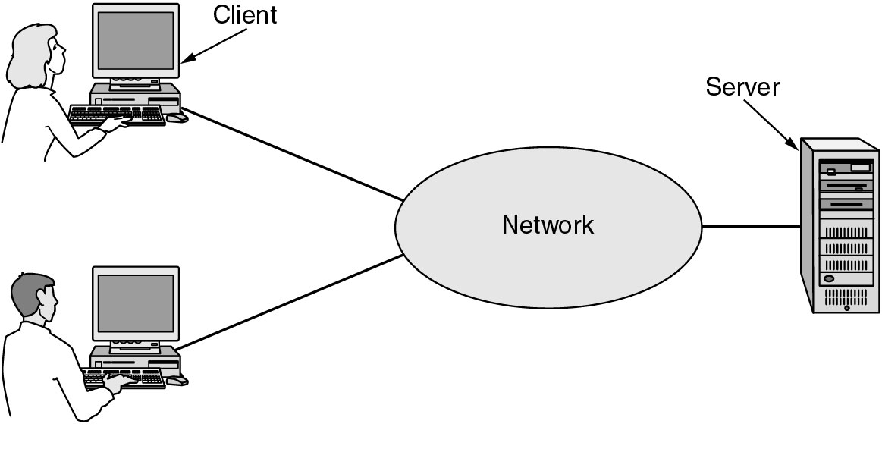
Business Applications of Networks
A network with two clients and one server.

Slide 82
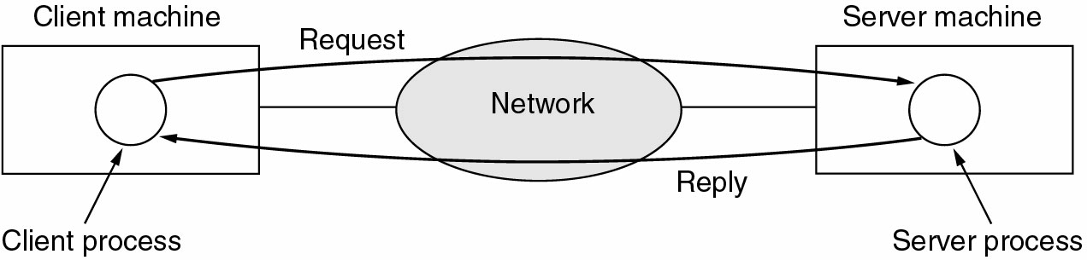
Business Applications (2)
The client-server model involves requests and replies.

Slide 83
Home Network Applications
Access to remote information
Person-to-person communication
Interactive entertainment
Electronic commerce

Slide 84
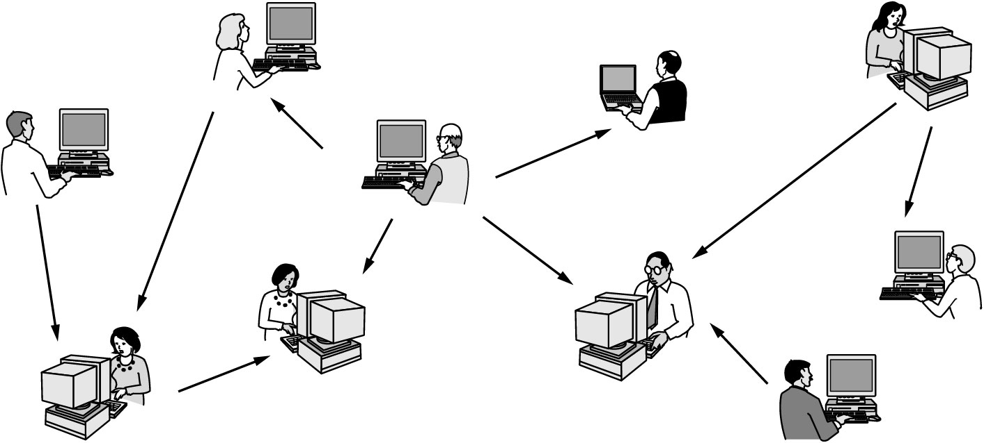
Home Network Applications (2)
In peer-to-peer system there are no fixed clients and servers.

Slide 85
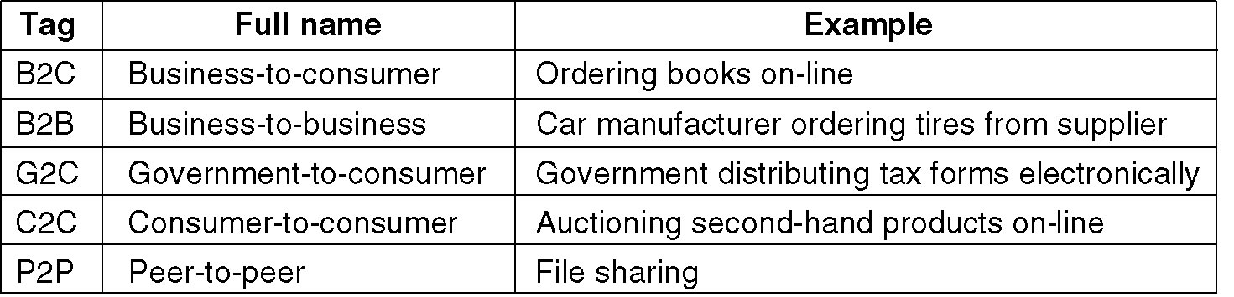
Home Network Applications (3)
Some forms of e-commerce.

Slide 86
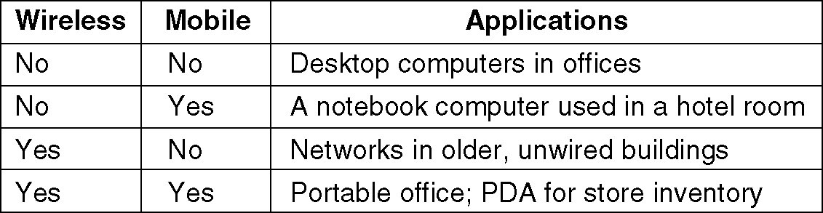
Mobile Network Users
Combinations of wireless networks & mobile computing.

Slide 87
Computer Network Classification
Local Area Networks
Metropolitan Area Networks
Wide Area Networks
Wireless Networks
Home Networks
Internetworks

Slide 88
Network classification Standard
By types of transmission technology
  Broadcast networks: a single communication channel shared by all the machines on the network
  Point-to-point networks: consisting of point-to-point links between pairs of machines

Slide 89
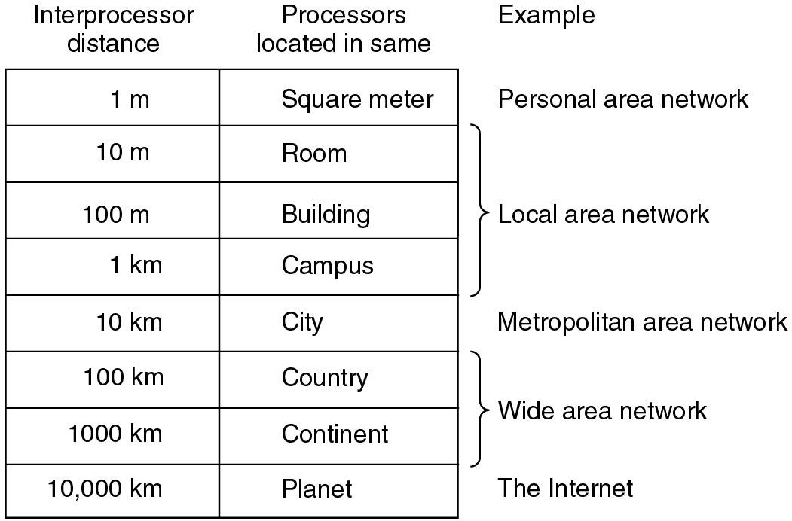
Network Classification Standard (2)
By scale or distance between interconnected processors

Slide 90
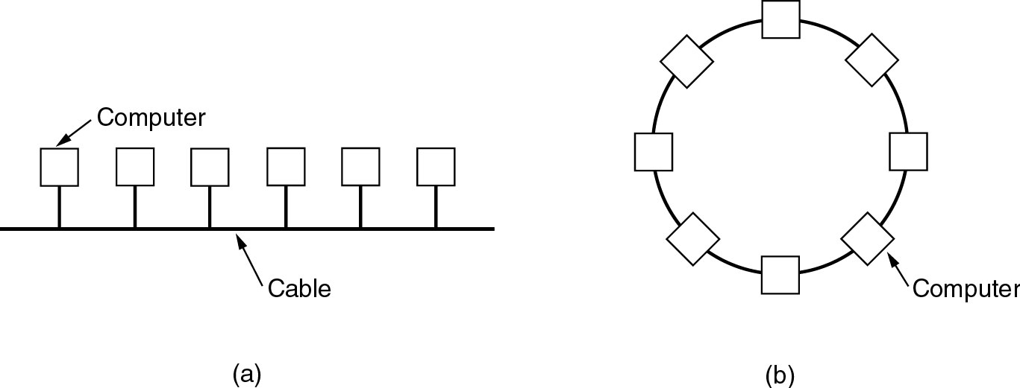
Local Area Networks
Two broadcast networks
  (a) Bus
  (b) Ring

Slide 91
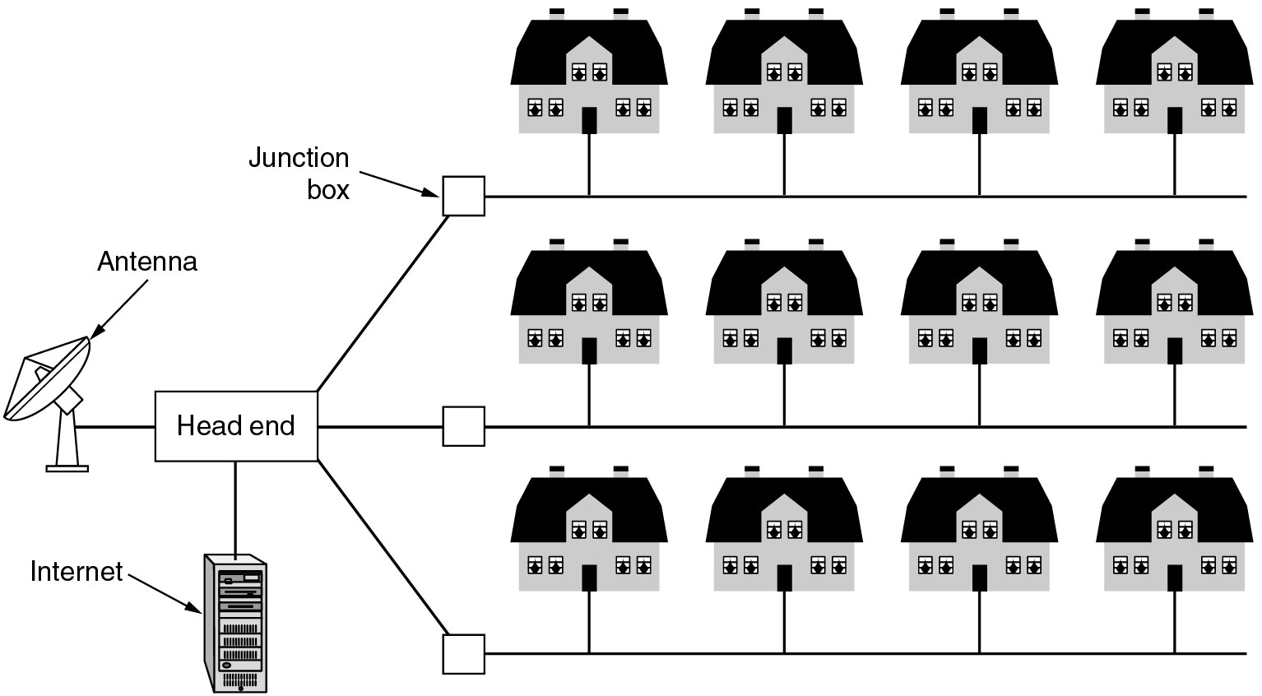
Metropolitan Area Networks
A metropolitan area network based on cable TV.

Slide 92
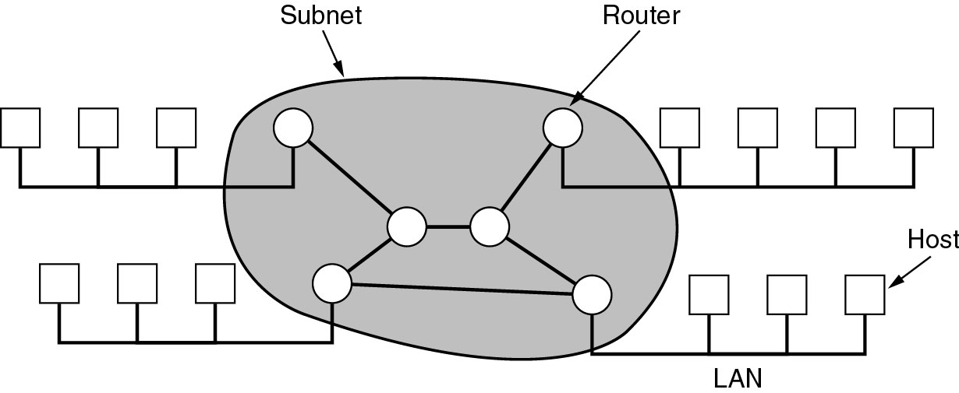
Wide Area Networks

Slide 93
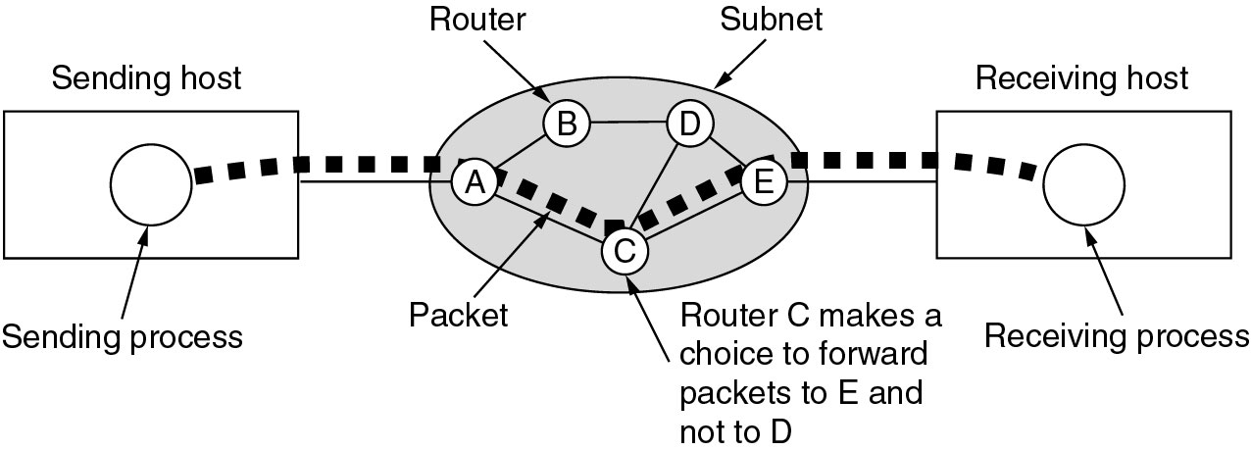
Wide Area Networks (2)
A stream of packets from sender to receiver.

Slide 94
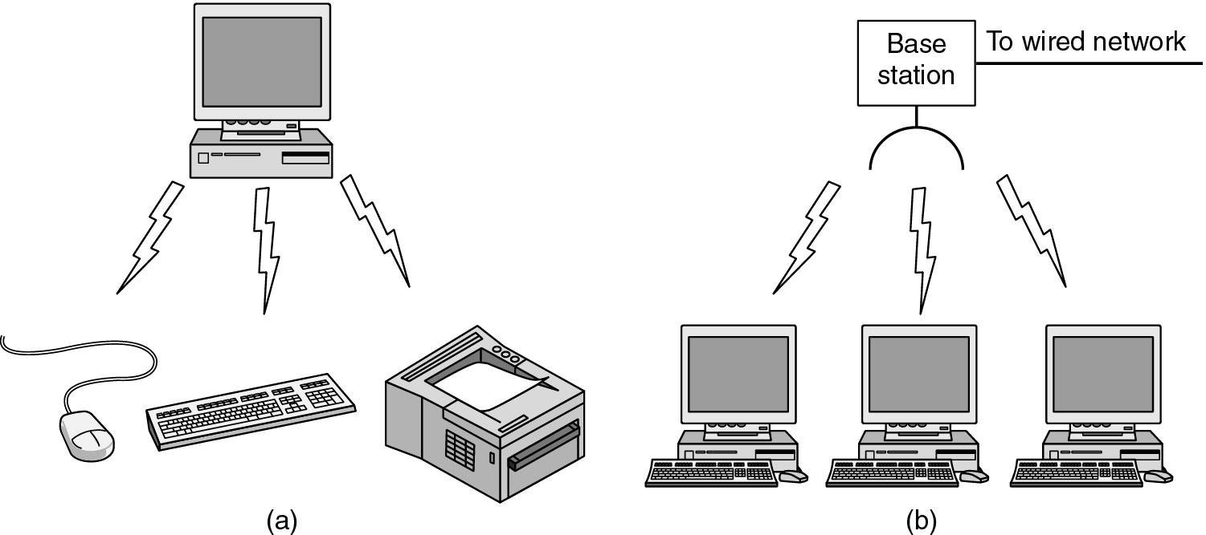
Wireless Networks (1)
(a) Bluetooth configuration
(b) Wireless LAN

Slide 95
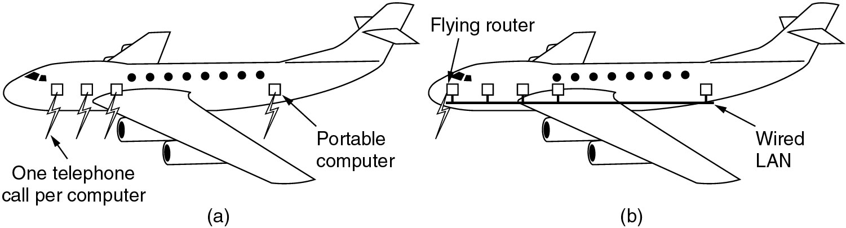
Wireless Networks (2)
(a) Individual mobile computers
(b) A flying LAN

Slide 96
Home Network Categories
Computers (desktop PC, PDA, shared peripherals
Entertainment (TV, DVD, VCR, camera, stereo, MP3)
Telecomm (telephone, cell phone, intercom, fax)
Appliances (microwave, fridge, clock, furnace, airco)
Telemetry (utility meter, burglar alarm, babycam).

Slide 97
Further Reading
Textbook: 1.1-1.2
Exercises: web search
  Find who invents WWW
  Find who wrote the TCP/IP
  Do Problem 1.16
  Determine who is the real founding father of Internet

