Slide 1
ECE 683
Computer Network Design & Analysis
Note 7: Local Area Networks

Slide 2
Outline
Overview of LANs
Ethernet
802.11 Wireless LAN
LAN Bridges

Slide 3
What is a LAN?
Local area means:
Private ownership
  freedom from regulatory constraints of WANs
Short distance (~1km) between computers
  low cost
  very high-speed, relatively error-free communication
  complex error control unnecessary
Machines are constantly moved
  Keeping track of location of computers a chore
  Simply give each machine a unique address
  Broadcast all messages to all machines in the LAN
Need a medium access control protocol

Slide 4
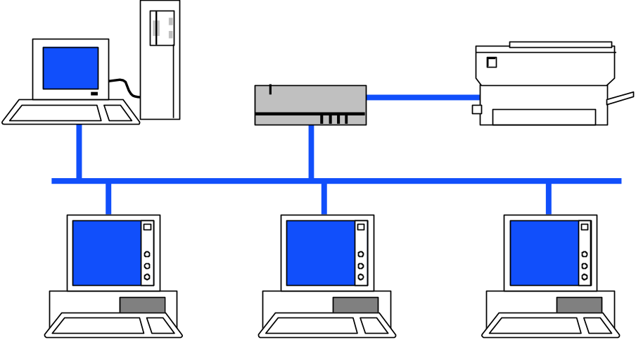

Typical LAN Structure
Transmission Medium
Network Interface Card (NIC)
Unique MAC “physical” address
RAM
Ethernet Processor
ROM
RAM

Slide 5
Medium Access Control Sublayer
In IEEE 802, Data Link Layer divided into:
Medium Access Control Sublayer
  Coordinate access to medium
  Connectionless frame transfer service
  Machines identified by MAC/physical address
  Broadcast frames with MAC addresses
Logical Link Control Sublayer
  Between Network layer & MAC sublayer

Slide 6
MAC Sub-layer
IEEE 802
OSI
Network layer
Network layer
LLC
802.2 Logical link control
Data link
layer
802.3
CSMA-CD
802.5
Token Ring
802.11
Wireless
LAN
Other
LANs
MAC
Various physical layers
Physical
layer
Physical
layer

Slide 7
Logical Link Control Layer
IEEE 802.2: LLC enhances service provided by MAC
A
C
A
Reliable frame service
C
Unreliable Datagram Service
LLC
LLC
LLC
MAC
MAC
MAC
MAC
MAC
MAC
PHY
PHY
PHY
PHY
PHY
PHY

Slide 8
Logical Link Control Services
Type 1: Unacknowledged connectionless service
  Unnumbered frame mode of HDLC
Type 2: Reliable connection-oriented service
  Asynchronous balanced mode of HDLC
Type 3: Acknowledged connectionless service
Additional addressing
  A workstation has a single MAC physical address
  Can handle several logical connections, distinguished by their SAP (service access points).

Slide 9
LLC PDU Structure
1 byte
1
1 or 2 bytes
1
Destination
SAP Address
Source
SAP Address
Control
Information
Destination SAP Address
Source SAP Address
I/G
C/R
1
7 bits
1
7 bits
I/G = Individual or group address
C/R = Command or response frame
Examples of SAP Addresses:
06 IP packet
E0 Novell IPX
FE OSI packet
AA SubNetwork Access protocol (SNAP)

Slide 10
Encapsulation of MAC frames
IP Packet
IP
LLC PDU
LLC Header
Data
MAC Header
FCS

Slide 11
Note 7: Local Area Networks
Ethernet

Slide 12

A bit of history…
1970 ALOHAnet radio network deployed in Hawaiian islands
1973 Metcalf and Boggs invent Ethernet, random access in wired net
1979 DIX Ethernet II Standard
1985 IEEE 802.3 LAN Standard (10 Mbps)
1995 Fast Ethernet (100 Mbps)
1998 Gigabit Ethernet
2002 10 Gigabit Ethernet
http://en.wikipedia.org/wiki/IEEE_802
Ethernet is the dominant LAN standard
Metcalf’s Sketch

Slide 13
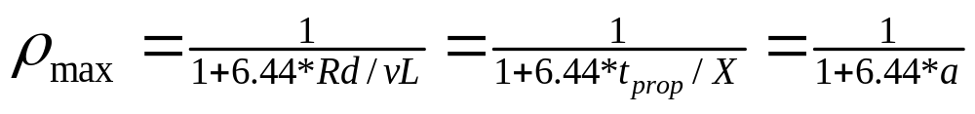
IEEE 802.3 MAC: Ethernet
CSMA/CD with 1-persistent mode
Truncated binary exponential backoff
  for retransmission n: 0 < r < 2^{k}, where k=min(n,10)
  Give up after 16 retransmissions
Single segments up to 500m; with up to 4 repeaters gives 2500m max length
Max 100 stations/segment, 1024 stations/Ethernet
Baseband signals broadcast, Manchester encoding, 32-bit CRC for error detection

Slide 14
IEEE 802.3 MAC: Ethernet
Collision Detection (CD)
  CD circuit operates by looking for voltage exceeding a transmitted voltage
  Want to ensure that a station does not complete transmission before the 1st bit of the colliding frame from the farthest-away station arrives
  Time to CD can thus take up to 2x{max prop. delay} (check CSMA/CD operations)

Slide 15
IEEE 802.3 MAC: Ethernet
Minimum frame size
  Speed of light is about 3x10⁸ m/s in vacuum and about 2x10⁸ in copper
  So, max Ethernet signal prop time is about 12.5 usec, or 25 usec RTT
  With repeaters (processing delays introduced), 802.3 requires up to 51.2 usec to detect a collision
  Thus, minimum frame size is 51.2 usec * 10 Mbps = 512 bits (64 bytes)
Notes:
Max length=2500 meters (4 repeators are needed)

Slide 16
IEEE 802.3 MAC: Ethernet
Maximum frame size
  1500 byte limitation on maximum frame size
  Later we will call this the MTU (Max Transmission Unit)
  limits maximum buffers at receiver
  allows for other stations to send

Slide 17
IEEE 802.3 MAC Frame
802.3 MAC Frame
7
1
6
6
2
4
Preamble
Destination
address
Source
address
Length
Information
Pad
FCS
SD
Synch
Start
frame
64 - 1518 bytes
Every frame transmission begins “from scratch”
Preamble helps receivers synchronize their clocks to transmitter clock
7 bytes of 10101010 generate a square wave
Start frame byte changes to 10101011
Receivers look for change in 10 pattern

Slide 18
IEEE 802.3 MAC Frame
802.3 MAC Frame
7
1
6
6
2
4
Preamble
Destination
address
Source
address
Length
Information
Pad
FCS
SD
Synch
Start
frame
64 - 1518 bytes
Destination address
  single address
  group address
  broadcast = 111...111
Addresses
  local or global
Global addresses
  first 24 bits assigned to manufacturer;
  next 24 bits assigned by manufacturer
  Cisco 00-00-0C
Single address
0
Group address
1
Local address
1
Global address
0
Note: Fig 6.52 in textbook may be misleading: it shows the bits in transmission order

Slide 19
IEEE 802.3 MAC Frame
802.3 MAC Frame
7
1
6
6
2
4
Preamble
Destination
address
Source
address
Length
Information
Pad
FCS
SD
Synch
Start
frame
64 - 1518 bytes
Length: # bytes in information field
  Max frame 1518 bytes, excluding preamble & SD
  Max information 1500 bytes: 05DC
Pad: ensures min frame of 64 bytes
FCS: CCITT-32 CRC, covers addresses, length, information, pad fields
  NIC discards frames with improper lengths or failed CRC

Slide 20


IEEE 802.3 Physical Layer
Table 6.2 IEEE 802.3 10 Mbps medium alternatives
 | 10base5 | 10base2 | 10baseT | 10baseFX
Medium | Thick coax | Thin coax | Twisted pair | Optical fiber
Max. Segment Length | 500 m | 200 m | 100 m | 2 km
Topology | Bus | Bus | Star | Point-to-point link
Hubs & Switches!
(a)
transceivers
(b)
Thick Coax: Stiff, hard to work with
T connectors flaky

Slide 21
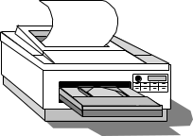
Ethernet Hubs & Switches
Single collision domain
High-Speed backplane or interconnection fabric
(a)
●     
(b)
●   
Twisted Pair Cheap
Easy to work with
Reliable
Star-topology CSMA-CD
Twisted Pair Cheap
Bridging increases scalability
Separate collision domains
Full or half duplex operation

Slide 22
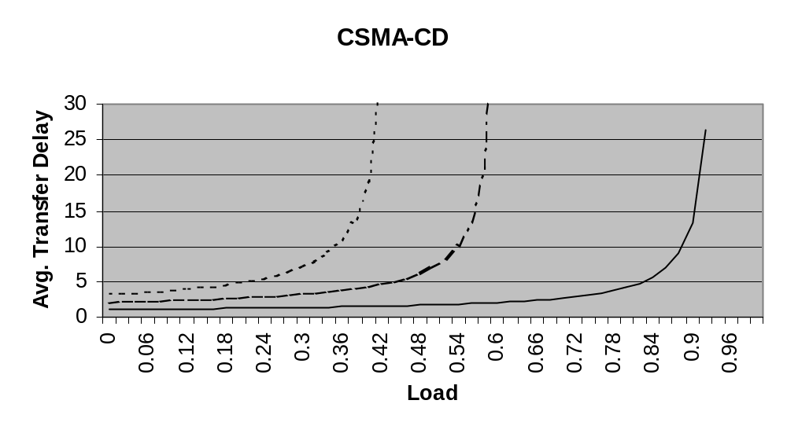
Ethernet Scalability
a = .1
a = .01
a = .2
CSMA-CD maximum throughput depends on normalized delay-bandwidth product a=t_{prop}/X=t_{prop}R/L
x10 increase in bit rate = x10 decrease in X
To keep a constant need to either: decrease t_{prop} (distance) by x10; or increase frame length x10
Notes:
X=L/R, time to transmit a frame.

Slide 23
Fast Ethernet
Table 6.4 IEEE 802.3 100 Mbps Ethernet medium alternatives
 | 100baseT4 | 100baseT | 100baseFX
Medium | Twisted pair category 3 UTP 4 pairs | Twisted pair category 5 UTP two pairs | Optical fiber multimode Two strands
Max. Segment Length | 100 m | 100 m | 2 km
Topology | Star | Star | Star
To preserve compatibility with 10 Mbps Ethernet:
Same frame format, same interfaces, same protocols
Hub topology only with twisted pair & fiber
Bus topology & coaxial cable abandoned

Slide 24
Gigabit Ethernet
Table 6.3 IEEE 802.3 1 Gbps Fast Ethernet medium alternatives
 | 1000baseSX | 1000baseLX | 1000baseCX | 1000baseT
Medium | Optical fiber multimode Two strands | Optical fiber single mode Two strands | Shielded copper cable | Twisted pair category 5 UTP
Max. Segment Length | 550 m | 5 km | 25 m | 100 m
Topology | Star | Star | Star | Star
Minimum frame length increased to 512 bytes
Small frames need to be extended to 512 B
Frame bursting to allow stations to transmit burst of short frames
Frame structure preserved but CSMA-CD essentially abandoned

Slide 25
10 Gigabit Ethernet
Table 6.5 IEEE 802.3 10 Gbps Ethernet medium alternatives
 | 10GbaseSR | 10GBaseLR | 10GbaseEW | 10GbaseLX4
Medium | Two optical fibers Multimode at 850 nm 64B66B code | Two optical fibers Single-mode at 1310 nm 64B66B | Two optical fibers Single-mode at 1550 nm SONET compatibility | Two optical fibers multimode/single-mode with four wavelengths at 1310 nm band 8B10B code
Max. Segment Length | 300 m | 10 km | 40 km | 300 m – 10 km
Frame structure preserved
CSMA-CD protocol officially abandoned
LAN PHY for local network applications
WAN PHY for wide area interconnection using SONET OC-192c

Slide 26

Typical Ethernet Deployment
Server farm
Server
Server
Server
Gigabit Ethernet links
Switch/router
Switch/router
Gigabit Ethernet links
Server
Ethernet switch
Ethernet switch
Server
Ethernet switch
Server
100 Mbps links
100 Mbps links
100 Mbps links
Hub
Hub
Hub
10 Mbps links
10 Mbps links
10 Mbps links
Department A
Department B
Department C

Slide 27
Note 7: Local Area Networks
802.11 Wireless LAN

Slide 28
Wireless Data Communications
Wireless communications compelling
  Easy, low-cost deployment
  Mobility & roaming: Access information anywhere
  Supports personal devices
    PDAs, laptops, smart phones, …
  Signal strength varies in space & time
  Signal can be captured by snoopers
  Spectrum is limited & usually regulated

Slide 29
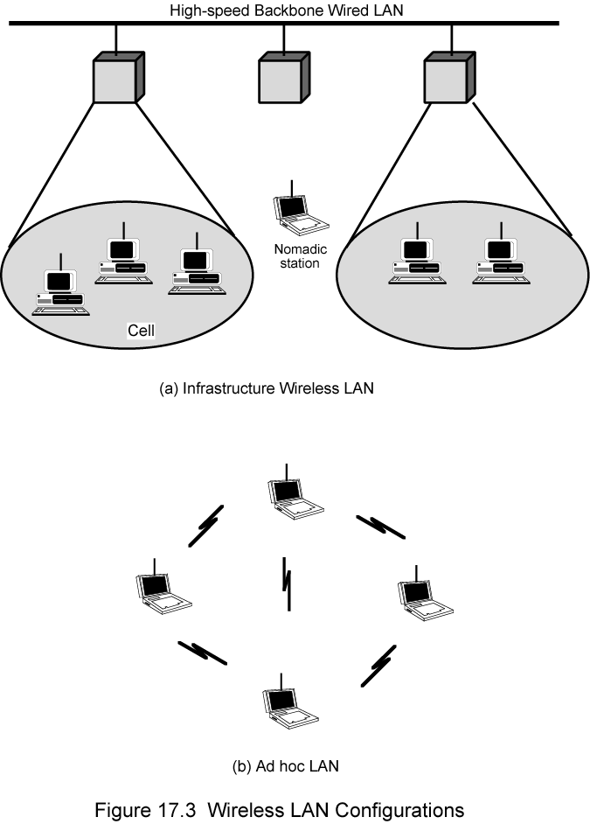
Infrastructure Wireless LAN

Slide 30
Ad Hoc Wireless LAN
Peer-to-peer network
Set up temporarily to meet some immediate need
E.g. group of employees, each with laptop or palmtop, in business or classroom meeting
Network for duration of meeting

Slide 31
IEEE 802.11 Wireless LAN
Stimulated by availability of unlicensed spectrum
  U.S. Industrial, Scientific, Medical (ISM) bands
  902-928 MHz, 2.400-2.4835 GHz, 5.725-5.850 GHz
Targeted wireless LANs @ 20 Mbps
MAC for high speed wireless LAN
Ad Hoc & Infrastructure networks
Variety of physical layers

Slide 32
802.11 Definitions
Basic Service Set (BSS)
  Group of stations that coordinate their access using a given instance of MAC
  Located in a Basic Service Area (BSA)
  Stations in BSS can communicate with each other
  Distinct collocated BSS’s can coexist
Extended Service Set (ESS)
  Multiple BSSs interconnected by Distribution System (DS)
  Each BSS is like a cell and stations in BSS communicate with an Access Point (AP)
  Portals attached to DS provide access to Internet

Slide 33
Distribution Services
Stations within BSS can communicate directly with each other
DS provides distribution services:
  Transfer MAC SDUs between APs in ESS
  Transfer MSDUs between portals & BSSs in ESS
  Transfer MSDUs between stations in same BSS
    Multicast, broadcast, or stations’s preference
ESS looks like single BSS to LLC layer

Slide 34
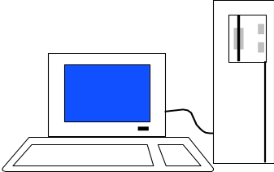

Infrastructure Network
Portal
Gateway to
the Internet
Server
Distribution System
Portal
AP1
AP2
A1
B1
A2
B2
BSS A
BSS B

Slide 35
Infrastructure Services
Select AP and establish association with AP
  Then can send/receive frames via AP & DS
Reassociation service to move from one AP to another AP
Dissociation service to terminate association
Authentication service to establish identity of other stations
Privacy service to keep contents secret

Slide 36
Medium Access in Wireless LANs
A unique feature in wireless LANs
  Not all stations are within range of one another, which means not all stations receive all transmissions
CSMA/CD cannot be used in wireless LANs
  Collision detection is not practical on a wireless network, as a transmitting station cannot effectively distinguish incoming weak signals from noise and the effects of its own transmission
  Hidden terminal problem
  Exposed terminal problem

Slide 37
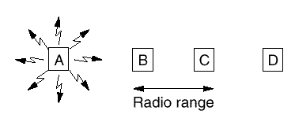
Hidden Terminal Problem
When A transmits to B and C also transmits to B simultaneously, the frames will be collided at B, as A and C can not hear each other

Slide 38
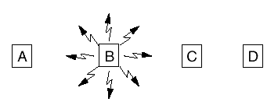
Exposed Terminal Problem
When C hears B’s transmission intended for A, it may falsely conclude that it cannot send to D now.
We need a new MAC protocol : CSMA-CA (Carrier Sensing Multiple Access with Collision Avoidance)

Slide 39
(a)
RTS
B
A requests to send
C
(b)
CTS
B
CTS
A
C
B announces A ok to send
(c)
B
Data Frame
A sends
C remains quiet
(d)
ACK
B
ACK
B sends ACK

Slide 40
IEEE 802.11 MAC
MAC sublayer responsibilities
  Channel access
  PDU addressing, formatting, error checking
  Fragmentation & reassembly of MAC SDUs
MAC security service options
  Authentication & privacy
MAC management services
  Roaming within ESS
  Power management

Slide 41
MAC Services
Contention Service: Best effort
Contention-Free Service: time-bounded transfer
MAC can alternate between Contention Periods (CPs) & Contention-Free Periods (CFPs)
MSDUs
MSDUs
Contention-free service
Contention service
Point coordination
function
Distribution coordination function
(CSMA-CA)
MAC
Physical

Slide 42
Distributed Coordination Function (DCF)
DIFS
Contention
window
PIFS
DIFS
SIFS
Busy medium
Next frame
Wait for
reattempt time
Time
Defer access
DCF provides basic access service
  Asynchronous best-effort data transfer
  All stations contend for access to medium
CSMA-CA
  Ready stations wait for completion of transmission
  All stations must wait Interframe Space (IFS)
  The length of IFS depends on the type of frames intended to send

Slide 43
Priorities through Interframe Spacing
DIFS
Contention
window
PIFS
DIFS
SIFS
Busy medium
Next frame
Wait for
reattempt time
Time
Defer access
High-Priority frames wait Short IFS (SIFS)
  Typically to complete exchange in progress
  ACKs, CTS, data frames of segmented MSDU, etc.
PCF IFS (PIFS) to initiate Contention-Free Periods
DCF IFS (DIFS) to transmit data & MPDUs

Slide 44
Contention & Backoff Behavior
If channel is still idle after DIFS period, ready station can transmit an initial MPDU
If channel becomes busy before DIFS, then station must schedule backoff time for reattempt
  Backoff period is integer # of idle contention time slots
  Waiting station monitors medium & decrements backoff timer each time an idle contention slot transpires
  Station can contend when backoff timer expires
A station that completes a frame transmission is not allowed to transmit immediately
  Must first perform a backoff procedure

Slide 45
Carrier Sensing in 802.11
Physical Carrier Sensing
  Analyze all detected frames
  Monitor relative signal strength from other sources
Virtual Carrier Sensing at MAC sublayer
  Source stations informs other stations of transmission time (in μsec) for an MPDU
  Carried in Duration field of RTS & CTS
  Stations adjust Network Allocation Vector to indicate when channel will become idle
Channel busy if either sensing is busy

Slide 46
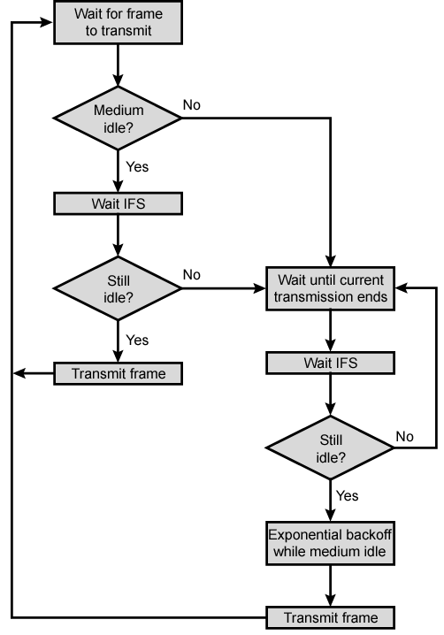
IEEE 802.11
Medium
Access
Control
Logic

Slide 47
Transmission of MPDU without RTS/CTS
DIFS
Data
Source
SIFS
ACK
Destination
DIFS
Other
NAV
Wait for Reattempt Time
Defer Access

Slide 48
Transmission of MPDU with RTS/CTS
DIFS
RTS
Data
Source
SIFS
SIFS
SIFS
CTS
Ack
Destination
DIFS
NAV (RTS)
Other
NAV (CTS)
NAV (Data)
Defer access

Slide 49
Collisions, Losses & Errors
Collision Avoidance
  When station senses channel busy, it waits until channel becomes idle for DIFS period & then begins random backoff time (in units of idle slots)
  Station transmits frame when backoff timer expires
  If collision occurs, recompute backoff over interval that is twice as long
Receiving stations of error-free frames send ACK
  Sending station interprets non-arrival of ACK as loss
  Executes backoff and then retransmits
  Receiving stations use sequence numbers to identify duplicate frames
  Stop and Wait ARQ with positive ACKs

Slide 50
Point Coordination Function
PCF provides connection-oriented, contention-free service through polling
Point coordinator (PC) in AP performs PCF
Polling table up to implementer
CFP repetition interval
  Determines frequency with which CFP occurs
  Initiated by beacon frame transmitted by PC in AP
  Contains CFP and CP
  During CFP stations may only transmit to respond to a poll from PC or to send ACK

Slide 51
PCF Frame Transfer
TBTT
Contention-free repetition interval
SIFS
SIFS
SIFS
SIFS
SIFS
Contention period
B
D1 + Poll
D2+Ack+Poll
CF End
U 1 + ACK
U 2 + ACK
PIFS
Reset NAV
NAV
CF_Max_duration
D1, D2 = frame sent by point coordinator
U1, U2 = frame sent by polled station
TBTT = target beacon transmission time
B = beacon frame

Slide 52
802.11 Frame Types
Management frames
  Station association & disassociation with AP
  Timing & synchronization
  Authentication & deauthentication
Control frames
  Handshaking
  ACKs during data transfer
Data frames
  Data transfer

Slide 53
Physical Layers
LLC PDU
LLC
MAC
layer
MAC
header
MAC SDU
CRC
Physical layer
convergence
procedure
Physical
layer
PLCP
preamble
PLCP
header
Physical medium
dependent
PLCP PDU
802.11 designed to
  Support LLC
  Operate over many physical layers

Slide 54
IEEE 802.11 Physical Layer Options
 | Frequency Band | Bit Rate | Modulation Scheme
802.11 | 2.4 GHz | 1-2 Mbps | Frequency-Hopping Spread Spectrum, Direct Sequence Spread Spectrum
802.11b | 2.4 GHz | 11 Mbps | Complementary Code Keying & QPSK
802.11g | 2.4 GHz | 54 Mbps | Orthogonal Frequency Division Multiplexing & CCK for backward compatibility with 802.11b
802.11a | 5-6 GHz | 54 Mbps | Orthogonal Frequency Division Multiplexing

Slide 55
Quiz #4
  For Aloha model, if there is 1 transmission attempt per 1 second in average, what is the average throughput? For Slotted-Aloha model, if there is 2 transmission attempt per 1 second in average, what is the average throughput?
  Assume 2 busy stations, and each may transmit with probability 0.5 in each contention time slot, how many time slots in average do the stations take to resolve the contention?
  For CDMA, user 1 transmits three information bits 101 with the code {-1, +1, -1, +1} user 2 transmits three information bit 111 with the code {+1, +1, +1, +1}. What is the combined signal of user 1 and user 2?

Slide 56
Note 7: Local Area Networks
LAN Bridges

Slide 57
Hubs, Bridges & Routers
Hub: Active central element in a star topology
  Twisted Pair: inexpensive, easy to insall
  Simple repeater in Ethernet LANs
  “Intelligent hub”: fault isolation, net configuration, statistics
  Requirements that arise:
User community grows, need to interconnect hubs
Hubs are for different types of LANs
?
Hub
Hub
Hub
Two Twisted
Pairs
Two Twisted
Pairs
Station
Station
Station
Station
Station
Station

Slide 58
Hubs, Bridges, Routers & Gateways
Interconnecting Hubs
  At the physical layer
    Repeater
  At the MAC or data link layer
    Bridges
  At the network layer
    Router
  At even higher layers
    Gateway
Higher
Scalability
?
Hub
Hub
Two Twisted
Pairs
Two Twisted
Pairs
Station
Station
Station
Station
Station
Station

Slide 59
General Bridge Issues
Network
Network
LLC
LLC
MAC
802.3
802.3
802.5
802.5
MAC
PHY
802.3
802.3
802.5
802.5
PHY
802.3
802.5
CSMA/CD
Token Ring
Operation at data link level implies capability to work with multiple network layers
However, must deal with
  Difference in MAC formats
  Difference in data rates; buffering; timers
  Difference in maximum frame length

Slide 60
Bridges of Same Type
Network
Network
LLC
Bridge
LLC
MAC
MAC
MAC
MAC
Physical
Physical
Physical
Physical
Common case involves LANs of same type
Bridging is done at MAC level

Slide 61
Transparent Bridges
Interconnection of IEEE LANs with complete transparency
Use table lookup, and
  discard frame, if source & destination in same LAN
  forward frame, if source & destination in different LAN
  use flooding, if destination unknown
Use backward learning to build table
  observe source address of arriving frames
  handle topology changes by removing old entries
S1
S2
S3
LAN1
Bridge
LAN2
S4
S5
S6

Slide 62
S1
S2
S3
S4
S5
LAN1
LAN2
LAN3
B1
B2
Port 1
Port 2
Port 1
Port 2
Address Port
Address Port

Slide 63
S1→S5
S1
S2
S3
S4
S5
S1 to S5
S1 to S5
S1 to S5
S1 to S5
LAN1
LAN2
LAN3
B1
B2
Port 1
Port 2
Port 1
Port 2
Address Port
Address Port
S1
1
S1
1

Slide 64
S3→S2
S1
S2
S3
S4
S5
S3→S2
S3→S2
S3→S2
S3→S2
S3→S2
LAN1
LAN2
LAN3
B1
B2
Port 1
Port 2
Port 1
Port 2
Address Port
Address Port
S1
1
S1
1
S3
2
S3
1

Slide 65
S4→S3
S1
S2
S3
S4
S5
S4 S3
S4→S3
S4→S3
LAN1
S4→S3
LAN2
LAN3
B1
B2
Port 1
Port 2
Port 1
Port 2
Address Port
Address Port
S1
1
S1
1
S3
2
S3
1
S4
2
S4
2

Slide 66
S2→S1
S1
S2
S3
S4
S5
S2→S1
LAN1
S2→S1
LAN2
LAN3
B1
B2
Port 1
Port 2
Port 1
Port 2
Address Port
Address Port
S1
1
S1
1
S3
2
S3
1
S4
2
S4
2
S2
1

Slide 67
Adaptive Learning
In a static network, tables eventually store all addresses & learning stops
In practice, stations are added & moved all the time
  Introduce timer (minutes) to age each entry & force it to be relearned periodically
  If frame arrives on port that differs from frame address & port in table, update immediately

Slide 68
Avoiding Loops
LAN1
(1)
(1)
B1
B2
(2)
B3
LAN2
B4
LAN3
B5
LAN4

Slide 69
Spanning Tree Algorithm
Select a root bridge among all the bridges.
  root bridge = the lowest bridge ID.
Determine the root port for each bridge except the root bridge
  root port = port with the least-cost path to the root bridge
Select a designated bridge for each LAN
  designated bridge = bridge has least-cost path from the LAN to the root bridge.
  designated port connects the LAN and the designated bridge
All root ports and all designated ports are placed into a “forwarding” state. These are the only ports that are allowed to forward frames. The other ports are placed into a “blocking” state.

Slide 70
LAN1
(1)
(1)
B1
B2
(1)
(2)
(2)
(3)
B3
LAN2
(1)
(2)
B4
(2)
LAN3
(1)
B5
(2)
LAN4

Slide 71
LAN1
(1)
(1)
Bridge 1 selected as root bridge
B1
B2
(1)
(2)
(2)
(3)
B3
LAN2
(1)
(2)
B4
(2)
LAN3
(1)
B5
(2)
LAN4

Slide 72
LAN1
(1)
R
(1)
Root port selected for every bridge except root bridge
B1
B2
R
(1)
(2)
(2)
(3)
B3
LAN2
R
(1)
(2)
B4
(2)
LAN3
R
(1)
B5
(2)
LAN4

Slide 73
LAN1
D
(1)
R
(1)
Select designated bridge for each LAN
B1
B2
R
(1)
D
(2)
(2)
(3)
B3
LAN2
R
(1)
(2)
D
D
B4
(2)
LAN3
R
(1)
B5
(2)
LAN4

Slide 74
LAN1
D
(1)
R
(1)
All root ports & designated ports put in forwarding state
B1
B2
R
(1)
D
(2)
(2)
(3)
B3
LAN2
R
(1)
(2)
D
D
B4
(2)
LAN3
R
(1)
B5
(2)
LAN4

Slide 75
Source Routing Bridges
To interconnect IEEE 802.5 token rings
Each source station determines route to destination
Routing information inserted in frame
Routing
Route 1
Route 2
Route m
control
designator
designator
designator
2 bytes
2 bytes
2 bytes
2 bytes
Destination
Source
Routing
Data
FCS
address
address
information

Slide 76
Route Discovery
To discover route to a destination each station broadcasts a single-route broadcast frame
Frame visits every LAN once & eventually reaches destination
Destination sends all-routes broadcast frame which generates all routes back to source
Source collects routes & picks best

Slide 77
Detailed Route Discovery
Bridges must be configured to form a spanning tree
Source sends single-route frame without route designator field
Bridges in first LAN add incoming LAN #, its bridge #, outgoing LAN # into frame & forwards frame
Each subsequent bridge attaches its bridge # and outgoing LAN #
Eventually, one single-route frame arrives at destination
When destination receives single-route broadcast frame it responds with all-routes broadcast frame with no route designator field
Bridge at first hop inserts incoming LAN #, its bridge #, and outgoing LAN # and forwards to outgoing LAN
Subsequent bridges insert their bridge # and outgoing LAN # and forward
Before forwarding bridge checks to see if outgoing LAN already in designator field
Source eventually receives all routes to destination station

Slide 78
Find routes from S1 to S3
LAN 2
B4
LAN 4
S1
B1
S2
LAN 1
B5
B3
B7
B2
S3
LAN 3
B6
LAN 5
B3
LAN3
B6
LAN5
LAN1
B1
LAN2
B4
LAN4

Slide 79
LAN 2
B4
LAN 4
S1
B1
S2
LAN 1
B3
B5
B7
B2
S3
LAN 3
B6
LAN 5
B3
B2
LAN1
B1
LAN2
B5
B4
LAN4
B7
B6
LAN3
B1
LAN1
B2
B3
LAN2
B5
B4
LAN4
B7
B4
LAN2
B1
LAN1
B2
B5
LAN4
B3
LAN5
B7
B3
B1
LAN1
B2
LAN3
B5
B4
LAN2
B6
B2
LAN1
B1
B7
LAN4
B3
LAN3
B5
B6
B3
B2
LAN1
B1
LAN2
B4
B5
LAN3
B3
LAN2
B1
LAN1
B2
B6
B4

Slide 80
Virtual LAN
VLAN 1
VLAN 2
VLAN 3
S3
S6
S9
Floor n + 1
Physical
partition
S2
S5
S8
Floor n
1
2
3
4
5
6
Bridge
or
switch
7
S1
S4
S7
8
9
Floor n – 1
Logical partition

Slide 81
Per-Port VLANs
VLAN 1
VLAN 2
VLAN 3
S3
S6
S9
Floor n + 1
S2
S5
S8
Floor n
1
2
3
4
5
6
Bridge
or
switch
7
S1
S4
S7
8
9
Floor n – 1
Logical partition
Bridge only forwards frames to outgoing ports associated with same VLAN

Slide 82
Tagged VLANs
More flexible than Port-based VLANs
Insert VLAN tag after source MAC address in each frame
  VLAN protocol ID + tag
VLAN-aware bridge forwards frames to outgoing ports according to VLAN ID
VLAN ID can be associated with a port statically through configuration or dynamically through bridge learning
IEEE 802.1q

