Slide 1
ECE 683
Computer Network Design & Analysis
Note 9: Routing in the Internet
(Chap. 8 except 8.4 & 8.5)

Slide 2
TCP/IP Protocol Suite
Application
Application
TCP
UDP
ICMP
IP
ARP
RARP
Network
interface

Slide 3
IP in TCP/IP Suite
IP: Internet Protocol
Provides a connectionless and best-effort service to transport layer
IPv4 is commonly used, IPv6 has been standardized
Packet is the PDU in IP layer
  20 bytes header
  Variable payload

Slide 4
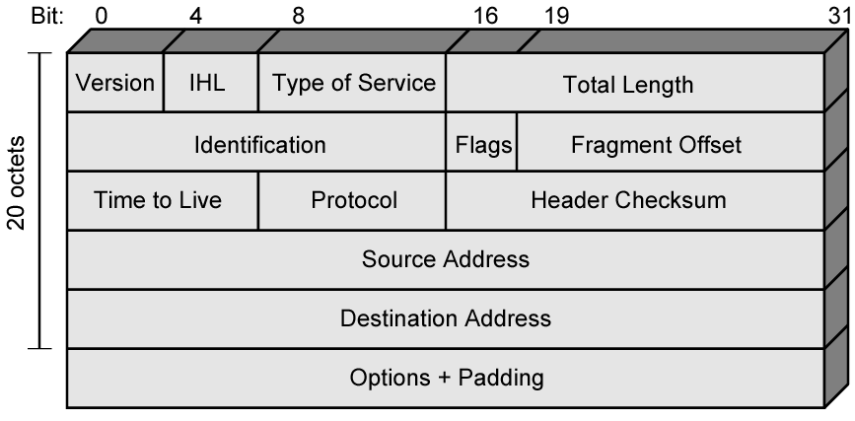
IPv4 Header

Slide 5
Packet Header
Various fields
  Version: current is 4, future is 6
  Internet Header Length (IHL): 32-bit unit
  ToS: specifies the priority
  Total length: length of the total packet in bytes
    Max: 64 KB. In Ethernet, the max size is 1500 B
  Identification, flags and fragment offset: fragmentation/assembly
  TTL: time-to-live
  Protocol: TCP, UDP, or ICMP
  Header checksum: protect the header part, crucial data

Slide 6
Packet Header
Various fields (cont)
  Address: IP address for source and destination
  Options: for special features such as security level, route to be taken (source routing), time-stamp etc
  Padding: adding zeros to make the packet as a multiple of 32 bits

Slide 7
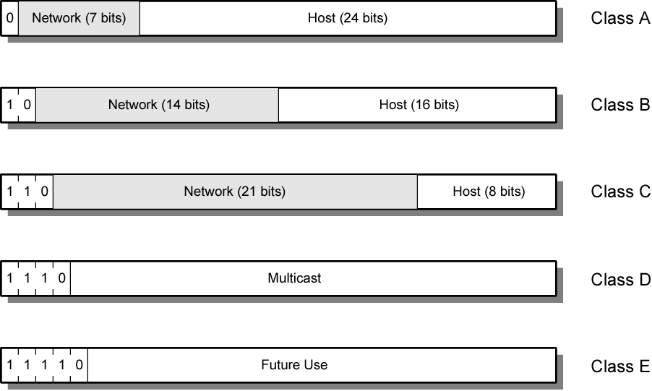
IPv4 Address Formats

Slide 8
IP Addresses - Class A
32 bit global internet address
Network part and host part
Class A
  Start with binary 0
  All 0 reserved
  01111111 (127) reserved for loopback
  Range 1.x.x.x to 126.x.x.x
  All allocated

Slide 9
IP Addresses - Class B
Start 10
Range 128.x.x.x to 191.x.x.x
Second Octet also included in network address
2¹⁴ = 16,384 class B addresses
All allocated

Slide 10
IP Addresses - Class C
Start 110
Range 192.x.x.x to 223.x.x.x
Second and third octet also part of network address
2²¹ = 2,097,152 addresses
Nearly all allocated
  See IPv6

Slide 11
Subnets and Subnet Masks
Allow arbitrary complexity of internetworked LANs within organization
Insulate overall internet from growth of network numbers and routing complexity
Site looks to rest of internet like single network
Each LAN assigned subnet number
Host portion of address partitioned into subnet number and host number
Local routers route within subnetted network
Subnet mask indicates which bits are subnet number and which are host number

Slide 12
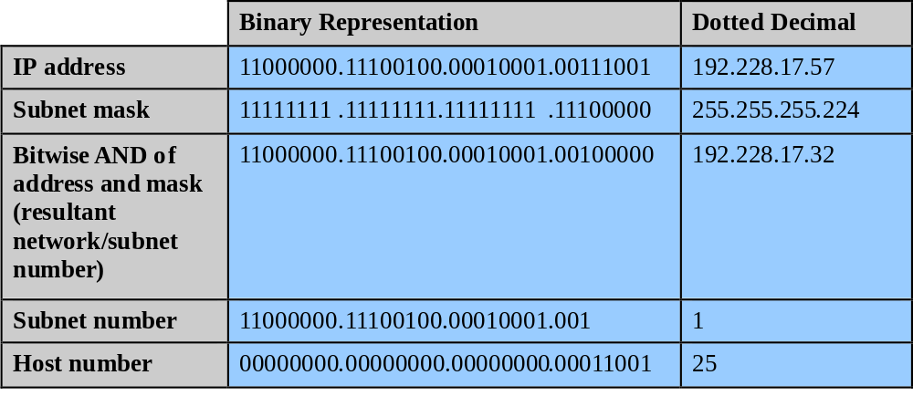
Subnet Mask Calculation

Slide 13
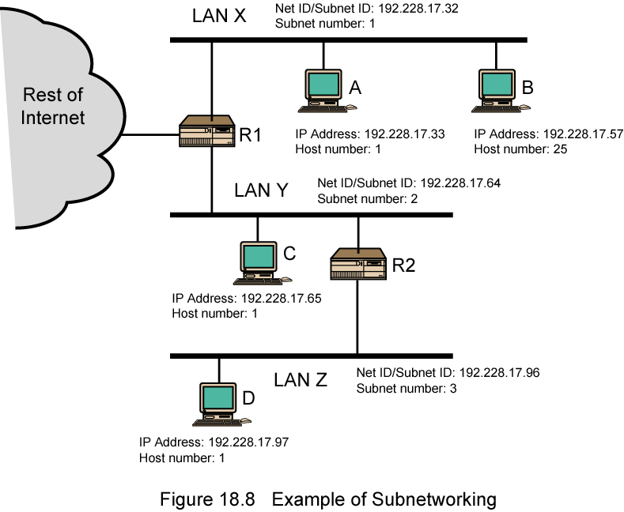
Routing Using Subnets

Slide 14
Address Resolution Protocol
Although IP address identifies a host, the packet is physically delivered by an underlying network (e.g., Ethernet) which uses its own physical address (MAC address in Ethernet). How to map an IP address to a physical address?
H1 wants to learn physical address of H3 -> broadcasts an ARP request
H1
H2
H3
H4
150.100.76.20
150.100.76.21
150.100.76.22
150.100.76.23
ARP request (what is the MAC address of 150.100.76.22?)
Every host receives the request, but only H3 reply with its physical address
H1
H2
H3
H4
ARP response (my MAC address is 08:00:5a:3b:94)

Slide 15
Internet Control Message Protocol (ICMP)
RFC 792; Encapsulated in IP packet (protocl type = 1)
Handles error and control messages
If router cannot deliver or forward a packet, it sends an ICMP “host unreachable” message to the source
If router receives packet that should have been sent to another router, it sends an ICMP “redirect” message to the sender; Sender modifies its routing table
ICMP “router discovery” messages allow host to learn about routers in its network and to initialize and update its routing tables
ICMP echo request and reply facilitate diagnostic and used in “ping”

Slide 16
IP v6 - Version Number
IP v 1-3 defined and replaced
IP v4 - current version
IP v5 - streams protocol
IP v6 - replacement for IP v4
  During development it was called IPng
  Next Generation

Slide 17
Why Change IP?
Reasons for inadequacy of 32-bit addresses
  Two-level addressing (network #+host #) wastes address space
  Network addresses needed even if not connected to Internet
  Explosive growth of networks and the Internet
  Extended use of TCP/IP usage into new areas results in rapidly growing demand for unique IP addresses
  Requirements for multiple IP addresses per host
Requirements for a new type of IP

Slide 18
IPv6 RFCs
1752 - Recommendations for the IP Next Generation Protocol
2460 - Overall specification
2373 - addressing structure
others (find them)
www.rfc-editor.org

Slide 19
Migration from IPv4 to IPv6
Gradual transition from IPv4 to IPv6
Dual IP stacks: routers run IPv4 & IPv6
  Type field used to direct packet to IP version
IPv6 islands can tunnel across IPv4 networks
  Encapsulate user packet insider IPv4 packet
  Tunnel endpoint at source host, intermediate router, or destination host
  Tunneling can be recursive

Slide 20
Migration from IPv4 to IPv6
Source
Tunnel head-end
Tunnel tail-end
Destination
Tunnel
(a)
IPv6 header
IPv6 network
IPv4 header
IPv6 network
IPv4 network
Source
Destination
Link
(b)
IPv6 network
IPv6 network

Slide 21
Internet Routing Protocols
Interior Routing: Inside AS (Autonomous System) or a domain sharing routing information
  RIP: based on DVR (outdated)
  OSPF: THE protocol
Exterior routing
  BGP: Border Gateway Protocol
    Internal, External
Internet Group Management Protocol (IGMP)

Slide 22
Autonomous Systems
Global Internet viewed as collection of autonomous systems.
Autonomous system (AS) is a set of routers or networks administered by a single organization
Same routing protocol need not be run within the AS
But, to the outside world, an AS should present a consistent picture of what ASs are reachable through it
Stub AS: has only a single connection to the outside world.
Multihomed AS: has multiple connections to the outside world, but refuses to carry transit traffic
Transit AS: has multiple connections to the outside world, and can carry transit and local traffic.

Slide 23
Peering and Inter-AS connectivity
Peering Centre
Tier 1 ISP (Transit AS)
Tier 1 ISP (Transit AS)
AS
Tier 2 (transit AS)
Tier 2 (transit AS)
Content or Application Service Provider (Non-transit)
Tier 2 (transit AS)
AS
AS
AS
AS
AS
AS
Non-transit AS’s (stub & multihomed) do not carry transit traffic
Tier 1 ISPs peer with each other, privately & peering centers
Tier 2 ISPs peer with each other & obtain transit services from Tier 1s; Tier 1’s carry transit traffic between their Tier 2 customers
Client AS’s obtain service from Tier 2 ISPs

Slide 24
AS Number
For exterior routing, an AS needs a globally unique AS 16-bit integer number
Currently, there are about 11,000 registered ASs in Internet (and growing)
Stub AS, which is the most common type, does not need an AS number since the prefixes are placed at the provider’s routing table
Transit AS needs an AS number
Request an AS number from the ARIN, RIPE and APNIC

Slide 25
Inter and Intra Domain Routing
Interior Gateway Protocol (IGP): routing within AS
  RIP, OSPF
Exterior Gateway Protocol (EGP): routing between AS’s
  BGPv4
Border Gateways perform IGP & EGP routing
IGP
R
EGP
IGP
R
R
R
R
R
AS A
AS C
R
R
IGP
AS B

Slide 26
Routing Information Protocol (RIP)
RFC 1058
RIP based on routed, “route d”, distributed in BSD UNIX
Uses the distance-vector algorithm
Runs on top of UDP, port number 520
Metric: number of hops
Max limited to 15
  suitable for small networks (local area environments)
  value of 16 is reserved to represent infinity
  small number limits the count-to-infinity problem

Slide 27
Open Shortest Path First
RFC 2328 (v2)
Fixes some of the deficiencies in RIP
Enables each router to learn complete network topology
Each router monitors the link state to each neighbor and floods the link-state information to other routers
Each router builds an identical link-state database
Allows router to build shortest path tree with router as root
OSPF typically converges faster than RIP when there is a failure in the network

Slide 28
Exterior Gateway Protocols
Within each AS, there is a consistent set of routes connecting the constituent networks
The Internet is woven into a coherent whole by Exterior Gateway Protocols (EGPs) that operate between AS’s
EGP enables two AS’s to exchange routing information about:
  The networks that are contained within each AS
  The AS’s that can be reached through each AS
EGP path selection guided by policy rather than path optimality
  Trust, peering arrangements, etc

Slide 29
EGP Example
Only EGP routers are shown
R2
R3
N1 reachable through AS3
AS2
R1
R4
N1
AS1
AS3
R4 advertises that network N1 can be reached through AS3
R3 examines announcement & applies policy to decide whether it will forward packets to N1 through R4
If yes, routing table updated in R3 to indicate R4 as next hop to N1

Slide 30
EGP Example
R2
R3
N1 reachable through AS2
AS2
R1
R4
N1
AS1
AS3
EGP routers within an AS, e.g. R3 and R2, are kept consistent
Suppose AS2 willing to handle transit packets from AS1 to N1
R2 advertises to AS1 the reachability of N1 through AS2
R1 applies its policy to decide whether to send to N1 via AS2

Slide 31
EGP Requirements
Scalability to global Internet
  Provide connectivity at global scale
  Link-state does not scale
  Should promote address aggregation
  Fully distributed
EGP path selection guided by policy rather than path optimality
  Trust, peering arrangements, etc
  EGP should allow flexibility in choice of paths

Slide 32
Border Gateway Protocol v4
AS2
AS1
AS6
AS3
AS5
AS4
AS7
BGP (RFC 1771) an EGP routing protocol to exchange network reachability information among BGP routers (also called BGP speakers)
Network reachability info contains sequence of ASs that packets traverse to reach a destination network
Info exchanged between BGP speakers allows a router to construct a graph of AS connectivity
  Routing loops can be pruned
  Routing policy at AS level can be applied

Slide 33
BGP Features
BGP is path vector protocol: advertises sequence of AS numbers to the destination network
Path vector info used to prevent routing loops
BGP enforces policy through selection of different paths to a destination and by control of redistribution of routing information
Uses CIDR to support aggregation & reduction of routing information

Slide 34
BGP Policy
Examples of policy:
  Never use AS X
  Never use AS X to get to a destination in AS Y
  Never use AS X and AS Y in the same path
Import policies to accept, deny, or set preferences on route advertisements from neighbors
Export policies to determine which routes should be advertised to which neighbors
  A route is advertised only if AS is willing to carry traffic on that route

Slide 35
Multicasting
G1
G1
1
2
3
7
2
4
2
3
4
1
2
1
5
2
5
3
3
G1
2
4
1
8
S
1
1
3
4
G1
5
4
2
2
4
1
2
3
6
3
1
1
3
4
G2
3
G3
G3
Source S sends packets to multicast group G1

Slide 36
Multicast Routing
Multicast routing useful when a source wants to transmits its packets to several destinations simultaneously
Relying on unicast routing by transmitting each copy of packet separately works, but can be very inefficient if number of destination is large
Typical applications is multi-party conferencing over the Internet
Example: Multicast Backbone (MBONE) uses reverse path multicasting

Slide 37
Reverse-Path Broadcasting (RPB)
Fact: Set of shortest paths to the source node S forms a tree that spans the network
  Approach: Follow paths in reverse direction
Assume each router knows current shortest path to S
  Upon receipt of a multicast packet, router records the packet’s source address and the port it arrives on
  If shortest path to source is through same port (“parent port”), router forwards the packet to all other ports
  Else, drops the packet
Loops are suppressed; each packet forwarded a router exactly once
Implicitly assume shortest path to source S is same as shortest path from source
  If paths asymmetric, need to use link state info to compute shortest paths from S

Slide 38
Example: Shortest Paths from S
G1
G1
1
2
3
7
2
4
2
3
4
1
2
1
5
5
2
3
3
G1
2
4
8
1
S
1
1
3
4
G1
5
4
2
2
4
1
2
3
6
3
1
1
3
4
G2
3
G3
G3
Spanning tree of shortest paths to node S and parent ports are shown in brown

Slide 39
Example: S sends a packet
G1
✓
G1
1
2
3
7
2
4
2
3
4
1
2
1
5
5
2
3
3
G1
2
4
8
1
S
1
1
3
4
G1
5
4
2
2
4
1
2
3
6
3
1
1
3
4
G2
3
G3
G3
S sends a packet to node 1
Node 1 forwards to all ports, except parent port

Slide 40
Example: Hop 1 nodes broadcast
G1
✓
G1
✓
1
2
3
7
2
4
2
3
4
1
2
1
5
5
2
✓
3
3
G1
2
4
8
1
S
1
1
4
G1
✓
3
5
4
2
2
4
1
2
3
6
3
1
1
3
4
G2
3
G3
G3
Nodes 2, 3, 4, and 5 broadcast, except on parent ports
All nodes, not only G1, receive packets

Slide 41
Example: Broadcast continues
G1
G1
1
2
3
7
2
4
2
3
4
1
2
1
5
5
2
3
3
G1
2
4
8
1
S
1
1
3
4
G1
5
4
2
2
4
1
2
3
6
3
1
1
3
4
G2
3
G3
G3
Truncated RPB (TRPB): Leaf routers do not broadcast if none of its attached hosts belong to packet’s multicast group

Slide 42
Internet Group Management Protocol (IGMP)
Internet Group Management Protocol:
  Host can join a multicast group by sending an IGMP message to its router
Each multicast router periodically sends an IGMP query message to check whether there are hosts belonging to multicast groups
  Hosts respond with list of multicast groups they belong to
  Hosts randomize response time; cancel response if other hosts reply with same membership
Routers determine which multicast groups are associated with a certain port
Routers only forward packets on ports that have hosts belonging to the multicast group

Slide 43
Reverse-Path Multicasting (RPM)
Reverse Path Multicasting (RPM) relies on IGMP to identify multicast group membership
The first packet to a given (source, group), i.e. (S,G) is transmitted to all leaf routers using TRPB
Each leaf router that has no hosts that belong to this group on any of its ports, sends a prune message to its upstream router to stop sending packets to (S, G)
Upstream routers that receive prune messages from all their downstream routers, send prune messages upstream
Prune entries in each router have finite lifetime
If a host requests to join a group, routers can cancel previous pruning with a graft message

Slide 44
Example: Pruning for G1
G1
G1
1
2
3
7
2
4
2
3
4
1
2
1
5
5
2
3
3
G1
2
4
8
1
S
1
1
3
4
G1
5
4
2
2
4
1
2
3
6
3
1
1
3
4
G2
3
G3
G3
Routers 3, 4, and 6 send prune messages upstream

Slide 45
Example: RPM Multicast Tree
G1
G1
1
2
3
7
2
4
2
3
4
1
2
1
5
5
2
3
3
G1
2
4
8
1
S
1
1
3
4
G1
5
4
2
2
4
1
2
3
6
3
1
1
3
4
G2
3
G3
G3
RPM multicast tree after pruning

Slide 46
Example: Graft from Router 6
G1
G1
1
2
3
7
2
4
2
3
4
1
2
1
5
5
2
3
3
G1
2
4
8
1
S
1
1
3
4
G1
5
4
Graft
2
2
4
1
2
3
6
3
1
1
3
4
G1
3
G3
G3
Graft message flows upstream to router 1

Slide 47
Example: RPM Tree after Graft
G1
G1
1
2
3
7
2
4
2
3
4
1
2
1
5
5
2
3
3
G1
2
4
8
1
S
1
1
3
4
G1
5
4
2
2
4
1
2
3
6
3
1
1
3
4
G1
3
G3
G3

Slide 48
DVMRP
Distance Vector Multicast Routing Protocol
  Uses variation of RIP to determine next hop towards the source
  Uses RPM and pruning to obtain multicast tree
  Uses tunneling to traverse non-multicast networks
Used in MBONE
Not scalable
  15 hop limit
  Flooding all leaf routers inefficient

Slide 49
DHCP
Dynamic Host Configuration Protocol (RFC 2131)
BOOTP (RFC 951, 1542) allows a diskless workstation to be remotely booted up in a network
  UDP port 67 (server) & port 68 (client)
DHCP builds on BOOTP to allow servers to deliver configuration information to a host
  Used extensively to assign temporary IP addresses to hosts
  Allows ISP to maximize usage of their limited IP addresses

Slide 50
DHCP Operation
Host broadcasts DHCP Discover message on its physical network
Server replies with Offer message (IP address + configuration information)
Host selects one offer and broadcasts DHCP Request message
Server allocates IP address for lease time T
  Sends DHCP ACK message with T, and threshold times T1 (=1/2 T) and T2 (=.875T)
At T1, host attempts to renew lease by sending DHCP Request message to original server
If no reply by T2, host broadcasts DHCP Request to any server
If no reply by T, host must relinquich IP address and start from the beginning

Slide 51
Network Address Translation (NAT)
Class A, B, and C addresses have been set aside for use within private internets
  Packets with private (“unregistered”) addresses are discarded by routers in the global Internet
NAT (RFC 1631): method for mapping packets from hosts in private internets into packets that can traverse the Internet
  A device (computer, router, firewall) acts as an agent between a private network and a public network
  A number of hosts can share a limited number of registered IP addresses
    Static/Dynamic NAT: map unregistered addresses to registered addresses
    Overloading: maps multiple unregistered addresses into a single registered address (e.g. Home LAN)

Slide 52




NAT Operation (Overloading)
Address Translation Table: 192.168.0.10; x 128.100.10.15; y
192.168.0.13; w 128.100.10.15; z
192.168.0.10;x
128.100.10.15;y
Private Network
NAT Device
Public Network
192.168.0.13;w
128.100.10.15; z
Hosts inside private networks generate packets with private IP address & TCP/UDP port #s
NAT maps each private IP address & port # into shared global IP address & available port #
Translation table allows packets to be routed unambiguously

Slide 53
Mobile IP
Proliferation of mobile devices: PDAs, laptops, cellphones, …
As user moves, point-of-attachment to network necessarily changes
Problem: IP address specifies point-of-attachment to Internet
  Changing IP address involves terminating all connections & sessions
Mobile IP (RFC 2002): device can change point-of-attachment while retaining IP address and maintaining communications

Slide 54
Routing in Mobile IP
Foreign
network
Mobile
Home
host #1
Foreign
network
agent
Mobile
host #2
Care-Of-Address
Home
agent
Internet
Home Agent (HA) keeps track of location of each Mobile Host (MH) in its network; HA periodically announces its presence
If an MH is in home network, e.g. MH#1, HA forwards packets directly to MH
When an MH moves to a Foreign network, e.g. MH#2, MH obtains a care-of-address from foreign agent (FA) and registers this new address with its HA

Slide 55
Routing in Mobile IP
Foreign
network
Home
Foreign
network
agent
Mobile
host
2
Home
agent
Internet
3
1
Correspondent
host
Correspondent Host (CH) sends packets as usual (1)
Packets are intercepted by HA which then forwards to Foreign Agent (FA) (2)
FA forwards packets to the MH
MH sends packet to CH as usual (3)
How does HA send packets to MH in foreign network?

Slide 56
IP-to-IP Encapsulation
Outer IP header
IP header
IP header
IP payload
IP payload
HA uses IP-to-IP encapsulation
IP packet has MH IP address
Outer IP header has HA’s address as source address and care-of-address as destination address
FA recovers IP packet and delivers to MH

Slide 57
Route Optimization
Foreign
network
Home
Foreign
network
agent
Mobile
host
2a
Home
agent
Internet
3
4
1
2b
Correspondent
host
Going to HA inefficient if CH and MH are in same foreign network
When HA receives pkt from CH (1), it tunnels using care-of-address (2a); HA also sends care-of-address to CH (2b)
CH can then send packets directly to care-of-address (4)

Slide 58
Quiz #5
1. One station transmits information to another station without noticing the potential collision. Is this hidden terminal or exposed terminal problem? How to resolve it?
2. What is the difference between Point Coordination Function (PCF) and Distributed Coordination Function (DCF) in CSMA/CA? If the load of the wireless network is high, which one cause higher access delay and why?
3. In the figure below, if the source transmits 1 Kbit message to the destination through a wireless channel with bit error rate (BER)=p=10⁻³ , how many number of bits does the source need to transmit on average in order to deliver the message to the destination? If the message is separated into 10 packets, how many number of bits does the source need to transmit on average in order to deliver the message to the destination?
1 Kbit
message
source
dest
BER=p=10⁻³

Slide 59
Further Reading
8.1, 8.2, 8.3, 8.6, 8.7, 8.8

