Slide 1
ECE 683
Computer Network Design & Analysis
Note 2: Applications and Layered Architectures

Slide 2
Outline
Protocols, Services & Layering
OSI Reference Model
TCP/IP Model
How the Layers Work Together
Application Layer Protocols & Utilities
Sockets

Slide 3
Layers, Services & Protocols
The overall communication process between two or more machines connected across one or more networks is very complex
Layering partitions related communication functions into groups that are manageable
Each layer provides a service to the layer above
Each layer operates according to a protocol
A protocol is a set of rules that govern how two or more communicating parties are to interact

Slide 4
Why Layering?
Layering simplifies design, implementation, and testing by partitioning overall communication process into parts
Protocols in each layer can be designed separately from those in other layers and make “calls” for services from layer below
Layering provides flexibility for modifying and evolving protocols and services without having to change layers below and above
Monolithic non-layered architectures are costly, inflexible, and soon obsolete

Slide 5
Web Browsing Application
World Wide Web allows users to access resources (i.e. documents) located in computers connected to the Internet
Documents are prepared using HyperText Markup Language (HTML)
A browser application program is used to access the web
The browser displays HTML documents that include links to other documents
Each link references a Uniform Resource Locator (URL) that gives the name of the machine and the location of the given document
Let’s see what happens when a user clicks on a link

Slide 6



1. DNS
A. 64.15.247.200
Q. www.nytimes.com?
User clicks on http://www.nytimes.com/
URL contains Internet name of machine (www.nytimes.com), but not Internet address
Internet needs Internet address to send information to a machine
Browser software uses Domain Name System (DNS) protocol to send query for Internet address
DNS system responds with Internet address

Slide 7
2. TCP
ACK
ACK, TCP Connection Request
From: 64.15.247.200 Port 80 To:128.100.11.13 Port 1127
TCP Connection Request
From: 128.100.11.13 Port 1127
To: 64.15.247.200 Port 80
Browser software uses HyperText Transfer Protocol (HTTP) to send request for document
HTTP server waits for requests by listening to a well-known port number (80 for HTTP)
HTTP client sends request messages through an “ephemeral port number,” e.g. 1127
HTTP needs a Transmission Control Protocol (TCP) connection between the HTTP client and the HTTP server to transfer messages reliably

Slide 8
3. HTTP
Content
200 OK
GET / HTTP/1.1
HTTP client sends its request message: “GET …”
HTTP server sends a status response: “200 OK”
HTTP server sends requested file
Browser displays document
Clicking a link sets off a chain of events across the Internet!
Let’s see how protocols & layers come into play…

Slide 9
Example: HTTP
HTTP is an application layer protocol
Retrieves documents on behalf of a browser application program
HTTP specifies fields in request messages and response messages
  Request types; Response codes
  Content type, options, cookies, …
HTTP specifies actions to be taken upon receipt of certain messages

Slide 10
HTTP Protocol
GET
HTTP
Client
HTTP
Server
Response
HTTP assumes messages can be exchanged directly between HTTP client and HTTP server
In fact, HTTP client and server are processes running in two different machines across the Internet
HTTP uses the reliable stream transfer service provided by TCP

Slide 11
Example: TCP
TCP is a transport layer protocol
Provides reliable byte stream service between two processes in two computers across the Internet
Sequence numbers keep track of the bytes that have been transmitted and received
Error detection and retransmission used to recover from transmission errors and losses
TCP is connection-oriented: the sender and receiver must first establish an association and set initial sequence numbers before data is transferred
Connection ID is specified uniquely by
(send port #, send IP address, receive port #, receiver IP address)

Slide 12
HTTP uses service of TCP
HTTP
server
HTTP
client
Response
GET
Port 1127
Port 80
TCP
TCP
GET
GET
Response
bytes
TCP
80, 1127
1127, 80
Response

Slide 13
Example: DNS Protocol
DNS protocol is an application layer protocol
DNS is a distributed database that resides in multiple machines in the Internet
DNS protocol allows queries of different types
  Name-to-address or Address-to-name
  Mail exchange
DNS usually involves short messages and so uses service provided by UDP
Well-known port 53

Slide 14
Local
Name
Server
Authoritative
Name
Server
1
5
4
2
3
6
Root
Name
Server
Local Name Server: resolve frequently-used names
  University department, ISP
  Contacts Root Name server if it cannot resolve query
Root Name Servers: 13 globally
  Resolves query or refers query to Authoritative Name Server
Authoritative Name Server: last resort
  Every machine must register its address with at least two authoritative name servers

Slide 15
Example: UDP
UDP is a transport layer protocol
Provides best-effort datagram service between two processes in two computers across the Internet
Port numbers distinguish various processes in the same machine
UDP is connectionless
Datagram is sent immediately
Quick, simple, but not reliable

Slide 16
Summary
Layers: related communication functions
  Application Layer: HTTP, DNS
  Transport Layer: TCP, UDP
  Network Layer: IP
Services: a protocol provides a communication service to the layer above
  TCP provides connection-oriented reliable byte transfer service
  UDP provides best-effort datagram service
Each layer builds on services of lower layers
  HTTP builds on top of TCP
  DNS builds on top of UDP
  TCP and UDP build on top of IP

Slide 17
Note 2: Applications and Layered Architectures
OSI Reference Model

Slide 18
Open Systems Interconnection
Network architecture:
  Definition of all the layers
  Design of protocols for every layer
By the 1970s every computer vendor had developed its own proprietary layered network architecture
Problem: computers from different vendors could not be networked together
Open Systems Interconnection (OSI) was an international effort by the International Organization for Standardization (ISO) to enable multivendor computer interconnection

Slide 19
OSI Reference Model
Describes a seven-layer abstract reference model for a network architecture
Purpose of the reference model was to provide a framework for the development of protocols
OSI also provided a unified view of layers, protocols, and services which is still in use in the development of new protocols
Detailed standards were developed for each layer, but most of these are not in use
TCP/IP protocols preempted deployment of OSI protocols

Slide 20
7-Layer OSI Reference Model
Application
Application
End-to-End Protocols
Application
Layer
Application
Layer
Presentation
Layer
Presentation
Layer
Session
Layer
Session
Layer
Transport
Layer
Transport
Layer
Network
Layer
Network
Layer
Network
Layer
Network
Layer
Data Link
Layer
Data Link
Layer
Data Link
Layer
Data Link
Layer
Physical
Layer
Physical
Layer
Physical
Layer
Physical
Layer
Communicating End Systems
One or More Network Nodes

Slide 21


Physical Layer
Transfers bits across link
Definition & specification of the physical aspects of a communications link
  Mechanical: cable, plugs, pins...
  Electrical/optical: modulation, signal strength, voltage levels, bit times, …
  functional/procedural: how to activate, maintain, and deactivate physical links…
Ethernet, DSL, cable modem, telephone modems…
Twisted-pair cable, coaxial cable optical fiber, radio, infrared, …

Slide 22
Data Link Layer
Transfers frames across direct connections
Groups bits into frames
Detection of bit errors; Retransmission of frames
Activation, maintenance, & deactivation of data link connections
Medium access control for local area networks
Flow control
frames
Data Link
Layer
Data Link
Layer
Physical
Layer
bits
Physical
Layer

Slide 23
Network Layer
Transfers packets across multiple links and/or multiple networks
Addressing must scale to large networks
Nodes jointly execute routing algorithm to determine paths across the network
Congestion control to deal with traffic surges
Connection setup, maintenance, and teardown when connection-based

Slide 24
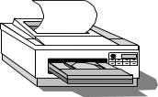

Internetworking
Ethernet LAN
Internetworking is part of network layer and provides transfer of packets across multiple possibly dissimilar networks
Gateways (routers) direct packets across networks
●     
ATM
Network
ATM
Switch
ATM
Switch
ATM
Switch
H
ATM
Switch
H
Net 3
Net 3
Net 1
G
Net 1
G
G
G
Net 5
Net 5
H
Net 2
G
Net 4
G
Net 2
H
G = gateway H = host

Slide 25
Transport Layer
Transfers data end-to-end from process in a machine to process in another machine
Reliable stream transfer or quick-and-simple single-block transfer
Port numbers enable multiplexing
Message segmentation and reassembly
Connection setup, maintenance, and release
Transport
Layer
Transport
Layer
Network
Layer
Network
Layer
Network
Layer
Network
Layer
Communication Network

Slide 26
Application & Upper Layers
Application Layer: Provides services that are frequently required by applications: DNS, web access, file transfer, email…
Presentation Layer: machine-independent representation of data…
Session Layer: dialog management, recovery from errors, …
Application
Application
Application
Layer
Application
Layer
Presentation
Layer
Transport
Layer
Session
Layer
Transport
Layer
Incorporated into Application Layer

Slide 27
Headers & Trailers
Each protocol uses a header that carries addresses, sequence numbers, flag bits, length indicators, etc…
CRC check bits may be appended for error detection
Application
APP DATA
Application
Application
Layer
AH
APP DATA
Application
Layer
Transport
Layer
Transport
Layer
TH
AH
APP DATA
Network
Layer
NH
TH
AH
APP DATA
Network
Layer
Data Link
Layer
Data Link
Layer
DH
NH
TH
AH
APP DATA
CRC
Physical
Layer
bits
Physical
Layer

Slide 28
OSI Unified View: Protocols
Layer n in one machine interacts with layer n in another machine to provide a service to layer n +1
The entities comprising the corresponding layers on different machines are called peer processes.
The machines use a set of rules and conventions called the layer-n protocol.
Layer-n peer processes communicate by exchanging Protocol Data Units (PDUs)
n-PDUs
n
Entity
n
Entity
Layer n peer protocol

Slide 29
OSI Unified View: Services
Communication between peer processes is virtual and actually indirect
Layer n+1 transfers information by invoking the services provided by layer n
Services are available at Service Access Points (SAP’s)
Each layer passes data & control information to the layer below it until the physical layer is reached and transfer occurs
The data passed to the layer below is called a Service Data Unit (SDU)
SDU’s are encapsulated in PDU’s

Slide 30
Layers, Services & Protocols
n+1
entity
n+1
entity
n-SDU
n-SDU
n-SAP
n-SAP
n-SDU
H
n entity
n entity
H
n-SDU
n-PDU

Slide 31
Interlayer Interaction
layer
N+1 user
N provider
N provider
N+1 user
Request
Indication
Response
Confirm
System A
System B

Slide 32
Connectionless &
Connection-Oriented Services
Connection-Oriented
  Three-phases:
    Connection setup between two SAPs to initialize state information
    SDU transfer
    Connection release
  E.g. TCP, ATM
Connectionless
  Immediate SDU transfer
  No connection setup
  E.g. UDP, IP
Layered services need not be of same type
  TCP operates over IP
  IP operates over ATM

Slide 33
Confirmed vs Unconfirmed Service
Confirmed service
  The sender must eventually be informed of the outcome
  E.g., connection setup is usually a confirmed service
Unconfirmed service
  The sender need not be informed of the outcome
  A connectionless service can be confirmed or unconfirmed

Slide 34
Segmentation & Reassembly
A layer may impose a limit on the size of a data block that it can transfer for implementation or other reasons
Thus a layer-n SDU may be too large to be handled as a single unit by layer-(n-1)
Sender side: SDU is segmented into multiple PDUs
Receiver side: SDU is reassembled from sequence of PDUs
(a)
Segmentation
n-SDU
n-PDU
n-PDU
n-PDU
(b)
Reassembly
n-SDU
n-PDU
n-PDU
n-PDU

Slide 35
Blocking & Unblocking
The layer-n SDUs may be too small as to efficiently use the services of layer n-1
Sender side: multiple SDUs are blocked into a single PDU
Receiver side: the received PDU is unblocked into individual SDUs
(a)
Blocking
n-SDU
n-SDU
n-SDU
n-PDU
(b)
unblocking
n-SDU
n-SDU
n-SDU
n-PDU

Slide 36
Multiplexing
Sharing of layer n service by multiple layer n+1 users
Multiplexing tag or ID required in each PDU to determine which users an SDU belongs to
n+1
entity
n+1
entity
n+1
entity
n+1
entity
n-SDU
n-SDU
n-SDU
H
n entity
n entity
H
n-SDU
n-PDU

Slide 37
Splitting
Splitting involves the use of several layer-n services to support a single layer-(n+1) user
Recombining is done at the destination to group multiple n-PDUs into a single n-SDU
Splitting can improve the transmission reliability when the underlying transmission mechanism is prone to errors
Splitting is also useful when the transfer rate required by a user exceeds the transfer rate available from individual services

Slide 38
Note 2: Applications and Layered Architectures
TCP/IP Architecture
How the Layers Work Together

Slide 39
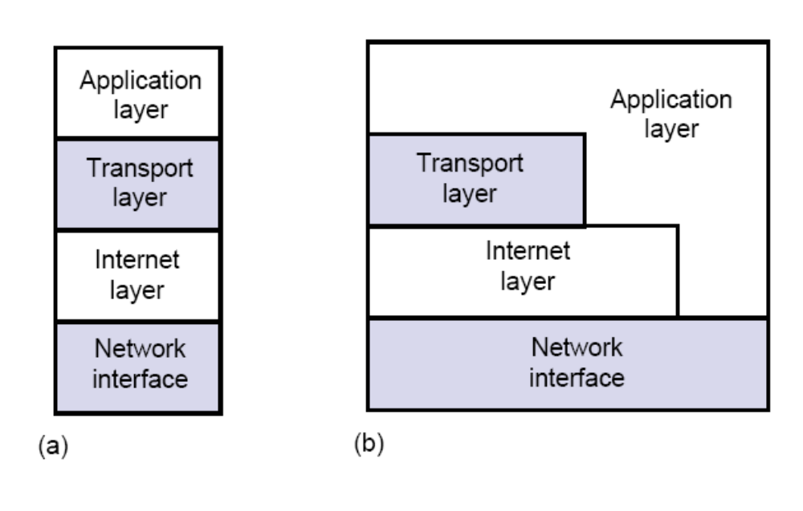
TCP/IP Network Architecture

Slide 40
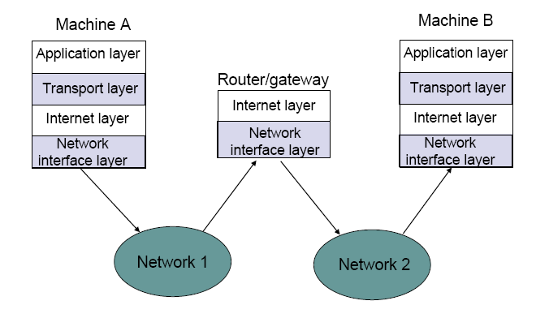
Internet & Network Interface Layers

Slide 41
Internet Protocol Approach
IP packets transfer information across Internet
Host A IP → router→ router…→ router→ Host B IP
IP layer in each router determines next hop (router)
Network interfaces transfer IP packets across networks
Host A
Router
Host B
Router
Transport
Layer
Internet
Layer
Transport
Layer
Internet
Layer
Internet
Layer
Network
Interface
Net 1
Internet
Layer
Net 5
Network
Interface
Router
Network
Interface
Network
Interface
Internet
Layer
Net 4
Net 5
Network
Interface
Net 3
Net 2
Net 5
Net 5

Slide 42
TCP/IP Protocol Suite
HTTP
SMTP
DNS
RTP
Distributed applications
Reliable stream service
User
datagram service
TCP
UDP
Best-effort
connectionless packet transfer
IP
(ICMP, ARP)
Network
interface 1
Network
interface 2
Network
interface 3
Diverse network technologies

Slide 43
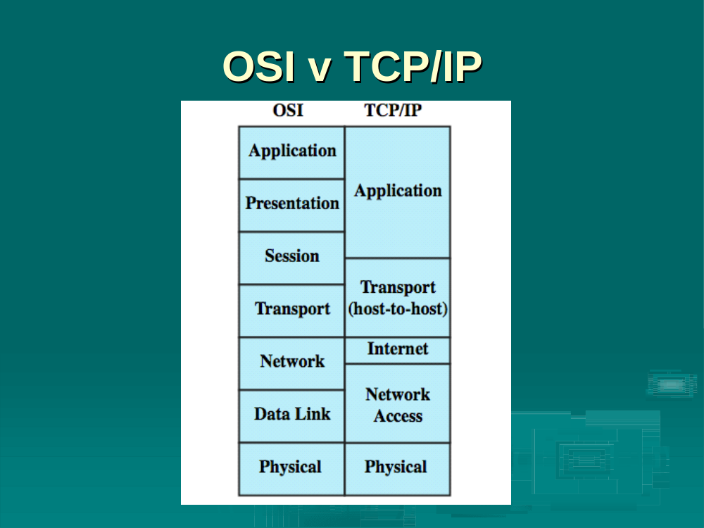
Comparison of OSI and TCP/IP

Slide 44
Internet Names & Addresses
Internet Names
Each host has a unique name
  Independent of physical location
  Facilitate memorization by humans
  Domain Name
  Organization under single administrative unit
Host Name
  Name given to host computer
User Name
  Name assigned to user
leongarcia@comm.utoronto.ca
Internet Addresses
Each host has globally unique logical 32 bit IP address
Separate address for each physical connection to a network
Routing decision is done based on destination IP address
IP address has two parts:
  netid and hostid
  netid unique
  netid facilitates routing
Dotted Decimal Notation:
  int1.int2.int3.int4
  (intj = jth octet)
  128.100.10.13
DNS resolves IP name to IP address

Slide 45
Physical Addresses
LANs (and other networks) assign physical addresses to the physical attachment to the network
The network uses its own address to transfer frames to the appropriate destination
IP address needs to be resolved to physical address at each IP network interface
Example: Ethernet uses 48-bit addresses
  Each Ethernet network interface card (NIC) has globally unique Medium Access Control (MAC) or physical address
  First 24 bits identify NIC manufacturer; second 24 bits are serial number
  00:90:27:96:68:07 12 hex numbers
Intel

Slide 46
Example internet
Server
PC
Router
(2,1)
(1,1)
PPP
Netid=2
s
(1,3) r
(2,2)
w
Ethernet
(netid=1)
*PPP does not use addresses
Workstation
(1,2)
 | netid | hostid | Physical address
server | 1 | 1 | s
workstation | 1 | 2 | w
router | 1 | 3 | r
router | 2 | 1 | -
PC | 2 | 2 | -

Slide 47
Encapsulation
IP header
IP Payload
Ethernet header
IP header
FCS
IP Payload
Ethernet header contains:
  source and destination physical addresses
  network protocol type (e.g. IP)

Slide 48
IP packet from workstation to server
Server
PC
Router
(2,1)
(1,1)
s
(1,3) r
PPP
(2,2)
Ethernet
w
w, s
(1,2), (1,1)
Workstation
(1,2)
IP packet has (1,2) IP address for source and (1,1) IP address for destination
IP table at workstation indicates (1,1) connected to same network, so IP packet is encapsulated in Ethernet frame with addresses w and s
Ethernet frame is broadcast by workstation NIC and captured by server NIC
NIC examines protocol type field and then delivers packet to its IP layer

Slide 49
IP packet from server to PC
Server
PC
Router
(2,1)
(1,1), (2,2)
(1,1)
s
(1,3) r
(2,2)
w
s, r
(1,1), (2,2)
Workstation
(1,2)
IP packet has (1,1) and (2,2) as IP source and destination addresses
IP table at server indicates packet should be sent to router, so IP packet is encapsulated in Ethernet frame with addresses s and r
Ethernet frame is broadcast by server NIC and captured by router NIC
NIC examines protocol type field and then delivers packet to its IP layer
IP layer examines IP packet destination address and determines IP packet should be routed to (2,2)
Router’s table indicates (2,2) is directly connected via PPP link
IP packet is encapsulated in PPP frame and delivered to PC
PPP at PC examines protocol type field and delivers packet to PC IP layer

Slide 50
How the layers work together
(a)
Server
PC
Router
(2,1)
(1,1)
s
(1,3) r
PPP
(2,2)
Ethernet
HTTP uses process-to-process
Reliable byte stream transfer of
TCP connection:
Server socket: (IP Address, 80)
PC socket (IP Address, Eph. #)
(b)
Server
PC
HTTP
TCP uses node-to-node
Unreliable packet transfer of IP
Server IP address & PC IP address
HTTP
TCP
TCP
IP
IP
IP
Network interface
Network interface
Network interface
Internet
Router
Ethernet
PPP

Slide 51
Encapsulation
TCP Header contains source & destination port numbers
HTTP Request
IP Header contains source and destination IP addresses; transport protocol type
TCP header
HTTP Request
Ethernet Header contains source & destination MAC addresses; network protocol type
IP header
TCP header
HTTP Request
Ethernet header
IP header
TCP header
FCS
HTTP Request
Notes:
Ended here-not lectured yet from this page.

Slide 52
How the layers work together: Network Analyzer Example
Internet
User clicks on http://www.nytimes.com/
Ethereal network analyzer captures all frames observed by its Ethernet NIC
Sequence of frames and contents of frame can be examined in detail down to individual bytes

Slide 53
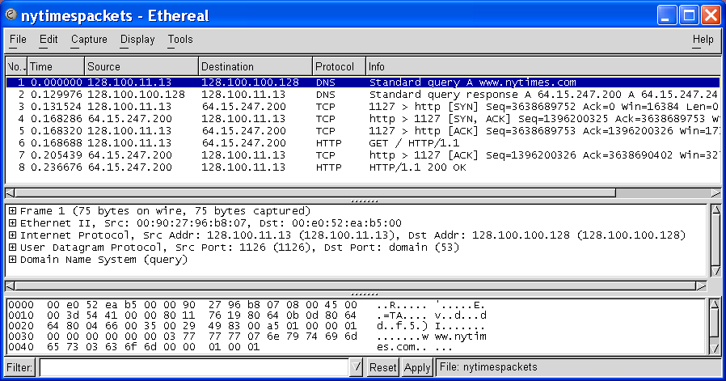
Ethereal windows
Top Pane shows frame/packet sequence
Middle Pane shows encapsulation for a given frame
Bottom Pane shows hex & text

Slide 54
Top pane: frame sequence
TCP Connection Setup
DNS Query
HTTP Request & Response

Slide 55
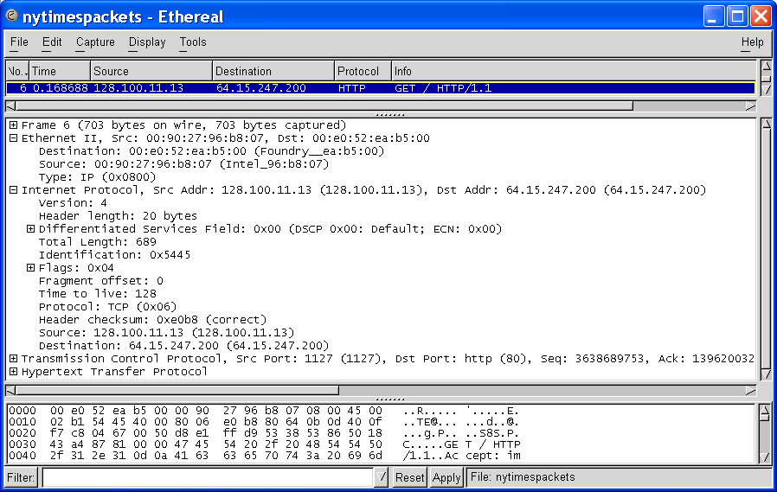
Middle pane: Encapsulation
Ethernet Frame
Ethernet Destination and Source Addresses
Protocol Type

Slide 56
Middle pane: Encapsulation
And a lot of other stuff!
IP Packet
IP Source and Destination Addresses
Protocol Type

Slide 57
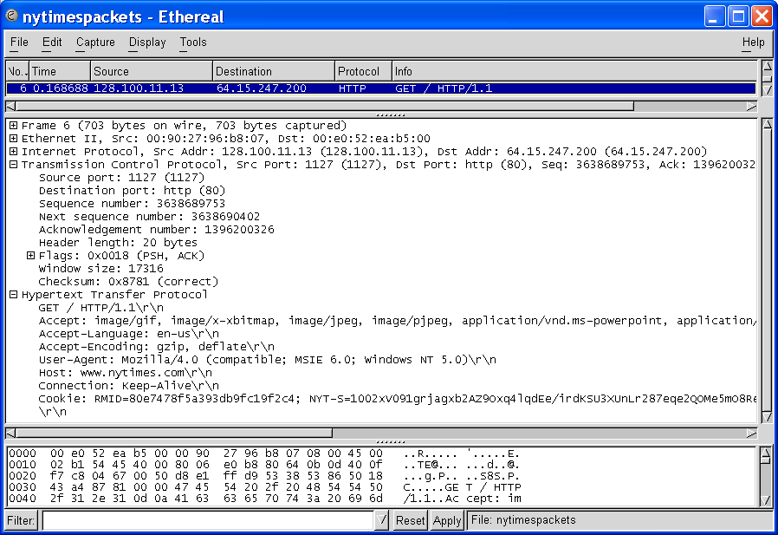
Middle pane: Encapsulation
TCP Segment
Source and Destination Port Numbers
GET
HTTP Request

Slide 58
Summary
Encapsulation is key to layering
IP provides for transfer of packets across diverse networks
TCP and UDP provide universal communications services across the Internet
Distributed applications that use TCP and UDP can operate over the entire Internet
Internet names, IP addresses, port numbers, sockets, connections, physical addresses

