Slide 1
Note 2: Applications and Layered Architectures
Application Layer Protocols & IP Utilities

Slide 2
Quiz #1
How many OSI layers are there, can you name those layers?
How many bits are there in an IPv4 address?
How many bits are there in a MAC address?
What do LAN, MAN and WAN mean? Can you expand them?
What is the default gateway for a host?
What kind of switching Telephone Networks use?
What kind of switching Internet uses?
What is the original name of Internet?
IP is connection-oriented or connectionless protocol?
The IP payload without IP header is the protocol data unit (PDU) of the transport layer or the data link layer?

Slide 3


Telnet (RFC 854)
Provides general bi-directional byte-oriented TCP-based communications facility (Network Virtual Terminal)
Initiating machine treated as local to the remote host
Used to connect to port # of other servers and to interact with them using command line
Server process
NVT
NVT

Slide 4
Network Virtual Terminal
Network Virtual Terminal
Each machine maps characteristics to NVT
Negotiate options for changes to the NVT
Data input sent to server & echoed back
Server control functions : interrupt, abort output, are-you-there, erase character, erase line
Default requires login & password

Slide 5
telnet
A program that uses the Telnet protocol
Establishes TCP socket
Sends typed characters to server
Prints whatever characters arrive
Try it to retrieve a web page (HTTP) or to send an email (SMTP)
Notes:
telnet towel.blinkenlights.nl 23 (watch star war)
Wireshark capture show unencrypted telnet data
Show echoed back characters

Slide 6
File Transfer Protocol (RFC 959)
Provides for transfer of file from one machine to another machine
Designed to hide variations in file storage
FTP parameter commands specify file info
  File Type: ASCII, EBCDIC, image, local.
  Data Structure: file, record, or page
  Transmission Mode: stream, block, compressed
Other FTP commands
  Access Control: USER, PASS, CWD, QUIT, …
  Service: RETR, STOR, PWD, LIST, …
Notes:
USER – Send username to the FTP server
PASS – Send the password (Anonymous servers need email address)
CWD – Change the working directory on the server
PASV – To enter the passive mode (To let client connect to the server)
RETR – To retrieve a remote file from the server
QUIT – To terminate the connection to the server

Slide 7


FTP File Transfer
User interface
Control
connection
Server PI
User PI
Server DTP
Data
connection
User DTP
Server FTP
User FTP
PI = Protocol interpreter DTP = Data transfer process

Slide 8
Two TCP Connections
  Control connection
  Set up using Telnet protocol on well-known port 21
  FTP commands & replies between protocol interpreters
  PIs control the data transfer process
  User requests close of control connection; server performs the close
  Data connection
  To perform file transfer, obtain lists of files, directories
  Each transfer requires new data connection
  Passive open by user PI with ephemeral port #
  Port # sent over control connection
  Active open by server using port 20

Slide 9
FTP Replies
Reply | Meaning
1yz | Positive preliminary reply (action has begun, but wait for another reply before sending a new command).
2yz | Positive completion reply (action completed successfully; new command may be sent).
3yz | Positive intermediary reply (command accepted, but action cannot be performed without additional information; user should send a command with the necessary information).
4yz | Transient negative completion reply (action currently cannot be performed; resend command later).
5zy | Permanent negative completion reply (action cannot be performed; do not resend it).
x0z | Syntax errors.
x1z | Information (replies to requests for status or help).
x2z | Connections (replies referring to the control and data connections).
x3z | Authentication and accounting (replies for the login process and accounting procedures).
x4z | Unspecified.
x5z | File system status.

Slide 10
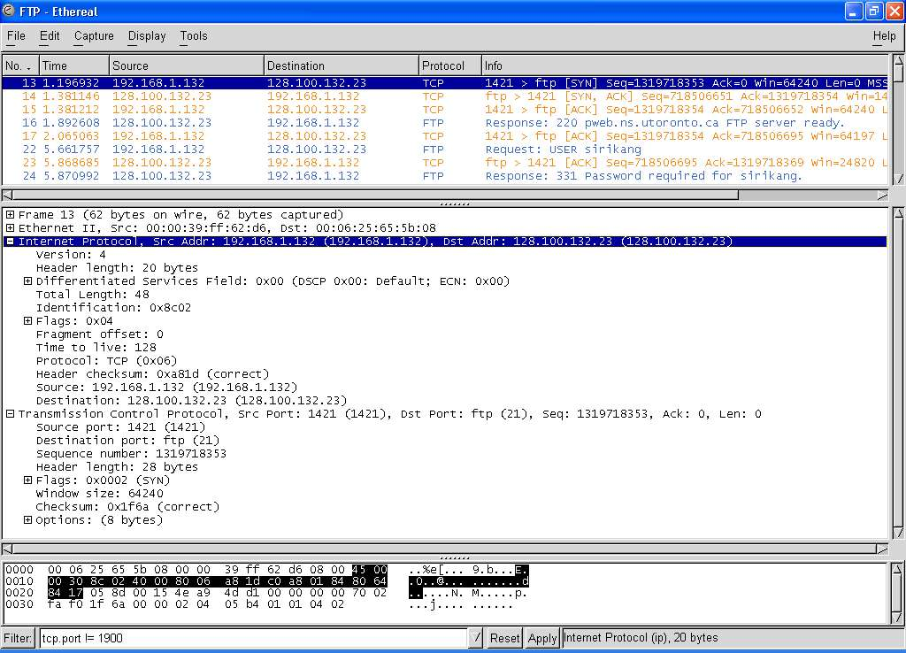
FTP Client (192.168.1.132: 1421) establishes Control Connection to FTP Server (128.100.132.23: 21)

Slide 11
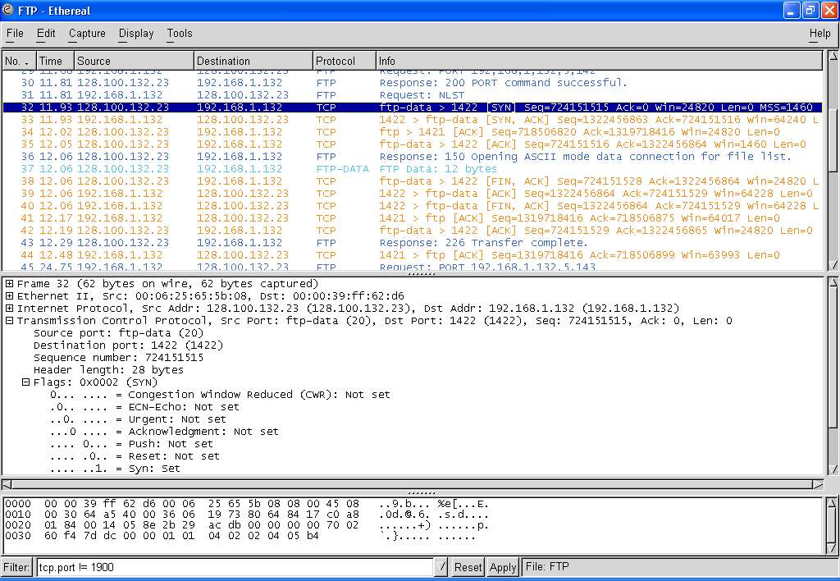
User types ls to list files in directory (frame 31 on control)
FTP Server (128.100.132.23: 20) establishes Data Connection to FTP Client (192.168.1.132: 1422)

Slide 12
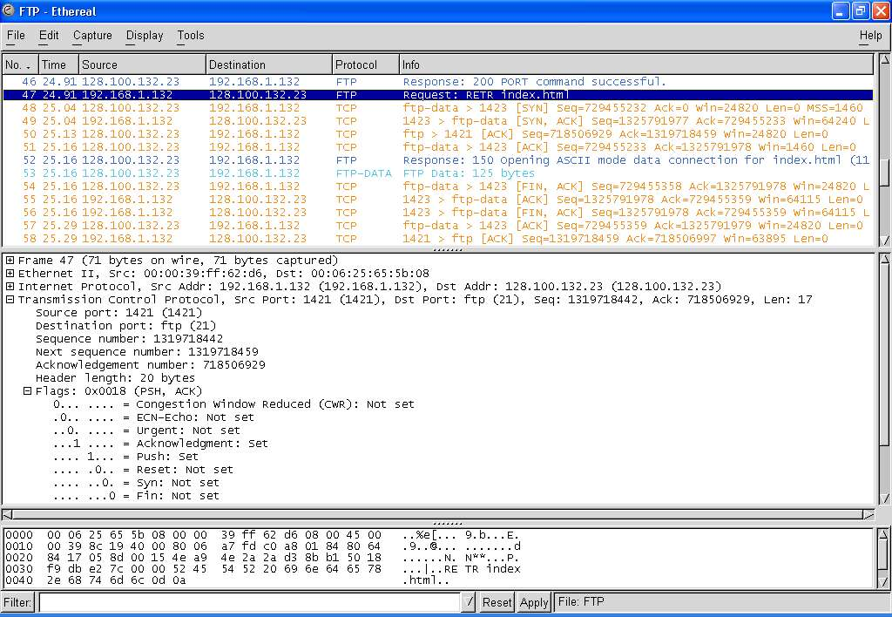
User types get index.html to request file transfer in control connection (frame 47 request); File transfer on new data connection (port 1423, fr. 48, 49, 51)
Notes:
telnet ftp.ietf.org 21
USER anonymous
331 Anonymous login ok, send complete email address as your password
PASS blogger@webdigi.co.uk
230 Anonymous access granted, restrictions apply
CWD ietf/ftpext/
250 CWD command successful
PASV
227 Entering Passive Mode (64,170,98,33,151,31).
RETR ftpext-charter.txt
150 Opening ASCII mode data connection for ftpext-charter.txt (6060 bytes)
226 Transfer complete
QUIT
221 Goodbye.

Slide 13
Hypertext Transfer Protocol
RFC 1945 (HTTP 1.0), RFC 2616 (HTTP 1.1)
HTTP provides communications between web browsers & web servers
Web: framework for accessing documents & resources through the Internet
Hypertext documents: text, graphics, images, hyperlinks
Documents prepared using Hypertext Markup Language (HTML)

Slide 14
HTTP Protocol
HTTP servers use well-known port 80
Client request / Server reply
Stateless: server does not keep any information about client
HTTP 1.0 new TCP connection per request/reply (non-persistent)
HTTP 1.1 persistent operation is default

Slide 15
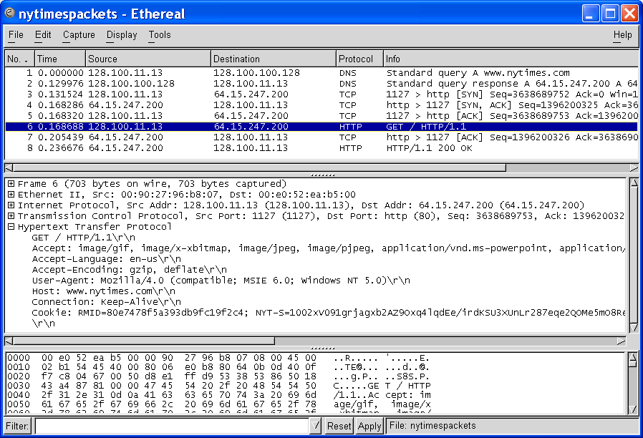
HTTP Typical Exchange

Slide 16
HTTP Message Formats
HTTP messages written in ASCII text
Request Message Format
  Request Line (Each line ends with carriage return)
    Method URL HTTP-Version \r\n
    Method specifies action to apply to object
    URL specifies object
  Header Lines (Ea. line ends with carriage return)
    Attribute Name: Attribute Value
    E.g. type of client, content, identity of requester, …
    Last header line has extra carriage return)
  Entity Body (Content)
    Additional information to server

Slide 17
HTTP Request Methods
Request method | Meaning
GET | Retrieve information (object) identified by the URL.
HEAD | Retrieve meta-information about the object, but do not transfer the object; Can be used to find out if a document has changed.
POST | Send information to a URL (using the entity body) and retrieve result; used when a user fills out a form in a browser.
PUT | Store information in location named by URL
DELETE | Remove object identified by URL
TRACE | Trace HTTP forwarding through proxies, tunnels, etc.
OPTIONS | Used to determine the capabilities of the server, or characteristics of a named resource.

Slide 18
Universal Resource Locator
Absolute URL
  scheme://hostname[:port]/path
  http://www.nytimes.com/
Relative URL
  /path
  /

Slide 19
HTTP Request Message

Slide 20
HTTP Response Message
Response Message Format
  Status Line
    HTTP-Version Status-Code Message
    Status Code: 3-digit code indicating result
    E.g. HTTP/1.0 200 OK
  Headers Section
    Information about object transferred to client
    E.g. server type, content length, content type, …
  Content
    Object (document)

Slide 21
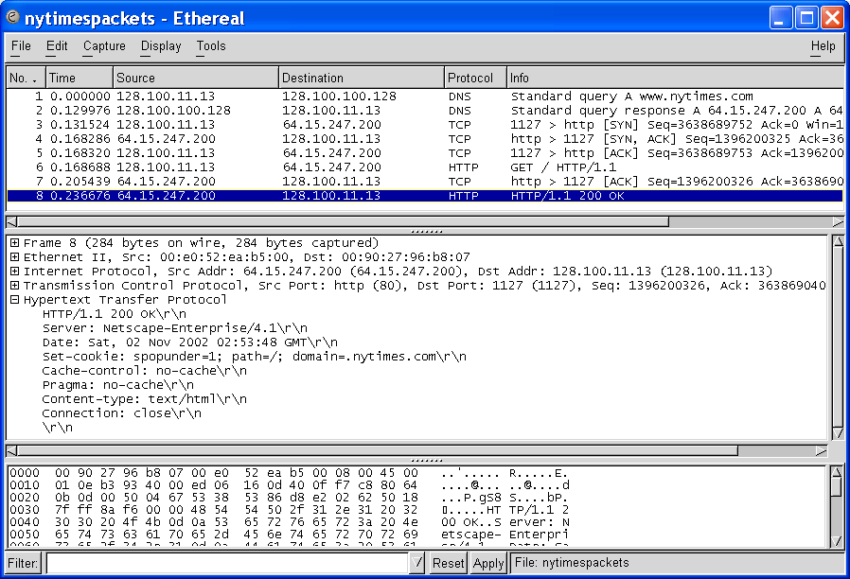
HTTP Response Message

Slide 22
HTTP Proxy Server & Caching
Web users generate large traffic volumes
Traffic causes congestion & delay
Can improve delay performance and reduce traffic in Internet by moving content to servers closer to the user
Web proxy servers cache web information
  Deployed by ISPs
  Customer browsers configured to first access ISPs proxy servers
  Proxy replies immediately when it has requested object or retrieves the object if it does not

Slide 23
Cookies and Web Sessions
Cookies are data exchanged by clients & servers as header lines
Since HTTP stateless, cookies can provide context for HTTP interaction
Set cookie header line in reply message from server includes unique ID number for client
If client accepts cookie, cookie added to client’s cookie file (must include expiration date)
Henceforth client requests include ID
Server site can track client interactions, store these in a separate database, and access database to prepare appropriate responses

Slide 24
Cookie Header Line;
ID is 24 hexadecimal numeral
Notes:
Curl www.google.com
Wireshark capture show request and response msgs

Slide 25
PING
Application to determine if host is reachable
Based on Internet Control Message Protocol
  ICMP informs source host about errors encountered in IP packet processing by routers or by destination host
  ICMP Echo message requests reply from destination host
PING sends echo message & sequence #
Determines reachability & round-trip delay
Sometimes disabled for security reasons

Slide 26
PING from NAL host
Microsoft(R) Windows DOS
(c)Copyright Microsoft Corp 1990-2001.
C:\DOCUME~1\1>ping nal.toronto.edu
Pinging nal.toronto.edu [128.100.244.3] with 32 bytes of data:
Reply from 128.100.244.3: bytes=32 time=84ms TTL=240
Reply from 128.100.244.3: bytes=32 time=110ms TTL=240
Reply from 128.100.244.3: bytes=32 time=81ms TTL=240
Reply from 128.100.244.3: bytes=32 time=79ms TTL=240
Ping statistics for 128.100.244.3:
Packets: Sent = 4, Received = 4, Lost = 0 (0% loss),
Approximate round trip times in milli-seconds:
Minimum = 79ms, Maximum = 110ms, Average = 88ms
C:\DOCUME~1\1>

Slide 27
Traceroute
Find route from local host to a remote host
Time-to-Live (TTL)
  IP packets have TTL field that specifies maximum # hops traversed before packet discarded
  Each router decrements TTL by 1
  When TTL reaches 0 packet is discarded
Traceroute
  Send UDP to remote host with TTL=1
  First router will reply ICMP Time Exceeded Msg
  Send UDP to remote host with TTL=2, …
  Each step reveals next router in path to remote host

Slide 28
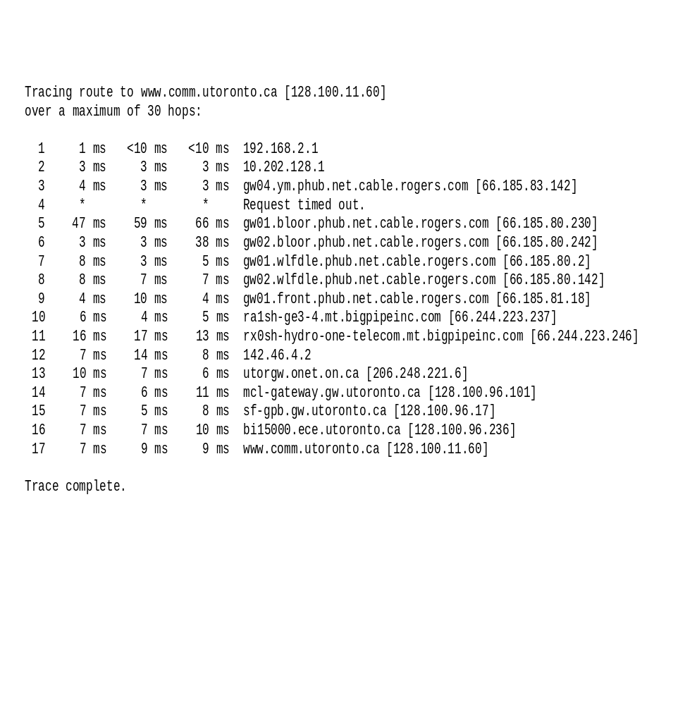
Traceroute from home PC to university host
Home Network
Rogers Cable
ISP
Shaw Net
Hydro One
Ontario Net
University of
Toronto
Notes:
Tracert www.google.com
Wireshark capture show TTL

Slide 29
ipconfig
Utility in Microsoft® Windows to display TCP/IP information about a host
Many options
  Simplest: IP address, subnet mask, default gateway for the host
  Information about each IP interface of a host
    DNS hostname, IP addresses of DNS servers, physical address of network card, IP address, …
  Renew IP address from DHCP server

Slide 30
netstat
Queries a host about TCP/IP network status
Status of network drivers & their interface cards
  #packets in, #packets out, errored packets, …
State of routing table in host
TCP/IP active server processes
TCP active connections

Slide 31
netstat protocol statistics
IPv4 Statistics
Packets Received = 71271
Received Header Errors = 0
Received Address Errors = 9
Datagrams Forwarded = 0
Unknown Protocols Received = 0
Received Packets Discarded = 0
Received Packets Delivered = 71271
Output Requests = 70138
Routing Discards = 0
Discarded Output Packets = 0
Output Packet No Route = 0
Reassembly Required = 0
Reassembly Successful = 0
Reassembly Failures = 0
Datagrams Successfully Fragmented = 0
Datagrams Failing Fragmentation = 0
Fragments Created = 0
UDP Statistics for IPv4
Datagrams Received = 6810
No Ports = 15
Receive Errors = 0
Datagrams Sent = 6309
ICMPv4 Statistics
Received Sent
Messages 10 6
Errors 0 0
Destination Unreachable 8 1
Time Exceeded 0 0
Parameter Problems 0 0
Source Quenches 0 0
Redirects 0 0
Echos 0 2
Echo Replies 2 0
Timestamps 0 0
Timestamp Replies 0 0
Address Masks 0 0
Address Mask Replies 0 0
TCP Statistics for IPv4
Active Opens = 798
Passive Opens = 17
Failed Connection Attempts = 13
Reset Connections = 467
Current Connections = 0
Segments Received = 64443
Segments Sent = 63724
Segments Retransmitted = 80

Slide 32
tcpdump and Network Protocol Analyzers
tcpdump program captures IP packets on a network interface (usually Ethernet NIC)
Filtering used to select packets of interest
Packets & higher-layer messages can be displayed and analyzed
tcpdump basis for many network protocol analyzers for troubleshooting networks
We use the open source Ethereal analyzer to generate examples
  www.ethereal.com

Slide 33
Note 2: Applications and Layered Architectures
Sockets

Slide 34
Socket API
API (Application Programming Interface)
  Provides a standard set of functions that can be called by applications
Berkeley UNIX Sockets API
  Abstraction for applications to send & receive data
  Applications create sockets that “plug into” network
  Applications write/read to/from sockets
  Implemented in the kernel
  Facilitates development of network applications
  Hides details of underlying protocols & mechanisms
Also in Windows, Linux, and other OS’s

Slide 35
Communications through Socket Interface
Client
Server
Socket interface
Application 1
Application 2
Socket interface
descriptor
User
User
descriptor
Kernel
Kernel
Socket
Socket
Application references a
socket through a descriptor
Socket bound to a port number
port number
port number
Underlying communication protocols
Underlying communication protocols
Communications network

Slide 36
Stream mode of service
Connection-oriented
First, setup connection between two peer application processes
Then, reliable bidirectional in-sequence transfer of byte stream (boundaries not preserved in transfer)
Multiple write/read between peer processes
Finally, connection release
Uses TCP
Connectionless
Immediate transfer of one block of information (boundaries preserved)
No setup overhead & delay
Destination address with each block
Send/receive to/from multiple peer processes
Best-effort service only
  Possible out-of-order
  Possible loss
Uses UDP

Slide 37
Client & Server Differences
Server
  Specifies well-known port # when creating socket
  May have multiple IP addresses (net interfaces)
  Waits passively for client requests
Client
  Assigned ephemeral port #
  Initiates communications with server
  Needs to know server’s IP address & port #
    DNS for URL & server well-known port #
  Server learns client’s address & port #

Slide 38
Socket Calls for Connection-Oriented Mode
Server does Passive Open
socket creates socket to listen for connection requests
Server specifies type: TCP (stream)
socket call returns: non-negative integer descriptor; or -1 if unsuccessful
Server
socket()
bind()
listen()
Client
accept()
socket()
Blocks
Connect negotiation
connect()
Data
write()
read()
write()
Data
read()
close()
close()

Slide 39
Socket Calls for Connection-Oriented Mode
Server does Passive Open
bind assigns local address & port # to socket with specified descriptor
Can wildcard IP address for multiple net interfaces
bind call returns: 0 (success); or -1 (failure)
Failure if port # already in use or if reuse option not set
Server
socket()
bind()
listen()
Client
accept()
socket()
Blocks
Connect negotiation
connect()
Data
write()
read()
write()
Data
read()
close()
close()

Slide 40
Socket Calls for Connection-Oriented Mode
Server does Passive Open
listen indicates to TCP readiness to receive connection requests for socket with given descriptor
Parameter specifies max number of requests that may be queued while waiting for server to accept them
listen call returns: 0 (success); or -1 (failure)
Server
socket()
bind()
listen()
Client
accept()
socket()
Blocks
Connect negotiation
connect()
Data
write()
read()
write()
Data
read()
close()
close()

Slide 41
Socket Calls for Connection-Oriented Mode
Server does Passive Open
Server calls accept to accept incoming requests
accept blocks if queue is empty
Server
socket()
bind()
listen()
Client
accept()
socket()
Blocks
Connect negotiation
connect()
Data
write()
read()
write()
Data
read()
close()
close()

Slide 42
Socket Calls for Connection-Oriented Mode
Client does Active Open
socket creates socket to connect to server
Client specifies type: TCP (stream)
socket call returns: non-negative integer descriptor; or -1 if unsuccessful
Server
socket()
bind()
listen()
Client
accept()
socket()
Blocks
Connect negotiation
connect()
Data
write()
read()
write()
Data
read()
close()
close()

Slide 43
Socket Calls for Connection-Oriented Mode
Client does Active Open
connect establishes a connection on the local socket with the specified descriptor to the specified remote address and port #
connect returns 0 if successful; -1 if unsuccessful
Server
socket()
bind()
listen()
Client
accept()
socket()
Note: connect initiates TCP three-way handshake
Blocks
Connect negotiation
connect()
Data
write()
read()
write()
Data
read()
close()
close()

Slide 44
Socket Calls for Connection-Oriented Mode
accept wakes with incoming connection request
accept fills client address & port # into address structure
accept call returns: descriptor of new connection socket (success); or -1 (failure)
Client & server use new socket for data transfer
Original socket continues to listen for new requests
Server
socket()
bind()
listen()
Client
accept()
socket()
Blocks
Connect negotiation
connect()
Data
write()
read()
write()
Data
read()
close()
close()

Slide 45
Socket Calls for Connection-Oriented Mode
Data Transfer
Client or server call write to transmit data into a connected socket
write specifies: socket descriptor; pointer to a buffer; amount of data; flags to control transmission behavior
write call returns: # bytes transferred (success); or -1 (failure); blocks until all data transferred
Server
socket()
bind()
listen()
Client
accept()
socket()
Blocks
Connect negotiation
connect()
Data
write()
read()
write()
Data
read()
close()
close()

Slide 46
Socket Calls for Connection-Oriented Mode
Data Transfer
Client or server call read to receive data from a connected socket
read specifies: socket descriptor; pointer to a buffer; amount of data
read call returns: # bytes read (success); or -1 (failure); blocks if no data arrives
Server
socket()
bind()
listen()
Client
accept()
socket()
Note: write and read can be called multiple times to transfer byte streams in both directions
Blocks
Connect negotiation
connect()
Data
write()
read()
write()
Data
read()
close()
close()

Slide 47
Socket Calls for Connection-Oriented Mode
Connection Termination
Client or server call close when socket is no longer needed
close specifies the socket descriptor
close call returns: 0 (success); or -1 (failure)
Server
socket()
bind()
listen()
Client
accept()
socket()
Note: close initiates TCP graceful close sequence
Blocks
Connect negotiation
connect()
Data
write()
read()
write()
Data
read()
close()
close()

Slide 48
Example: TCP Echo Server
/* A simple echo server using TCP */
#include <stdio.h>
#include <sys/types.h>
#include <sys/socket.h>
#include <netinet/in.h>
#define SERVER_TCP_PORT 3000
#define BUFLEN 256
int main(int argc, char **argv)
{
int n, bytes_to_read;
int sd, new_sd, client_len, port;
struct sockaddr_in server, client;
char *bp, buf[BUFLEN];
switch(argc) {
case 1:
port = SERVER_TCP_PORT;
break;
case 2:
port = atoi(argv[1]);
break;
default:
fprintf(stderr, "Usage: %s [port]\n", argv[0]);
exit(1);
}
/* Create a stream socket */
if ((sd = socket(AF_INET, SOCK_STREAM, 0)) == -1) {
fprintf(stderr, "Can't create a socket\n");
exit(1);
}
/* Bind an address to the socket */
bzero((char *)&server, sizeof(struct sockaddr_in));
server.sin_family = AF_INET;
server.sin_port = htons(port);
server.sin_addr.s_addr = htonl(INADDR_ANY);
if (bind(sd, (struct sockaddr *)&server,
sizeof(server)) == -1) {
fprintf(stderr, "Can't bind name to socket\n");
exit(1);
}
/* queue up to 5 connect requests */
listen(sd, 5);
while (1) {
client_len = sizeof(client);
if ((new_sd = accept(sd, (struct sockaddr *)&client,
&client_len)) == -1) {
fprintf(stderr, "Can't accept client\n");
exit(1);
}
bp = buf;
bytes_to_read = BUFLEN;
while ((n = read(new_sd, bp, bytes_to_read)) > 0) {
bp += n;
bytes_to_read -= n;
}
printf("Rec'd: %s\n", buf);
write(new_sd, buf, BUFLEN);
printf("Sent: %s\n", buf);
close(new_sd);
}
close(sd);
return(0);
}

Slide 49
Example: TCP Echo Client
/* A simple TCP client */
#include <stdio.h>
#include <netdb.h>
#include <sys/types.h>
#include <sys/socket.h>
#include <netinet/in.h>
#define SERVER_TCP_PORT 3000
#define BUFLEN 256
int main(int argc, char **argv)
{
int n, bytes_to_read;
int sd, port;
struct hostent *hp;
struct sockaddr_in server;
char *host, *bp, rbuf[BUFLEN], sbuf[BUFLEN];
switch(argc) {
case 2:
host = argv[1];
port = SERVER_TCP_PORT;
break;
case 3:
host = argv[1];
port = atoi(argv[2]);
break;
default:
fprintf(stderr, "Usage: %s host [port]\n", argv[0]);
exit(1);
}
/* Create a stream socket */
if ((sd = socket(AF_INET, SOCK_STREAM, 0)) == -1) {
fprintf(stderr, "Can't create a socket\n");
exit(1);
}
bzero((char *)&server, sizeof(struct sockaddr_in));
server.sin_family = AF_INET;
server.sin_port = htons(port);
if ((hp = gethostbyname(host)) == NULL) {
fprintf(stderr, "Can't get server's address\n");
exit(1);
}
bcopy(hp->h_addr, (char *)&server.sin_addr, hp->h_length);
/* Connecting to the server */
if (connect(sd, (struct sockaddr *)&server,
sizeof(server)) == -1) {
fprintf(stderr, "Can't connect\n");
exit(1);
}
printf("Connected: server's address is %s\n", hp->h_name);
printf("Transmit:\n");
gets(sbuf); write(sd, sbuf, BUFLEN);
printf("Receive:\n");
bp = rbuf;
bytes_to_read = BUFLEN;
while ((n = read(sd, bp, bytes_to_read)) > 0) {
bp += n;
bytes_to_read -= n;
}
printf("%s\n", rbuf);
close(sd);
return(0);
}

Slide 50
Socket Calls for Connection-Less Mode
Server started
socket creates socket of type UDP (datagram)
socket call returns: descriptor; or -1 if unsuccessful
bind assigns local address & port # to socket with specified descriptor; Can wildcard IP address
Server
socket()
bind()
Client
recvfrom()
socket()
Blocks until server receives data from client
Data
sendto()
sendto()
Data
recvfrom()
close()
close()

Slide 51
Socket Calls for Connection-Less Mode
recvfrom copies bytes received in specified socket into a specified location
recvfrom blocks until data arrives
Server
socket()
bind()
Client
recvfrom()
socket()
Blocks until server receives data from client
Data
sendto()
sendto()
Data
recvfrom()
close()
close()

Slide 52
Socket Calls for Connection-Less Mode
Client started
socket creates socket of type UDP (datagram)
socket call returns: descriptor; or -1 if unsuccessful
Server
socket()
bind()
Client
recvfrom()
socket()
Blocks until server receives data from client
Data
sendto()
sendto()
Data
recvfrom()
close()
close()

Slide 53
Socket Calls for Connection-Less Mode
Client started
sendto transfer bytes in buffer to specified socket
sendto specifies: socket descriptor; pointer to a buffer; amount of data; flags to control transmission behavior; destination address & port #; length of destination address structure
sendto returns: # bytes sent; or -1 if unsuccessful
Server
socket()
bind()
Client
recvfrom()
socket()
Blocks until server receives data from client
Data
sendto()
sendto()
Data
recvfrom()
close()
close()

Slide 54
Socket Calls for Connection-Less Mode
recvfrom wakes when data arrives
recvfrom specifies: socket descriptor; pointer to a buffer to put data; max # bytes to put in buffer; control flags; copies: sender address & port #; length of sender address structure
recvfrom returns # bytes received or -1 (failure)
Server
socket()
bind()
Client
recvfrom()
socket()
Note: receivefrom returns data from at most one send, i.e. from one datagram
Blocks until server receives data from client
Data
sendto()
sendto()
Data
recvfrom()
close()
close()

Slide 55
Socket Calls for Connection-Less Mode
Socket Close
Client or server call close when socket is no longer needed
close specifies the socket descriptor
close call returns: 0 (success); or -1 (failure)
Server
socket()
bind()
Client
recvfrom()
socket()
Blocks until server receives data from client
Data
sendto()
sendto()
Data
recvfrom()
close()
close()

Slide 56
Example: UDP Echo Server
/* Echo server using UDP */
#include <stdio.h>
#include <sys/types.h>
#include <sys/socket.h>
#include <netinet/in.h>
#define SERVER_UDP_PORT 5000
#define MAXLEN 4096
int main(int argc, char **argv)
{
int sd, client_len, port, n;
char buf[MAXLEN];
struct sockaddr_in server, client;
switch(argc) {
case 1:
port = SERVER_UDP_PORT;
break;
case 2:
port = atoi(argv[1]);
break;
default:
fprintf(stderr, "Usage: %s [port]\n", argv[0]);
exit(1);
}
/* Create a datagram socket */
if ((sd = socket(AF_INET, SOCK_DGRAM, 0)) == -1) {
fprintf(stderr, "Can't create a socket\n");
exit(1);
}
/* Bind an address to the socket */
bzero((char *)&server, sizeof(server));
server.sin_family = AF_INET;
server.sin_port = htons(port);
server.sin_addr.s_addr = htonl(INADDR_ANY);
if (bind(sd, (struct sockaddr *)&server,
sizeof(server)) == -1) {
fprintf(stderr, "Can't bind name to socket\n");
exit(1);
}
while (1) {
client_len = sizeof(client);
if ((n = recvfrom(sd, buf, MAXLEN, 0,
(struct sockaddr *)&client, &client_len)) < 0) {
fprintf(stderr, "Can't receive datagram\n");
exit(1);
}
if (sendto(sd, buf, n, 0,
(struct sockaddr *)&client, client_len) != n) {
fprintf(stderr, "Can't send datagram\n");
exit(1);
}
}
close(sd);
return(0);
}

Slide 57
Example: UDP Echo Client
#include <stdio.h>
#include <string.h>
#include <sys/time.h>
#include <netdb.h>
#include <sys/types.h>
#include <sys/socket.h>
#include <netinet/in.h>
#define SERVER_UDP_PORT 5000
#define MAXLEN 4096
#define DEFLEN 64
long delay(struct timeval t1, struct timeval t2)
{
long d;
d = (t2.tv_sec - t1.tv_sec) * 1000;
d += ((t2.tv_usec - t1.tv_usec + 500) / 1000);
return(d);
}
int main(int argc, char **argv)
{
int data_size = DEFLEN, port = SERVER_UDP_PORT;
int i, j, sd, server_len;
char *pname, *host, rbuf[MAXLEN], sbuf[MAXLEN];
struct hostent *hp;
struct sockaddr_in server;
struct timeval start, end;
unsigned long address;
pname = argv[0];
argc--;
argv++;
if (argc > 0 && (strcmp(*argv, "-s") == 0)) {
if (--argc > 0 && (data_size = atoi(*++argv))) {
argc--;
argv++;
}
else {
fprintf(stderr,
"Usage: %s [-s data_size] host [port]\n", pname);
exit(1);
}
}
if (argc > 0) {
host = *argv;
if (--argc > 0)
port = atoi(*++argv);
}
else {
fprintf(stderr,
"Usage: %s [-s data_size] host [port]\n", pname);
exit(1);
}
if ((sd = socket(AF_INET, SOCK_DGRAM, 0)) == -1) {
fprintf(stderr, "Can't create a socket\n");
exit(1);
}
bzero((char *)&server, sizeof(server));
server.sin_family = AF_INET;
server.sin_port = htons(port);
if ((hp = gethostbyname(host)) == NULL) {
fprintf(stderr, "Can't get server's IP address\n");
exit(1);
}
bcopy(hp->h_addr, (char *) &server.sin_addr, hp->h_length);
if (data_size > MAXLEN) {
fprintf(stderr, "Data is too big\n");
exit(1);
}
for (i = 0; i < data_size; i++) {
j = (i < 26) ? i : i % 26;
sbuf[i] = 'a' + j;
}
gettimeofday(&start, NULL); /* start delay measurement */
server_len = sizeof(server);
if (sendto(sd, sbuf, data_size, 0, (struct sockaddr *)
&server, server_len) == -1) {
fprintf(stderr, "sendto error\n");
exit(1);
}
if (recvfrom(sd, rbuf, MAXLEN, 0, (struct sockaddr *)
&server, &server_len) < 0) {
fprintf(stderr, "recvfrom error\n");
exit(1);
}
gettimeofday(&end, NULL); /* end delay measurement */
if (strncmp(sbuf, rbuf, data_size) != 0)
printf("Data is corrupted\n");
close(sd);
return(0);
}

Slide 58
Further Reading
Textbook: 2.1-2.3 (emphasis) 2.4-2.5

