Slide 1
ECE 683
Computer Network Design & Analysis
Note 3: Digital Transmission Fundamentals

Slide 2
Outline
Overview of physical layer
Digital representation of Information
Why digital transmission?
Line coding
Modulation/demodulation
Properties of transmission media

Slide 3
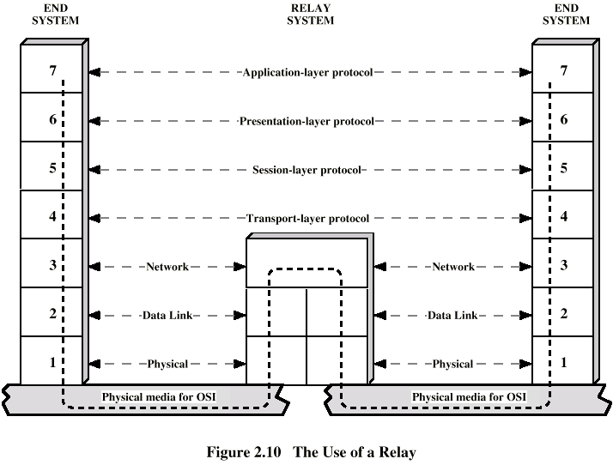
Introduction

Slide 4
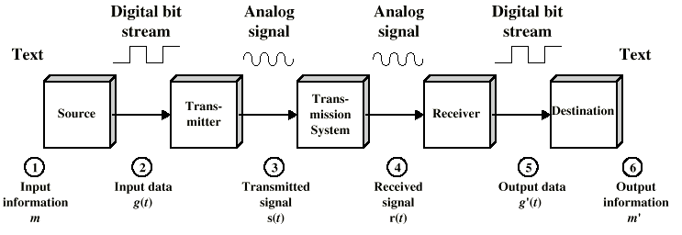
Physical layer

Slide 5
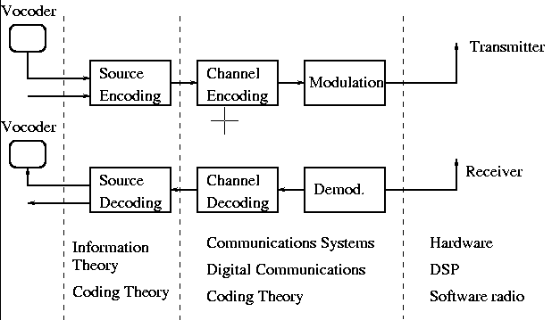
What You Need for Better Understanding

Slide 6
Source Coding
Networks are handling streams of 0’s and 1’
Source Encoding: compression, according to statistics of 0’s and 1’s, map blocks of bits to more regular “shorter” blocks! Get rid of redundancy
Source Decoding: inverse of source encoding

Slide 7
Channel Coding
Channel Encoding: According to channel conditions, add redundancy for more reliable transmission
Channel decoding: the inverse
Observation: source encoding attempts to eliminate “useless information”, while channel encoding add “useful information”; both deal with redundancies!

Slide 8
Modulation/Demodulation
Modulation: maps blocks of bits to well-defined waveforms or symbols (a set of signals for better transmission), then shifts transmission to the carrier frequency band (the band you have right to transmit)
Demodulation: the inverse of modulation
Demodulation vs. Detection: Detection is to recover the modulated signal from the “distorted noisy” received signals
Notes:
Why mention detection here?

Slide 9
Physical Components
Transmitter
Receiver
Transmission media
  Guided: cable, twisted pair, fiber
  Unguided: wireless (radio, infrared)

Slide 10
Information Carriers
s(t) = A sin (2πft+ φ) * Amplitude: A * Frequency: f --- f=1/T, T---period * Phase: φ , angle (2πft+ φ)

Slide 11
Signal Types
Basic form: A signal is a time function
Continuous signal: varying continuously with time, e.g., speech
Discrete signal: varying at discrete time instants
Periodic signal: Pattern repeated over time
Aperiodic signal: Pattern not repeated over time, e.g., speech

Slide 12
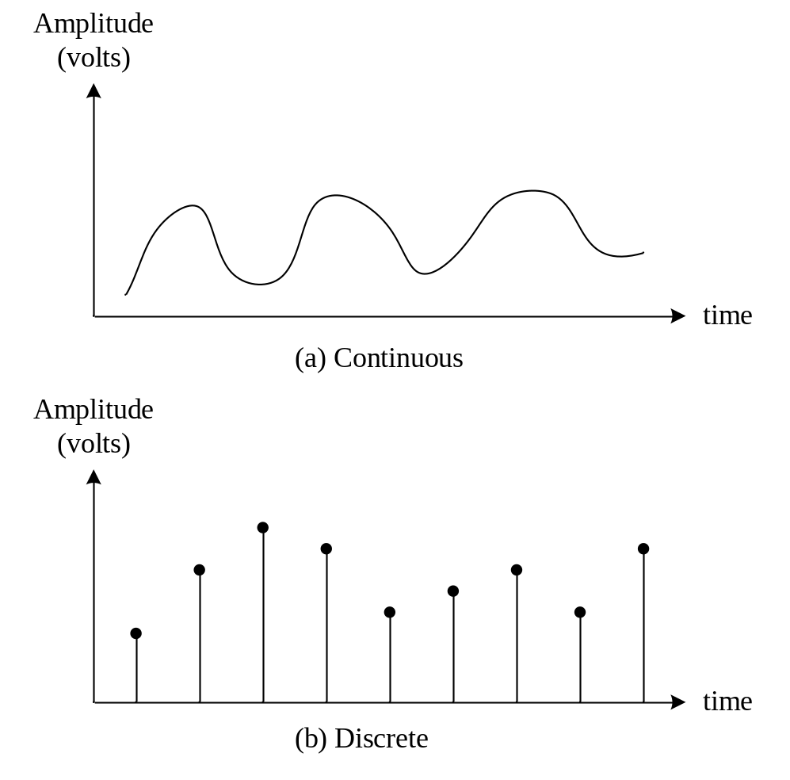
Continuous & Discrete Signals

Slide 13
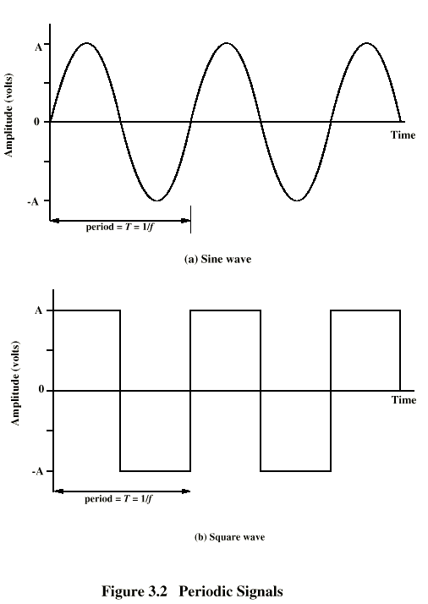
Periodic
Signals

Slide 14
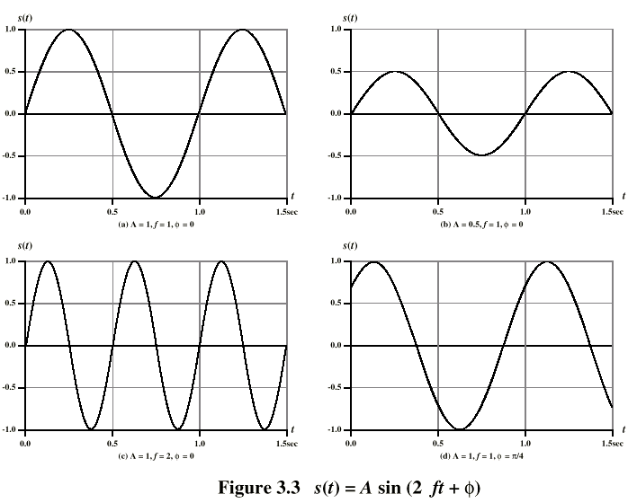
Varying Sine Waves

Slide 15
Frequency Domain Concept
Signal is usually made up of many frequencies
Components are sine waves
Can be shown (Fourier analysis) that any signal is made up of component sine waves
Can plot frequency domain functions
Time domain representation is equivalent to frequency domain representation: they contain the same information!
Frequency domain representation is easier for design

Slide 16
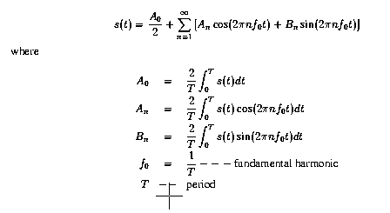
Fourier Representation
n

Slide 17
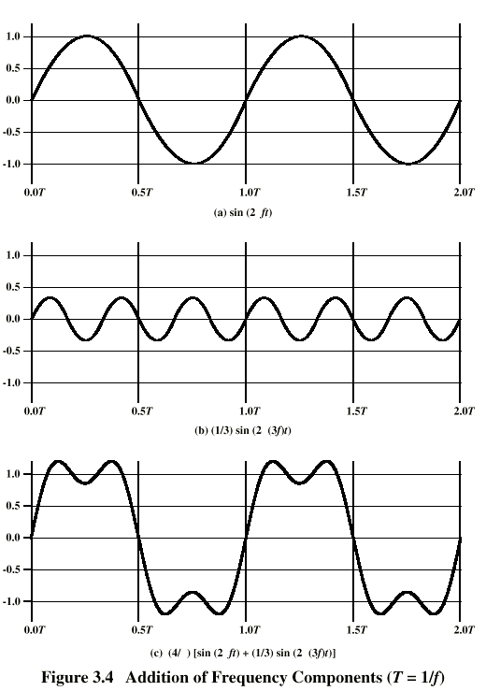
Addition of
Signals

Slide 18
Received Signals
Any receiver can only receive signals in a certain frequency range, corresponding to a finite number of terms in the Fourier series approximation:
  physically: a finite number of harmonics
  mathematically: a finite number of terms
Transmitted signal design: allocate as many terms as possible in the intended receiver’s receiving range (most power is contained in the intended receiving frequency band)

Slide 19
Signal Spectrum & Bandwidth
Spectrum: the range of frequencies contained in a signal
Absolute bandwidth: width of spectrum or the frequency range in which the signal’s Fourier transform is non-zero
Effective bandwidth: just called BW (BandWidth), Narrow band of frequencies containing most of the energy
  3 dB BW
  Percentage BW: percentage power in the frequency band
DC Component: Frequency component of zero frequency (i.e., constant)
Notes:
The db (decibel) is a relative unit of measurement for providing a reference for input and output levels. 10Log(P2/P1) where Log’s base is 10, P2 is the measured or calculated power and P1 a reference power.

Slide 20
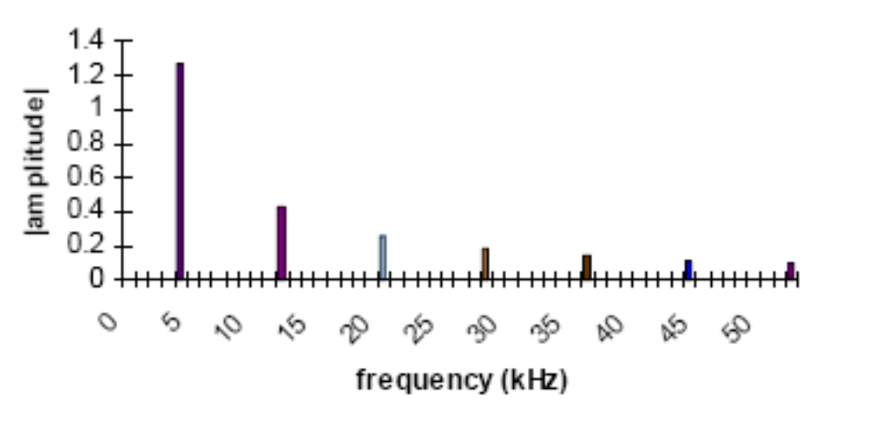
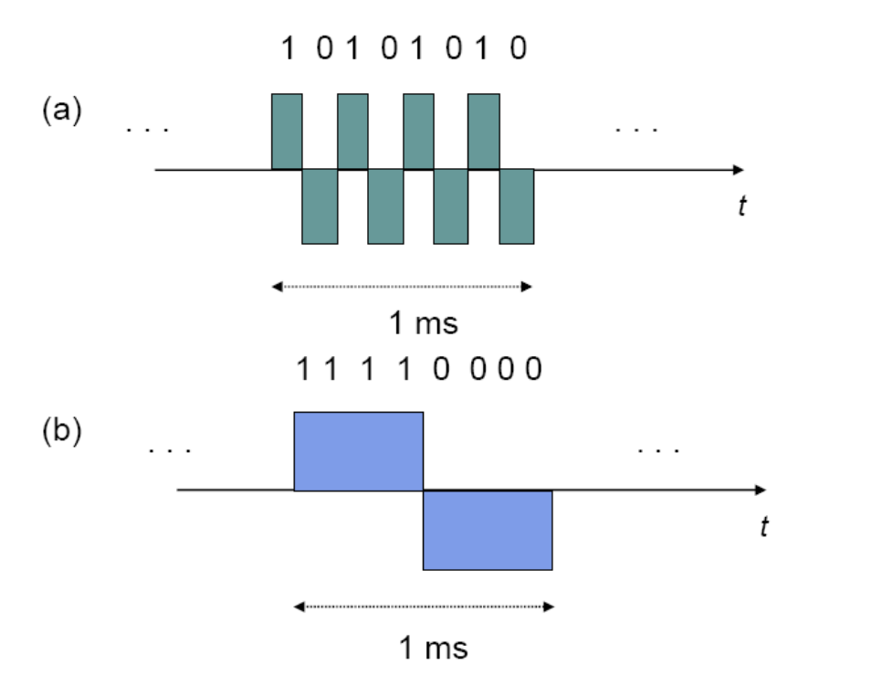
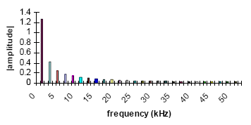
Signal Bandwidth Illustration
Bandwidth of a signal is a measure of how fast its parameters (e.g., amplitude or phase) change with time

Slide 21
Note 3: Digital Transmission Fundamentals
Digital Representation of Information

Slide 22
Bits, numbers, information
Bit: number with value 0 or 1
  n bits: digital representation for 0, 1, … , 2^{n}
  Byte or Octet, n = 8
  Computer word, n = 16, 32, or 64
n bits allows enumeration of 2^{n} possibilities
  n-bit field in a header
  n-bit representation of a voice sample
  Message consisting of n bits
The number of bits required to represent a message is a measure of its information content
  More bits → More content

Slide 23
Block vs. Stream Information
Block
Information that occurs in a single block
  Text message
  Data file
  JPEG image
  MPEG file
Size = Bits / block
or bytes/block
  1 kbyte = 2¹⁰ bytes
  1 Mbyte = 2²⁰ bytes
  1 Gbyte = 2³⁰ bytes
Stream
Information that is produced & transmitted continuously
  Real-time voice
  Streaming video
Bit rate = bits / second
  1 kbps = 10³ bps
  1 Mbps = 10⁶ bps
  1 Gbps = 10⁹ bps
Notes:
The prefix giga also means 10⁹ in the International System of Units. It also means 1024³ in computer and IT.

Slide 24
Transmission Delay
L number of bits in message
R bps speed of digital transmission system
L/R time to transmit the information
t_{prop} time for signal to propagate across medium
d distance in meters
c speed of light (3x10⁸ m/s in vacuum)
Delay = t_{prop} + L/R = d/c + L/R seconds
Use data compression to reduce L
Use higher-speed modem to increase R
Place receiver closer to reduce d

Slide 25
Compression
Information usually not represented efficiently
Data compression algorithms
  Represent the information using fewer bits
  Lossless: original information recovered exactly
    E.g. zip, rar, compress, GIF, fax
  Lossy: recover information approximately
    JPEG
    Tradeoff: # bits vs. quality
Compression Ratio
  #bits (original file) / #bits (compressed file)

Slide 26
Color Image
W
W
W
W
Color image
Red component image
Green component image
Blue component image
H
=
H
+
H
+
H
Total bits = 3 × H × W pixels × B bits/pixel = 3HWB bits
Example: 8×10 inch picture at 400 × 400 pixels per inch²
400 × 400 × 8 × 10 = 12.8 million pixels
8 bits/pixel/color
12.8 megapixels × 3 bytes/pixel = 38.4 megabytes

Slide 27
Examples of Block Information
Type | Method | Format | Original | Compressed (Ratio)
Text | Zip, compress | ASCII | Kbytes- Mbytes | (2-6)
Fax | CCITT Group 3 | A4 page 200x100 pixels/in² | 256 kbytes | 5-54 kbytes (5-50)
Color Image | JPEG | 8x10 in² photo 400² pixels/in² | 38.4 Mbytes | 1-8 Mbytes (5-30)

Slide 28
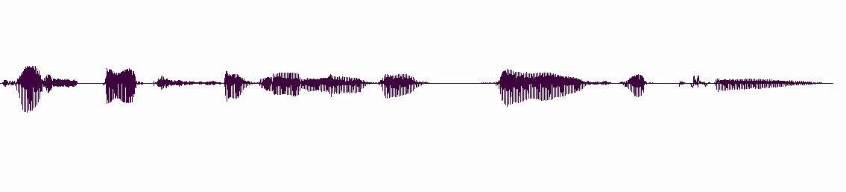
Stream Information
A real-time voice signal must be digitized & transmitted as it is produced
Analog signal level varies continuously in time
Th e s p ee ch s i g n al l e v el v a r ie s w i th t i m(e)

Slide 29
Digitization of Analog Signal
Sample analog signal in time and amplitude
Find closest approximation
Original signal
Sample value
7Δ/2
Approximation
5Δ/2
3Δ/2
Δ/2
3 bits / sample
−Δ/2
−3Δ/2
−5Δ/2
−7Δ/2
R_{s} = Bit rate = # bits/sample x # samples/second

Slide 30
Bit Rate of Digitized Signal
Bandwidth W_{s} Hertz: how fast the signal changes
  Higher bandwidth → more frequent samples
  Minimum sampling rate = 2 x W_{s} (the Nyquist rate)
Representation accuracy: range of approximation error
  Higher accuracy
  → smaller spacing between approximation values
  → more bits per sample
Notes:
Nyquist rate=2Ws. In discrete time systems, Nyquist frequency=half of the sampling rate. Nyquist rate may be called Nyquist signaling rate or Nyquist sampling rate.

Slide 31
Example: Voice & Audio
Telephone voice
W_{s} = 4 kHz → 8000 samples/sec
8 bits/sample
R_{s}=8 x 8000 = 64 kbps
Cellular phones use more powerful compression algorithms: 8-12 kbps
CD Audio
W_{s} = 22 kHertz → 44000 samples/sec
16 bits/sample
R_{s}=16 x 44000= 704 kbps per audio channel
MP3 uses more powerful compression algorithms: 50 kbps per audio channel

Slide 32
Video Signal
Sequence of picture frames
  Each picture digitized & compressed
Frame repetition rate
  10-30-60 frames/second depending on quality
Frame resolution
  Small frames for videoconferencing
  Standard frames for conventional broadcast TV
  HDTV frames
30 fps
Rate = M bits/pixel x (WxH) pixels/frame x F frames/second

Slide 33
Video Frames
176
QCIF videoconferencing
144
at 30 frames/sec =
760,000 pixels/sec
720
Broadcast TV
at 30 frames/sec =
10.4 x 10⁶ pixels/sec
480
1920
HDTV
at 30 frames/sec =
67 x 10⁶ pixels/sec
1080
Notes:
QCIF="Quarter CIF” where CIF=

Slide 34
Digital Video Signals
Type | Method | Format | Original | Compressed
Video Confer-ence | H.261 | 176x144 or 352x288 pix @10-30 fr/sec | 2-36 Mbps | 64-1544 kbps
Full Motion | MPEG2 | 720x480 pix @30 fr/sec | 249 Mbps | 2-6 Mbps
HDTV | MPEG2 | 1920x1080 @30 fr/sec | 1.6 Gbps | 19-38 Mbps

Slide 35
Transmission of Stream Information
Constant bit-rate (CBR)
  Signals such as digitized telephone voice produce a steady stream: e.g. 64 kbps
  Network must support steady transfer of signal, e.g. 64 kbps circuit
Variable bit-rate (VBR)
  Signals such as digitized video produce a stream that varies in bit rate, e.g., according to motion and detail in a scene
  Network must support variable transfer rate of signal, e.g., packet switching or rate-smoothing with constant bit-rate circuit

Slide 36
Stream Service Quality Issues
Network Transmission Impairments
Delay: Is information delivered in timely fashion?
Jitter: Is information delivered in sufficiently smooth fashion?
Loss: Is information delivered without loss? If loss occurs, is delivered signal quality acceptable?
Applications & application layer protocols developed to deal with these impairments

Slide 37
Note 3: Digital Transmission Fundamentals
Why Digital Transmission?

Slide 38
A Transmission System
Transmitter
Receiver
Communication channel
Transmitter
Converts information into signal suitable for transmission
Injects energy into communication medium or channel
  Telephone converts voice into electric current
  Modem converts bits into tones
Receiver
Receives energy from medium
Converts received signal into a form suitable for delivery to users
  Telephone converts current into voice
  Modem converts tones into bits

Slide 39
Analog vs. Digital Transmission
Analog transmission: all details must be reproduced accurately
Distortion
Attenuation
Sent
Received
Digital transmission: only discrete levels need to be reproduced
Sent
Distortion
Attenuation
Received
Simple Receiver: Was original pulse positive or negative?

Slide 40
Transmission Impairments
Transmitter
Transmitted Signal
Received Signal
Receiver
Communication channel
Communication Channel
Pair of copper wires
Coaxial cable
Radio
Light in optical fiber
Light in air
Infrared
Transmission Impairments
Signal attenuation
Signal distortion
Spurious noise
Interference from other signals

Slide 41
Analog Long-Distance Communications
Transmission segment
Source
Repeater
. . .
Repeater
Destination
Each repeater attempts to restore analog signal to its original form
Restoration is imperfect
  Distortion is not completely eliminated
  Noise & interference are only partially removed
Signal quality decreases with # of repeaters
Communication is distance-limited
Still used in analog cable TV systems
Analogy: Copy a song using a cassette recorder

Slide 42
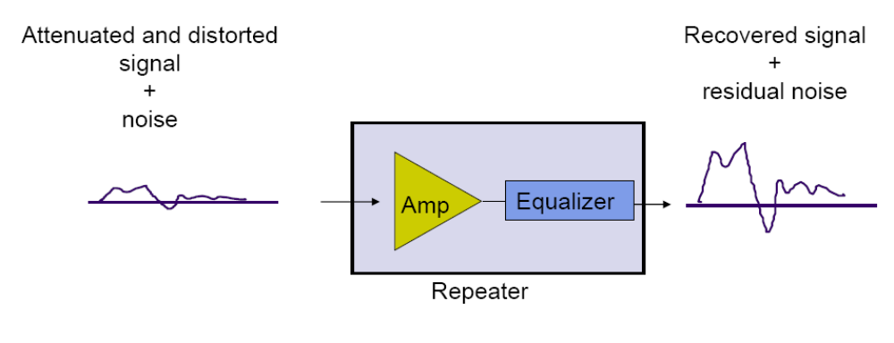
An Analog Repeater

Slide 43
Digital Long-Distance Communications
Transmission segment
Source
Regenerator
. . .
Regenerator
Destination
Regenerator recovers original data sequence and retransmits on the next segment
Can design so such that the error probability is very small
Then each regeneration is like the first time!
Analogy: copy an MP3 file
Communication is possible over very long distances

Slide 44
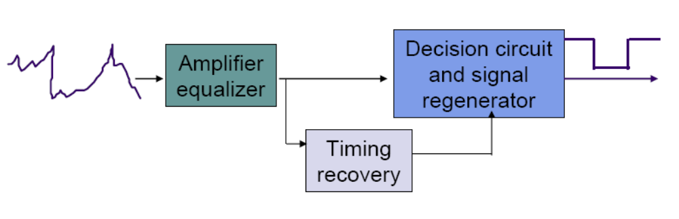
A Digital Regenerator

Slide 45
Advantages of Digital over Analog
Digital regenerators eliminate the accumulation of noise that takes place in analog systems
  It is thus possible to provide long-distance transmission that is nearly independent of distance
Digital transmission systems can operate with lower signal levels or with greater distances between regenerators
  This translates into lower overall system cost
Digital transmission facilitates the monitoring of the quality of a transmission channel in service
  Nonintrusive monitoring is much more difficult in analog transmission systems
Digital transmission systems can multiplex and switch any type of information represented in a digital form
Digital transmission also allows networks to exploit the advances in digital computer technology
  Error correction, data encryption, various types of network protocols

Slide 46
Digital Binary Signal
1
0
1
1
0
1
+A
0
T
2T
3T
4T
5T
6T
-A
Bit rate = 1 bit / T seconds
For a given communication medium:
How do we increase transmission speed?
How do we achieve reliable communications?
Are there limits to speed and reliability?

Slide 47
Pulse Transmission Rate
Objective: Maximize pulse rate through a channel, that is, make T as small as possible
Channel
T
t
t
If input is a narrow pulse, then typical output is a spread-out pulse with ringing
Question: How frequently can these pulses be transmitted without interfering with each other?
Answer: 2 x W_{c} pulses/second (Nyquist rate), where W_{c} is the bandwidth of the channel

Slide 48
Bandwidth of a Channel
X(t) = a cos(2πft)
Channel
Y(t) = A(f) a cos(2πft)
If input is sinusoid of frequency f, then
  output is a sinusoid of same frequency f
  Output is attenuated by an amount A(f) that depends on f
  A(f)≈1, then input signal passes readily
  A(f)≈0, then input signal is blocked
Bandwidth W_{c} is range of frequencies passed by channel
A(f)
1
f
0
W_{c}
Ideal low-pass channel

Slide 49
Multilevel Pulse Transmission
Assume a channel of bandwidth W_{c}, and transmit 2 W_{c} pulses/sec (without interference)
If pulses amplitudes are either -A or +A, then each pulse conveys 1 bit, so
Bit Rate = 1 bit/pulse x 2W_{c} pulses/sec = 2W_{c} bps
If amplitudes are from {-A, -A/3, +A/3, +A}, then bit rate is 2 x 2W_{c} bps
By going to M = 2^{m} amplitude levels, we achieve
Bit Rate = m bits/pulse x 2W_{c} pulses/sec = 2mW_{c} bps
In the absence of noise, the bit rate can be increased without limit by increasing m

Slide 50
Noise & Reliable Communications
All physical systems have noise
  Electrons always vibrate at non-zero temperature
  Motion of electrons induces noise
Presence of noise limits accuracy of measurement of received signal amplitude
Errors occur if signal separation is comparable to noise level
Bit Error Rate (BER) increases with decreasing signal-to-noise ratio
Noise places a limit on how many amplitude levels can be used in pulse transmission

Slide 51
Signal-to-Noise Ratio
Signal
Noise
Signal + noise
High
SNR
t
t
t
No errors
Signal
Noise
Signal + noise
Low
SNR
t
t
t
Average signal power
error
SNR =
Average noise power
SNR (dB) = 10 log₁₀ SNR

Slide 52
Shannon Channel Capacity
C = W_{c} log₂ (1 + SNR) bps
Arbitrarily reliable communication is possible if the transmission rate R < C.
If R > C, then arbitrarily reliable communication is not possible.
“Arbitrarily reliable” means the BER can be made arbitrarily small through sufficiently complex coding.
C can be used as a measure of how close a system design is to the best achievable performance.
Bandwidth W_{c} & SNR determine C

Slide 53
Example
Find the Shannon channel capacity for a telephone channel with W_{c} = 3400 Hz and SNR = 10000
C = 3400 log₂ (1 + 10000)
= 3400 log₁₀ (10001)/log₁₀2 = 45200 bps
Note 1: SNR = 10000 corresponds to
SNR (dB) = 10 log₁₀(10000) = 40 dB
Note 2: log₁₀2=
You are required to find C given W_{c} in proper unit, e.g., Hz, kHz, and MHz, and SNR in dB.

Slide 54
Bit Rates of Digital Transmission Systems
System | Bit Rate | Observations
Telephone twisted pair | 33.6-56 kbps | 4 kHz telephone channel
Ethernet twisted pair | 10 Mbps, 100 Mbps | 100 meters of unshielded twisted copper wire pair
Cable modem | 500 kbps-4 Mbps | Shared CATV return channel
ADSL twisted pair | 64-640 kbps in, 1.536-6.144 Mbps out | Coexists with analog telephone signal
2.4 GHz radio | 2-11 Mbps | IEEE 802.11 wireless LAN
28 GHz radio | 1.5-45 Mbps | 5 km multipoint radio
Optical fiber | 2.5-10 Gbps | 1 wavelength
Optical fiber | >1600 Gbps | Many wavelengths

Slide 55
Examples of Channels
Channel | Bandwidth | Bit Rates
Telephone voice channel | 3 kHz | 33 kbps
Copper pair | 1 MHz | 1-6 Mbps
Coaxial cable | 500 MHz (6 MHz channels) | 30 Mbps/ channel
5 GHz radio (IEEE 802.11) | 300 MHz (11 channels) | 54 Mbps / channel
Optical fiber | Many TeraHertz | 40 Gbps / wavelength

Slide 56
Note 3: Digital Transmission Fundamentals
Line Coding

Slide 57
Source vs. Channel vs. Line Coding
Source coding: eliminating redundancy in order to make efficient use of storage space and/or transmission channels
  Huffman coding/ Morse code
Channel coding: a pre-transmission mapping applied to a digital signal or file, usually designed to make error-correction possible
  Parity check / Hamming code / Reed-Soloman code
Line coding: performed to adapt the transmitted signal to the (electrical) characteristics of a transmission channel
Order: source coding -> channel coding -> line coding

Slide 58
What is Line Coding?
Mapping of binary information sequence into the digital signal that enters the channel
  Ex. “1” maps to +A square pulse; “0” to –A pulse
Line code selected to meet system requirements:
  Transmitted power: Power consumption = $
  Bit timing: Transitions in signal help timing recovery
  Bandwidth efficiency: Excessive transitions wastes bw
  Low frequency content: Some channels block low frequencies
    long periods of +A or of –A causes signal to “droop”
    Waveform should not have low-frequency content
  Error detection: Ability to detect errors helps
  Complexity/cost: Is code implementable in chip at high speed?

Slide 59
Line coding examples
1
0
1
0
1
1
1
0
0
Unipolar
NRZ
NRZ=Non-Return-to-Zero
Polar NRZ
NRZ-inverted
(differential
encoding)
Bipolar
encoding
Manchester
encoding
Differential
Manchester
encoding

Slide 60
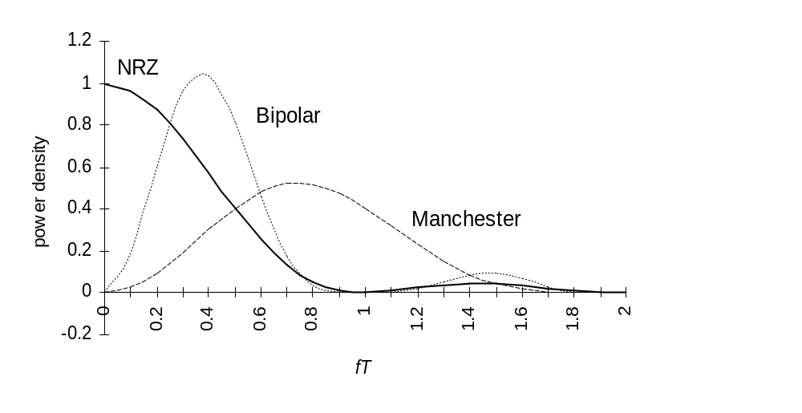
Spectrum of Line codes
Assume 1s & 0s independent & equiprobable
NRZ has high content at low frequencies
Bipolar tightly packed around f=1/(2T) or 0.5/T
Manchester wasteful of bandwidth

Slide 61
Unipolar & Polar
Non-Return-to-Zero (NRZ)
1
0
1
0
1
1
1
0
0
Unipolar NRZ
Polar NRZ
Unipolar NRZ
“1” maps to +A pulse
“0” maps to no pulse
High Average Power
  0.5*A² +0.5*0²=A²/2
Long strings of A or 0
  Poor timing
  Low-frequency content
Simple
Polar NRZ
“1” maps to +A/2 pulse
“0” maps to –A/2 pulse
Better Average Power
  0.5*(A/2)² +0.5*(-A/2)²=A²/4
Long strings of +A/2 or –A/2
  Poor timing
  Low-frequency content
Simple

Slide 62
Bipolar Code
1
0
1
0
1
1
1
0
0
Bipolar Encoding
Three signal levels: {-A, 0, +A}
“1” maps to +A or –A in alternation
“0” maps to no pulse
  Every +pulse matched by –pulse so little content at low frequencies
String of 1s produces a square wave
  Spectrum centered at around f=1/(2T) or 0.5/T
Long string of 0s causes receiver to lose synchronization
Zero-substitution codes are needed

Slide 63
Manchester code & mBnB codes
1
0
1
0
1
1
1
0
0
Manchester Encoding
“1” maps into A/2 first T/2, -A/2 last T/2
“0” maps into -A/2 first T/2, A/2 last T/2
Every interval has transition in middle
  Timing recovery easy
  Uses double the minimum bandwidth
Simple to implement
Used in 10-Mbps Ethernet & other LAN standards
mBnB line code
Maps block of m bits into n bits
Manchester code is 1B2B code
4B5B code used in FDDI LAN
8B10b code used in Gigabit Ethernet
64B66B code used in 10G Ethernet
Notes:
FDDI=Fiber Distributed Data Interface. 4B5B, pre-define a dictoionary, e.g., 0=0000➔11110, 1=0001➔01001, …., 15=1111➔11101. Other 5 bits can be used for error detection and other control purpose.

Slide 64
Differential Coding
1
0
1
0
1
1
1
0
0
NRZ-inverted
(differential
encoding)
Differential
Manchester
encoding
Errors in some systems cause transposition in polarity, +A become –A and vice versa
  All subsequent bits in Polar NRZ coding would be in error
Differential line coding provides robustness to this type of error
“1” mapped into transition in signal level
“0” mapped into no transition in signal level
Also used along with Manchester coding

Slide 65
Note 3: Digital Transmission Fundamentals
Modulation/Demodulation

Slide 66
Bandpass Channels
0
f_{c} – W_{c}/2
f_{c}
f_{c} + W_{c}/2
Bandpass channels pass a range of frequencies around some center frequency f_{c}
  Radio channels, telephone & DSL modems
Digital modulators embed information into waveform with frequencies passed by bandpass channel
Sinusoid of frequency f_{c} is centered in middle of bandpass channel
Modulators embed information into a sinusoid

Slide 67
Amplitude Modulation and Frequency Modulation
Information
1
0
1
1
0
1
+1
Amplitude
Shift
Keying
t
0
T
2T
3T
4T
5T
6T
-1
Map bits into amplitude of sinusoid: “1” send sinusoid; “0” no sinusoid
Demodulator looks for signal vs. no signal
+1
Frequency
Shift
Keying
t
0
T
2T
3T
4T
5T
6T
-1
Map bits into frequency: “1” send frequency f_{c} + δ ; “0” send frequency f_{c} - δ
Demodulator looks for power around f_{c} + δ or f_{c} - δ

Slide 68
Phase Modulation
Information
1
0
1
1
0
1
+1
Phase
Shift
Keying
T
2T
3T
4T
5T
6T
t
0
-1
Map bits into phase of sinusoid:
  “1” send A cos(2πft) , i.e. phase is 0
  “0” send A cos(2πft+π) , i.e. phase is π
Equivalent to multiplying cos(2πft) by +A or -A
  “1” send A cos(2πft) , i.e. multiply by 1
  “0” send A cos(2πft+π) = - A cos(2πft) , i.e. multiply by -1
We will focus on phase modulation

Slide 69
Modulator & Demodulator
Modulate cos(2πf_{c}t) by multiplying by A_{k} for T seconds:
A_{k}
x
Y_{i}(t) = A_{k} cos(2πf_{c}t)
cos(2πf_{c}t)
Transmitted signal
during kth interval
Demodulate (recover A_{k}) by multiplying by 2cos(2πf_{c}t) for T seconds and lowpass filtering (smoothing):
Lowpass
Filter
(Smoother)
Y_{i}(t) = A_{k}cos(2πf_{c}t)
x
X_{i}(t)
Received signal
during kth interval
2cos(2πf_{c}t)
2A_{k} cos²(2πf_{c}t) = A_{k} {1 + cos(2π2f_{c}t)}

Slide 70
Example of Modulation
Information
1
0
1
1
0
1
+A
Baseband
Signal
0
T
2T
3T
4T
5T
6T
-A
+A
Modulated
Signal
x(t)
0
T
2T
3T
4T
5T
6T
-A
A cos(2πft)
-A cos(2πft)

Slide 71
Example of Demodulation
A {1 + cos(4πft)}
-A {1 + cos(4πft)}
+A
After multiplication
at receiver
x(t) cos(2πf_{c}t)
0
T
2T
3T
4T
5T
6T
-A
+A
Baseband
signal discernable after smoothing
0
T
2T
3T
4T
5T
6T
-A
Recovered
Information
1
0
1
1
0
1

Slide 72
Quadrature Amplitude Modulation (QAM)
QAM uses two-dimensional signaling
  A_{k} modulates in-phase cos(2πf_{c}t)
  B_{k} modulates quadrature phase sin(2πf_{c}t)
  Transmit sum of inphase & quadrature phase components
A_{k}
x
Y_{i}(t) = A_{k} cos(2πf_{c}t)
cos(2πf_{c}t)
+
Y(t)
x
Transmitted
Signal
B_{k}
Y_{q}(t) = B_{k} sin(2πf_{c}t)
sin(2πf_{c}t)
Y_{i}(t) and Y_{q}(t) both occupy the bandpass channel
QAM sends 2 pulses/Hz

Slide 73
QAM Demodulation
Lowpass
filter
(smoother)
Y(t)
x
A_{k}
2cos(2πf_{c}t)
2cos²(2πf_{c}t)+2B_{k} cos(2πf_{c}t)sin(2πf_{c}t)
= A_{k} {1 + cos(4πf_{c}t)}+B_{k} {0 + sin(4πf_{c}t)}
smoothed to zero
x
Lowpass
filter
(smoother)
B_{k}
2sin(2πf_{c}t)
2B_{k} sin²(2πf_{c}t)+2A_{k} cos(2πf_{c}t)sin(2πf_{c}t)
= B_{k} {1 - cos(4πf_{c}t)}+A_{k} {0 + sin(4πf_{c}t)}
smoothed to zero

Slide 74
Signal Constellations
Each pair (A_{k}, B_{k}) defines a point in the plane
Signal constellation set of signaling points
B_{k}
B_{k}
(-A,A)
(A, A)
A_{k}
A_{k}
(-A,-A)
(A,-A)
4 possible points per T sec.
2 bits / pulse
16 possible points per T sec.
4 bits / pulse

Slide 75
Other Signal Constellations
Point selected by amplitude & phase
A_{k} cos(2πf_{c}t) + B_{k} sin(2πf_{c}t) = √A_{k}² + B_{k}² cos(2πf_{c}t + tan⁻¹(B_{k}/A_{k}))
B_{k}
B_{k}
A_{k}
A_{k}
4 possible points per T sec.
16 possible points per T sec.

Slide 76
Telephone Modem Standards
Telephone Channel for modulation purposes has
W_{c} = 2400 Hz → 2400 pulses per second
Modem Standard V.32bis
Trellis modulation maps m bits into one of 2^{m+1} constellation points
14,400 bps Trellis 128 2400x6
9600 bps Trellis 32 2400x4
4800 bps QAM 4 2400x2
Modem Standard V.34 adjusts pulse rate to channel
2400-33600 bps Trellis 960 2400-3429 pulses/sec

Slide 77
Note 3: Digital Transmission Fundamentals
Transmission Media

Slide 78
Fundamental Issues in
Transmission Media
d meters
Communication channel
t = 0
t = d/c
Information-carrying capability is determined by
  Amplitude-response/phase-shift functions & bandwidth
    dependence on distance
  Susceptibility to noise & interference
    Error rates & SNRs
Propagation speed of signal
  c = 3 x 10⁸ meters/second in vacuum
  ν = c/√ε speed of light in medium where ε>1 is the dielectric constant of the medium
  ν = 2.3 x 10⁸ m/sec in copper wire; ν = 2.0 x 10⁸ m/sec in optical fiber

Slide 79
Communications systems & Electromagnetic Spectrum
Frequency of communications signals
Analog telephone
WiFi
Optical fiber
DSL
Cell phone
Frequency (Hz)
10²
10⁴
10⁶
10⁸
10¹⁰
10¹²
10¹⁴
10¹⁶
10¹⁸
10²⁰
10²²
10²⁴
Power and
telephone
Broadcast
radio
Microwave
radio
Infrared light
Gamma rays
Visible light
Ultraviolet light
X-rays
10⁶
10⁴
10²
10
10⁻²
10⁻⁴
10⁻⁶
10⁻⁸
10⁻¹⁰
10⁻¹²
10⁻¹⁴
Wavelength (meters)

Slide 80
Wireless & Wired Media
Wireless Media
Signal energy propagates in space, limited directionality
Interference possible, so spectrum regulated
Limited bandwidth
Simple infrastructure: antennas & transmitters
No physical connection between network & user
Users can move
Wired Media
Signal energy contained & guided within medium
Spectrum can be re-used in separate media (wires or cables), more scalable
Extremely high bandwidth
Complex infrastructure: ducts, conduits, poles, right-of-way

Slide 81
Attenuation
Attenuation varies with media
  Dependence on distance
Wired media has exponential dependence
  Received power at d meters proportional to 10^{-kd}
  Attenuation in dB = k d, where k is dB/meter
Wireless media has logarithmic dependence
  Received power at d meters proportional to d^{-n}
  Attenuation in dB = n log d, where n is path loss exponent; n=2 in free space
  Signal level maintained for much longer distances
  Space communications possible

Slide 82
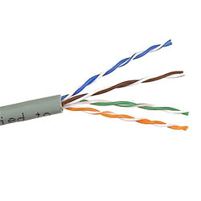
Twisted Pair
Twisted pair
Two insulated copper wires arranged in a regular spiral pattern to minimize interference
Various thicknesses, e.g. 0.016 inch (24 gauge)
Low cost
Telephone subscriber loop from customer to CO
Old trunk plant connecting telephone COs
Intra-building telephone from wiring closet to desktop
In old installations, loading coils added to improve quality in 3 kHz band, but more attenuation at higher frequencies
30
26 gauge
24 gauge
24
22 gauge
18
Attenuation (dB/mi)
19 gauge
12
6
f (kHz)
1
1000
10
100
Lower attenuation rate analog telephone
Higher attenuation rate
for DSL

Slide 83
Twisted Pair Bit Rates
Twisted pairs can provide high bit rates at short distances
Asymmetric Digital Subscriber Loop (ADSL)
  High-speed Internet Access
  Lower 3 kHz for voice
  Upper band for data
  64 kbps inbound
  640 kbps outbound
Much higher rates possible at shorter distances
  Strategy for telephone companies is to bring fiber close to home & then twisted pair
  Higher-speed access + video
Table 3.5 Data rates of 24-gauge twisted pair
Standard | Data Rate | Distance
T-1 | 1.544 Mbps | 18,000 feet, 5.5 km
DS2 | 6.312 Mbps | 12,000 feet, 3.7 km
1/4 STS-1 | 12.960 Mbps | 4500 feet, 1.4 km
1/2 STS-1 | 25.920 Mbps | 3000 feet, 0.9 km
STS-1 | 51.840 Mbps | 1000 feet, 300 m

Slide 84



Ethernet LANs
Category 3 unshielded twisted pair (UTP): ordinary telephone wires
Category 5 UTP: tighter twisting to improve signal quality
Shielded twisted pair (STP): to minimize interference; costly
10BASE-T Ethernet
  10 Mbps, Baseband, Twisted pair
  Two Category 3 UTPs
  Manchester coding, 100 meters
100BASE-T4 Fast Ethernet
  100 Mbps, Baseband, Twisted pair
  Four Category 3 UTPs
  Three pairs for one direction at-a-time
  100/3 Mbps per pair;
  Limited to100 meters
Category 5 & STP provide other options
●     

Slide 85


Coaxial Cable
Cylindrical braided outer conductor surrounds insulated inner wire conductor
High interference immunity
Higher bandwidth than twisted pair
Hundreds of MHz
Cable TV distribution
Long distance telephone transmission
Original Ethernet LAN medium
35
0.7/2.9 mm
30
25
1.2/4.4 mm
20
Attenuation (dB/km)
15
10
2.6/9.5 mm
5
0.1
1.0
10
100
f (MHz)

Slide 86
Optical Fiber
Electrical
signal
Modulator
Optical fiber
Receiver
Electrical
signal
Optical
source
Light sources (lasers, LEDs) generate pulses of light that are transmitted on optical fiber
  Very long distances (>1000 km)
  Very high speeds (>40 Gbps/wavelength)
  Nearly error-free (BER of 10⁻¹⁵)
Profound influence on network architecture
  Dominates long distance transmission
  Distance less of a cost factor in communications
  Plentiful bandwidth for new services

Slide 87
Transmission in Optical Fiber
Geometry of optical fiber
Light
Cladding
Jacket
Core
Total Internal Reflection in optical fiber
θ_{c}
Very fine glass cylindrical core surrounded by concentric layer of glass (cladding)
Core has higher index of refraction than cladding
Light rays incident at less than critical angle θ_{c} is completely reflected back into the core

Slide 88
Multimode & Single-mode Fiber
Multimode fiber: multiple rays follow different paths
Reflected path
Direct path
Single-mode fiber: only direct path propagates in fiber
Multimode: Thicker core, shorter reach
  Rays on different paths interfere causing dispersion & limiting bit rate
Single mode: Very thin core supports only one mode (path)
    More expensive lasers, but achieves very high speeds

Slide 89
Optical Fiber Properties
Advantages
Very low attenuation
Noise immunity
Extremely high bandwidth
Security: Very difficult to tap without breaking
No corrosion
More compact & lighter than copper wire
Disadvantages
New types of optical signal impairments & dispersion
  Polarization dependence
  Wavelength dependence
Limited bend radius
  If physical arc of cable too high, light lost or won’t reflect
  Will break
Difficult to splice
Mechanical vibration becomes signal noise

Slide 90
Further Reading
Textbook: 3.1, 3.2, 3.5, 3.6, 3.7, 3.8

