Slide 1
ECE 683
Computer Network Design & Analysis
Note 4: Circuit-Switching Networks

Slide 2
Circuit Switching Networks
End-to-end dedicated circuits between clients
  Client can be a person or equipment (router or switch)
Circuit can take different forms
  Dedicated path for the transfer of electrical current
  Dedicated time slots for transfer of voice samples
  Dedicated frames for transfer of Nx51.84 Mbps signals
  Dedicated wavelengths for transfer of optical signals
Circuit switching networks require:
  Multiplexing & switching of circuits
  Signaling & control for establishing circuits
These are the subjects covered in this chapter

Slide 3
Outline
Multiplexing
  TDM/FDM/WDM/CDM
Circuit switches
  Space-division switches
  Time-division switches
Telephone network
Signaling
Cellular telephone networks

Slide 4
Multiplexing
Multiplexing: sharing of an expensive transmission channel by multiple connections or information flows
  Channel = 1 wire, 1 optical fiber, or 1 frequency band
Implicit or explicit information is required to demultiplex the information flows
(a)
(b)
A
A
A
Trunk
group
A
B
B
B
MUX
MUX
B
C
C
C
C
Figure 4.1

Slide 5
Frequency-Division Multiplexing (FDM)
Channel divided into frequency slots
A
f
0
W_{u}
(a) Individual signals occupy W_{u} Hz
Guard bands required
AM or FM radio stations
TV stations in air or cable
Analog telephone systems
B
0
W_{u}
f
C
f
0
W_{u}
(b) Combined signal fits into channel bandwidth
A
B
C
f
0
W

Slide 6
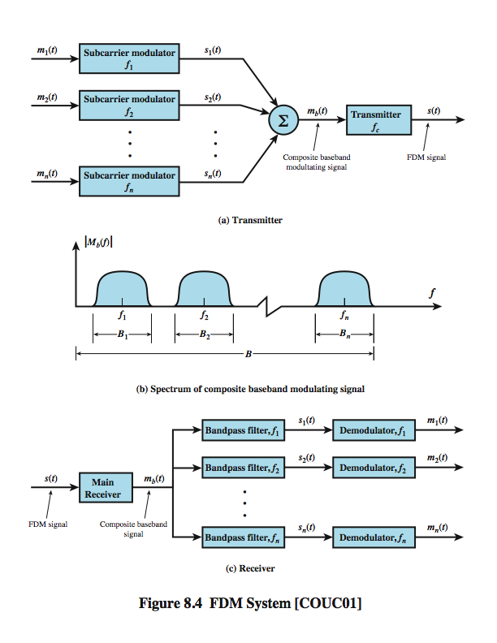
FDM
System Overview
Notes:
A generic depiction of an FDM system is shown in Stallings DCC8e Figure 8.4. A number of analog or digital signals [m_{i}(t), i = 1, n] are to be multiplexed onto the same transmission medium. Modulation equipment is needed to move each signal to the required frequency band, and multiplexing equipment is needed to combine the modulated signals. Each signal m_{i}(t) is modulated onto a carrier f_{i}; because multiple carriers are to be used, each is referred to as a subcarrier. Any type of modulation may be used. The resulting analog, modulated signals are then summed to produce a composite baseband signal m_{b}(t). Figure 8.4b shows the result. The spectrum of signal m_{i}(t) is shifted to be centered on f_{i}. For this scheme to work, f_{i} must be chosen so that the bandwidths of the various signals do not significantly overlap. Otherwise, it will be impossible to recover the original signals. The composite signal may then be shifted as a whole to another carrier frequency by an additional modulation step. The FDM signal s(t) has a total bandwidth B = Sum B_{i} . This analog signal may be transmitted over a suitable medium. At the receiving end, the FDM signal is demodulated to retrieve m_{b}(t), which is then passed through n bandpass filters, each filter centered on f_{i} and having a bandwidth B_{i}, for 1 ≤ i ≤ n. In this way, the signal is again split into its component parts. Each component is then demodulated to recover the original signal.

Slide 7
Time-Division Multiplexing (TDM)
High-speed digital channel divided into time slots
A₁
A₂
…
t
0T
3T
6T
Framing required
Telephone digital transmission
Digital transmission in backbone network
(a) Each signal transmits 1 unit every 3T seconds
B₁
B₂
…
t
0T
3T
6T
C₁
C₂
…
t
0T
3T
6T
(b) Combined signal transmits 1 unit every T seconds
A₁
B₁
C₁
A₂
B₂
C₂
…
t
0T 1T 2T 3T 4T 5T 6T

Slide 8
T-Carrier System
Digital telephone system uses TDM.
PCM voice channel is basic unit for TDM
  1 channel = 8 bits/sample x 8000 samples/sec. = 64 kbps
T-1 carrier carries Digital Signal 1 (DS-1) that combines 24 voice channels into a digital stream:
1
1
2
MUX
MUX
2
. . .
22
. . .
23
24
b
1
2
. . .
24
b
24
Frame
24
Framing bit
Bit Rate = 8000 frames/sec. x (1 + 8 x 24) bits/frame
    = 1.544 Mbps
Notes:
PCM=Pulse-code modulation

Slide 9

North American Digital Multiplexing Hierarchy
1
.
DS1 signal, 1.544Mbps
.
Mux
24
1
.
DS2 signal, 6.312Mbps
24 DS0
.
4 DS1
Mux
4
1
.
DS3 signal, 44.736Mpbs
.
7 DS2
Mux
7
1
.
DS0, 64 Kbps channel
DS1, 1.544 Mbps channel
DS2, 6.312 Mbps channel
DS3, 44.736 Mbps channel
DS4, 274.176 Mbps channel
.
6 DS3
Mux
6
DS4 signal
274.176Mbps

Slide 10
CCITT Digital Hierarchy
CCITT digital hierarchy based on 30 PCM channels
1
.
2.048 Mbps
.
Mux
30
1
.
8.448 Mbps
64 Kbps
.
Mux
4
1
.
34.368 Mpbs
.
Mux
4
139.264 Mbps
E1, 2.048 Mbps channel
E2, 8.448 Mbps channel
E3, 34.368 Mbps channel
E4, 139.264 Mbps channel
1
.
.
Mux
4
Notes:
CCITT=Comité Consultatif International Téléphonique et Télégraphique, now known as ITU (the parent organization), has defined many important standards for data communication.

Slide 11
Wavelength Division Multiplexing (WDM)
Similar to FDM (one-to-one correspondence to frequency), commonly used in optical networks
One fiber line transmits multiple colors
Optical
MUX
Optical
deMUX
λ₁
λ₁
λ₂
λ₁
λ_{2.}
λ₂
λ_{m}
Optical
fiber
λ_{m}
λ_{m}
Figure 4.18

Slide 12
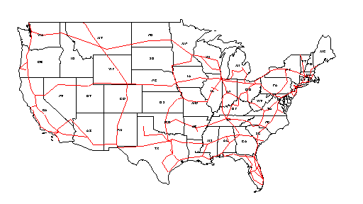
Typical U.S. Optical Long-Haul Network
In 1998

Slide 13
Code Division Multiplexing (CDM)
Different connections or flows use different codes: orthogonal codes are used
Commonly used in wireless systems: multiple users share the same channel
Notes:
An analogy to the problem of multiple access is a room (channel) in which people wish to talk to each other simultaneously. To avoid confusion, people could take turns speaking (time division), speak at different pitches (frequency/wavelength division), or speak in different languages (code division). Orthogonal codes have a cross-correlation equal to zero; in other words, they do not interfere with each other.

Slide 14
Note 4: Circuit-Switching Networks
Circuit Switches

Slide 15
Switching
Long distance transmission is typically done over a network of switching nodes
Intermediate switching nodes not concerned with content of data
End devices are stations
  Computer, terminal, phone, etc.
Data routed by being switched from node to node (router is a more complicated switch)

Slide 16
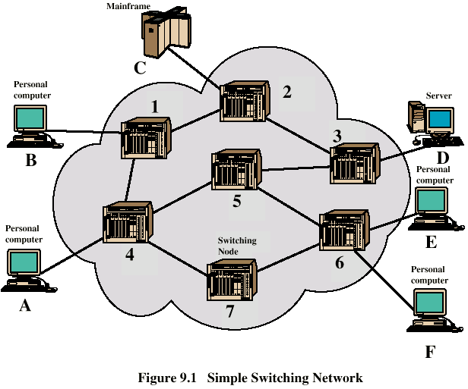
Simple Switched Network

Slide 17
Circuit Switches
Blocking
  Only finite paths in switches
  A switch is unable to connect stations because all paths are in use
  Blocking is possible: “all circuits are busy”
  Used on voice systems
    Short duration calls
Non-blocking
  Permits all stations to connect (in pairs) at once, no blocking inside a switch
  Used for some data connections (high speed)

Slide 18
Space Division Switching
Developed for analog environment
Separate physical paths
Crossbar switch
  Number of crosspoints grows as square of number of stations
  Loss of crosspoint prevents connection
  Inefficient use of crosspoints
    All stations connected, only a few crosspoints in use
  Non-blocking

Slide 19
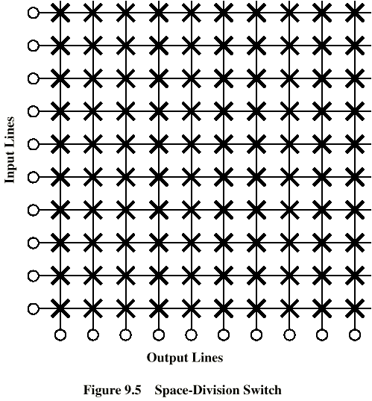
Crossbar Matrix

Slide 20
Multistage Switch
Reduced number of crosspoints
Increase the scalability
More than one path through network
  Increased reliability
More complex control
May be blocking

Slide 21
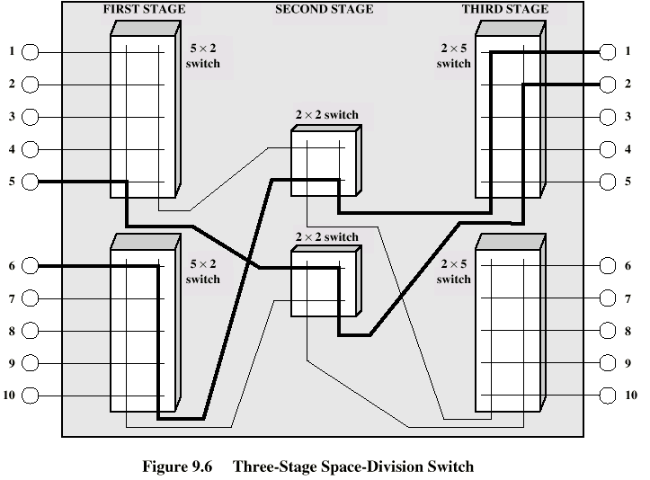
Three-Stage Switch

Slide 22
Three-Stage Switch
2(N/n)nk + k (N/n)² crosspoints
n×k
N/n × N/n
k×n
1
1
1
n×k
k×n
N
inputs
2
N/n × N/n
2
N
outputs
n×k
2
k×n
3
3
…
…
…
n×k
k×n
N/n
N/n × N/n
N/n
k

Slide 23
[Clos] Non-Blocking Condition: k=2n-1
Request connection from last input to input switch j to last output in output switch m
Worst Case: All other inputs have seized top n-1 middle switches AND all other outputs have seized next n-1 middle switches
If k=2n-1, there is another path left to connect desired input to desired output
nxk
N/n x N/n
kxn
1
1
1
…
…
n-1
busy
N/n x N/n
Desired
output
Desired
input
nxk
n-1
kxn
j
m
N/n x N/n
n-1
busy
…
n+1
…
N/n x N/n
2n-2
nxk
kxn
N/n
Free path
N/n x N/n
Free path
2n-1
N/n

Slide 24


Minimum Complexity Clos Switch
C(n) = number of crosspoints in Clos switch
= 2Nk + k( )² = 2N(2n – 1)+(2n – 1)( )²
Differentiate with respect to n:
0 = = 4N – + ≈ 4N – ==> n ≈
The minimized number of crosspoints is then:
C* = (2N + )(2( )^{1/2} – 1) ≈
This is lower than N² for large N
N n
N n
δC δn
2N² n²
2N² n³
2N² n²
N² N/2
N 2

Slide 25
Time-Slot Interchange (TSI) Switching
Write bytes from arriving TDM stream into memory
Read bytes in permuted order into outgoing TDM stream
Max # slots = 125 μsec / (2 x memory cycle time)
1
a
2
b
Read slots according to connection permutation
3
d
c
…
b
a
b
a
…
d
c
24
23
2
1
  
24
23
2
1
Write slots in order of arrival
22
23
c
Incoming TDM stream
Outgoing TDM stream
24
d
Time-slot interchange

Slide 26
Time-Space-Time Hybrid Switch
Use TSI in first & third stage; Use crossbar in middle
Replace n input x k output space switch by TSI switch that takes n-slot input frame and switches it to k-slot output frame
nxk
N/n x N/n
kxn
1
1
1
nxk
N
inputs
2
Input TDM frame with n slots
Output TDM frame with k slots
nxk
1
3
2
…
  
n … 2 1
k … 2 1
nxk
n
N/n
Time-slot interchange

Slide 27
Flow of time slots between switches
First slot
First slot
n × k
N/n × N/n
k × n
1
1
1
n × k
k × n
2
N/n × N/n
2
2
…
…
…
n × k
k × n
N/n
N/n × N/n
N/n
kth slot
k
kth slot
Only one space switch active in each time slot

Slide 28
Time-Share the Crossbar Switch
TSI stage
Space stage
TSI stage
TDM
n slots
nxk
TDM
k slots
TDM
k slots
kxn
1
1
n slots
nxk
kxn
N
inputs
2
N/n x N/n
Time-shared
space switch
2
N
outputs
n slots
nxk
kxn
3
3
…
…
n slots
nxk
kxn
N/n
N/n
Interconnection pattern of space switch is reconfigured every time slot
Very compact design: fewer lines because of TDM & less space because of time-shared crossbar

Slide 29
Example: A→2, B→4, C→1, D→3
(a)
A
C
B
A
3-stage Space Switch
C
D
D
B
(b)
B₂
A₂
B₁
A₁
B₁
A₁
C₁
A₁
3x2
A₁
C₁
2x3
1
1
Equivalent TST Switch
D₂
C₂
D₁
C₁
D₁
C₁
D₁
B₁
3x2
B₁
D₁
2x3
2
2

Slide 30
Example: T-S-T Switch Design
For N = 960
Single stage space switch ~ 1 million crosspoints
T-S-T
  Let n = 120 N/n = 8 TSIs
  k = 2n – 1 = 239 for non-blocking
  Pick k = 240 time slots
  Need 8x8 time-multiplexed space switch
For N = 96,000
T-S-T
  Let n = 120 k = 239
  N / n = 800
  Need 800x800 space switch

Slide 31
Note 4: Circuit-Switching Networks
Telephone networks

Slide 32

Telephone Call
User requests connection
Network signaling establishes connection
Speakers converse
User(s) hang up
Network releases connection resources
Source
Signal
Signal
Go
ahead
Message
Release
Signal
Destination

Slide 33
Call Routing
Local calls routed through local network (In U.S. Local Access & Transport Area)
(a)
4
C
D
2
3
5
A
B
1
Long distance calls routed to long distance service provider
(b)
Net 1
Net 2
LATA 1
LATA 2

Slide 34
Telephone Local Loop
Local Loop: “Last Mile”
Copper pair from telephone to CO
Pedestal to SAI to Main Distribution Frame (MDF)
2700 cable pairs in a feeder cable
MDF connects
  voice signal to telephone switch
  DSL signal to routers
Pedestal
Serving area interface
Local telephone office
Distribution cable
Distribution frame
Switch
Serving area interface
Feeder cable
For interesting pictures of switches & MDF, see
web.mit.edu/is/is/delivery/5ess/photos.html
www.museumofcommunications.org/coe.html
Notes:
SAI=Serving Area Interface. CO=Central Office. DSL=Digital subscriber line (Digital subscriber loop).

Slide 35
Fiber-to-the-Home or
Fiber-to-the-Curve?
Fiber connection to the home provides huge amount of bandwidth, but cost of optical modems still high
Fiber to the curve (pedestal) with shorter distance from pedestal to home can provide high speeds over copper pairs
Table 3.5 Data rates of 24-gauge twisted pair
Standard | Data Rate | Distance
T-1 | 1.544 Mbps | 18,000 feet, 5.5 km
DS2 | 6.312 Mbps | 12,000 feet, 3.7 km
1/4 STS-1 | 12.960 Mbps | 4500 feet, 1.4 km
1/2 STS-1 | 25.920 Mbps | 3000 feet, 0.9 km
STS-1 | 51.840 Mbps | 1000 feet, 300 m

Slide 36
Two- & Four-wire connections
From telephone to CO, two wires carry signals in both directions
Inside network, 1 wire pair per direction
Conversion from 2-wire to 4-wire occurs at hybrid transformer in the CO
Signal reflections can occur causing speech echo
Echo cancellers used to subtract the echo from the voice signals
Original signal
Transmit pair
Received signal
Four Wires
Echoed signal
Hybrid transformer
Two Wires
Receive pair

Slide 37
Note 4: Circuit-Switching Networks
Signaling

Slide 38
Setting Up Connections
Manually
Human Intervention
Telephone
  Voice commands & switchboard operators
Transport Networks
  Order forms & dispatching of craftpersons
Automatically
Management Interface
  Replace operators at console who set up connections at various switches
Automatic signaling
  Request for connection generates signaling messages that control connection setup in switches

Slide 39
Stored-Program Control (SPC) Switches
SPC switches (1960s)
  Crossbar switches with crossbars built from relays that open/close mechanically through electrical control
  Computer program controls set up opening/closing of crosspoints to establish connections between switch inputs and outputs
Signaling required to coordinate path set up across network
SPC
Control
Signaling Message

Slide 40
Message Signaling
Processors that control switches exchange signaling messages
Protocols defining messages & actions defined
Modems developed to communicate digitally over converted voice trunks
Office A
Trunks
Office B
Switch
Switch
Processor
Modem
Modem
Processor
Signaling

Slide 41
Network Intelligence
Intelligent Peripherals provide additional service capabilities
Voice Recognition & Voice Synthesis systems allow users to access applications via speech commands
“Voice browsers” currently under development (See: www.voicexml.org)
Long-term trend is for IP network to replace signaling system and provide equivalent services
Services can then be provided by telephone companies as well as new types of service companies
External
Database
Signaling
Network
Intelligent
Peripheral
SSP
SSP
Transport Network
Notes:
SSP=service switching point_x0013_

Slide 42
Signaling System Protocol Stack
Lower 3 layers ensure delivery of messages to signaling nodes
SCCP allows messages to be directed to applications
TCAP defines messages & protocols between applications
ISUP performs basic call setup & release
TUP instead of ISUP in some countries
Application layer
Presentation layer
TUP
TCAP
ISUP
Session layer
Transport layer
SCCP
Network layer
MTP level 3
Data link layer
MTP level 2
Physical layer
MTP level 1
ISUP = ISDN user part MTP = message transfer part
SCCP = signaling connection control part TCAP = transaction capabilities part
TUP = telephone user part

Slide 43
Note 4: Circuit-Switching Networks
Cellular Telephone Networks

Slide 44
Radio Communications
1900s: Radio telephony demonstrated
1920s: Commercial radio broadcast service
1930s: Spectrum regulation introduced to deal with interference
1940s: Mobile Telephone Service
  Police & ambulance radio service
  Single antenna covers transmission to mobile users in city
  Less powerful car antennas transmit to network of antennas around a city
  Very limited number of users can be supported

Slide 45
Cellular Communications
Two basic concepts:
Frequency Reuse
  A region is partitioned into cells
  Each cell is covered by base station
  Power transmission levels controlled to minimize inter-cell interference
  Spectrum can be reused in other cells
Handoff
  Procedures to ensure continuity of call as user moves from cell to another
  Involves setting up call in new cell and tearing down old one

Slide 46
Frequency Reuse
2
Adjacent cells may not use same band of frequencies
Frequency Reuse Pattern specifies how frequencies are reused
Figure shows 7-cell reuse: frequencies divided into 7 groups & reused as shown
Also 4-cell & 12-cell reuse possible
Note: CDMA allows adjacent cells to use same frequencies (Chapter 6)
7
3
1
6
4
5
2
2
7
3
7
3
1
1
6
4
6
4
5
5

Slide 47

Cellular Network
Base station
Transmits to users on forward channels
Receives from users on reverse channels
Mobile Switching Center
Controls connection setup within cells & to telephone network
BSS
BSS
MSC
HLR
STP
SS7
VLR
Wireline
terminal
EIR
PSTN
AC
AC = authentication center
BSS = base station subsystem
EIR = equipment identity register
HLR = home location register
MSC = mobile switching center
PSTN = public switched telephone network
STP = signal transfer point
VLR = visitor location register
Notes:
Signalling System 7 (SS7) protocols which are responsible for the call setup, management, and termination with other service switching points.

Slide 48
Signaling & Connection Control
Setup channels set aside for call setup & handoff
  Mobile unit selects setup channel with strongest signal & monitors this channel
Incoming call to mobile unit
  MSC sends call request to all BSSs
  BSSs broadcast request on all setup channels
  Mobile unit replies on reverse setup channel
  BSS forwards reply to MSC
  BSS assigns forward & reverse voice channels
  BSS informs mobile to use these
  Mobile phone rings

Slide 49
Mobile Originated Call
Mobile sends request in reverse setup channel
Message from mobile includes serial # and possibly authentication information
BSS forwards message to MSC
MSC consults Home Location Register for information about the subscriber
MSC may consult Authentication center
MSC establishes call to PSTN
BSS assigns forward & reverse channel

Slide 50
Handoff
Base station monitors signal levels from its mobiles
If signal level drops below threshold, MSC notified & mobile instructed to transmit on setup channel
Base stations in vicinity of mobile instructed to monitor signal from mobile on setup channel
Results forward to MSC, which selects new cell
Current BSS & mobile instructed to prepare for handoff
MSC releases connection to first BSS and sets up connection to new BSS
Mobile changes to new channels in new cell
Brief interruption in connection (except for CDMA)

Slide 51
Roaming
Users subscribe to roaming service to use service outside their home region
Signaling network used for message exchange between home & visited network
Roamer uses setup channels to register in new area
MSC in visited areas requests authorization from users Home Location Register
Visitor Location Register informed of new user
User can now receive & place calls

Slide 52
Further Reading
Textbook: 4.1, 4.4, 4.5, 4.6, 4.8

