Slide 1
ECE 683
Computer Network Design & Analysis
Note 5: Peer-to-Peer Protocols

Slide 2
Outline
Peer-to-Peer Protocols and Service Models
Error Control (Detection and Correction)
  Forward Error Control (FEC)
  Error detection (3.8)
  Automatic Retransmission Request (ARQ)

Slide 3
Note 5: Peer-to-Peer Protocols and Data Link Control
Peer-to-Peer Protocols and Service Models

Slide 4
Peer-to-Peer Protocols
●  
●  
Peer-to-Peer processes execute layer-n protocol to provide service to layer-(n+1)
n + 1 peer process
n + 1 peer process
SDU
SDU
Layer-(n+1) peer calls layer-n and passes Service Data Units (SDUs) for transfer
PDU
n peer process
n peer process
Layer-n peers exchange Protocol Data Units (PDUs) to effect transfer
n – 1 peer process
n – 1 peer process
Layer-n delivers SDUs to destination layer-(n+1) peer
●  
●  

Slide 5
Service Models
The service model specifies the information transfer service layer-n provides to layer-(n+1)
The most important distinction is whether the service is:
  Connection-oriented
  Connectionless
Other possible features of a service model :
  Arbitrary message size or structure
  Sequencing and Reliability
  Timing, Pacing, and Flow control
  Multiplexing
  Privacy, integrity, and authentication

Slide 6
Connection-Oriented Transfer Service
Connection Establishment
  Connection must be established between layer-n peers
  Layer-n protocol must: Set initial parameters, e.g. sequence numbers; and Allocate resources, e.g. buffers
Message transfer phase
  Exchange of SDUs
Disconnect phase
Example: TCP, PPP
n + 1 peer process
send
n + 1 peer process
receive
SDU
Layer n connection-oriented service
SDU

Slide 7
Connectionless Transfer Service
No Connection setup, simply send SDU
Each message send independently
Must provide all address information per message
Simple & quick
Example: UDP, IP
n + 1 peer process
send
n + 1 peer process
receive
SDU
Layer n connectionless service

Slide 8
Message Size and Structure
What message size and structure will a service model accept?
  Different services impose restrictions on size & structure of data it will transfer
  Single bit? Block of bytes? Byte stream?
  Ex: Transfer of voice mail = 1 long message
  Ex: Transfer of voice call = byte stream
1 voice mail= 1 message = entire sequence of speech samples
(a)
1 call = sequence of 1-byte messages
(b)

Slide 9
Segmentation & Blocking
To accommodate arbitrary message size, a layer may have to deal with messages that are too long or too short for its protocol
Segmentation & Reassembly: a layer breaks long messages into smaller blocks and reassembles these at the destination
Blocking & Unblocking: a layer combines small messages into bigger blocks prior to transfer
1 long message
2 or more short messages
2 or more blocks
1 block

Slide 10
Reliability & Sequencing
Reliability: Are messages or information stream delivered error-free and without loss or duplication?
Sequencing: Are messages or information stream delivered in order?
ARQ protocols combine error detection, retransmission, and sequence numbering to provide reliability & sequencing
Examples: TCP and HDLC
Notes:
ARQ=automatic retransmission request

Slide 11
Pacing and Flow Control
Messages can be lost if receiving system does not have sufficient buffering to store arriving messages
Pacing & Flow Control provide backpressure mechanisms that control transfer according to availability of buffers at the destination
Examples: TCP and HDLC

Slide 12
Timing
Applications involving voice and video generate units of information that are related temporally
Destination application must reconstruct temporal relation in voice/video units
Network transfer introduces delay & jitter
Timing Recovery protocols use timestamps & sequence numbering to control the delay & jitter in delivered information
Examples: RTP & associated protocols in Voice over IP

Slide 13
Multiplexing
Multiplexing enables multiple layer-(n+1) users to share a layer-n service
A multiplexing tag is required to identify specific users at the destination
Examples: UDP, IP

Slide 14
Privacy, Integrity, & Authentication
Privacy: ensuring that information transferred cannot be read by others
Integrity: ensuring that information is not altered during transfer
Authentication: verifying that sender and/or receiver are who they claim to be
Security protocols provide these services and are discussed in Chapter 11
Examples: IPSec, SSL

Slide 15
End-to-End vs. Hop-by-Hop
A service feature can be provided by implementing a protocol
  end-to-end across the entire network
  across every hop in the network
Example:
  Perform error control at every hop in the network or only between the source and destination?
  Perform flow control between every hop in the network or only between source & destination?
We next consider the tradeoffs between the two approaches

Slide 16
Error control in Data Link Layer
Packets
Packets
Data Link operates over wire-like, directly-connected systems
Frames can be corrupted or lost, but arrive in order
Data link performs error-checking & retransmission
Ensures error-free packet transfer between two systems
(a)
Data link
layer
Data link
layer
A
Frames
Physical
layer
B
Physical
layer
(b)
1
1
2
2
1
2
3
2
1
1
2
3
2
1
Medium
2
A
B
1
1
Physical layer entity
2
Data link layer entity
3
Network layer entity

Slide 17
Error Control in Transport Layer
Transport layer protocol (e.g. TCP) sends segments across network and performs end-to-end error checking & retransmission
Underlying network is assumed to be unreliable
Messages
Messages
Transport
layer
Segments
Transport
layer
Network
layer
Network
layer
Network
layer
Network
layer
Data link
layer
Data link
layer
Data link
layer
Data link
layer
End system
A
End system
B
Physical
layer
Physical
layer
Physical
layer
Physical
layer
Network

Slide 18
Segments can experience long delays, can be lost, or arrive out-of-order because packets can follow different paths across network
End-to-end error control protocol more difficult
1
2
3
2
1
C
2
2
1
1
End System
α
1
1
End System
β
1
2
2
2
4
3
2
1
1
2
3
2
1
1
2
3
2
1
1
2
3
4
Medium
2
A
B
1
Network
3
Network layer entity
4
Transport layer entity

Slide 19
End-to-End Approach Preferred
Hop-by-hop
Hop-by-hop cannot ensure E2E correctness
Data
Data
Data
Data
1
2
3
4
5
Faster recovery
ACK/NAK
ACK/NAK
ACK/NAK
ACK/NAK
Simple inside the network
End-to-end
ACK/NAK
More scalable if complexity at the edge
1
2
3
4
5
Data
Data
Data
Data

Slide 20
Quiz #2
What is the typical purpose of querying a DNS server?
What is the Shannon Capacity if SNR=40 dB and Bandwidth=20 MHz?
What is the maximum pulse rate (no inter-pulse interference) for a channel of bandwidth W?
How much time does it take for the 1st bit sent from transmitter to arrive at the receiver if distance=d meters, light speed=c m/s, msg size=L bits, transmission rate = R bits/s?
Compare NxN cross-bar and the multistage switches in terms of space complexity, blockage, and robustness to faults.

Slide 21
Note 5: Peer-to-Peer Protocols and Data Link Control
Error Control: Detection & Correction

Slide 22
Error Control
Digital transmission systems introduce errors
  Copper wires, BER = 10⁻⁶
  Optical fiber, BER= 10⁻⁹
  Wireless transmission, BER = 10⁻³
Applications require certain reliability level
  Data applications require error-free transfer
  Voice & video applications tolerate some errors
Error control is used when transmission system does not meet application requirement
Error control ensures a data stream is transmitted to a certain level of accuracy despite errors

Slide 23
Error Control Approaches
Error detection & ARQ
  The receiver detects errors and sends an automatic retransmission request (ARQ) when errors are detected
  A return channel is required for retransmissions requests
Forward error correction (FEC)
  The sender adds redundant data to its messages, also known as an error correction code. This allows the receiver to detect and correct errors (within some bound) without the need to ask the sender for additional data.
  A return channel is not required, or that retransmission of data can often be avoided, at the cost of higher bandwidth requirements on average.
  Applied in situations where retransmissions are relatively costly or impossible: satellite and deep-space communications; audio/video CD recordings

Slide 24
Key Idea of Error Detection
All transmitted data blocks (“codewords”) satisfy a pattern
If received block doesn’t satisfy pattern, it is in error
Redundancy: additional information required to transmit
Blindspot: when channel transforms a codeword into another codeword
All inputs to channel
satisfy pattern or condition
Channel
output
Deliver user
information or
set error alarm
User
information
Encoder
Channel
Pattern
checking

Slide 25
Single Parity Check
Append an overall parity check to k information bits
Info Bits: b₁, b₂, b₃, …, b_{k}
Check Bit: b_{k+1}= b₁+ b₂+ b₃+ …+ b_{k} modulo 2
Codeword: (b₁, b₂, b₃, …, b_{k,}, b_{k+1})
All codewords have even # of 1s
Receiver checks to see if # of 1s in a codeword is even
  All error patterns that change an odd # of bits are detectable
  All even-numbered patterns are undetectable
Parity bit used in ASCII code

Slide 26
Example of Single Parity Code
Information (7 bits): (0, 1, 0, 1, 1, 0, 0)
Parity Bit: b₈ = 0 + 1 +0 + 1 +1 + 0 = 1
Codeword (8 bits): (0, 1, 0, 1, 1, 0, 0, 1)
If single error in bit 3 : (0, 1, 1, 1, 1, 0, 0, 1)
  # of 1’s in the codeword = 5, odd;
  Error detected
If errors in bits 3 and 5: (0, 1, 1, 1, 0, 0, 0, 1)
  # of 1’s =4, even;
  Error not detected

Slide 27
Checkbits & Error Detection
Information bits
Received information bits
Recalculate check bits
k bits
Channel
Calculate check bits
Compare
Sent check
bits
Received check bits
Information accepted if check bits match

Slide 28
How good is the single parity check code?
Redundancy: Single parity check code adds 1 redundant bit per k information bits: overhead = 1/(k + 1)
Coverage: all error patterns with odd # of errors can be detected
  An error patten is a binary (k + 1)-tuple with 1s where errors occur and 0’s elsewhere
  Of 2^{k+1} binary (k + 1)-tuples, ½ are odd, so 50% of error patterns can be detected
Is it possible to detect more errors if we add more check bits?
Yes, with the right codes

Slide 29
What is a good code?
If codewords are close to each other, then detection failures will occur.
Good codes should maximize separation between codewords to minimize the likelihood of the channel converting one valid codeword into another.
o
o
o
x
o
x
Poor
distance properties
x
x
x
o
o
o
x
x
o
o
o
o
o
x = codewords
o = noncodewords
o
x
o
x
o
o
o
Good
distance properties
x
o
x
o
x
o
o
o
x
o
x
o

Slide 30
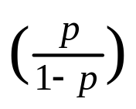
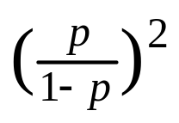
What if bit errors are random?
Many transmission channels introduce bit errors at random, independently of each other, and with probability p
Some error patterns are more probable than others:
P[10000000] = p(1 – p)⁷ = (1 – p)⁸ and
P[11000000] = p²(1 – p)⁶ = (1 – p)⁸
In any worthwhile channel p < 0.5, and so p/(1 – p) < 1
It follows that patterns with 1 error are more likely than patterns with 2 errors and so forth
What is the probability that an undetectable error pattern occurs?

Slide 31
Single parity check code with random bit errors
Undetectable error pattern if even # of bit errors:
P[error detection failure] = P[undetectable error pattern]
= P[error patterns with even number of 1s]
= p²(1 – p)^{n-2} + p⁴(1 – p)^{n-4} + …
n
2
n
4
Example: Evaluate above for n = 32, p = 10⁻³
32
2
32
4
P[undetectable error] = (10⁻³)² (1 – 10⁻³)³⁰ + (10⁻³)⁴ (1 – 10⁻³)²⁸
≈ 496 (10⁻⁶) + 35960 (10⁻¹²) ≈ 4.96 (10⁻⁴)
For this example, roughly 1 in 2000 msgs is undetectable

Slide 32
Two-Dimensional Parity Check
More parity bits to improve coverage
Arrange information as columns
Add single parity bit to each column
Add a final “parity” column
Used in early error control systems
1 0 0 1 0 0
0 1 0 0 0 1
1 0 0 1 0 0
1 1 0 1 1 0
1 0 0 1 1 1
Last column consists of check bits for each row
Bottom row consists of check bit for each column

Slide 33
Error-detecting capability
1 0 0 1 0 0
0 0 0 0 0 1
1 0 0 1 0 0
1 1 0 1 1 0
1 0 0 1 1 1
1 0 0 1 0 0
0 0 0 0 0 1
1 0 0 1 0 0
1 0 0 1 1 0
1 0 0 1 1 1
One error
Two errors
1, 2, or 3 errors can always be detected; Not all patterns >4 errors can be detected
1 0 0 1 0 0
0 0 0 1 0 1
1 0 0 1 0 0
1 0 0 1 1 0
1 0 0 1 1 1
1 0 0 1 0 0
0 0 0 1 0 1
1 0 0 1 0 0
1 0 0 0 1 0
1 0 0 1 1 1
Three errors
Four errors (undetectable)
Arrows indicate failed check bits

Slide 34
Other Error Detection Codes
Many applications require very low error rate
Need codes that detect the vast majority of errors
Single parity check codes do not detect enough errors
Two-dimensional codes require too many check bits
The following error detecting codes used in practice:
  Internet Check Sums
  CRC Polynomial Codes

Slide 35
Internet Checksum
Several Internet protocols (e.g. IP, TCP, UDP) use check bits to detect errors in the IP header (or in the header and data for TCP/UDP)
A checksum is calculated for header contents and included in a special field.
Checksum recalculated at every router, so algorithm selected for ease of implementation in software
Let header consist of L, 16-bit words,
  b₀, b₁, b₂, ..., b_{L-1}
The algorithm appends a 16-bit checksum b_{L}

Slide 36
Checksum Calculation
The checksum b_{L} is calculated as follows:
Treating each 16-bit word as an integer, find
x = b₀ + b₁ + b₂+ ...+ b_{L-1} modulo 2¹⁶-1
The checksum is then given by:
b_{L} = - x modulo 2¹⁶-1
Thus, the headers must satisfy the following pattern:
0 = b₀ + b₁ + b₂+ ...+ b_{L-1} + b_{L} modulo 2¹⁶-1
The checksum calculation is carried out in software using one’s complement arithmetic

Slide 37
Internet Checksum Example
Use Modulo Arithmetic
Assume 4-bit words
Use mod 2⁴-1 arithmetic
b₀=1100 = 12
b₁=1010 = 10
b₀+b₁=12+10=7 mod15
b₂ = -7 = 8 mod15
Therefore
b₂=1000
Use Binary Arithmetic
Note 16 =1 mod15
So: 10000 = 0001 mod15
leading bit wraps around
b₀ + b₁ = 1100+1010
=10110
=10000+0110
=0001+0110
=0111
=7
Take 1s complement
b₂ = -0111 =1000

Slide 38
Polynomial Codes
Polynomials instead of vectors for codewords
Polynomial arithmetic instead of checksums
Implemented using shift-register circuits
Also called cyclic redundancy check (CRC) codes
Most data communications standards use polynomial codes for error detection
Polynomial codes also basis for powerful error-correction methods

Slide 39
Binary Polynomial Arithmetic
Binary vectors map to polynomials
(i_{k-1} , i_{k-2} ,…, i₂ , i₁ , i₀) → i_{k-1}x^{k-1} + i_{k-2}x^{k-2} + … + i₂x² + i₁x + i₀
Addition:
(x⁷ + x⁶ + 1) + (x⁶ + x⁵) = x⁷ + x⁶ + x⁶ + x⁵ + 1
= x⁷ +(1+1)x⁶ + x⁵ + 1
= x⁷ +x⁵ + 1 since 1+1=0 mod2
Multiplication:
(x + 1) (x² + x + 1) = x(x² + x + 1) + 1(x² + x + 1)
= (x³ + x² + x) + (x² + x + 1)
= x³ + 1

Slide 40
Binary Polynomial Division
Division with Decimal Numbers
4
3
quotient
dividend = quotient x divisor +remainder
35 ) 1222
dividend
105
1222 = 34 x 35 + 32
divisor
2
17
140
32
remainder
Polynomial Division
x³
+ x²
+ x
= q(x) quotient
x³ + x + 1 ) x⁶ + x⁵
x⁶ + x⁴ + x³
dividend
divisor
x⁵ + x⁴ + x³
x⁵ + x³ + x²
Note: Degree of r(x) is less than degree of divisor
x⁴ + x²
x⁴ + x² + x
x
= r(x) remainder
Notes:
Lecture #5 finished here.

Slide 41
Polynomial Coding
Code has binary generating polynomial of degree n–k
g(x) = x^{n-k} + g_{n-k-1}x^{n-k-1} + … + g₂x² + g₁x + 1
k information bits define polynomial of degree k – 1
i(x) = i_{k-1}x^{k-1} + i_{k-2}x^{k-2} + … + i₂x² + i₁x + i₀
Find remainder polynomial of at most degree n – k – 1
q(x)
g(x) ) x^{n-k} i(x)
x^{n-k}i(x) = q(x)g(x) + r(x)
r(x)
Define the codeword polynomial of degree n – 1
b(x) = x^{n-k}i(x) + r(x)
n bits
k bits
n-k bits
Notes:
n>k is precondition.

Slide 42
Polynomial example: k = 4, n=7, n–k = 3
Generator polynomial: g(x)= x³ + x + 1
Information: (1,1,0,0) i(x) = x³ + x²
Encoding: x³i(x) = x⁶ + x⁵
x³ + x² + x
1110
x³ + x + 1 ) x⁶ + x⁵
1011 ) 1100000
x⁶ + x⁴ + x³
1011
x⁵ + x⁴ + x³
1110
x⁵ + x³ + x²
1011
x⁴ + x²
1010
x⁴ + x² + x
1011
x
010
Transmitted codeword: b(x) = x^{n-k}i(x) + r(x)
      b(x) =x³ (x³ + x²)+ x= x⁶ + x⁵ + x
      b = (1,1,0,0,0,1,0)

Slide 43
The Pattern in Polynomial Coding
All codewords satisfy the following pattern:
b(x) = x^{n-k}i(x) + r(x) = q(x)g(x) + r(x) + r(x) = q(x)g(x)
All codewords are a multiple of g(x)!
Receiver should divide received n-tuple by g(x) and check if remainder is zero
If remainder is nonzero, then received n-tuple is not a codeword

Slide 44
Undetectable error patterns
(Transmitter)
(Receiver)
b(x)
+
R(x)=b(x)+e(x)
(Channel)
  e(x)
Error polynomial
e(x) has 1s in error locations & 0s elsewhere
Receiver divides the received polynomial R(x) by g(x)
Blindspot: If e(x) is a multiple of g(x), that is, e(x) is a nonzero codeword, then
R(x) = b(x) + e(x) = q(x)g(x) + q’(x)g(x)
Choose the generator polynomial so that selected error patterns can be detected.

Slide 45
Designing good polynomial codes
Select generator polynomial so that likely error patterns are not multiples of g(x)
Detecting Single Errors
  e(x) = x^{i} for error in location i + 1
  If g(x) has more than 1 term, it cannot divide x^{i}
Detecting Double Errors
  e(x) = x^{i} + x^{j} = x^{i}(x^{j-i}+1) where 0 <= i< j <= n-1
  If g(x) has more than 1 term, it cannot divide x^{i}
  If g(x) is a primitive polynomial, it cannot divide x^{m}+1 for all
  m<2^{n-k}-1 (Need to keep codeword length not larger than 2^{n-k}-1)
  Primitive polynomials can be found by consulting coding theory books

Slide 46
Designing good polynomial codes
Detecting Odd Numbers of Errors
  Suppose all codeword polynomials have an even # of 1s, then all odd numbers of errors can be detected
  As well, b(x) evaluated at x = 1 is zero because b(x) has an even number of 1s
  This implies x + 1 must be a factor of all b(x)
  Pick g(x) = (x + 1) p(x) where p(x) is primitive

Slide 47
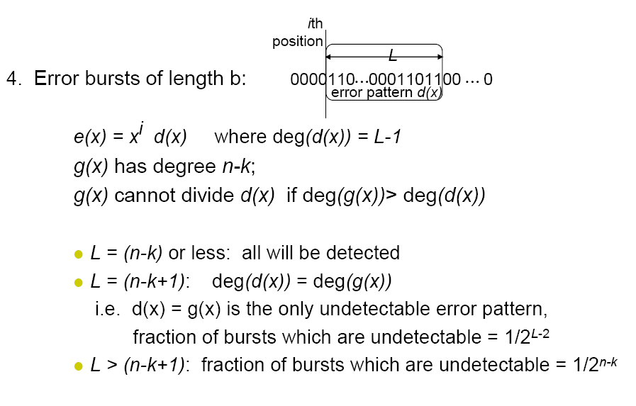
Detecting error bursts

Slide 48
Standard Generator Polynomials
CRC = cyclic redundancy check
CRC-8:
CRC-16:
CCITT-16:
CCITT-32:
= x⁸ + x² + x + 1
ATM
= x¹⁶ + x¹⁵ + x² + 1
= (x + 1)(x¹⁵ + x + 1)
Bisync
= x¹⁶ + x¹² + x⁵ + 1
HDLC, XMODEM, V.41
IEEE 802, DoD, V.42
= x³² + x²⁶ + x²³ + x²² + x¹⁶ + x¹² + x¹¹ + x¹⁰ + x⁸ + x⁷ + x⁵ + x⁴ + x² + x + 1

Slide 49
FEC based on Erasure Codes
Basic idea
  All packets in error are considered lost or erased
  Given a message of M blocks, generate N blocks for N>M, such that the original message can be recovered from any M’ of those encoded blocks
  M’/N – the rate
  M’=M – optimal erasure codes, often costly in terms of memory usage, CPU time or both when N is large
  M’= (1+r)M – nearly optimal erasure codes; r can be reduced at the cost of CPU time
  Rateless erasure codes (fountain codes): N can be potentially limitless, i.e., the percentage of packets that must be received to decode the message can be arbitrarily small
Notes:
FEC=Forward Error Correction

Slide 50
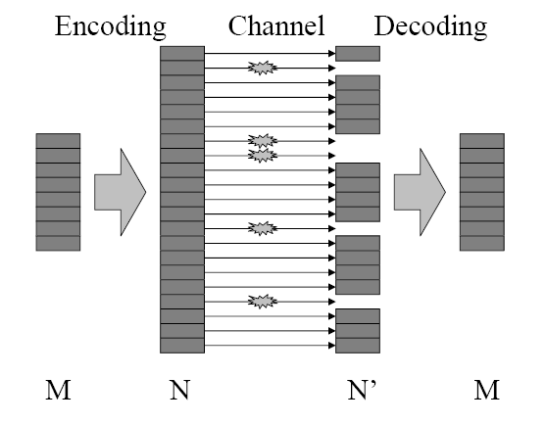
Erasure Codes Illustration
’

