Slide 1
Automatic Repeat Request (ARQ)
Purpose:
  ensure a sequence of information packets is delivered in order and without errors or duplications despite transmission errors & losses
We will look at:
  Stop-and-Wait ARQ
  Go-Back N ARQ
  Selective Repeat ARQ
Basic elements of ARQ:
  Error-detecting code with high error coverage
  Information frames (I-frame)
  Control frames (C-frame)
  Time-out methanisms

Slide 2
Basic Elements of ARQ
Transmit a frame, wait for ACK
Packet
Error-free
packet
Information frame
Transmitter
(Process A)
Receiver
(Process B)
Timer set after each frame transmission
Control frame
Header
CRC
Information
packet
Header
CRC
Information frame
Control frame: ACKs or NAKs

Slide 3
Stop-and-Wait ARQ
The transmitter A and receiver B works on delivering one frame at a time
  A sends an I-frame to B and then stops and waits for an ACK from B
  If no ACK is received within some time-out period, A resends the frame and once gain stops and waits

Slide 4
Need for Sequence Numbers
(a) Frame 0 OK but 1 lost
Time-out
Time
A
Frame
0
Frame
1
Frame
1
Frame
2
B
ACK
ACK
(b) Frame 1’s ACK lost
Time-out
Time
A
Frame
0
Frame
1
Frame
1
Frame
2
ACK
ACK
ACK
B
  In cases (a) & (b) the transmitting station A acts the same way
  But in case (b) the receiving station B accepts frame 1 twice
  Question: How is the receiver to know the second frame is also frame 1?
  Answer: Add frame sequence number in header
  S_{last} is sequence number of most recent transmitted frame

Slide 5
Sequence Numbers
(c) Premature Time-out
Time-out
Time
A
Frame
0
Frame
0
Frame
1
Frame
2
ACK
ACK
B
  The transmitting station A misinterprets duplicate ACKs
  Incorrectly assumes second ACK acknowledges Frame 1
  Question: How is the receiver to know second ACK is for frame 0?
  Answer: Add frame sequence number in ACK header
  R_{next} is sequence number of next frame expected by the receiver
  Implicitly acknowledges receipt of all prior frames

Slide 6
1-Bit Sequence Numbering Suffices
0 1
0 1
0 1
0 1
0 1
0 1
0 1
0 1
S_{last}
R_{next}
Timer
Transmitter A
S_{last}
Receiver B
R_{next}
Global State:
(S_{last}, R_{next})
Error-free frame 0
arrives at receiver
(0,0)
(0,1)
ACK for
frame 0
arrives at
transmitter
ACK for
frame 1
arrives at
transmitter
Error-free frame 1
arrives at receiver
(1,0)
(1,1)

Slide 7
Stop-and-Wait ARQ
Transmitter
Ready state
Await request from higher layer for packet transfer
When request arrives, transmit frame with updated S_{last} and CRC
Go to Wait State
Wait state
Wait for ACK or timer to expire; block requests from higher layer
If timeout expires
  retransmit frame and reset timer
If ACK received:
  If sequence number is incorrect or if errors detected: ignore ACK
  If sequence number is correct (R_{next} = S_{last} +1): accept frame, go to Ready state
Receiver
Always in Ready State
Wait for arrival of new frame
When frame arrives, check for errors
If no errors detected and sequence number is correct (S_{last}=R_{next}), then
  accept frame,
  update R_{next},
  send ACK frame with R_{next},
  deliver packet to higher layer
If no errors detected but wrong sequence number
  discard frame
  send ACK frame with R_{next}
If errors detected
  discard frame

Slide 8
Applications of Stop-and-Wait ARQ
IBM Binary Synchronous Communications protocol (Bisync): character-oriented data link control
Xmodem: modem file transfer protocol
Trivial File Transfer Protocol (RFC 1350): simple protocol for file transfer over UDP

Slide 9
Stop-and-Wait Efficiency
Last frame bit enters channel
ACK arrives
First frame bit enters channel
Channel idle while transmitter waits for ACK
t
A
B
t
First frame bit arrives at receiver
Receiver processes frame and
prepares ACK
Last frame bit arrives at receiver
10000 bit frame @ 1 Mbps takes 10 ms to transmit
If wait for ACK = 1 ms, then efficiency = 10/11= 91%
If wait for ACK = 20 ms, then efficiency =10/30 = 33%

Slide 10
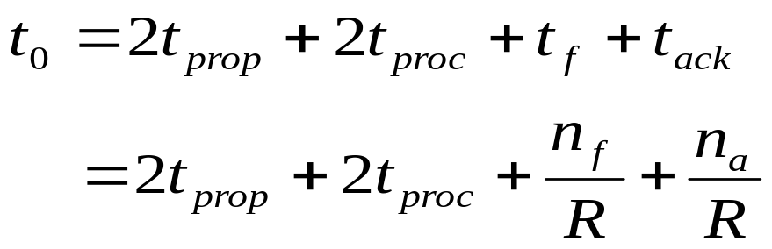
Stop-and-Wait Model
      t₀ = total time to transmit 1 frame
A
t_{proc}
B
t_{prop}
frame
t_{f} time
t_{proc}
t_{ack}
t_{prop}
bits/info frame
bits/ACK frame
channel transmission rate

Slide 11
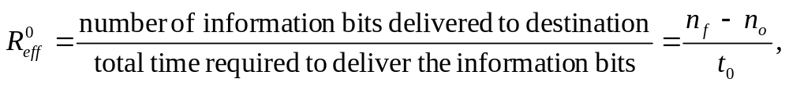
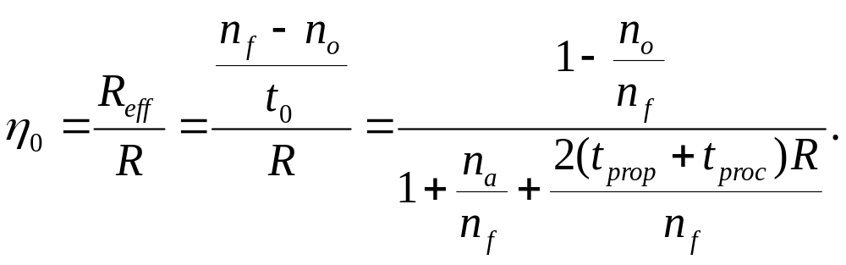
S&W Efficiency on Error-free channel
Effective transmission rate:
bits for header & CRC
Transmission efficiency:
Effect of
frame overhead
Effect of
Delay-Bandwidth Product
Effect of
ACK frame

Slide 12
Example: Impact of
Delay-Bandwidth Product
n_{f}=1250 bytes = 10000 bits, n_{a}=n_{o}=25 bytes = 200 bits
2xDelayxBW Efficiency | 1 ms 200 km | 10 ms 2000 km | 100 ms 20000 km | 1 sec 200000 km
1 Mbps | 10³ 88% | 10⁴ 49% | 10⁵ 9% | 10⁶ 1%
1 Gbps | 10⁶ 1% | 10⁷ 0.1% | 10⁸ 0.01% | 10⁹ 0.001%
Stop-and-Wait does not work well for very high speeds or long propagation delays.
The higher the speed, the lower the transmission efficiency.
The longer the propagation delay, the lower the efficiency.

Slide 13
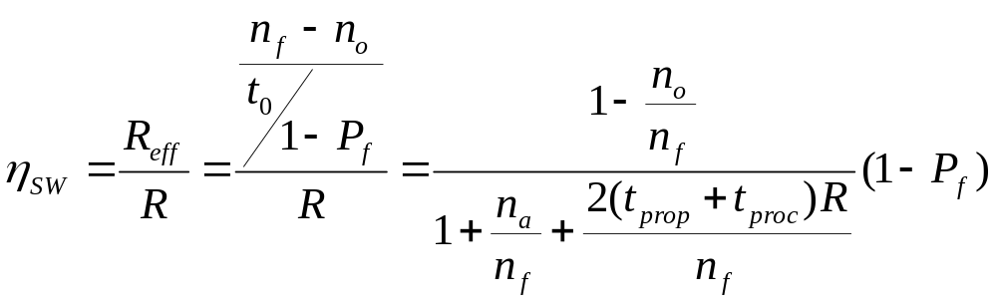
S&W Efficiency in Channel with Errors
Let 1 – P_{f} = probability frame arrives w/o errors
Avg. # of transmissions to first correct arrival is then 1/ (1–P_{f} )
“If 1-in-10 get through without error, then avg. 10 tries to succeed”
Avg. Total Time per frame is then t₀/(1 – P_{f})
Effect of frame loss

Slide 14
Example: Impact Bit Error Rate
n_{f}=1250 bytes = 10000 bits, n_{a}=n_{o}=25 bytes = 200 bits, R= 1Mbps,
2(t_{prop}+t_{proc)} =1 ms
Find efficiency for random bit errors with p=0, 10⁻⁶, 10⁻⁵, ad 10⁻⁴
1 Mbps & 1 ms | 0 | 10⁻⁶ | 10⁻⁵ | 10⁻⁴
1 – P_{f} Efficiency | 1 88% | 0.99 86.6% | 0.905 79.2% | 0.368 32.2%
Bit errors impact performance as n_{f}p approaches 1.

Slide 15
Go-Back-N
Improve Stop-and-Wait by not waiting!
Keep channel busy by continuing to send frames
Allow a window of up to W_{s} outstanding frames
Use m-bit sequence numbering
If ACK for the oldest frame arrives before window is exhausted, we can continue transmitting
If window is exhausted, pull back and retransmit all outstanding frames
Alternative: Use timeout

Slide 16
Go-Back-N ARQ
Go-Back-4:
4 frames are outstanding; so go back 4
fr
0
fr
1
fr
2
fr
3
fr
4
fr
5
fr
6
fr
3
fr
4
fr
5
fr
6
fr
7
fr
8
fr
9
Time
A
B
ACK1
ACK2
ACK3
out of sequence frames
ACK4
ACK5
ACK6
ACK7
ACK8
ACK9
R_{next} 0 1 2 3 3 4 5 6 7 8 9
  Frame transmission are pipelined to keep the channel busy
  Frame with errors and subsequent out-of-sequence frames are ignored
  Transmitter is forced to go back when window of 4 is exhausted

Slide 17
Window size long enough to cover round trip time
Stop-and-Wait ARQ
Time-out expires
fr
0
fr
0
fr
1
Time
A
B
Receiver is looking for R_{next}=0
ACK1
Go-Back-N ARQ
Four frames are outstanding; so go back 4
fr
0
fr
1
fr
2
fr
3
fr
0
fr
1
fr
2
fr
3
fr
4
fr
5
fr
6
Time
A
B
Receiver is looking for R_{next}=0
Out-of-sequence frames
ACK1
ACK2
ACK3
ACK4
ACK5
ACK6

Slide 18
Go-Back-N with Timeout
Problem with Go-Back-N as presented:
  If frame is lost and source does not have frame to send, then window will not be exhausted and recovery will not commence
Use a timeout with each frame
  When timeout expires, resend all outstanding frames

Slide 19
Go-Back-N Transmitter & Receiver
Transmitter
Receiver
Send Window
Receive Window
...
Frames
transmitted
and ACKed
S_{last}
S_{recent}
S_{last}+W_{s}-1
Buffers
Frames
received
oldest un-ACKed frame
R_{next}
Timer
S_{last}
Receiver will only accept
a frame that is error-free and
that has sequence number R_{next}
When such frame arrives R_{next} is incremented by one, so the receive window slides forward by one
Timer
S_{last}+1
...
S_{recent}
most recent transmission
Timer
...
S_{last}+W_{s}-1
max Seq # allowed

Slide 20
Sliding Window Operation
Transmitter
m-bit Sequence Numbering
Send Window
...
0
Frames
transmitted
and ACKed
2^{m} – 1
1
S_{last}
S_{recent}
S_{last}+W_{s}-1
2
Transmitter waits for error-free ACK frame with sequence number S_{last}
When such ACK frame arrives, S_{last} is incremented by one, and the send window slides forward by one
S_{last}
send
window
i
i + W_{s} – 1
i + 1

Slide 21
Maximum Allowable Window Size is W_{s} = 2^{m}-1
M = 2² = 4, Go-Back - 4:
Transmitter goes back 4
fr
0
fr
1
fr
2
fr
3
fr
0
fr
1
fr
2
fr
3
Time
A
B
ACK1
ACK2
ACK3
ACK
0
Receiver has R_{next}= 0, but it does not know whether its ACK for frame 0 was received, so it does not know whether this is the old frame 0 or a new frame 0
R_{next} 0 1 2 3 0
M = 2² = 4, Go-Back-3:
Transmitter goes back 3
fr
0
fr
1
fr
2
fr
0
fr
1
fr
2
Time
A
B
ACK1
ACK2
ACK3
Receiver has R_{next}= 3 , so it rejects the old frame 0
R_{next} 0 1 2 3

Slide 22
ACK Piggybacking in Bidirectional GBN
Transmitter
S^{A}_{recent} R^{A} _{next}
Receiver
Receiver
Transmitter
S^{B}_{recent} R^{B} _{next}
“A” Receive Window
“B” Receive Window
R^{A} _{next}
R^{B} _{next}
“A” Send Window
“B” Send Window
...
...
S^{A} _{last}
S^{A} _{last}+W^{A} _{s}-1
S^{B} _{last}
S^{B} _{last}+W^{B} _{s}-1
Buffers
Buffers
Timer
S^{A} _{last}
Timer
S^{B} _{last}
Timer
S^{A} _{last}+1
Note: Out-of-sequence error-free frames discarded after R_{next} examined
Timer
S^{B}_{last}+1
...
...
Timer
S^{A}_{recent}
Timer
S^{B}_{recent}
...
...
Timer
S^{A} _{last}+W^{A} _{s}-1
Timer
S^{B} _{last}+W^{B} _{s}-1
Notes:
s

Slide 23
Applications of Go-Back-N ARQ
HDLC (High-Level Data Link Control): bit-oriented data link control
V.42 modem: error control over telephone modem links

Slide 24
Required Timeout & Window Size
T_{out}
T_{proc}
T_{prop}
T_{f}
T_{f}
T_{prop}
Timeout value should allow for:
  Two propagation times + 1 processing time: 2 T_{prop} + T_{proc}
  A frame that begins transmission right before our frame arrives T_{f}
  Next frame carries the ACK, T_{f}
W_{s} should be chosen larger than the delay-bandwidth product to keep the channel busy or full

Slide 25
Required Window Size for
Delay-Bandwidth Product
Frame = 1250 bytes =10,000 bits (n_{f}), R = 1 Mbps
2(t_{prop} + t_{proc}) | 2 x Delay x BW | Window
1 ms | 1000 bits | 1
10 ms | 10,000 bits | 2
100 ms | 100,000 bits | 11
1 second | 1,000,000 bits | 101
Notes:
e.g., 1msx1Mbps=10⁻³x10⁶=10³ bits. Delay-Bandwidth=1000/n_{f}=1000/100000=0.1

Slide 26
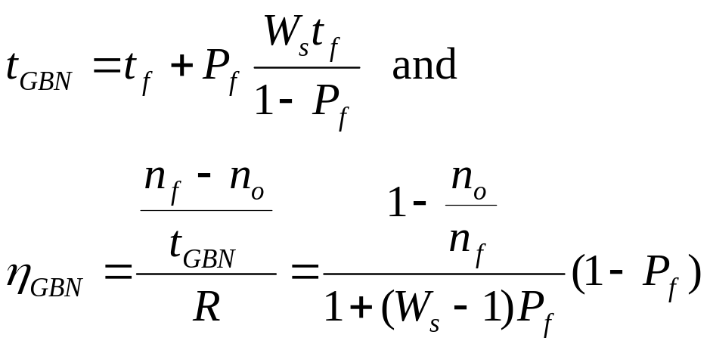
Efficiency of Go-Back-N
GBN is completely efficient, if W_{s} large enough to keep channel busy, and if channel is error-free
Assume P_{f} frame loss probability, then time to deliver a frame is:
  See Appendix 5A for the derivation
Delay-bandwidth product determines W_{s}

Slide 27
Example: Impact Bit Error Rate on GBN
n_{f}=1250 bytes = 10000 bits, n_{a}=n_{o}=25 bytes = 200 bits
Compare S&W with GBN efficiency for random bit errors with p = 0, 10⁻⁶, 10⁻⁵, 10⁻⁴ and R = 1 Mbps & reaction time = 100 ms
1 Mbps x 100 ms = 100000 bits = 10 frames → Use W_{s} = 11
Efficiency | 0 | 10⁻⁶ | 10⁻⁵ | 10⁻⁴
S&W | 8.9% | 8.8% | 8.0% | 3.3%
GBN | 98% | 88.2% | 45.4% | 4.9%
Go-Back-N significant improvement over Stop-and-Wait for large delay-bandwidth product
Go-Back-N becomes inefficient as error rate increases

Slide 28
Selective Repeat ARQ
Go-Back-N ARQ is inefficient because multiple frames are resent when errors or losses occur
Selective Repeat retransmits only an individual frame
  Timeout causes individual outstanding frame to be resent
  NAK causes retransmission of the oldest un-acked frame
Receiver maintains a receive window of sequence numbers that can be accepted
  Error-free, but out-of-sequence frames with sequence numbers within the receive window are buffered
  Arrival of frame with R_{next} causes window to slide forward by 1 or more

Slide 29
Selective Repeat ARQ
fr
0
fr
1
fr
2
fr
3
fr
4
fr
5
fr
6
fr
2
fr
7
fr
8
fr
9
fr
10
fr
11
fr
12
Time
A
B
ACK1
ACK2
NAK2
NAK2
NAK2
NAK2
ACK7
ACK8
ACK9
ACK10
ACK11
ACK12

Slide 30
Selective Repeat ARQ
Transmitter
Receiver
Send Window
Receive Window
...
Frames
transmitted
and ACKed
Frames
received
S_{last}
S_{recent}
S_{last}+ W_{s}-1
R_{next}
R_{next} + W_{r}-1
Buffers
Buffers
Timer
S_{last}
R_{next}+ 1
Timer
S_{last}+ 1
R_{next}+ 2
...
S_{recent}
...
Timer
R_{next}+ W_{r}- 1
max Seq # accepted
...
S_{last}+ W_{s} - 1

Slide 31
Send & Receive Windows
Transmitter
Receiver
0
0
2^{m}-1
1
2^{m}-1
1
2
2
R_{next}
S_{last}
send
window
receive
window
j
i
i
i + W_{s} – 1
i + 1
j + W_{r} – 1
Moves k forward when ACK
arrives with R_{next} = S_{last} + k
k = 1, …, W_{s}-1
Moves forward by 1 or more when frame arrives with Seq. # = R_{next}

Slide 32
What size W_{s} and W_{r} allowed?
Example: M=2²=4, W_{s}=3, W_{r}=3
Frame 0 resent
Send Window
{0,1,2}
{1,2}
{2}
{.}
A
fr0
fr1
fr2
fr0
Time
B
Receive Window
ACK1
ACK2
ACK3
{0,1,2}
{1,2,3}
{2,3,0}
{3,0,1}
Old frame 0 accepted as a
new frame because it falls
in the receive window

Slide 33
W_{s} + W_{r} = 2^{m} is maximum allowed
Example: M=2²=4, W_{s}=2, W_{r}=2
Frame 0 resent
Send Window
{0,1}
{1}
{.}
A
fr0
fr1
fr0
Time
B
Receive Window
ACK1
ACK2
{0,1}
{1,2}
{2,3}
Old frame 0 rejected because it falls outside the receive window

Slide 34
Why W_{s} + W_{r} = 2^{m} works
Transmitter sends frames 0 to Ws-1; send window empty
All arrive at receiver
All ACKs lost
Receiver window starts at {0, …, W_{r}}
Window slides forward to {W_{s},…,W_{s}+W_{r}-1}
Receiver rejects frame 0 because it is outside receive window
Transmitter resends frame 0
0
0
2^{m}-1
1
2^{m}-1
1
S_{last}
W_{s} +W_{r}-1
2
2
receive
window
R_{next}
W_{s}
send
window
W_{s}-1

Slide 35
Applications of Selective Repeat ARQ
TCP (Transmission Control Protocol): transport layer protocol uses variation of selective repeat to provide reliable stream service
Service Specific Connection Oriented Protocol: error control for signaling messages in ATM networks

Slide 36
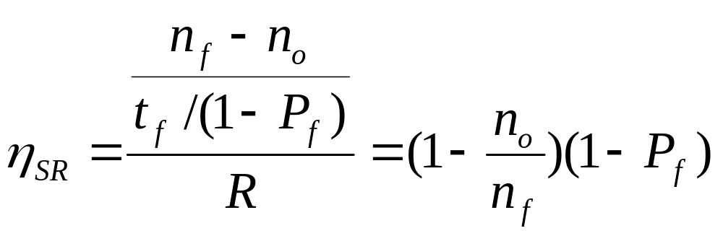
Efficiency of Selective Repeat
Assume that P_{f} is frame loss probability, then number of transmissions required to deliver a frame is:
  t_{f} /(1-P_{f})
Notes:
t_{f}=n_{f}/R

Slide 37
Example: Impact Bit Error Rate on Selective Repeat
n_{f}=1250 bytes = 10000 bits, n_{a}=n_{o}=25 bytes = 200 bits
Compare S&W, GBN & SR efficiency for random bit errors with p=0, 10⁻⁶, 10⁻⁵, 10⁻⁴ and R= 1 Mbps & 100 ms
Efficiency | 0 | 10⁻⁶ | 10⁻⁵ | 10⁻⁴
S&W | 8.9% | 8.8% | 8.0% | 3.3%
GBN | 98% | 88.2% | 45.4% | 4.9%
SR | 98% | 97% | 89% | 36%
Selective Repeat outperforms GBN and S&W, but efficiency drops as error rate increases

Slide 38
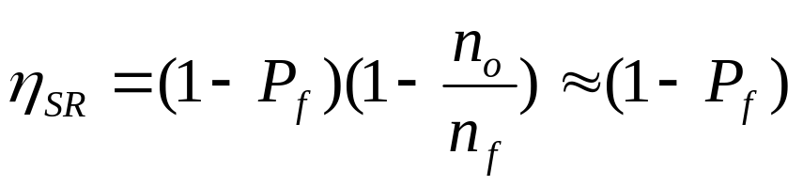
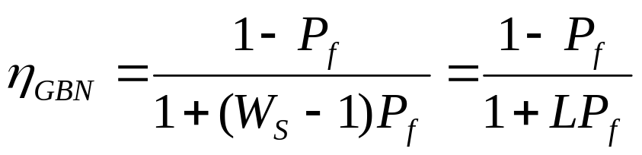
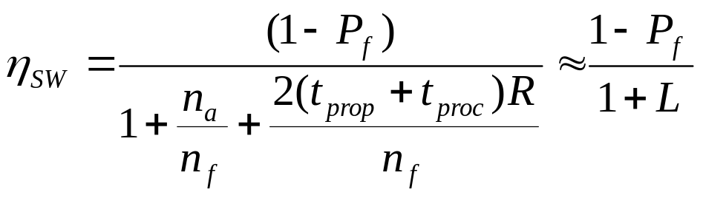
Comparison of ARQ Efficiencies
Assume n_{a} and n_{o} are negligible relative to n_{f}, and
L = 2(t_{prop}+t_{proc})R/n_{f} =(W_{s}-1), then
Selective-Repeat:
Go-Back-N:
For P_{f}≈0, SR & GBN same
For P_{f}→1, GBN & SW same
Stop-and-Wait:

Slide 39
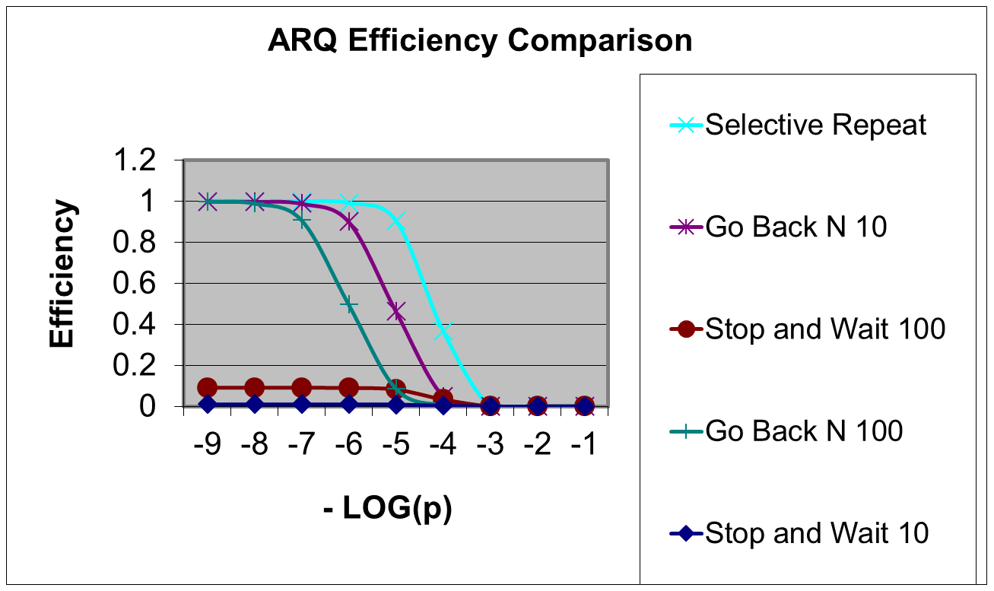
ARQ Efficiencies
10⁻⁹ 10⁻⁸ 10⁻⁷ 10⁻⁶ 10⁻⁵ 10⁻⁴ 10⁻³ 10⁻² 10⁻¹
p
0
Delay-Bandwidth product = 10 and 100 frames

