Slide 1
ECE 683
Computer Network Design & Analysis
Note 6: Medium Access Control Protocols

Slide 2
Outline
Multiple Access Communications
Random Access
  ALOHA
  Slotted ALOHA
  Carrier Sense Multiple Access (CSMA)
  CSMA with Collision Detection (CSMA-CD)
Scheduling
Channelization

Slide 3
Multiple Access Communications
Shared media is the basis of broadcast networks
  Inexpensive: radio over air; copper or coaxial cable
  M users communicate by broadcasting into the medium
Key issue: How to share the medium?
3
2
4
1
Shared multiple
access medium
M
5
…
Broadcast networks are often also referred to as multiple access networks

Slide 4
Approaches to Media Sharing
Medium sharing techniques
MAC protocols
Static channelization
Dynamic medium access control
Partition medium
Dedicated allocation to users
Satellite transmission
Cellular Telephone
Scheduling
Random access
Polling: take turns
Request for slot in transmission schedule
Token ring
Wireless LANs
Loose coordination
Send, wait, retry if necessary
Aloha
Ethernet

Slide 5
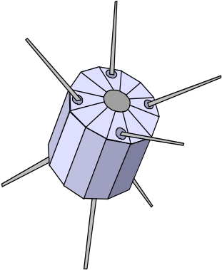

Channelization: Satellite
Satellite Channel
uplink f_{in}
downlink f_{out}

Slide 6


Channelization: Cellular
uplink f₁ ; downlink f₂
uplink f₃ ; downlink f₄

Slide 7
Scheduling: Polling
Inbound line
Data from 1
Data from 2
Poll 1
Poll 2
Data to M
Outbound line
Host
computer
1
2
3
M
Stations

Slide 8
Scheduling: Token-Passing
Ring networks
token
Data to M
token
Station that holds token transmits into ring

Slide 9
Random Access
Multitapped Bus
Crash!!
Transmit when ready
Collisions can occur; need retransmission strategy

Slide 10

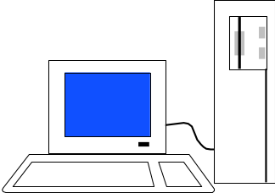
Wireless LAN
AdHoc: station-to-station
Infrastructure: stations to base station
Random access & polling

Slide 11
Delay-Bandwidth Product
Delay-bandwidth product is the key parameter
  Coordination in sharing medium involves using bandwidth (explicitly or implicitly)
  Difficulty of coordination is commensurate with delay-bandwidth product
Simple two-station example
  Station with frame to send listens to medium and transmits if medium is found idle
  Station monitors medium to detect collision
  If collision occurs, station that begin transmitting earlier retransmits (propagation time is known)

Slide 12
Two-Station MAC Example
Two stations are trying to share a common medium
Distance d meters
t_{prop} = d / ν seconds
A transmits at t = 0
A
B
Case 1
B does not transmit before t = t_{prop} & A captures channel
A
B
Case 2
B transmits before t = t_{prop} and detects
collision soon
thereafter
A
B
A detects
collision at
t = 2 t_{prop}
A
B

Slide 13
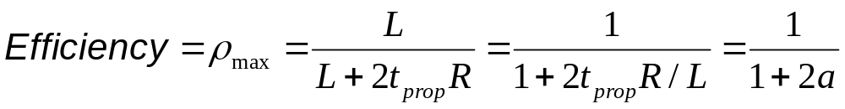
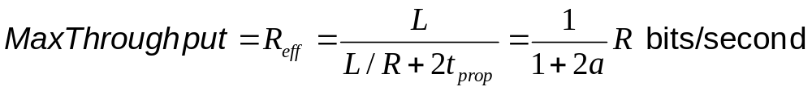
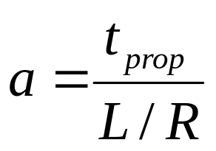
Efficiency of Two-Station Example
Each frame transmission requires 2t_{prop} of quiet time
  Station B needs to be quiet t_{prop} before and after time when Station A transmits
  R transmission bit rate
  L bits/frame
Normalized Delay-Bandwidth Product
Propagation delay
Time to transmit a frame

Slide 14
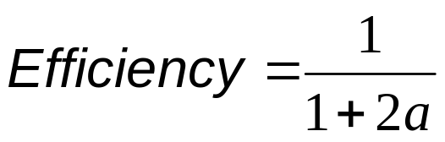
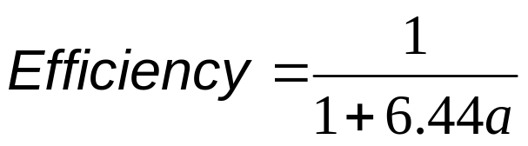
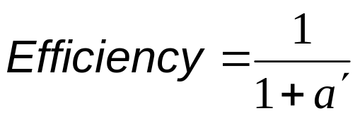
Typical MAC Efficiencies
Two-Station Example:
If a<<1, then efficiency close to 100%
As a approaches 1, the efficiency becomes low
CSMA-CD (Ethernet) protocol:
Token-ring network
a΄= latency of the ring (bits)/average frame length

Slide 15
Typical Delay-Bandwidth Products
Distance | 10 Mbps | 100 Mbps | 1 Gbps | Network Type
1 m | 3.33 x 10⁻⁰² | 3.33 x 10⁻⁰¹ | 3.33 x 10⁰ | Desk area network
100 m | 3.33 x 10⁰¹ | 3.33 x 10⁰² | 3.33 x 10⁰³ | Local area network
10 km | 3.33 x 10⁰² | 3.33 x 10⁰³ | 3.33 x 10⁰⁴ | Metropolitan area network
1000 km | 3.33 x 10⁰⁴ | 3.33 x 10⁰⁵ | 3.33 x 10⁰⁶ | Wide area network
100000 km | 3.33 x 10⁰⁶ | 3.33 x 10⁰⁷ | 3.33 x 10⁰⁸ | Global area network
Max size Ethernet frame: 1500 bytes = 12000 bits
Long and/or fat pipes give large a

Slide 16
Factors in Selecting a MAC protocol
Delay-bandwidth product
Efficiency
Transfer delay
Fairness
Reliability
Capability to carry different types of traffic
Quality of service
Scalability
Cost

Slide 17
MAC Delay Performance
Frame transfer delay
  From the first bit of a frame arrives at source MAC
  To the last bit of a frame delivered at destination MAC
Throughput
  Actual transfer rate through the shared medium
  Measured in frames/sec or bits/sec
Parameters
  R bits/sec & L bits/frame
  λ frames/second average arrival rate
  X=L/R sec/frame (frame transmission time)
  Load ρ = λL/R<1, rate at which “work” arrives
  Maximum throughput (@100% efficiency): R/L fr/sec

Slide 18
Normalized Delay versus Load
E[T]/X
E[T] = average frame
transfer delay
At low arrival rate, only frame transmission time
At high arrival rates, increasingly longer waits to access channel
Max efficiency typically less than 100%
X = average frame
transmission time
Transfer delay
1
ρ
ρ_{max}
1
Load

Slide 19
Dependence on Rt_{prop}/L
E[T]/X
a′ > a
a′
a
Transfer Delay
1
ρ
ρ′_{max}
ρ_{max}
1
Load

Slide 20
Note 6: Medium Access Control Protocols
Random Access

Slide 21
ALOHA
Wireless link to provide data transfer between main campus & remote campuses of University of Hawaii
Simplest solution: just do it
  A station transmits whenever it has data to transmit
  If more than one frames are transmitted, they interfere with each other (collide) and are lost
  If ACK not received within timeout, then a station picks random backoff time (to avoid repeated collision)
  Station retransmits frame after backoff time
First transmission
Retransmission
Backoff period B
t
t₀-X
t₀
t₀+X
t₀+X+2t_{prop}
t₀+X+2t_{prop} + B
Vulnerable
period
Time-out

Slide 22
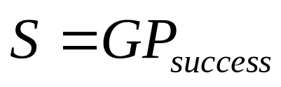
ALOHA Model
Definitions and assumptions
  X: frame transmission time (assumed to be constant)
  S: throughput (average # of successful frame transmissions per X seconds)
  G: load (average # of transmission attempts per X sec.)
  P_{success} : probability a frame transmission is successful
Any transmission that begins during vulnerable period leads to collision
Success if no arrivals during 2X seconds
X
X
Prior interval
frame transmission

Slide 23
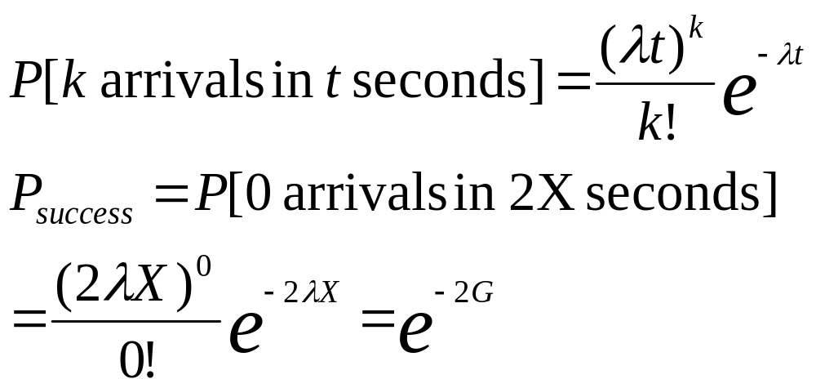
Abramson’s Assumption
What is probability of no arrivals in vulnerable period?
Abramson assumption: The backoff algorithm spreads the retransmissions so that frame transmissions, new and repeated, are equally likely to occur at any instant
This implies that the number of frames transmitted in a time interval has a Poisson distribution

Slide 24
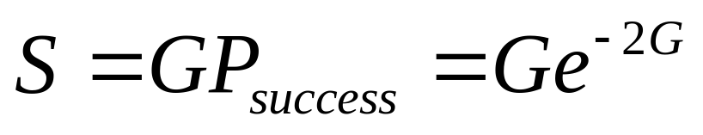
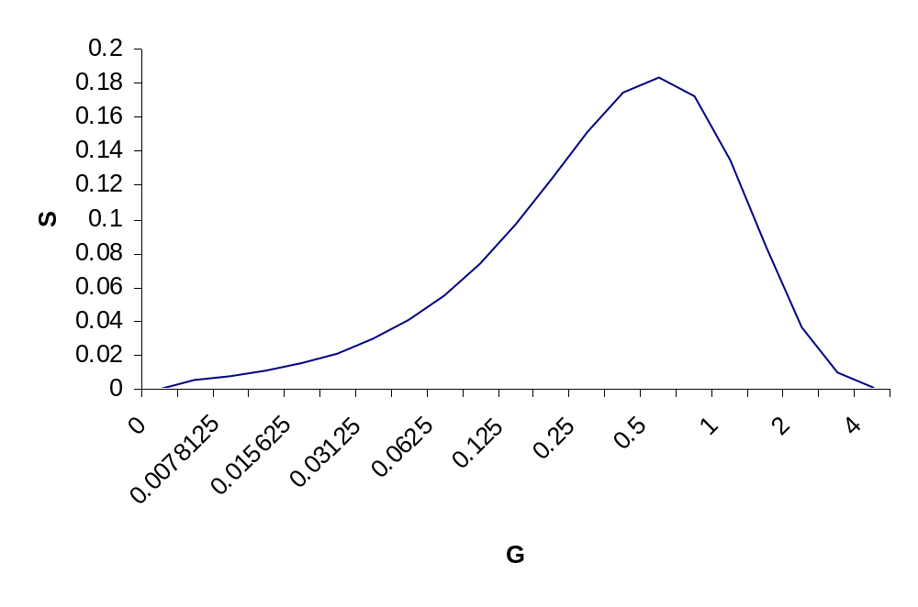
Throughput of ALOHA
Collisions are means for coordinating access
Max throughput is ρ_{max}= 1/2e (18.4%)
Bimodal behavior:
  Small G, S≈G
  Large G, S↓0
Collisions can snowball and drop throughput to zero
1/2e = 0.184

Slide 25
Slotted ALOHA
Time is slotted in X seconds slots
Stations synchronized to frame times
Stations transmit frames in first slot after frame arrival
Backoff intervals in multiples of slots
Backoff period B
t
kX
(k+1)X
t₀ +X+2t_{prop}
t₀ +X+2t_{prop}+ B
Vulnerableperiod
Time-out
Only frames that arrive during prior X seconds collide

Slide 26
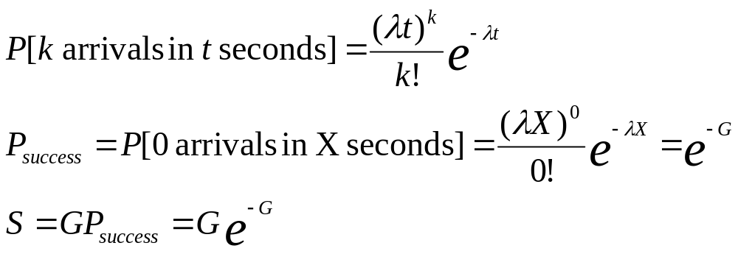
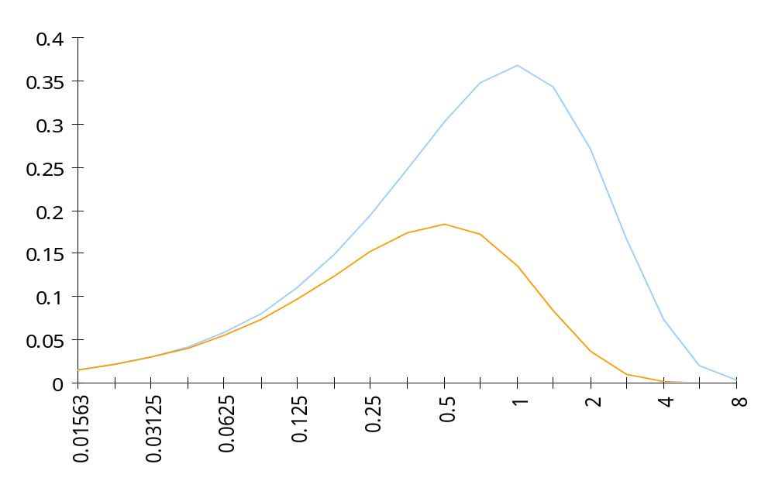
Throughput of Slotted ALOHA
0.368
S
Ge^{-G}
0.184
Ge^{-2G}
G

Slide 27
Application of Slotted Aloha
cycle
. . .
. . .
Reservation mini-slots
X-second slot
Reservation protocol allows a large number of stations with infrequent traffic to reserve slots to transmit their frames in future cycles
Each cycle has mini-slots allocated for making reservations
Stations use slotted Aloha during mini-slots to request slots

Slide 28
Carrier Sensing Multiple Access (CSMA)
A station senses the channel before it starts transmission
  If busy, either wait or schedule backoff (different options)
  If idle, start transmission
  Vulnerable period is reduced to t_{prop} (due to channel capture effect)
  Collisions in ALOHA or Slotted ALOHA involve 2 or 1 frame transmission times X
  If t_{prop} >X (or if a>1), no gain compared to ALOHA or slotted ALOHA
Station A begins transmission at t = 0
A
Station A captures
channel at t = t_{prop}
A

Slide 29
CSMA Options
Transmitter behavior when busy channel is sensed
  1-persistent CSMA (most greedy)
    Start transmission as soon as the channel becomes idle
    Low delay and high collision rates
  Non-persistent CSMA (least greedy)
    Wait a backoff period, then sense carrier again
    High delay and low collision rates
  p-persistent CSMA (adjustable greedy)
    Wait till channel becomes idle, transmit with prob. p; or wait another t_{prop} & re-sense with probability 1-p
    Delay and collisions rates can be balanced
Sensing

Slide 30
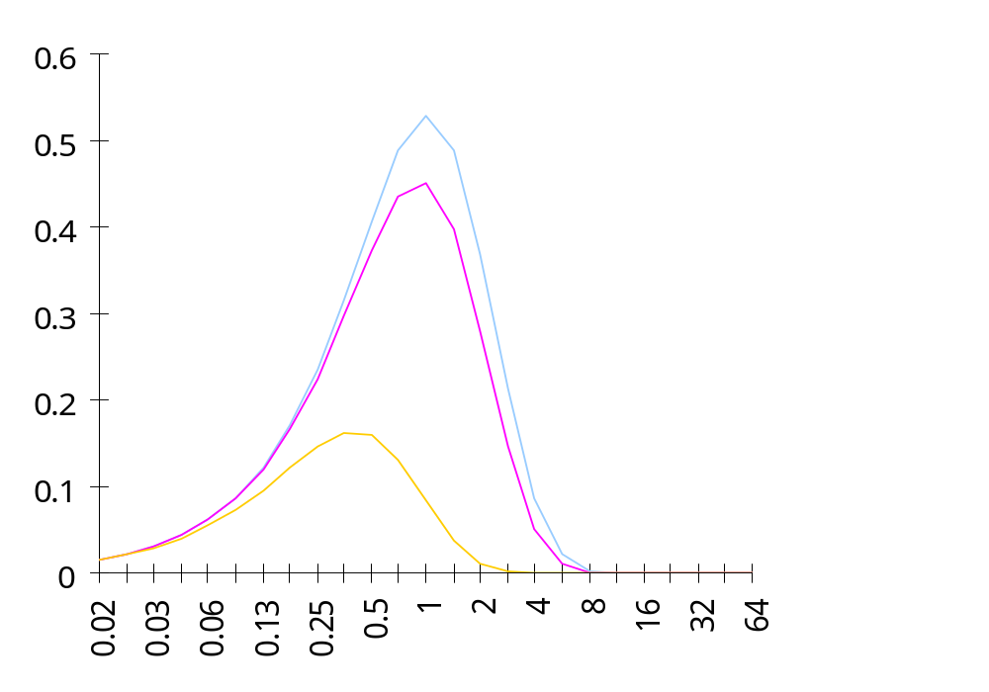
1-Persistent CSMA Throughput
S
0.53
Better than Aloha & slotted Aloha for small a
Worse than Aloha for a > 1
a = 0.01
0.45
0.16
a =0.1
G
a = 1

Slide 31
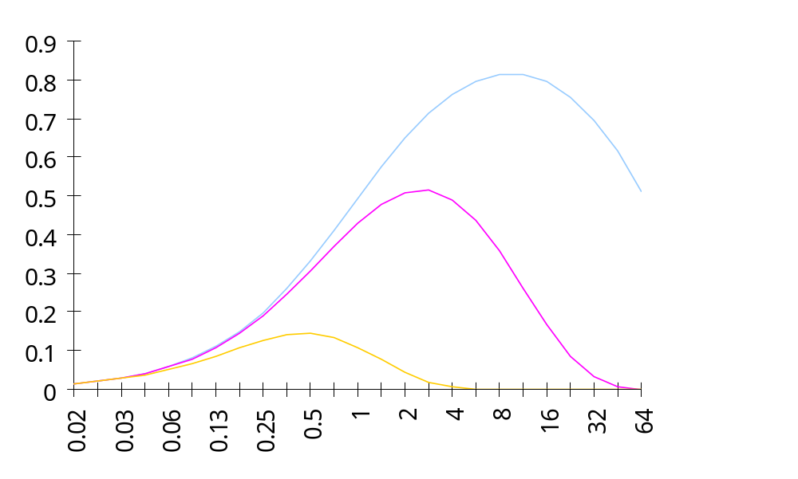
Non-Persistent CSMA Throughput
a = 0.01
S
0.81
Higher maximum throughput than 1-persistent for small a
Worse than Aloha for a > 1
0.51
a = 0.1
0.14
G
a = 1

Slide 32
CSMA with Collision Detection
(CSMA/CD)
Monitor for collisions & abort transmission
  Stations with frames to send, first do carrier sensing
  After beginning transmissions, stations continue listening to the medium to detect collisions
  If collisions detected, all stations involved stop transmission, reschedule random backoff times, and try again at scheduled times
In CSMA collisions result in wastage of X seconds spent transmitting an entire frame
CSMA-CD reduces wastage to time to detect collision and abort transmission

Slide 33
CSMA/CD reaction time
A begins to
transmit at
t = 0
A
B
B begins to
transmit at
t = t_{prop}- δ; 
B detects
collision at
t = t_{prop}
A
B
A detects
collision at
t= 2 t_{prop}- δ
A
B
It takes 2 t_{prop} to find out if channel has been captured

Slide 34
CSMA-CD Model
Assumptions
  Collisions can be detected and resolved in 2t_{prop}
  Time slotted in 2t_{prop} slots during contention periods
  Assume n busy stations, and each may transmit with probability p in each contention time slot
  Once the contention period is over (a station successfully occupies the channel), it takes X seconds for a frame to be transmitted
  It takes t_{prop} before the next contention period starts.
(a)
Busy
Contention
Busy
Idle
Contention
Busy
Time

Slide 35
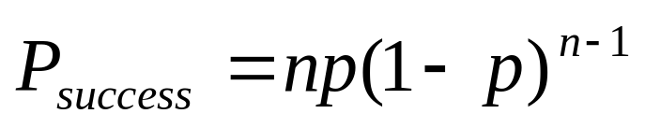
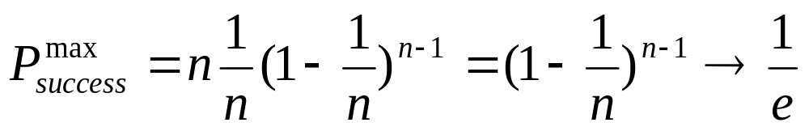
Contention Resolution
How long does it take to resolve contention?
Contention is resolved (“success’) if exactly 1 station transmits in a slot:
By taking derivative of P_{success} we find max occurs at p=1/n
On average, 1/P^{max} = e = 2.718 time slots to resolve contention
Notes:
n=# of busy stations, each of which has a probability p to transmit.

Slide 36
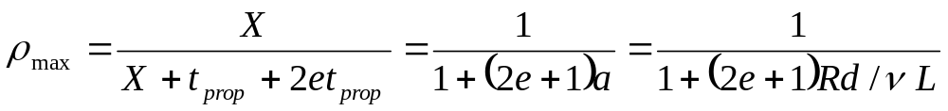
CSMA/CD Throughput
Busy
Contention
Busy
Contention
Busy
Contention
Busy
Time
At maximum throughput, systems alternates between contention periods and frame transmission times
Rd/(vL)
where:
  R bits/sec, L bits/frame, X=L/R seconds/frame
  a = t_{prop}/X
  ν meters/sec. speed of light in medium
  d meters is diameter of system
  2e+1 = 6.44

Slide 37
CSMA-CD Application: Ethernet
First Ethernet LAN standard used CSMA-CD
  1-persistent Carrier Sensing
  R = 10 Mbps
  t_{prop} = 51.2 microseconds
    512 bits = 64 byte slot
    accommodates 2.5 km + 4 repeaters
  Truncated Binary Exponential Backoff
    After the nth collision, select backoff from {0, 1,…, 2^{k} – 1}, where k=min(n, 10)

Slide 38
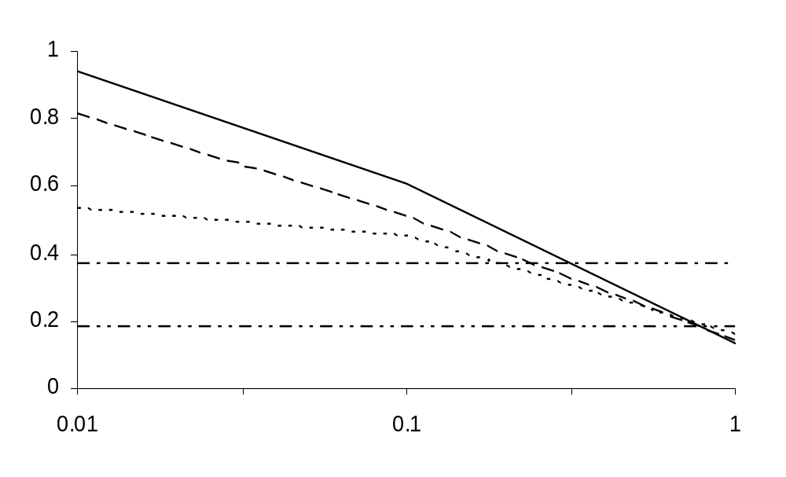
Throughput for Random Access MACs
CSMA/CD
1-P CSMA
Non-P CSMA
ρ_{max}
Slotted ALOHA
ALOHA
a
For small a: CSMA-CD has best throughput
For larger a: Aloha & slotted Aloha better throughput

Slide 39
Carrier Sensing and Priority Transmission
Certain applications require faster response than others, e.g. ACK messages
Impose different interframe times
  High priority traffic sense channel for time τ₁
  Low priority traffic sense channel for time τ₂>τ₁
  High priority traffic, if present, seizes channel first
This priority mechanism is used in IEEE 802.11 wireless LAN

Slide 40
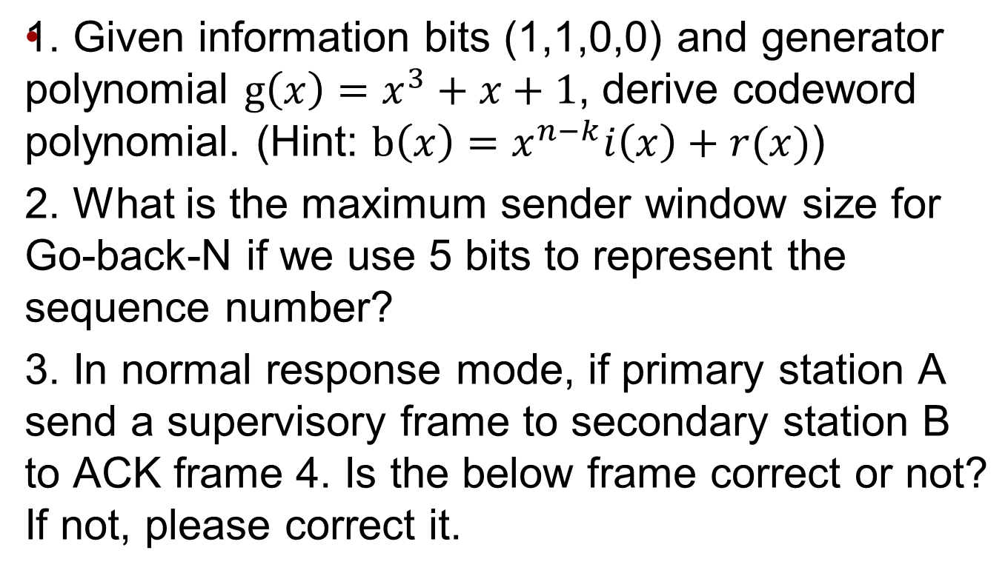
Quiz #3
A, RR, 4, P

Slide 41
Note 6: Medium Access Control Protocols
Scheduling

Slide 42
Scheduling for Medium Access Control
Schedule frame transmissions to avoid collision in shared medium
  More efficient channel utilization
  Less variability in delays
  Can provide fairness to stations
  Increased computational or procedural complexity
Two main approaches
  Reservation
  Polling

Slide 43
Reservation Systems
Reservation
interval
Frame
transmissions
r
d
d
d
r
d
d
d
Time
Cycle n
Cycle (n + 1)
r
=
1
2
3
M
Transmissions organized into cycles
Cycle: reservation interval + frame transmissions
The reservation intervals has a minislot for each station to request reservations for frame transmissions

Slide 44
Reservation System Options
Centralized or distributed system
  Centralized systems: A central controller listens to reservation information, decides order of transmission, issues grants
  Distributed systems: Each station determines its slot for transmission from the reservation information
Single or Multiple Frames
  Single frame reservation: Only one frame transmission can be reserved within a reservation cycle
  Multiple frame reservation: More than one frame transmission can be reserved within a frame
Channelized or Random Access Reservations
  Channelized (typically TDMA) reservation: Reservation messages from different stations are multiplexed without any risk of collision
  Random access reservation: Each station transmits its reservation message randomly until the message goes through

Slide 45
Example
Initially stations 3 & 5 have reservations to transmit frames
(a)
r
3
5
r
3
5
r
3
5
8
r
3
5
8
r
3
t
Station 8 becomes active and makes reservation
Cycle now also includes frame transmissions from station 8
(b)
8
r
3
5
r
3
5
r
3
5
8
r
3
5
8
r
3
t

Slide 46
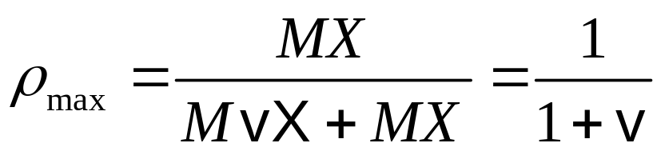
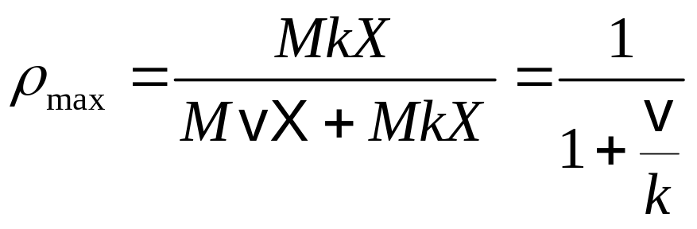
Efficiency of Reservation Systems
Assume minislot duration = vX
TDM single frame reservation scheme
  If propagation delay is negligible, a single frame transmission requires (1+v)X seconds
  Link is fully loaded when all stations transmit, maximum efficiency is:
TDM k frame reservation scheme
  If k frame transmissions can be reserved with a reservation message and if there are M stations, as many as Mk frames can be transmitted in XM(k+v) seconds
  Maximum efficiency is:

Slide 47
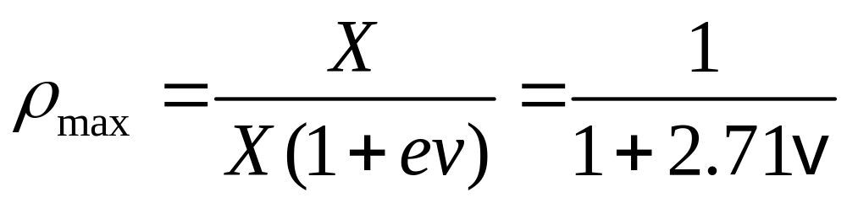
Random Access Reservation Systems
Large number of light traffic stations
  Dedicating a minislot to each station is inefficient
Slotted ALOHA reservation scheme
  Stations use slotted Aloha on reservation minislots
  On average, each reservation takes at least e minislot attempts
  Effective time required for the reservation is 2.71vX

Slide 48
Example: GPRS
General Packet Radio Service
  Packet data service in GSM cellular radio
  GPRS devices, e.g. cellphones or laptops, send packet data over radio and then to Internet
  Slotted Aloha MAC used for reservations
  Single & multi-slot reservations supported

Slide 49
Polling Systems
Centralized polling systems: A central controller transmits polling messages to stations according to a certain order
Distributed polling systems: A permit for frame transmission is passed from station to station according to a certain order
A signaling procedure exists for setting up order
Central
Controller

Slide 50
Polling System Options
Service Limits: How much is a station allowed to transmit per poll?
  Exhaustive: until station’s data buffer is empty (including new frame arrivals)
  Gated: all data in buffer when poll arrives
  Frame-Limited: one frame per poll
  Time-Limited: up to some maximum time
Priority mechanisms
  More bandwidth & lower delay for stations that appear multiple times in the polling list
  Issue polls for stations with message of priority k or higher

Slide 51
Walk Time & Cycle Time
Assume polling order is round robin
Time is “wasted” in polling stations
  Time to prepare & send polling message
  Time for station to respond
Walk time: from when a station completes transmission to when next station begins transmission
Cycle time is between consecutive polls of a station
Overhead/cycle = total walk time/cycle time
Polling messages
1
2
3
4
5
…
M
1
2
t
Frame transmissions
Cycle Time

Slide 52
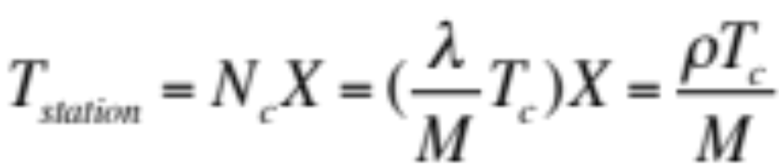

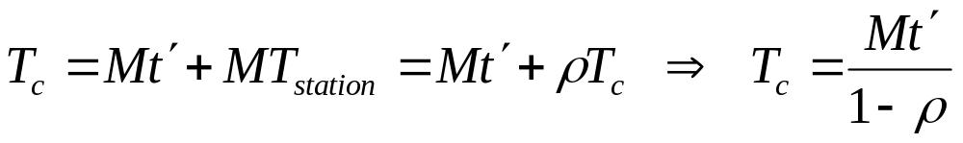
Average Cycle Time
t’
t’
t’
t’
t’
t’
1
2
3
4
5
…
M
1
t
T_{c}
Assume walk times all equal to t’
Exhaustive Service: stations empty their buffers
Cycle time = Mt’ + time to empty M station buffers
λ/M be frame arrival rate at a station
N_{C} average number of frames transmitted from a station
Time to empty one station buffer:
Average Cycle Time:

Slide 53
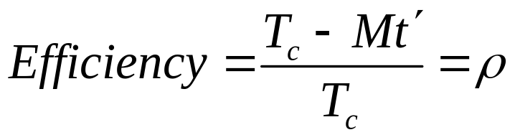
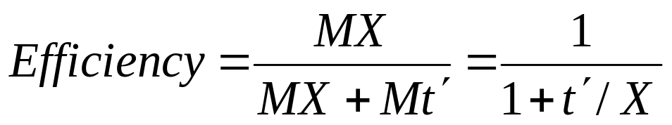
Efficiency of Polling Systems
Exhaustive Service
  Cycle time increases as traffic increases, so delays become very large
  Walk time per cycle becomes negligible compared to cycle time:
Can approach 100%
Limited Service
  Many applications cannot tolerate extremely long delays
  Time or transmissions per station are limited
  This limits the cycle time and hence delay
  Efficiency of 100% is not possible
Single frame
per poll

Slide 54
Application: Token-Passing Rings
token
Free Token = Poll
Frame Delimiter is Token
Free = 01111110
Busy = 01111111
Listen mode
Transmit mode
Input
from
ring
Output
to
ring
Delay
Delay
To device
From device
Ready station looks for free token
Flips bit to change free token to busy
Ready station inserts its frames
Reinserts free token when done

Slide 55
Methods of Token Reinsertion
Multi-token operation
  Free token transmitted immediately after last bit of data frame
Single-token operation
  Free token inserted after last bit of the busy token is received back
  Transmission time at least ring latency
  If frame transmission time is longer than ring latency, equivalent to multi-token operation
Single-Frame operation
  Free token inserted after transmitting station has received last bit of its frame
  Equivalent to attaching trailer equal to ring latency
Busy token
Free token
Frame
Idle Fill

Slide 56
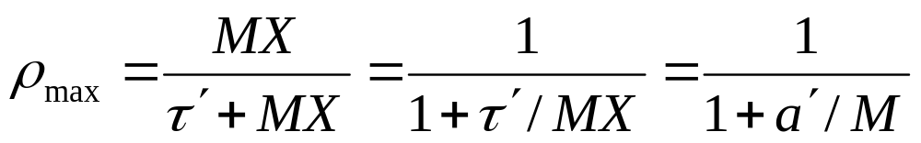
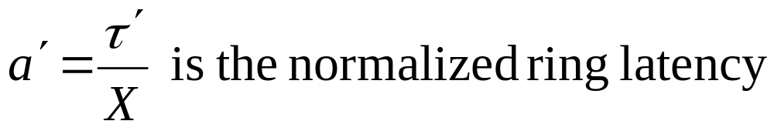
Token Ring Throughput
Definition
  τ’: ring latency (time required for bit to circulate ring)
  X: maximum frame transmission time allowed per station
Multi-token operation
  Assume network is fully loaded, and all M stations transmit for X seconds upon the reception of a free token
  This is a polling system with limited service time:

Slide 57
Token Ring Throughput
Single-token operation
  Effective frame transmission time is maximum of X and τ’ , therefore
MX
τ΄+ M max{(X,τ΄}
1
max{1, a΄} + a΄/M
ρ_{max} = =
Single-frame operation
  Effective frame transmission time is X+ τ’ ,therefore
MX
τ΄+ M(X+ τ΄)
1 1+a΄(1 + 1/M)
ρ_{max} = =

Slide 58
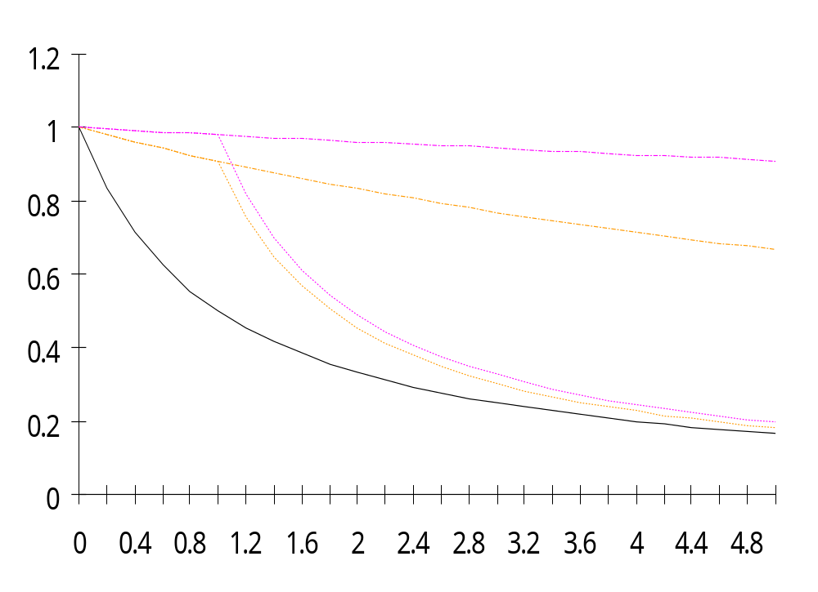
Token Reinsertion Efficiency Comparison
M = 50
M = 10
Multiple token
operation
M = 50
Maximum throughput
M = 10
Single frame
operation
Single token
operation
a ′
a <<1, any token reinsertion strategy acceptable
a ≈1, single token reinsertion strategy acceptable
a >1, multitoken reinsertion strategy necessary

Slide 59
Application Examples
Single-frame reinsertion
  IEEE 802.5 Token Ring LAN @ 4 Mbps
Single token reinsertion
  IBM Token Ring @ 4 Mbps
Multitoken reinsertion
  IEEE 802.5 and IBM Ring LANs @ 16 Mbps
  FDDI Ring @ 50 Mbps
All of these LANs incorporate token priority mechanisms

Slide 60
Comparison of MAC approaches
Aloha & Slotted Aloha
  Simple & quick transfer at very low load
  Accommodates a large number of low-traffic bursty users
  Highly variable delay at moderate loads
  Efficiency does not depend on a
CSMA-CD
  Quick transfer and high efficiency for low delay-bandwidth product
  Can accommodate a large number of bursty users
  Variable and unpredictable delay

Slide 61
Comparison of MAC approaches
Reservation
  On-demand transmission of bursty or steady streams
  Accommodates large number of low-traffic users with slotted Aloha reservations
  Can incorporate QoS
  Handles large delay-bandwidth product via delayed grants
Polling
  Generalization of time-division multiplexing
  Provides fairness through regular access opportunities
  Can provide bounds on access delay
  Performance deteriorates with large delay-bandwidth product

Slide 62
Note 6: Medium Access Control Protocols
Channelization

Slide 63
Why Channelization?
Channelization
  Semi-static bandwidth allocation of portion of shared medium to a given user
Highly efficient for constant-bit rate traffic
Preferred approach in
  Cellular telephone networks
  Terrestrial & satellite broadcast radio & TV

Slide 64
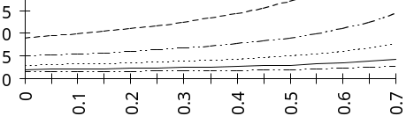
Why not Channelization?
Inflexible in allocation of bandwidth to users with different requirements
Inefficient for bursty traffic
Does not scale well to large numbers of users
  Average transfer delay increases with number of users M
Dynamic MAC much better at handling bursty traffic

Slide 65
Channelization Approaches
Frequency Division Multiple Access (FDMA)
  Frequency band allocated to users
  Broadcast radio & TV, analog cellular phone
Time Division Multiple Access (TDMA)
  Periodic time slots allocated to users
  Telephone backbone, GSM digital cellular phone
Code Division Multiple Access (CDMA)
  Code allocated to users
  Cellular phones, 3G cellular

Slide 66
Channelization: FDMA
Divide channel into M frequency bands
Each station transmits and listens on assigned bands
Frequency
1
Guard bands
W
2
…
M–1
M
Time
Each station transmits at most R/M bps
Good for stream traffic; Used in connection-oriented systems
Inefficient for bursty traffic

Slide 67
Channelization: TDMA
Dedicate 1 slot per station in transmission cycles
Stations transmit data burst at full channel bandwidth
Frequency
Guard time
W
1
2
3
...
M
1
Time
One cycle
Each station transmits at R bps 1/M of the time
Excellent for stream traffic; Used in connection-oriented systems
Inefficient for bursty traffic due to unused dedicated slots

Slide 68
Guardbands
FDMA
  Frequency bands must be non-overlapping to prevent interference
  Guardbands ensure separation; form of overhead
TDMA
  Stations must be synchronized to common clock
  Time gaps between transmission bursts from different stations to prevent collisions; form of overhead
  Must take into account propagation delays

Slide 69
Channelization: CDMA
Code Division Multiple Access
  Channels determined by a code used in modulation and demodulation
Stations transmit over entire frequency band all of the time!
Frequency
1
2
W
3
Time

Slide 70
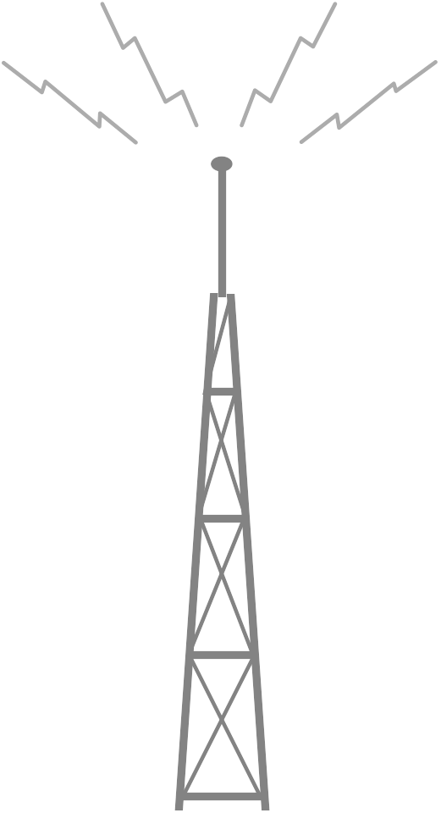
CDMA Spread Spectrum Signal
Transmitter from one user
Binary
information
R₁ bps
W₁ Hz
×
×
Radio
antenna
R >> R₁bps
W >> W₁ Hz
Unique user binary random sequence
Digital
modulation
User information mapped into: +1 or -1 for T sec.
Multiply user information by pseudo- random binary pattern of G “chips” of +1’s and -1’s
Resulting spread spectrum signal occupies G times more bandwidth: W = GW₁
Modulate the spread signal by sinusoid at appropriate f_{c}

Slide 71
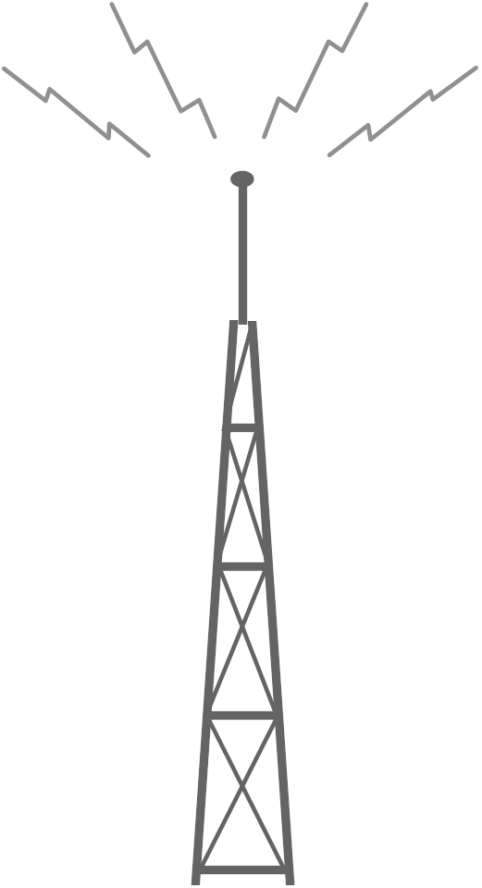
CDMA Demodulation
Signal and residual
interference
×
×
Binary
information
Signals
from all
transmitters
Digital
demodulation
Correlate to
user binary
random sequence
Recover spread spectrum signal
Synchronize to and multiply spread signal by same pseudo-random binary pattern used at the transmitter
In absence of other transmitters & noise, we should recover the original +1 or -1 of user information
Other transmitters using different codes appear as residual noise

Slide 72
Pseudorandom pattern generator
Feedback shift register with appropriate feedback taps can be used to generate pseudorandom sequence
g₀
g₂
g₃
Time R₀ R₁ R₂
0 1 0 0
1 0 1 0
2 1 0 1
3 1 1 0
4 1 1 1
5 0 1 1
6 0 0 1
7 1 0 0
Sequence repeats
from here onwards
R₀
R₁
R₂
output
g(x) = x³ + x² + 1
The coefficients of a
primitive generator polynomial
determine the feedback taps
Notes:
For the above g(x), g0=1, g1=0, g2=1, and g3=1.

Slide 73
Channelization in Code Space
Each channel uses a different pseudorandom code
Codes should have low cross-correlation
  If they differ in approximately half the bits the correlation between codes is close to zero and the effect at the output of each other’s receiver is small
As number of users increases, effect of other users on a given receiver increases as additive noise
CDMA has gradual increase in BER due to noise as number of users is increased
Interference between channels can be eliminated if codes are selected so they are orthogonal and if receivers and transmitters are synchronized
  Shown in next example

Slide 74
Example: CDMA with 3 users
Assume three users share same medium
Users are synchronized & use different 4-bit orthogonal codes:
{-1,-1,-1,-1}, {-1, +1,-1,+1}, {-1,-1,+1,+1}
-1
-1
+1
User 1
x
Receiver
+1
-1
+1
+
User 2
x
+1
+1
-1
Shared
Medium
User 3
x

Slide 75
Sum signal is input to receiver
Channel 1: 110 -> +1+1-1 -> (-1,-1,-1,-1),(-1,-1,-1,-1),(+1,+1,+1,+1)
Channel 2: 010 -> -1+1-1 -> (+1,-1,+1,-1),(-1,+1,-1,+1),(+1,-1,+1,-1)
Channel 3: 001 -> -1-1+1 -> (+1,+1,-1,-1),(+1,+1,-1,-1),(-1,-1,+1,+1)
Sum Signal: (+1,-1,-1,-3),(-1,+1,-3,-1),(+1,-1,+3,+1)
Channel 1
Channel 2
Channel 3
Sum Signal

Slide 76
Example: Receiver for Station 2
Each receiver takes sum signal and integrates by code sequence of desired transmitter
Integrate over T seconds to smooth out noise
Decoding signal from station 2
Integrate
over T sec
+
x
Shared
Medium

Slide 77
Decoding at Receiver 2
Sum Signal: (+1,-1,-1,-3),(-1,+1,-3,-1),(+1,-1,+3,+1)
Channel 2 Sequence: (-1,+1,-1,+1),(-1,+1,-1,+1),(-1,+1,-1,+1)
Correlator Output: (-1,-1,+1,-3),(+1,+1,+3,-1),(-1,-1,-3,+1)
Integrated Output: -4, +4, -4
Binary Output: 0, 1, 0
Sum Signal
X
Channel 2
Sequence
=
Correlator
Output
+4
Integrator
Output
-4
-4

Slide 78
Walsh Functions
Walsh functions provide orthogonal code sequences by mapping 0 to -1 and 1 to +1
Walsh matrices constructed recursively as follows:
W_{n} W_{n}
W_{n} W_{n}^{c}
W_{2n}=
W₁=
0
0 0
0 1
0 0
0 1
0 0
0 1
0 0
0 1
0 0
0 1
W₂=
0 0
0 1
1 1
1 0
0 0
0 1
1 1
1 0
0 0
0 1
0 0
0 1
W₈=
0 0
0 1
0 0
0 1
1 1
1 0
1 1
1 0
W₄=
0 0
0 1
1 1
1 0
0 0
0 1
1 1
1 0
1 1
1 0
0 0
0 1

Slide 79
Channelization in
Cellular Telephone Networks
Cellular networks use frequency reuse
  Band of frequencies reused in other cells that are sufficiently far that interference is not a problem
  Cellular networks provide voice connections that are steady streams
FDMA used in AMPS
TDMA used in IS-54 and GSM
CDMA used in IS-95

Slide 80
Further Reading
Textbook: 6.1, 6.2, 6.3, 6.4

