Slide 1

W4111 – 02: Introduction to Databases
Lecture 7: ER Modeling, SQL, Relational Closure (for now)
Donald F. Ferguson dff9@Columbia.edu
TRANSCENDING DISCIPLINES, TRANSFORMING LIVES

Slide 2

We will start in a a couple of minutes.
2 | W4111_02_F20: Introduction to Databases -- Lecture 7

Slide 3
Today’s Agenda
3 | W4111_02_F20: Introduction to Databases – Lecture 7

Slide 4
Today’s Agenda
Questions/answers.
Some worked examples.
4 | W4111_02_F20: Introduction to Databases – Lecture 7

Slide 5
Questions, Answers, Discussion
5 | W4111_02_F20: Introduction to Databases -- Lecture 7
Notes:
bb

Slide 6
NULL – Complex SQL Question and Codd’s 3rd Rule
6 | W4111_02_F20: Introduction to Databases – Lecture 7

Slide 7
ER Model, Relation Model, SQL Closure (for now)
7 | W4111_02_F20: Introduction to Databases -- Lecture 7
Notes:
bb

Slide 8

Weak Entity Sets
8 | W4111_02_F20: Introduction to Databases -- Lecture 6

Slide 9
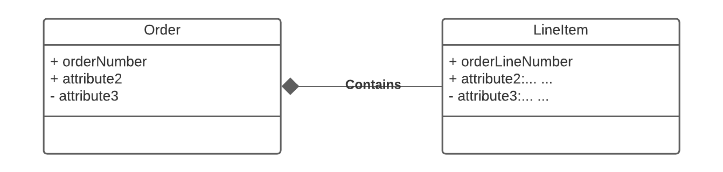
Example Order Form – Order “Contains” Line Items
Customer ID: 201
OrderNo: 31
OrderedDate:504
Containment is a common concept in data models.
Containment implementation is common in object-oriented models.
Domains are atomic in the relational model → Lists/Arrays are not possible.
Weak Entity is one way to model.
ProductID | Quantity | Price | OrderID
111 | 2 | 2.10 | 31
101 | 11 | 1.30 | 31
333 | 102 | 47.5 | 31
public class LineItem { }
public class Order { LineItem lineItem[]; }
9 | W4111_02_F20: Introduction to Databases – Lecture 6

Slide 10
Weak Entity Sets
Consider a section entity, which is uniquely identified by a course_id, semester, year, and sec_id.
Clearly, section entities are related to course entities. Suppose we create a relationship set sec_course between entity sets section and course.
Note that the information in sec_course is redundant, since section already has an attribute course_id, which identifies the course with which the section is related.
One option to deal with this redundancy is to get rid of the relationship sec_course; however, by doing so the relationship between section and course becomes implicit in an attribute, which is not desirable.

Slide 11
Weak Entity Sets (Cont.)
An alternative way to deal with this redundancy is to not store the attribute course_id in the section entity and to only store the remaining attributes section_id, year, and semester.
However, the entity set section then does not have enough attributes to identify a particular section entity uniquely
To deal with this problem, we treat the relationship sec_course as a special relationship that provides extra information, in this case, the course_id, required to identify section entities uniquely.
A weak entity set is one whose existence is dependent on another entity, called its identifying entity
Instead of associating a primary key with a weak entity, we use the identifying entity, along with extra attributes called discriminator to uniquely identify a weak entity.

Slide 12
Weak Entity Sets (Cont.)
An entity set that is not a weak entity set is termed a strong entity set.
Every weak entity must be associated with an identifying entity; that is, the weak entity set is said to be existence dependent on the identifying entity set.
The identifying entity set is said to own the weak entity set that it identifies.
The relationship associating the weak entity set with the identifying entity set is called the identifying relationship.
Note that the relational schema we eventually create from the entity set section does have the attribute course_id, for reasons that will become clear later, even though we have dropped the attribute course_id from the entity set section.

Slide 13
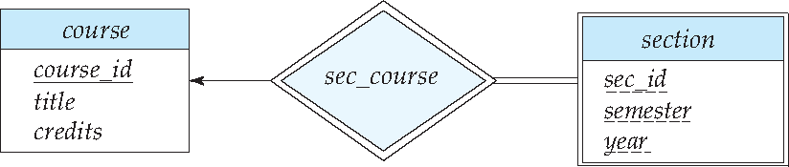
Expressing Weak Entity Sets
In E-R diagrams, a weak entity set is depicted via a double rectangle.
We underline the discriminator of a weak entity set with a dashed line.
The relationship set connecting the weak entity set to the identifying strong entity set is depicted by a double diamond.
Primary key for section – (course_id, sec_id, semester, year)

Slide 14
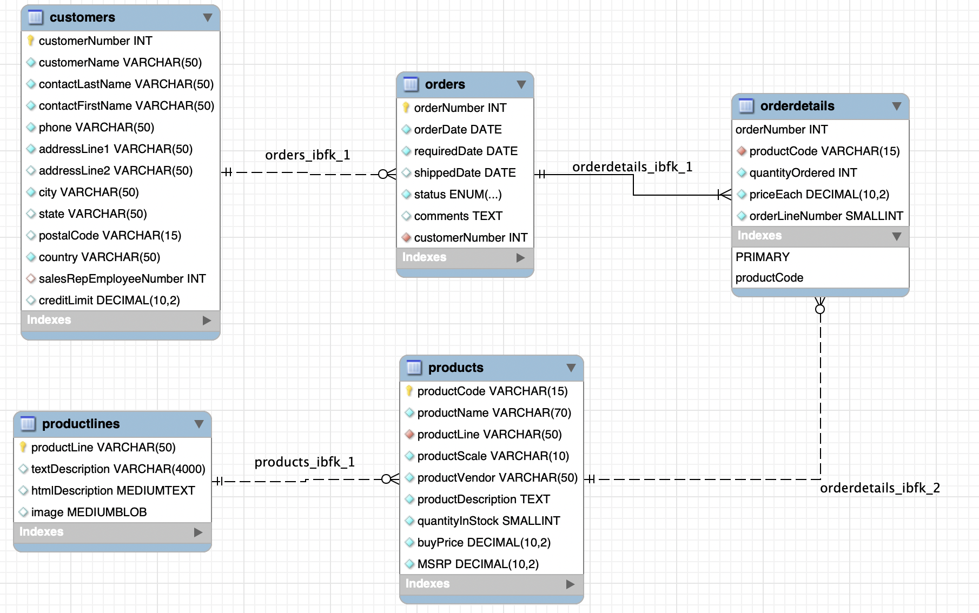
Weak Entity Example: Orders, OrderDetails
https://www.mysqltutorial.org/mysql-sample-database.aspx/
14 | W4111_02_F20: Introduction to Databases – Lecture 6

Slide 15
Inheritance, IsA, Specialization
15 | W4111_02_F20: Introduction to Databases -- Lecture 6

Slide 16
Specialization
Top-down design process; we designate sub-groupings within an entity set that are distinctive from other entities in the set.
These sub-groupings become lower-level entity sets that have attributes or participate in relationships that do not apply to the higher-level entity set.
Depicted by a triangle component labeled ISA (e.g., instructor “is a” person).
Attribute inheritance – a lower-level entity set inherits all the attributes and relationship participation of the higher-level entity set to which it is linked.

Slide 17
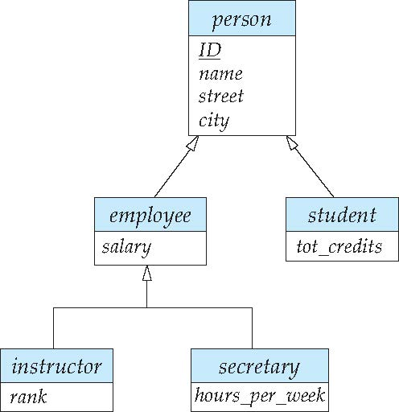
Specialization Example
Overlapping – employee and student
Disjoint – instructor and secretary
Total and partial

Slide 18
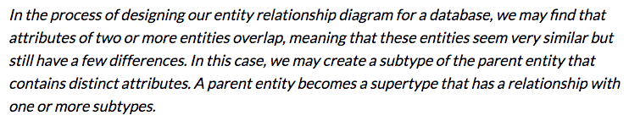
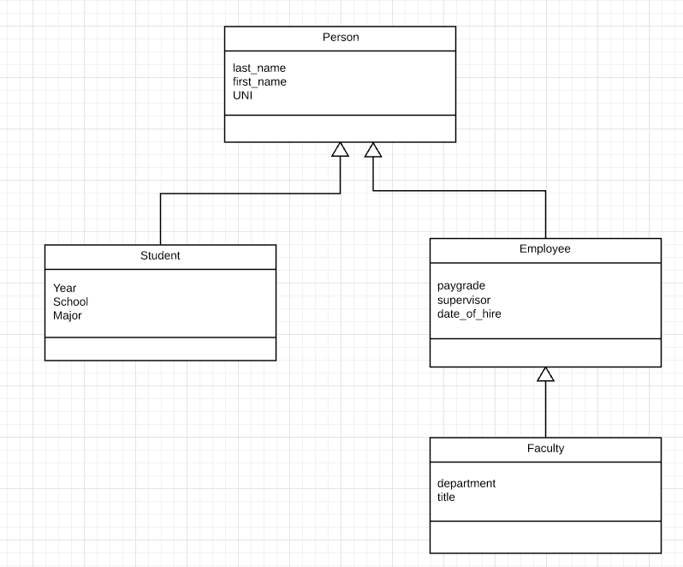
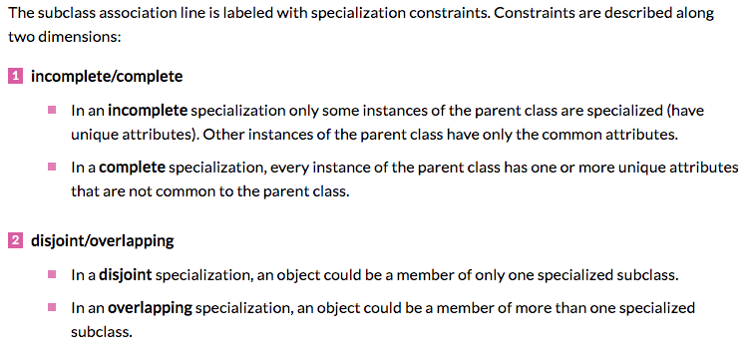
Inheritance, IsA, Specialization
Are all employees faculty?
Can students also be employees?
http://www.vertabelo.com/blog/technical-articles/inheritance-in-a-relational-database
18 | W4111_02_F20: Introduction to Databases – Lecture 6

Slide 19
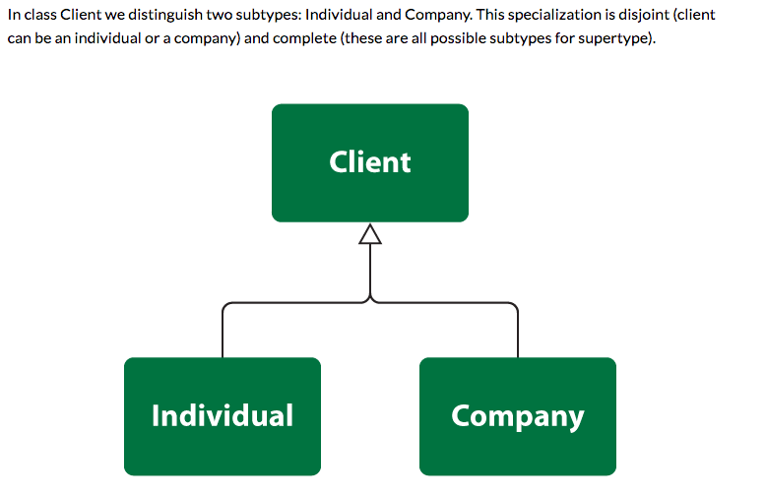
Simpler Example
19 | W4111_02_F20: Introduction to Databases – Lecture 6

Slide 20
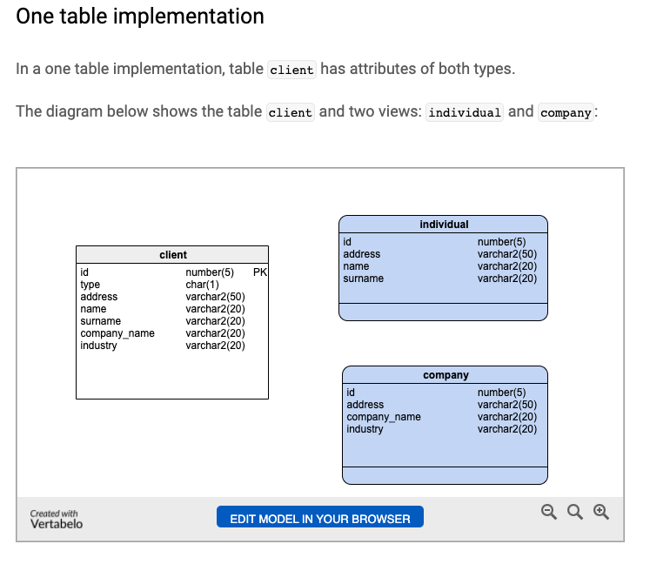
One Table Implementation
Views
Tables
20 | W4111_02_F20: Introduction to Databases – Lecture 6

Slide 21
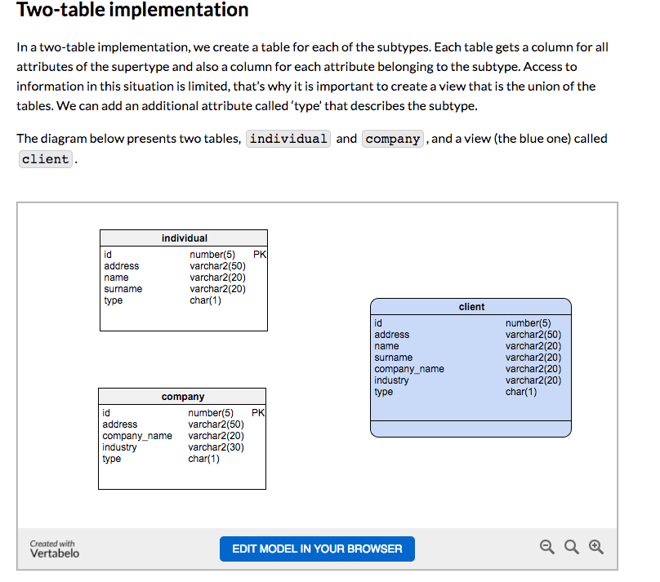
Two Table Implementation
View
Tables
21 | W4111_02_F20: Introduction to Databases – Lecture 6

Slide 22
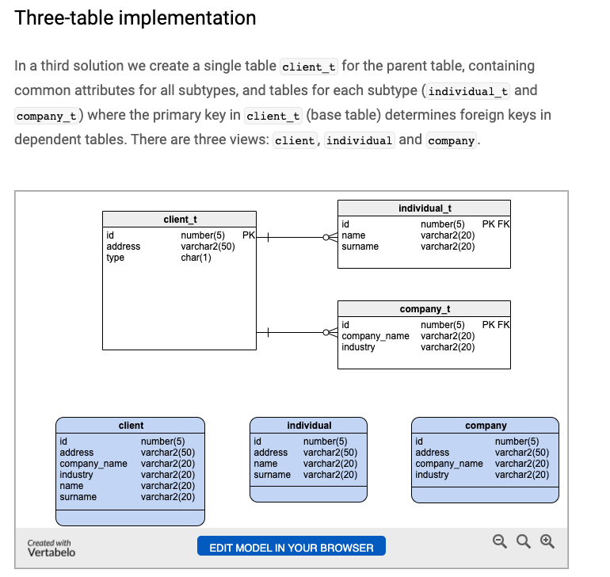
Two Table Implementation
Tables
Views
22 | W4111_02_F20: Introduction to Databases – Lecture 6

Slide 23
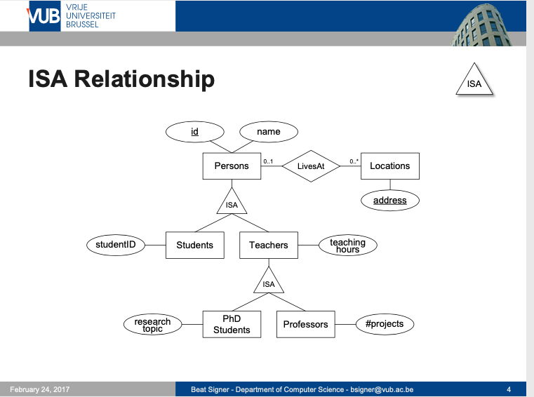
Modeling
23 | W4111_02_F20: Introduction to Databases – Lecture 6

Slide 24
ER vs. UML Class Diagrams
ER Diagram Notation
Equivalent in UML
I use this approach in Crow’s Foot Notation but that is not standard.
* Generalization can use merged or separate arrows independent
of disjoint/overlapping

Slide 25
Redundant Attributes
25 | W4111_02_F20: Introduction to Databases -- Lecture 7

Slide 26

Redundant Attributes
Suppose we have entity sets:
instructor, with attributes: ID, name, dept_name, salary
department, with attributes: dept_name, building, budget
We model the fact that each instructor has an associated department using a relationship set inst_dept
The attribute dept_name in instructor replicates information present in the relationship and is therefore redundant
and needs to be removed.
BUT: when converting back to tables, in some cases the attribute gets reintroduced, as we will see later.

Slide 27
Design Alternatives
In designing a database schema, we must ensure that we avoid two major pitfalls:
Redundancy: a bad design may result in repeat information.
Redundant representation of information may lead to data inconsistency among the various copies of information
Incompleteness: a bad design may make certain aspects of the enterprise difficult or impossible to model.
Avoiding bad designs is not enough. There may be a large number of good designs from which we must choose.
Emphasis Added
Notes:
27

Slide 28
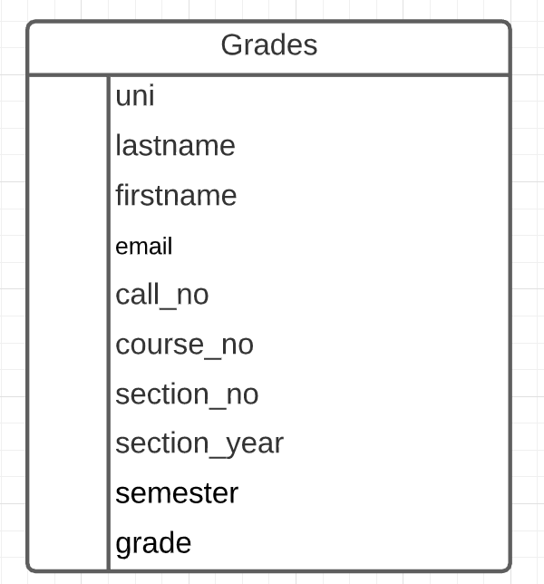
Redundant Information Example
Consider the Grades table/relation:
Uni identifies student.
lastname, firstname, email have obvious meaning.
call_no, course_no, section_no, semester, section_year, grade have the obvious meanings relative to Columbia course info.
Let’s focus on redundant information problems:
Inside the table:
(uni, lastname, firstname, email)
(call_no, course_no, section_no, section_year, semester)
Between tables: Presumable there are other tables with information on
Course descriptions and sections.
Course enrollments.
Additional student information.
This is easier if we make some data and show how we can “break it.”
28 | W4111_02_F20: Introduction to Databases – Lecture 6

Slide 29
Worked Examples, Pulling Together the Pieces
29 | W4111_02_F20: Introduction to Databases -- Lecture 7
Notes:
bb

Slide 30
“Inheritance”
30 | W4111_02_F20: Introduction to Databases -- Lecture 5

Slide 31
Inheritance – Putting Some Pieces Together
We will
Model Person, Faculty, Student.
Implement using a two-table solution.
Use a function to generate UNIs.
Integrity
Use
View
Constraints
Security
Stored Procedure
Triggers
To implement integrity.
31 | W4111_02_F20: Introduction to Databases – Lecture 6

