Slide 1
Chapter 11: Data Analytics

Slide 2
Chapter 11: Data Analytics
Overview
Data Warehousing
Online Analytical Processing
Data Mining

Slide 3
Overview
Data analytics: the processing of data to infer patterns, correlations, or models for prediction
Primarily used to make business decisions
Per individual customer
E.g., what product to suggest for purchase
Across all customers
E.g., what products to manufacture/stock, in what quantity
Critical for businesses today

Slide 4
Overview (Cont.)
Common steps in data analytics
Gather data from multiple sources into one location
Data warehouses also integrated data into common schema
Data often needs to be extracted from source formats, transformed to common schema, and loaded into the data warehouse
Can be done as ETL (extract-transform-load), or ELT (extract-load-transform)
Generate aggregates and reports summarizing data
Dashboards showing graphical charts/reports
Online analytical processing (OLAP) systems allow interactive querying
Statistical analysis using tools such as R/SAS/SPSS
Including extensions for parallel processing of big data
Build predictive models and use the models for decision making

Slide 5
Overview (Cont.)
Predictive models are widely used today
E.g., use customer profile features (e.g. income, age, gender, education, employment) and past history of a customer to predict likelihood of default on loan
and use prediction to make loan decision
E.g., use past history of sales (by season) to predict future sales
And use it to decide what/how much to produce/stock
And to target customers
Other examples of business decisions:
What items to stock?
What insurance premium to change?
To whom to send advertisements?

Slide 6
Overview (Cont.)
Machine learning techniques are key to finding patterns in data and making predictions
Data mining extends techniques developed by machine-learning communities to run them on very large datasets
The term business intelligence (BI) is synonym for data analytics
The term decision support focuses on reporting and aggregation

Slide 7
Data Warehousing

Slide 8
Data Warehousing
Data sources often store only current data, not historical data
Corporate decision making requires a unified view of all organizational data, including historical data
A data warehouse is a repository (archive) of information gathered from multiple sources, stored under a unified schema, at a single site
Greatly simplifies querying, permits study of historical trends
Shifts decision support query load away from transaction processing systems

Slide 9
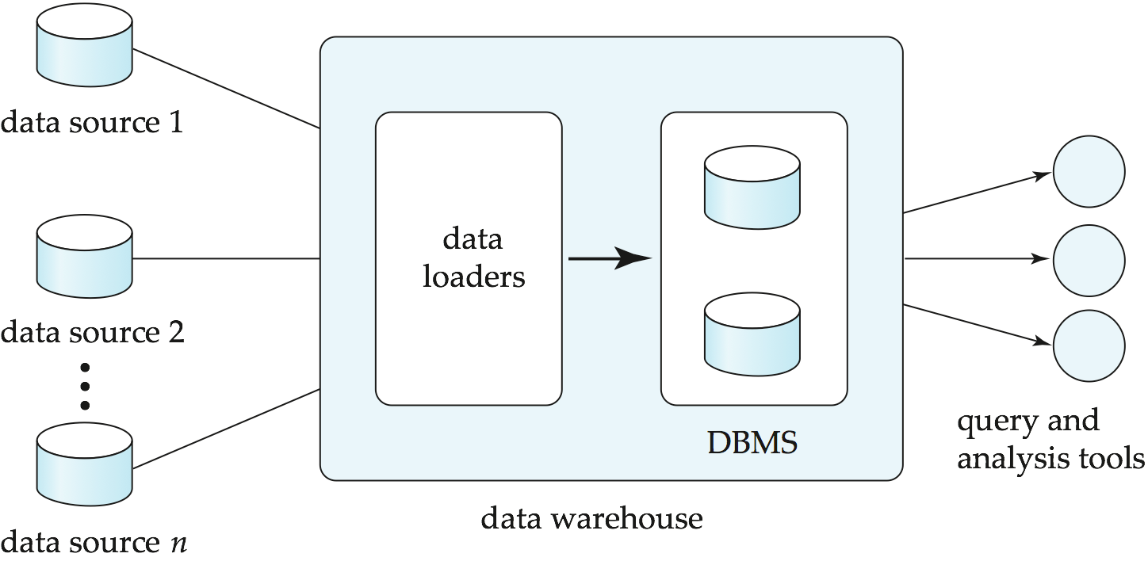
Data Warehousing

Slide 10
Design Issues
When and how to gather data
Source driven architecture: data sources transmit new information to warehouse
either continuously or periodically (e.g., at night)
Destination driven architecture: warehouse periodically requests new information from data sources
Synchronous vs asynchronous replication
Keeping warehouse exactly synchronized with data sources (e.g., using two-phase commit) is often too expensive
Usually OK to have slightly out-of-date data at warehouse
Data/updates are periodically downloaded form online transaction processing (OLTP) systems.
What schema to use
Schema integration

Slide 11
More Warehouse Design Issues
Data transformation and data cleansing
E.g., correct mistakes in addresses (misspellings, zip code errors)
Merge address lists from different sources and purge duplicates
How to propagate updates
Warehouse schema may be a (materialized) view of schema from data sources
View maintenance
What data to summarize
Raw data may be too large to store on-line
Aggregate values (totals/subtotals) often suffice
Queries on raw data can often be transformed by query optimizer to use aggregate values

Slide 12
Multidimensional Data and Warehouse Schemas
Data in warehouses can usually be divided into
Fact tables, which are large
E.g, sales(item_id, store_id, customer_id, date, number, price)
Dimension tables, which are relatively small
Store extra information about stores, items, etc.
Attributes of fact tables can be usually viewed as
Measure attributes
measure some value, and can be aggregated upon
e.g., the attributes number or price of the sales relation
Dimension attributes
dimensions on which measure attributes are viewed
e.g., attributes item_id, color, and size of the sales relation
Usually small ids that are foreign keys to dimension tables

Slide 13
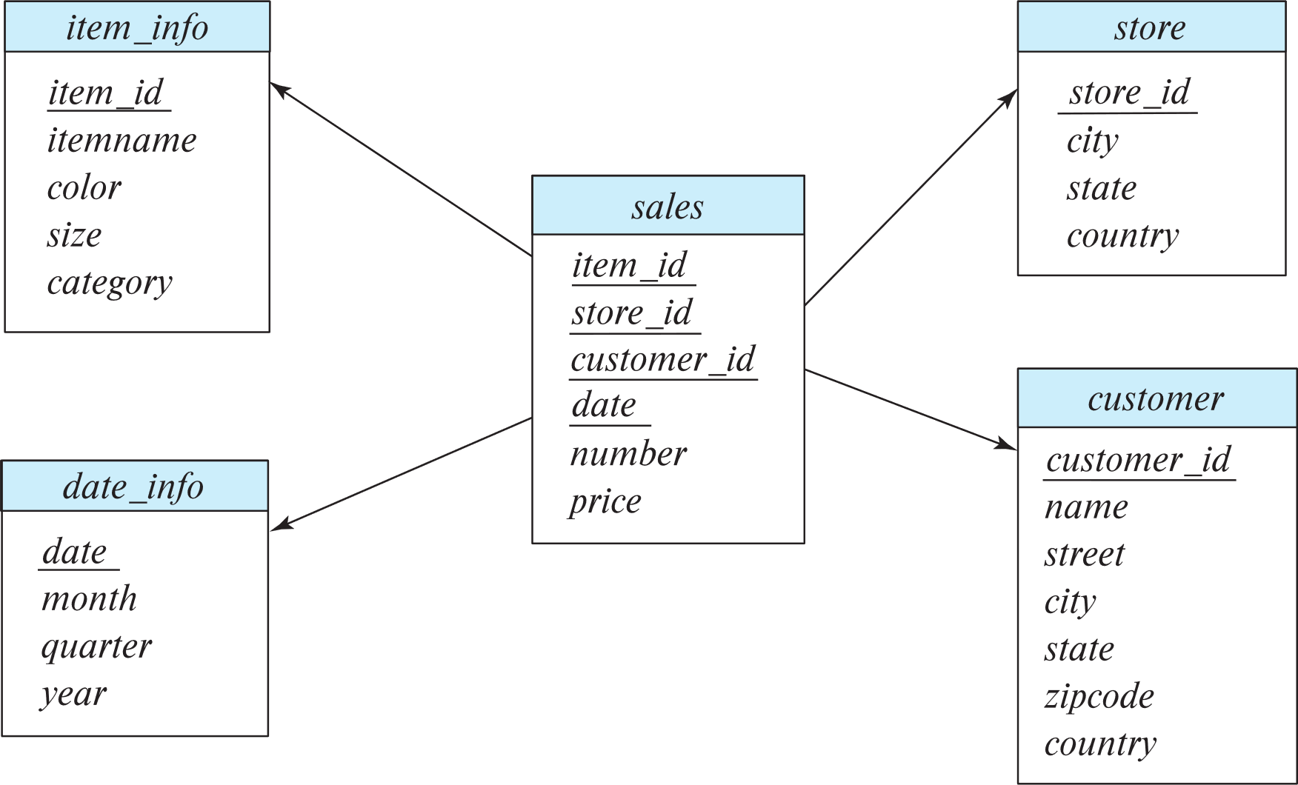
Data Warehouse Schema

Slide 14
Multidimensional Data and Warehouse Schemas
Resultant schema is called a star schema
More complicated schema structures
Snowflake schema: multiple levels of dimension tables
May have multiple fact tables
Typically
fact table joined with dimension tables and then
group-by on dimension table attributes, and then
aggregation on measure attributes of fact table
Some applications do not find it worthwhile to bring data to a common schema
Data lakes are repositories which allow data to be stored in multiple formats, without schema integration
Less upfront effort, but more effort during querying

Slide 15
Database Support for Data Warehouses
Data in warehouses usually append only, not updated
Can avoid concurrency control overheads
Data warehouses often use column-oriented storage
E.g., a sequence of sales tuples is stored as follows
Values of item_id attribute are stored as an array
Values of store_id attribute are stored as an array,
And so on
Arrays are compressed, reducing storage, IO and memory costs significantly
Queries can fetch only attributes that they care about, reducing IO and memory cost
More details in Section 13.6
Data warehouses often use parallel storage and query processing infrastructure
Distributed file systems, Map-Reduce, Hive, …

Slide 16
OLAP

Slide 17
Data Analysis and OLAP
Online Analytical Processing (OLAP)
Interactive analysis of data, allowing data to be summarized and viewed in different ways in an online fashion (with negligible delay)
We use the following relation to illustrate OLAP concepts
sales (item_name, color, clothes_size, quantity)
This is a simplified version of the sales fact table joined with the dimension tables, and many attributes removed (and some renamed)

Slide 18
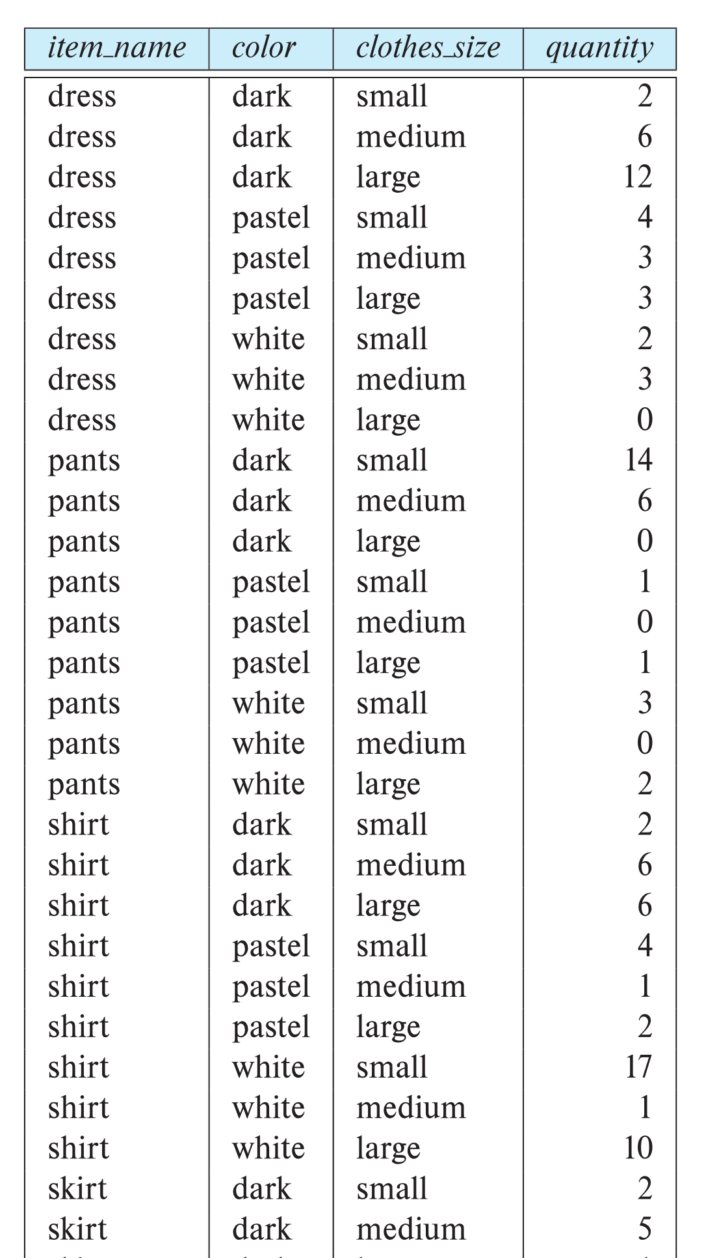
Example sales relation
...
...
...
...
...
...
...
...

Slide 19
Cross Tabulation of sales by item_name and color
The table above is an example of a cross-tabulation (cross-tab), also referred to as a pivot-table.
Values for one of the dimension attributes form the row headers
Values for another dimension attribute form the column headers
Other dimension attributes are listed on top
Values in individual cells are (aggregates of) the values of the dimension attributes that specify the cell.

Slide 20
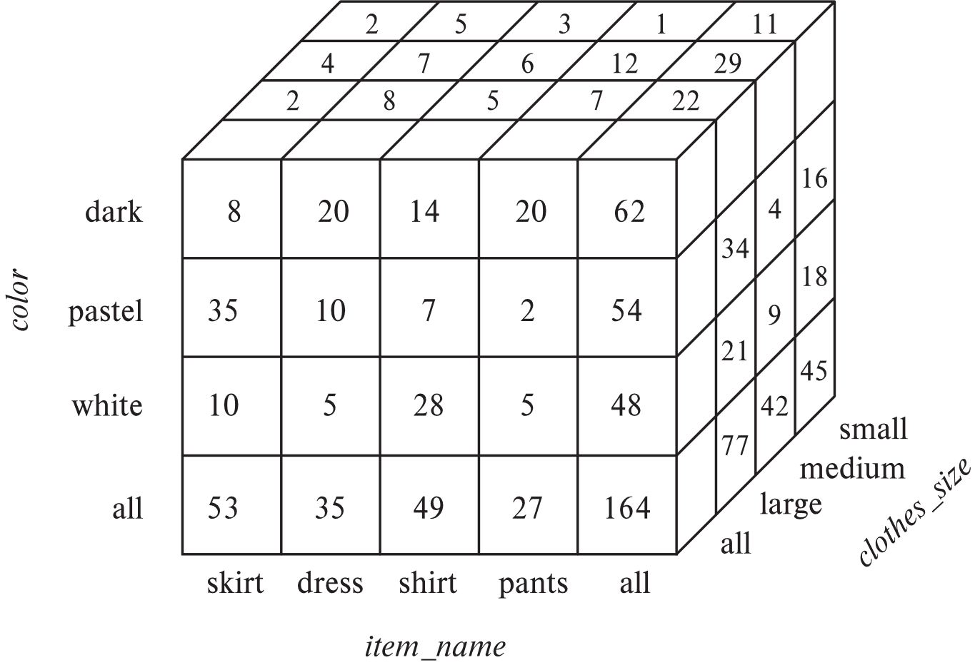
Data Cube
A data cube is a multidimensional generalization of a cross-tab
Can have n dimensions; we show 3 below
Cross-tabs can be used as views on a data cube

Slide 21
Online Analytical Processing Operations
Pivoting: changing the dimensions used in a cross-tab
E.g., moving colors to column names
Slicing: creating a cross-tab for fixed values only
E.g., fixing color to white and size to small
Sometimes called dicing, particularly when values for multiple dimensions are fixed.
Rollup: moving from finer-granularity data to a coarser granularity
E.g., aggregating away an attribute
E.g., moving from aggregates by day to aggregates by month or year
Drill down: The opposite operation - that of moving from coarser-granularity data to finer-granularity data

Slide 22
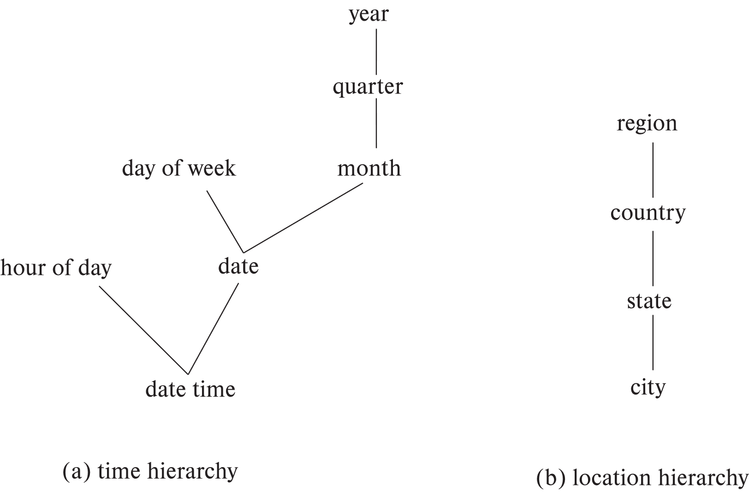
Hierarchies on Dimensions
Hierarchy on dimension attributes: lets dimensions be viewed at different levels of detail
E.g., the dimension datetime can be used to aggregate by hour of day, date, day of week, month, quarter or year

Slide 23
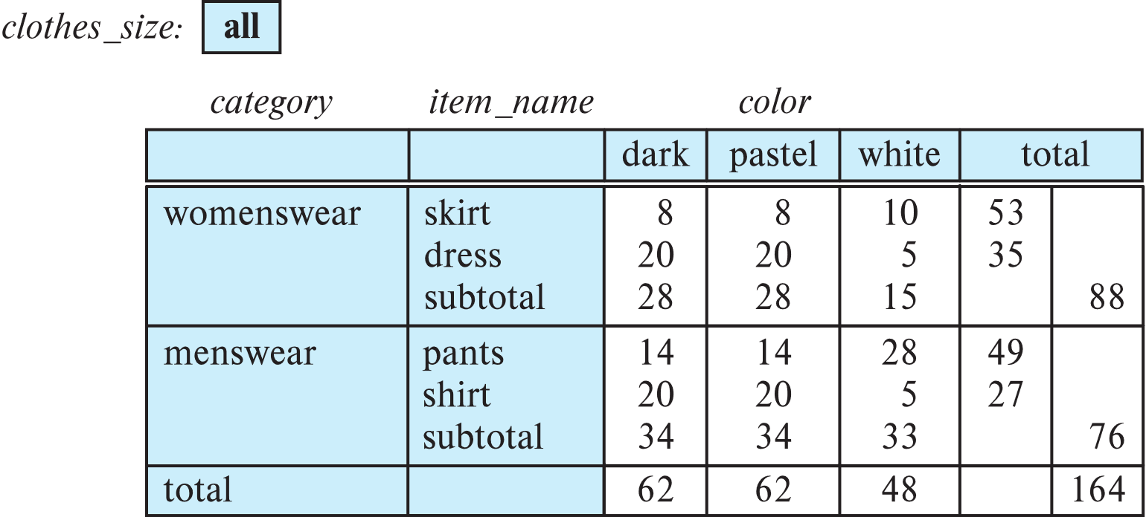
Cross Tabulation With Hierarchy
Cross-tabs can be easily extended to deal with hierarchies
Can drill down or roll up on a hierarchy
E.g. hierarchy: item_name → category

Slide 24
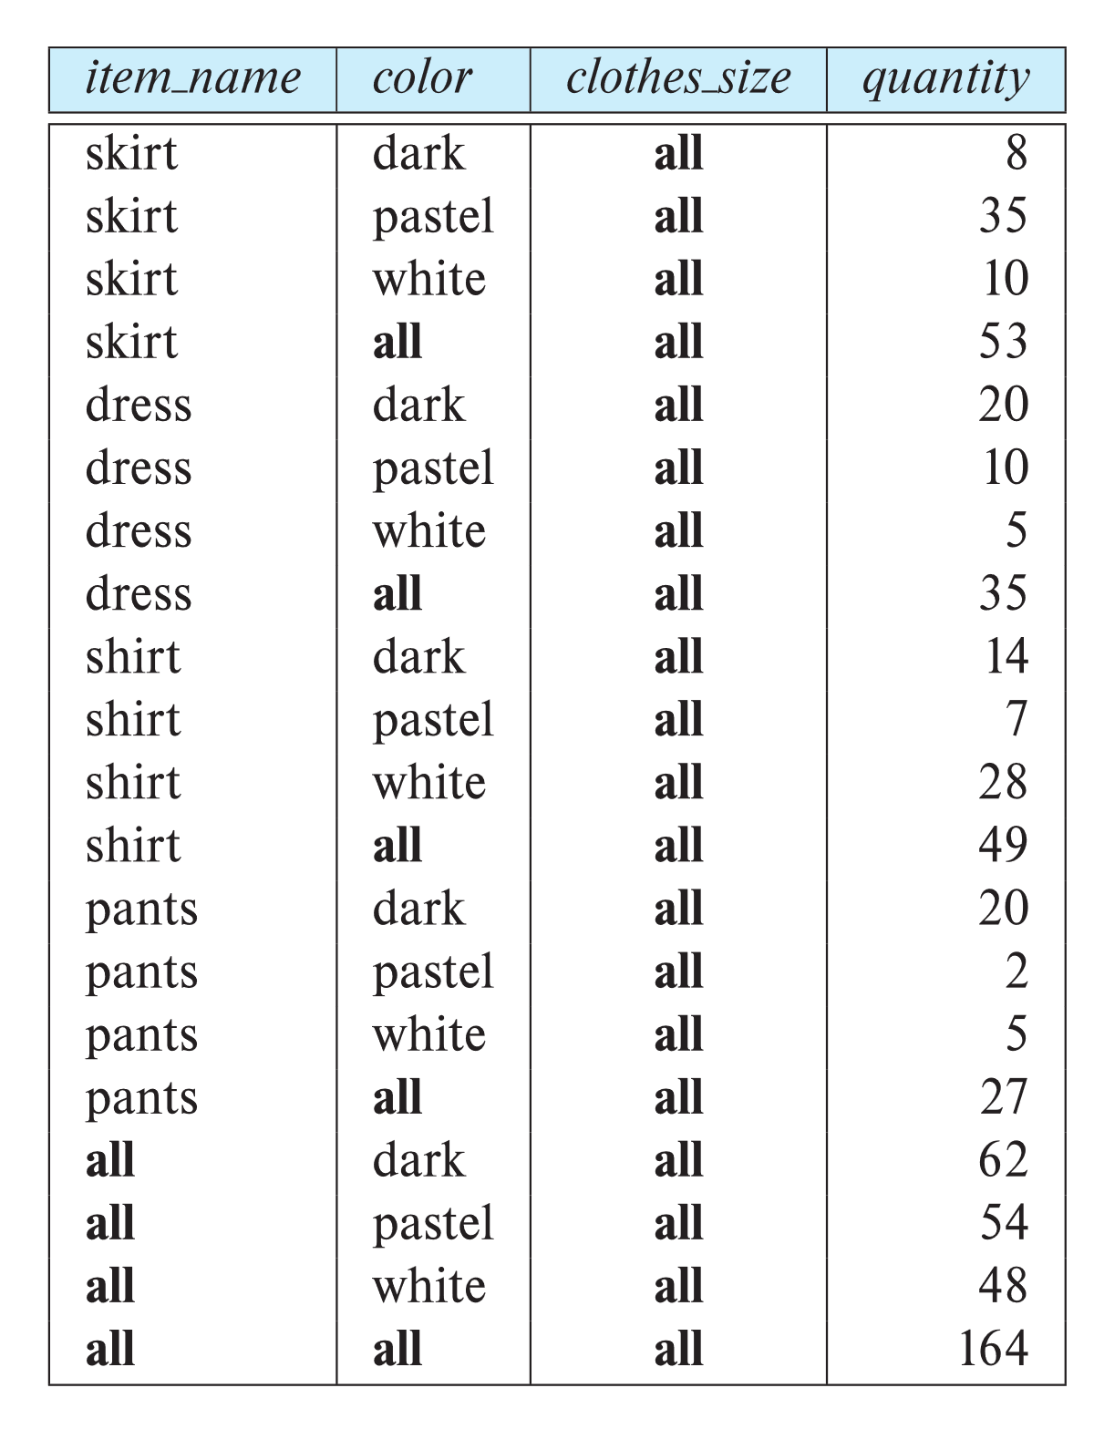
Relational Representation of Cross-tabs
Cross-tabs can be represented as relations
We use the value all to represent aggregates.
The SQL standard actually uses null values in place of all
Works with any data type
But can cause confusion with regular null values.

Slide 25
Some DFF Material

Slide 26
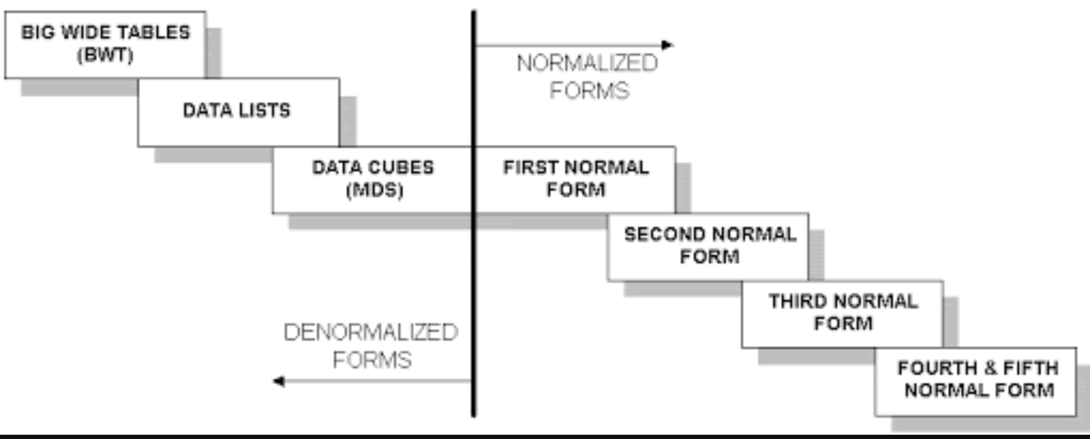
NORMALIZATION VS WIDE-FLAT
Good for Integrity
Good for Query

Slide 27
NORMALIZATION VS WIDE-FLAT
http://jjmontesl.github.io/cubesviewer/
Look at the project data.
AWS Quicksight

Slide 28
Olap in SQL

Slide 29
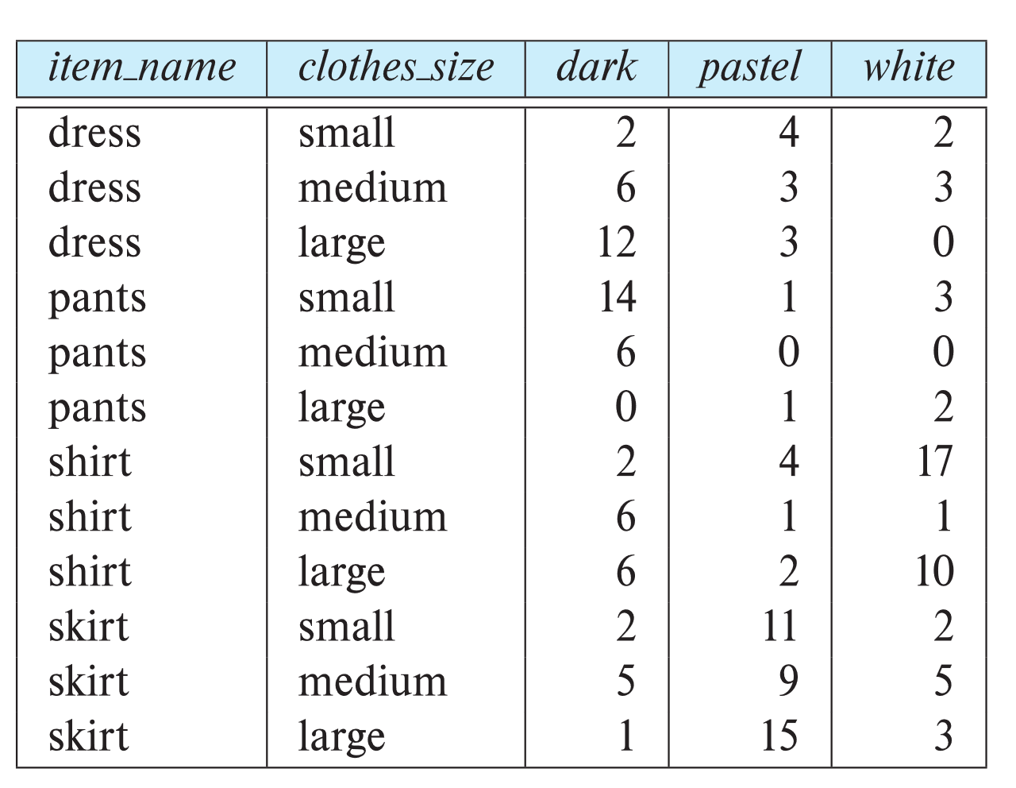
Pivot Operation
select * from sales pivot ( sum(quantity) for color in ('dark','pastel','white') ) order by item name;

Slide 30
Cube Operation
The cube operation computes union of group by’s on every subset of the specified attributes
E.g., consider the query
select item_name, color, size, sum(number) from sales group by cube(item_name, color, size)
This computes the union of eight different groupings of the sales relation:
{ (item_name, color, size), (item_name, color), (item_name, size), (color, size), (item_name), (color), (size), ( ) }
where ( ) denotes an empty group by list.
For each grouping, the result contains the null value for attributes not present in the grouping.
Notes:
30

Slide 31
Online Analytical Processing Operations
Relational representation of cross-tab that we saw earlier, but with null in place of all, can be computed by
select item_name, color, sum(number) from sales group by cube(item_name, color)
The function grouping() can be applied on an attribute
Returns 1 if the value is a null value representing all, and returns 0 in all other cases.
select case when grouping(item_name) = 1 then 'all’ else item_name end as item_name, case when grouping(color) = 1 then 'all’ else color end as color, 'all' as clothes size, sum(quantity) as quantity from sales group by cube(item name, color);
Notes:
31

Slide 32
Online Analytical Processing Operations
Can use the function decode() in the select clause to replace such nulls by a value such as all
E.g., replace item_name in first query by decode( grouping(item_name), 1, ‘all’, item_name)
Notes:
32

Slide 33
Extended Aggregation (Cont.)
The rollup construct generates union on every prefix of specified list of attributes
select item_name, color, size, sum(number) from sales group by rollup(item_name, color, size)
Generates union of four groupings:
{ (item_name, color, size), (item_name, color), (item_name), ( ) }
Rollup can be used to generate aggregates at multiple levels of a hierarchy.
E.g., suppose table itemcategory(item_name, category) gives the category of each item. Then
select category, item_name, sum(number) from sales, itemcategory where sales.item_name = itemcategory.item_name group by rollup(category, item_name)
would give a hierarchical summary by item_name and by category.
Notes:
33

Slide 34
Extended Aggregation (Cont.)
Multiple rollups and cubes can be used in a single group by clause
Each generates set of group by lists, cross product of sets gives overall set of group by lists
E.g.,
select item_name, color, size, sum(number) from sales group by rollup(item_name), rollup(color, size)
generates the groupings
{item_name, ()} X {(color, size), (color), ()}
= { (item_name, color, size), (item_name, color), (item_name), (color, size), (color), ( ) }
select item_name, color, clothes_size, sum(quantity) from sales group by grouping sets ((color, clothes_size), (clothes_size, item_name));
Notes:
34

Slide 35
OLAP Implementation
The earliest OLAP systems used multidimensional arrays in memory to store data cubes, and are referred to as multidimensional OLAP (MOLAP) systems.
OLAP implementations using only relational database features are called relational OLAP (ROLAP) systems
Hybrid systems, which store some summaries in memory and store the base data and other summaries in a relational database, are called hybrid OLAP (HOLAP) systems.

Slide 36
OLAP Implementation (Cont.)
Early OLAP systems precomputed all possible aggregates in order to provide online response
Space and time requirements for doing so can be very high
2^{n} combinations of group by
It suffices to precompute some aggregates, and compute others on demand from one of the precomputed aggregates
Can compute aggregate on (item_name, color) from an aggregate on (item_name, color, size)
For all but a few “non-decomposable” aggregates such as median
is cheaper than computing it from scratch
Several optimizations available for computing multiple aggregates
Can compute aggregate on (item_name, color) from an aggregate on (item_name, color, size)
Can compute aggregates on (item_name, color, size), (item_name, color) and (item_name) using a single sorting of the base data

Slide 37
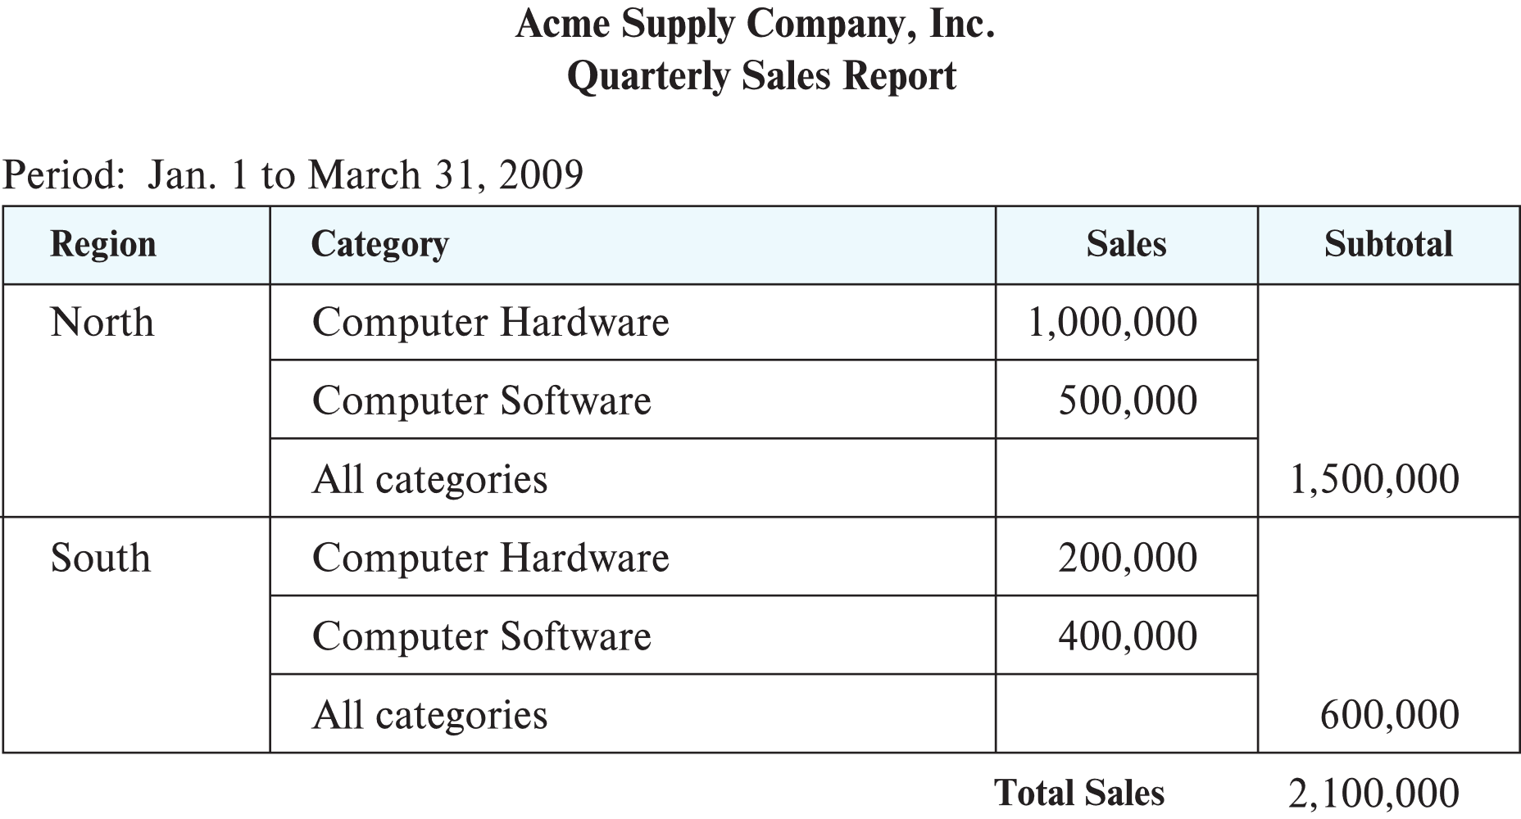
Reporting and Visualization
Reporting tools help create formatted reports with tabular/graphical representation of data
E.g., SQL Server reporting services, Crystal Reports
Data visualization tools help create interactive visualization of data
E.g., Tableau, FusionChart, plotly, Datawrapper, Google Charts, etc.
Frontend typically based on HTML+JavaScript

Slide 38
Data mining

Slide 39
Data Mining
Data mining is the process of semi-automatically analyzing large databases to find useful patterns
Similar goals to machine learning, but on very large volumes of data
Part of the larger area of knowledge discovery in databases (KDD)
Some types of knowledge can be represented as rules
More generally, knowledge is discovered by applying machine learning techniques on past instances of data, to form a model
Model is then used to make predictions for new instances

Slide 40
Types of Data Mining Tasks
Prediction based on past history
Predict if a credit card applicant poses a good credit risk, based on some attributes (income, job type, age, ..) and past history
Predict if a pattern of phone calling card usage is likely to be fraudulent
Some examples of prediction mechanisms:
Classification
Items (with associated attributes) belong to one of several classes
Training instances have attribute values and classes provided
Given a new item whose class is unknown, predict to which class it belongs based on its attribute values
Regression formulae
Given a set of mappings for an unknown function, predict the function result for a new parameter value

Slide 41
Data Mining (Cont.)
Descriptive Patterns
Associations
Find books that are often bought by “similar” customers. If a new such customer buys one such book, suggest the others too.
Associations may be used as a first step in detecting causation
E.g., association between exposure to chemical X and cancer,
Clusters
E.g., typhoid cases were clustered in an area surrounding a contaminated well
Detection of clusters remains important in detecting epidemics

Slide 42
Classification Rules
Classification rules help assign new objects to classes.
E.g., given a new automobile insurance applicant, should he or she be classified as low risk, medium risk or high risk?
Classification rules for above example could use a variety of data, such as educational level, salary, age, etc.
∀ person P, P.degree = masters and P.income > 75,000
⇒ P.credit = excellent
∀ person P, P.degree = bachelors and (P.income ≥ 25,000 and P.income ≤ 75,000) ⇒ P.credit = good
Rules are not necessarily exact: there may be some misclassifications
Classification rules can be shown compactly as a decision tree.

Slide 43
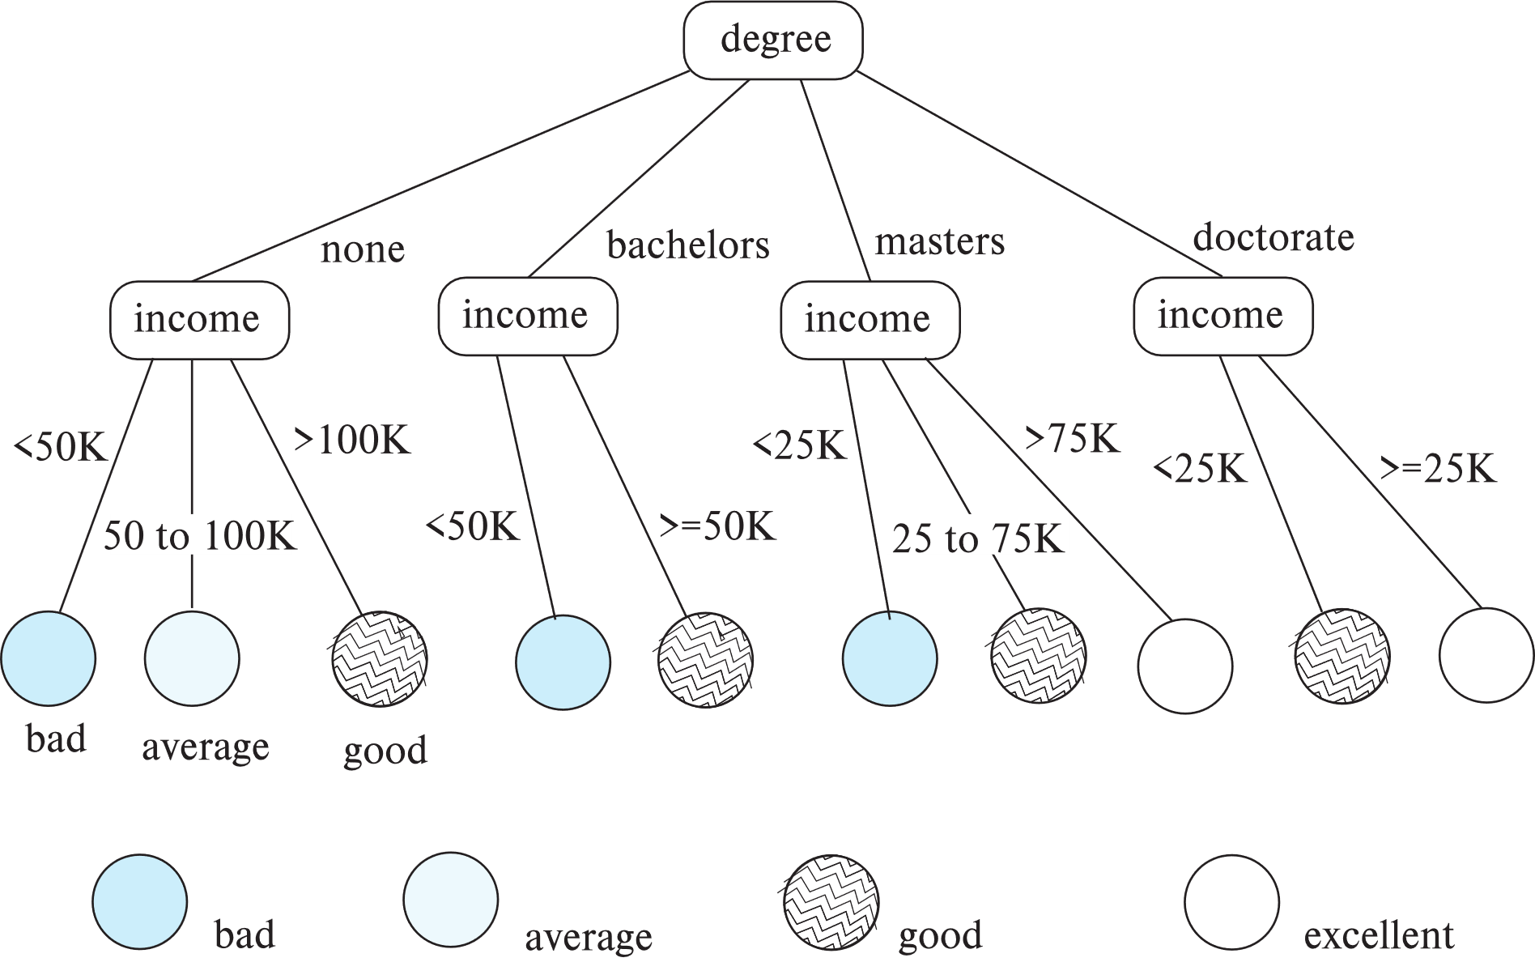
Decision Tree Classifiers

Slide 44
Decision Trees
Each internal node of the tree partitions the data into groups based on a partitioning attribute, and a partitioning condition for the node
Leaf node:
all (or most) of the items at the node belong to the same class, or
all attributes have been considered, and no further partitioning is possible.
Traverse tree from top to make a prediction
Number of techniques for constructing decision tree classifiers
We omit details

Slide 45
Bayesian Classifiers
Bayesian classifiers use Bayes theorem, which says
p (c_{j} | d ) = p (d | c_{j} ) p(c_{j} )
p (d) where p (c_{j} | d) = probability of instance d being in class c_{j},
p (d | c_{j} ) = probability of generating instance d given class c_{j},
p (c_{j} ) = probability of occurrence of class c_{j}, and
p (d) = probability of instance d occuring

Slide 46
Naïve Bayesian Classifiers
Bayesian classifiers require
computation of p (d | c_{j} )
precomputation of p (c_{j} )
p (d) can be ignored since it is the same for all classes
To simplify the task, naïve Bayesian classifiers assume attributes have independent distributions, and thereby estimate
p (d | c_{j}) = p (d₁ | c_{j} ) * p (d₂ | c_{j} ) * ….* (p (d_{n} | c_{j} )
Each of the p (d_{i} | c_{j} ) can be estimated from a histogram on d_{i} values for each class c_{j}
the histogram is computed from the training instances
Histograms on multiple attributes are more expensive to compute and store

Slide 47
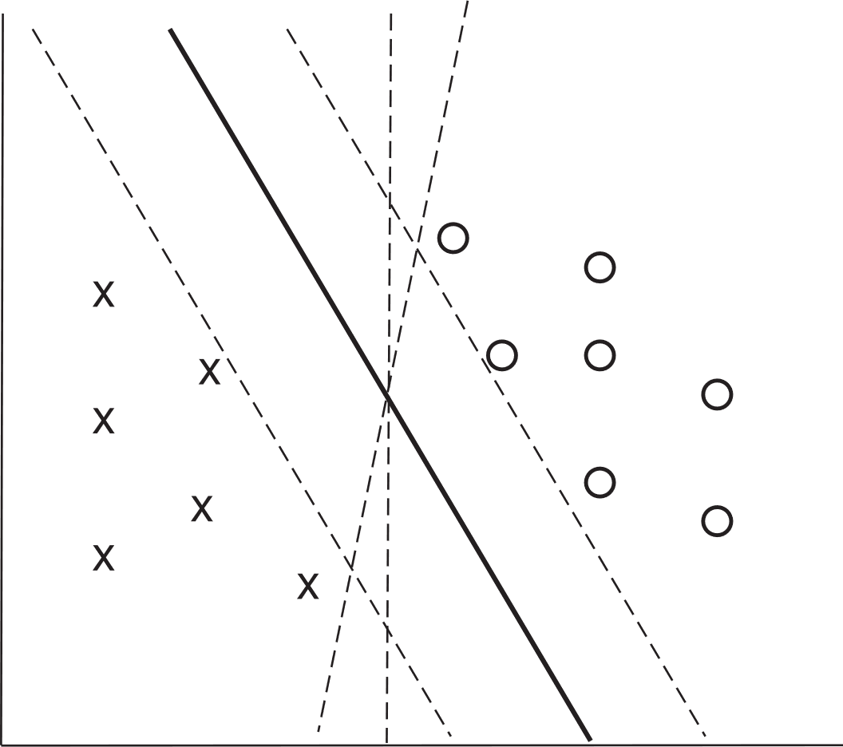
Support Vector Machine Classifiers
Simple 2-dimensional example:
Points are in two classes
Find a line (maximum margin line) s.t. line divides two classes, and distance from nearest point in either class is maximum

Slide 48
Support Vector Machine
In n-dimensions points are divided by a plane, instead of a line
SVMs can be used separators that are curve, not necessarily linear, by transforming points before classification
Transformation functions may be non-linear and are called kernel functions
Separator is a plane in the transformed space, but maps to curve in original space
There may not be an exact planar separator for a given set of points
Choose plane that best separates points
N-ary classification can be done by N binary classifications
In class i vs. not in class i.

Slide 49
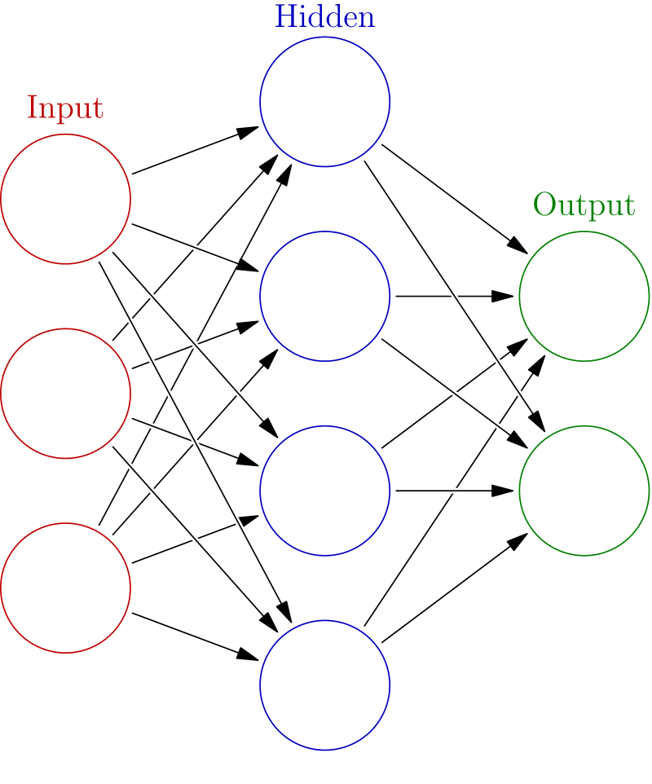
Neural Network Classifiers
Neural network has multiple layers
Each layer acts as input to next later
First layer has input nodes, which are assigned values from input attributes
Each node combines values of its inputs using some weight function to compute its value
Weights are associated with edges
For classification, each output value indicates likelihood of the input instance belonging to that class
Pick class with maximum likelihood
Weights of edges are key to classification
Edge weights are learnt during training phase

Slide 50
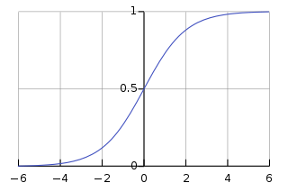
Neural Network Classifiers
Value of a node may be linear combination of inputs, or may be a non-linear function
E.g., sigmoid function
Backpropagation algorithm works as follows
Weights are set randomly initially
Training instances are processed one at a time
Output is computed using current weights
If classification is wrong, weights are tweaked to get a higher score for the correct class

Slide 51
Neural Networks (Cont.)
Deep neural networks have a large number of layers with large number of nodes in each layer
Deep learning refers to training of deep neural network on very large numbers of training instances
Each layer may be connected to previous layers in different ways
Convolutional networks used for image processing
More complex architectures used for text processing, and machine translation, speech recognition, etc.
Neural networks are a large area in themselves
Further details beyond scope of this chapter

Slide 52
Regression
Regression deals with the prediction of a value, rather than a class.
Given values for a set of variables, X₁, X₂, …, X_{n}, we wish to predict the value of a variable Y.
One way is to infer coefficients a₀, a₁, a₁, …, a_{n} such that Y = a₀ + a₁ * X₁ + a₂ * X₂ + … + a_{n} * X_{n}
Finding such a linear polynomial is called linear regression.
In general, the process of finding a curve that fits the data is also called curve fitting.
The fit may only be approximate
because of noise in the data, or
because the relationship is not exactly a polynomial
Regression aims to find coefficients that give the best possible fit.

Slide 53
Association Rules
Retail shops are often interested in associations between different items that people buy.
Someone who buys bread is quite likely also to buy milk
A person who bought the book Database System Concepts is quite likely also to buy the book Operating System Concepts.
Associations information can be used in several ways.
E.g. when a customer buys a particular book, an online shop may suggest associated books.
Association rules:
bread ⇒ milk DB-Concepts, OS-Concepts ⇒ Networks
Left hand side: antecedent, right hand side: consequent
An association rule must have an associated population; the population consists of a set of instances
E.g. each transaction (sale) at a shop is an instance, and the set of all transactions is the population

Slide 54
Association Rules (Cont.)
Rules have an associated support, as well as an associated confidence.
Support is a measure of what fraction of the population satisfies both the antecedent and the consequent of the rule.
E.g., suppose only 0.001 percent of all purchases include milk and screwdrivers. The support for the rule is milk ⇒ screwdrivers is low.
Confidence is a measure of how often the consequent is true when the antecedent is true.
E.g., the rule bread ⇒ milk has a confidence of 80 percent if 80 percent of the purchases that include bread also include milk.
We omit further details, such as how to efficiently infer association rules

Slide 55
Clustering
Clustering: Intuitively, finding clusters of points in the given data such that similar points lie in the same cluster
Can be formalized using distance metrics in several ways
Group points into k sets (for a given k) such that the average distance of points from the centroid of their assigned group is minimized
Centroid: point defined by taking average of coordinates in each dimension.
Another metric: minimize average distance between every pair of points in a cluster
Hierarchical clustering: example from biological classification
(the word classification here does not mean a prediction mechanism)
chordata mammalia reptilia
leopards humans snakes crocodiles

Slide 56
Clustering and Collaborative Filtering
Goal: predict what movies/books/… a person may be interested in, on the basis of
Past preferences of the person
Preferences of other people
One approach based on repeated clustering
Cluster people based on their preferences for movies
Then cluster movies on the basis of being liked by the same clusters of people
Again cluster people based on their preferences for (the newly created clusters of) movies
Repeat above till equilibrium
Given new user
Find most similar cluster of existing users and
Predict movies in movie clusters popular with that user cluster
Above problem is an instance of collaborative filtering

Slide 57
Other Types of Mining
Text mining: application of data mining to textual documents
Sentiment analysis
E.g., learn to predict if a user review is positive or negative about a product
Information extraction
Create structured information from unstructured textual description or semi-structured data such as tabular displays
Entity recognition and disambiguation
E.g., given text with name “Michael Jordan” does the name refer to the famous basketball player or the famous ML expert
Knowledge graph (see Section 8.4)
Can be constructed by information extraction from different sources, such as Wikipedia

Slide 58
End of Chapter

Slide 59
Best Splits
Pick best attributes and conditions on which to partition
The purity of a set S of training instances can be measured quantitatively in several ways.
Notation: number of classes = k, number of instances = |S|, fraction of instances in class i = p_{i}.
The Gini measure of purity is defined as
[
Gini (S) = 1 - ∑
When all instances are in a single class, the Gini value is 0
It reaches its maximum (of 1 –1 /k) if each class the same number of instances.
k
p²_{i}
i- 1

Slide 60
Best Splits (Cont.)
Another measure of purity is the entropy measure, which is defined as
entropy (S) = – ∑
When a set S is split into multiple sets Si, I=1, 2, …, r, we can measure the purity of the resultant set of sets as:
purity(S₁, S₂, ….., S_{r}) = ∑
The information gain due to particular split of S into S_{i}, i = 1, 2, …., r
Information-gain (S, {S₁, S₂, …., S_{r}) = purity(S ) – purity (S₁, S₂, … S_{r})
k
p_{i}log₂ p_{i}
i- 1
r
|S_{i}|
|S|
purity (S_{i})
i= 1

Slide 61
Best Splits (Cont.)
Measure of “cost” of a split: Information-content (S, {S₁, S₂, ….., S_{r}})) = – ∑
Information-gain ratio = Information-gain (S, {S₁, S₂, ……, S_{r}})
Information-content (S, {S₁, S₂, ….., S_{r}})
The best split is the one that gives the maximum information gain ratio
r
|S_{i}|
|S|
|S_{i}|
|S|
log₂
i- 1

Slide 62
Finding Best Splits
Categorical attributes (with no meaningful order):
Multi-way split, one child for each value
Binary split: try all possible breakup of values into two sets, and pick the best
Continuous-valued attributes (can be sorted in a meaningful order)
Binary split:
Sort values, try each as a split point
E.g., if values are 1, 10, 15, 25, split at ≤1, ≤ 10, ≤ 15
Pick the value that gives best split
Multi-way split:
A series of binary splits on the same attribute has roughly equivalent effect

Slide 63
Decision-Tree Construction Algorithm
Procedure GrowTree (S ) Partition (S ); Procedure Partition (S) if ( purity (S ) > δ_{p} or |S| < δ_{s} ) then return; for each attribute A evaluate splits on attribute A; Use best split found (across all attributes) to partition S into S₁, S₂, …., S_{r}, for i = 1, 2, ….., r Partition (S_{i} );

Slide 64
Finding Association Rules
We are generally only interested in association rules with reasonably high support (e.g., support of 2% or greater)
Naïve algorithm
Consider all possible sets of relevant items.
For each set find its support (i.e., count how many transactions purchase all items in the set).
Large itemsets: sets with sufficiently high support
Use large itemsets to generate association rules.
From itemset A generate the rule A - {b } ⇒b for each b ∈ A.
Support of rule = support (A).
Confidence of rule = support (A ) / support (A - {b })

Slide 65
Finding Support
Determine support of itemsets via a single pass on set of transactions
Large itemsets: sets with a high count at the end of the pass
If memory not enough to hold all counts for all itemsets use multiple passes, considering only some itemsets in each pass.
Optimization: Once an itemset is eliminated because its count (support) is too small none of its supersets needs to be considered.
The a priori technique to find large itemsets:
Pass 1: count support of all sets with just 1 item. Eliminate those items with low support
Pass i: candidates: every set of i items such that all its i-1 item subsets are large
Count support of all candidates
Stop if there are no candidates

Slide 66
Other Types of Associations
Basic association rules have several limitations
Deviations from the expected probability are more interesting
E.g., if many people purchase bread, and many people purchase cereal, quite a few would be expected to purchase both
We are interested in positive as well as negative correlations between sets of items
Positive correlation: co-occurrence is higher than predicted
Negative correlation: co-occurrence is lower than predicted
Sequence associations / correlations
E.g., whenever bonds go up, stock prices go down in 2 days
Deviations from temporal patterns
E.g., deviation from a steady growth
E.g., sales of winter wear go down in summer
Not surprising, part of a known pattern.
Look for deviation from value predicted using past patterns

Slide 67
Hierarchical Clustering
Agglomerative clustering algorithms
Build small clusters, then cluster small clusters into bigger clusters, and so on
Divisive clustering algorithms
Start with all items in a single cluster, repeatedly refine (break) clusters into smaller ones

Slide 68
Clustering Algorithms
Clustering algorithms have been designed to handle very large datasets
E.g., the Birch algorithm
Main idea: use an in-memory R-tree to store points that are being clustered
Insert points one at a time into the R-tree, merging a new point with an existing cluster if is less than some δ distance away
If there are more leaf nodes than fit in memory, merge existing clusters that are close to each other
At the end of first pass we get a large number of clusters at the leaves of the R-tree
Merge clusters to reduce the number of clusters

