Slide 1
聚类及主成分分析
生物信息学概论
教师：李梢教授
助教：博士生 祖松鹏
2014-11-15

Slide 2
CONTENT
Hierarchical Clustering
K-means Clustering
Gaussian Mixture Model
Principal Component Analysis
Reference

Slide 3
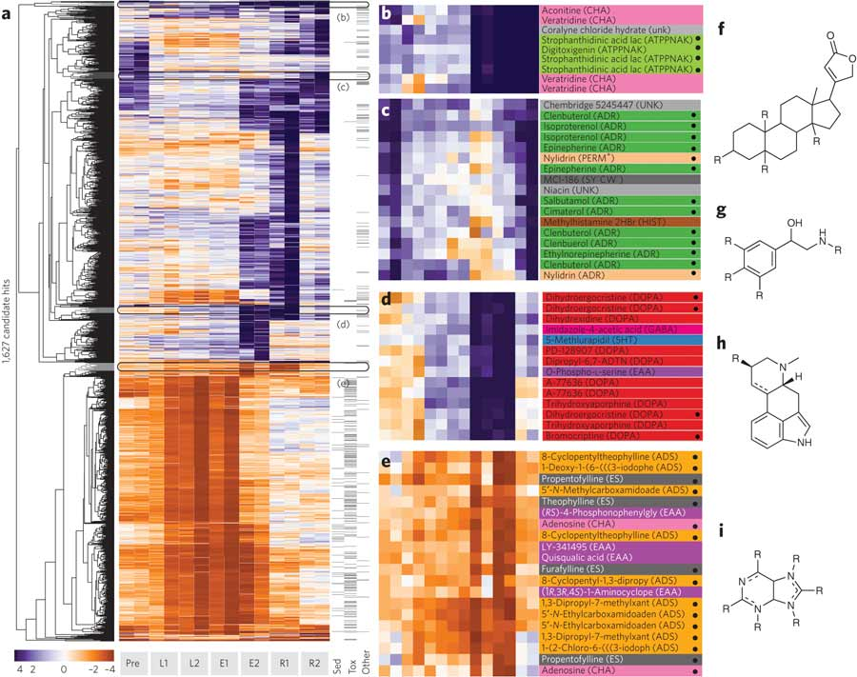

Slide 4
Introduction
Illustrative Example
Agglomerative and divisive clustering on the data set {a, b, c, d,e }
Step 0
Step 1
Step 2
Step 3
Step 4
Agglomerative
a
a b
b
a b c d e
c
c d e
d
d e
e
Divisive
Step 4
Step 3
Step 2
Step 1
Step 0

Slide 5
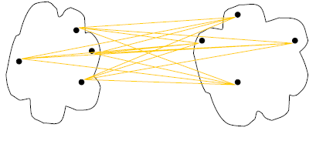
Cluster Distance Measures
Single link: smallest distance between an element in one cluster and an element in the other, i.e., d(C_{i}, C_{j}) = min{d(x_{ip}, x_{jq})}
Complete link: largest distance between an element in one cluster and an element in the other, i.e., d(C_{i}, C_{j}) = max{d(x_{ip}, x_{jq})}
Average: avg distance between elements in one cluster and elements in the other, i.e.,
d(C_{i}, C_{j}) = avg{d(x_{ip}, x_{jq})}
single link
(min)
complete link
(max)
average
Notes:
Define D(C, C)=0, the distance between two exactly same clusters is ZERO!

Slide 6
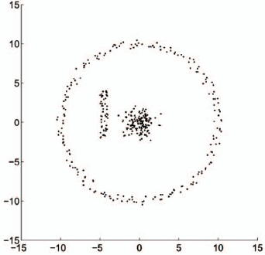
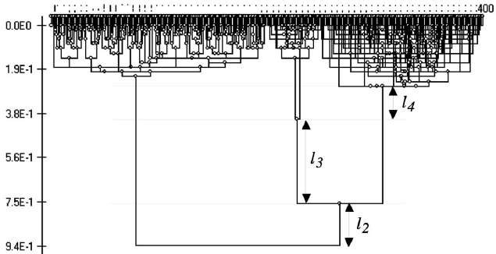

Slide 7
K-means Algorithm
Choose K centroids at random
Expression in Sample1
Expression in Sample2
Iteration = 0

Slide 8
K-means Algorithm
Choose K centroids at random
Assign object i to closest centroid
Iteration = 1

Slide 9
K-means Algorithm
Choose K centroids at random
Assign object i to closest centroid
Recalculate centroid based on current cluster assignment
Iteration = 2

Slide 10
K-means Algorithm
Choose K centroids at random
Assign object i to closest centroid
Recalculate centroid based on current cluster assignment
Repeat until assignment stabilize
Iteration = 3

Slide 11
K-means Algorithm Example
10
10
9
9
8
8
7
7
6
6
5
5
4
Assign each objects to most similar center
Update the cluster means
4
3
3
2
2
1
1
0
0
0
1
2
3
4
5
6
7
8
9
10
0
1
2
3
4
5
6
7
8
9
10
reassign
reassign
K=2
Arbitrarily choose K object as initial cluster center
Update the cluster means

Slide 12
K-means Algorithm
Deterministic method
Initial cluster centers important
Can be trapped in local optimal
How to pick initial cluster centers
Run hierarchical cluster, find cut line
Random start many times with different initial centers
Not tolerant to outliers or noise

Slide 13
How to Pick K
K = 2, gradually increase
Improvement: reduce within cluster distance and increase between cluster distance
Cost: cost with each increase in K
Compare the cost with improvement, stop when not worth it

Slide 14
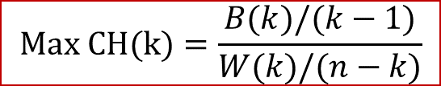
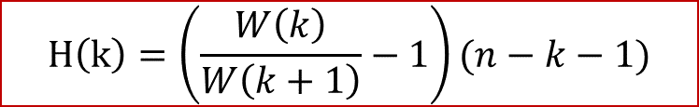
How to Pick K
W(k) = total sum of squares within clusters
B(k) = sum of squares between cluster means
n = total number of data points
Calinski & Harabasz, 1974
Hartigan, 1975
stop when H(k) < 10
$$Max CH(k)=\frac{B(k)/(k−1)}{W(k)/(n−k)}$$
$$H\left(k\right)=\left(\frac{W\left(k\right)}{W\left(k+1\right)}−1\right)(n−k−1)$$

Slide 15
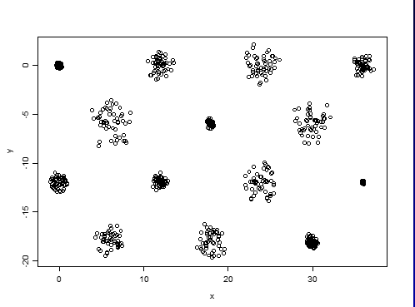
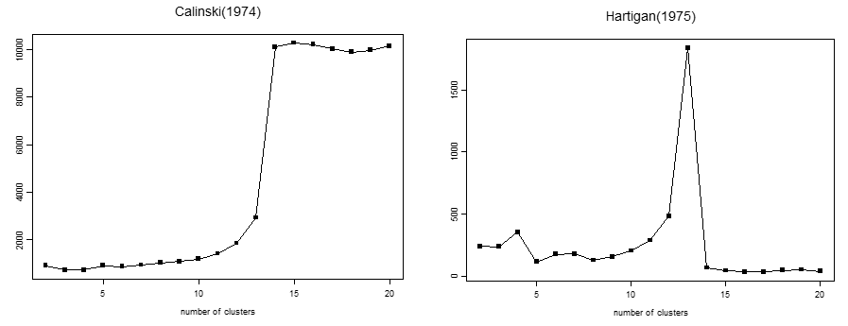
How to Pick K

Slide 16
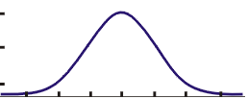
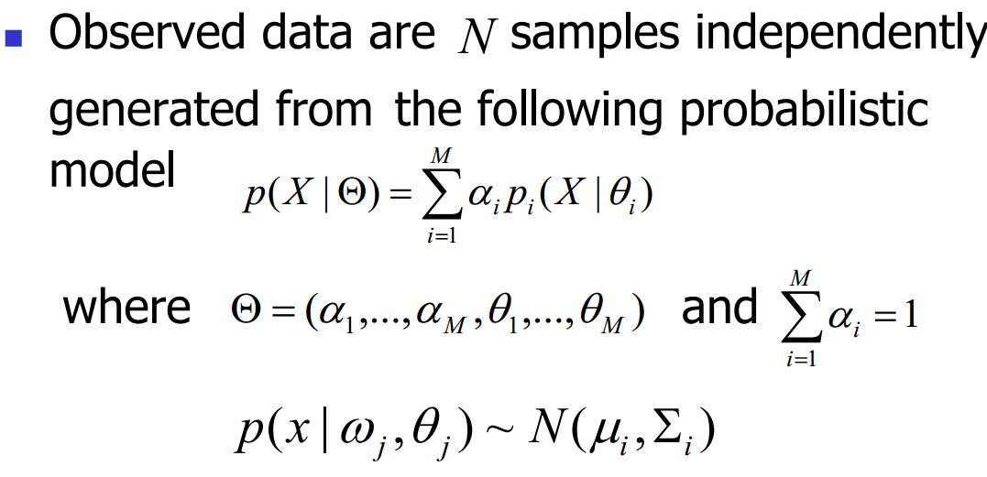
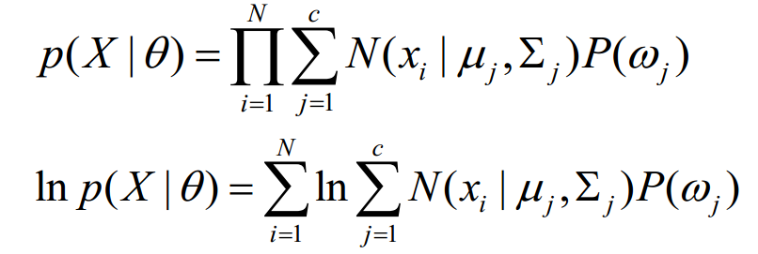
Gaussian Mixture Model
G1,w1
G2,w2
G3,w3
G5.w5
G4,w4

Slide 17
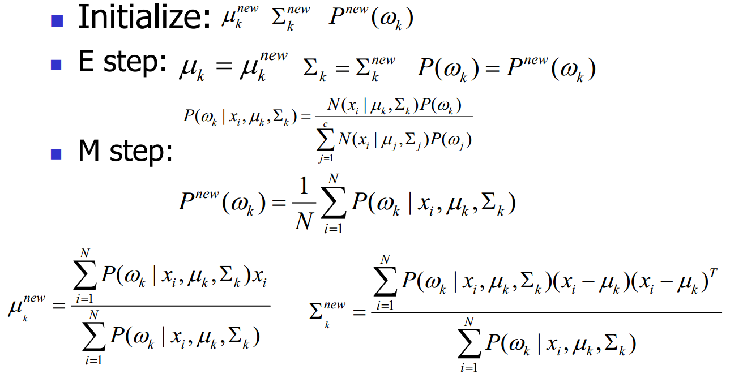
EM Algorithm

Slide 18
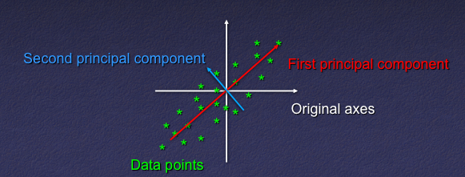
Principal Component Analysis (PCA)
A linear transformation of the original coordinates system to capture as much of the variation in data.
Mainly used in Dimension Reduction.

Slide 19
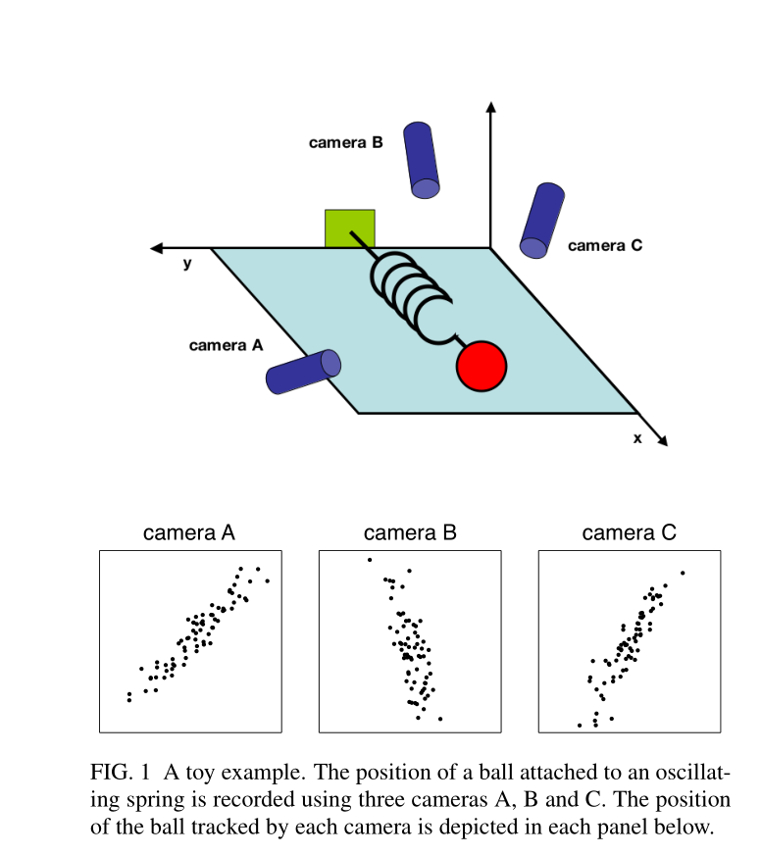

Slide 20
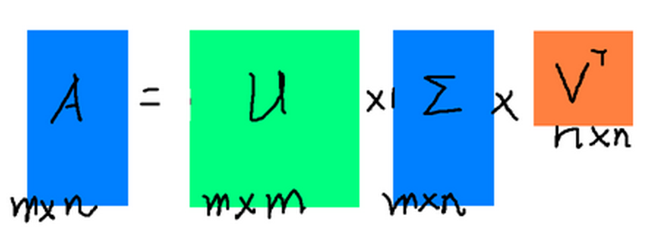

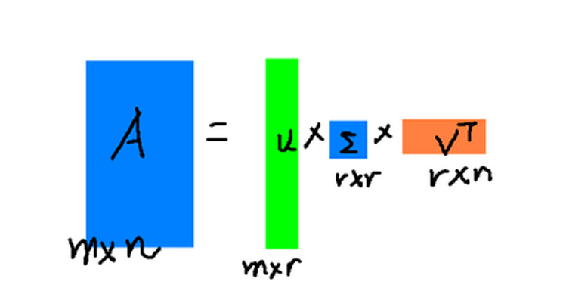
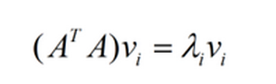
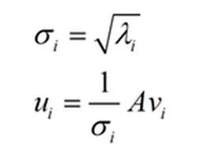

Singular Value Decomposition (SVD)

Slide 21
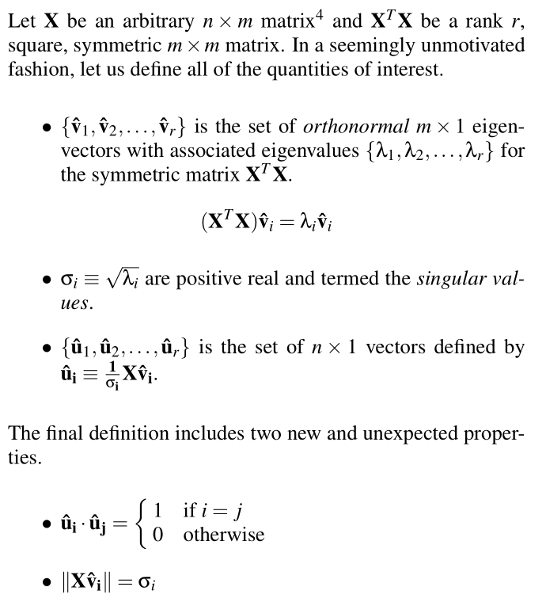

Slide 22
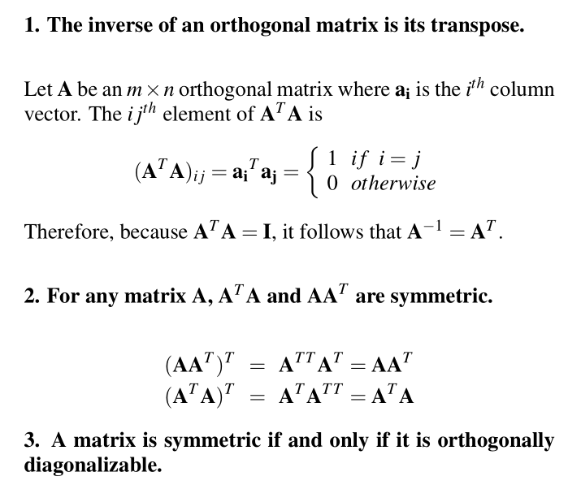
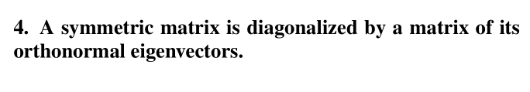

Slide 23
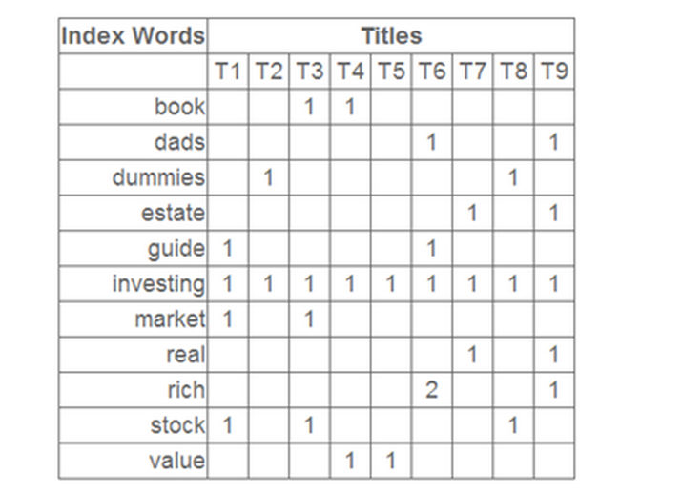
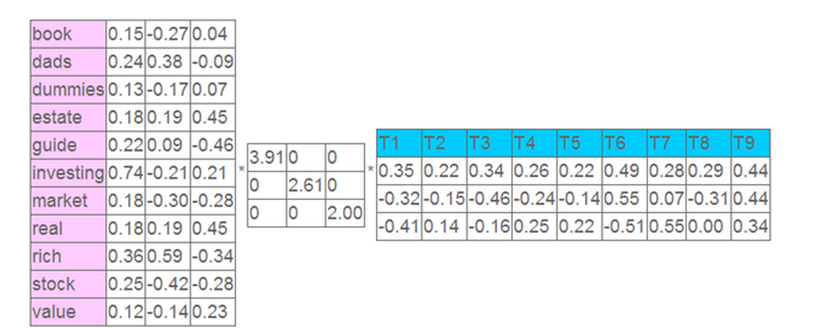
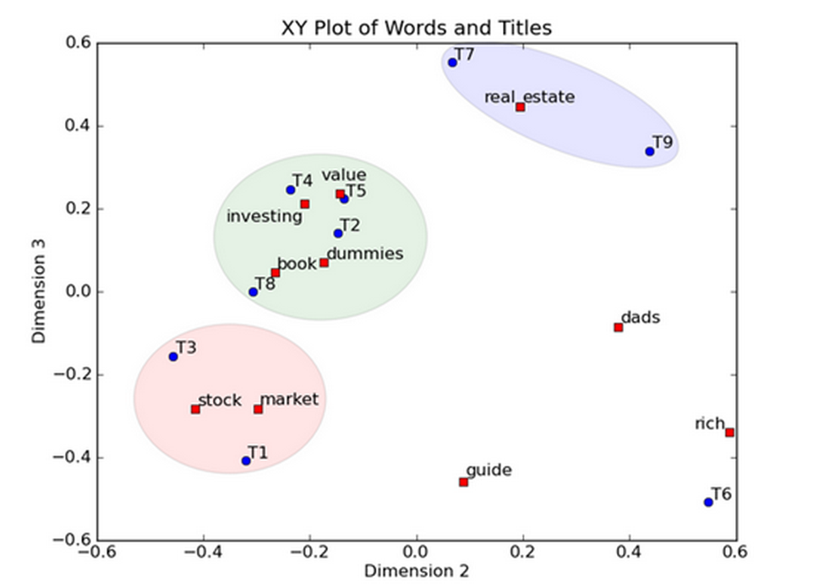

Slide 24
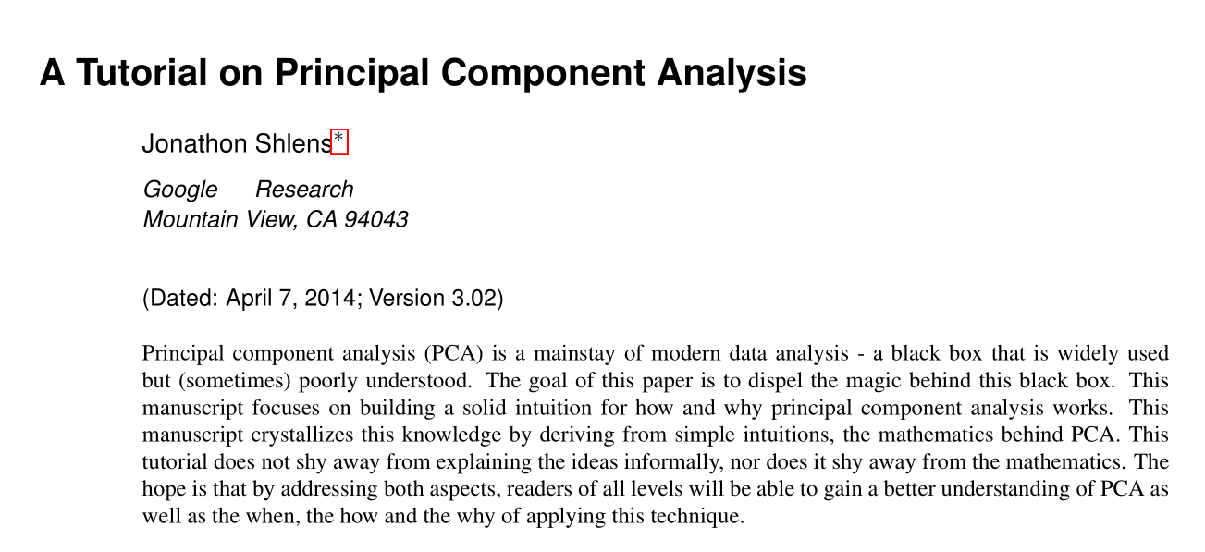
PCA & SVD

Slide 25
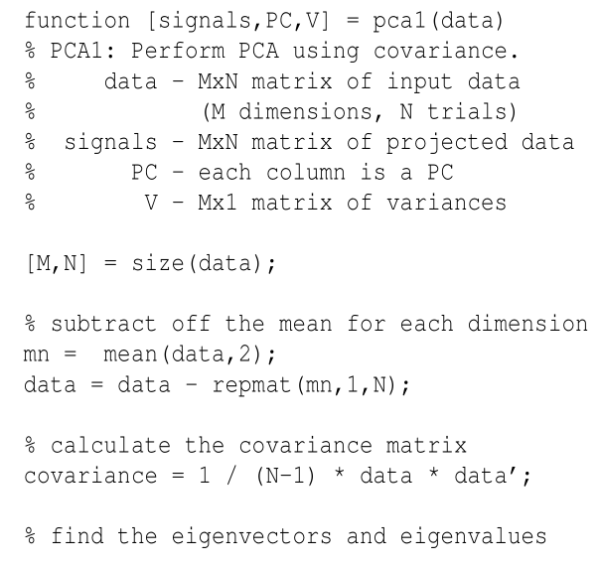
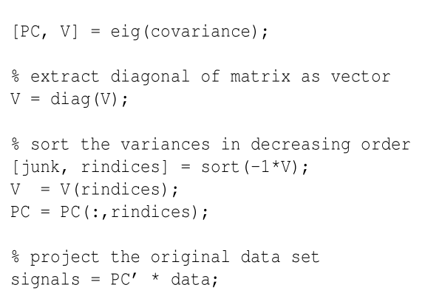

Slide 26
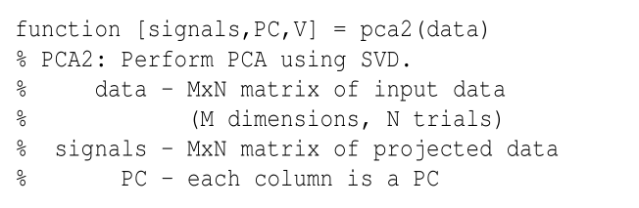
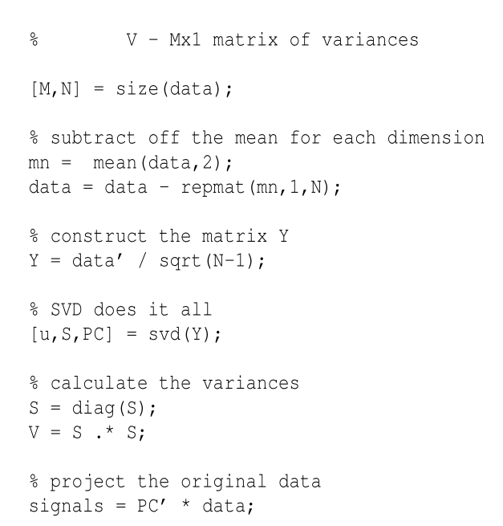

Slide 27
REFERENCE
PPT from Xiaole Shirley Liu, STAT115/STAT215, Harvard.
http://www.cnblogs.com/leftnoteasy/archive/2011/01/19/svd-and-applications.html

