Slide 1
网络分析
生物信息学概论
教师：李梢教授
助教：博士生 祖松鹏
2014-12-10

Slide 2
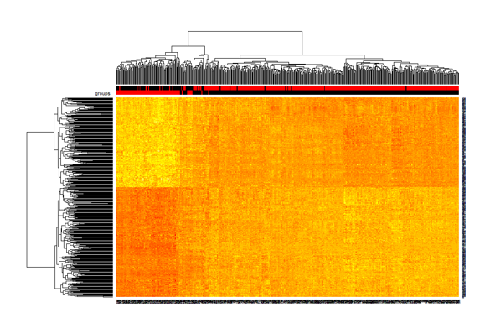
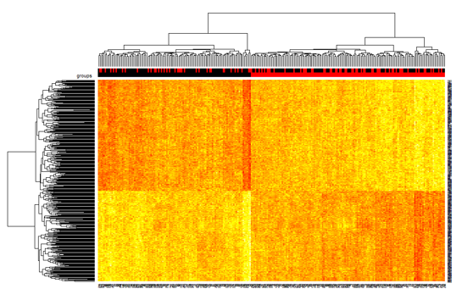

Slide 3
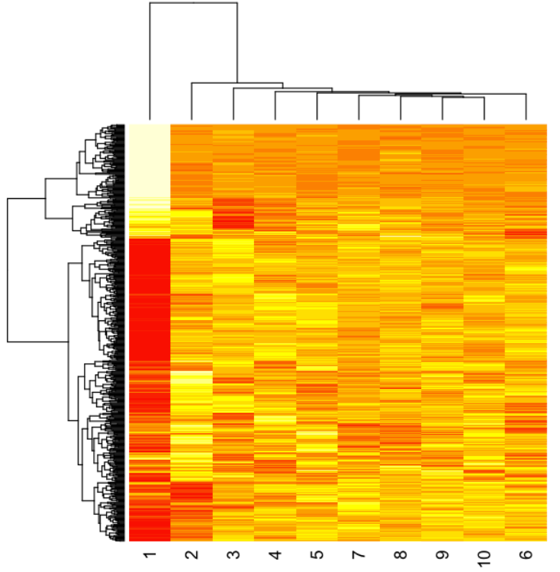
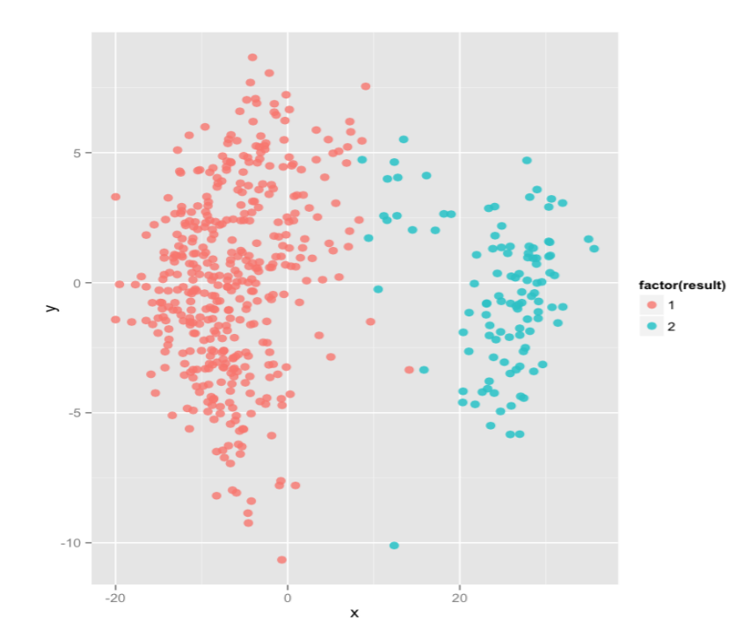
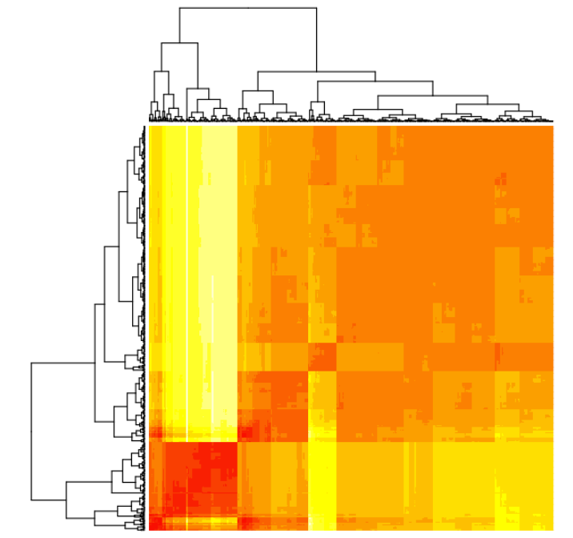

Slide 4
CONTENT
Topology of Complex Network
Controllability of Complex Networks
Network Medicine
Discussion
Further Reading
Homework

Slide 5
Topology of Complex Network
Complex network: a wide range of systems in nature and society.
Several observations:
Small world: “six degree of separation”.
(Random graphs are small worlds as well)
Clustering: cliques form
Degree distribution: power-law degree distribution vs. Poisson distribution in random graphs.
Error and Attack Tolerance: redundant and network topology.

Slide 6
Topology of Complex Network
The Barabasi-Albert model: a minimal model to capture the power-law degree distribution
Growth: start with m nodes, every time, add one node with n edges towards different nodes.
Preferential attachment: The probability of connection is correlated with the degree of the node.
Albert, Réka, and Albert-László Barabási. "Statistical mechanics of complex networks." Reviews of modern physics 74.1 (2002): 47.
Cited by 14561

Slide 7
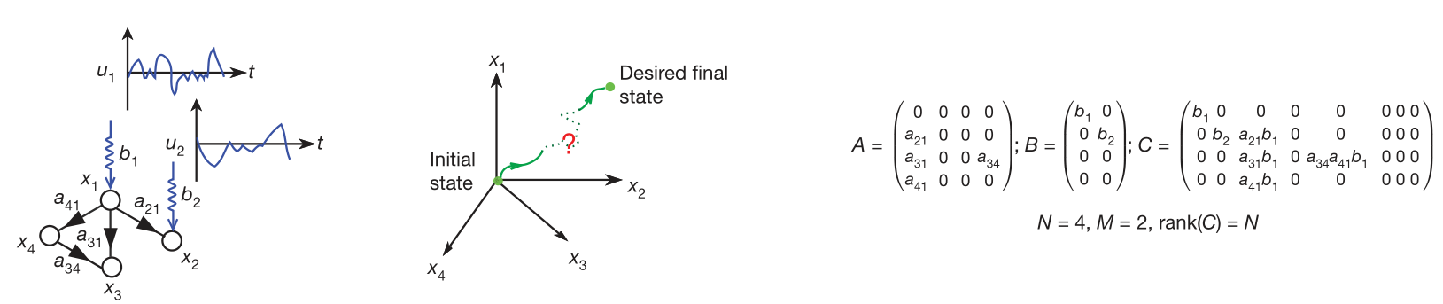



Controllability of Complex Networks
Liu and his colleagues (Liu et al., Nature, 2011) firstly developed analytical tools to study this topic,
Controllability ?
Kalman’s controllability rank condition

Slide 8
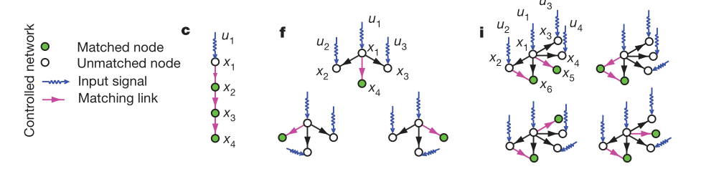
Controllability of Complex Networks
Difficulty:
We need to know the A matrix in details.
In reality, we want to identify the minimum number of driver nodes. And only a brute-force search can be used here.
Structural Controllable
Maximum Matching Rule

Slide 9

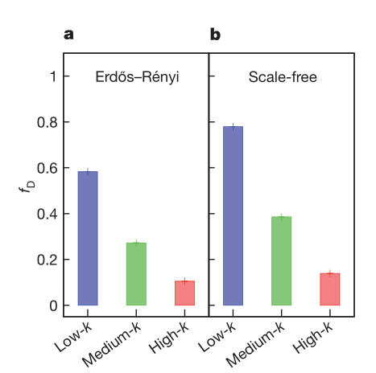
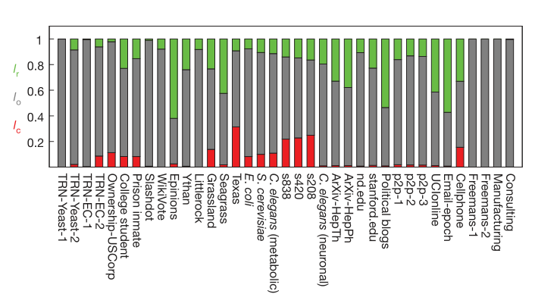
Controllability of Complex Networks
The fraction of driver nodes is significantly higher among low-k nodes.
Relating controllability with the degree distribution.
Sparse and heterogeneous networks require the most driver nodes.
Robustness of control under unavoidable link failure.

Slide 10
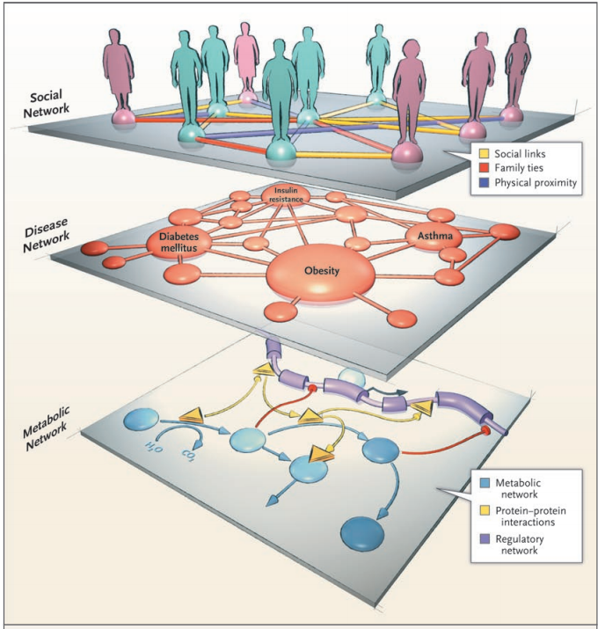
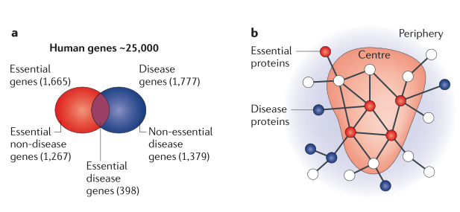
Network Medicine
Barabasi and his colleagues (Barabasi N Engl J Med, 2007; Barabasi et al., Nat Rev Genet,2011) proposed the conception of Network Medicine.

Slide 11
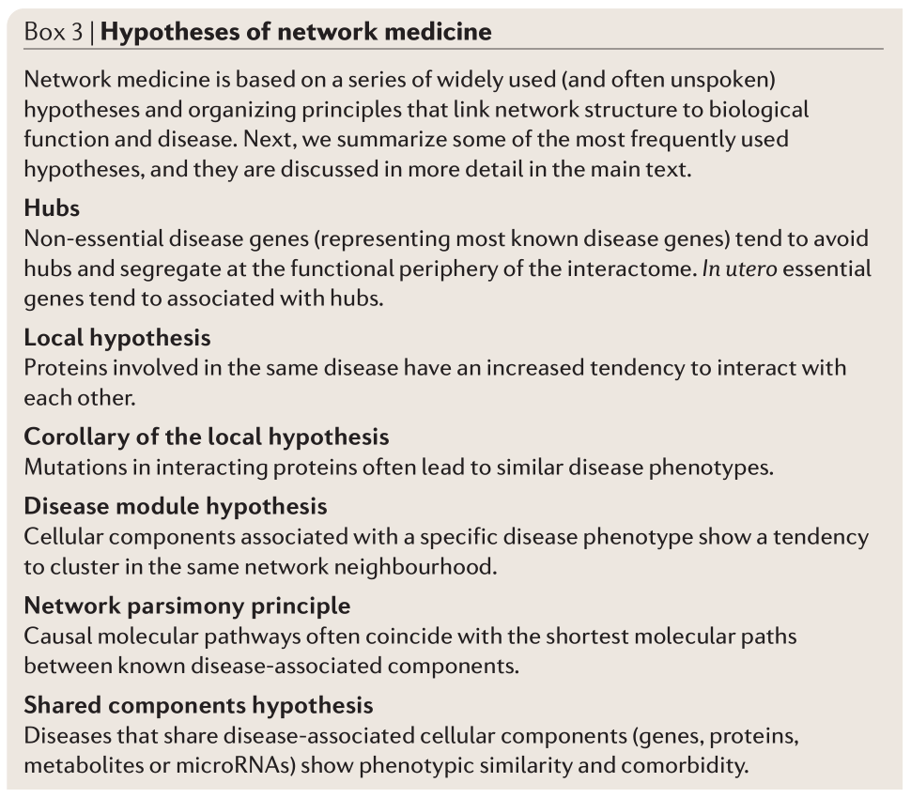
Network Medicine
Element of biological networks
Modules
Motifs
Betweenness centrality

Slide 12
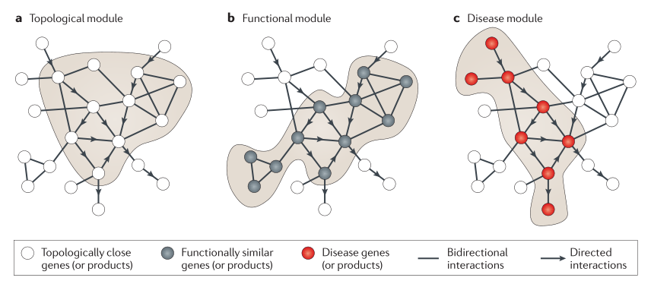
Network Medicine
The tacit assumption in network medicine is that the topological, functional and disease modules overlap, so that functional modules correspond to topological modules and a disease can be viewed as the breakdown of a functional module.

Slide 13
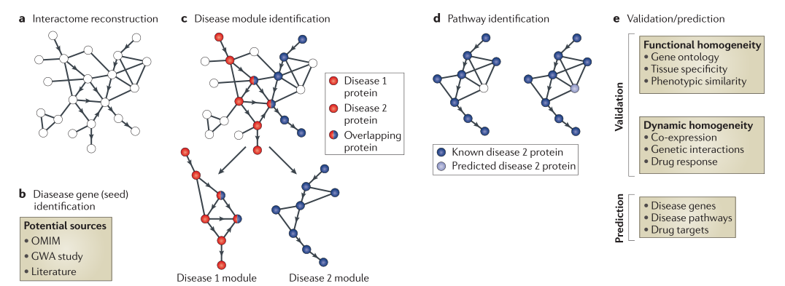
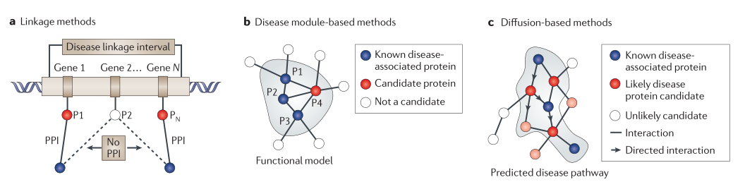
Network Medicine

Slide 14
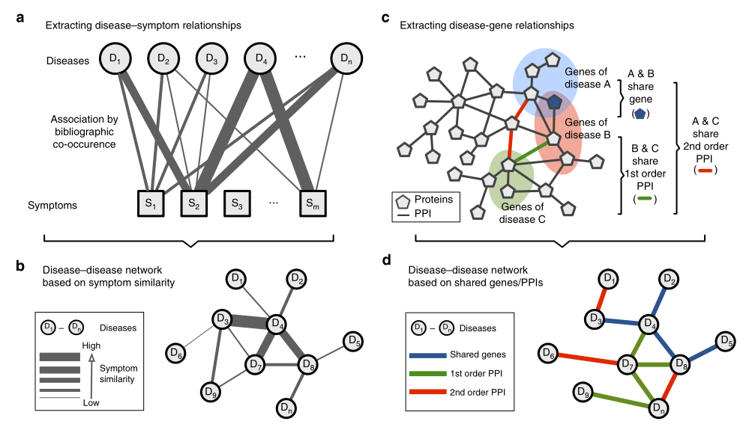
Network Medicine
Zhou et al., Nature Communications,2014

Slide 15
Discussion
The first step is quite difficulty.
Network definition and construction
Validation of detected sub-networks is quite hard.
Network pharmacology
Hammersley–Clifford theorem
Relating traditional Chinese medicine with network medicine and network pharmacology

Slide 16
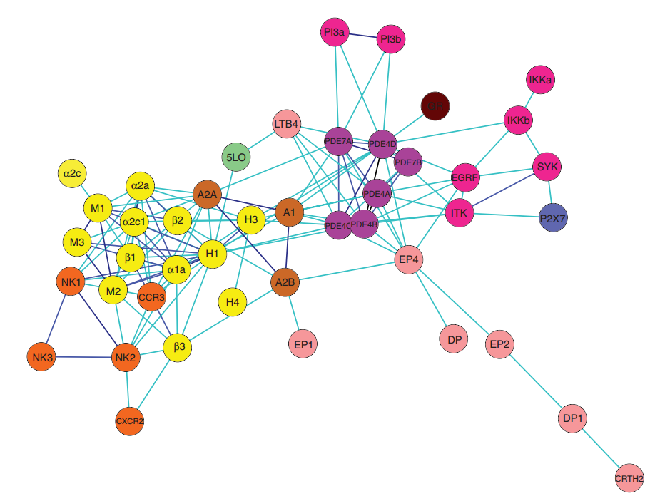
Network Pharmacology
The dominant paradigm drug discovery:
Maximally selective ligands against individual drug targets
Two major issues in drug discovery:
Efficacy
Toxicity
Network pharmacology:
Multi-targets
Lower binding affinities
Hopkins, A.L. (2008) Network pharmacology: the next paradigm in drug discovery, Nature Chemical Biology, 4, 682-690.

Slide 17
Network Pharmacology
Validate target combinations
Identify perturbation results of combination of nodes
Druggability (Only 15% proteins may be chemically tractable)
Non-hub bottlenecks and bridging proteins (Less lethality )
Optimize multiple structure-activity relationships
Multiple individual medications (cocktails)
Multicomponent drugs
Single drugs targeting multi proteins
Hopkins, A.L. (2008) Network pharmacology: the next paradigm in drug discovery, Nature Chemical Biology, 4, 682-690.

Slide 18
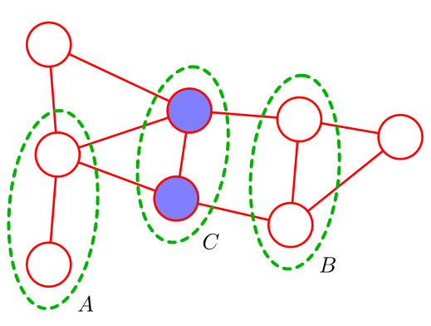
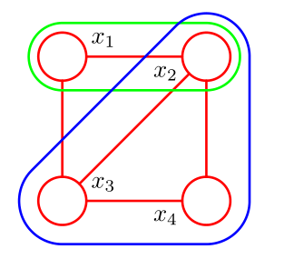


Hammersley–Clifford Theorem
Markov Random Field
Clique
Hammersley-Clifford Theorem:

Slide 19
Further Reading
http://www.barabasi.com/pubs.php
Barzel, B. and Barabási, A. (2013) Universality in network dynamics, Nature Physics, 9, 673-681.
Gao, J., Liu, Y., D'Souza, R.M. and Barabási, A. (2014) Target control of complex networks, Nature Communications, 5, 5415.
Jia, T., Liu, Y., Csóka, E., Pósfai, M., Slotine, J. and Barabási, A. (2013) Emergence of bimodality in controlling complex networks, Nature Communications, 4.
Barzel, B. and Barabási, A. (2013) Network link prediction by global silencing of indirect correlations, Nat Biotechnol, 31, 720-725.
Wang, D., Song, C. and Barabasi, A.L. (2013) Quantifying Long-Term Scientific Impact, Science, 342, 127-132.
Maximilian Schich, C.S.Y.A. and Mauro Martino, A.B.D.H. (2014) A network framework of cultural history, Science, 345, 554-558

Slide 20
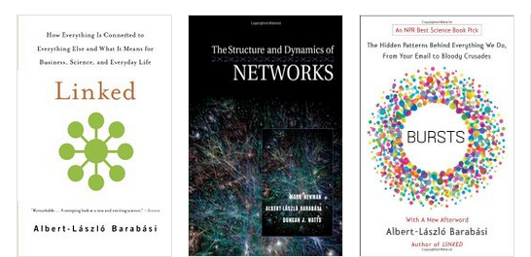
Homework
Given a real network, calculate its network topology.
Paper Reading: choose one papers from the further reading list.

