Slide 1
生物信息学概论 习题课 V
主讲教师：李梢教授
助教：直博生 祖松鹏, 张鹏
日期：2015-12-23

Slide 2
内容
广义线性模型
总结
Final Project

Slide 3
Generalized Linear Models (GLMs)
If Y is not a continuous variable, can we use linear regression ?
Can we use linear regression for classification ?
If the variance of Y depends on the mean, then ?

Slide 4
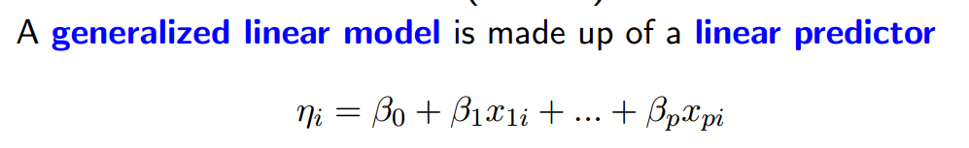
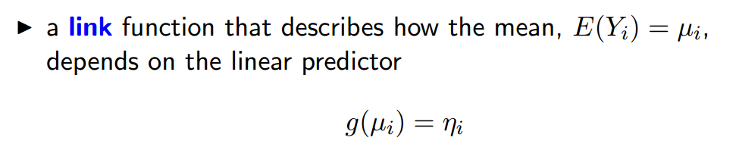
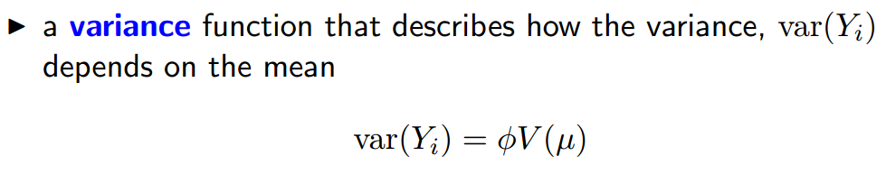
GLMs

Slide 5
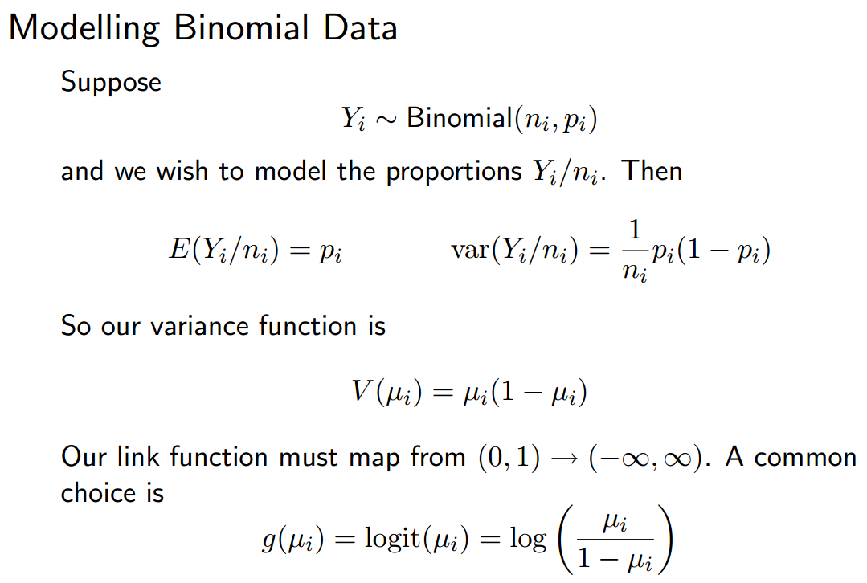
GLMs

Slide 6
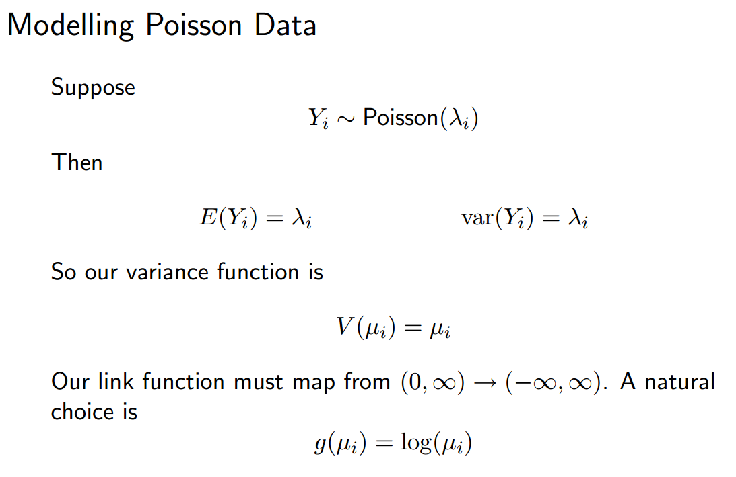
GLMs

Slide 7
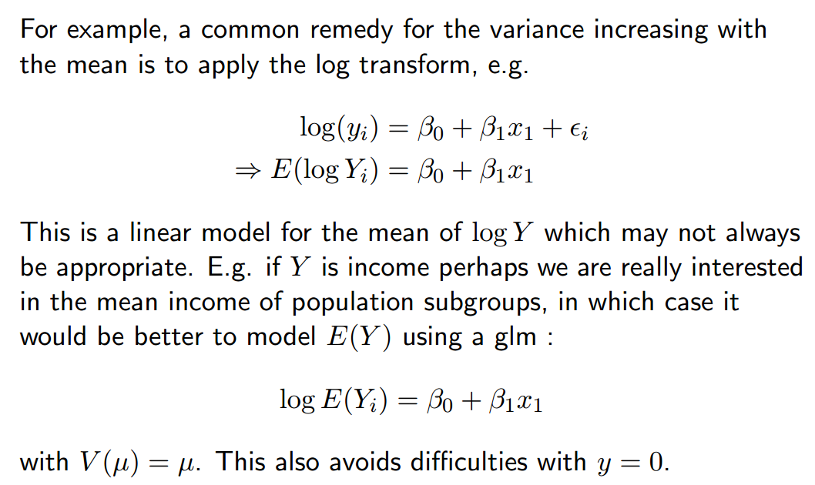
Transformation vs. GLMs

Slide 8

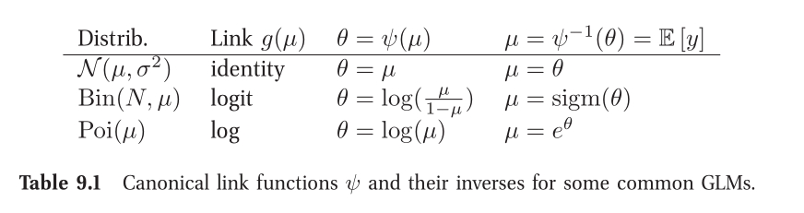

Learning of GLMs
From probabilistic view, we have

Slide 9
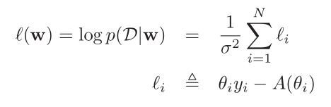
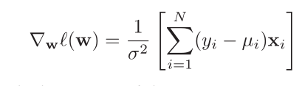
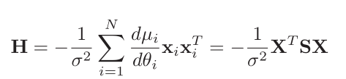
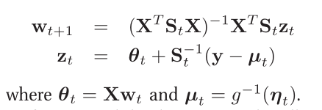

Learning of GLMs
MLE estimation

Slide 10



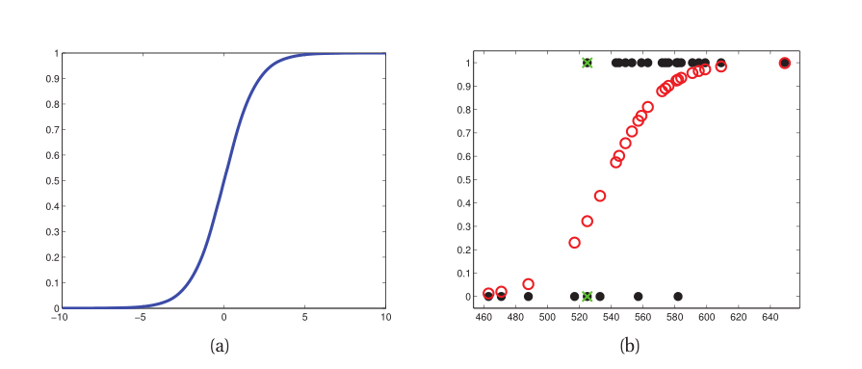
Logistic Regression

Slide 11
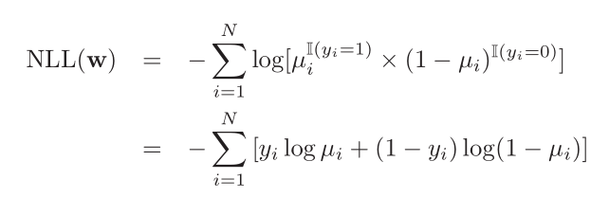
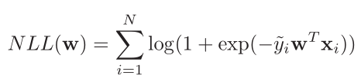

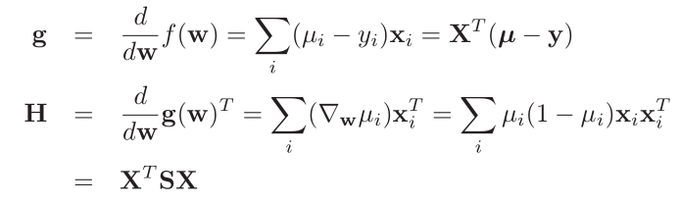
Logistic Regression

Slide 12
总结
Statistics + Coding + Biology = Bioinformatics (Computational Biology)
Machine Learning
Part of statistics
Loss Function + Regularization
Relative to the posterior distribution from Bayesian.
No black box.
Occam's Razor.
“Essentially, all models are wrong, but some are useful.”

Slide 13
Final Project
电子版报告形式
中英文均可
课程相关题目
可以合作形式，三名同学以内
举几个栗子

Slide 14

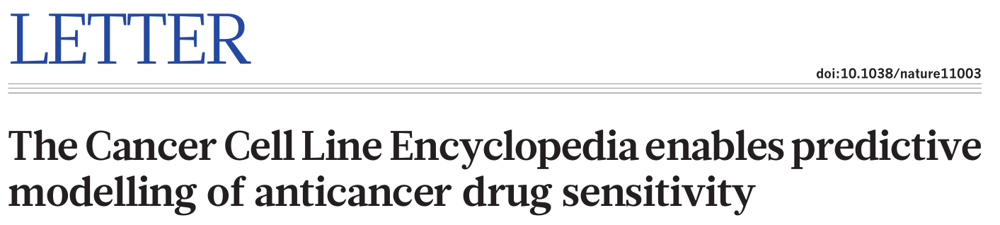
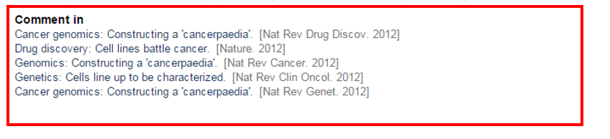
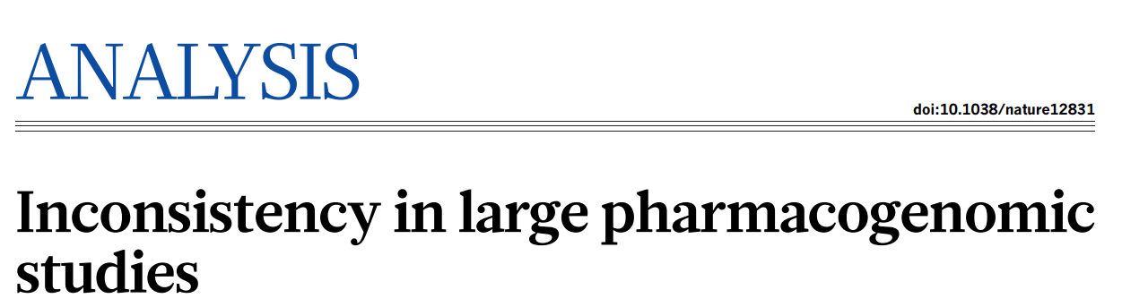
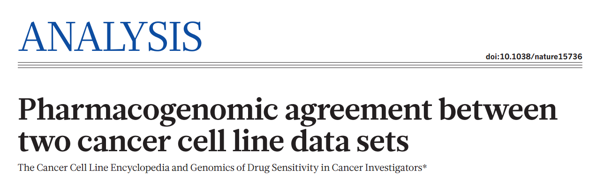
Final Project

Slide 15
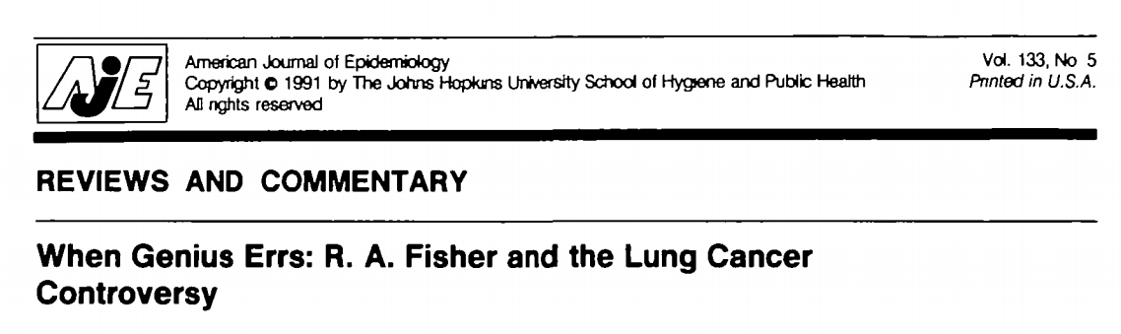
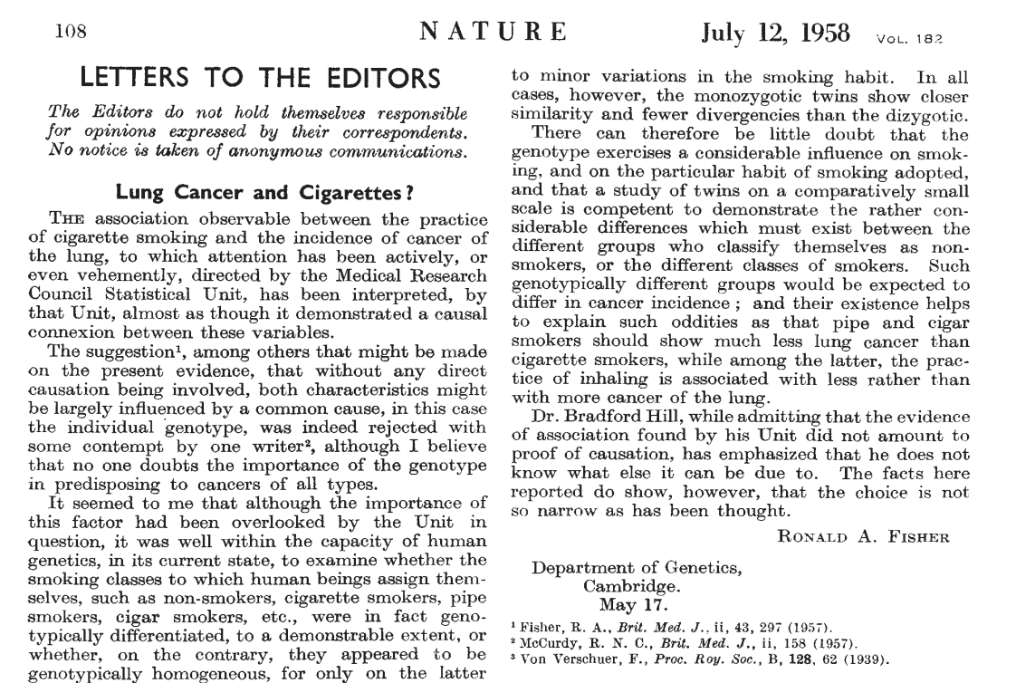

Final Project

Slide 16
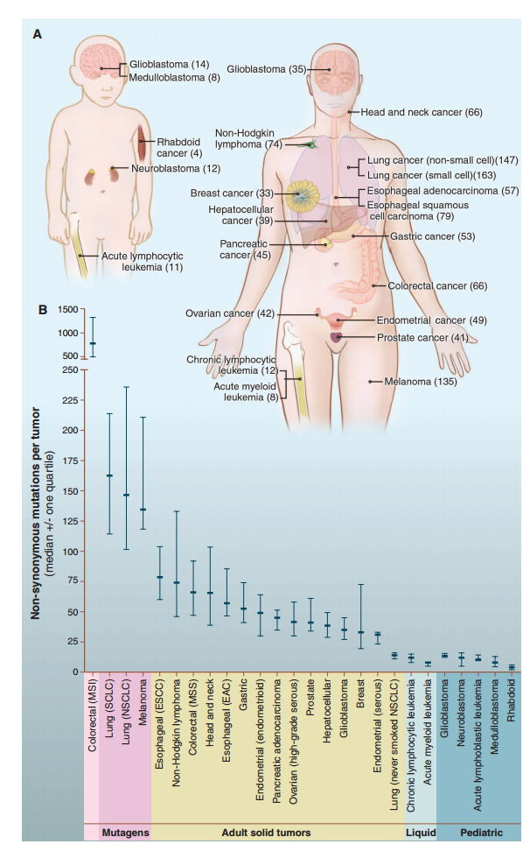

Final Project

Slide 17
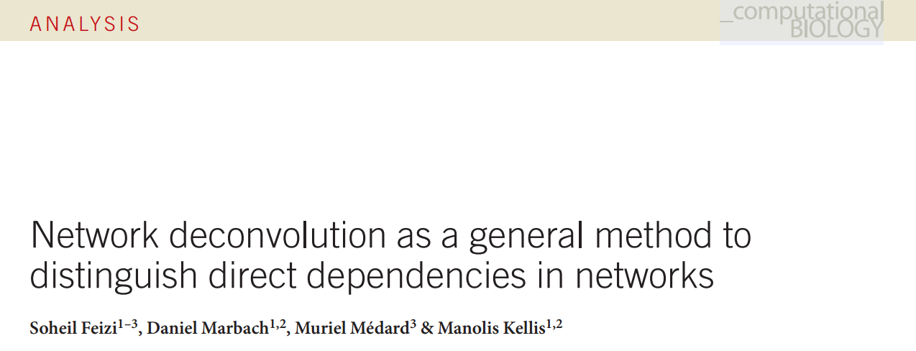
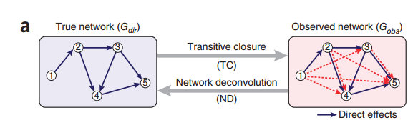
Final Project
https://liorpachter.wordpress.com/2014/02/11/the-network-nonsense-of-manolis-kellis/

Slide 18
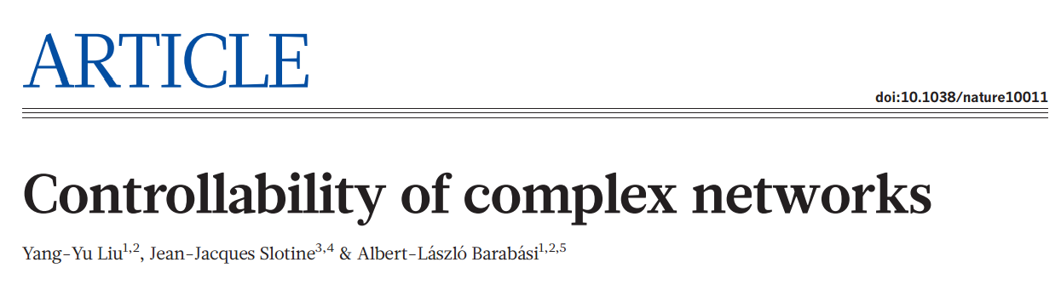
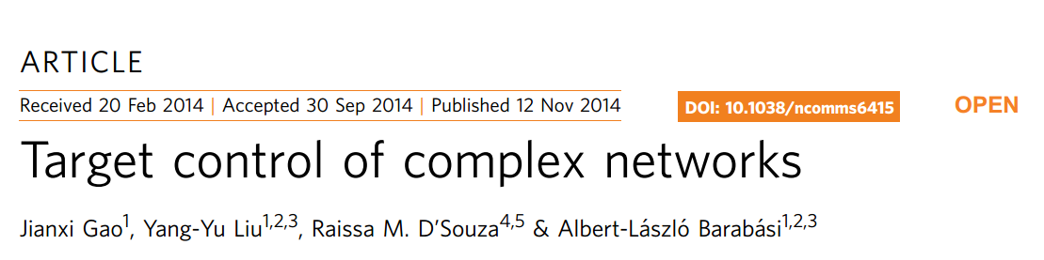

Final Project
https://liorpachter.wordpress.com/2014/02/10/the-network-nonsense-of-albert-laszlo-barabasi/

