Slide 1
Sequence Alignment
PRACTICE 1
Songpeng Zu
2013-10-08

Slide 2
CONTENT
Sequence Alignment
Smith-Waterman Algorithm
E-value
BLAST from NCBI
p-value
Reference

Slide 3
CONTENT
Sequence Alignment
Smith-Waterman Algorithm
E-value
P-value and FDR
BLAST from NCBI and HOMEWORK 1
Reference

Slide 4


Slide 5
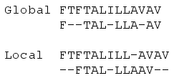
Why Align Sequences?
Similar sequences may have similar function.
Similar sequences may have a common ancestor.
What is sequence alignment?

Slide 6
Methods of Sequence Alignment
Pair-wise Sequence Alignment
Dot Matrix Analysis
Dynamic Programming Algorithm
Word or k-tuple methods (BLAST,FASTA,BLAT)
Multiple Sequence Alignment

Slide 7
Methods of Sequence Alignment
Pair-wise Sequence Alignment
Dot Matrix Analysis
Dynamic Programming Algorithm
Word or k-tuple methods (BLAST,FASTA,BLAT)
Multiple Sequence Alignment

Slide 8
Dynamic Programming
A general algorithm design technique for solving problems defined by recurrences with overlapping sub problems.
Global alignment : Needleman-Wunsch
Local alignment : Smith-Waterman
Both of them used dynamic programming.

Slide 9
Global Alignment

Slide 10
Theorem. C(i,j) satisfies the following relationships:
Initial conditions:
Recurrence relation: For 1 ≤ i ≤ n, 1 ≤ j ≤ m:

Slide 11
Justification
S₁ S₂ . . . S_{i-1} S_{i}
S₁ S₂ . . . S_{i-1} S_{i}
T₁ T₂ . . . T_{j-1} T_{j}
T₁ T₂ . . . T_{j} —
C(i-1,j-1) + w(S_{i},T_{j})
C(i-1,j) −γ
S₁ S₂ . . . S_{i} —
T₁ T₂ . . . T_{j-1} T_{j}
C(i,j-1) −γ

Slide 12
Example
Case 1: Line up S_{i} with T_{j}
i
i - 1
S: C A T T C A C
T: C - T T C A G
j -1
j
Case 2: Line up S_{i} with space
i - 1
i
S: C A T T C A - C
T: C - T T C A G -
j
Case 3: Line up T_{j} with space
i
S: C A T T C A C -
T: C - T T C A - G
j -1
j

Slide 13
Computation Procedure
C(0,0)
C(i-1,j-1)
C(i-1,j)
C(i,j-1)
C(i,j)
C(n,m)

Slide 14
λ C T C G C A G C
λ
0 -5 -10 -15 -20 -25 -30 -35 -40
C
-5
10
5
A
-10
T
-15
T
-20
C
-25
A
-30
C
-35
+10 for match, -2 for mismatch, -5 for space
Notes:
We first compute T[i, j] for the smallest possible values of i and j, then for increasing values of i and j
Usually performed with a table of size
(n + 1) X (m + 1)

Slide 15
λ C T C G C A G C
λ
0 | -5 | -10 | -15 | -20 | -25 | -30 | -35 | -40
-5 | 10 | 5 | 0 | -5 | -10 | -15 | -20 | -25
-10 | 5 | 8 | 3 | -2 | -7 | 0 | -5 | -10
-15 | 0 | 15 | 10 | 5 | 0 | -5 | -2 | -7
-20 | -5 | 10 | 13 | 8 | 3 | -2 | -7 | -4
-25 | -10 | 5 | 20 | 15 | 18 | 13 | 8 | 3
-30 | -15 | 0 | 15 | 18 | 13 | 28 | 23 | 18
-35 | -20 | -5 | 10 | 13 | 28 | 23 | 26 | 33
C
A
T
*
T
*
C
A
C
Traceback can yield both optimum alignments

Slide 16
Local alignment
Initialize with zeros (free gaps at start).
Locate max position.

Slide 17
λ C T C G C A G C
λ
0 0 0 0 0 0 0 0 0
C
0
10 5 10 5 10 5 0 10
A
0
5 8 5 8 5 20 15 10
T
0
0 15 10 5 6 15 18 13
T
0
-2 10 13 8 3 10 13 16
C
0
10 5 20 15 18 13 8 23
A
0
5 8 15 18 13 28 23 18
G
0
0 3 10 25 20 23 38 33
+10 for match, -2 for mismatch, -5 for gap
Notes:
We first compute T[i, j] for the smallest possible values of i and j, then for increasing values of i and j
Usually performed with a table of size
(n + 1) X (m + 1)

Slide 18
CONTENT
Sequence Alignment
Smith-Waterman Algorithm
E-value
BLAST from NCBI
p-value
Reference

Slide 19
E-value
Assesse the statistical significance of a particular alignment.
E-value: The expected (average) number of alignments with scores bigger than or equal to “S” that are expected to occur by chance.
How to evaluate the E-value?

Slide 20
How to evaluate the E-value?
The random sequence alignment scores follow a distribution called the extreme value distribution.
The number of matched regions that exceeds the alignment score could be predicted by the Poisson distribution where the mean of the Poisson distribution is given by the alignment score.

Slide 21
0.40
0.35
0.30
0.25
normal
distribution
probability
0.20
0.15
0.10
0.05
0
-5
-4
-3
-2
-1
0
1
2
3
4
5
x

Slide 22
The probability density function of the extreme
value distribution (characteristic value u=0 and
decay constant λ=1)
0.40
0.35
0.30
0.25
normal
distribution
extreme
value
distribution
probability
0.20
0.15
0.10
0.05
0
-5
-4
-3
-2
-1
0
1
2
3
4
5
x

Slide 23
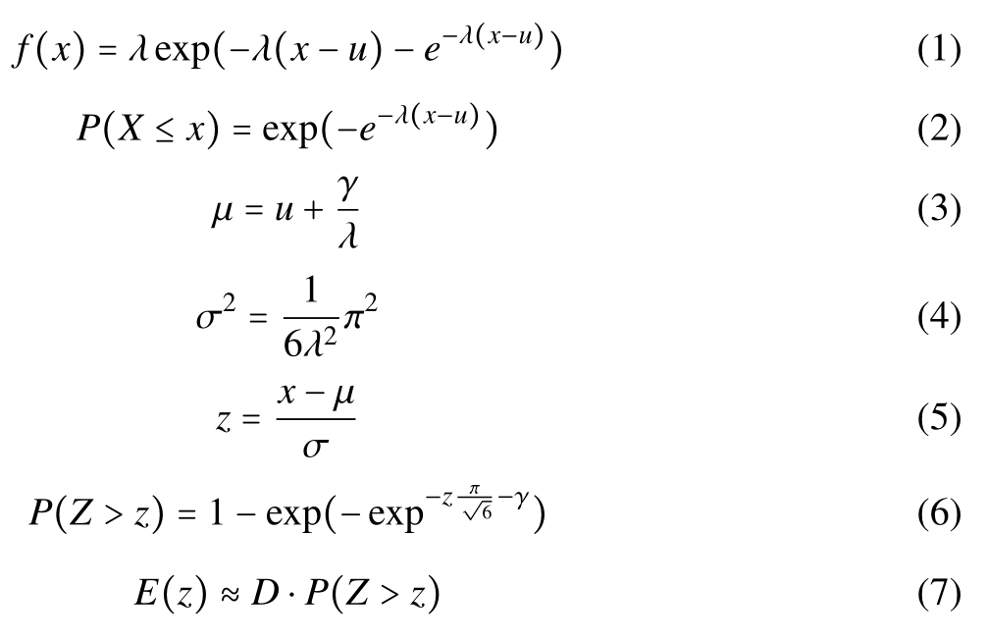
How to evaluate the E-value?
Euler-Mascheroni costant

Slide 24
CONTENT
Sequence Alignment
Smith-Waterman Algorithm
E-value
BLAST from NCBI
p-value
Reference

Slide 25
BLAST
Basic Local Alignment Search Tool or BLAST allows rapid sequence comparison of a sequence against a database.

Slide 26
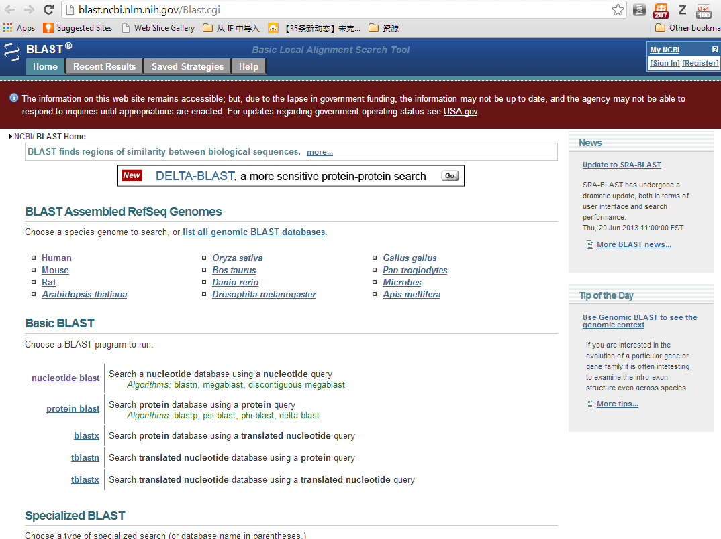

Slide 27
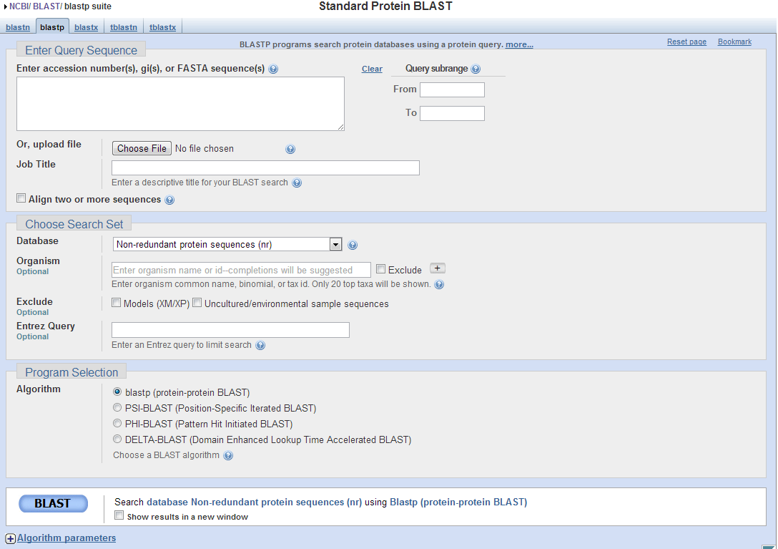

Slide 28
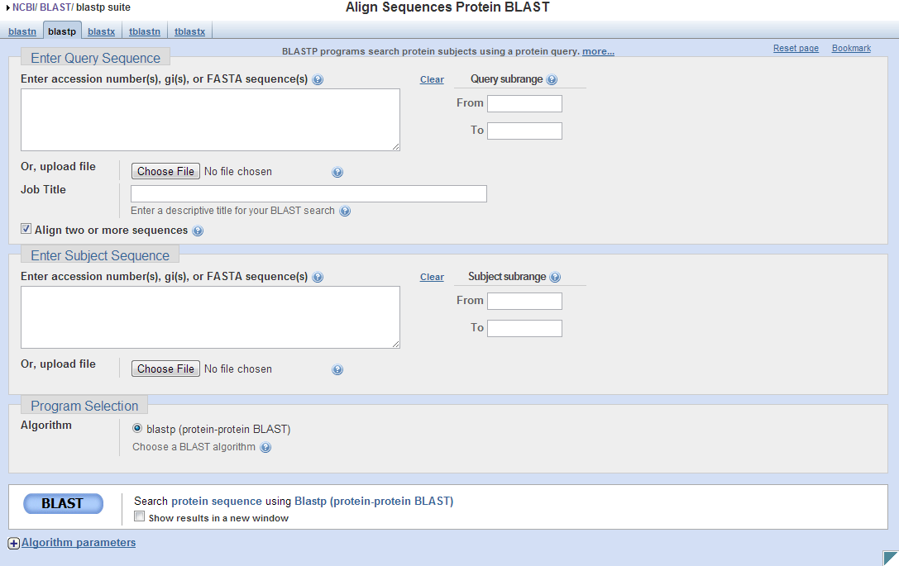

Slide 29
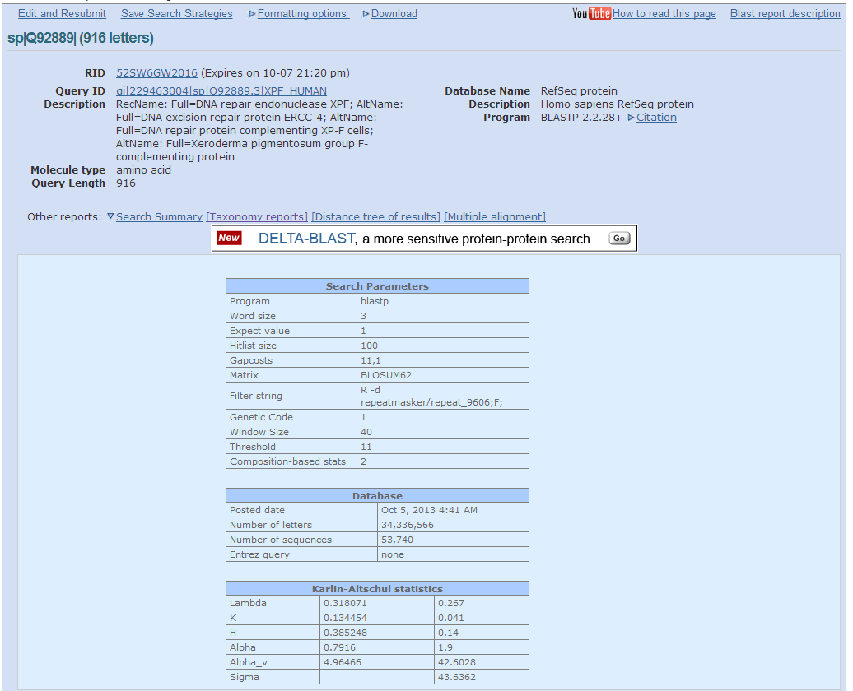

Slide 30
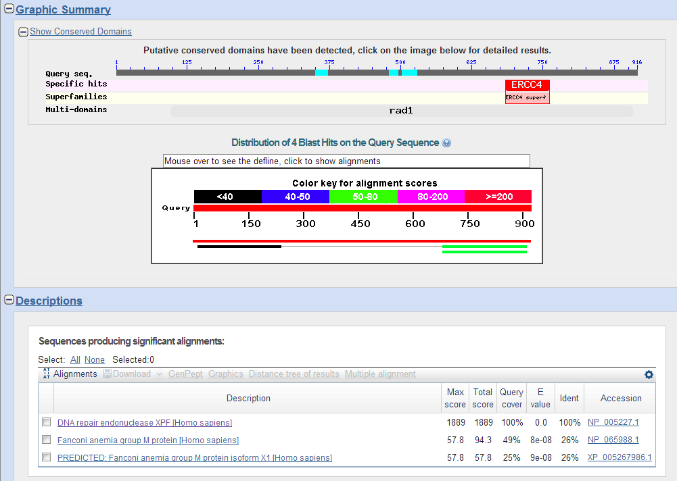

Slide 31
How a BLAST search works
“The central idea of the BLAST
algorithm is to confine attention
to segment pairs that contain a
word pair of length w with a score
of at least T.”
Altschul et al. (1990)

Slide 32
How the original BLAST algorithm works:
3 phases
Phase 1: compile a list of word pairs (w = 3)
above threshold T
Example: for a human RBP query
…FSGTWYA…
A list of words (w = 3) is:
FSG SGT GTW TWY WYA
YSG TGT ATW SWY WFA
FTG SVT GSW TWF WYS

Slide 33
Phase 1: compile a list of words (w=3)
GTW 6,5,11 22
neighborhood GSW 6,1,11 18
word hits ATW 0,5,11 16
> threshold DTW -1,5,11 15
GTY 6,5, 2 13
GNW 10
GAW 9
word hits
below threshold
(T=11)

Slide 34
How a BLAST search works: 3 phases
Phase 2:
Scan the database for entries that match the
compiled list.
This is fast and relatively easy.

Slide 35
How a BLAST search works: 3 phases
Phase 3: when you manage to find a hit
(i.e. a match between a “word” and a database
entry), extend the hit in either direction.
Keep track of the score (use a scoring matrix)
Stop when the score drops below some cutoff.
KENFDKARFSGTWYAMAKKDPEG 50 RBP (query)
MKGLDIQKVAGTWYSLAMAASD. 44 lactoglobulin (hit)
extend
extend
Hit!

Slide 36
How a BLAST search works: 3 phases
Phase 3:
In the original (1990) implementation of BLAST,
hits were extended in either direction.
In a 1997 refinement of BLAST, two independent
hits are required. The hits must occur in close
proximity to each other (40 nt). With this modification, only one seventh as many extensions occur, greatly speeding the time required for a search.

Slide 37
How a BLAST search works: threshold
You can modify the threshold parameter.
The default value for blastp is 11.
To change it, enter “-f 16” or “-f 5” in the
advanced options.

Slide 38
How to interpret a BLAST search: expect value
The expect value E is the number of alignments
with scores greater than or equal to score S
that are expected to occur by chance in a
database search.
An E value is related to a probability value p.
The key equation describing an E value is:
E = Kmn e^{-λS}

Slide 39
E = Kmn e^{-λS}
This equation is derived from a description
of the extreme value distribution
S = the score
E = the expect value = the average number of HSPs (High Score Pairs) expected to occur with
a score of at least S
m, n = the length of two sequences
λ, K = Karlin-Altschul statistics

Slide 40
How to interpret BLAST: E values and p values
The expected value E is the number of alignments
with scores greater than or equal to score S
that are expected to occur by chance in a
database search. A p value is a different way of
representing the significance of an alignment.
p = 1 - e^{-Ε}
“p value” is the probability that a random alignment occurring with a score bigger than or equal to “S”.

Slide 41
How to interpret BLAST: E values and p values
Very small E values are very similar to p values.
E values of about 1 to 10 are far easier to interpret
than corresponding p values.
E p
10 0.99995460
5 0.99326205
2 0.86466472
1 0.63212056
0.1 0.09516258 (about 0.1)
0.05 0.04877058 (about 0.05)
0.001 0.00099950 (about 0.001)
0.0001 0.0001000

Slide 42
CONTENT
Sequence Alignment
Smith-Waterman Algorithm
E-value
BLAST from NCBI
p-value
Reference

Slide 43
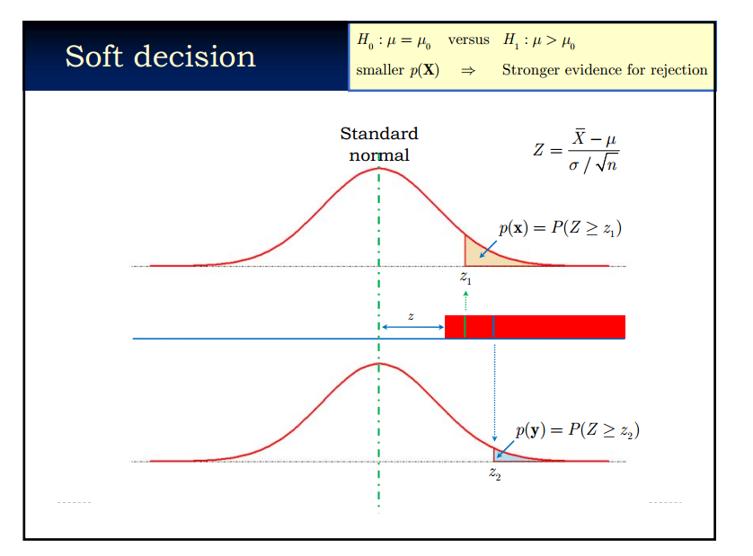

Slide 44
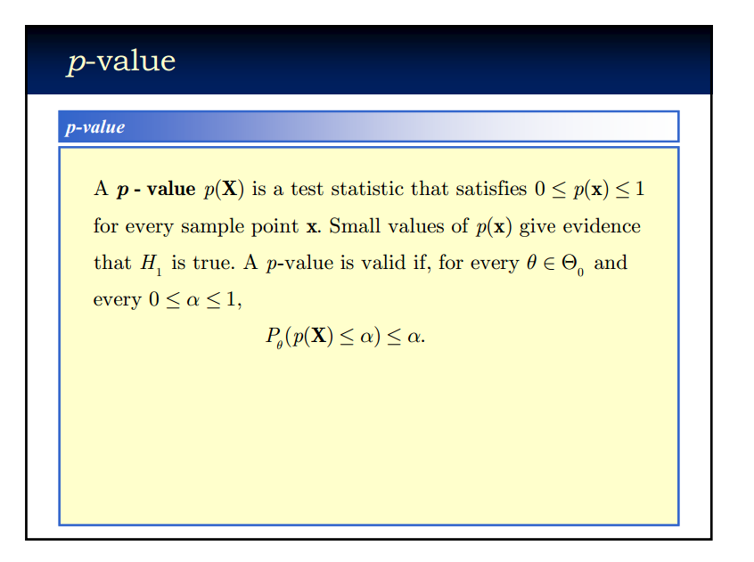

Slide 45
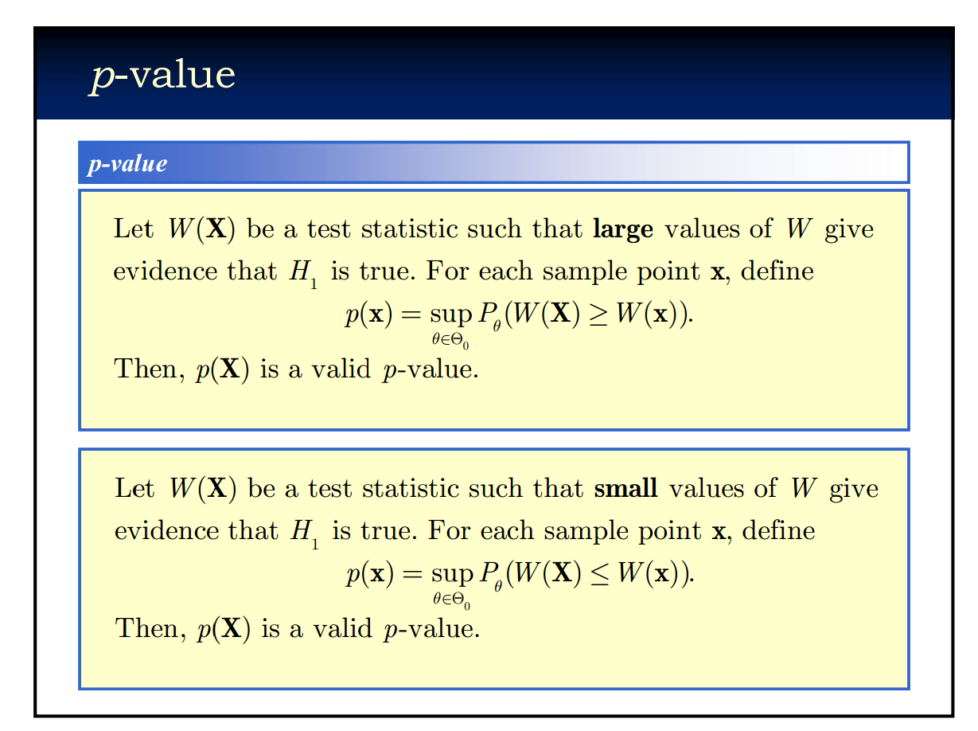

Slide 46
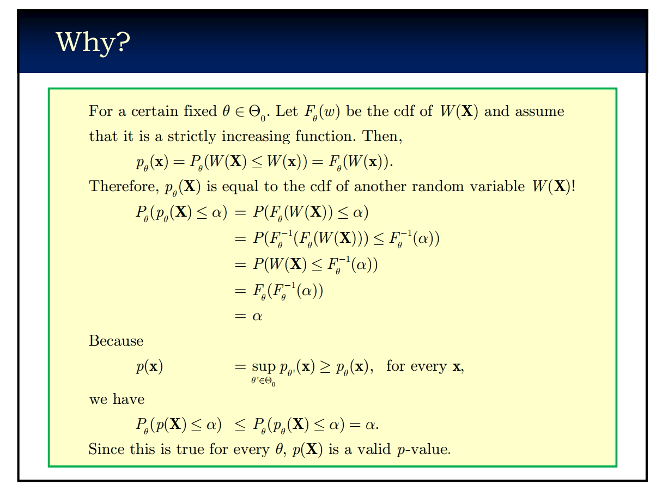

Slide 47
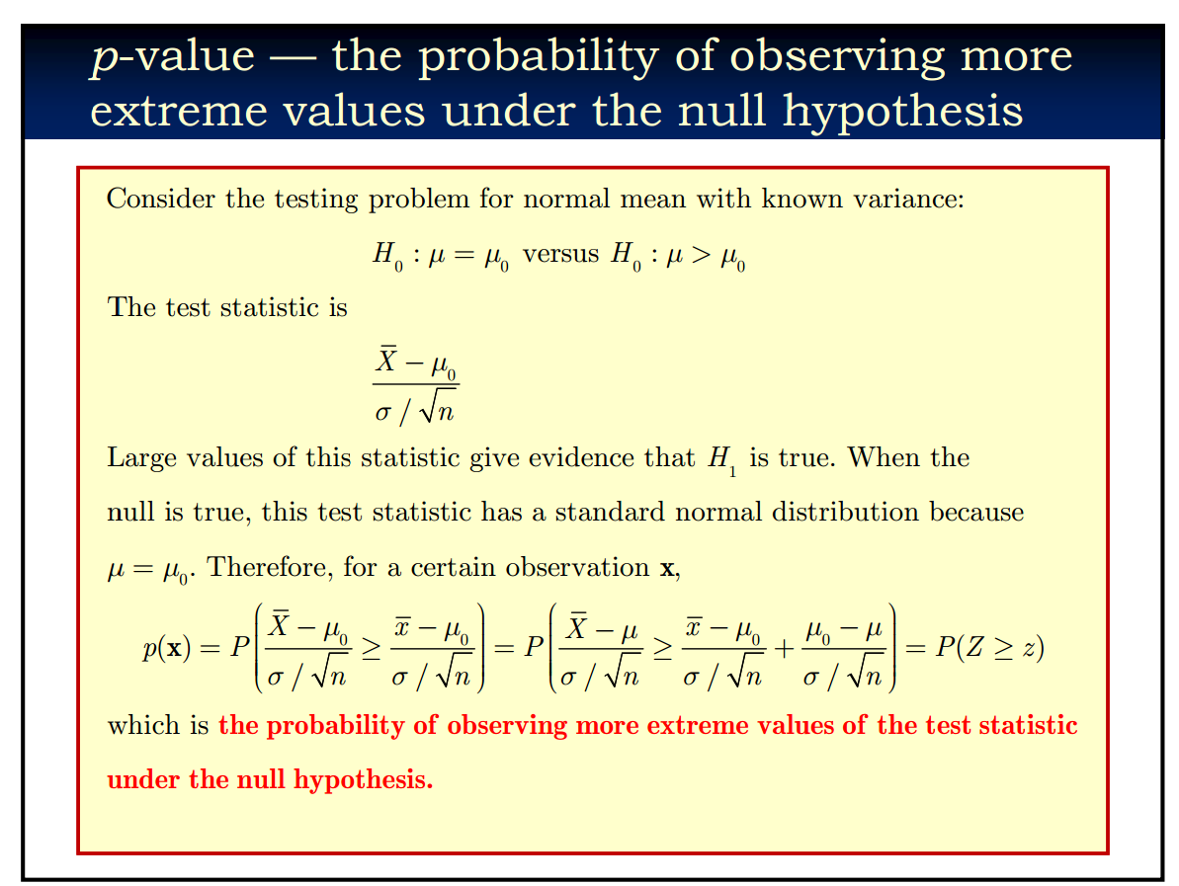

Slide 48
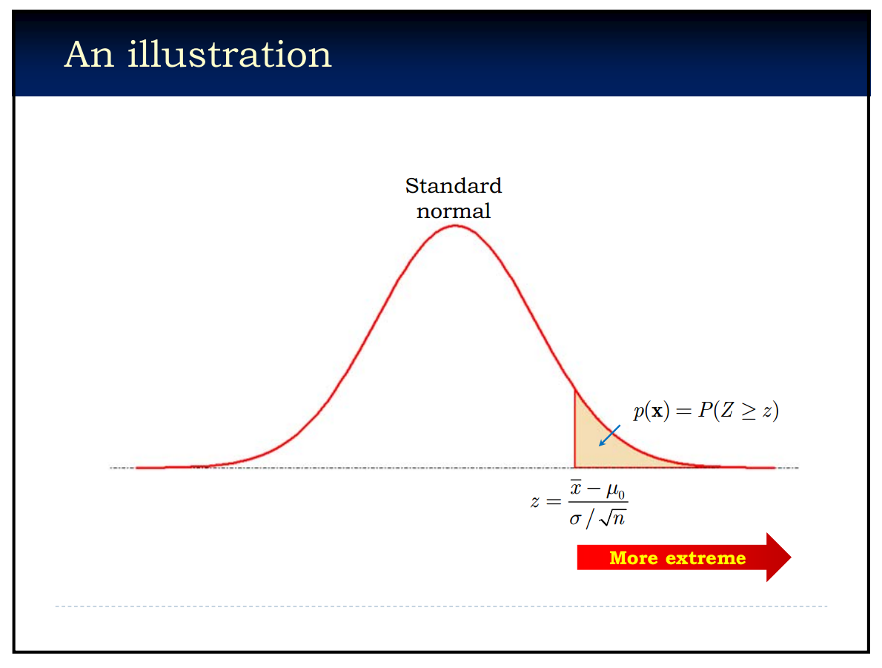

Slide 49
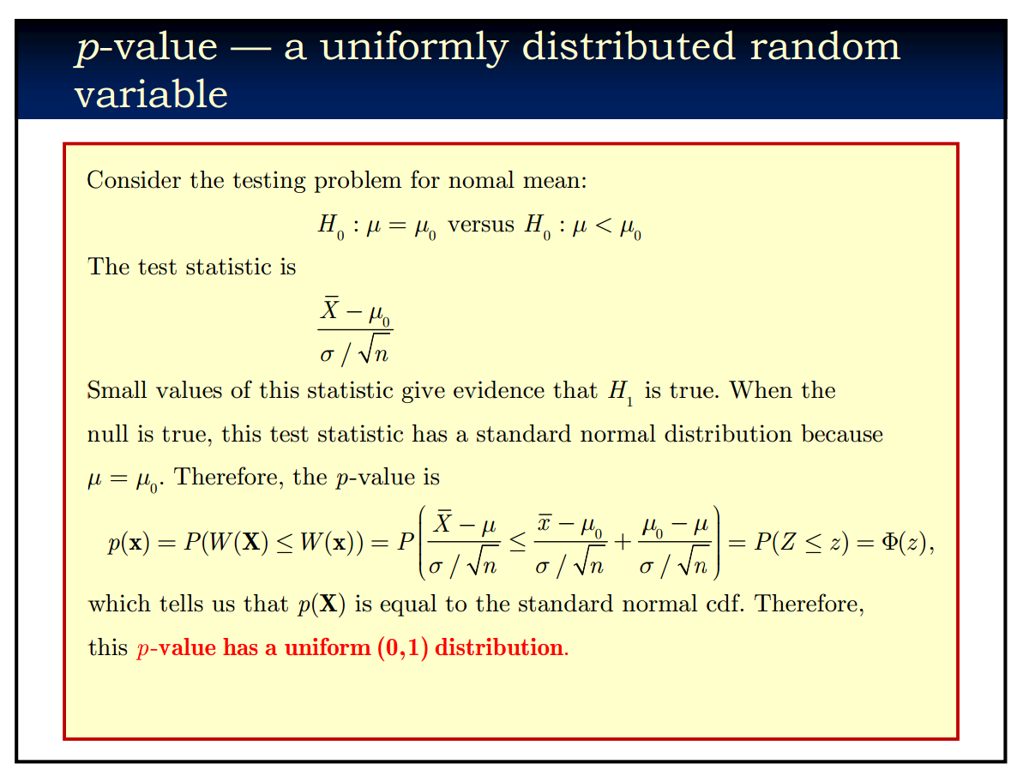

Slide 50

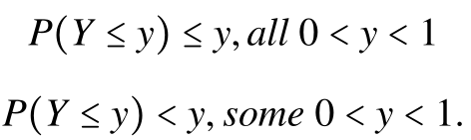
Note
Let X have continuous cdf Fx(X) and define Y = Fx(X). Then Y is uniformly distribution on (0,1).
For discrete random variables, we have:

Slide 51
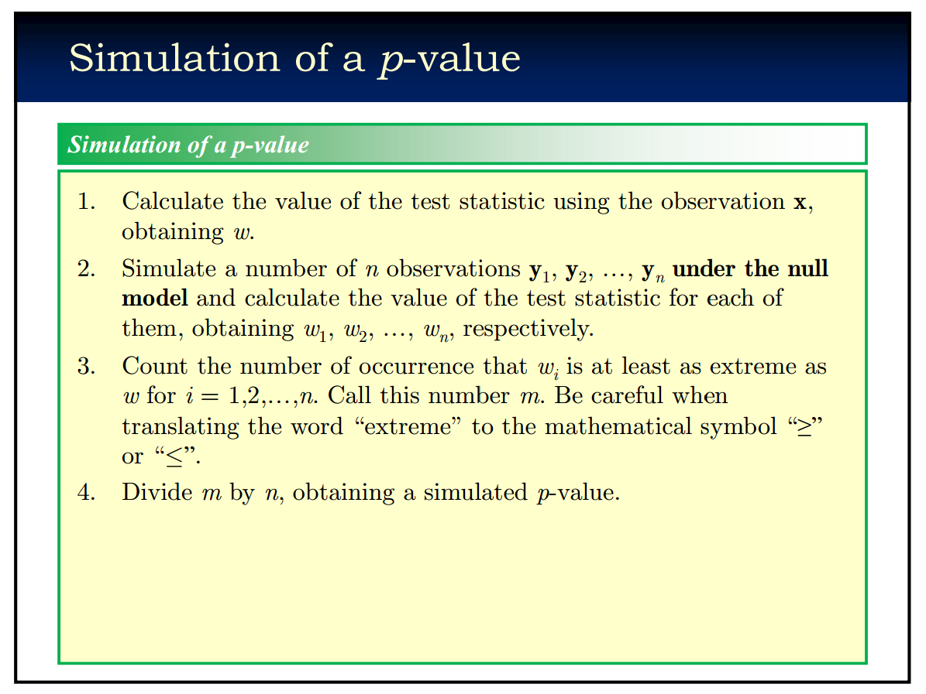

Slide 52
p-value
A test statistic.
The probability of observing more extreme value of the realized test statistic under the null hypothesis.
Usually uniformly distributed under the null hypothesis.
Simulation of a p-value is important.

Slide 53
Homework 1
Implement the Swiss-Waterman algorithm. (Matlab, C/C++, Perl, Python…)
Blast: (See the word document).
Read blast from WiKi.
*E-value:
Read the paper “relating protein pharmacology by ligand chemistry”(Nature Biotechnology 2007) and its supplementary information.
Can you understand how the author applied the idea of E-value in the method?

Slide 54
REFERENCE
The Book “Bioinformatics –Sequence and Genome Analysis ” by David W.Mount
Extreme Value Distribution (http://mathworld.wolfram.com/ExtremeValueDistribution.html)
PPT of Sequence Alignment from Lakshmanan Iyer, Ph. D.
PPT of Dynamic_Programming.ppt on line.
PPT of BLAST Similarity Searching Clark University, Spring 2008
Dynamic Programming: WiKi.
PPT of Statistical Inference from Rui Jiang
The Book “Statistical Inference” by George Casella and Roger L.Berger.

