Slide 1
生物信息学概论 习题课 II
主讲教师：李梢教授
助教：直博生 祖松鹏, 张鹏
日期：2015-10-28

Slide 2
内容
如何阅读文献
序列比对
课程作业
Coding 作业及提交方式说明
文献阅读报告的安排

Slide 3


如何阅读文献
文献类别：
Review, Article, Letter, Comment, …
文章如何发表：
解决了什么问题
有什么创新点
文章的结构：“八股文”
Title
Abstract
Introduction
Methods
Results
Discussion/Conclusion
文章的关键要素：Figure

Slide 4
如何阅读文献
“苏轼读书法”
每遍阅读，目标少而明确 (UNIX: KISS)
先主线后细节，逐遍深入 (“文与可画竹，胸有成竹。”)
阅读者的四种身份
普通人：文章语言的通俗易懂性
审稿人：抓住文章的主要贡献，明晰主线，去伪存真
作者自身：设身处地，思路对比，问题扩展
学习者：模仿，抠细节

Slide 5


如何阅读文献

Slide 6

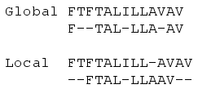
序列比对
著名的序列比对在线工具: BLAST from NCBI
动态规划算法
全局序列比对
局部序列比对

Slide 7
Global Alignment

Slide 8
Theorem. C(i,j) satisfies the following relationships:
Initial conditions:
Recurrence relation: For 1 ≤ i ≤ n, 1 ≤ j ≤ m:

Slide 9
Justification
S₁ S₂ . . . S_{i-1} S_{i}
S₁ S₂ . . . S_{i-1} S_{i}
T₁ T₂ . . . T_{j-1} T_{j}
T₁ T₂ . . . T_{j} —
C(i-1,j-1) + w(S_{i},T_{j})
C(i-1,j) −γ
S₁ S₂ . . . S_{i} —
T₁ T₂ . . . T_{j-1} T_{j}
C(i,j-1) −γ

Slide 10
Example
Case 1: Line up S_{i} with T_{j}
i
i - 1
S: C A T T C A C
T: C - T T C A G
j -1
j
Case 2: Line up S_{i} with space
i - 1
i
S: C A T T C A - C
T: C - T T C A G -
j
Case 3: Line up T_{j} with space
i
S: C A T T C A C -
T: C - T T C A - G
j -1
j

Slide 11
Computation Procedure
C(0,0)
C(i-1,j-1)
C(i-1,j)
C(i,j-1)
C(i,j)
C(n,m)

Slide 12
λ C T C G C A G C
λ
0 -5 -10 -15 -20 -25 -30 -35 -40
C
-5
10
5
A
-10
T
-15
T
-20
C
-25
A
-30
C
-35
+10 for match, -2 for mismatch, -5 for space
Notes:
We first compute T[i, j] for the smallest possible values of i and j, then for increasing values of i and j
Usually performed with a table of size
(n + 1) X (m + 1)

Slide 13
λ C T C G C A G C
λ
0 | -5 | -10 | -15 | -20 | -25 | -30 | -35 | -40
-5 | 10 | 5 | 0 | -5 | -10 | -15 | -20 | -25
-10 | 5 | 8 | 3 | -2 | -7 | 0 | -5 | -10
-15 | 0 | 15 | 10 | 5 | 0 | -5 | -2 | -7
-20 | -5 | 10 | 13 | 8 | 3 | -2 | -7 | -4
-25 | -10 | 5 | 20 | 15 | 18 | 13 | 8 | 3
-30 | -15 | 0 | 15 | 18 | 13 | 28 | 23 | 18
-35 | -20 | -5 | 10 | 13 | 28 | 23 | 26 | 33
C
A
T
*
T
*
C
A
C
Traceback can yield both optimum alignments

Slide 14
Local alignment
Initialize with zeros (free gaps at start).
Locate max position.

Slide 15
λ C T C G C A G C
λ
0 0 0 0 0 0 0 0 0
C
0
10 5 10 5 10 5 0 10
A
0
5 8 5 8 5 20 15 10
T
0
0 15 10 5 6 15 18 13
T
0
-2 10 13 8 3 10 13 16
C
0
10 5 20 15 18 13 8 23
A
0
5 8 15 18 13 28 23 18
G
0
0 3 10 25 20 23 38 33
+10 for match, -2 for mismatch, -5 for gap
Notes:
We first compute T[i, j] for the smallest possible values of i and j, then for increasing values of i and j
Usually performed with a table of size
(n + 1) X (m + 1)

Slide 16
E-value
Assesse the statistical significance of a particular alignment.
E-value: The expected (average) number of alignments with scores bigger than or equal to “S” that are expected to occur by chance.
How to evaluate the E-value?

Slide 17
How to evaluate the E-value?
The random sequence alignment scores follow a distribution called the extreme value distribution.
The number of matched regions that exceeds the alignment score could be predicted by the Poisson distribution where the mean of the Poisson distribution is given by the alignment score.

Slide 18
0.40
0.35
0.30
0.25
normal
distribution
probability
0.20
0.15
0.10
0.05
0
-5
-4
-3
-2
-1
0
1
2
3
4
5
x

Slide 19
The probability density function of the extreme
value distribution (characteristic value u=0 and
decay constant λ=1)
0.40
0.35
0.30
0.25
normal
distribution
extreme
value
distribution
probability
0.20
0.15
0.10
0.05
0
-5
-4
-3
-2
-1
0
1
2
3
4
5
x

Slide 20
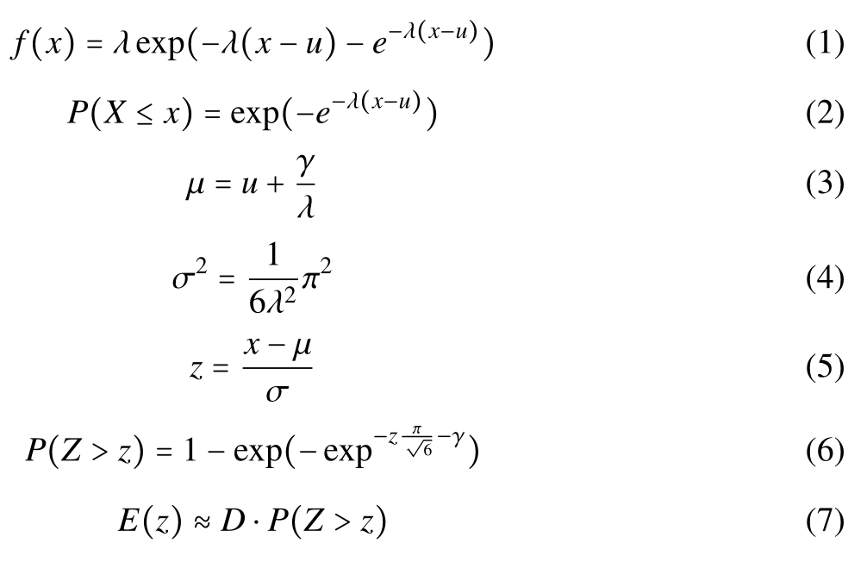
How to evaluate the E-value?
Euler-Mascheroni costant

Slide 21
How to interpret a BLAST search: expect value
The expect value E is the number of alignments
with scores greater than or equal to score S
that are expected to occur by chance in a
database search.
An E value is related to a probability value p.
The key equation describing an E value is:
E = Kmn e^{-λS}

Slide 22
E = Kmn e^{-λS}
This equation is derived from a description
of the extreme value distribution
S = the score
E = the expect value = the average number of HSPs (High Score Pairs) expected to occur with
a score of at least S
m, n = the length of two sequences
λ, K = Karlin-Altschul statistics

Slide 23
How to interpret BLAST: E values and p values
The expected value E is the number of alignments
with scores greater than or equal to score S
that are expected to occur by chance in a
database search. A p value is a different way of
representing the significance of an alignment.
p = 1 - e^{-Ε}
“p value” is the probability that a random alignment occurring with a score bigger than or equal to “S”.

Slide 24
How to interpret BLAST: E values and p values
Very small E values are very similar to p values.
E values of about 1 to 10 are far easier to interpret
than corresponding p values.
E p
10 0.99995460
5 0.99326205
2 0.86466472
1 0.63212056
0.1 0.09516258 (about 0.1)
0.05 0.04877058 (about 0.05)
0.001 0.00099950 (about 0.001)
0.0001 0.0001000

Slide 25
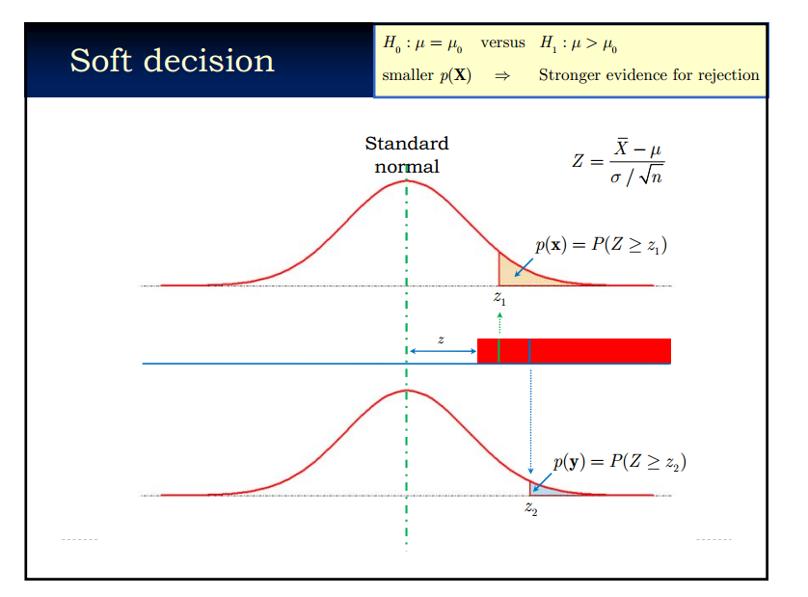
p-value

Slide 26
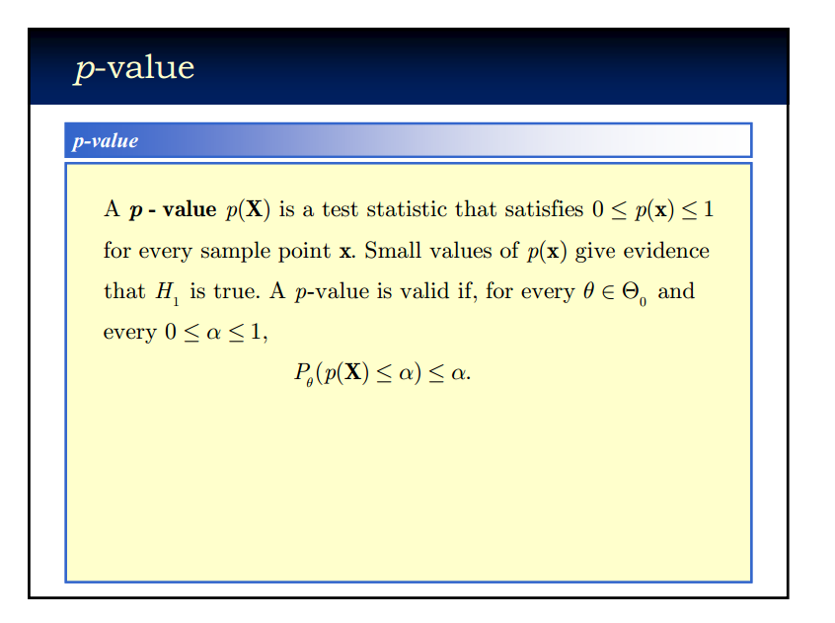

Slide 27
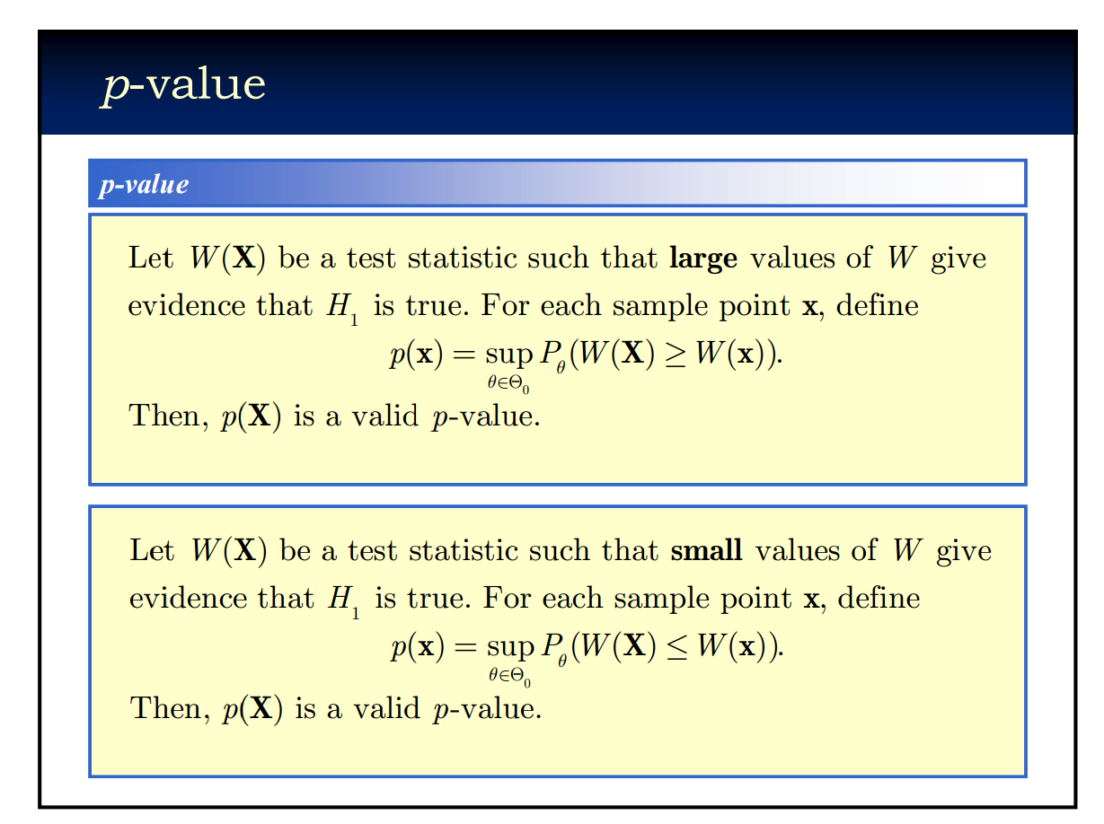

Slide 28
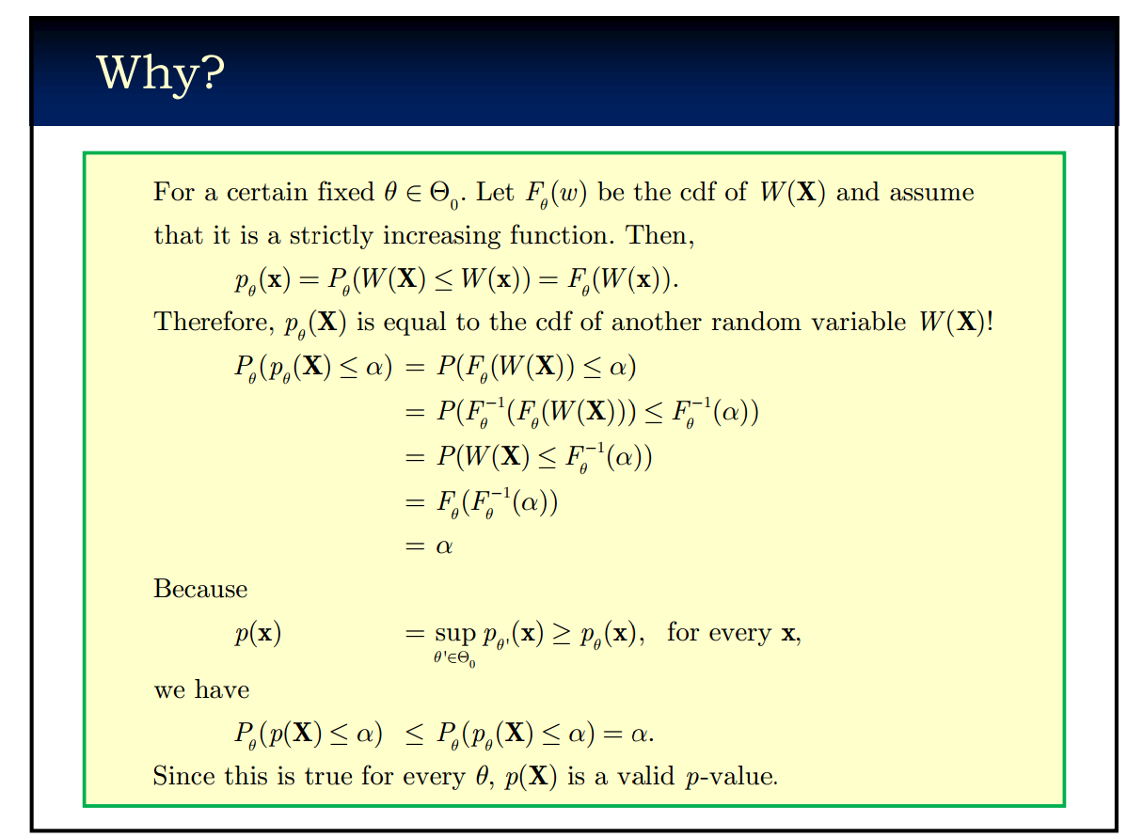

Slide 29
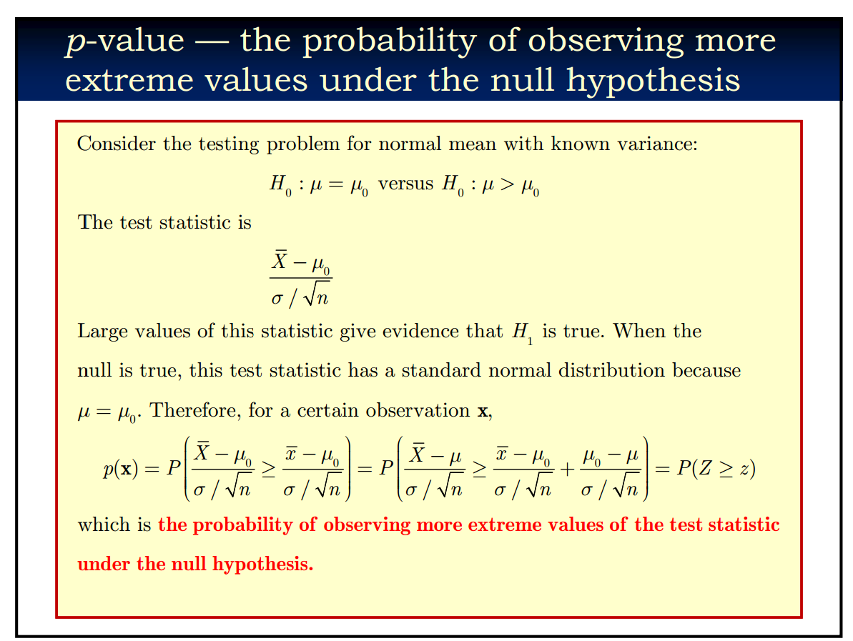

Slide 30
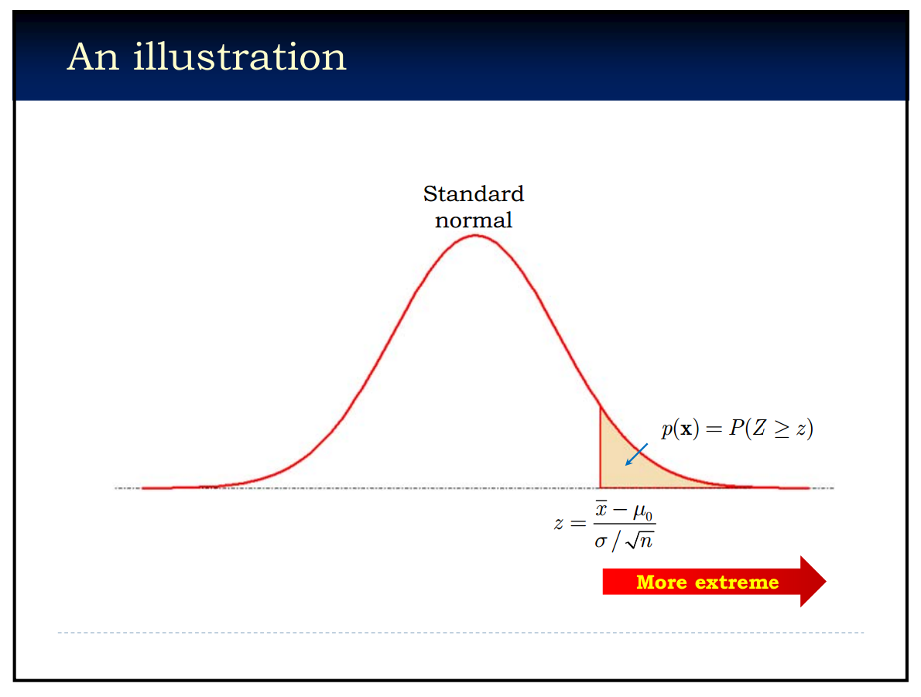

Slide 31
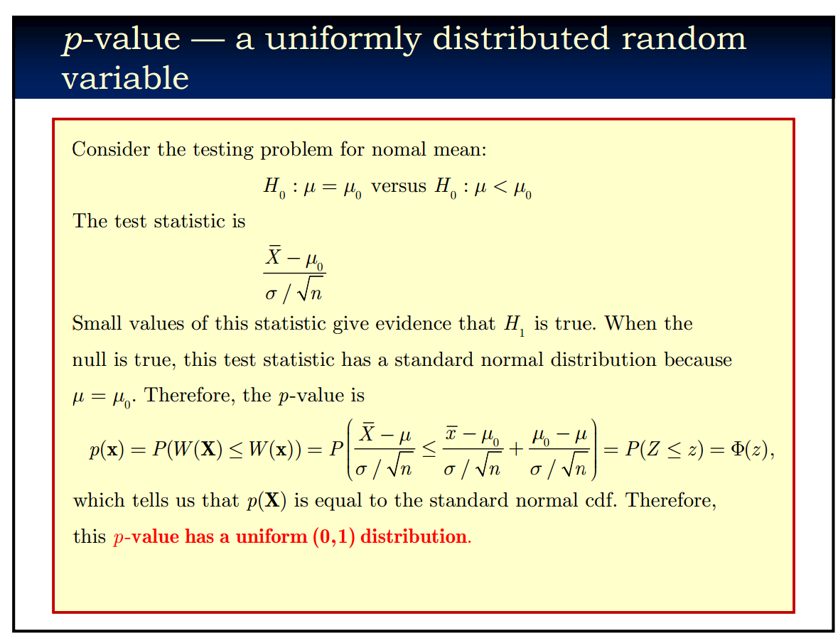

Slide 32

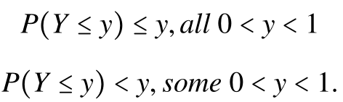
Note
Let X have continuous cdf Fx(X) and define Y = Fx(X). Then Y is uniformly distribution on (0,1).
For discrete random variables, we have:

Slide 33
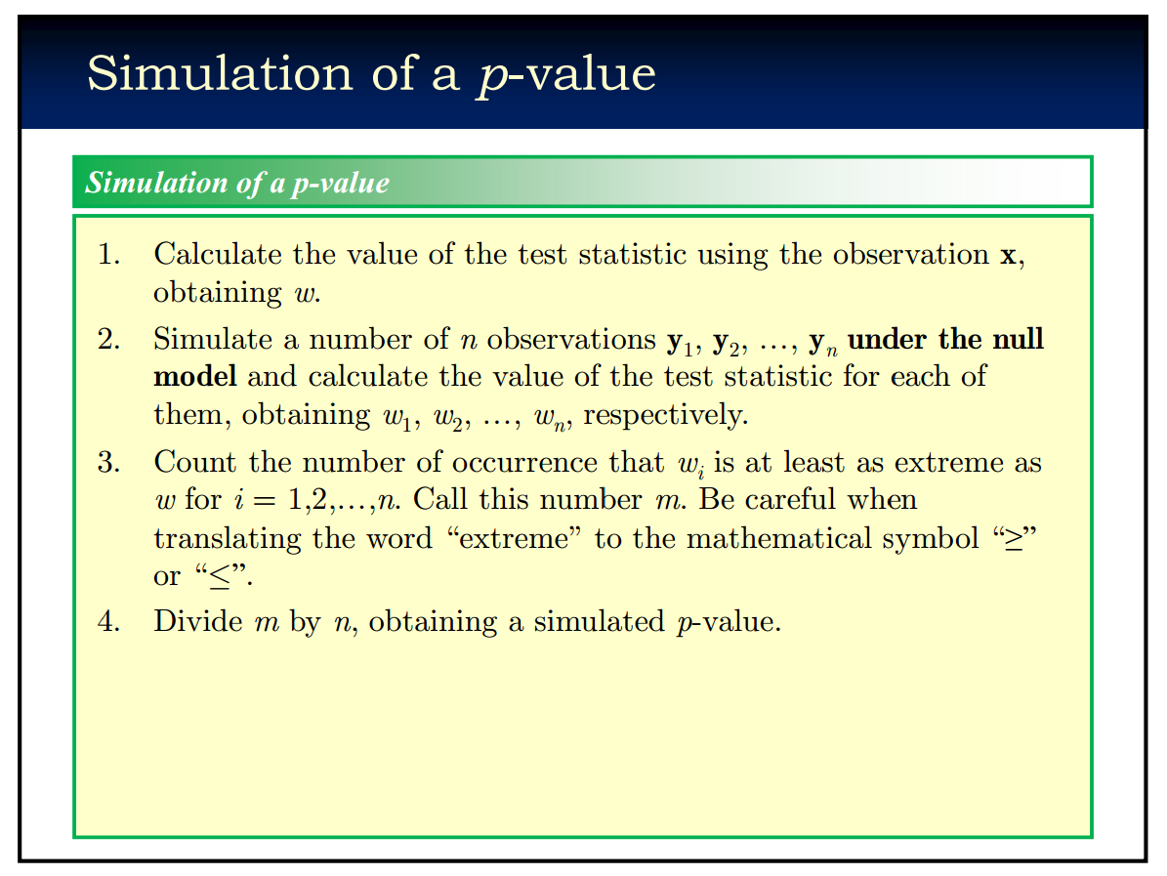

Slide 34
p-value
A test statistic.
The probability of observing more extreme value of the realized test statistic under the null hypothesis.
Usually uniformly distributed under the null hypothesis.
Simulation of a p-value is important.

Slide 35
课程作业
Coding 作业及提交方式说明
编写序列比对算法
Code 提交到Github, Pull Request To me.
文献阅读报告安排

Slide 36

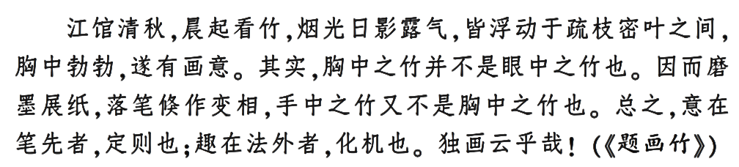
Notes

