Slide 1
回归分析
生物信息学概论
教师：李梢教授
助教：博士生 祖松鹏
2014-12-24

Slide 2
CONTENT
Basic linear regression
Regularization
Ridge
LASSO
Generalized Linear Model
Logistic Regression
Summary

Slide 3



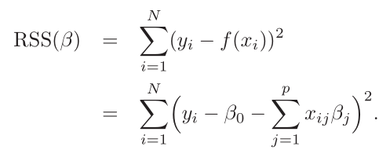

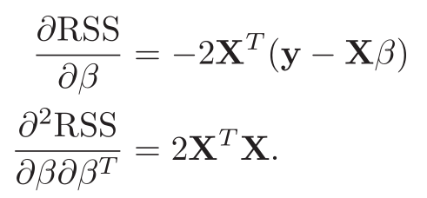
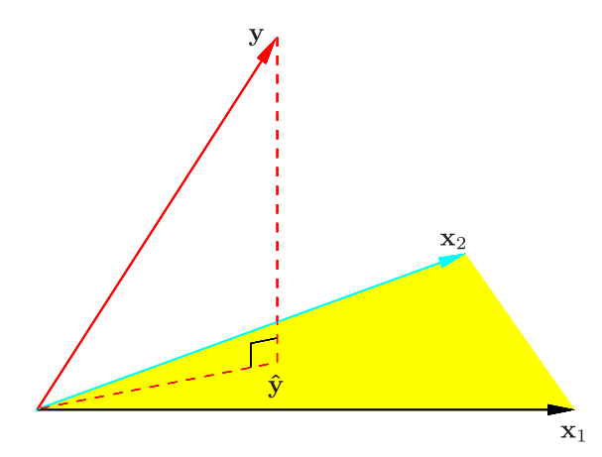
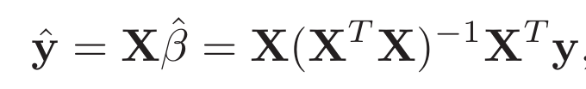

Basic Linear Regression
The variables (covariates, features, predictors), can come from:
Quantitative inputs;
Basis expansions, or transformation of the quantitative inputs, such as log, square.
“dummy” variables.
Interactions between variables, like
Least squares

Slide 4
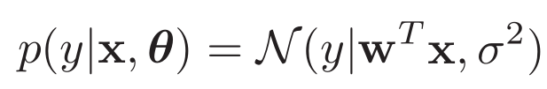

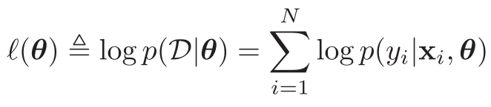
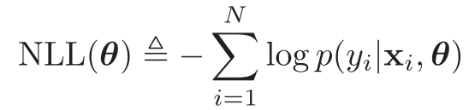
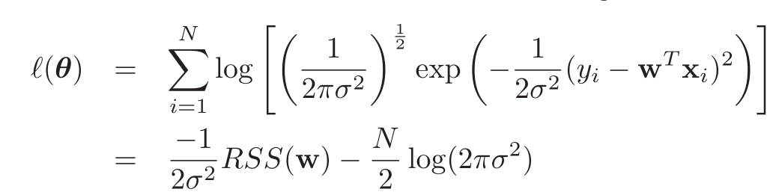
Basic Linear Regression
A linear regression is a model of the form
Maximum likelihood estimation

Slide 5
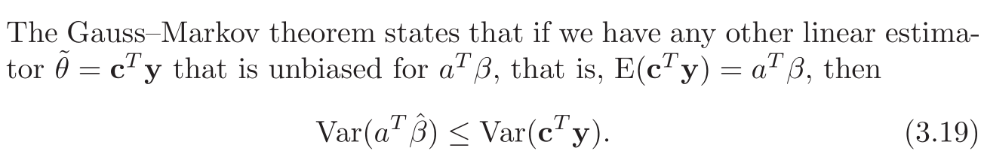
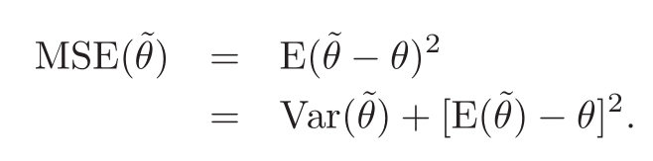
Basic linear regression
The Gauss-Markov Theorem
MSE = Variance + bias

Slide 6

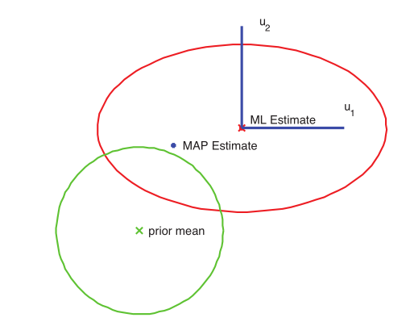
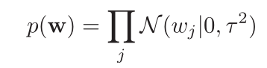
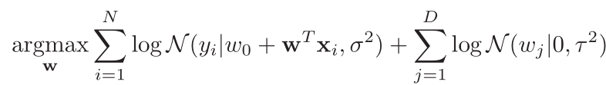
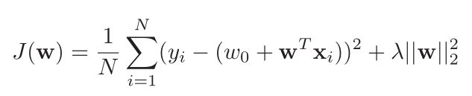
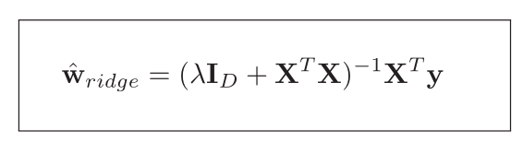
Regularization: Ridge Regression
Recall
If the coefficients have the priors, then ?
Ridge Regression

Slide 7

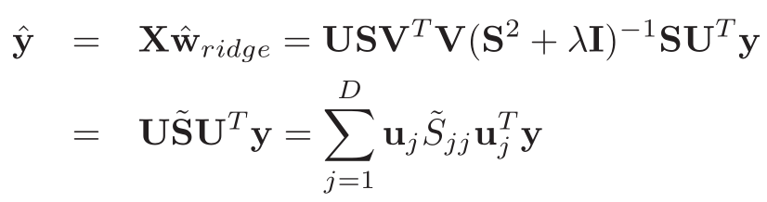
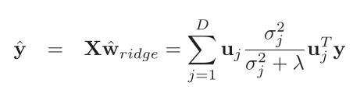
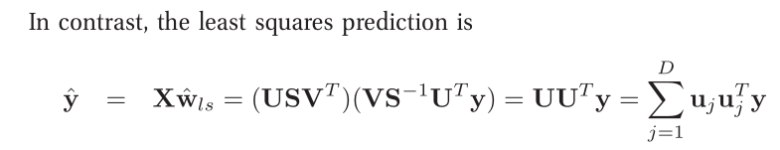
Connection with PCA

Slide 8
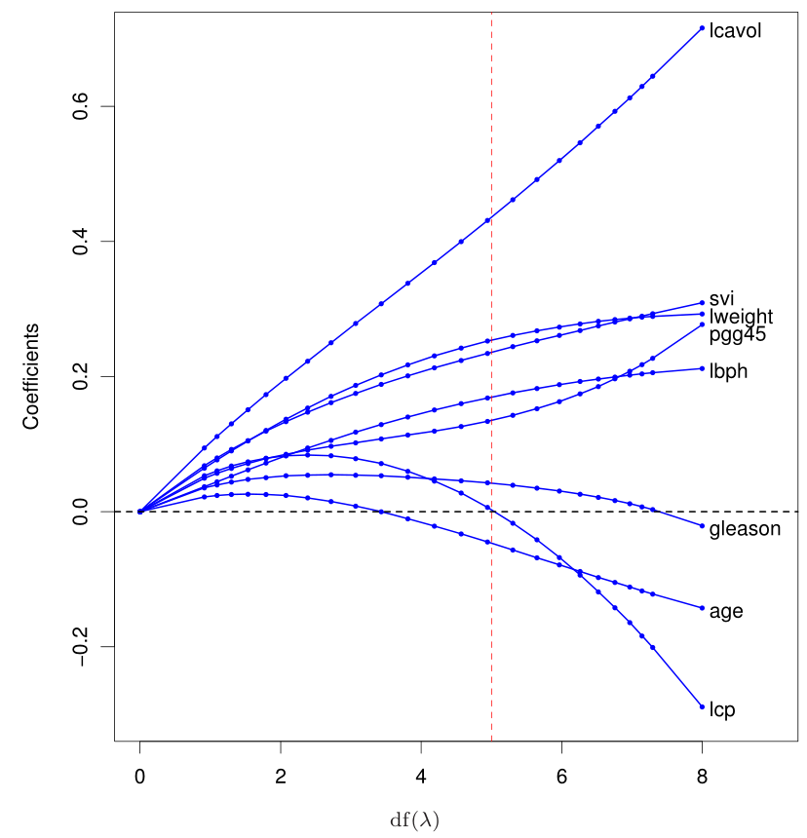
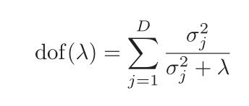
Degree of freedom

Slide 9
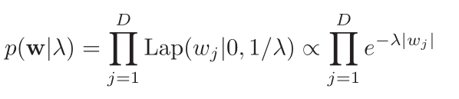
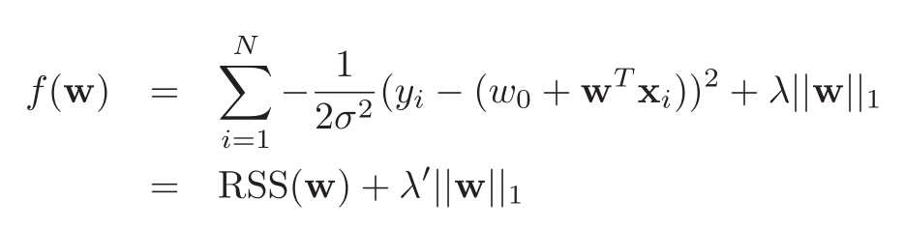
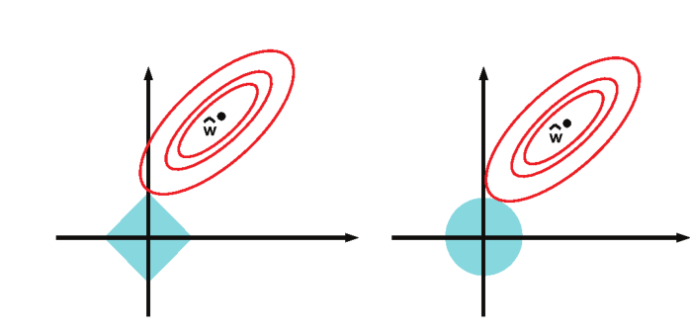
Regularization: LASSO
If we choose another prior, such as Laplace prior, then ?

Slide 10
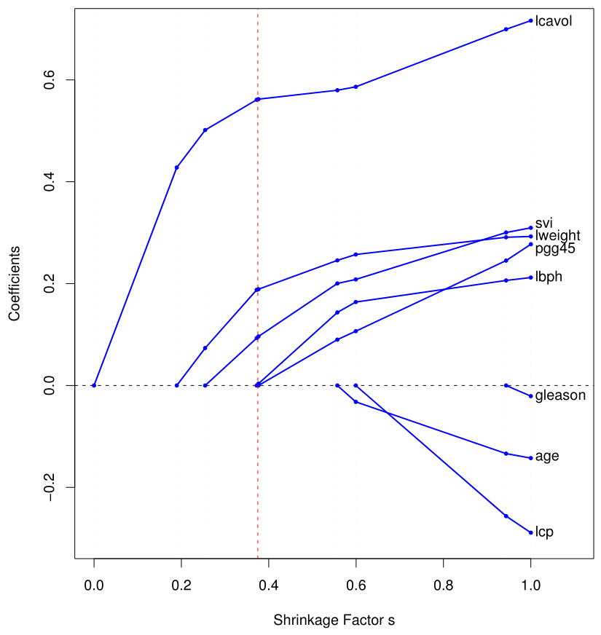
Degree of freedom

Slide 11
How to solve LASSO
Subgradient and Optimization
*LARS (统计学习那些事 by 杨灿)
*General L1-norm optimization – ADMM
*Proximal and gradient projection methods
*EM for lasso

Slide 12
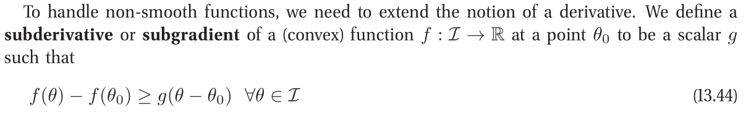
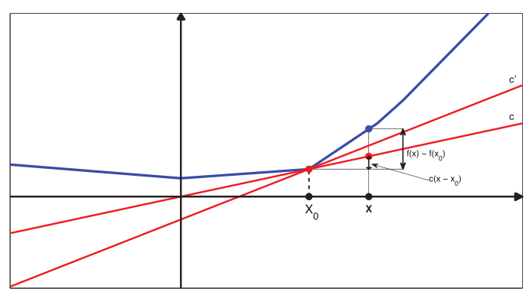

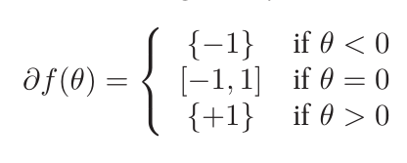
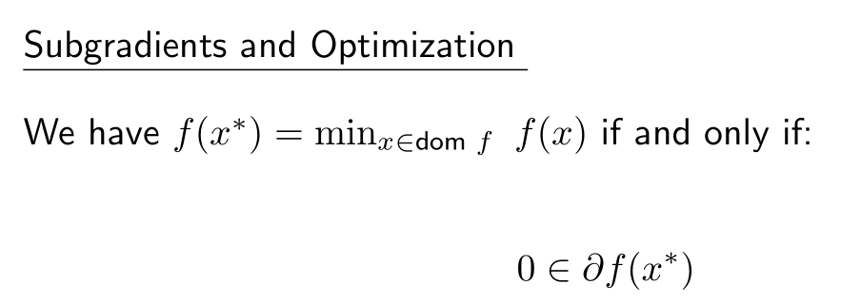
Subgradient

Slide 13
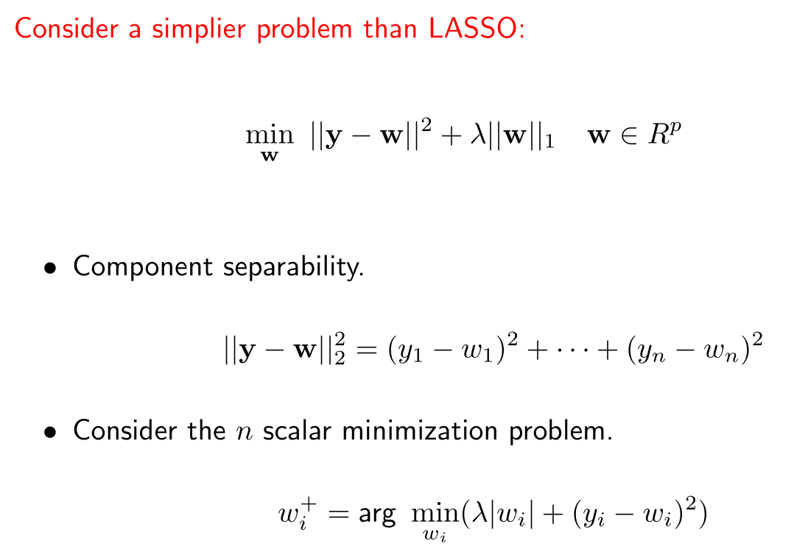
Subgradient

Slide 14
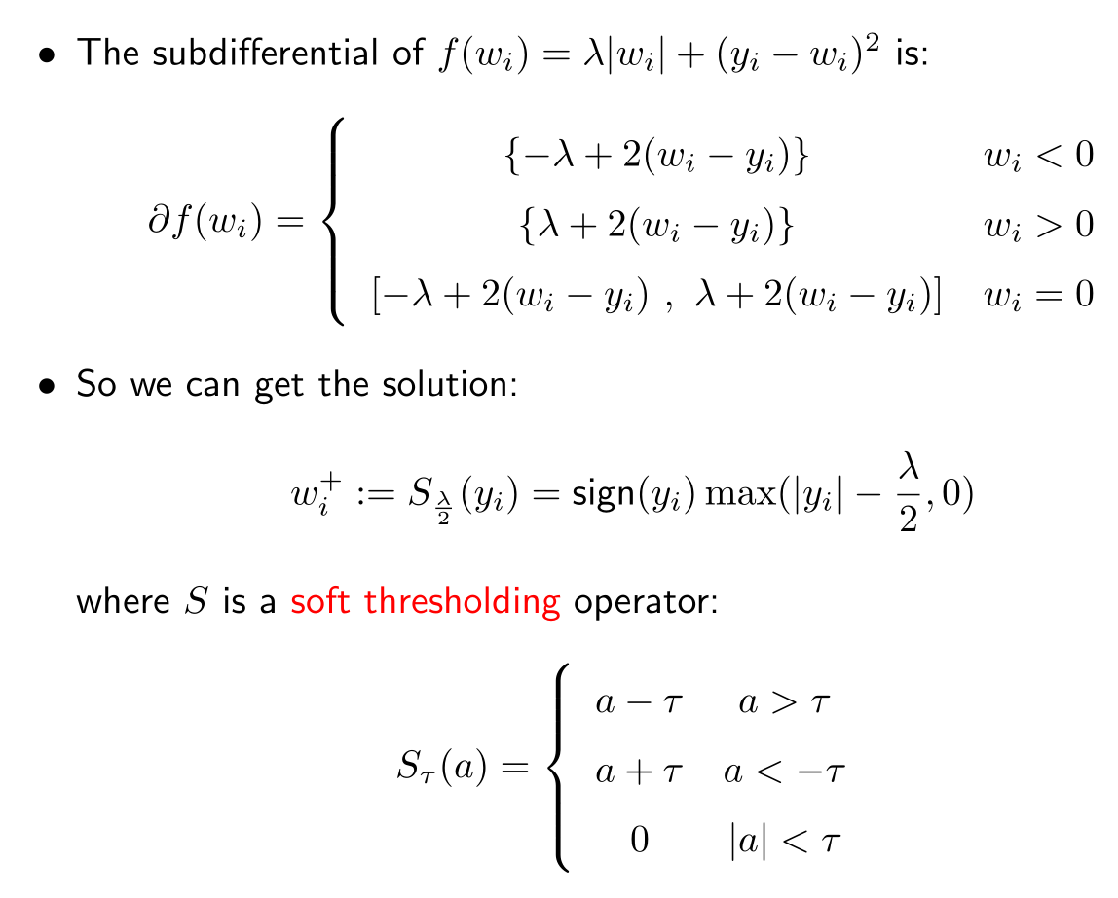
Subgradient

Slide 15
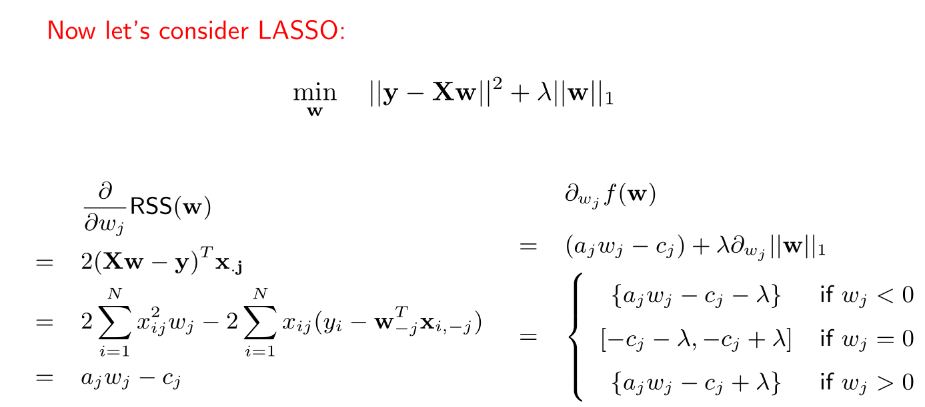
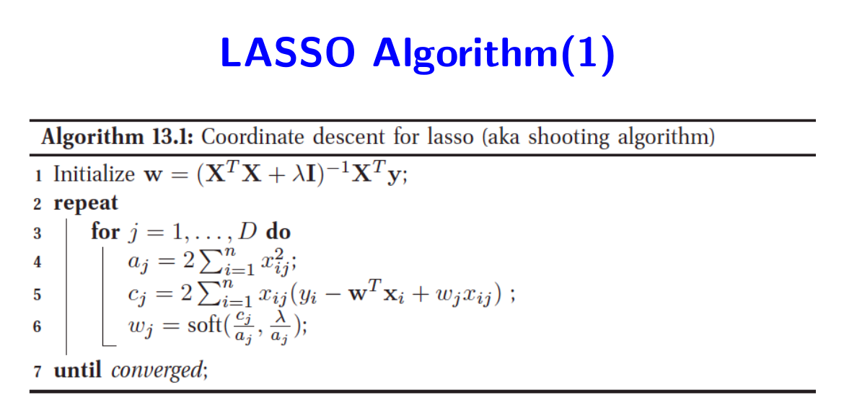
Subgradient

Slide 16
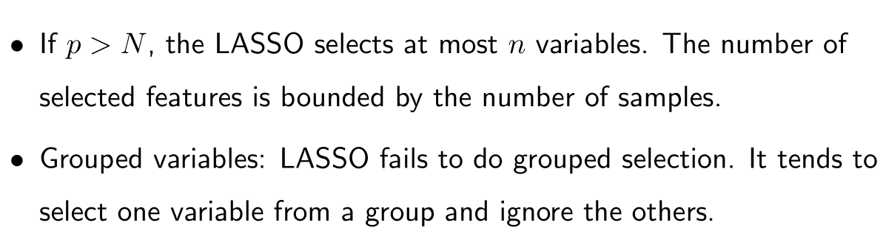
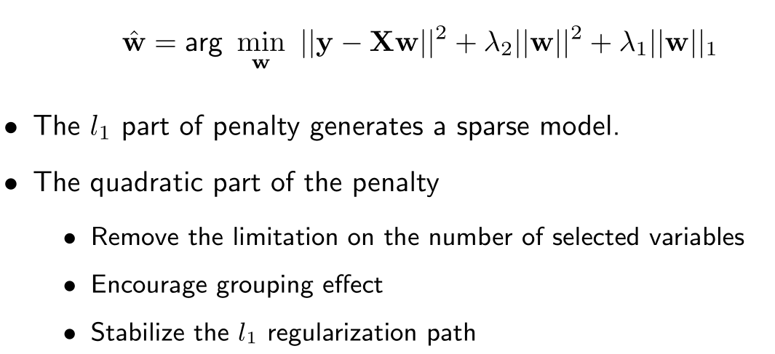
The limitations of LASSO
Elastic Net (R glmnet package)

Slide 17
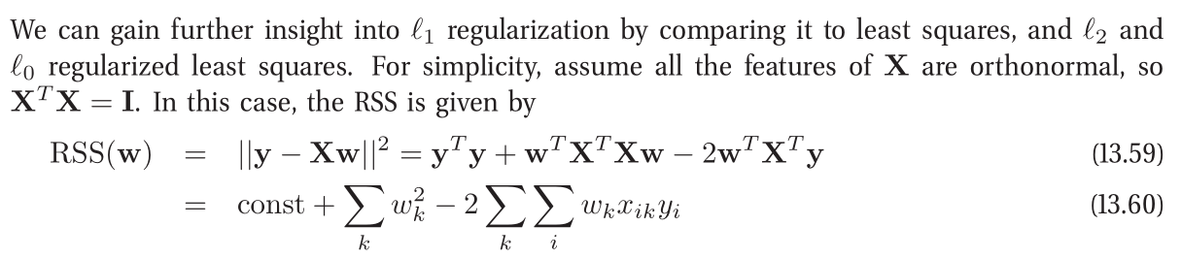

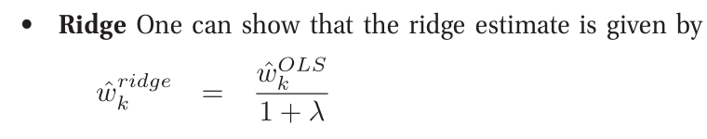
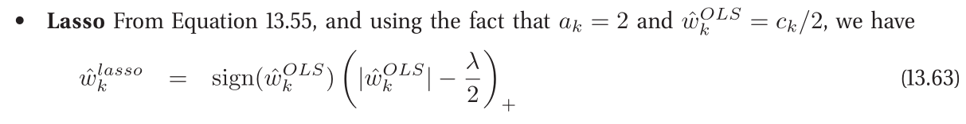
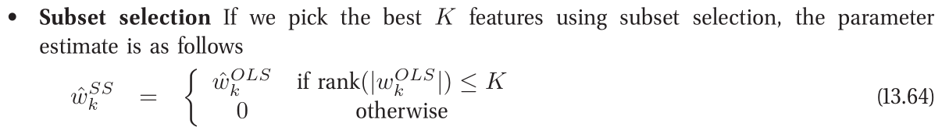
Comparison of these models

Slide 18
Generalized Linear Models (GLMs)
If Y is not a continuous variable, can we use linear regression ?
Can we use linear regression for classification ?
If the variance of Y depends on the mean, then ?

Slide 19
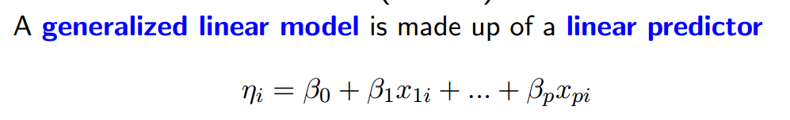
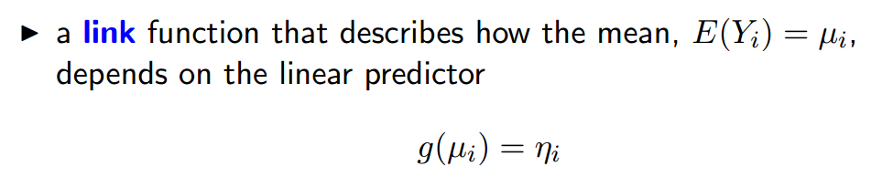
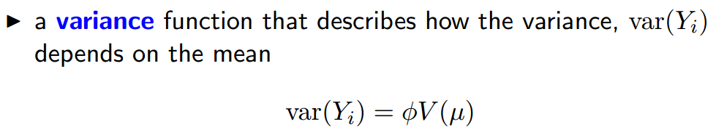
GLMs

Slide 20
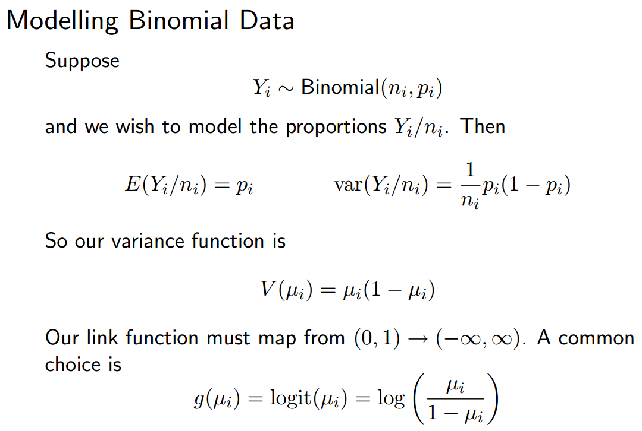
GLMs

Slide 21
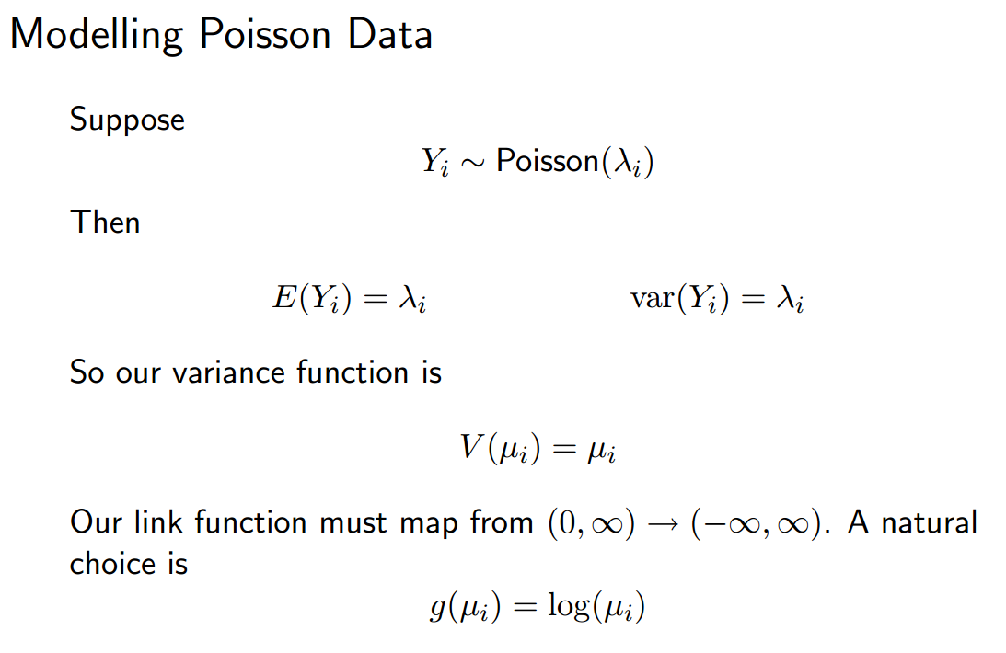
GLMs

Slide 22
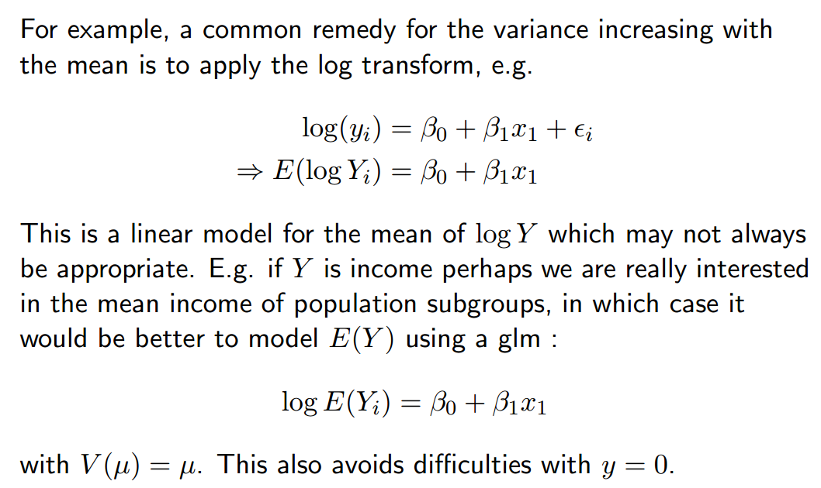
Transformation vs. GLMs

Slide 23

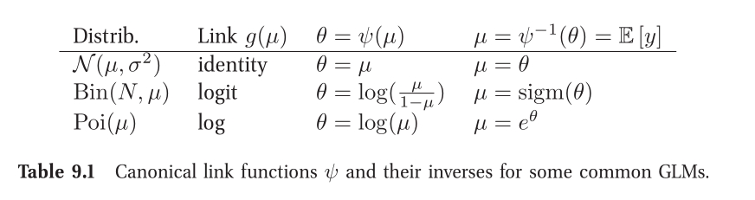

Learning of GLMs
From probabilistic view, we have

Slide 24
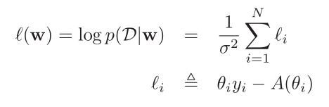
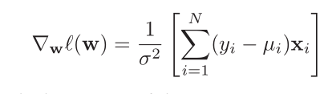
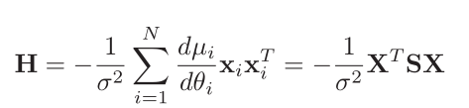
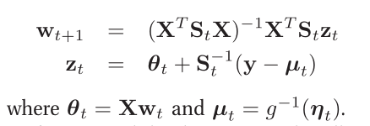

Learning of GLMs
MLE estimation

Slide 25



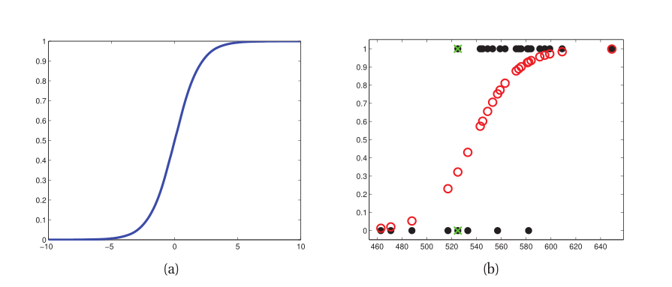
Logistic Regression

Slide 26




Logistic Regression

Slide 27
Summary
Machine Learning is like “搭积木”.
Kernel
Regularization
Different priors
Sparsity
PCA
…
How to solve it ?
Numerical optimization
Monte Carlo strategy
Approximation
“Never give an estimation without variance.”
“Bet on sparsity.”
Before you design the algorithm, see some practical cases.

Slide 28
Reference
Machine Learning – A Probabilistic Perspective. 2012
The Elements of Statistical Learning (Second Edition) 2008

