Slide 1
旺欉 – 第二個模組建置
羅紹賢 副工程師
創生處 技術加值 組
2022.08.25

Slide 2
大綱
標記資料說明
模型分析結果
模組解釋結果
透過局部可解釋性模組：Lime(Local Interpretable Model-agnostic Explanations)
參考

Slide 3
標記資料說明
使用資料範圍
第一次標記資料：111/5/9，使用一個模具，共生產36錠
第二次標記資料：111/7/4，使用兩個模具，分別生產31、31錠
共生產98錠

Slide 4
模型分析結果
explained_variance_ratio_:
[0.35791650760628924, 0.17557461751690026, 0.07945347163123094, 0.06567824219260726, 0.05462428190291081, 0.04457508605980149, 0.04012583145456623, 0.036502831961990126, 0.025497527659332938, 0.02025717759455791, 0.016966606500729856, 0.01535502341259626, 0.012011882621586678, 0.010047543029377215, 0.008084608072411601, 0.0067660661450392266, 0.006007972467998723, 0.005269255031447236, 0.004351564141915397, 0.003629097598244681, 0.0027422546770023135, 0.0020899760731532832, 0.001339305434135295, 0.0011040772833036119, 0.0009375891183674148, 0.0007509394290300356, 0.0006219321894799413, 0.00041837852700705704, 0.0003630736718887858, 0.00022839225718995892, 0.00018354781562430217, 0.00015502672262951496, 0.00010400012496677542, 6.753554468986672e-05, 5.645729442092024e-05, 3.924810159781084e-05, 2.6983661186282536e-05, 2.1889856393570347e-05, 1.5219598654008747e-05, 1.3986715603131457e-05, 7.480795178522625e-06, 5.413981448725019e-06, 3.144146718896354e-06, 2.7951283882893196e-06, 1.7341766794118758e-06, 1.623938469887692e-06, 1.2520847647160618e-06, 4.935153444401027e-07, 4.015265512676754e-07, 2.9965831202989835e-07, 1.1051760655600723e-07, 8.563206158941875e-08, 5.8381135423640344e-08, 3.5688047117566294e-08, 3.170582926462981e-08, 1.2403138610825746e-08, 7.2192591340005e-09, 3.956123823530791e-09, 2.88598396233359e-09, 2.418682734905555e-09, 6.465081716272249e-10, 5.558886493479653e-10, 2.2011152680925074e-10, 1.1310413588554101e-10, 5.753175951522864e-12, 1.0142642484113037e-12, 2.97266215362931e-14, 7.91840920951743e-15, 2.2337668467151817e-16, 9.75134719027965e-18, 1.9612166742731402e-33, 1.9612166742731402e-33, 1.9612166742731402e-33, 1.9612166742731402e-33, 1.9612166742731402e-33]
explained_variance_ratio_ cumsum:
[0.35791650760628924, 0.5334911251231895, 0.6129445967544205, 0.6786228389470277, 0.7332471208499385, 0.77782220690974, 0.8179480383643063, 0.8544508703262964, 0.8799483979856293, 0.9002055755801872, 0.9171721820809171, 0.9325272054935134, 0.9445390881151001, 0.9545866311444773, 0.9626712392168889, 0.9694373053619282, 0.975445277829927, 0.9807145328613742, 0.9850660970032896, 0.9886951946015343, 0.9914374492785366, 0.9935274253516899, 0.9948667307858252, 0.9959708080691289, 0.9969083971874962, 0.9976593366165263, 0.9982812688060062, 0.9986996473330133, 0.9990627210049021, 0.9992911132620921, 0.9994746610777164, 0.999629687800346, 0.9997336879253128, 0.9998012234700027, 0.9998576807644236, 0.9998969288660214, 0.9999239125272077, 0.9999458023836013, 0.9999610219822553, 0.9999750086978585, 0.999982489493037, 0.9999879034744857, 0.9999910476212046, 0.9999938427495929, 0.9999955769262723, 0.9999972008647422, 0.999998452949507, 0.9999989464648514, 0.9999993479914027, 0.9999996476497147, 0.9999997581673212, 0.9999998437993828, 0.9999999021805182, 0.9999999378685652, 0.9999999695743945, 0.9999999819775331, 0.9999999891967922, 0.9999999931529161, 0.9999999960389001, 0.9999999984575828, 0.999999999104091, 0.9999999996599797, 0.9999999998800911, 0.9999999999931952, 0.9999999999989484, 0.9999999999999627, 0.9999999999999925, 1.0000000000000004, 1.0000000000000007, 1.0000000000000007, 1.0000000000000007, 1.0000000000000007, 1.0000000000000007, 1.0000000000000007, 1.0000000000000007]
PCA累積貢獻度

Slide 5
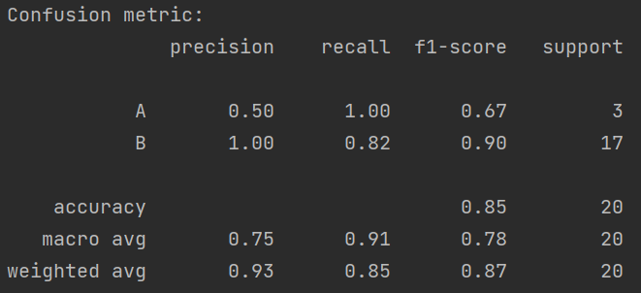
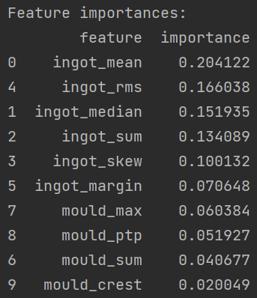
模型分析結果
混淆矩陣
從混淆矩陣中可以觀察出：
針對A、B兩級的召回率有91%
相較於A級，B級的f1-score高出許多，表示綜合來說正確預測B級的機率較A級高
特徵重要性排序
從特徵重要性排序中可以觀察出：
於已篩選出的前10個統計特徵中，前6大影響品質重要程度的皆為與擠錠溫度相關的統計特徵，與現場經驗符合
其中，擠錠溫度的平均值、平方平均數與中位數為影響最大的

Slide 6
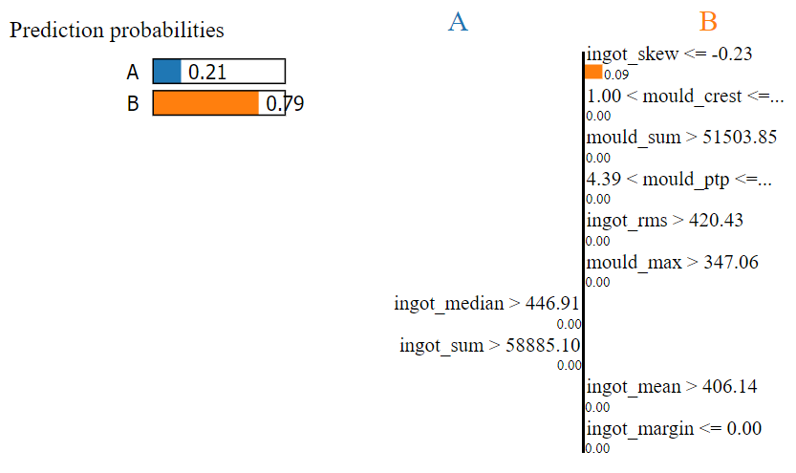
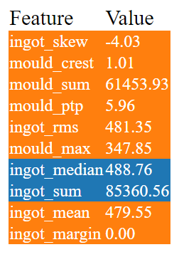
模組解釋結果
透過LIME解釋一筆測試資料
解釋後數據影響品質大小排序
從Lime解釋結果可以觀察出：
模組預測該筆測試資料為B級，機率為0.79
影響最大的統計特徵為擠錠溫度偏度，原因為：擠錠溫度偏度值-4.03 ≤ -0.23

