Slide 1

Literature Survey on TransMLA: Multi-Head Latent Attention Is All You Need
Pengli Shao - 002295825
CS6120.MERGED.202530 – NLP
Khoury College of Computer Science
April 16, 2025

Slide 2
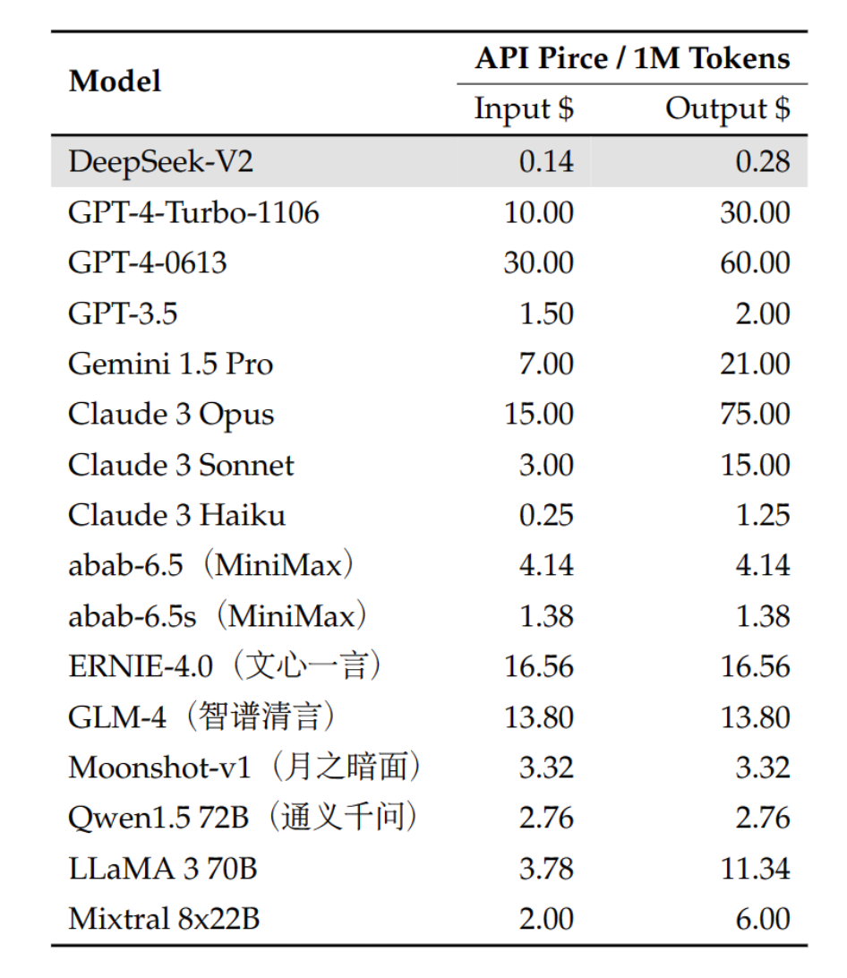
Introduction
Inference Model – A well-trained model for prediction and generation tasks, it does not update parameters.
Problem that all inference model has? – As input sequence length increase, KV cache will increases, it has already become a bottleneck for all inference models.
In Transformer architecture, every new generated token need to calculate attention output with every K and V with all the tokens before it, therefore we need to save every token’s K and V. As the layer increase, head number increase, sequence size increase, KV cache will increase exponentially.

Slide 3
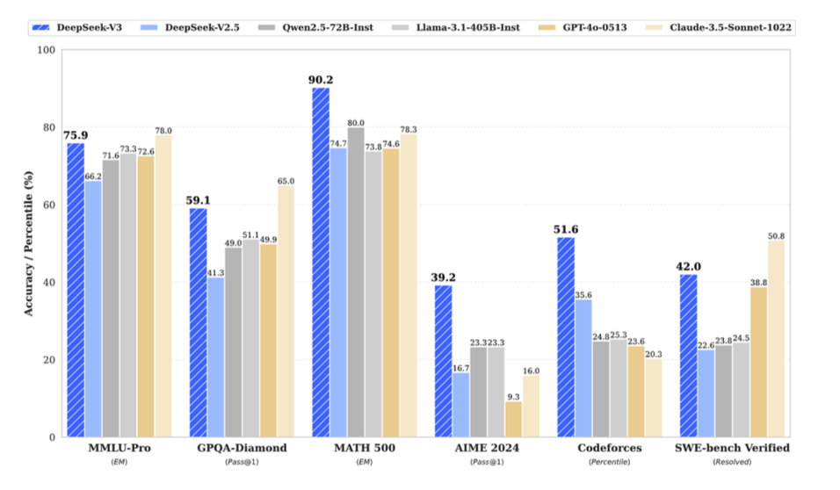
Introduction
In this literature survey, we primarily focus on these papers:
TransMLA: Multi-head Latent Attention is All You Need[1]
Deepseek V2: A strong, economical, and efficient mixture-of-experts language model.[2]
Gqa: Training generalizaed multi-query transformer models from multi-head checkpoints.[3]

Slide 4
Methodology
Search Strategy: This survey mainly used Google Scholar, GitHub, and arxiv.org.
Keywords: MLA, KV cache, Technique report, GPT, MQA, GQA.
Selection Criteria: The report mainly focuses on techniques about saving KV cache. Including all techniques introduced in TransMLA[1], DeepSeek V2[2], and GQA[3] paper.

Slide 5
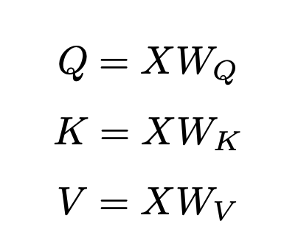
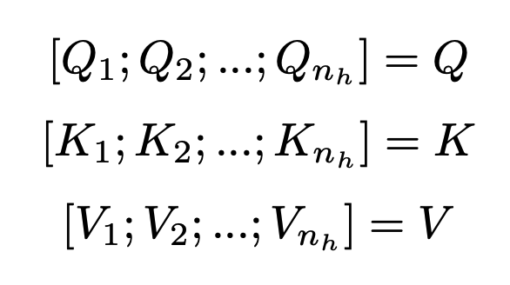
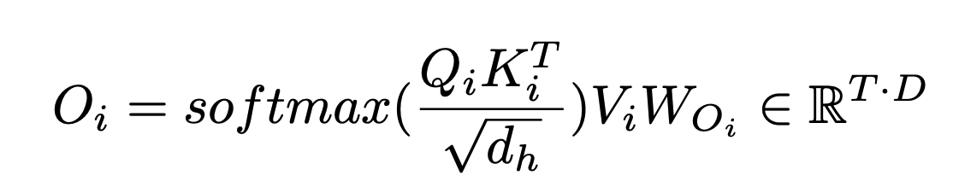
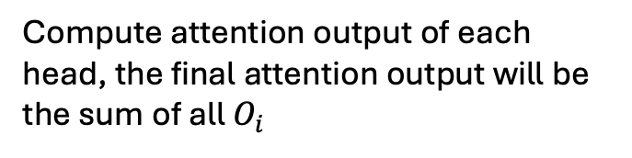
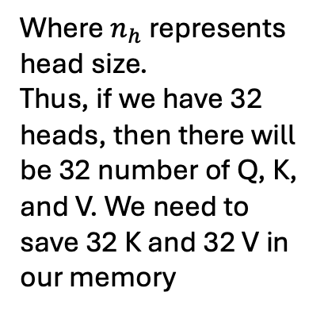
Literature Review – Basic Understanding 1. MHA – Multi-head Attention
Compute QKV
Where $n_{h}$ represents head size.
Thus, if we have 32 heads, then there will be 32 number of Q, K, and V. We need to save 32 K and 32 V in our memory
Compute attention output of each head, the final attention output will be the sum of all $O_{i}$

Slide 6
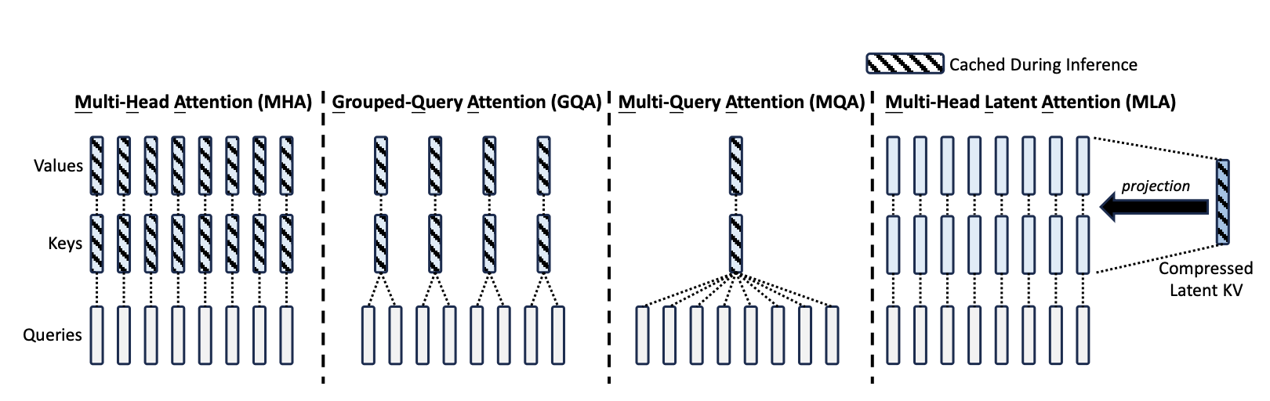
Literature Review – Basic Understanding Techniques to save KV cache

Slide 7
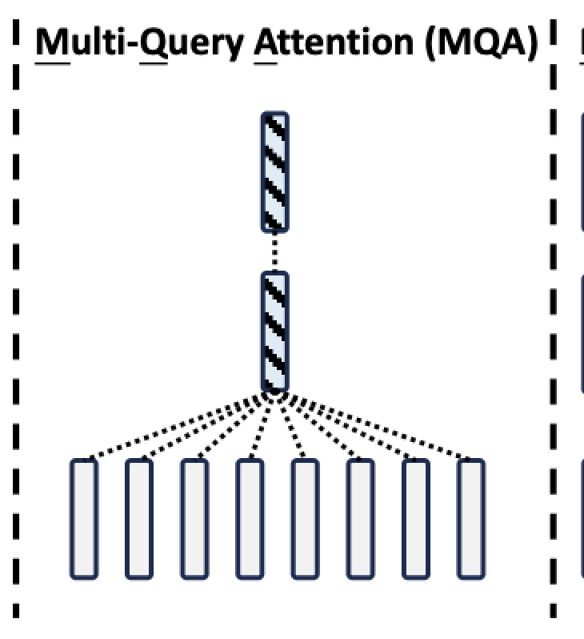
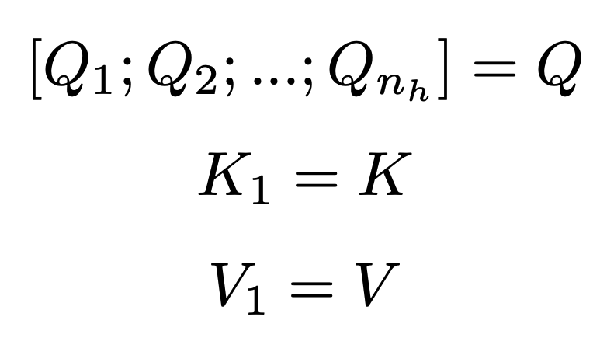
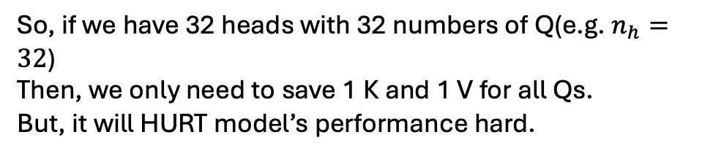
Literature Review – Basic Understanding 2. MQA – Multi-Query Attention
Every Q will share the same K and V for all heads, such that:
So, if we have 32 heads with 32 numbers of Q(e.g. $n_{h}=32$)
Then, we only need to save 1 K and 1 V for all Qs.
But, it will HURT model’s performance hard.

Slide 8
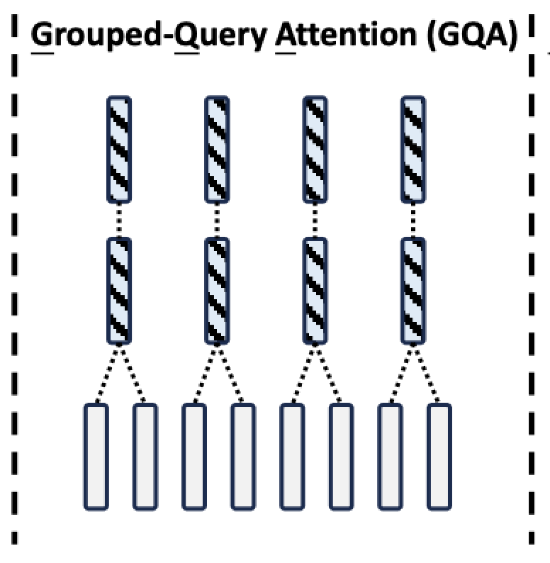
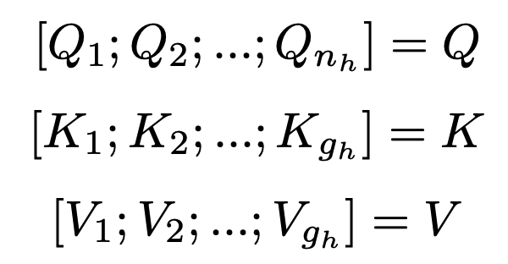
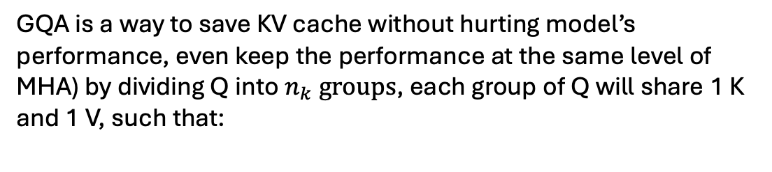
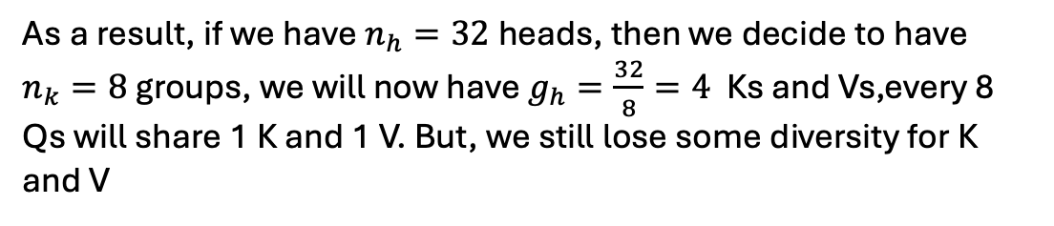
Literature Review – Basic Understanding 2. GQA – Group Query Attention
GQA is a way to save KV cache without hurting model’s performance, even keep the performance at the same level of MHA) by dividing Q into $n_{k} groups$, each group of Q will share 1 K and 1 V, such that:
As a result, if we have $n_{h}=32$ heads, then we decide to have $n_{k}=8$ groups, we will now have $g_{h}=\frac{32}{8}=4$ Ks and Vs,every 8 Qs will share 1 K and 1 V. But, we still lose some diversity for K and V

Slide 9
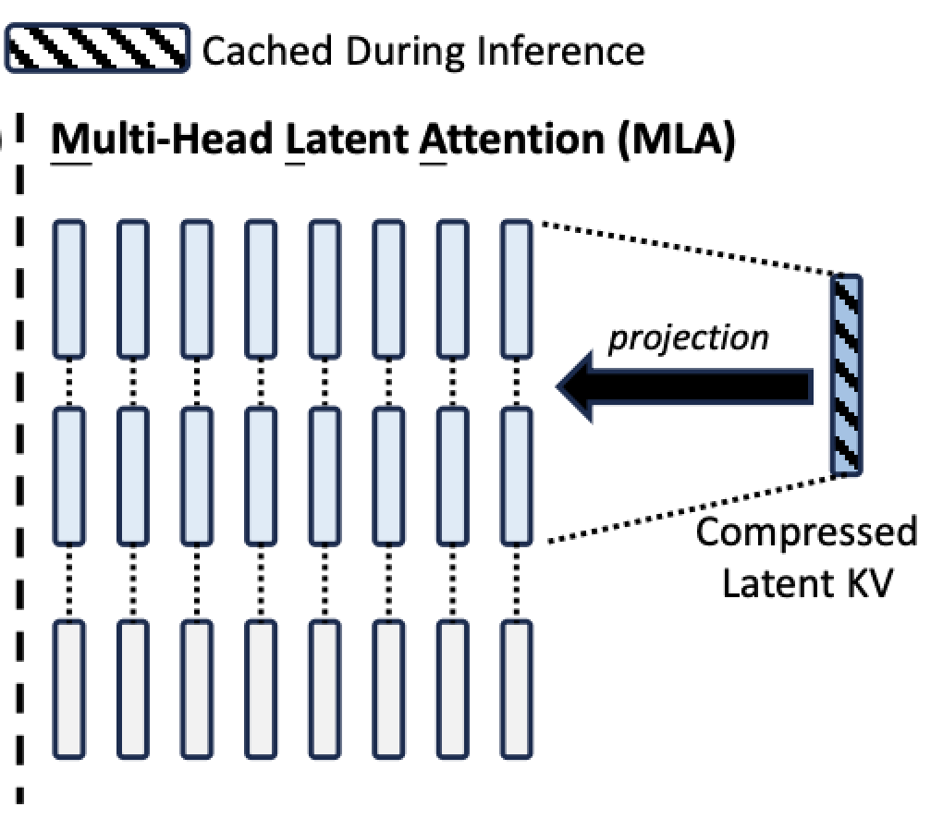
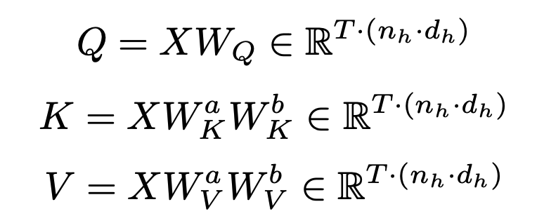
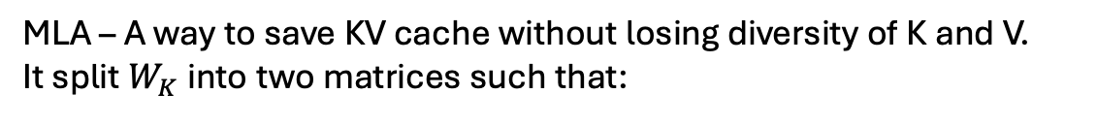
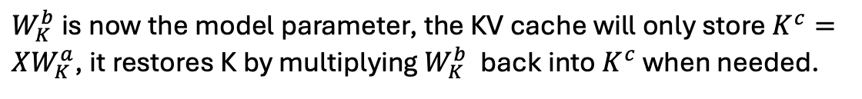
Literature Review – Basic Understanding 3. MLA – Multi-head Latent Attention
MLA – A way to save KV cache without losing diversity of K and V.
It split $W_{K}$ into two matrices such that:
$W_{K}^{b}$ is now the model parameter, the KV cache will only store $K^{c}=XW_{K}^{a}$, it restores K by multiplying $W_{K}^{b}$ back into $K^{c}$ when needed.

Slide 10
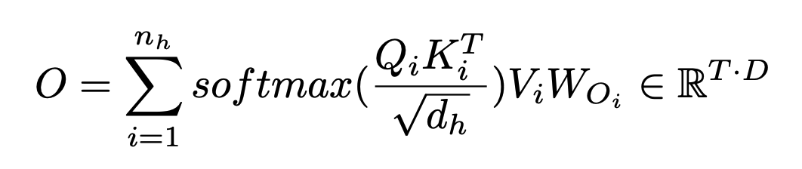
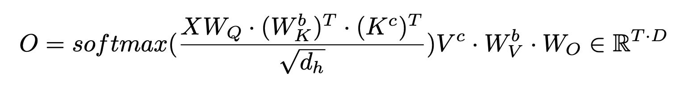
Literature Review – Basic Understanding 3. MLA – Multi-head Latent Attention
The full calculation of attention output changed, the KV cache of MLA only need to save a smaller K and V without losing diversity like GQA
Here is the attention output of each head, take the sum of each head equals to MHA attention output function.

Slide 11
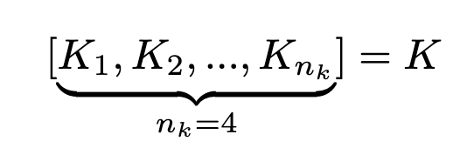
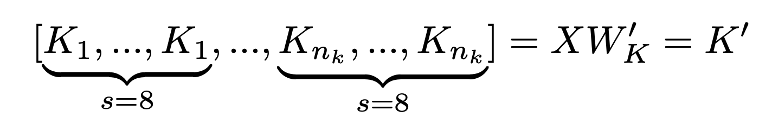
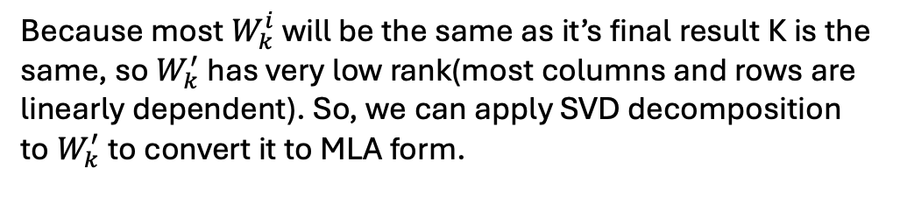
Literature Review – Basic Understanding 4. TransMLA – Convert GQA-based to MLA-based
Assume we have 32 heads, and 32 different Qs for each heads, those Qs will be divided into 8 groups.
Then, GQA has 4 different Ks for each group of Q.
To match the number of head size for K, we can think it as to copy each unique K 8 times to match the size of Q.
Because most $W_{k}^{i}$ will be the same as it’s final result K is the same, so $W_{k}^{′}$ has very low rank(most columns and rows are linearly dependent). So, we can apply SVD decomposition to $W_{k}^{′}$ to convert it to MLA form.

Slide 12
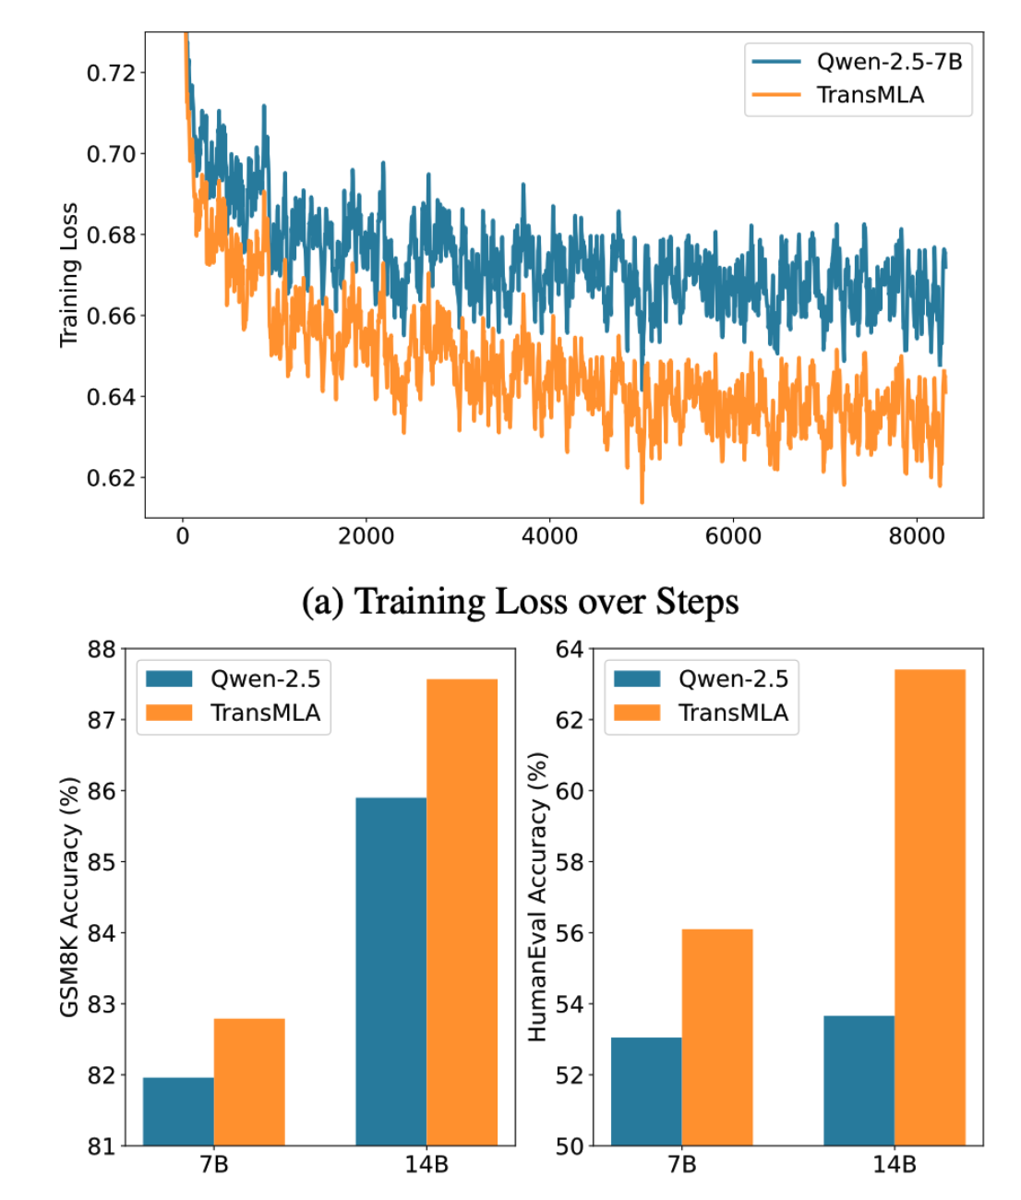
Findings - TransMLA Model Performance
DeepSeek group conducted an experiment that convert Qwen-2.5 7B and 14B model from GQA-based into MLA-based.
The result shows that MLA-based Qwen model shows decrease in training loss, an increase in models accuracy in GSM8K and HumanEval tests.
BUT, they only convert Qwen model, and it is a relatively small model and not that mainstream.
#Qwen is a model from Baidu, China’s biggest search engine company.

Slide 13
Comparison Analysis GQA paper[3] and TransMLA paper[1]
Both paper have similar structure.
GQA paper evaluate GQA-based model, MHA model, and MQA-based model by summarization, Q&A, and translation tasks.
MLA paper evaluate GQA-based Qwen model and MLA-based Qwen model by coding and math tasks. Qwen model is relatively a small model.

Slide 14
Critical Analysis
That fact that TransMLA was only applied to Qwen model is a big problem of the paper, yet we still don’t know how effective it is to convert some large model such as LLaMA and Mistral from GQA-based to MLA-based.
The MLA-based model only compared with GQA-based model, without showing the difference in performance with MHA model and MQA model. Although in GQA paper[3], it already proved GQA outperforms MQA, but it still indicates that the experiments in MLA paper[1] is not that comprehensive.
The problem of GQA paper is that it’s experiment evaluate the performance of GQA-based model, MHA model, and MQA-based model by summarization, translation, and Q&A tasks. Those tasks are relatively easier comparing to coding and math tasks.
If any companies or individuals want to convert an GQA-based inference model specifically for coding and math tasks to MLA-based, TransMLA is a simple and remarkable technique for them.

Slide 15
Conclusion
This literature survey introduced the math-behind of GQA, MQA, MHA, and MLA, mainly focusing
on comparing GQA and MLA, the two techniques that allow models to save KV cache during
inference step. We found that GQA outperforms MQA in summarization, translation, and Q&A
tasks while keeping its accuracy level close to MHA architecture model. And, MLA-based Qwen-2.5
7B and 14B model outperforms GQA-based Qwen-2.5 7B and 14B in model in math and coding
tasks after fine-tuning both models. The technique called TransMLA allows GQA-based model such
as Qwen to convert into MLA-based model by using SVD decomposition of K and V heads weight
parameter while bringing least influence to the original model.
However, we also observe that the MLA paper lacks of experimental comparisons with MHA and
only applied TransMLA on one model. It is still unclear if TransMLA can still enhance model’s
performance for larger model.
For future research, it would be beneficial to:
• Conduct a comparison analysis between MLA and MHA and other cache-saving techniques in more downstream tasks.
Explore the capability of TransMLA technique on large models besides Qwen.

Slide 16
References
[1] Meng, F., Yao, Z., & Zhang, M. (2025). TransMLA: Multi-head Latent Attention Is All You Need. arXiv preprint arXiv:2502.07864.
[2] Liu, A., Feng, B., Wang, B., Wang, B., Liu, B., Zhao, C., ... & Xu, Z. (2024). Deepseek-v2: A strong, economical, and efficient mixture-of-experts language model. arXiv preprint arXiv:2405.04434.
[3] Ainslie, J., Lee-Thorp, J., De Jong, M., Zemlyanskiy, Y., Lebr´on, F., & Sanghai, S. (2023). Gqa: Training generalized multi-query transformer models from multi-head checkpoints. arXiv preprint arXiv:2305.13245.

