Slide 1
DS5110-Final Project
Pengli Shao
Sentiment Analysis and Future App Score Prediction
of User Feedback Across Different Version of Spotify

Slide 2
Problem Description
The review comment and score is the key to determine whether a new version of an app is successful or not. As a mainstream music app, Spotify has tons of comments that contains hidden messages/information that can help it to improve it’s app in next version.

Slide 3
Methodology
Data Cleaning
Text Cleaning & Keyword Extraction
Sentient Analysis
Prediction
Association Rule Mining
Visualization
Drop rows that contain NA values
Text mining by using nltk and re. Extract keywords by TF-IDF
Analyze sentiment of each comment
Prediction of future comments base on Logistic Regression
Identify Problems by Rule Mining
Visualize Result
The goal of this project is to analyze the sentiment of user's feedback of different version. Therefore, I do not fill in NA with some value.
Frequent itemsets mining
Association Rule Mining
Visualize result by word cloud graph
Use vaderSentiment to identify the sentiment of each comment:
Positive
Negative
Neutral
Use the keywords extracted by TF-IDF and sentiment to predict future score by Random Forest and Logistic
Symbol Removing
Drop non-english chars
Text tokenize
Text lemmatize

Slide 4
Data
Original Spotify review data sets contains 84165 rows
There are 8 columns:
• reviewId
• userName
• content
• score
• thumbsUpCount
• reviewCreatedVersion
• at
• appVersion
Missing values in each column:
reviewId 0
userName 4
content 0
score 0
thumbsUpCount 0
reviewCreatedVersion 5768
at 0
appVersion 5768
dtype: int64

Slide 5
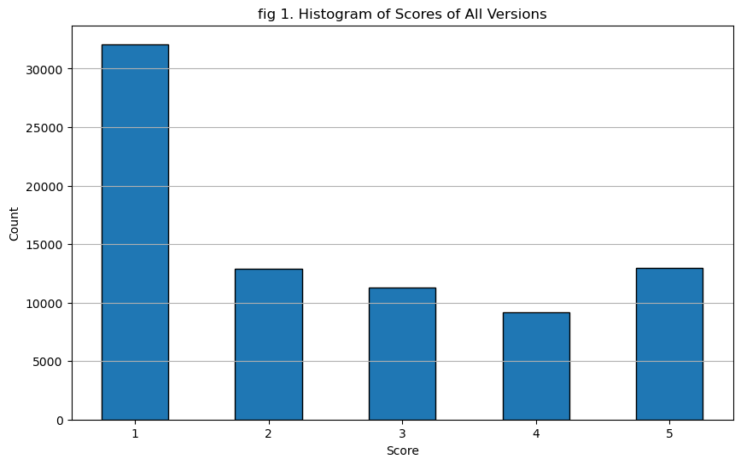
Visualizations for Pre-processing

Slide 6
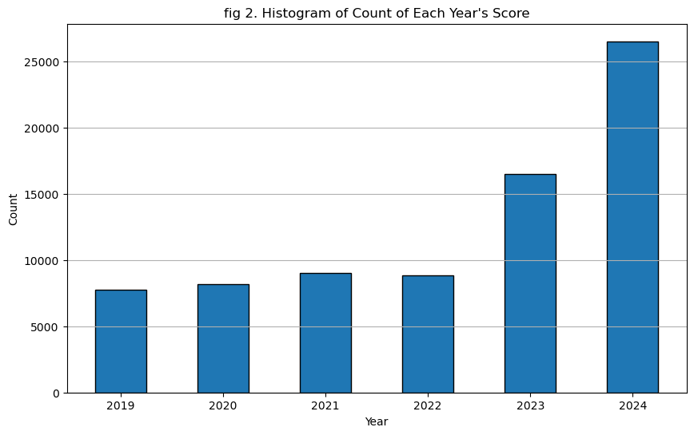
Visualizations for Pre-processing

Slide 7
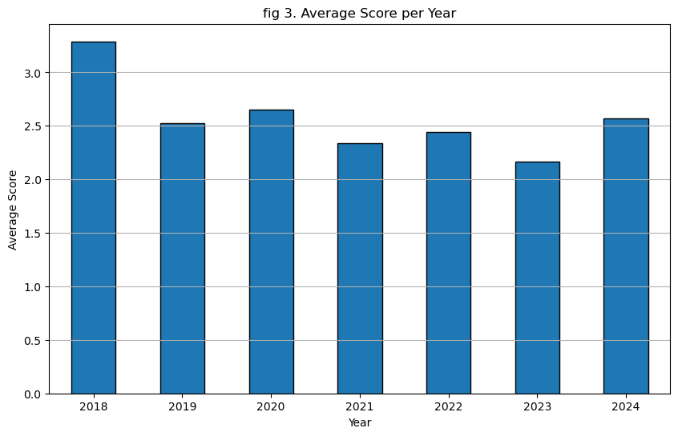
Visualizations for Pre-processing

Slide 8
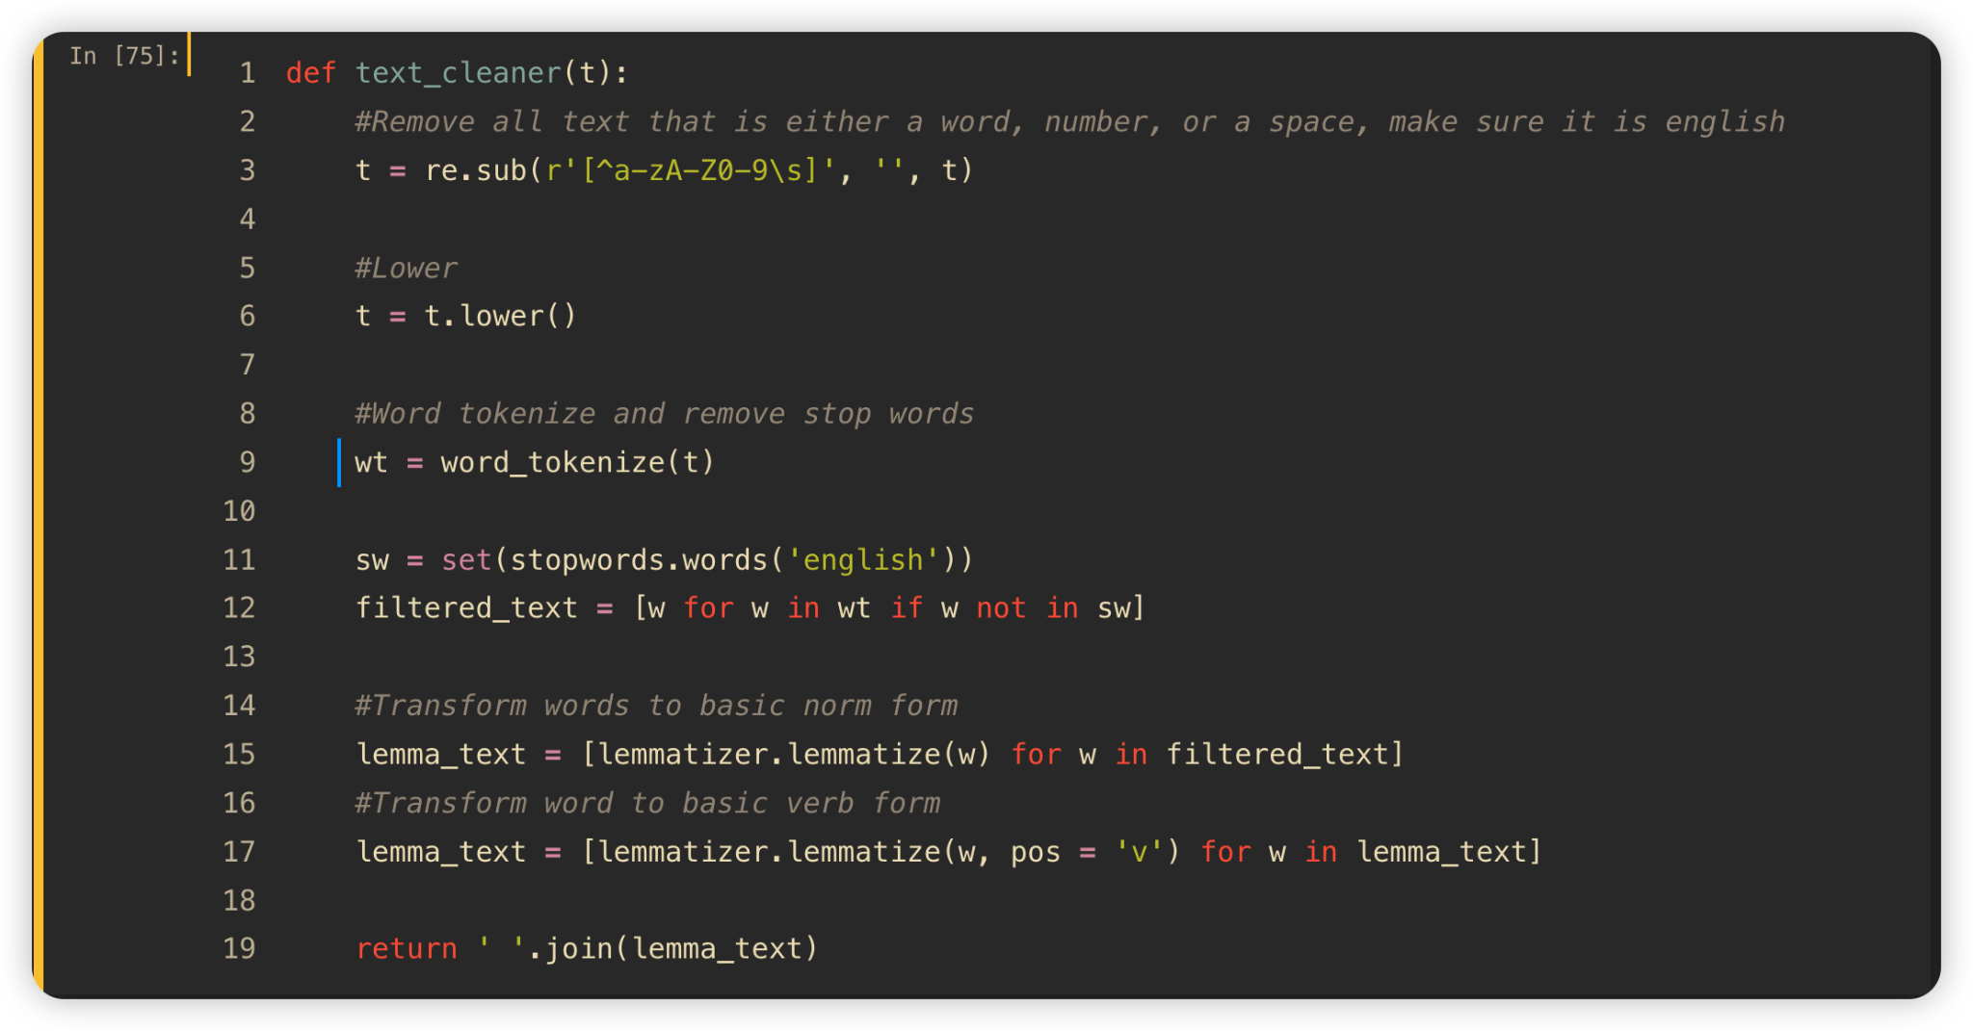
Text Cleaning

Slide 9
Text Cleaning
content \
1 I love this app so much, I've been using Spoti...
2 Perfect
3 Best all around music streaming app I have use...
4 Are y'all fr gatekeeping the play button on so...
5 Loved it
clean_content
1 love app much ive use spotify 2 year different...
2 perfect
3 best around music stream app use family plan g...
4 yall fr gatekeeping play button song
5 love

Slide 10
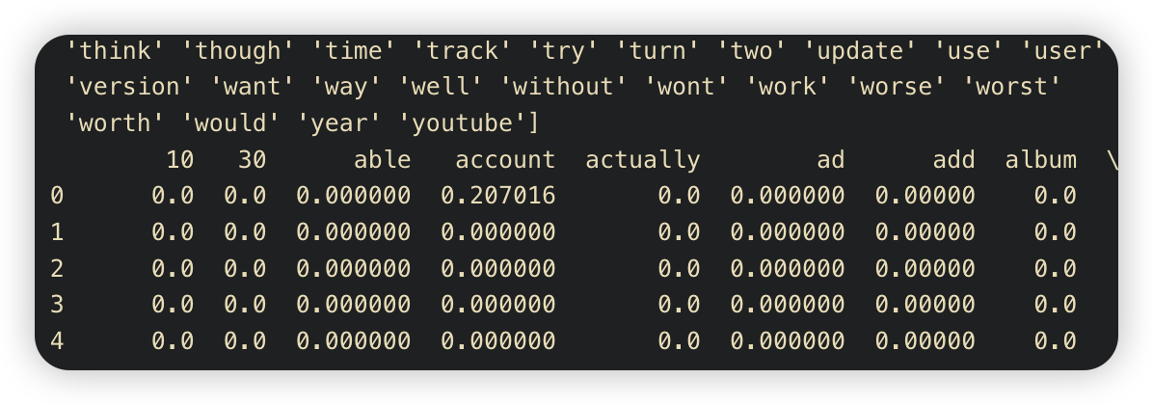
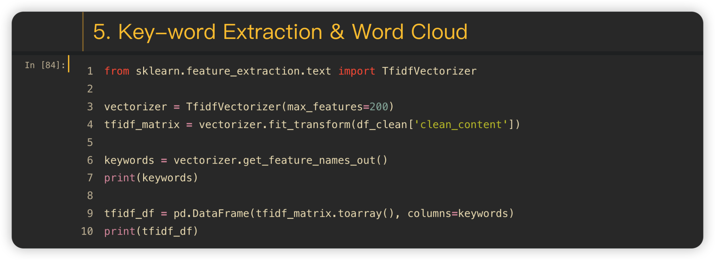
Keyword Extraction

Slide 11
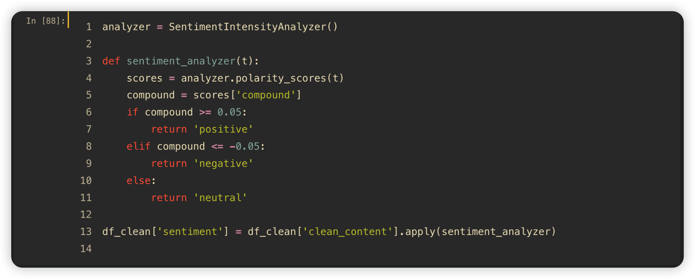
Sentiment Analysis

Slide 12
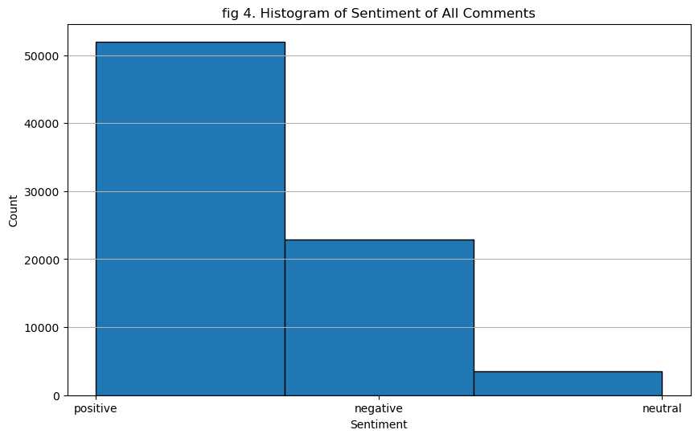
Sentiment Analysis

