Slide 1
DS5110-Final Project
Pengli Shao
Sentiment Analysis and Future App Score Prediction
of User Feedback Across Different Version of Spotify

Slide 2
Problem Description
The review comment and score is the key to determine whether a new version of an app is successful or not. As a mainstream music app, Spotify has tons of comments that contains hidden messages/information that can help it to improve it’s app in next version.
This project will identify and analyze the users’ sentiment from it’s comment by Bert, locate the problem of the app by keyword extraction and topic modeling.

Slide 3
Literature Review
In How do users like this feature? a fine grained sentiment analysis of app reviews. [1] by Guzman and Maalej, 2014, they conducted a sentiment analysis and topic modeling research on 32,210 reviews from 7 apps on IOS and Android. Their average precision is about 51% and the maximum percision is about 91%, their maximum recall is 73% and the average recall is also 51%. However, they used a tool called SentiStrength that is design for sentiment analysis for short and low quality contents based on rules and dictionary.

Slide 4
Literature Review
In this project, I used BERT(Bidirectional Encoder Representations from Transformers), a model developed by Google in 2018 that read the content from both direction in pre- training. In BERT: a sentiment analysis odyssey [2] by Alaparthi and Mishra, they conducted sentiment analysis for 50,000 reviews and used 4 kinds of sentiment analysis tools including BERT. They found out that precision of Bert for sentiment analysis is 92.35%, and the recall score of 92.31% represents BERT is capable of correctly identify users’ sentiments. The major different of BERT and all other rule & dictionary based sentiment classifiers is that BERT is a unsupervised model that is pre-trained by large datasets like Wikipedia, and it is capable of reading the content from both direction to understand the context.

Slide 5
Methodology
Keywords Extraction & Word Cloud
Visualization of Sentiment Analysis
Topic Modeling & Analysis
Data Cleaning
Text Cleaning
Sentient Analysis
Drop rows that contain NA values
Text mining by using nltk and re.
Analyze sentiment of each comment
Extract keywords based on TF-IDF
Visualize the results of sentiment analysis
Topic modeling by LDA and analysis negative topics
Different Packages:
vaderSentiment.SentimentIntensityAnalyzer
TextBlob
transformers
Used TfidfVectorizer from sklearn.feature_extraction.text to identify most important keywords in positive reviews and negative reviews. Perform a consistency analyze by rule-based sentiment analysis.
The goal of this project is to analyze the sentiment of user's feedback of different version. Therefore, I do not fill in NA with some value.
Symbol Removing(Does not include question and exclamation mark.
Drop non-English chars
Text tokenize
Text lemmatize
Sentiment trend over time
Score distribution by sentiment
Negative keywords distribution
Find the top 5 negative topics with top 10 negative keywords. Then examine the sample reviews of each negative topic.

Slide 6
Data
Original Spotify review data sets contains 84165 rows
There are 8 columns:
• reviewId
• userName
• content
• score
• thumbsUpCount
• reviewCreatedVersion
• at
• appVersion
Missing values in each column:
reviewId 0
userName 4
content 0
score 0
thumbsUpCount 0
reviewCreatedVersion 5768
at 0
appVersion 5768
dtype: int64

Slide 7
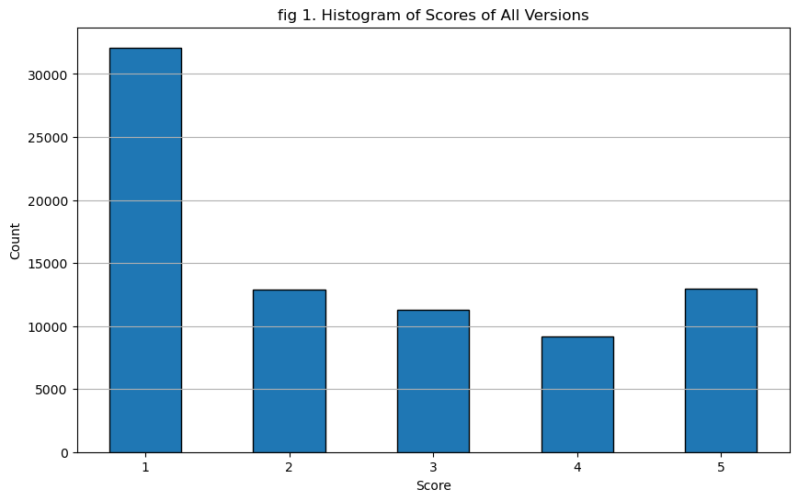
Visualizations for Pre-processing

Slide 8
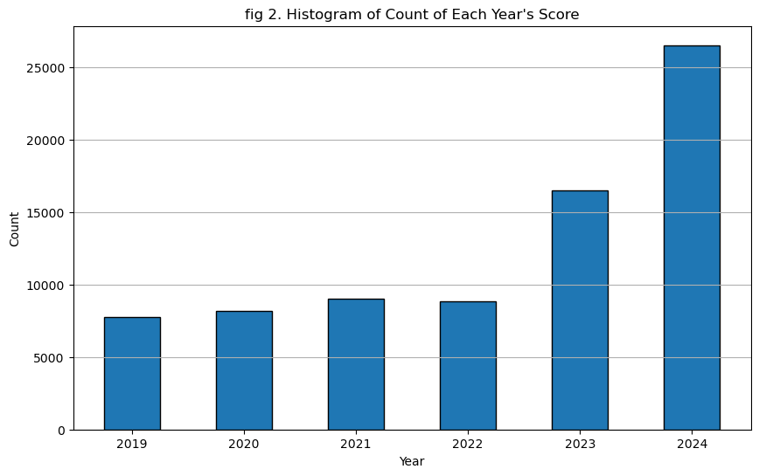
Visualizations for Pre-processing

Slide 9
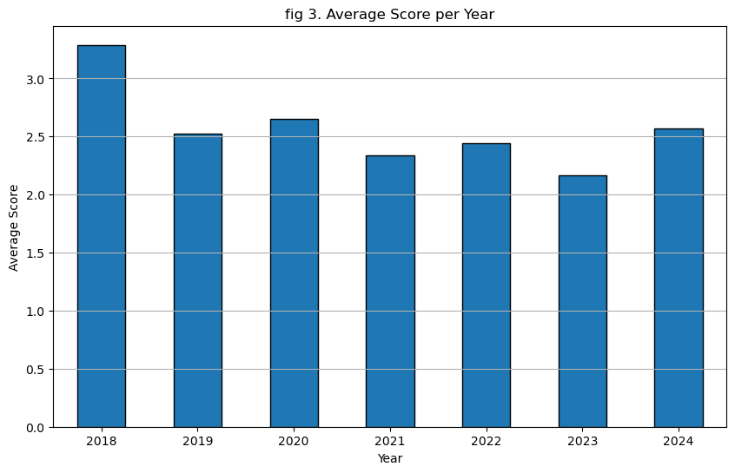
Visualizations for Pre-processing

Slide 10
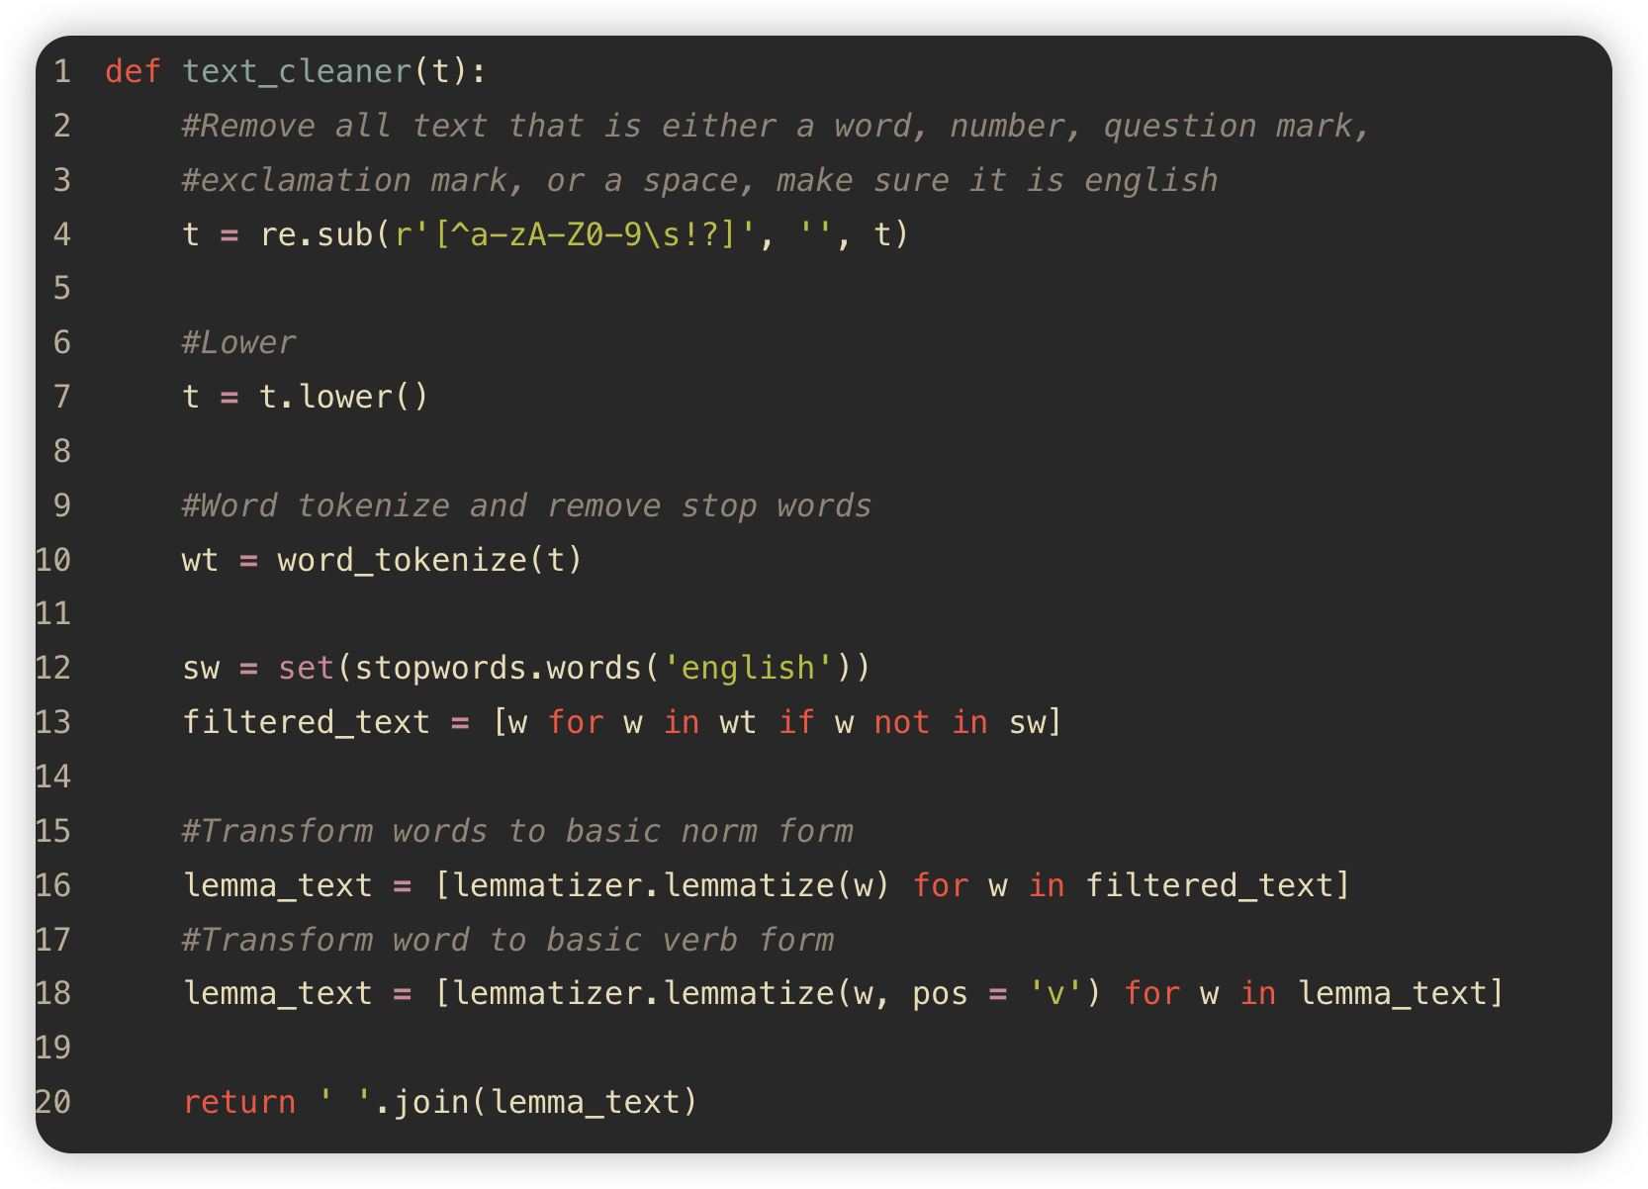
Text Cleaning
Only keep English characters, question mark, and exclamation mark.
Lower the word
Lemmatization

Slide 11
Text Cleaning
content \
1 I love this app so much, I've been using Spoti...
2 Perfect
3 Best all around music streaming app I have use...
4 Are y'all fr gatekeeping the play button on so...
5 Loved it
clean_content
1 love app much ive use spotify 2 year different...
2 perfect
3 best around music stream app use family plan g...
4 yall fr gatekeeping play button song ! ?
5 love

Slide 12
Sentiment Analysis
Vader
A package specifically designed for social media contents, it analyzes the sentiment based on dictionary and rule-based analysis. Very high efficiency but average accuracy.
TextBlob
TextBlob uses pre-train dictionary to classify sentiment of text.
3. Bidirectional Encoder Representations from Transformers(BERT)
A deep learning model developed by Google, it reads the text from left-to-right and right-to-left, which makes it good and understand the context. It’s pre-train data is Wikipedia data. The Hugging Face Transformers package provide an api to attach to a pre-trained Bert model.

Slide 13
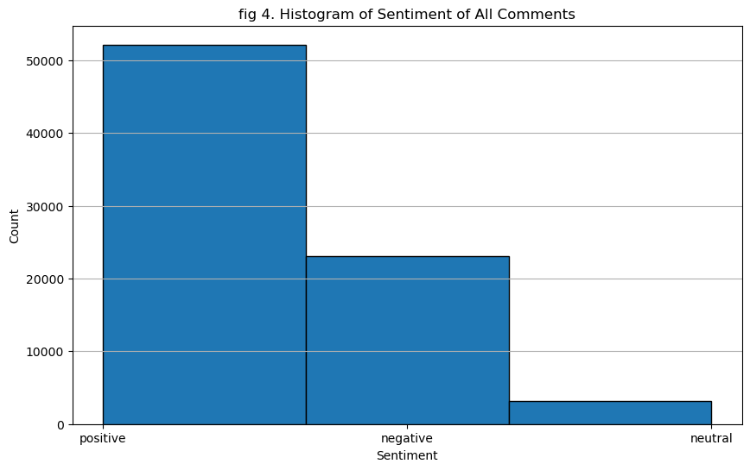
Sentiment Analysis - Vader
Vader suggests more than 60% of the comments are positive.
Problems:
It does not fit the score distribution that about 40% of the score is 1.
It mistakenly identify negative comments as positive.

Slide 14
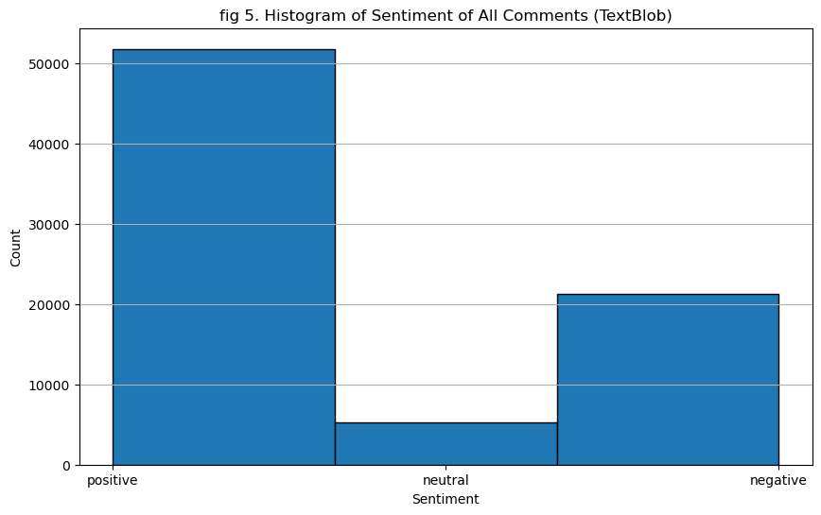
Sentiment Analysis - TextBlob
TextBlob also suggests more than 60% of the comments are positive.
Problems:
Can’t handle “But” situation.

Slide 15
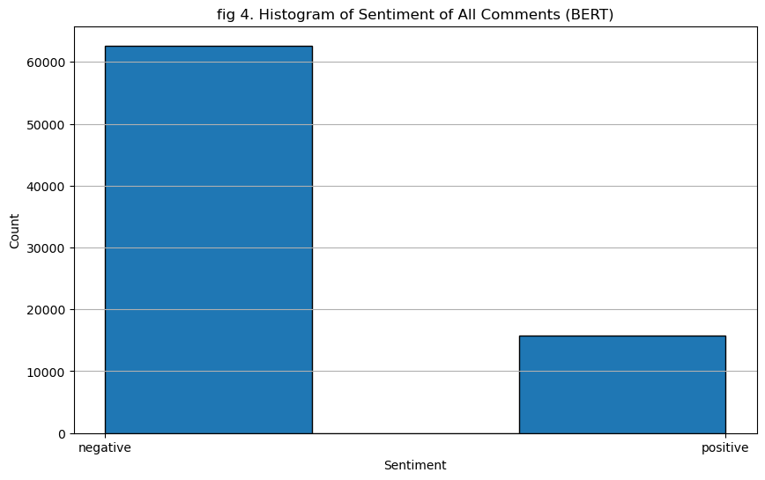
Sentiment Analysis - Bert
Bert suggests that the majority comments is negative:
Pros:
Correctly identify “but” situation.
Understand slangs.
Cons:
Very x10 slow.
It will not consider a comment neutral.
Very sensitive to ”But” situation.

Slide 16
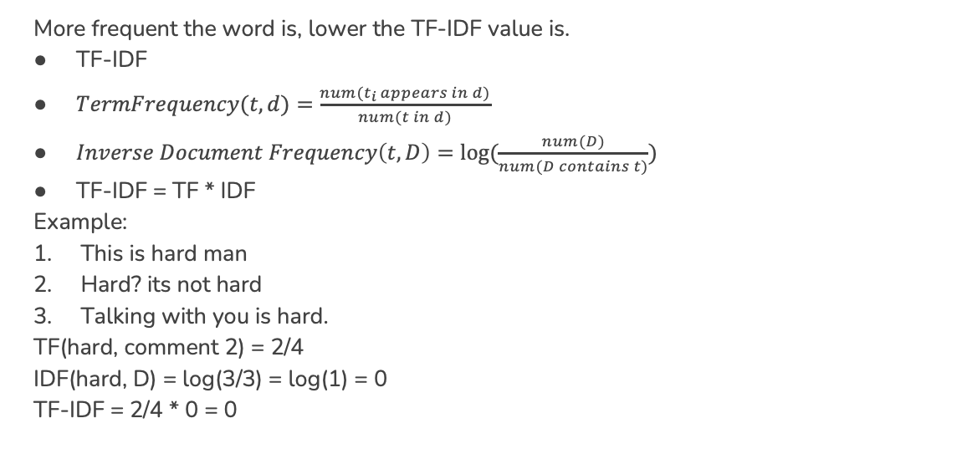
Keywords Extraction
More frequent the word is, lower the TF-IDF value is.
TF-IDF
$TermFrequency(t,d)=\frac{num(t_{i} appears in d)}{num(t in d)}$
$Inverse Document Frequency\left(t, D\right)=log⁡(\frac{num(D)}{num(D contains t)})$
TF-IDF = TF * IDF
Example:
This is hard man
Hard? its not hard
Talking with you is hard.
TF(hard, comment 2) = 2/4
IDF(hard, D) = log(3/3) = log(1) = 0
TF-IDF = 2/4 * 0 = 0

Slide 17
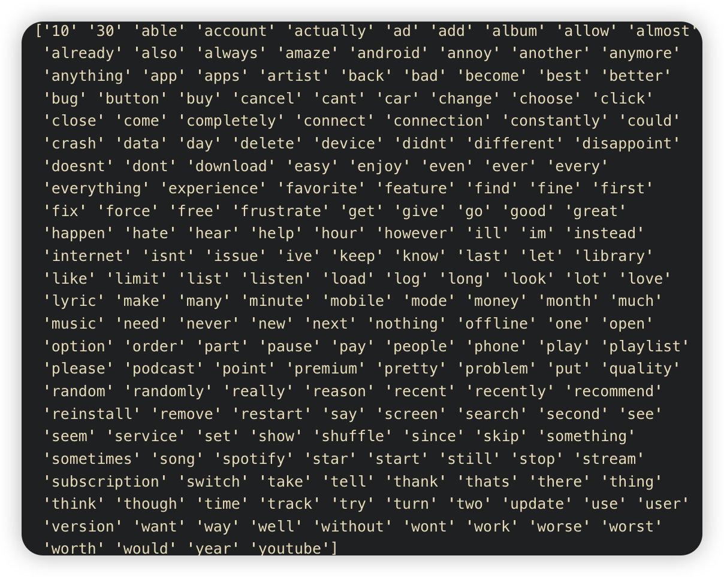
Keywords Extraction Most Important 200 words

Slide 18
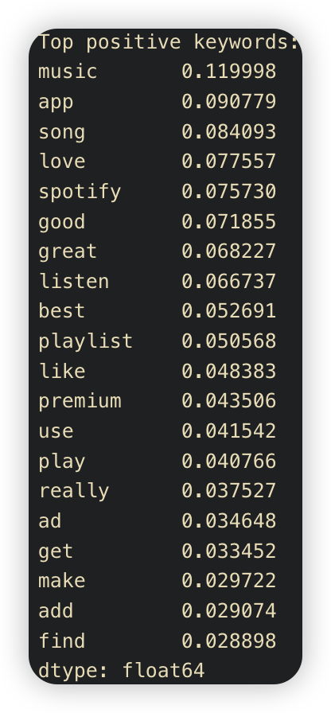
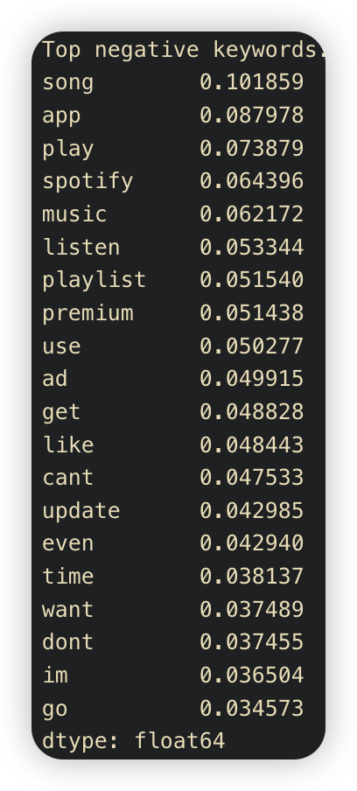
Keywords Extraction
Top 20 positive words
Top 20 negative words

Slide 19
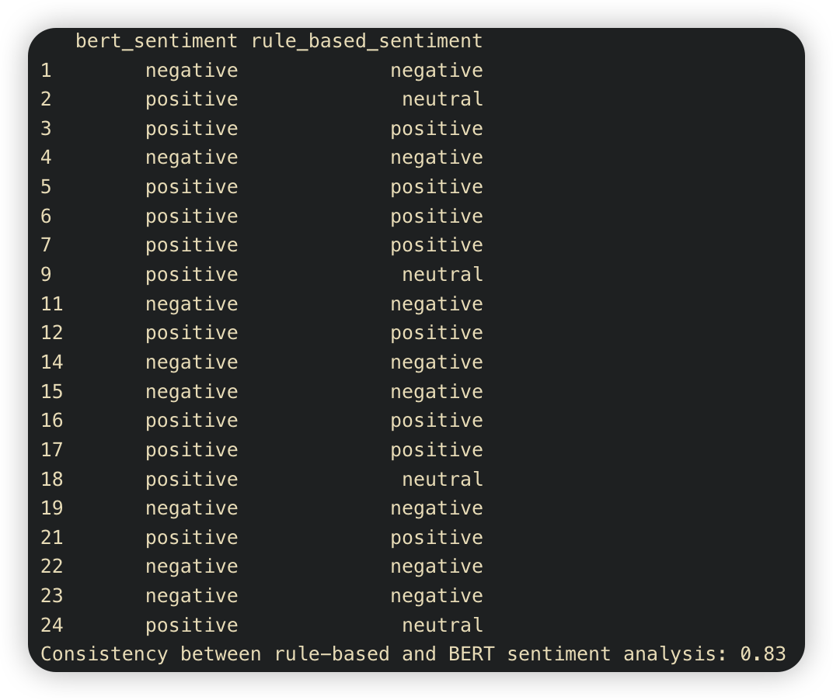
Keywords Extraction Consistency analysis - rule based VS bert
Rule-based sentiment analysis collect all the 200 keywords by TF-IDF.
Split comments into positive comments and negative comments.
Then calculate the average TF-IDF value in positive and negative.
If val(TF-IDF_positive) > (TF-IDF negative): positive;
Elif val(TF-IDF_positive) < (TF-IDF negative): negative;
Else: neutral
#Provide ”neutral” conments

Slide 20
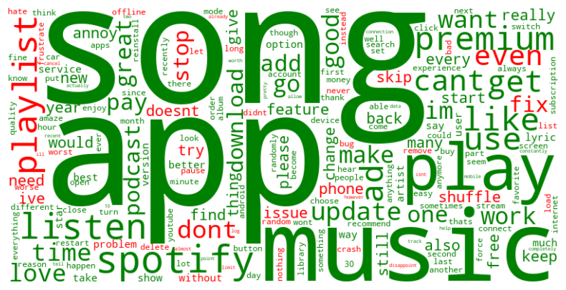
Word Cloud – BertB

Slide 21
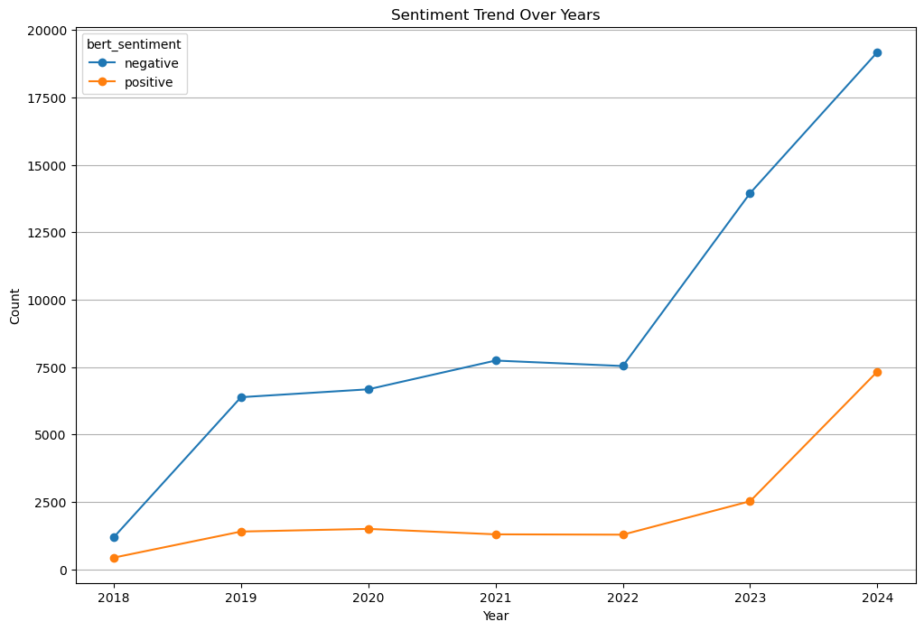
Data Visualization Sentiment Trend Over Time

Slide 22
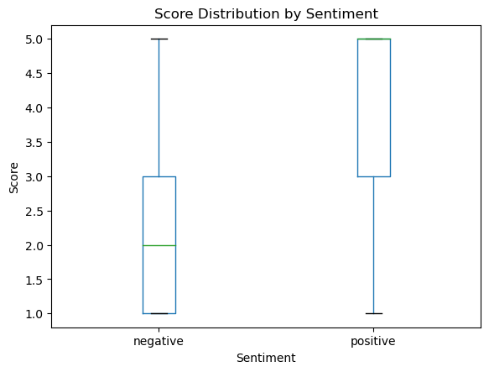
Data Visualization Score Distribution by Sentiment

Slide 23
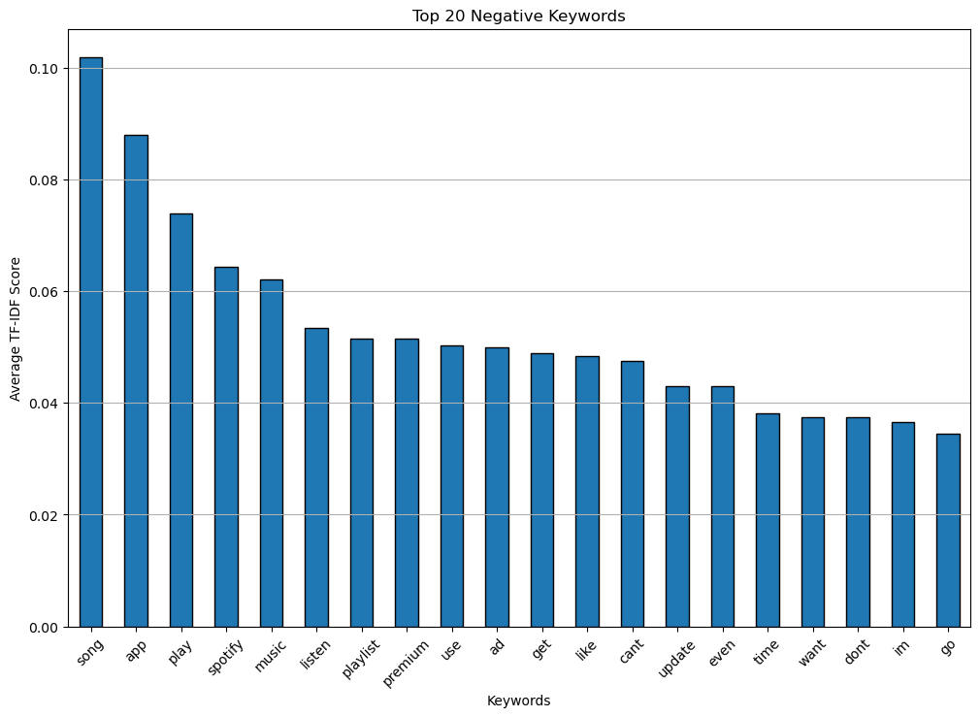
Data Visualization Negative Keywords Distribution

Slide 24
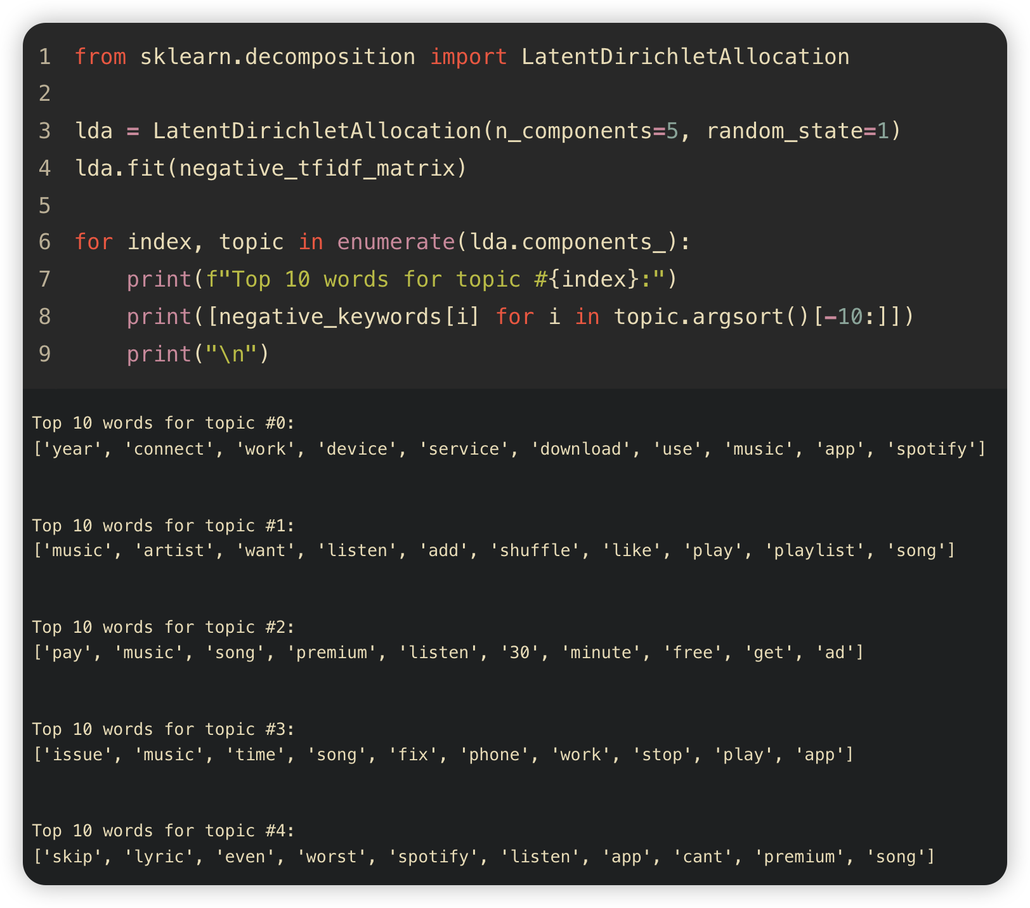
Topic Analysis – Topic Modeling
1. Generate topics by defined number
Each word will be assigned to a topic randomly, then update the keywords in each topic by iteration.
Ex: a. I love burger
b. chips are the best
c. I hate fish
Topics: 1. Food: Burger, Chips, Fish
2. Sentiment: Love, hate
By topic modeling, we can find the top 10 keywords of most common topics for negative reviews and find out the main issue that our user is experiencing.

Slide 25
Discussion
In our findings, the correlation of user’s sentiment and review score is 0.5179, which is very close to the correlation tested in Guzman and Maalej’s research [1] of 0.592. There- fore, our assumption that user’s sentiment will not be revealed by review score is not fully supported.
The reason that this research do not present the precision and recall score is because the data used in Alaparthi and Mishra’s research [2] already classified each review’s sen- timent.

Slide 26
Literature Review
The intersection of topics is inevitable for apps that do not contains lots of features, espicially for music app like spotify. Guzman and Maalej’s research [1] also pointed out that they have the same problem of similar topics, one of the potential solution is to lower the number of the topics.

Slide 27
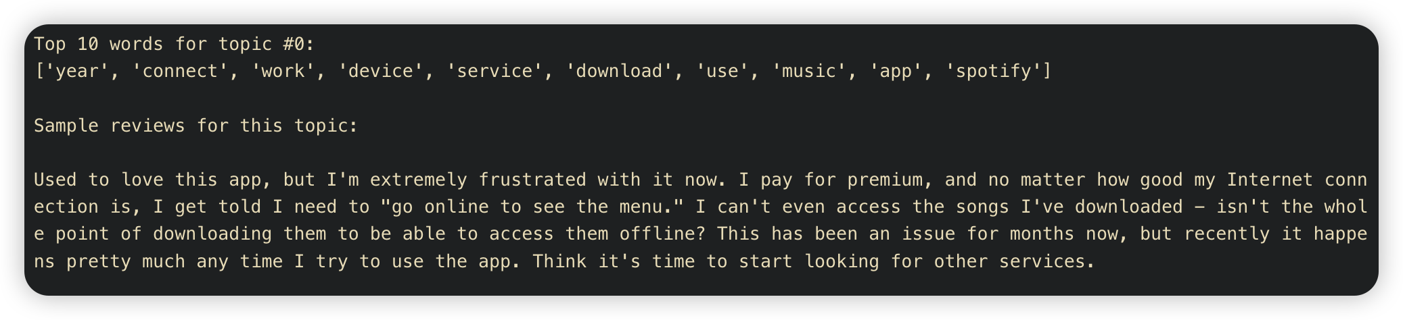
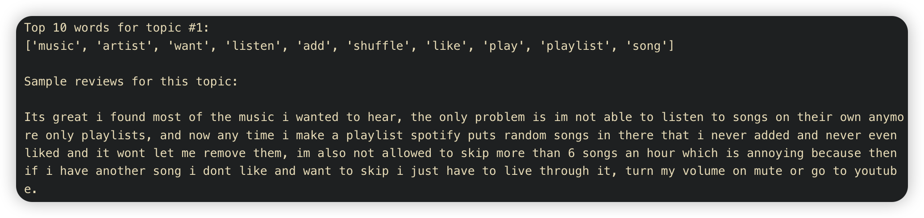
Topic Analysis – Results

Slide 28
References
[1] Guzman, E., & Maalej, W. (2014, August). How do users like this feature? a fine grained sentiment analysis of app reviews. In 2014 IEEE 22nd international require- ments engineering conference (RE) (pp. 153-162). IEEE.
[2] Alaparthi, S., & Mishra, M. (2021). BERT: A sentiment analysis odyssey. Journal of Marketing Analytics, 9(2), 118-126.

