Slide 1
Car Price Prediction Using Machine Learning Techniques
DS5220 - Supervised Machine Learning
Pengli Shao

Slide 2
Introduction - Background Information
In the used car market, many websites or companies provide users with estimated prices for cars that are for sale and preparing to sell. These price estimators greatly help buyers and sellers in the used car market to estimate the value of a vehicle.
After all, each used car has different conditions, and some of these conditions can significantly affect the price of the vehicle.

Slide 3
Introduction - Objectives and Goals
The goal of this project is to find the best fit model for used car price prediction by building multiple models and optimize the performance of these models.

Slide 4
Introduction - Data Structure
This data contains 55,839 rows of data from 1990 to 2015:
Year
Make
Model
Trim
Body
Transmission
Vin
State
Condition
Odometer
Color
Interior
Seller
MMR
Sellingprice
Saledate

Slide 5
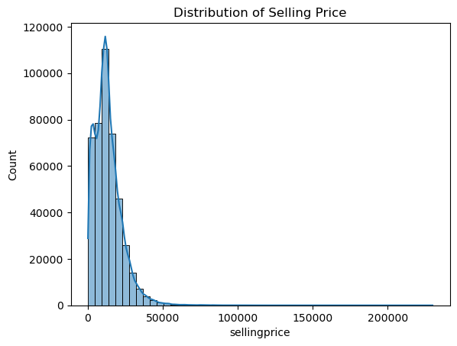
Introduction – Data Structure
Extremely left-skewed
Lots of outliers
472,325 data points after cleaned

Slide 6
Literature Review - Used Cars Price Prediction Using Supervised Learning Techniques
A research conducted by Venkatasubbu and Ganesh in 2019 used multiple regression model, lasso regression model, and regression tree(Decision Tree Model) to predict the used car price. I noticed that although the error of their models are all below 5%, but the data they used is from 2005 GM cars and only contains 804 rows of data. This research provided a comprehensive comparison on different model but it does not include random forest and the data is out-of-date. The going price of used car varies every year so I do not think their prediction still fits the current market.

Slide 7
Literature Review - Used Car Price Prediction Using Machine Learning: A Case Study
In another research conducted by Hankar and Birjali, they predicted the used cars price in Morocco by using 8000 rows of data and 4 models - K-nearest neighbors regressor, random forest regressor, gradient boosting regressor, and artificial neural network based regressor. The highest R-squared value is GBR of 0.80, and the RMSE for all model is higher than 40,000.
In my opinion, the independent variables are not enough to capture the pattern of used car price. (mileage, fuel type, production year, mark, model, and fiscal power).
Those researches make me realize that used car price prediction is a difficult topic.

Slide 8
Methodology – Data Cleaning
Dropped ‘seller’, ‘saledate’, ‘state’, ‘vin’ columns
Dropped all NA values
Dropped rows with selling price equal to 1
Dropped rows with abnormal odometer(greater than 800,000 and lower than 100)
Dropped all rows that exterior color and interior color is number or symbol
Checked for duplicates

Slide 9
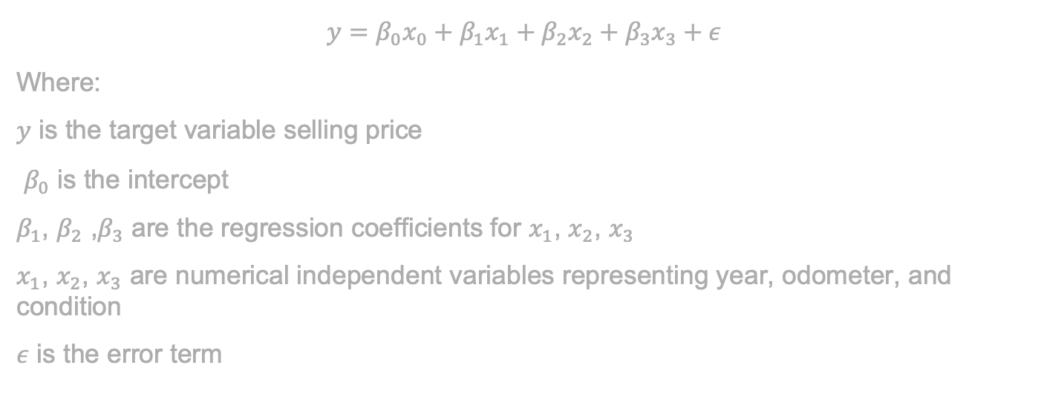
Methodology - Multiple Linear Regression
$$y=β_{0}x_{0}+β_{1}x_{1}+β_{2}x_{2}+β_{3}x_{3}+ε$$
Where:
$y$ is the target variable selling price
$β_{0}$ is the intercept
$β_{1}$, $β_{2}$ ,$β_{3}$ are the regression coefficients for $x_{1}$, $x_{2}$, $x_{3}$
$x_{1}$, $x_{2}$, $x_{3}$ are numerical independent variables representing year, odometer, and condition
$ε$ is the error term

Slide 10
Methodology – Multiple Regression with Lasso and Ridge K-fold Cross Validation
I used lasso and ridge for regularization to prevent overfitting. Lasso and Ridge add a objective function to lower the regression coefficient of each variable.
Then, I implemented K-fold to fully prevent the possibility of overfitting for my multiple regression model. The k was set to 5 and shuffled. The goal of this method is to fully denied the possibility of overfitting.

Slide 11
Methodology – One-Hot Encoding
To further optimize multiple regression model, adding more features is one of the solution, I used One-Hot encoding to transfer all categorical variables to Booleans.
Ex: color = [‘red’, ’blue’, ’gray’]
 | Color_blue | Color_red | Color_gray
0 | 0 | 1 | 0
1 | 1 | 0 | 0
2 | 0 | 0 | 1

Slide 12
Methodology – Decision Tree and Random Forest
I implemented decision tree regressor, it is a tree type structure supervised machine learning algorithm that input the date from root node, split the data at each internal nodes, and output the result from leaf node.
Decision Tree regressor can capture non-linear relationship, but overfitting is a inevitable problem. Therefore, random forest regressor, which generate multiple decision trees and take the average of the results of all decision trees to reduce the possibility of overfitting.

Slide 13
Methodology – Performance Measurements
Mean Squared Error – the average of the squared differences between p and a
Mean Absolute Error – the avg of the abs differences between p and a
R-squared – indicates the proportion of the target variable that can be explained by independent variables
RMSE – Root of MSE

Slide 14
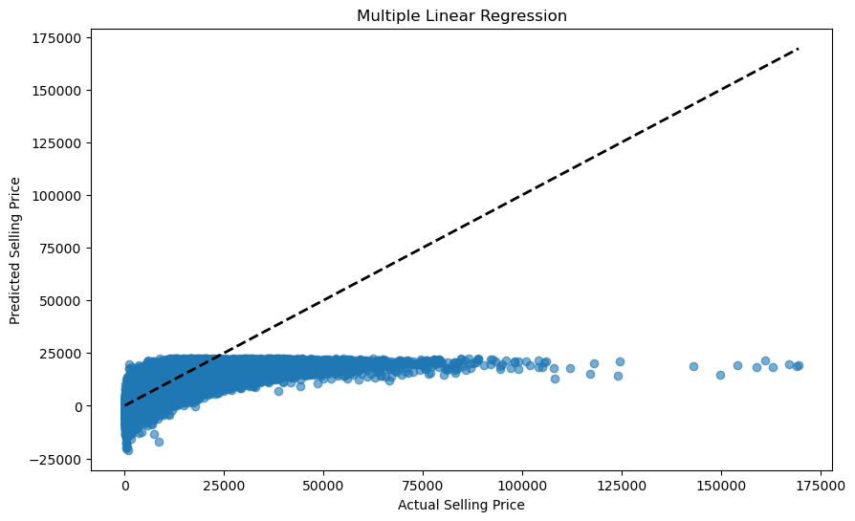
Analysis and Results – MLR
MSE: 54608852.22
MAE: 5086.46
R^2: 0.40
RMSE:7389.78

Slide 15
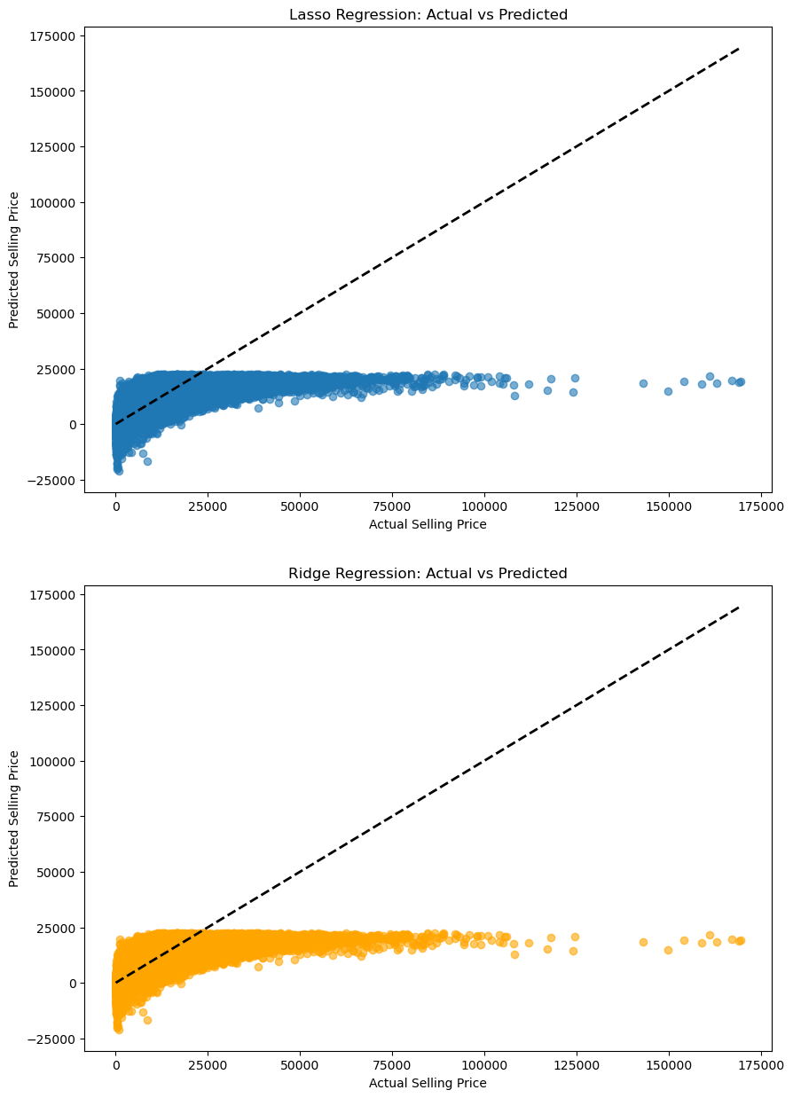
Analysis and Results Lasso and Ridge
Lasso:
MSE: 54608853.38
MAE: 5086.46
R^2: 0.40
RMSE: 7389.78
Ridge:
MSE: 54608852.24
MAE: 5086.46
R^2: 0.40
RMSE: 7389.78

Slide 16
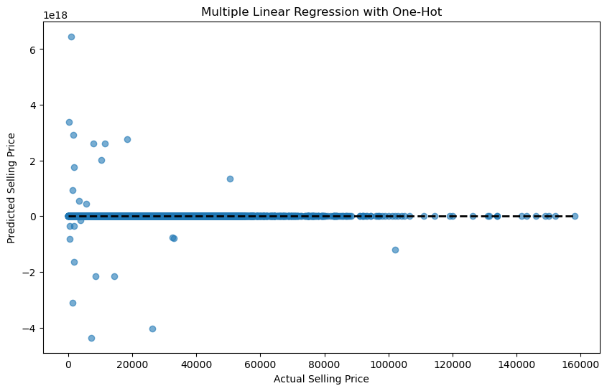
Analysis and Results – MLR with One-Hot
MSE: 1.7550106787134506e+33 MAE:
567534496073094.2
R^2:
-1.952400731737232e+25 RMSE: 4.189284758420524e+16

Slide 17
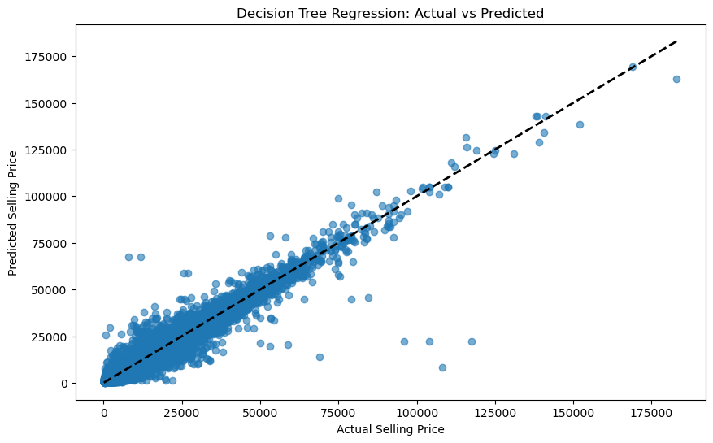
Analysis and Results – Decision Tree Regressor
MSE: 4254711.175258203 MAE: 1286.0819851933095 R^2: 0.9525269189658437 RMSE: 2062.695124166003

Slide 18
Analysis and Results – Random Forest
MSE: 2198737.8696241416 MAE: 949.5651954231788 R^2: 0.9757051241704635 RMSE: 1482.8141723169972

Slide 19
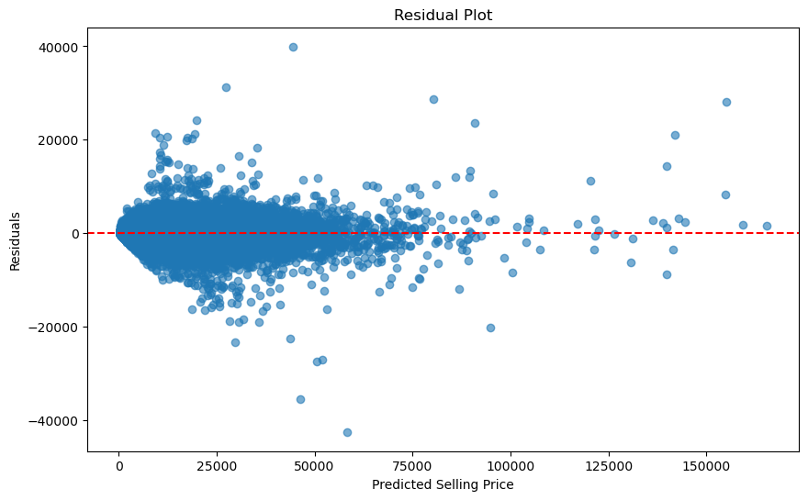
Discussion - Conclusion
Good at predicting price between 25,000 to 75,000

Slide 20
Discussion - Why
CURSE OF DIMENSION
100 Features, 10 possible values 1000 new columns
color
red
blue
gray
 | Color_blue | Color_red | Color_gray
0 | 0 | 1 | 0
1 | 1 | 0 | 0
2 | 0 | 0 | 1

Slide 21
Discussion - Why
Non-linear relationship
2023 Honda civic: $26,000
2022 Honda Civic: $23,000
2011 Honda Civic LX: $8500
2010 Honda Civic LX: $8500

Slide 22
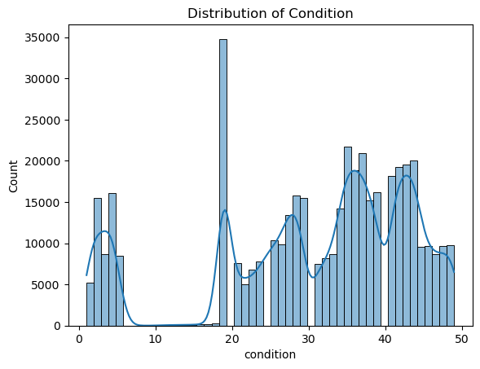
Discussion - Limitations
Model needs to update
Computing resources
Low Interpretability
Variable ‘Condition’ is unclear

Slide 23
References
Venkatasubbu, P., & Ganesh, M. (2019). Used cars price prediction using supervised learning techniques. Int. J. Eng. Adv. Technol.(IJEAT), 9(1S3).
Hankar, M., Birjali, M., & Beni-Hssane, A. (2022, May). Used car price prediction using machine learning: A case study. In 2022 11th International symposium on signal, image, video and communications (ISIVC) (pp. 1-4). IEEE.

