Slide 1

Building a Light-weight Sentiment & Sarcasm Classifier
Pengli Shao

Slide 2
Motivation - Scenario
Accurate sentiment recognition plays an important role in product market analysis and software updates. Yet much of the web comments, posts, reviews, and tweets contains memes, sarcasm, and rhetorical questions, which often cause analysis tools to misclassify users’ emotions
    For example, YouTube users complain that non-subscribers have to watch a minute-long ads before watching videos. YouTube ”fixes” the issue by splitting the ad into three 20-second segments inserted at different points in the video. At this point, a comment like “Great Job, Einstein” could be misclassified as positive by analysis tools.

Slide 3
Motivation - Problem
Currently, strong performance on both sentiment and sarcasm detection is mostly achieved by large base foundation models, which require substantial resources usage and long inference time.
So, how to identify users’ sentiment and sarcasm accurately and fast is crucial for certain tasks.

Slide 4
Project Goal
Fine-tune a light-weight model for sentiment & sarcasm classifier task for comments/posts/tweets/reviews:
  Llama 3.1-8B-Instruct
  Qwen 2.5-7B-Instruct

Slide 5
Data - Source
Sentiment data:
  TweetEval – Sentiment task
  MARC
  Stanford Sentiment Treebank (SST-5)
Sarcasm data:
  iSarcasmEval
  TweetEval – Irony Task
  SemEval2018

Slide 6
Data - Proprocessing
Language detection (English only)
Emoji to UTF-8
Short text deletion
  Short text ratio: Sentiment: 0.0003 Sarcasm: 0.0069
Check and remove Nas
Unified label (Sentiment: 0 = neg, 1 = neu, 2 = pos; Sarcasm: 0 = non-sarcastic, 1 = sarcastic)
Train test split + validation subset for model evaluation
Duplicate data removal by SimHash
Garbled data
  Garbled rate: Sentiment: 0.0 Sarcasm: 0.001

Slide 7
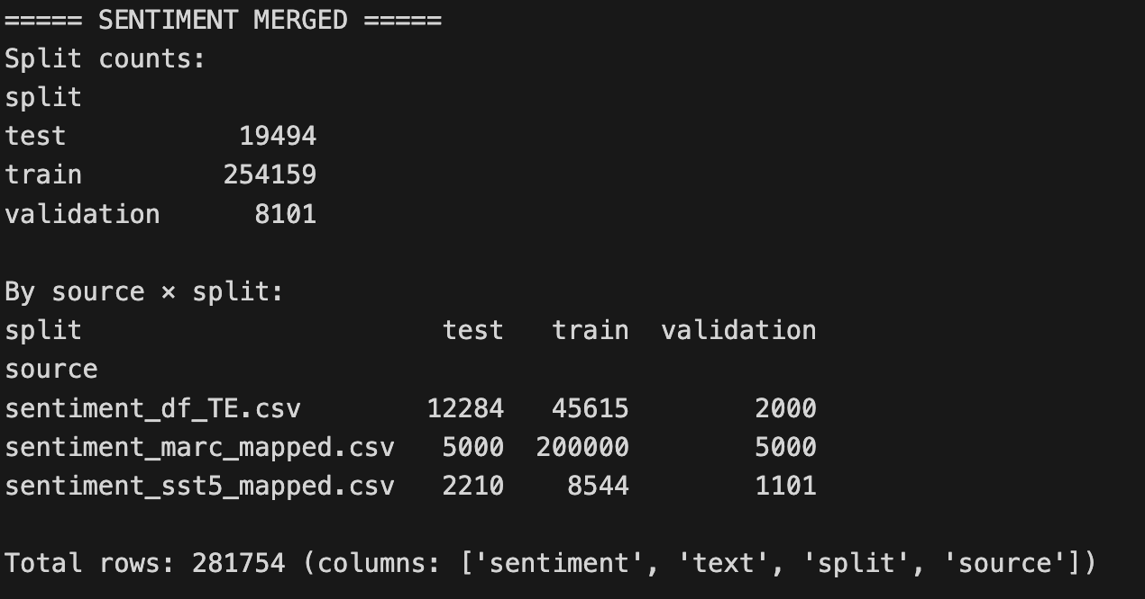
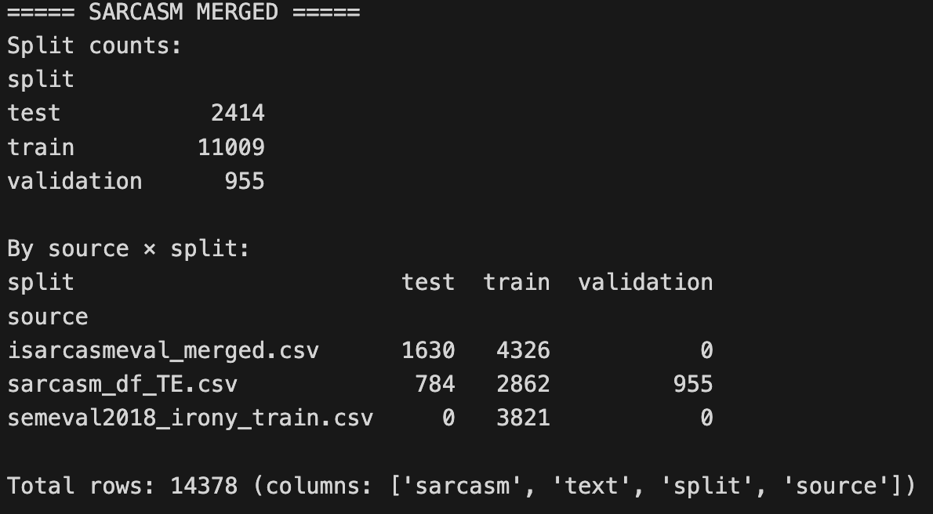
Data – General Info
Sentiment Data General Information
Sarcasm Data General Information

Slide 8
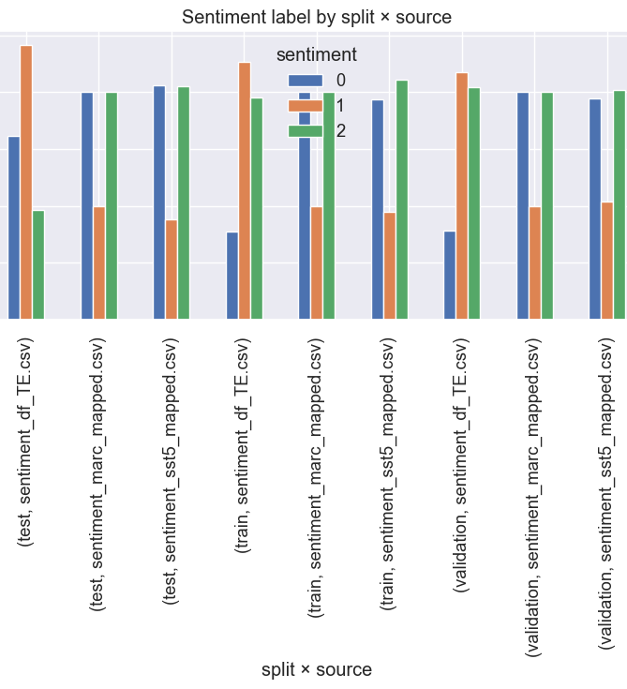
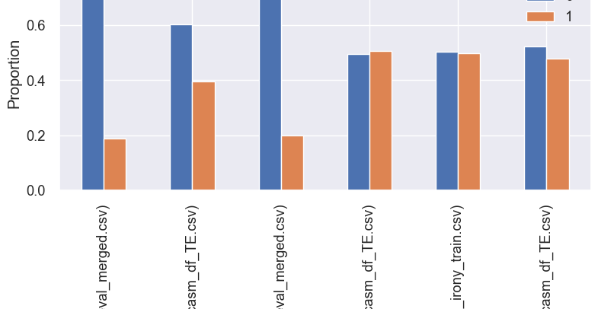
Data – Label Distribution
Problem: Class Imbalance and Distribution Shift
We use stratified sampling to solve this problem, split the data into different groups by (source, label)

Slide 9
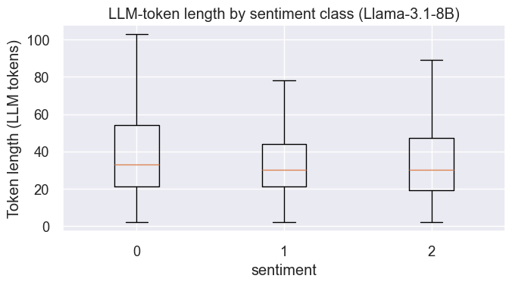
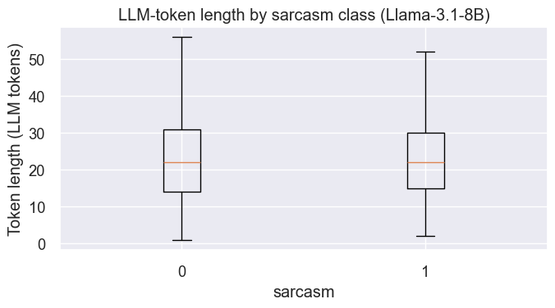
Data – Token Length
Based on the token-length distribution and hardware constraits, we decided to set the training maximum sequence length at 128 tokens.

Slide 10
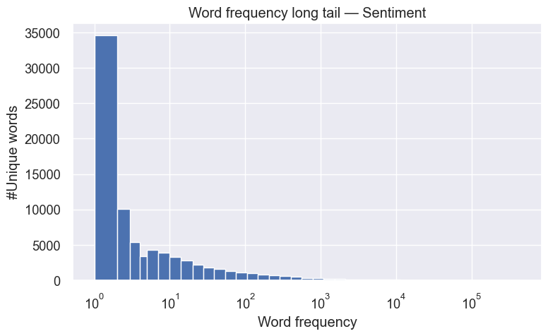
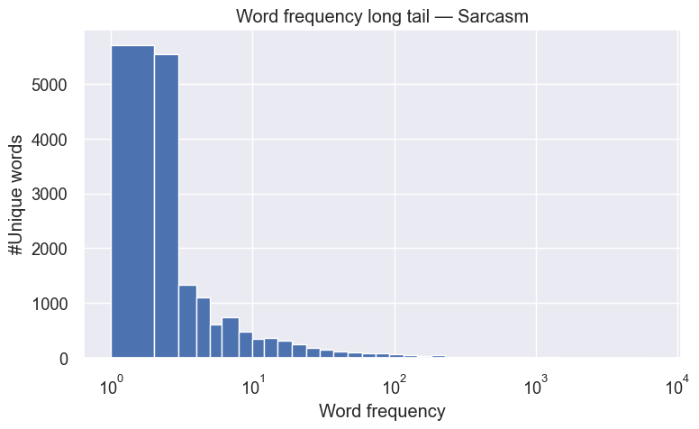
Data – Word Frequency Long Tail Distribution
Problem: Long-tail word frequency leads to sparsity and memorization, poor cross-domain generalization, noisy tokenization, and inefficient memory usage.
To solve the problem of long tail distribution, we decided to split hashtags into words by Camel Case Segment (“#HappyBirthdaySomeGuy” -> “happy birthday some guy”); Replace all @SomeUser -> <USER>, all url -> <URL>, and add those special tokens to tokenizer.

Slide 11
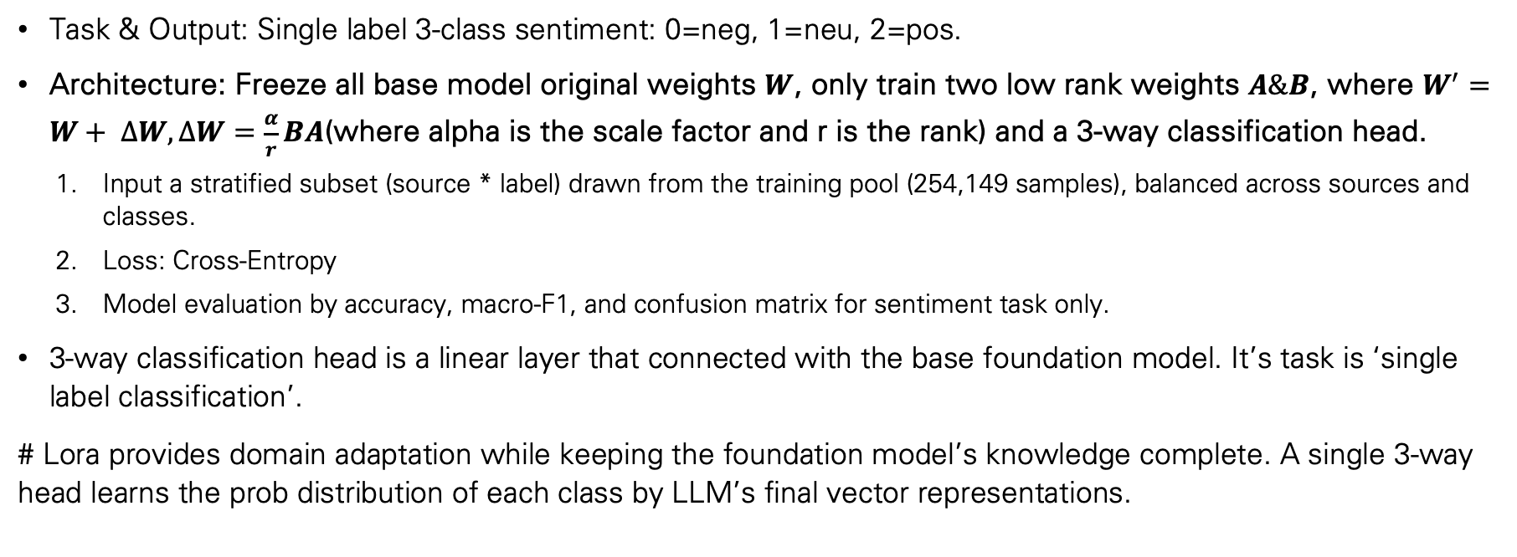
Methology – Stage 1
Task & Output: Single label 3-class sentiment: 0=neg, 1=neu, 2=pos.
Architecture: Freeze all base model original weights $W$, only train two low rank weights $A\&B$, where $W^{′}=W+ ∆W, ∆W=\frac{α}{r}BA$(where alpha is the scale factor and r is the rank) and a 3-way classification head.
  Input a stratified subset (source * label) drawn from the training pool (254,149 samples), balanced across sources and classes.
  Loss: Cross-Entropy
  Model evaluation by accuracy, macro-F1, and confusion matrix for sentiment task only.
3-way classification head is a linear layer that connected with the base foundation model. It’s task is ‘single label classification’.
# Lora provides domain adaptation while keeping the foundation model’s knowledge complete. A single 3-way head learns the prob distribution of each class by LLM’s final vector representations.

Slide 12
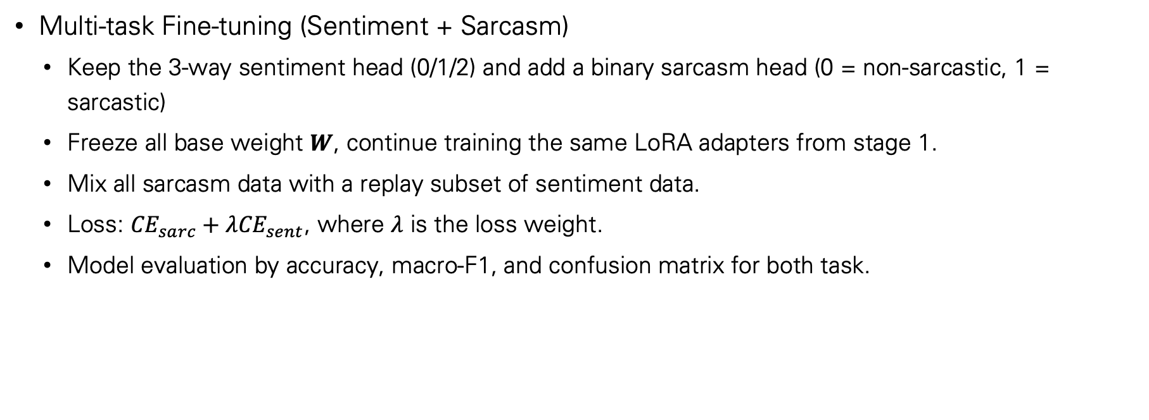
Methology – Stage 2
Multi-task Fine-tuning (Sentiment + Sarcasm)
  Keep the 3-way sentiment head (0/1/2) and add a binary sarcasm head (0 = non-sarcastic, 1 = sarcastic)
  Freeze all base weight $W$, continue training the same LoRA adapters from stage 1.
  Mix all sarcasm data with a replay subset of sentiment data.
  Loss: ${CE}_{sarc}+λ{CE}_{sent}$, where $λ$ is the loss weight.
  Model evaluation by accuracy, macro-F1, and confusion matrix for both task.

Slide 13
Baseline Model – Accuracy and Macro-F1
Our baseline model is the base foundation model Llama-3.1-8B with proper prompt. The model will only output 0/1/2 for sentiment task, 0/1 for sarcasm task.
Task | N | Accuracy | Macro-F1
Sentiment | 8101 | 0.2680 | 0.2090
Sarcasm | 955 | 0.4640 | 0.4140

Slide 14
Baseline Model – Confusion Matrix
Class | Precision | Recall | F1-score
Negative | 0.7143 | 0.1000 | 0.1754
Neutral | 1.000 | 0.0375 | 0.0723
Positive | 0.2340 | 1.0000 | 0.3793
Sentiment Only Task
Class | Precision | Recall | F1-score
Non-sarcastic | 1.0000 | 0.1383 | 0.2429
Sarcastic | 0.4136 | 1.0000 | 0.5851
Sarcasm Only Task
Base foundation model’s performance on validation subset underperforms majority-class accuracy on both tasks, sarcasm macro-f1 is only slightly above baseline due to a near-perfect sarcastic recall, the model tend to classify every document into one specific group showing it is not able to identify both sentiment and sarcasm.

Slide 15
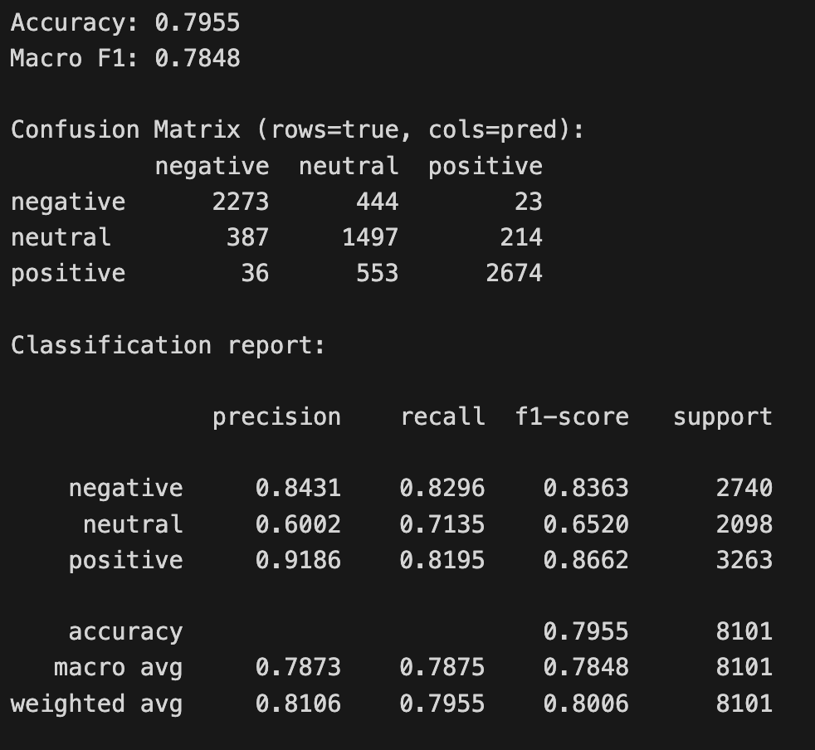
Stage 1 – Accuracy & Macro-F1
In stage 1, we set scaling (lora alpha) equal to 32 to stabilize training and preserve the base model’s behavior.
Also, setting rank to 16 to increase the capacity of the adapter with more parameters and VRAM usages.
We applied LoRA to attention (Q/K/V’s projection) and to the SwiGLU MLP (up/down/gate’s projection).
Overall, the result is promising.

Slide 16
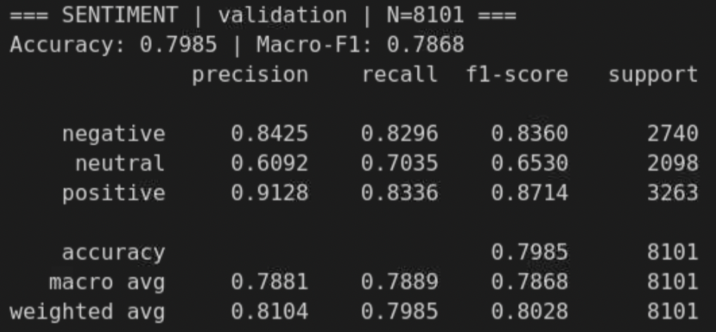
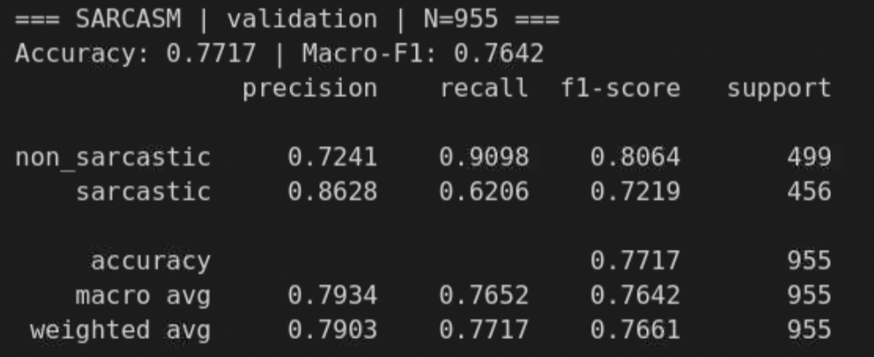
Stage 2 – Accuracy & Confusion Matrix
As we mentioned, the target of stage 2 is to improve the performance of sarcasm classification task without sacrificing too much of the performance of sentiment classification task.
Compare to stage 1, our accuracy actually increased from 0.7955 to 0.7985, over macro-f1 increased from 0.7848 to 0.7868.
Compare to our baseline model, both accuracy and macro-f1 increased for about 30%.
But, the model seems having a hard time identify neutral comparing to identify negative and positive.

Slide 17
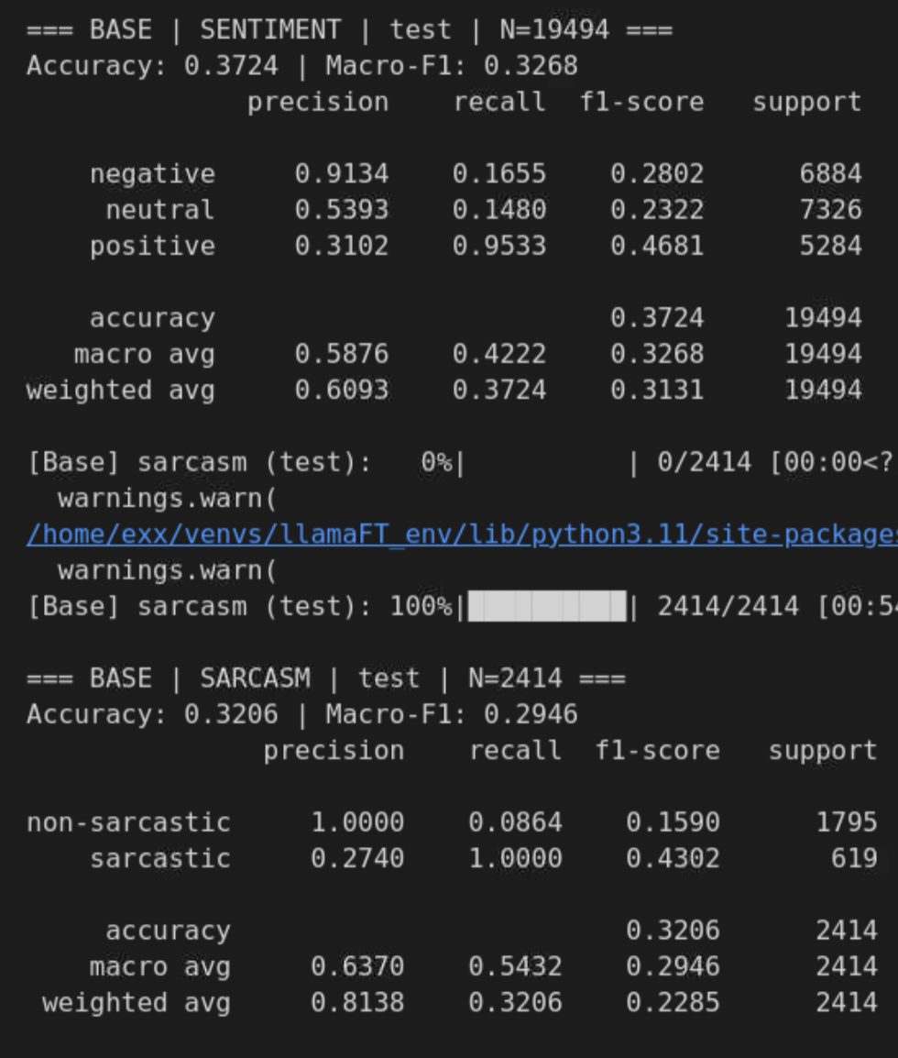
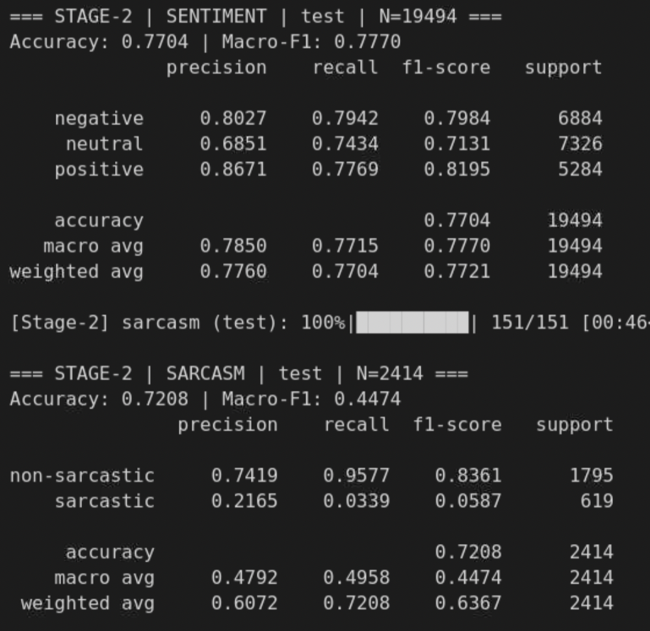
Final Comparison
Baseline
Stage 2
Run sentiment and sarcasm classification task on ‘test’ data subset (unbalanced distribution, like real-life data).
All the stage 2 targets increase for about 40% like what we expected except Micro-F1 for sarcasm task.
From the low precision and extremely low racall of sarcastic class, our fine-tuned model still cannot identify sarcastic text in real-life like dataset.

Slide 18
Conclusion
Compare to our base model, our fine-tuned model’s performance in sentiment and sarcasm task improved for a certain level (20% to 40%).
But, model’s ability in accurately identifying neutral in sentiment task and sarcastic in sarcasm task is still unsatisfactory. Our sampling strategy in training stage of each task has the same number of data of each class make sure that our model should not have bias to some particular class with huge number (such as dataset with 100 positive data, 5 neutral data and 50 negative data).
The reason might be that model is not sensitive to samples with no significant polarity in sentiment training data, and Llama’s pretrain data is not large enough for the model to identify sarcastic without information-rich context, but more tweets and reddit posts require large background info to understand the irony inside short text even for human.

Slide 19
Future Optional Steps
Apply TransMLA technique to further lower the inference time and KV cache usage.
  Llama-3,1-8B is a GQA (Group Query Attention) based model, which means it divides Qs into different groups, each group will share one K and one V. For example, if there are 32 heads, then 32 Qs will be divided into 4 groups, each group will share 1 K and 1 V.
  MLA is an attention variant that projects K/V into a smaller latent space, it saves KV cache without sacrificing too much of the model’s performance.
  TransMLA is a technique that transform GQA based model into MLA based model.
Use multi-objective Bayesian optimization to find the optimal hyper parameters for LoRA.

