Slide 1
使用Google Cloud Platform Kubernetes Engine

Slide 2
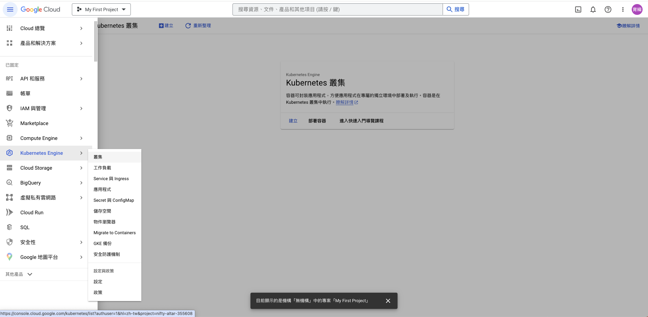
選擇Kubernetes engine on GCP

Slide 3
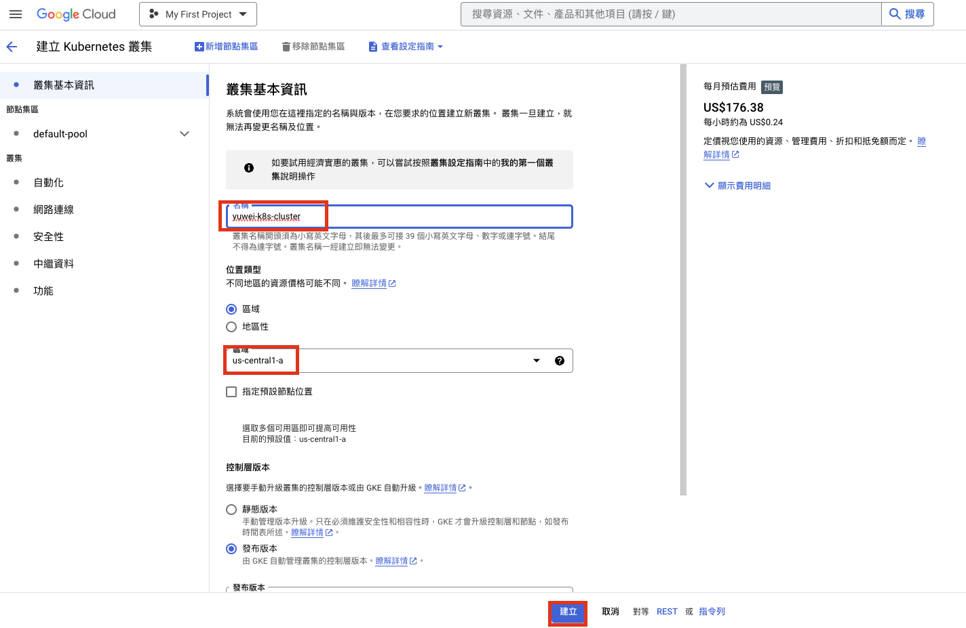
建立GKE

Slide 4
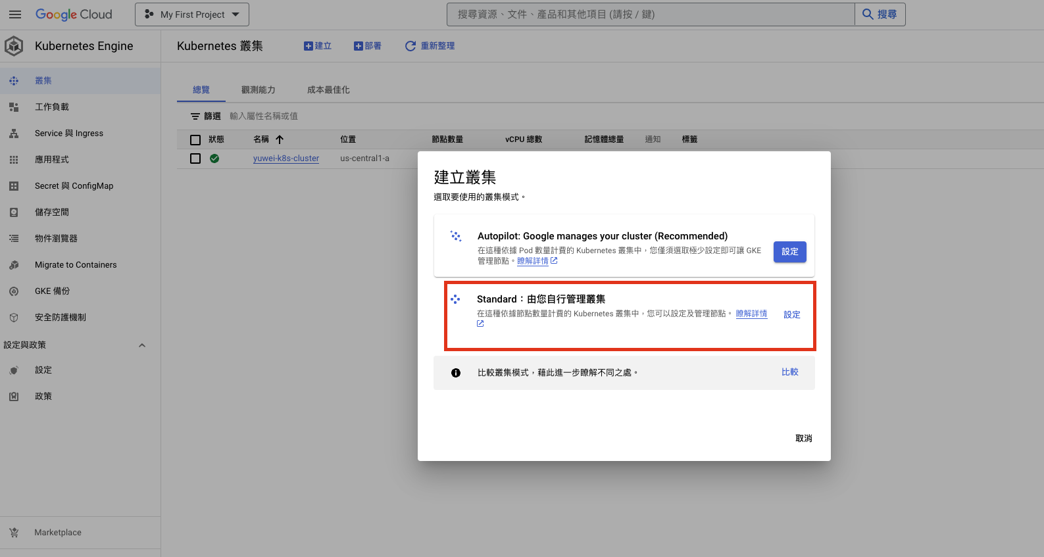
選擇Standard cluster

Slide 5
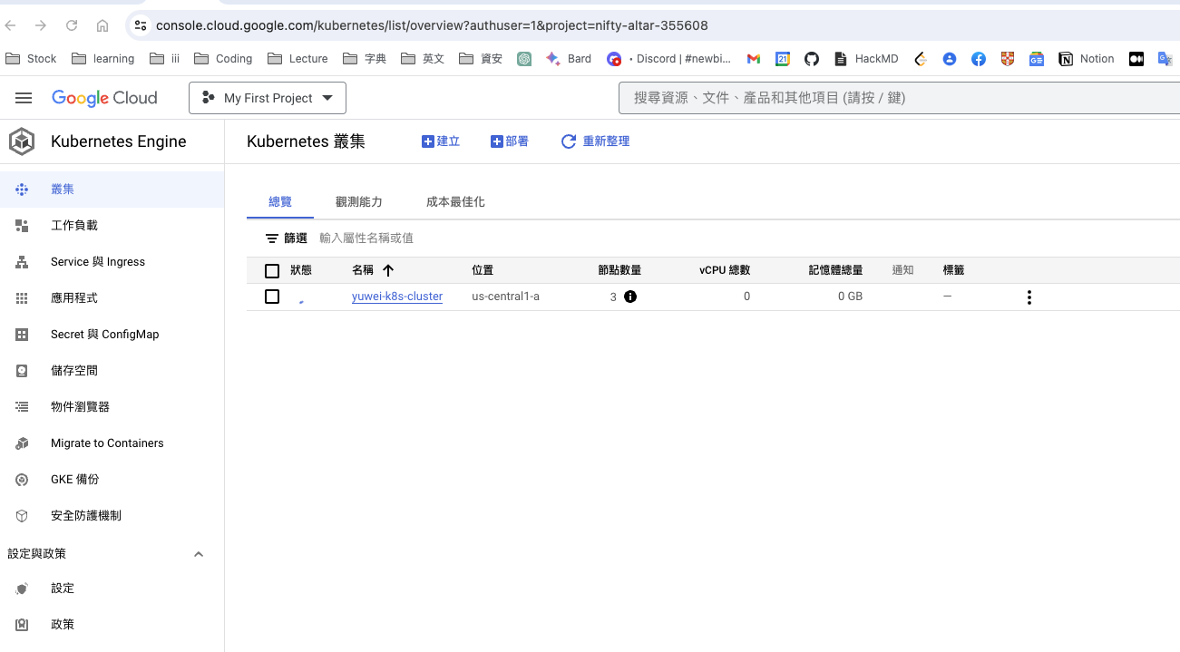
等待 GKE 建立中

Slide 6
Install Google Cloud CLI
For mac
https://cloud.google.com/sdk/docs/quickstart-macos
For windows
https://cloud.google.com/sdk/docs/quickstart-windows

Slide 7
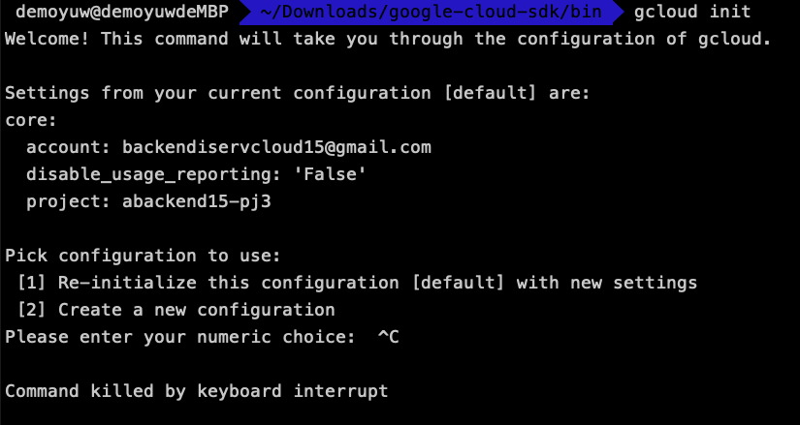
Install Google Cloud CLI
安裝
./google-cloud-sdk/install.sh
初始化
cd google-cloud-sdk/bin/
gcloud init

Slide 8
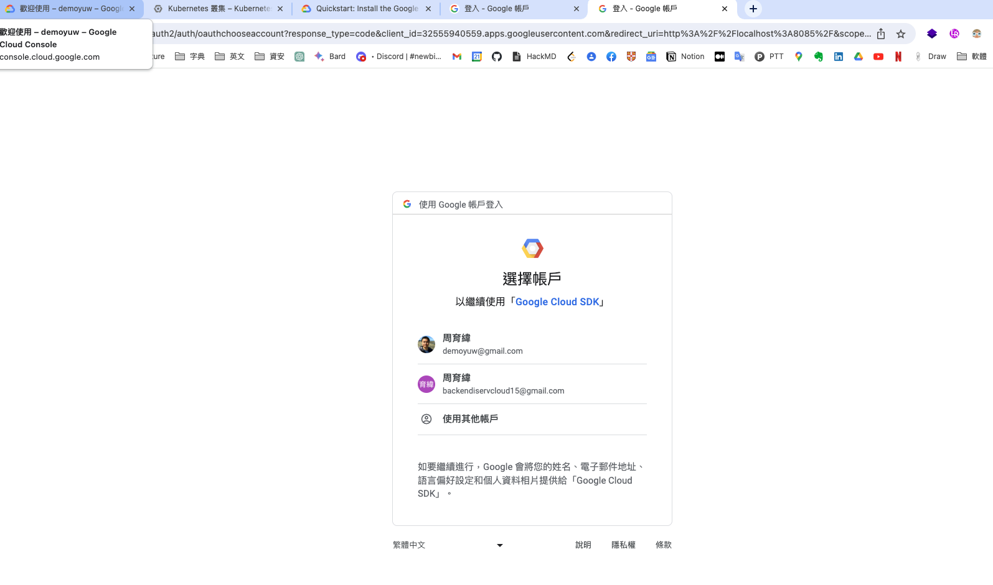
取得GCP Cotainer cluster 操作權限-1
gcloud auth login
登入google 帳號

Slide 9
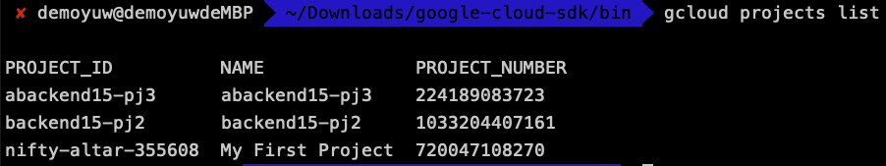
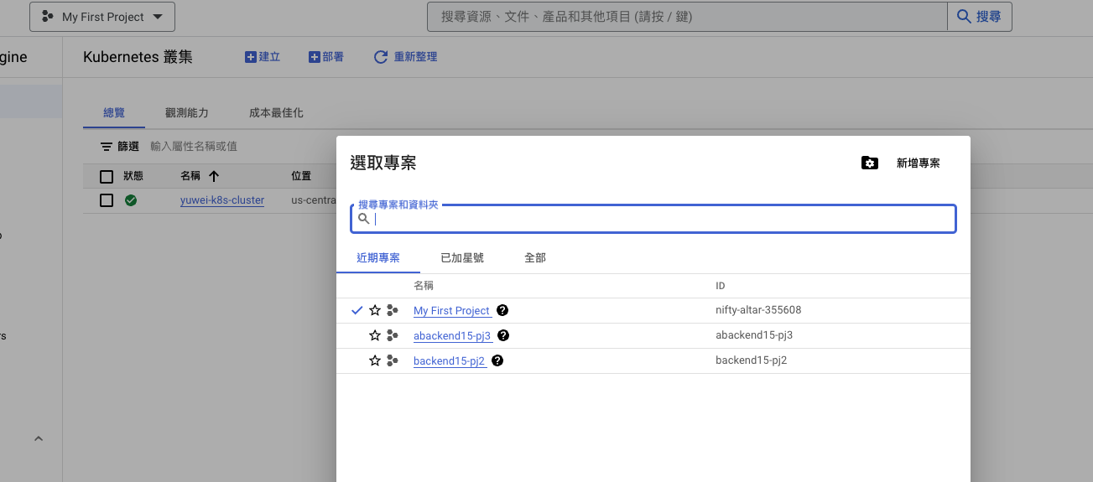
GKE project
gcloud projects list
List all projects
在UI上找到剛建立GKE的project

Slide 10
指定project
gcloud config set project {project name}
選擇所使用的project
e.g. gcloud config set project nifty-altar-355608

Slide 11
取得GCP Cotainer cluster 操作權限-2
gcloud container clusters list
取得k8s 列表

Slide 12
取得指定k8s的授權
gcloud container clusters get-credentials {container-cluster-name} --zone={Location}
gcloud container clusters get-credentials yuwei-k8s-cluster --zone=us-central1

Slide 13
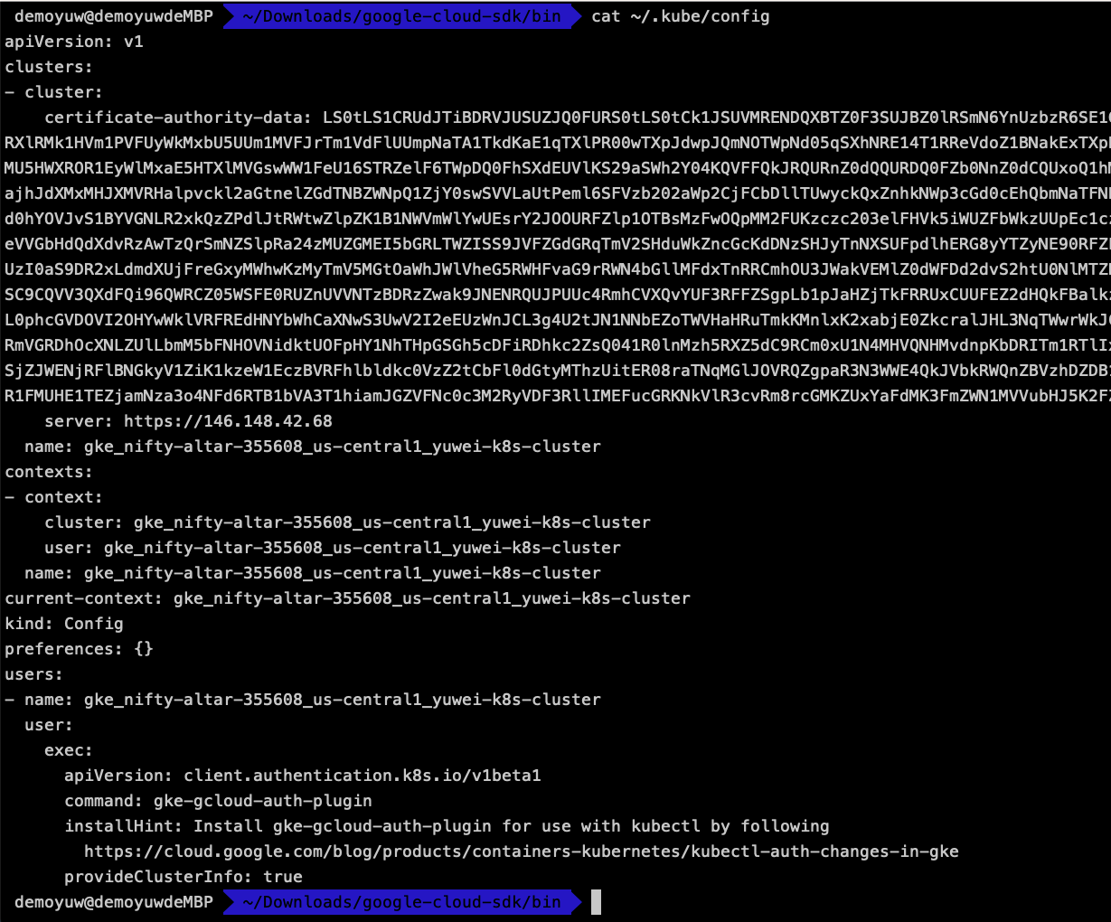
瀏覽 ~/.kube/config, 會發現GKE授權檔已匯入其中
cat ~/.kube/config

Slide 14
取得GCP Cotainer cluster 操作權限 -2
kubectl get all

Slide 15
建立Deployment 與 LoadBalaner Service
kubectl create deployment hello-server --image gcr.io/google-samples/hello-app:1.0 --port 8080
kubectl expose deployment hello-server --type LoadBalancer --port 80 --target-port 8080

Slide 16
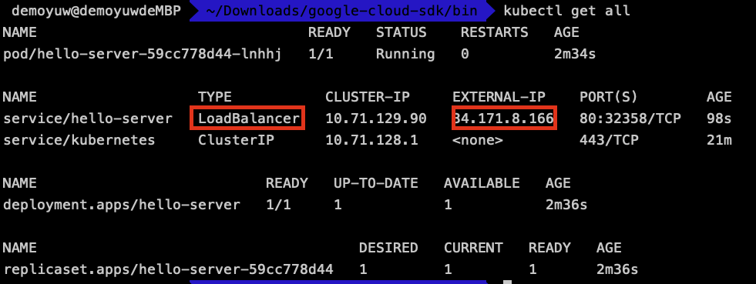
檢查Deployment與Service部署狀態

Slide 17
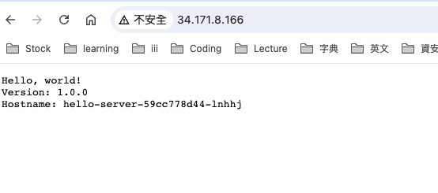
測試Load balance

Slide 18
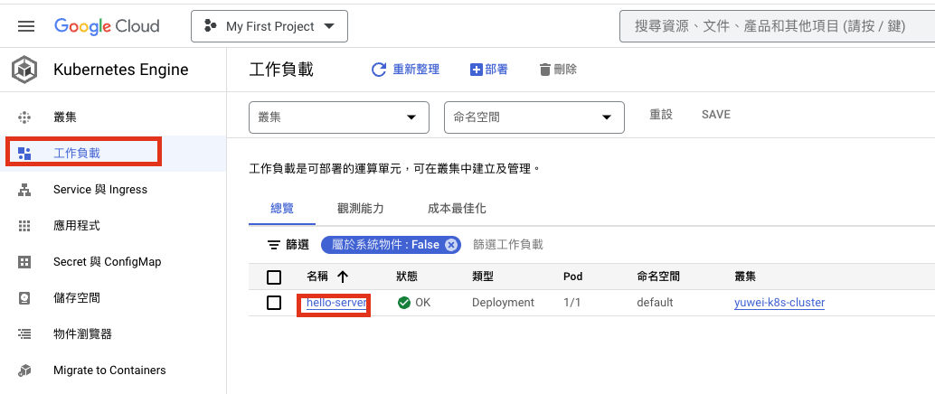
檢查GKE工作負載-1

Slide 19
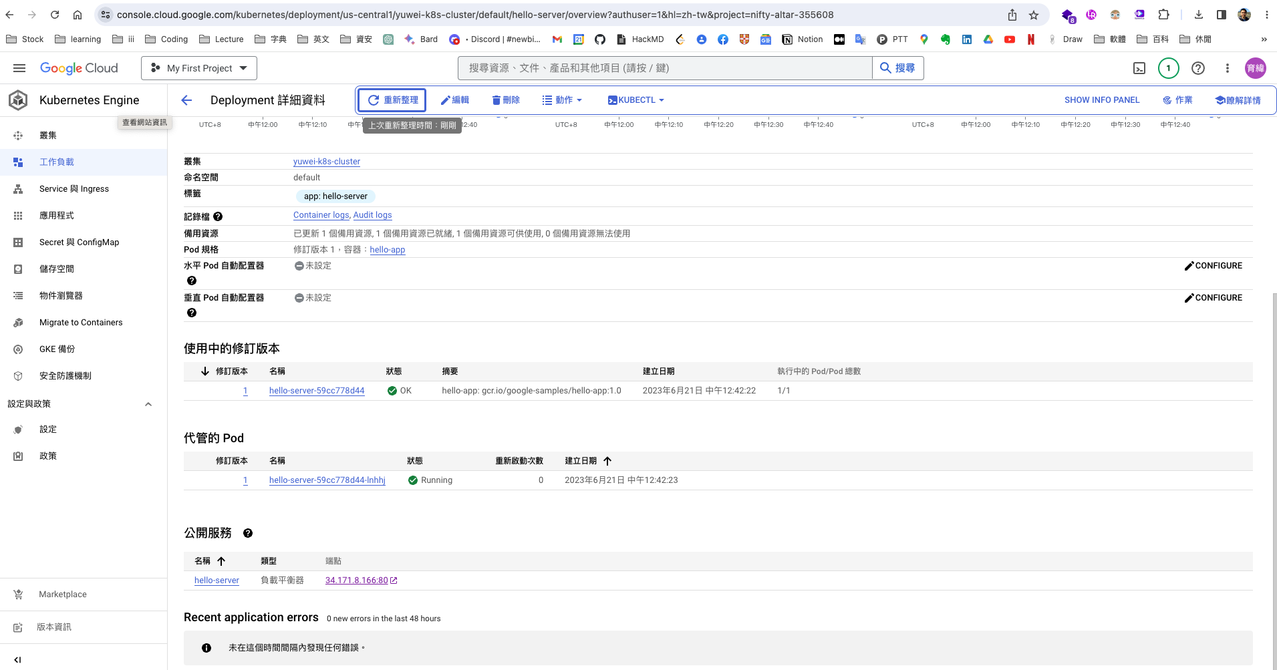
檢查GKE工作負載-2

Slide 20
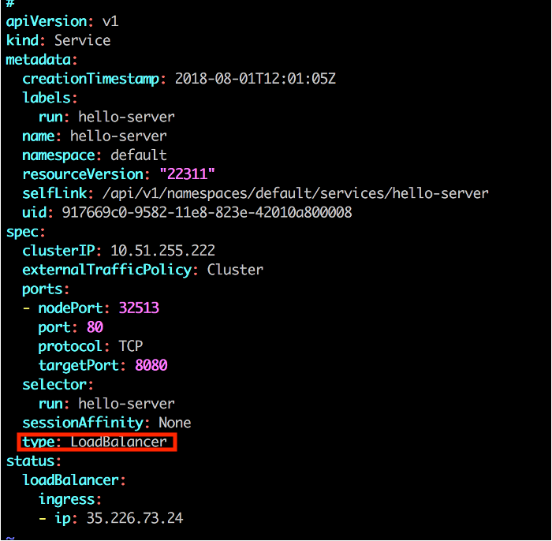
GCP Kubernetes 使用load balance -4

Slide 21
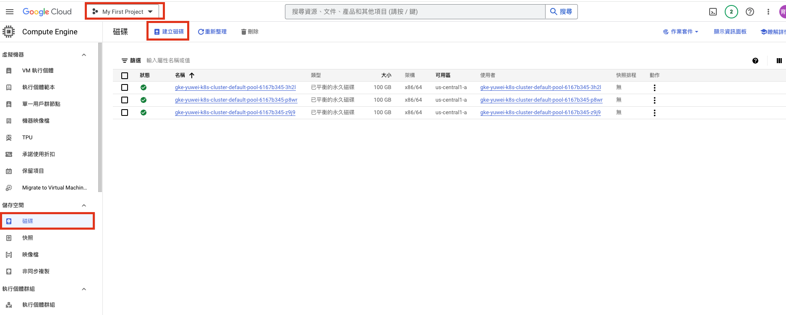
建立硬碟

Slide 22
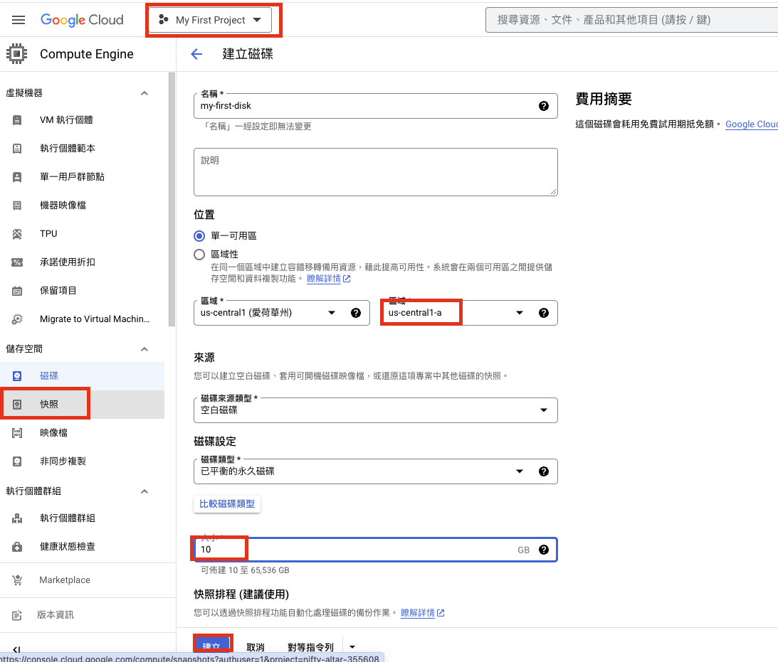
Volume: GCP volume - 建Volume

Slide 23
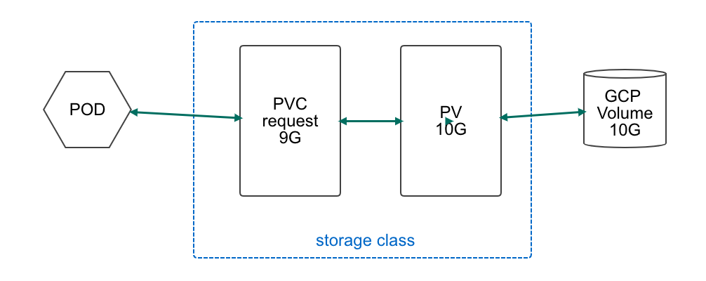
PVC, PV, Storage class關係圖

Slide 24
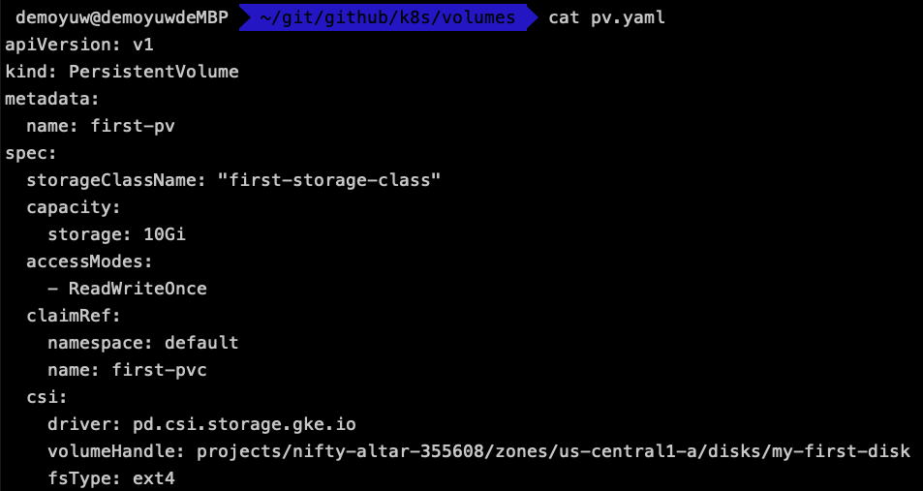
Volume: GCP volume - 建PersistemtVolume -1
K8s/volumes/pv.yaml

Slide 25
建立PV
kubectl apply -f volumes/pv.yaml

Slide 26
Volume: GCP volume - 建PersistemtVolume -2
spec.capacity.accessModes:
ReadWriteOnce:
1個pods寫入與讀取
ReadOnlyMany:
1個pods寫入與多個pods讀取
ReadWriteMany:
多個pods寫入與多個pods讀取

Slide 27
Volume: GCP volume - 建PersistemtVolume -3
Spec.gcePersistentDisk
除了gce，還有多種
nfs
rbd
awsElasticBlcokStorage
List
Kubectl get pv

Slide 28
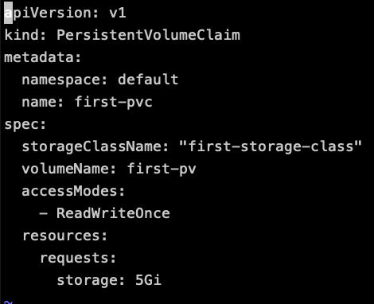
GCP Volume: 建PersistemtVolumeClaim
K8s/volumes/pvc.yamlPods 界接storage層
List
Kubectl get pvc

Slide 29
部署pvc
Apply
Get status

Slide 30
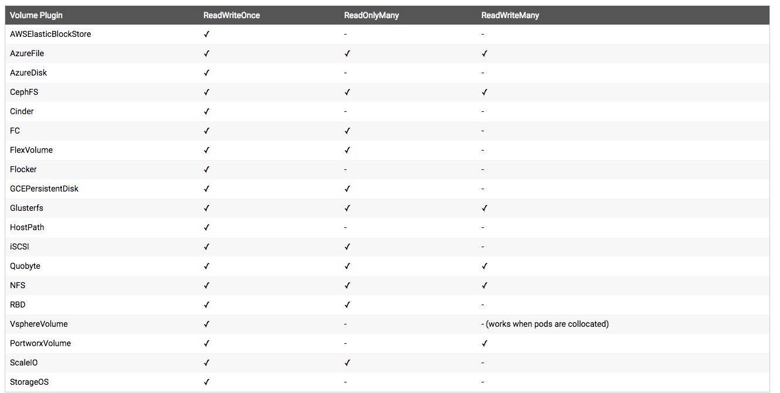
Volume plugin 支援程度

Slide 31
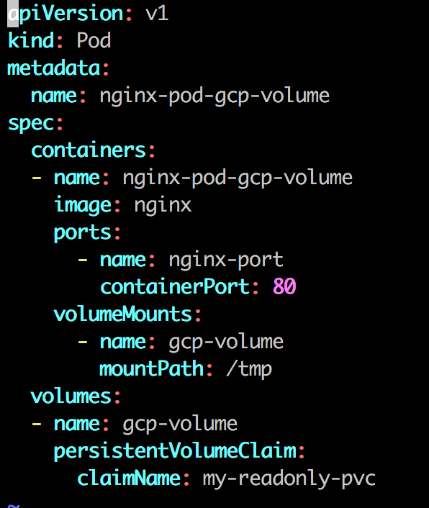
GCP Volume :用pod界接volume
k8s/pods/nginx-gcpvolume.yaml

Slide 32
GCP Volume :部署pod
kubectl apply -f pods/nginx-gcpvolume.yaml

Slide 33
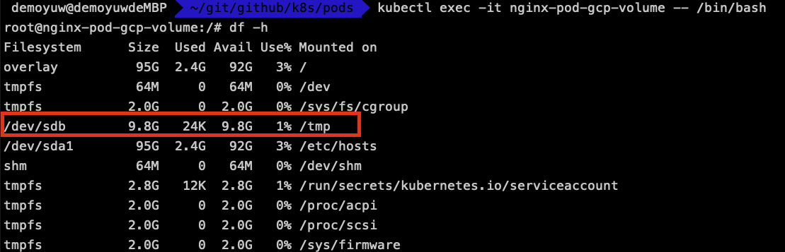
GCP Volume: 檢查pod內掛載狀態。
kubectl exec -it nginx-pod-gcp-volume -- /bin/bash

Slide 34

GCP Volume: 寫入檔案，刪除再重建pod，寫入檔案還是存在-1

Slide 35
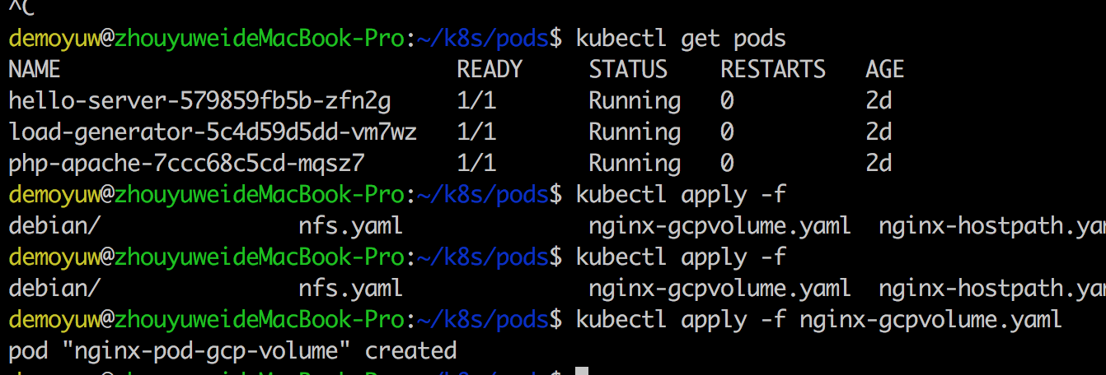
GCP Volume: 寫入檔案，刪除再重建pod，寫入檔案還是存在-2
Kubectl delete pods nginx-pod-gcp-volume

Slide 36
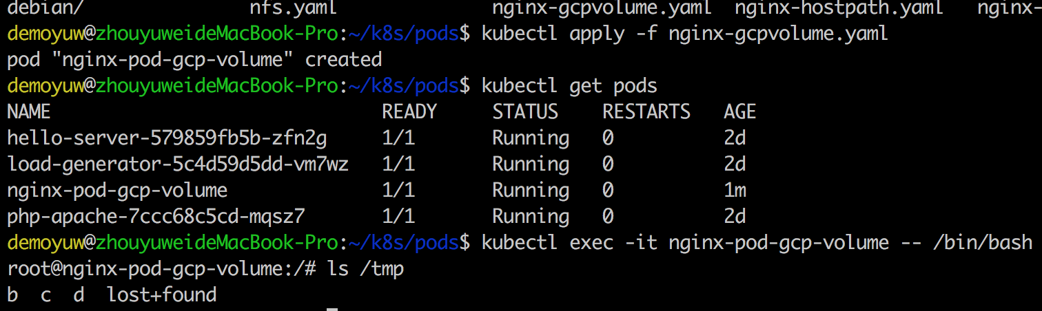
GCP Volume: 寫入檔案，刪除再重建pod，寫入檔案還是存在-3
Kubetctl apply -f nginx-gcpvolume.yaml

Slide 37

K8s auto scaling - 部署受壓測端deploy
部署受壓測deployment php-apahce
kubectl apply -f k8s/deployment/autoscaling/php-apache-deploy.yaml

Slide 38
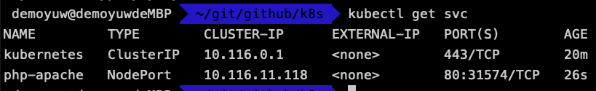
K8s auto scaling -部署受壓測端service
部署受壓測service php-apache
kubectl apply -f k8s/deployment/autoscaling/php-apache-service.yaml

Slide 39
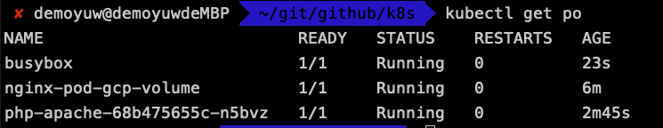
K8s auto scaling -部署壓測別人pod
部署一個壓測別人的pod busybox
kubectl apply -f k8s/deployment/autoscaling/busybox.yaml

Slide 40
K8s - autoscaling - 設定AutoScale
kubectl autoscale deployment php-apache --cpu-percent=50 --min=1 --max=10
kubectl get hpa

Slide 41
K8s - autoscaling - 進行壓測
進入busybox pod 中，對php-apahce進行壓測
kubectl exec -it busybox -- /bin/sh
對php-apache Service的 web進行壓測
while true; do wget -q -O- http://php-apache; done

Slide 42
K8s - autoscaling - 監控hpa
開另一個terminal，監控hpa
watch kubectl get hpa

Slide 43
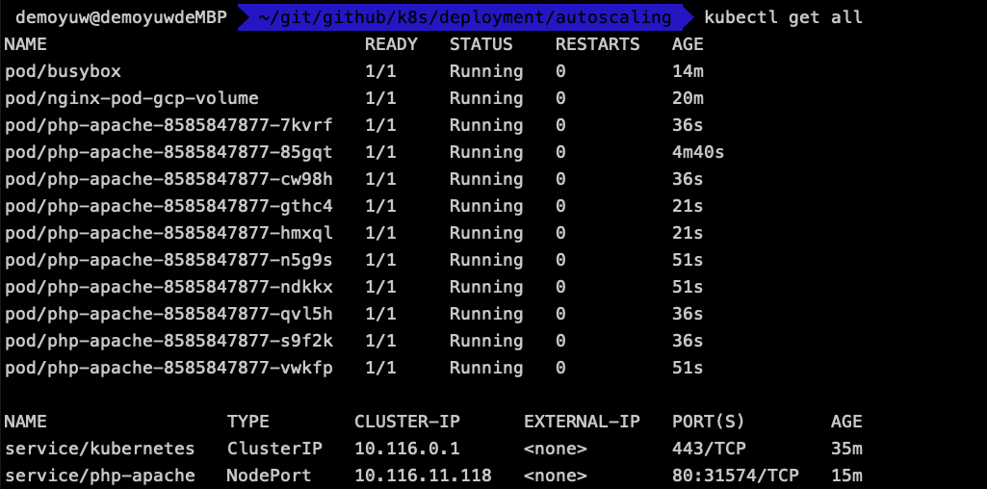
K8s - autoscaling - 監控pod

Slide 44
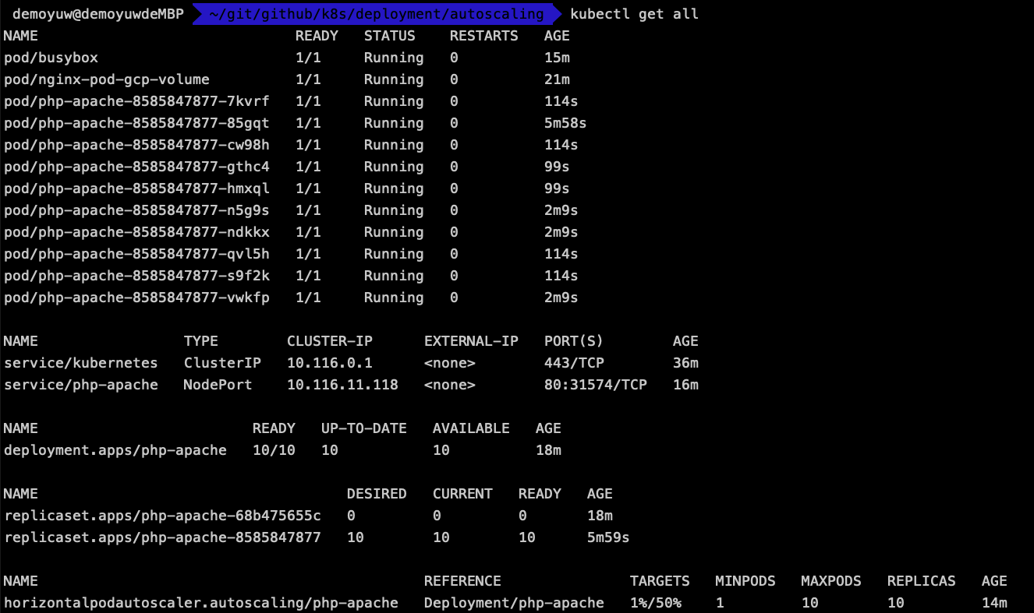
K8s - autoscaling - 停止壓測後

