Slide 1
Docker Compose
2021/4/21

Slide 2
Docker Compose
2021/4/21
描述Container間的相依性應用
使用Yaml file紀錄docker run 相關參數
會建置虛擬網路，並內建dns server
Install
sudo apt install docker-ce-cli -y
sudo apt install docker-compose -y

Slide 3
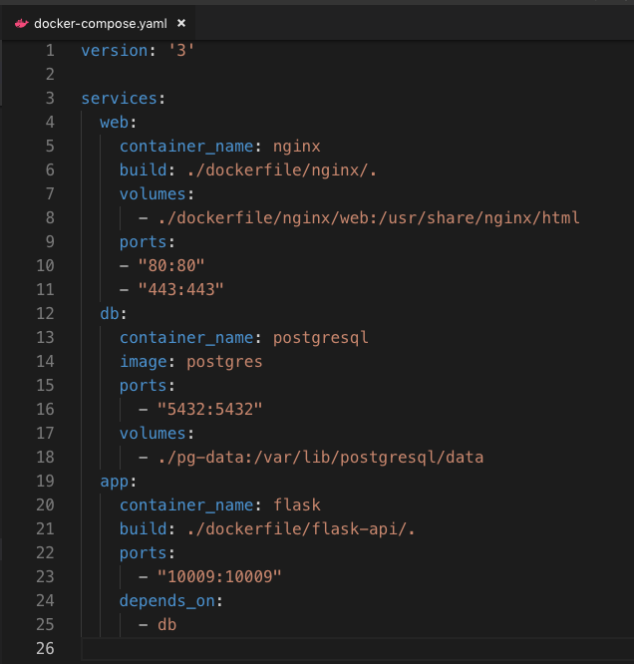
2021/4/21

Slide 4
Docker Compose Web
2021/4/21
web:
container_name: nginx
build: ./dockerfile/nginx/.
volumes:
- ./dockerfile/nginx/web:/usr/share/nginx/html
ports:
- "80:80"
- "443:443"

Slide 5
Docker Compose db
2021/4/21
db:
container_name: postgresql
image: postgres
ports:
- "5432:5432"
volumes:
- ./pg-data:/var/lib/postgresql/data

Slide 6
Docker Compose app
2021/4/21
app:
container_name: flask
build: ./dockerfile/flask-api/.
ports:
- "10009:10009"
depends_on:
- db

Slide 7
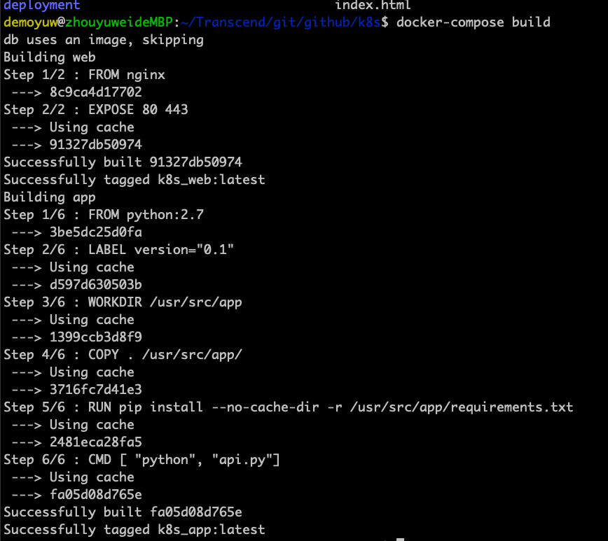
Docer-compose command -1
2021/4/21
docker-compose build
建立docker-compose image

Slide 8
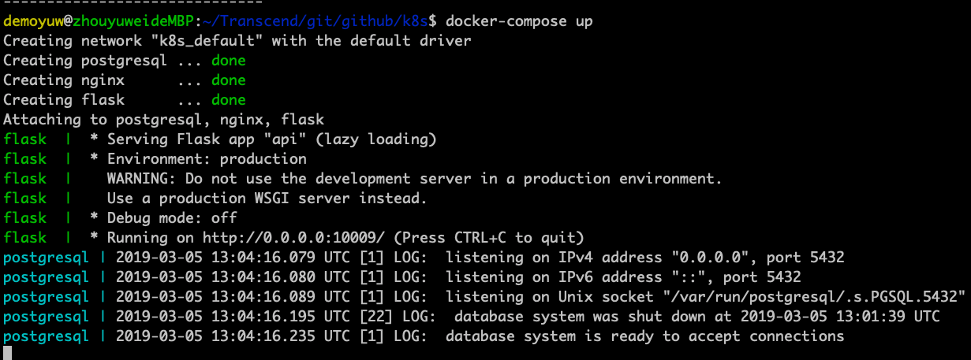
Docer-compose command -2
2021/4/21
啟動 Services
docker-compose up: 終端執行
docker-compose up -d: 在背景執行

Slide 9
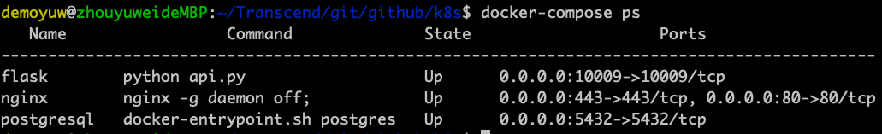
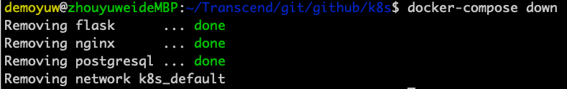
Docer-compose command -3
2021/4/21
docker-compose ps
列出執行中的process
docker-compose down
停止並刪除 Services

