Slide 1

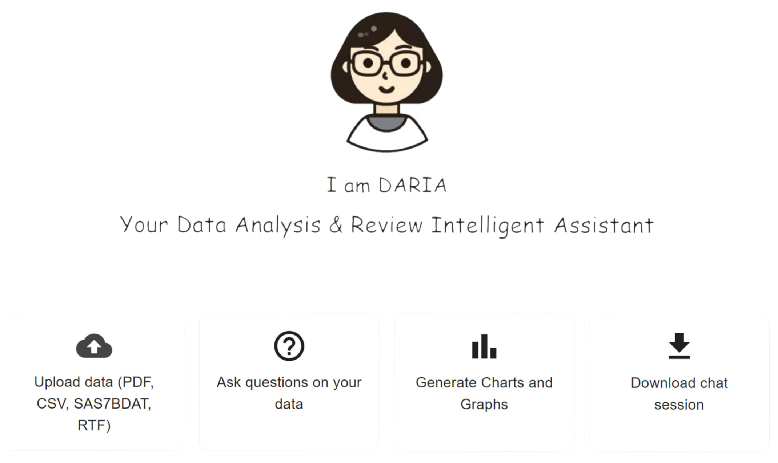
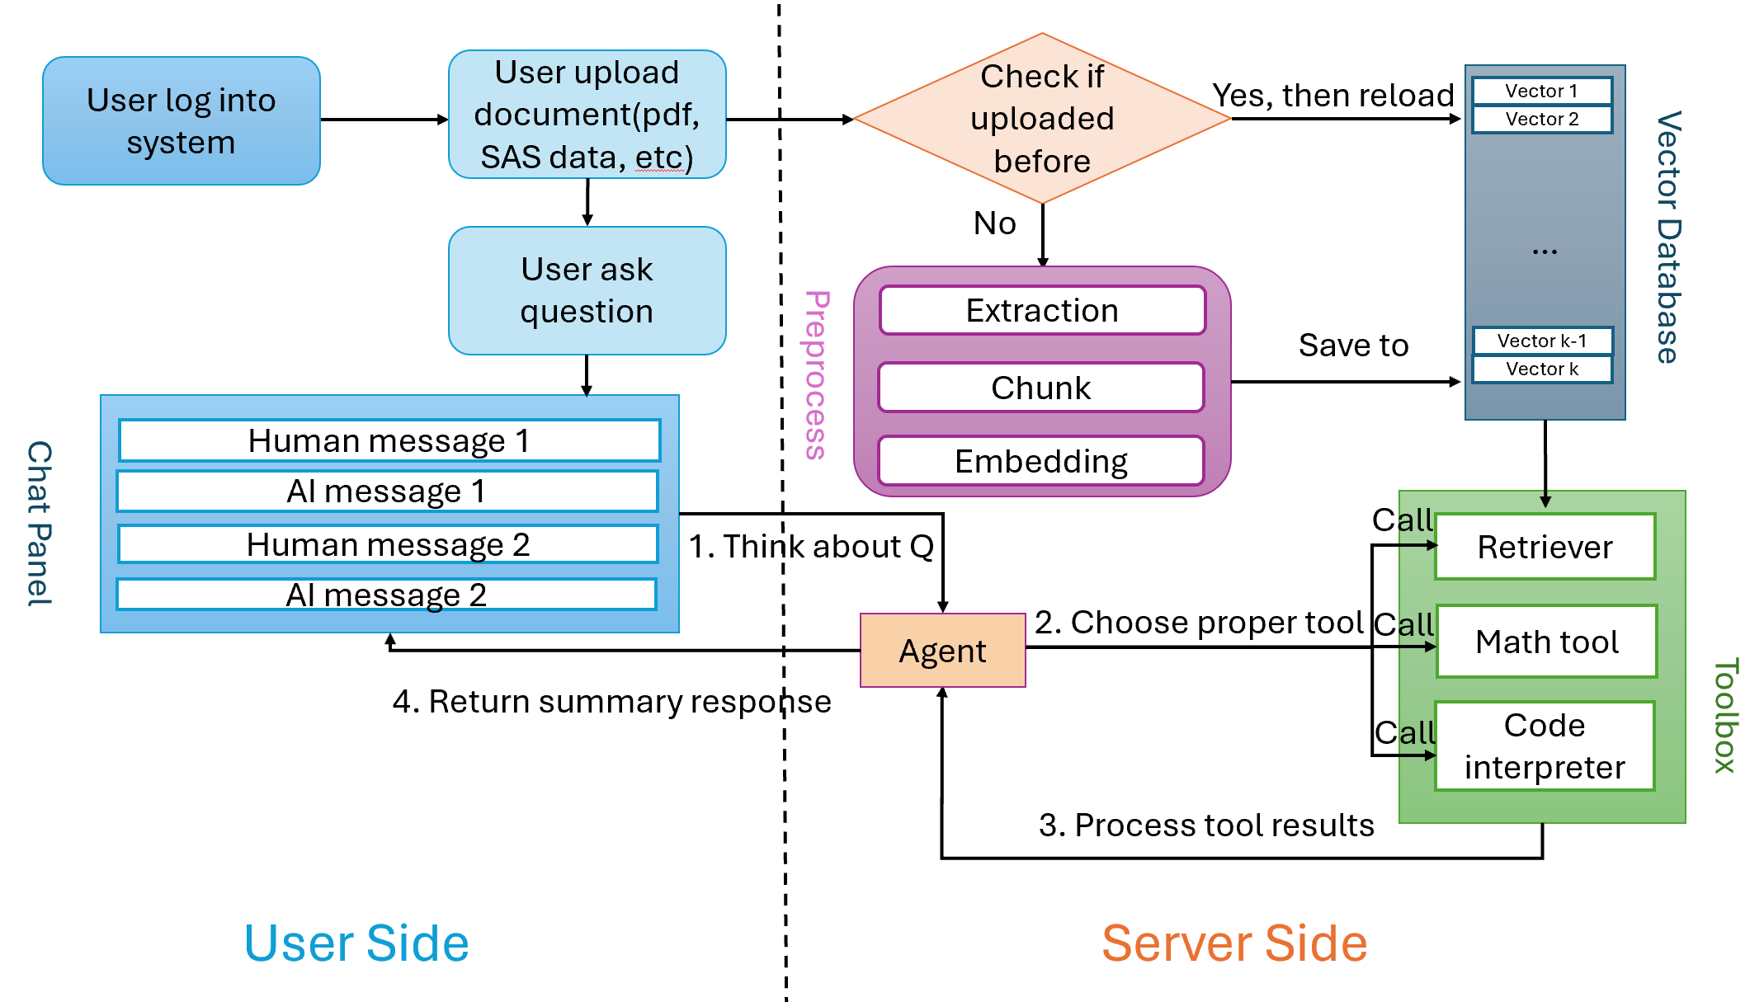
Data Analysis and Review Intelligent Assistant (DARIA)
– A GenAI Tool for Medical Review
Lizhong Liu, PhD; Peng Zhang, PhD; Tai Xie, PhD
CIMS Global - Somerset, NJ
Reshaping the future of clinical trials
Abstract
Methodology
The integration of advanced AI technologies is revolutionizing the healthcare industry, particularly in how medical information is processed, understood, and queried. Here we showcase an innovative system that leverages Retrieval-Augmented Generation (RAG) and Large Language Models (LLMs) to revolutionize clinical reporting processes. By automating the processing and enhancement of medical documents through natural language interaction and real-time response, this system significantly improves the efficiency of decision support systems within healthcare settings. Join us to explore how this cutting-edge technology is reshaping the future of clinical reporting.
System Architecture:
User Interface:
  DMC members interact via a chat panel using natural language queries.
  Immediate response related to data without long waiting.
Backend Processing:
  RAG Technology: Enables retrieval and generation of relevant data in real-time
  Toolbox Components:
    Retriever: Fetches specific data points from vast datasets.
    Math Tool: Performs statistical analyses instantly.
    Code Interpreter: Allows for advanced data manipulation when needed.
Workflow:
  Step 1: User inputs query (e.g., “Summarize adverse events for subject X").
  Step 2: Agent analyzes the input and selects appropriate tool to execute.
  Step 3: System processes results from tool, performing necessary analyses. Step 4: Summarize and returns a concise, accurate response in real-time.
Objectives
Provide DMCs with real-time response to questions towards clinical data.
Reduce the workload and time required to review extensive clinical documents.
Enhance accuracy and reduce human error in data querying and analysis.
Figure 1. Interface of DARIA system
Features
Obstacles/Challenges
Support for multiple filetype upload with unlimited file size limitation.
Continuous Chatting with Session History.
Professional Narrative Writing and Interactive Graph Generation.
Client Privacy and System Localization.
Adaptive Performance Enhancement with LLM Integration.
Customizable Tools on Demand.
System is designed to be compliant with good clinical practice standards.
Data Volume:
Too Much Data to Review: DMCs face thousands of pages of TFLs and SAE reports, making timely review challenging.
Process Inefficiencies:
Delayed Response: Inquiries require assigning tasks to programmers and statisticians, leading to delays.
Organizational silos: Coordination between departments takes days to weeks.
Technical Challenges:
Offline Data Processing: Implementing systems capable of handling and analyzing large datasets instantly.
Human Resources:
High Human Cost: Significant personnel required for data querying and analysis.
Risk of Human Error: Manual processes increase the likelihood of mistakes.
LLM:
Hallucination: Model’s response are not reliable all times
Knowledge Out-of-date: Model’s knowledge is based on training data
No external knowledge: Model have no access to external or domain knowledges
Advantages
Real-Time Response: Eliminates delays caused by cross-department tasks, improve efficiency by at least 10 times faster.
Natural Interaction: Users ask questions in plain language without technical barriers.
Reduced Human Cost: Minimizes the need for programmers and statisticians for various queries.
Error Reduction: Automated processes lower the risk of human mistakes.
Scalability: Capable of processing vast amounts of data efficiently.
Flexibility: tools are extensible and can be customized for different applications. Framework can be easily converted for different requirements.
Figure 2. Structure design of DARIA system
Contact
Name: Lizhong Liu
Email: lliu@cims-global.com
Phone: 305-487-0284
Website: https://cims-global.com/

