Slide 1
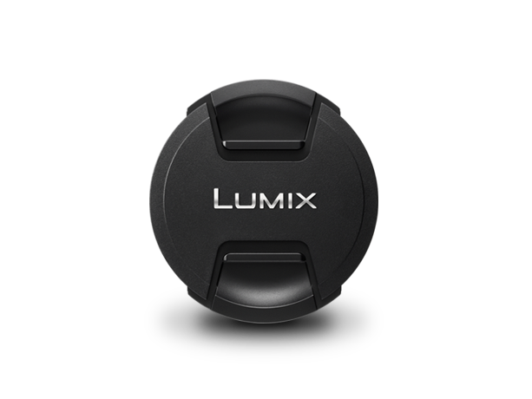
Lens Cap
Image
Text | Lens Cap
Model Number | DMW-LFC46

