Slide 1
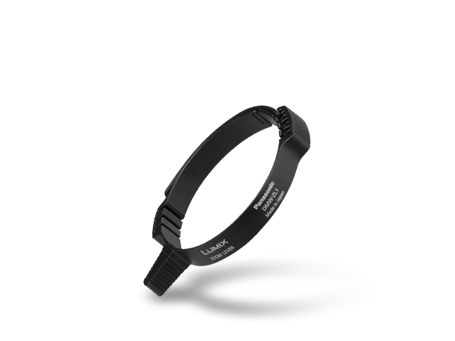
Zoom Lever
Image
Text | Zoom Lever
Model Number | DMW-ZL1

