Slide 1
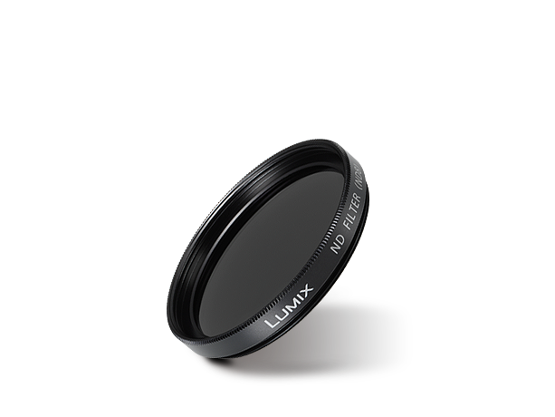
Filters / Mount Adaptors
Image
Text | ND Filter
Model Number | DMW-LND37

