Slide 1
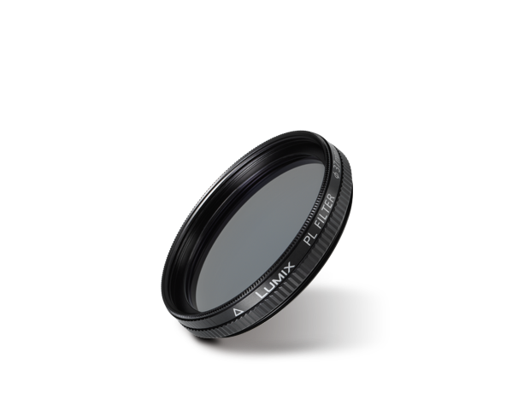
Filters / Mount Adaptors
Image
Text | PL Filter
Model Number | DMW-LPL37

