Slide 1
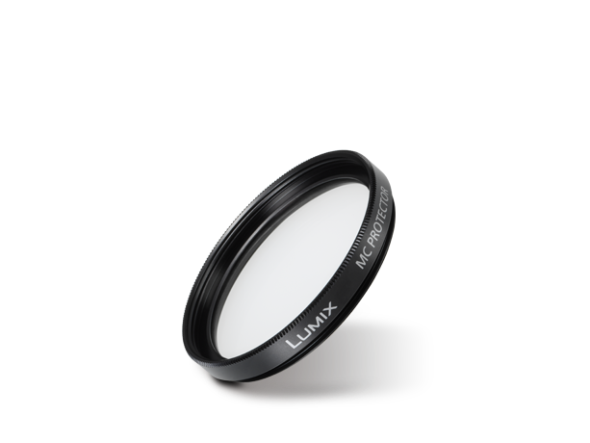
Filters / Mount Adaptors
Image
Text | MC Protector
Model Number | DMW-LMCH37

