Slide 1
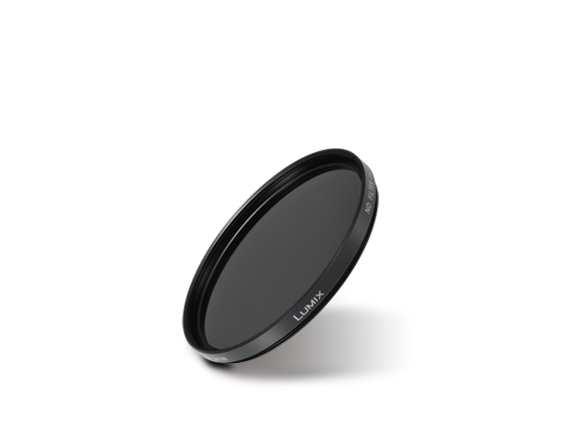
Filters
Image
Text | ND Filter
Model Number | DMW-LND58

