Slide 1
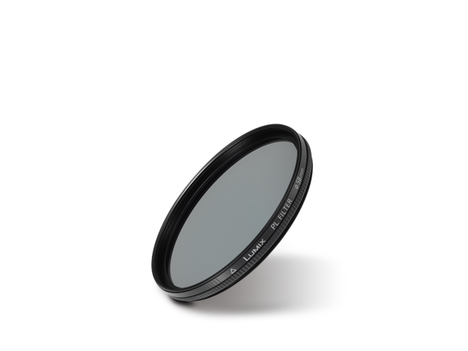
Filters
Image
Text | PL Filter
Model Number | DMW-LPL58

