Slide 1
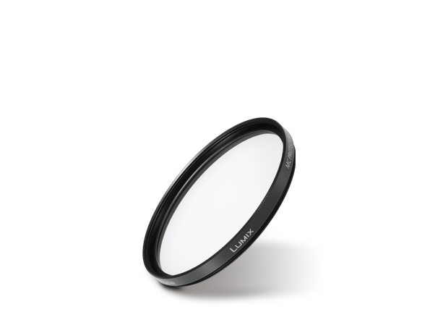
Filters
Image
Text | MC Protector
Model Number | DMW-LMCH58

